Slide 1
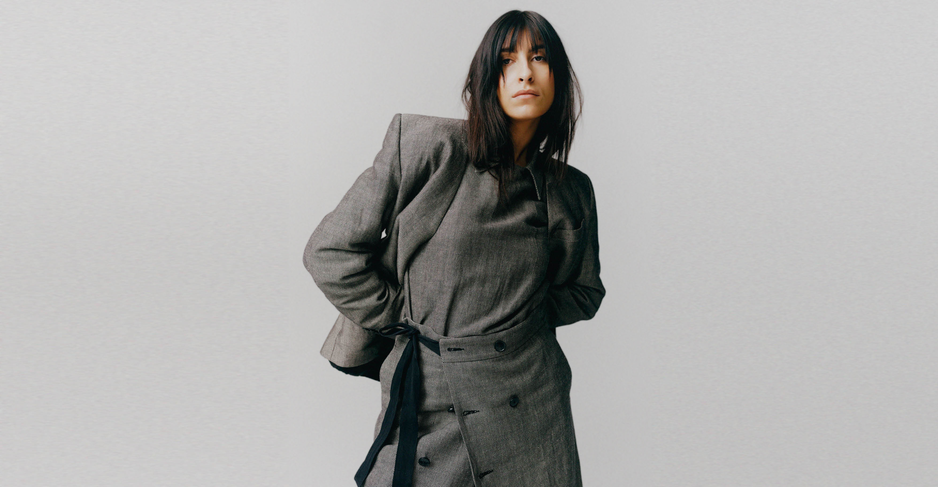
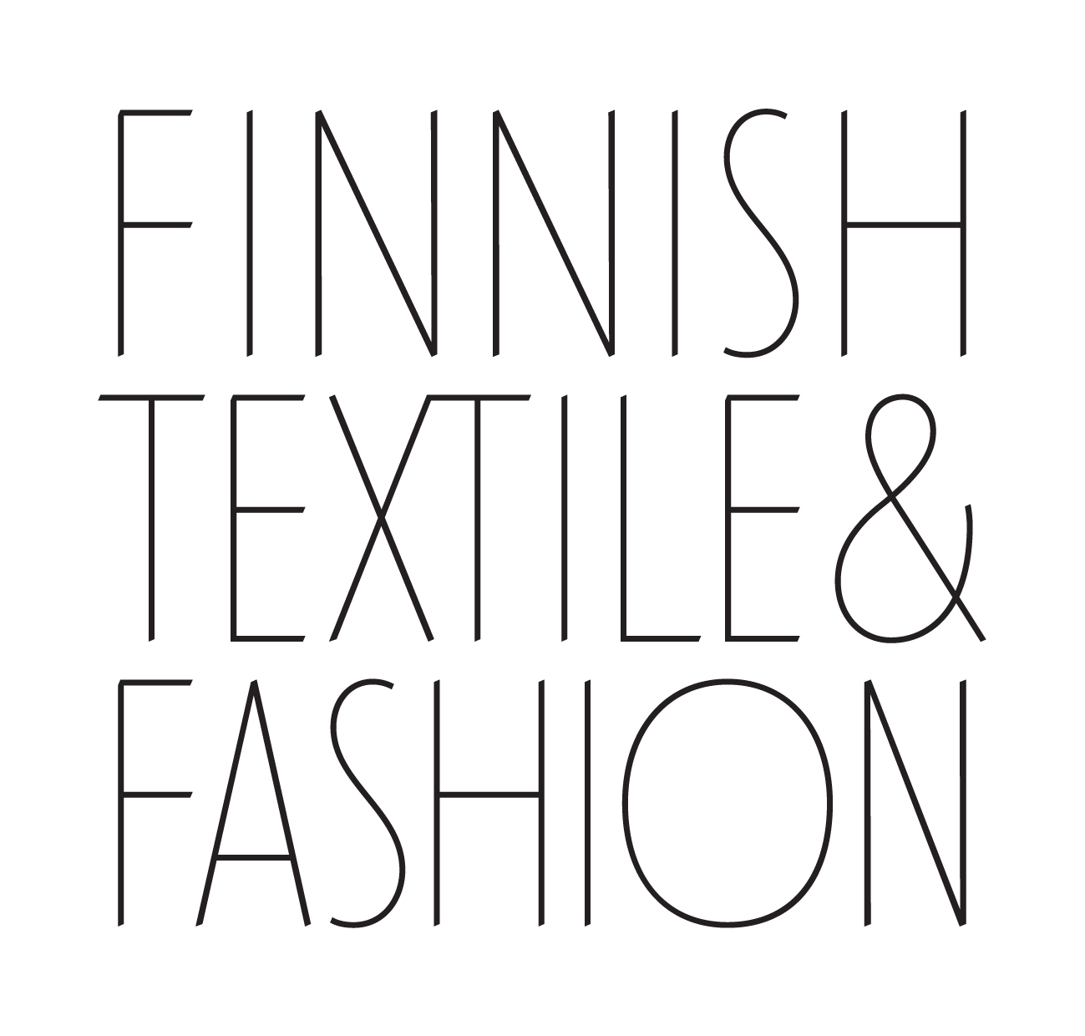
10 COMMON THREADS
OF FINNISH FASHION
Finnish Textile & Fashion Image Bank, Clothing By Hinders.
Photo: Sebastian Johansson & Gut Studio

Slide 2
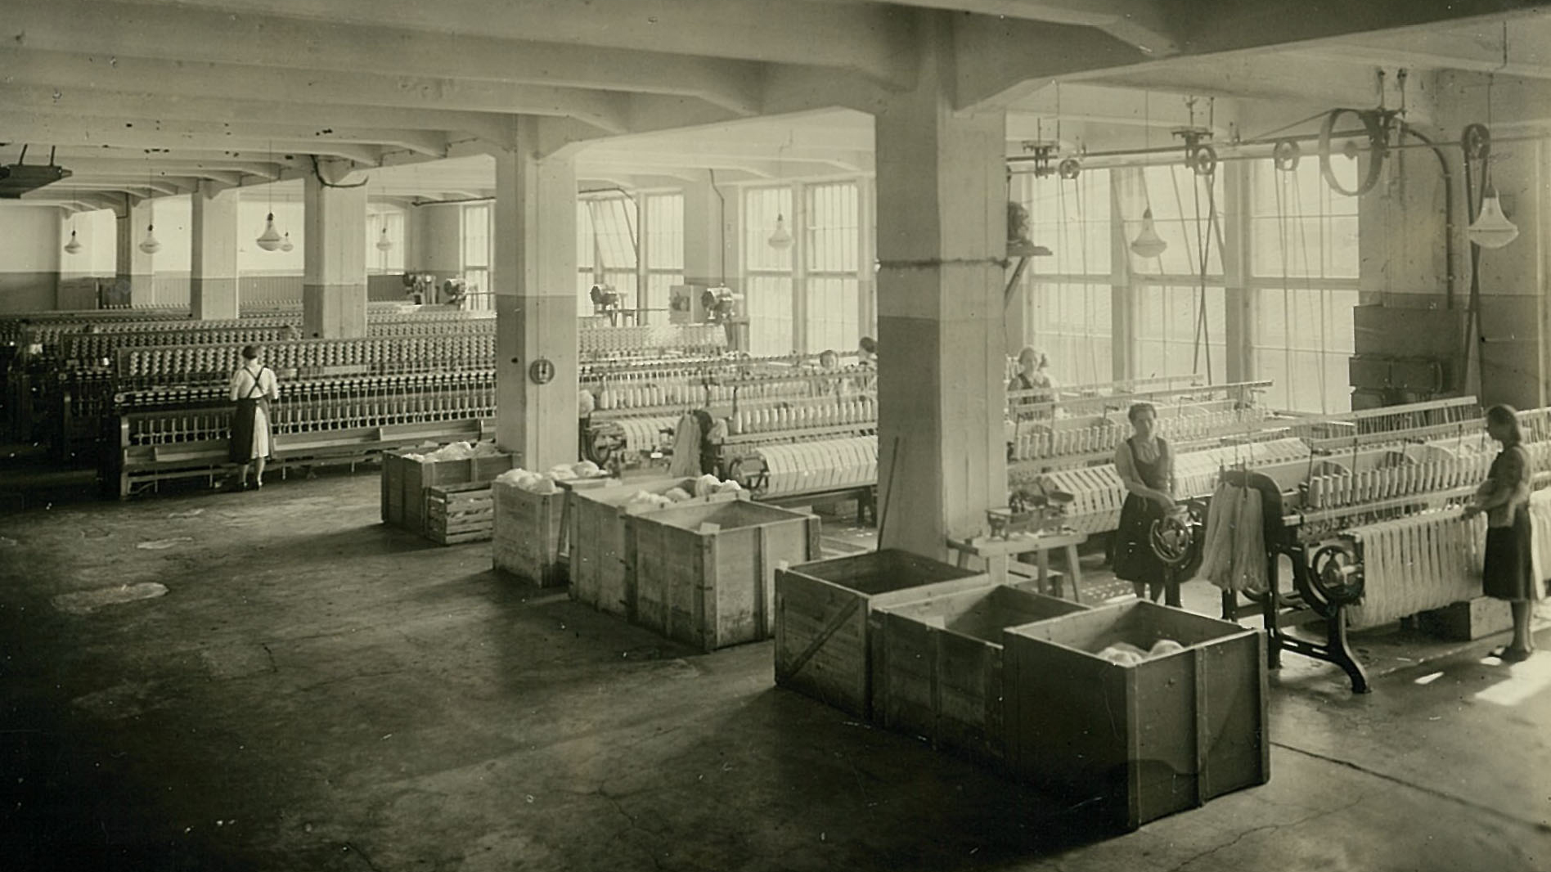
1/10
The textile industry spun entire
cities and communities.
Photo: Courtesy of Novita’s history archive

Slide 3
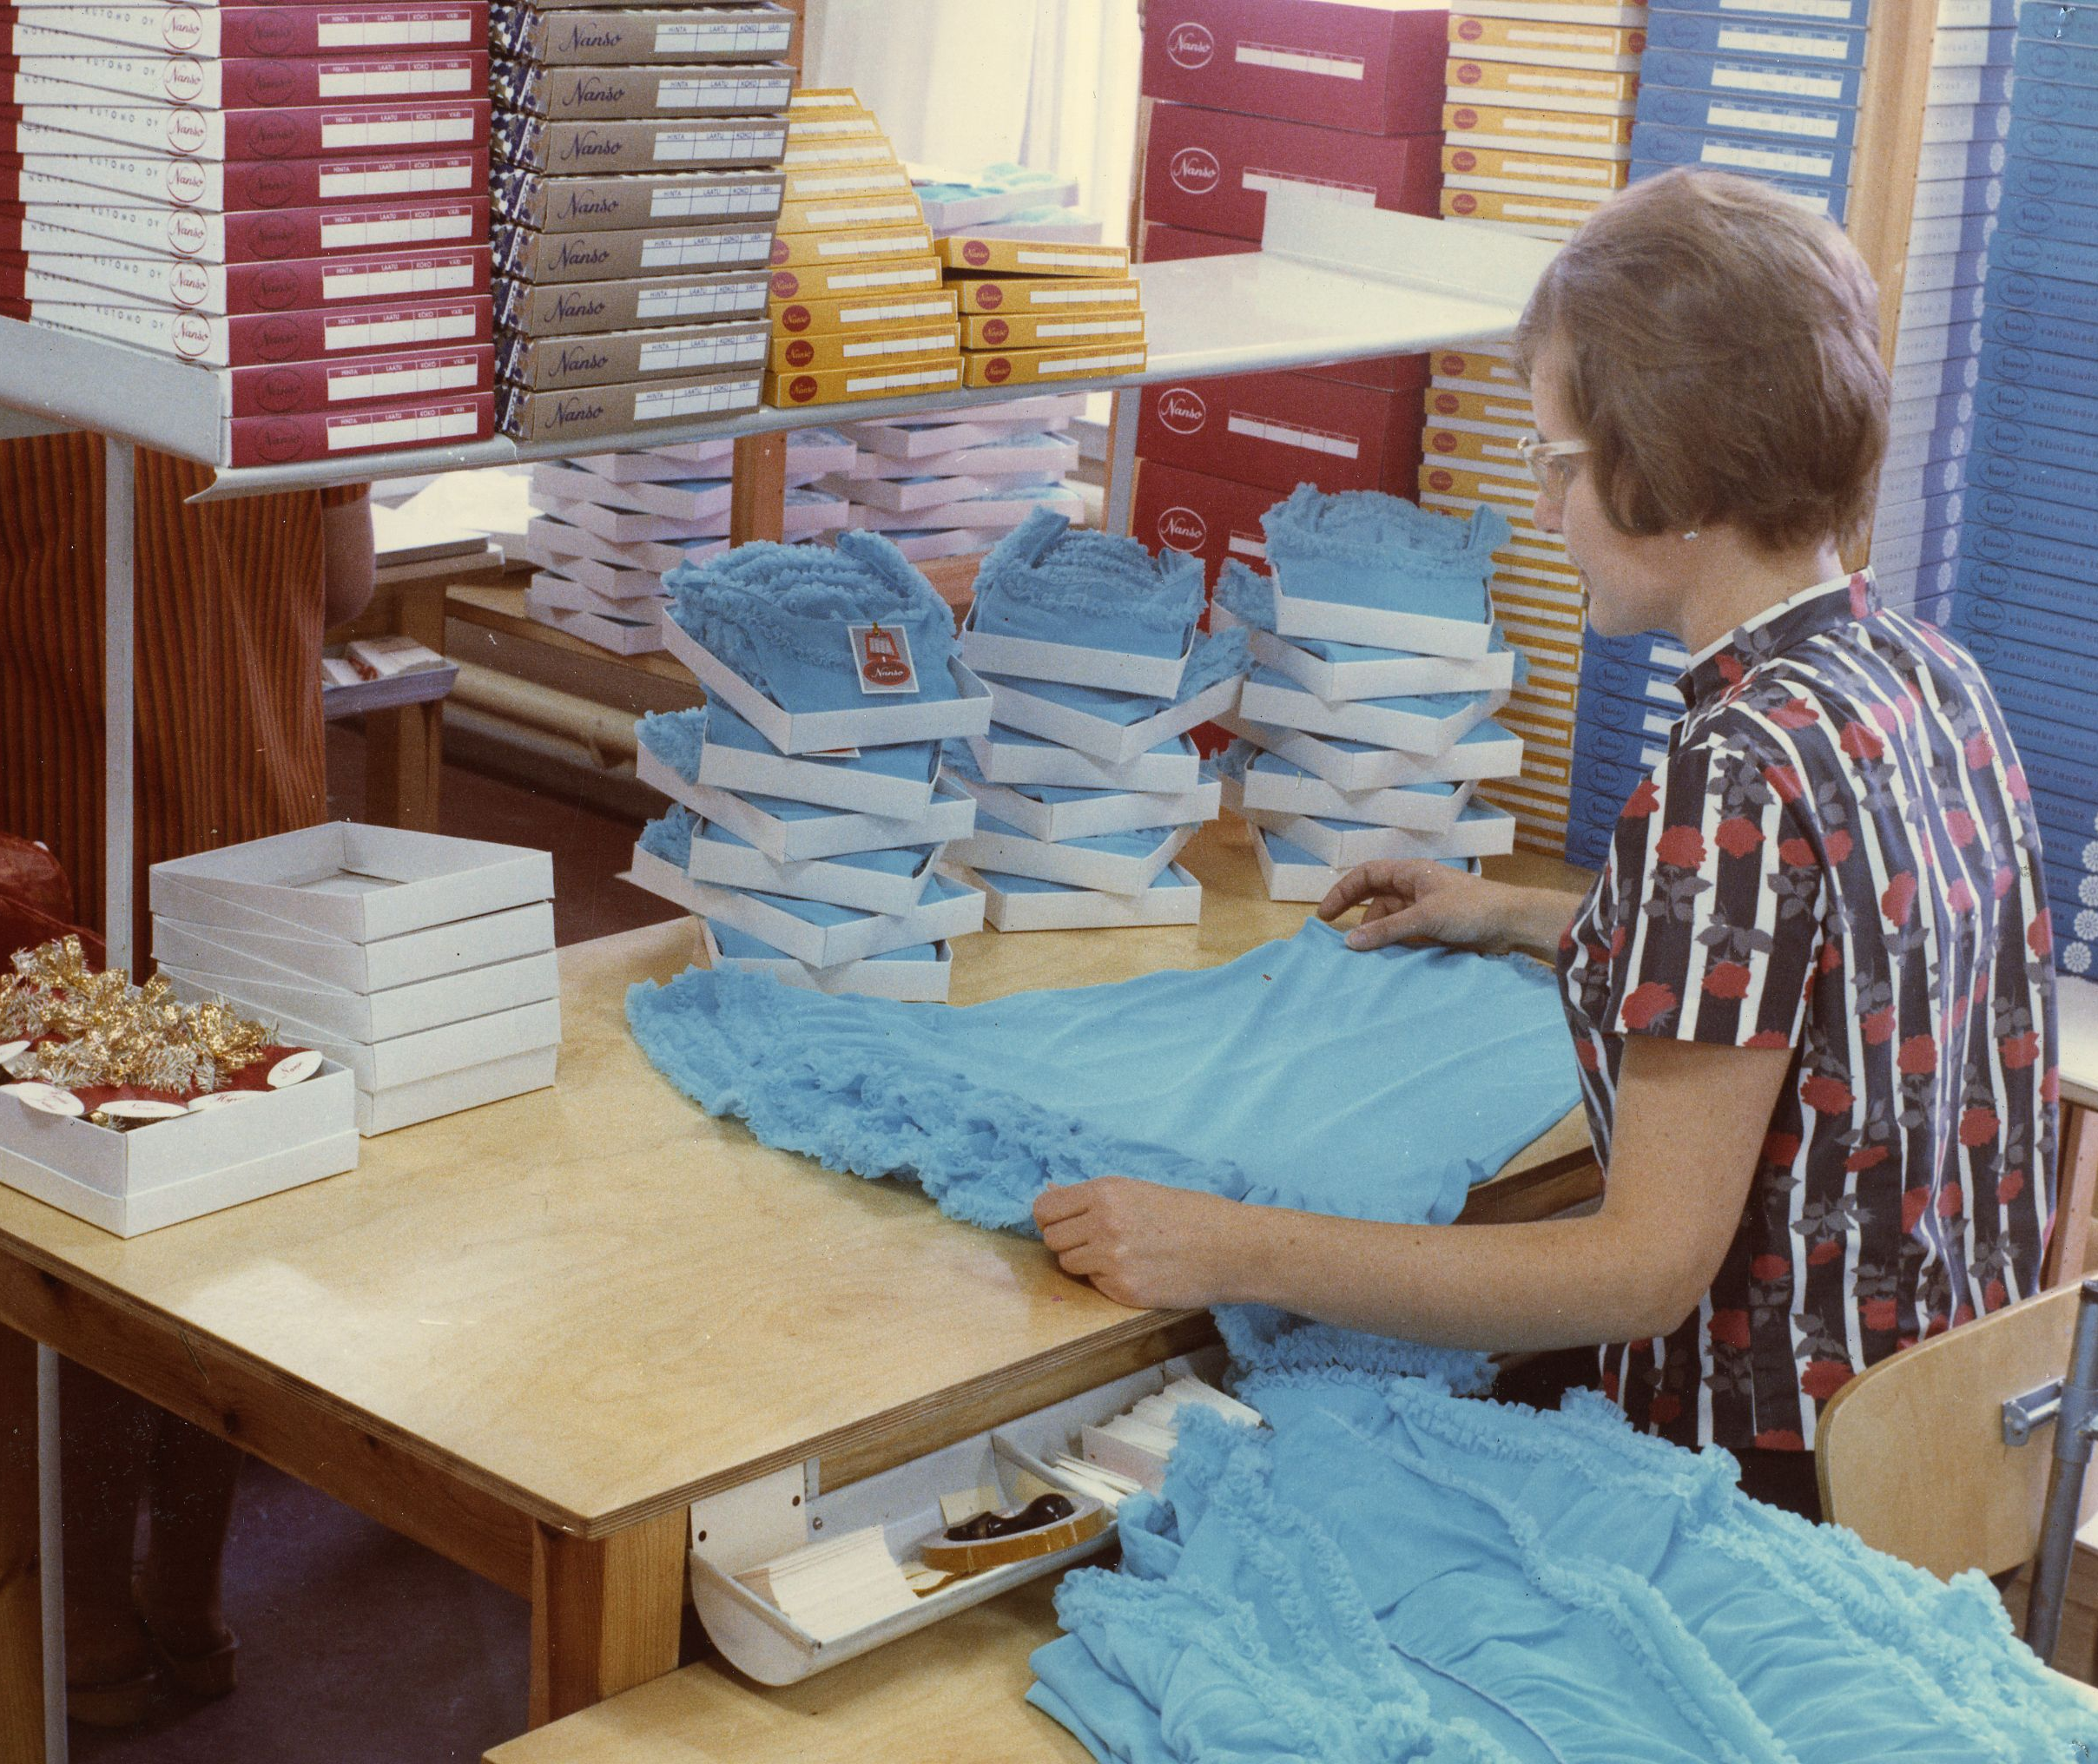
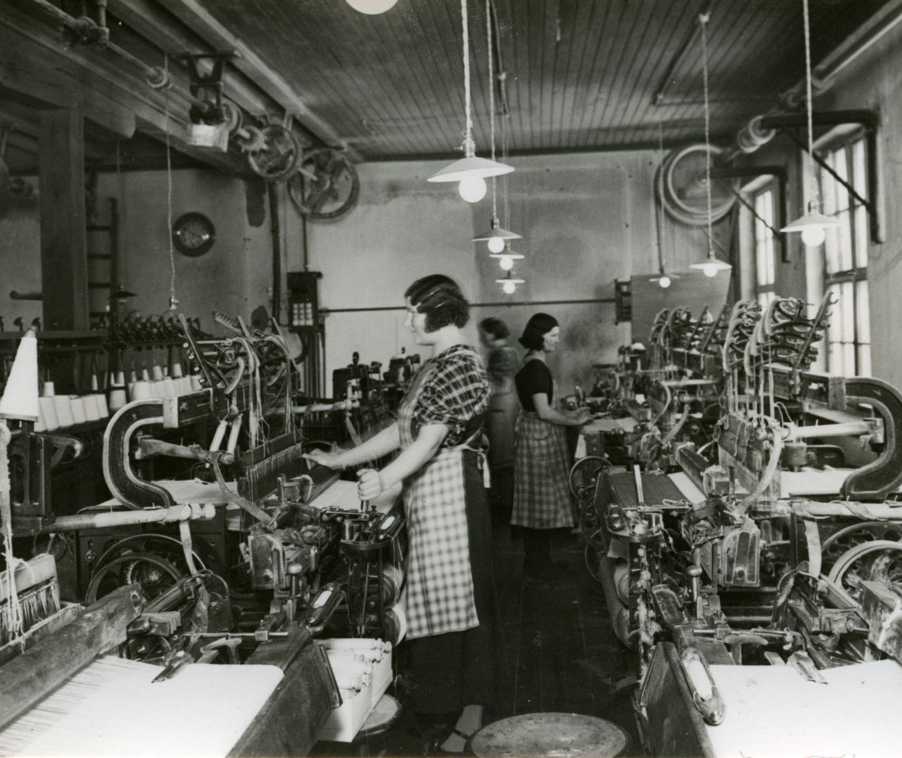
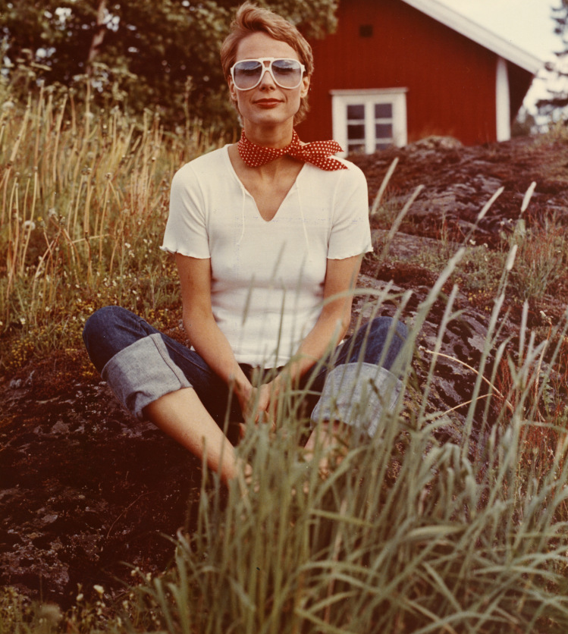
The textile industry spun entire cities and communities.
10 COMMON THREADS OF FINNISH FASHION
1
2
3
4
5
6
7
8
9
10
Finlayson's factory in Tampere
was the largest industrial facility
in Finland and the largest industrial
site in the Nordic countries
until the 1920s.
In the 1850s every third Tamperenian was employed
by Finlayson.
Photo: Courtesy of Nanso's history archive
Photo: Courtesy of Nanso's history archive
Photo: Courtesy of Nanso's history archive
Notes:
There is a long history of textile and fashion industry in Finland, starting from the 16th century. The industry has played a strong role in growing cities and communities in Finland.
Finland’s textile industry can be said to have truly begun only in the early 1700s in Turku, when in 1738, a Turku-based merchant, dyer, and member of parliament, Esaias Wechter, founded a broadcloth manufacturing establishment inspired by a decree issued in 1738, which required that supplies for the army be of domestic origin.
The textile and clothing industry has been a significant sector in employing women from it's very beginning.
Finnish cities and towns such as Tampere, Turku and Forssa formed around textile factories and other industrial operators. Kuopio (Piretta, Essilä) and Lahti (Luhta) also thrived thanks to the textile industry.
Finlayson and Tampereen Verkatehdas were among the largest textile companies in the Nordic countries. In the mid-1900s, the textile industry was one of the largest employers in Tampere and played a significant role in the city’s economy and image as an industrial town.
The Forssa Cotton Spinning Company, founded by Axel Wilhelm Wahren in 1847, began textile production, and the town grew into a significant center of the textile industry. Forssa became the first place in Finland for industrial textile printing in 1861.
In Turku region Turun Verkatehdas Oy and still-active Barker Textiles were also among the biggest companies and one of the first members of The Finnish Weaving Industry Employers’ Association (now known as Finnish Textile & Fashion, Suomen Tekstiili & Muoti ry).
The clothing industry only began in the early 20th century. It did not develop properly during the war, so the clothing industry can be said to have truly started from 1920 onward.
Companies such as Finlayson, Tamsilk, Nanso, Lindström, Novita still operate today, having been around for over 100 years.

Slide 4
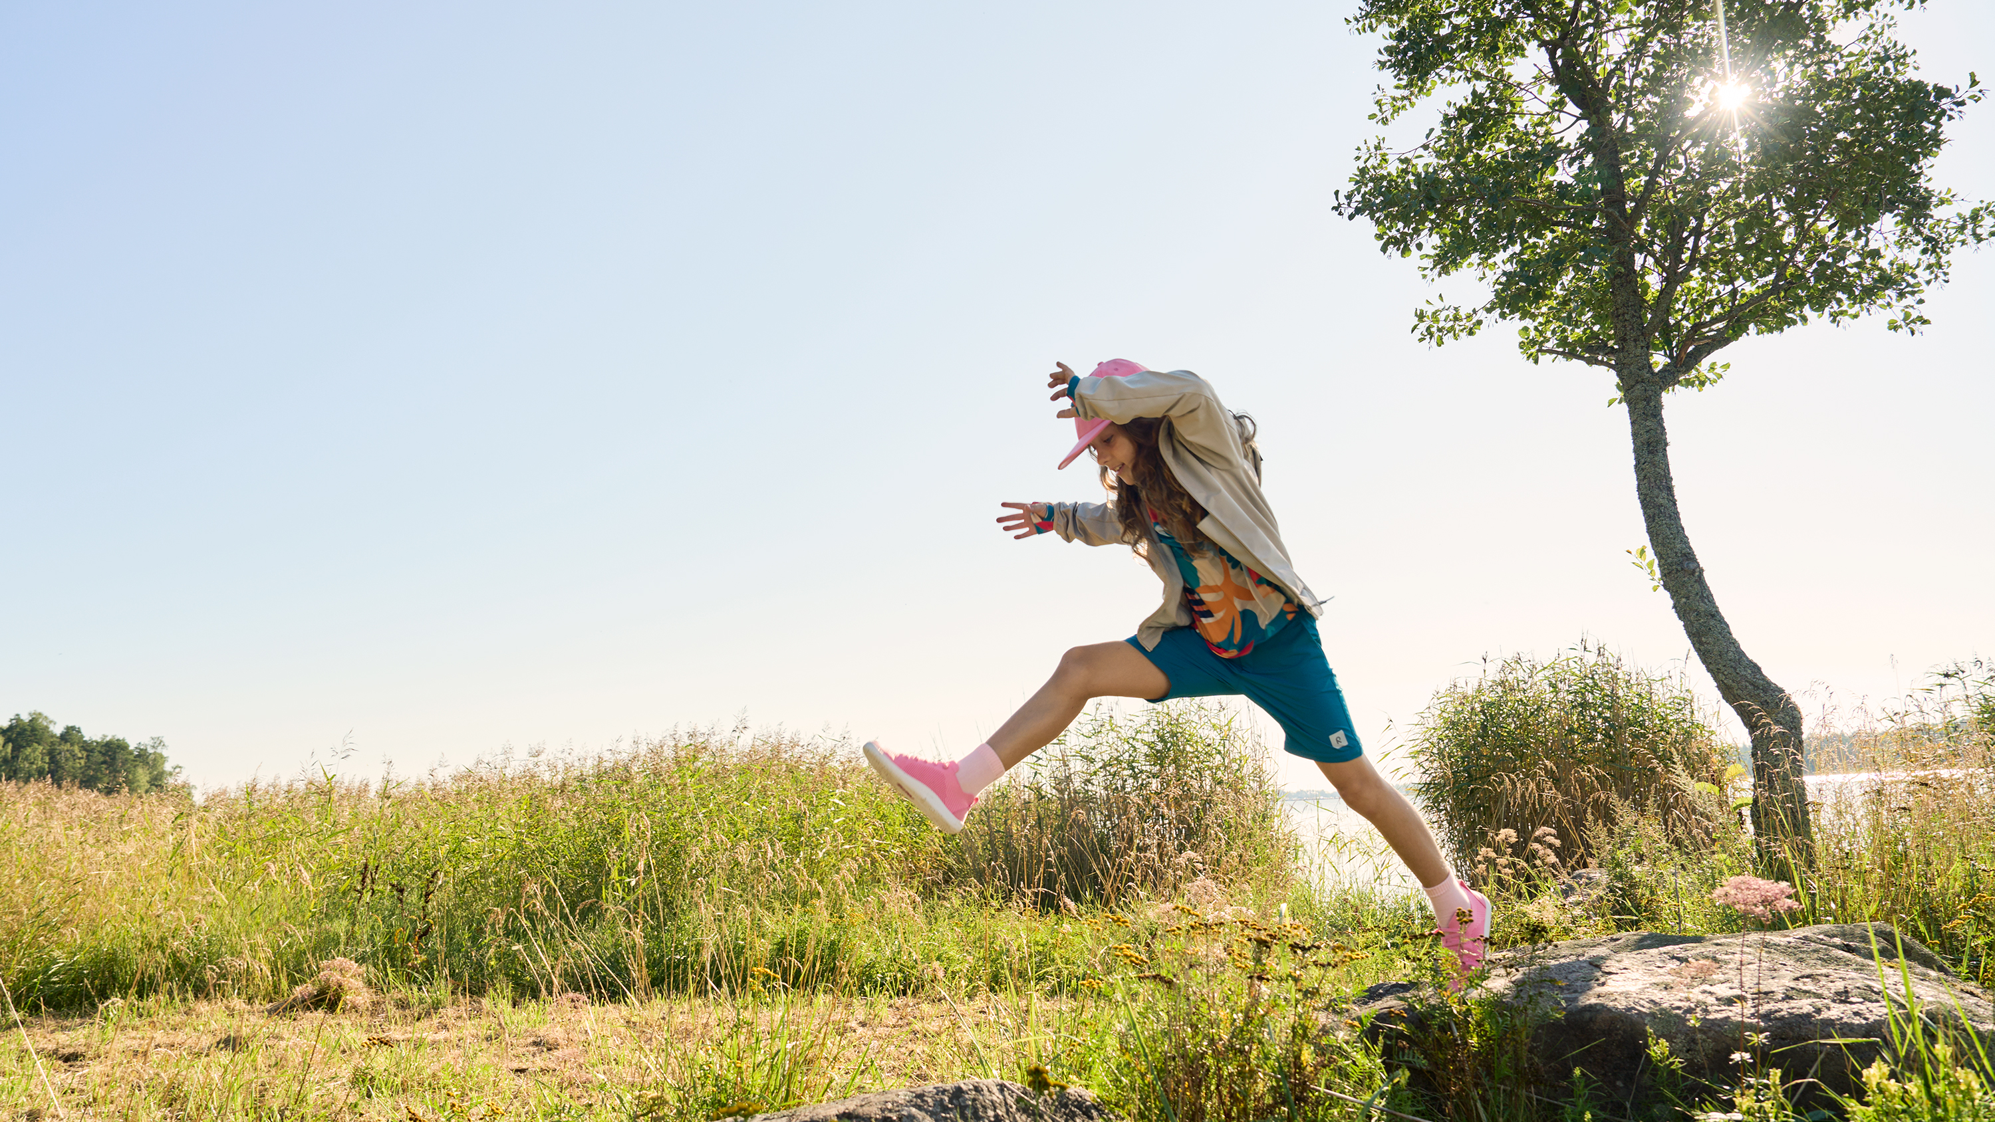
2/10
An active outdoor life has
always been our style.
Photo: Reima

Slide 5
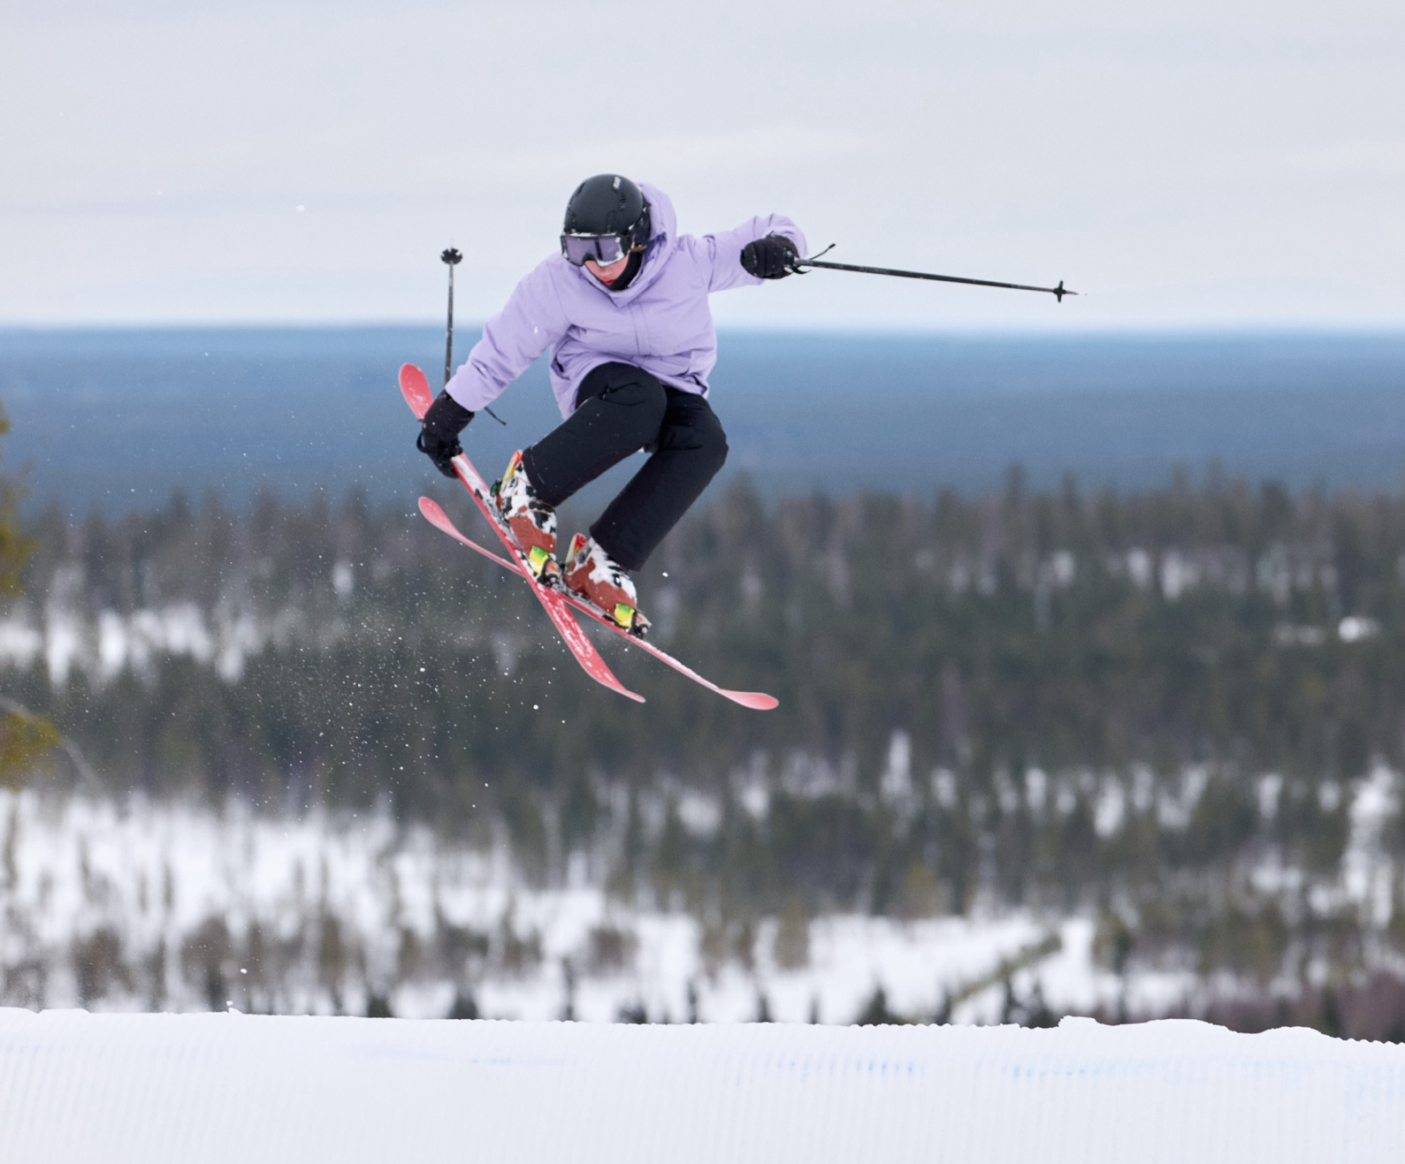
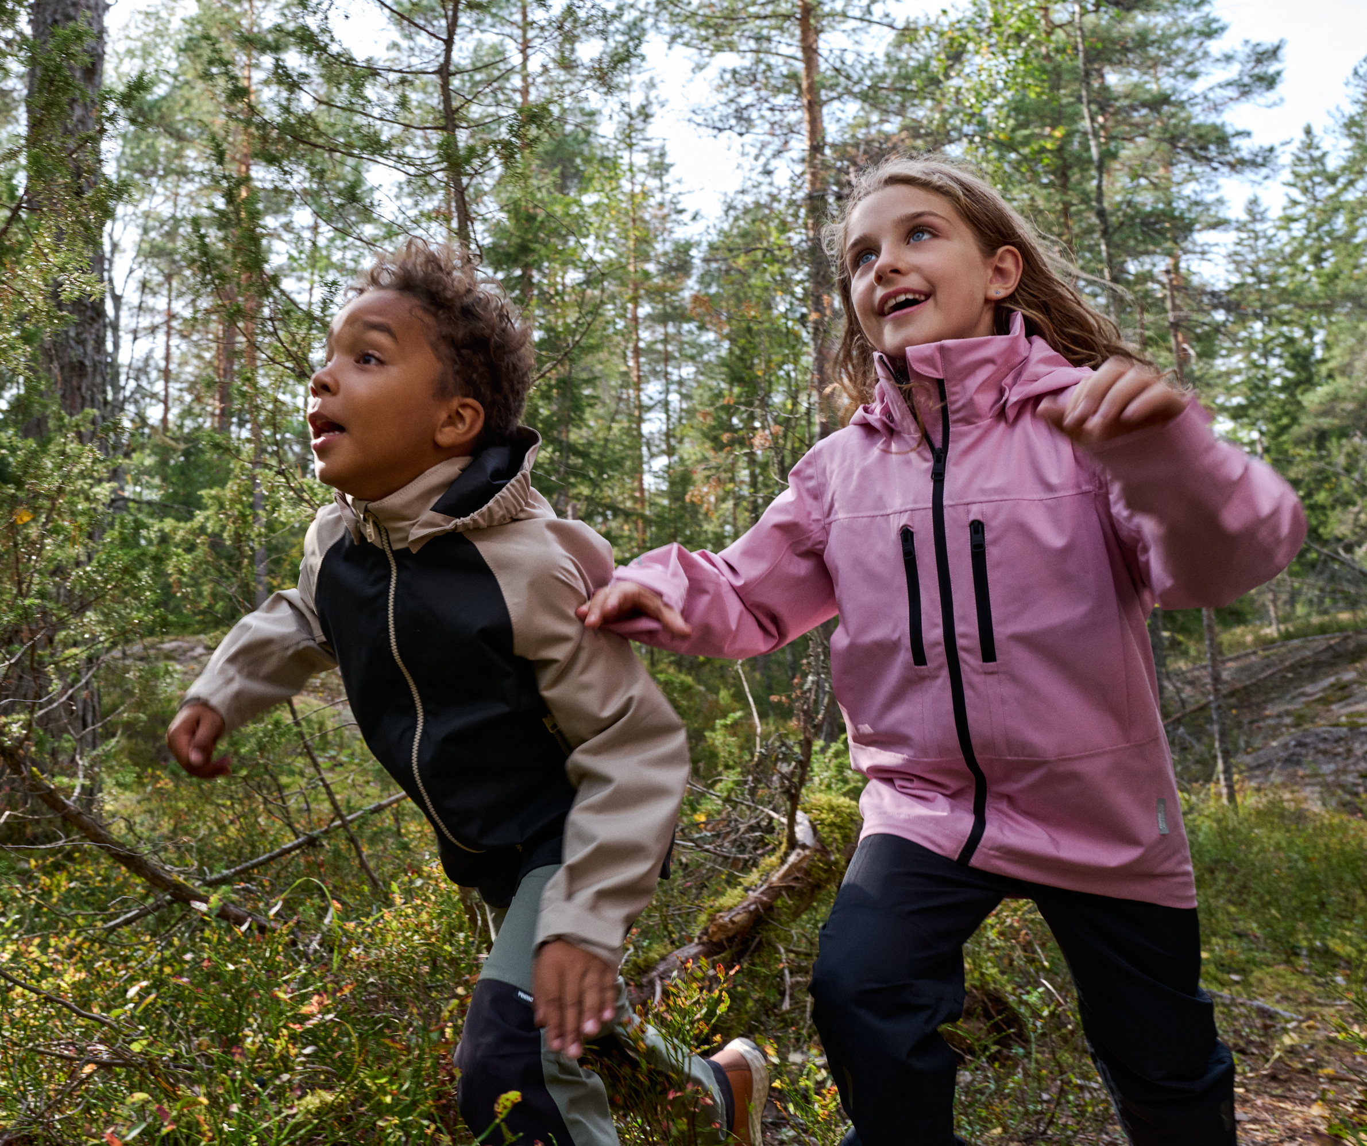
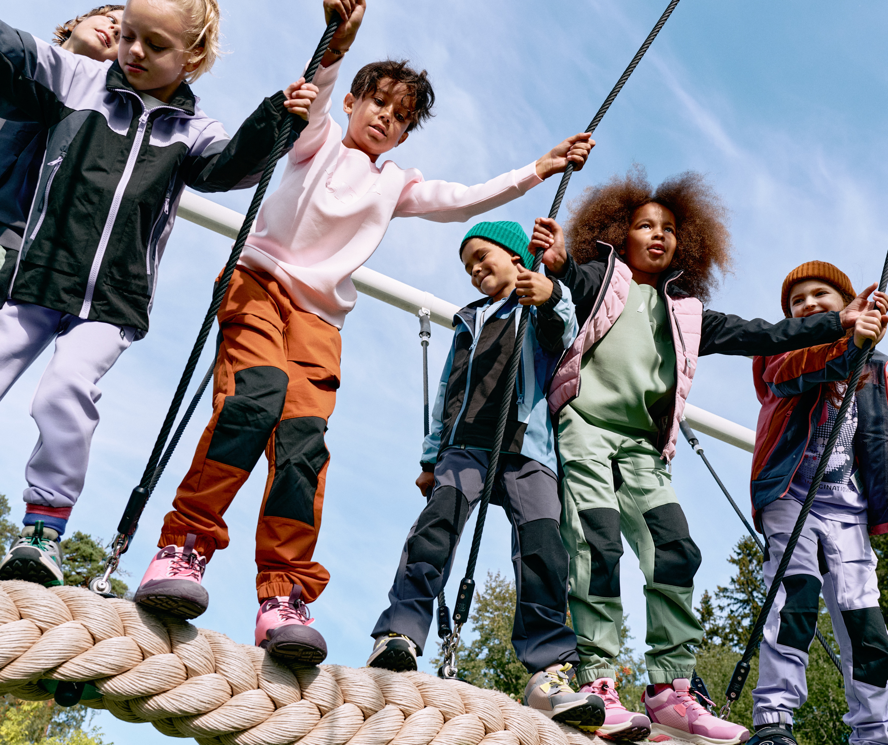
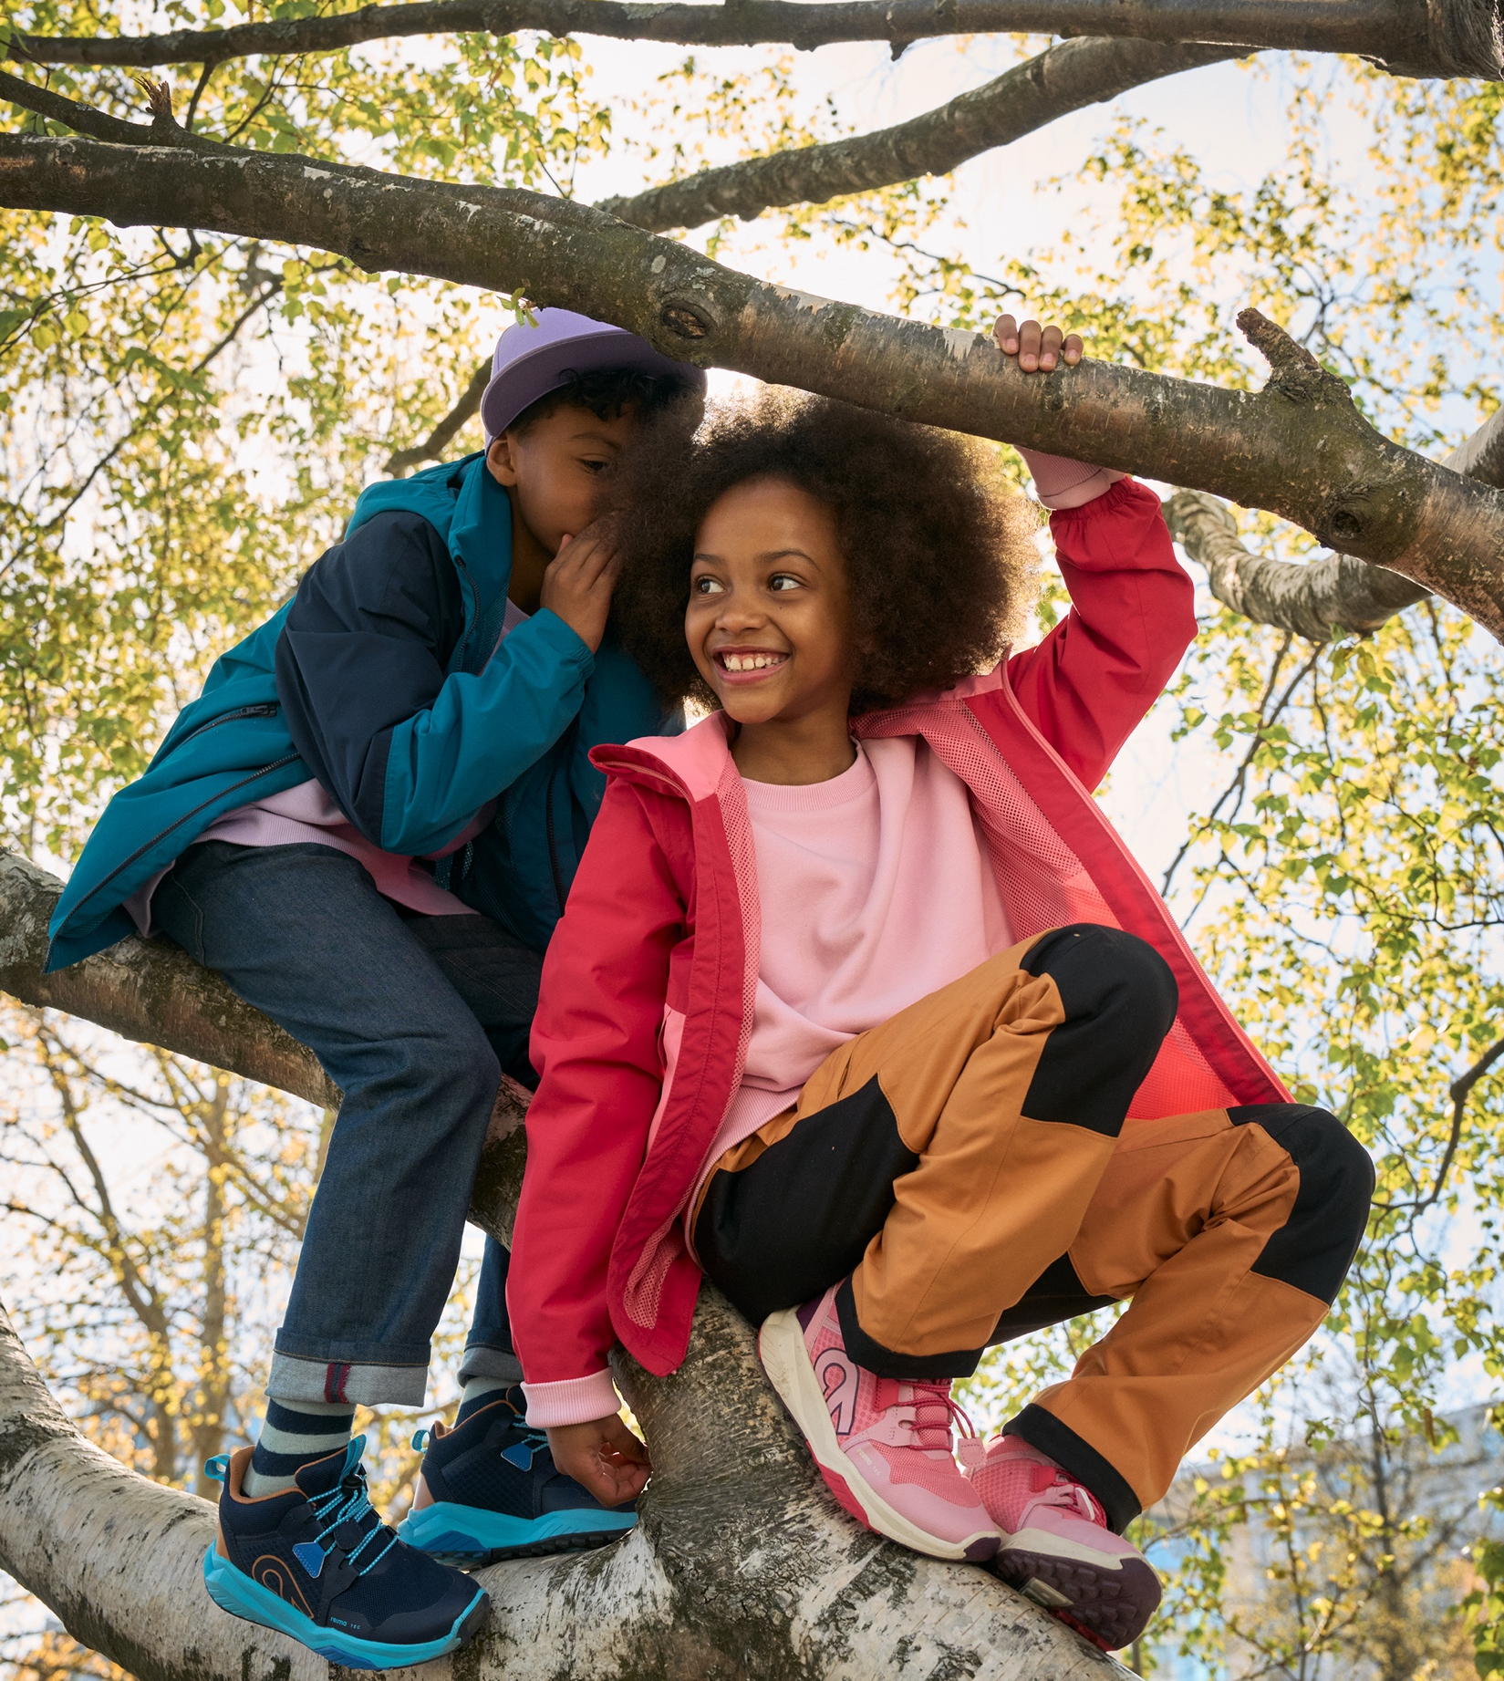
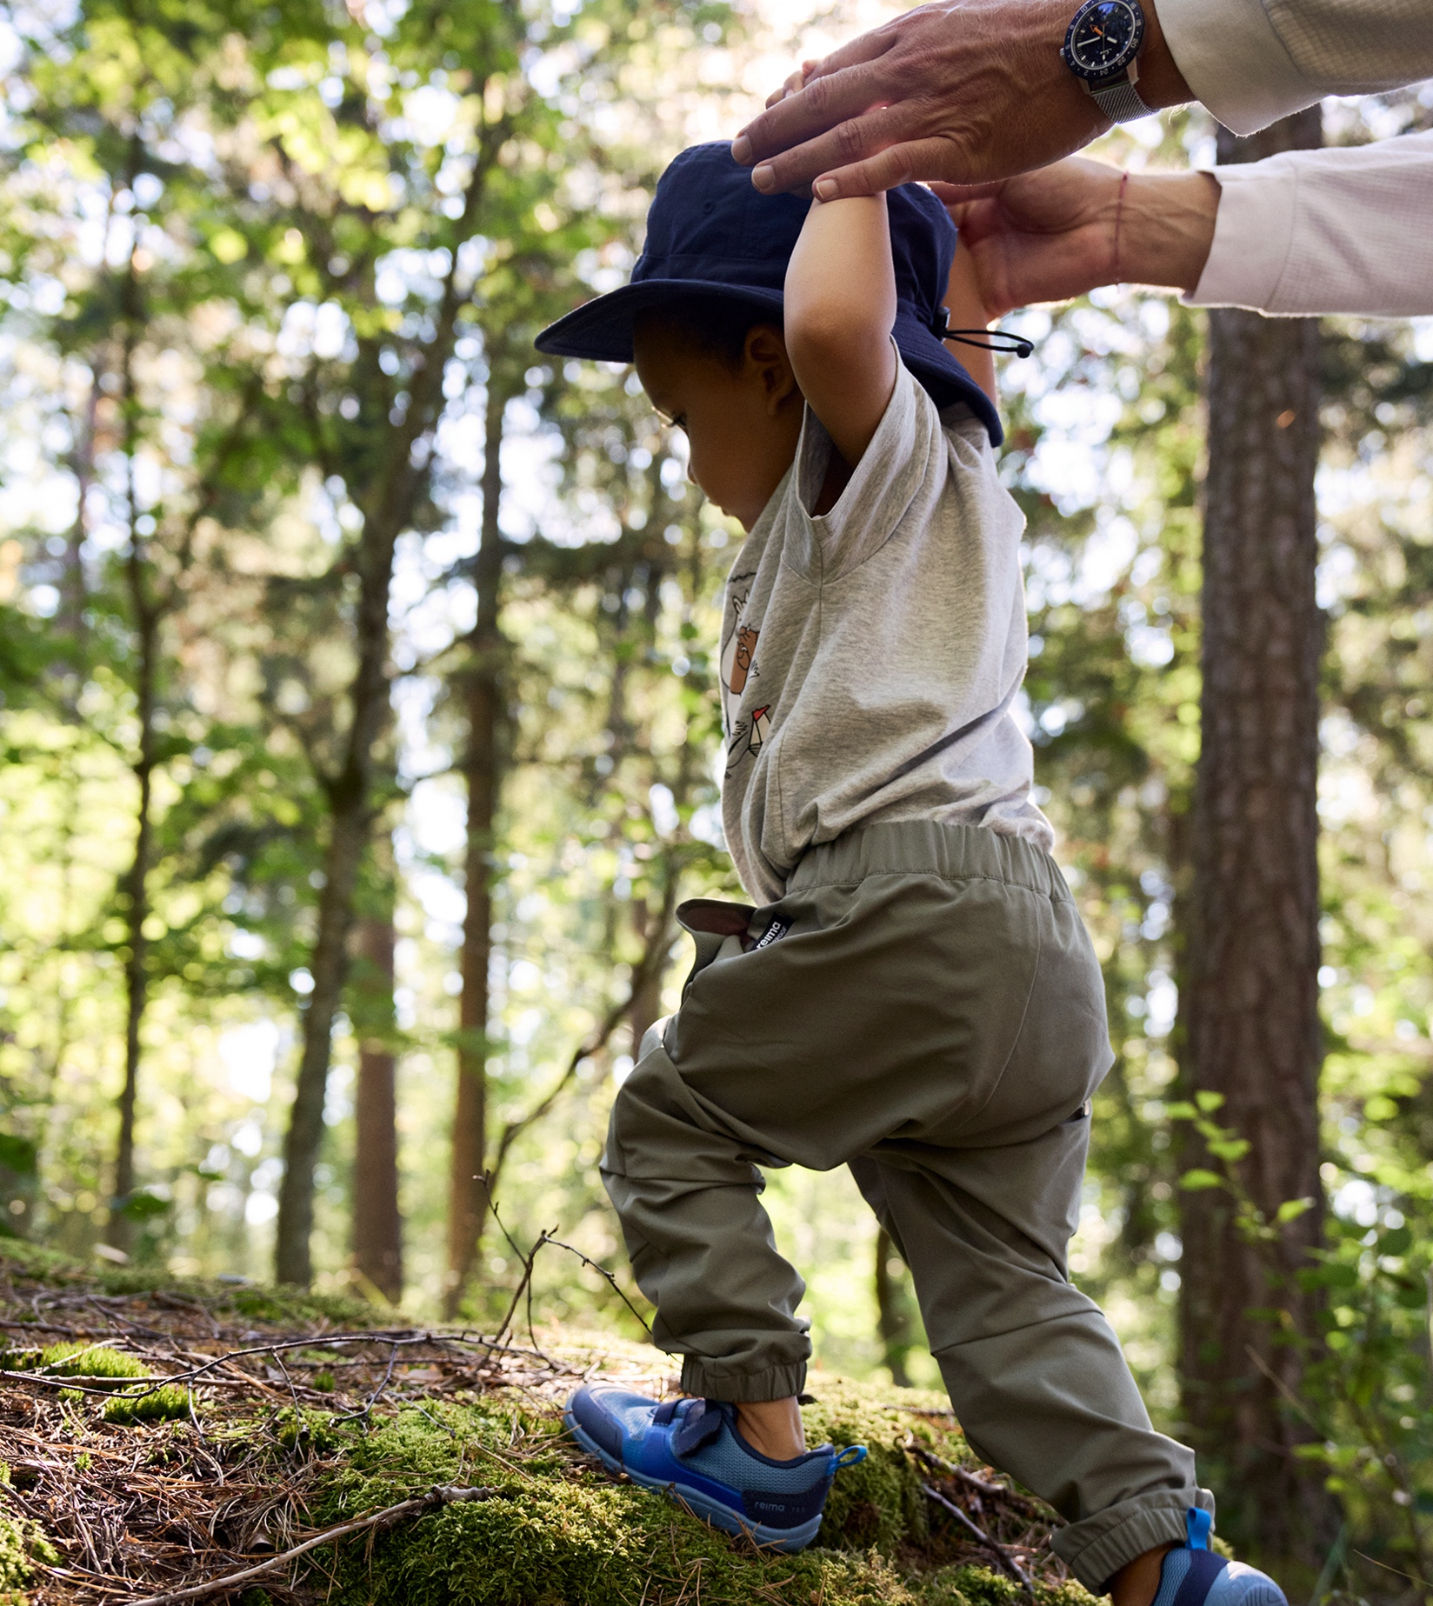
An active outdoor life has always been our style.
10 COMMON THREADS OF FINNISH FASHION
1
2
3
4
5
6
7
8
9
10
Finland is the
land of four
seasons.
Functional outerwear is essential not just for outdoor activities and sports,
but survival.
Photo: Reima
Photo: Reima
Photo: Reima
Photo: Reima
Photo: Reima
Notes:
Finns require a variety of lasting outerwear: 78 % of Finland is covered by forests, we have 168 000 lakes (of over 5 acres) and 1 100 kilometres of coastline and there's snow for 4-6 months a year, in average.
Finnish brands like Halti, Luhta, Joutsen and Makia design and create outerwear for Finnish conditions. Makia even has a slogan "Through the rough seas".
Luhta and it's sub-brands have designed Olympic uniforms for the Finnish Olympic Team for several years.

Slide 6
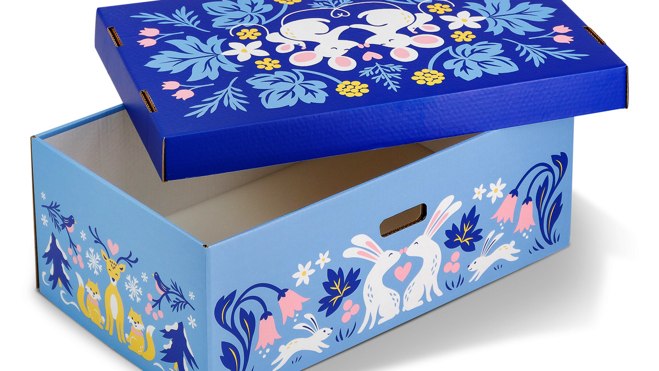
3/10
Children born in Finland
are cradled in design.
Photo: Kansaneläkelaitos

Slide 7
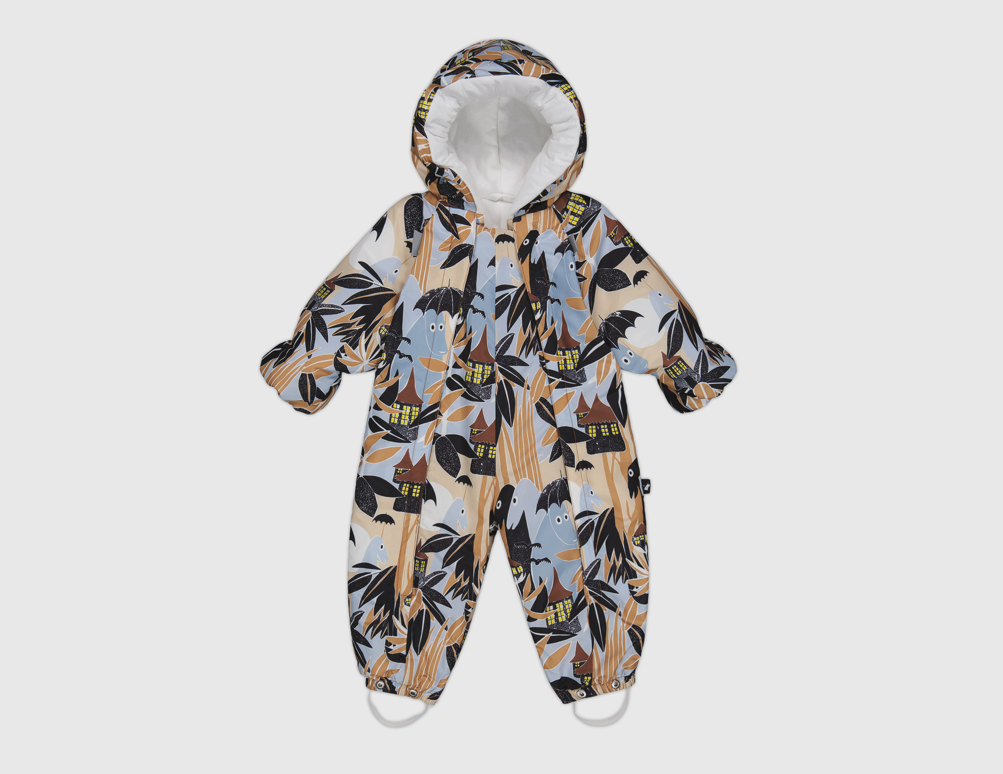
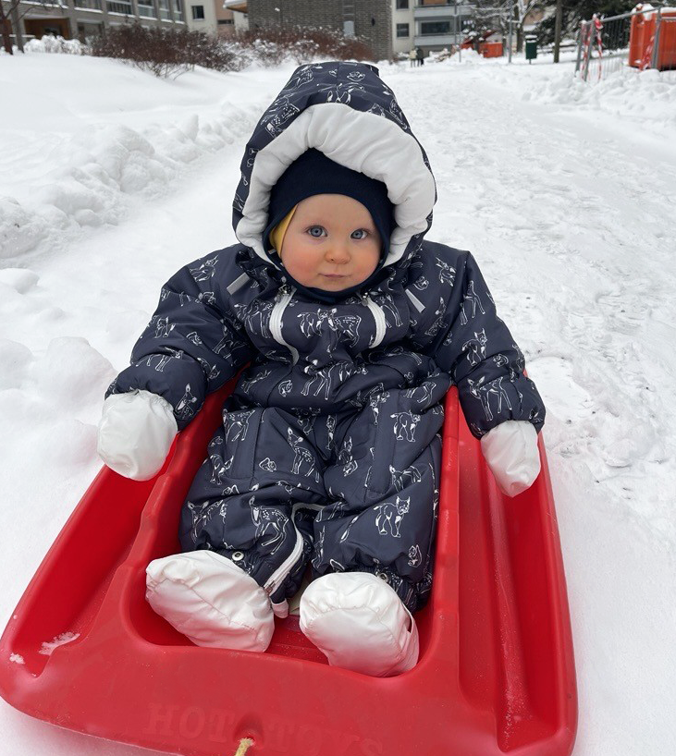
Children born in Finland are cradled in design.
10 COMMON THREADS OF FINNISH FASHION
1
2
3
4
5
6
7
8
9
10
The Maternity
Package
– a Finnish innovation – provides families with high-quality Finnish products and has inspired similar initiatives in over 60 countries worldwide.
Reima Snowsuit/sleeping bag.
Photo: Kansaneläkelaitos
Photo: Sini Koskenseppä / Finnish Textile & Fashion
Notes:
The maternity package is given to a pregnant mother or adoptive mother living in Finland. It is provided by Kela (The Social Insurance Institution of Finland).
The maternity package includes baby clothes and other essential items, such as a towel, bedding, a blanket, a sleeping bag, and care supplies.
The roots of the maternity package date back to the 1920s circulating baskets, which the Mannerheim League for Child Welfare filled with baby supplies to be loaned to low-income mothers.
Instead of the maternity package, a parent can choose a cash maternity grant. Since June 2018, the monetary grant has been €170 (previously it was €140).
The maternity package is chosen by 95% of first-time mothers and 66% of all mothers.
Around 36 000 families choose the Maternity Package every year.
There are fewer items in terms of quantity, they are now more durable and adaptable than before.
This year’s maternity package once again includes several high-quality Finnish products, such as a Reima overall, a fox bodysuit, mittens and booties, a merino wool cap from Tuohimäki, a mattress from Carpenter, and sanitary pads from Delipap.

Slide 8
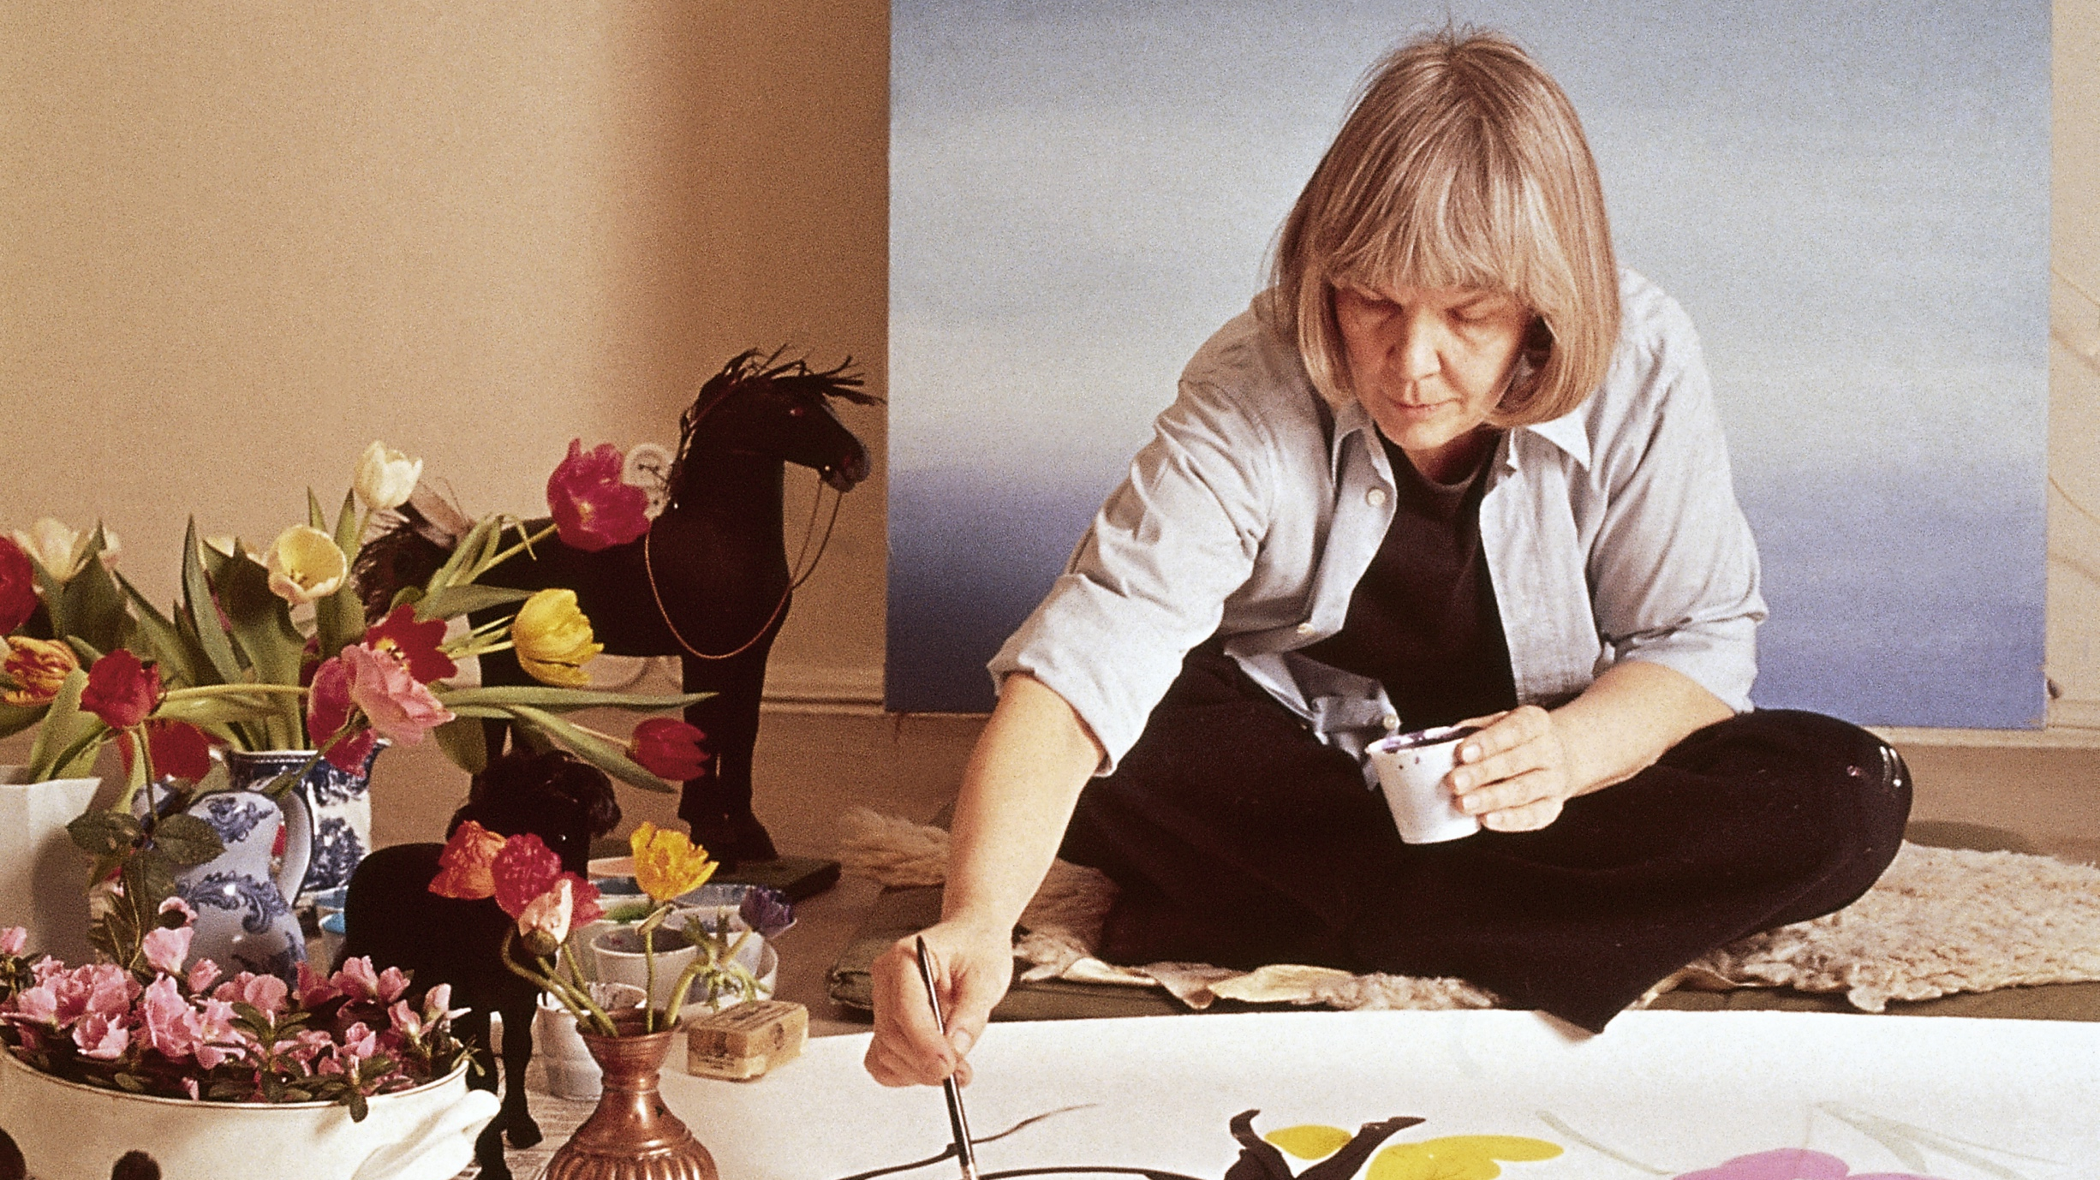
4/10
Icons across generations.
Maija Isola, Marimekko, in the 1970s. Photo: Designmuseo

Slide 9
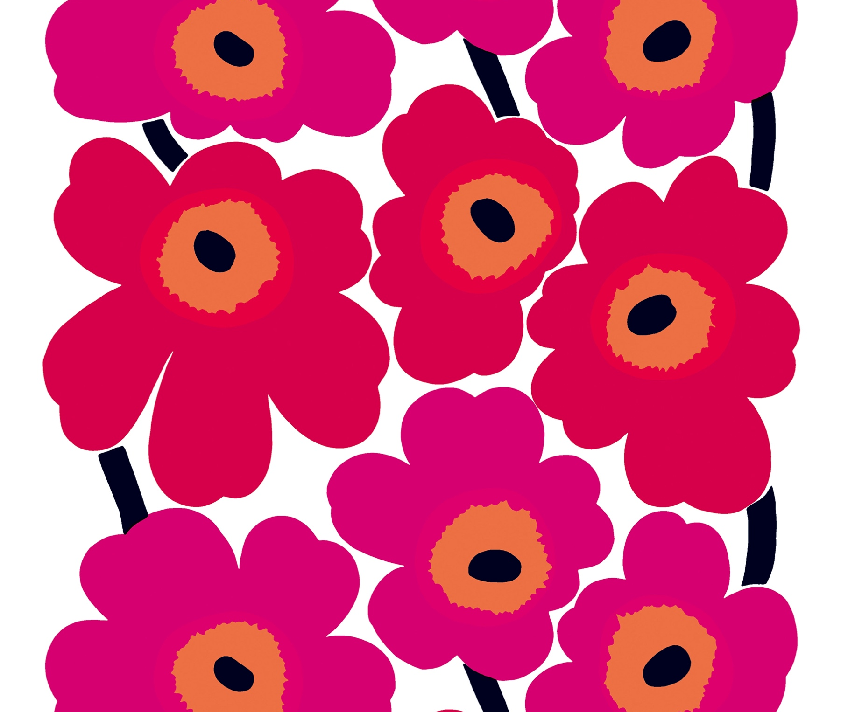
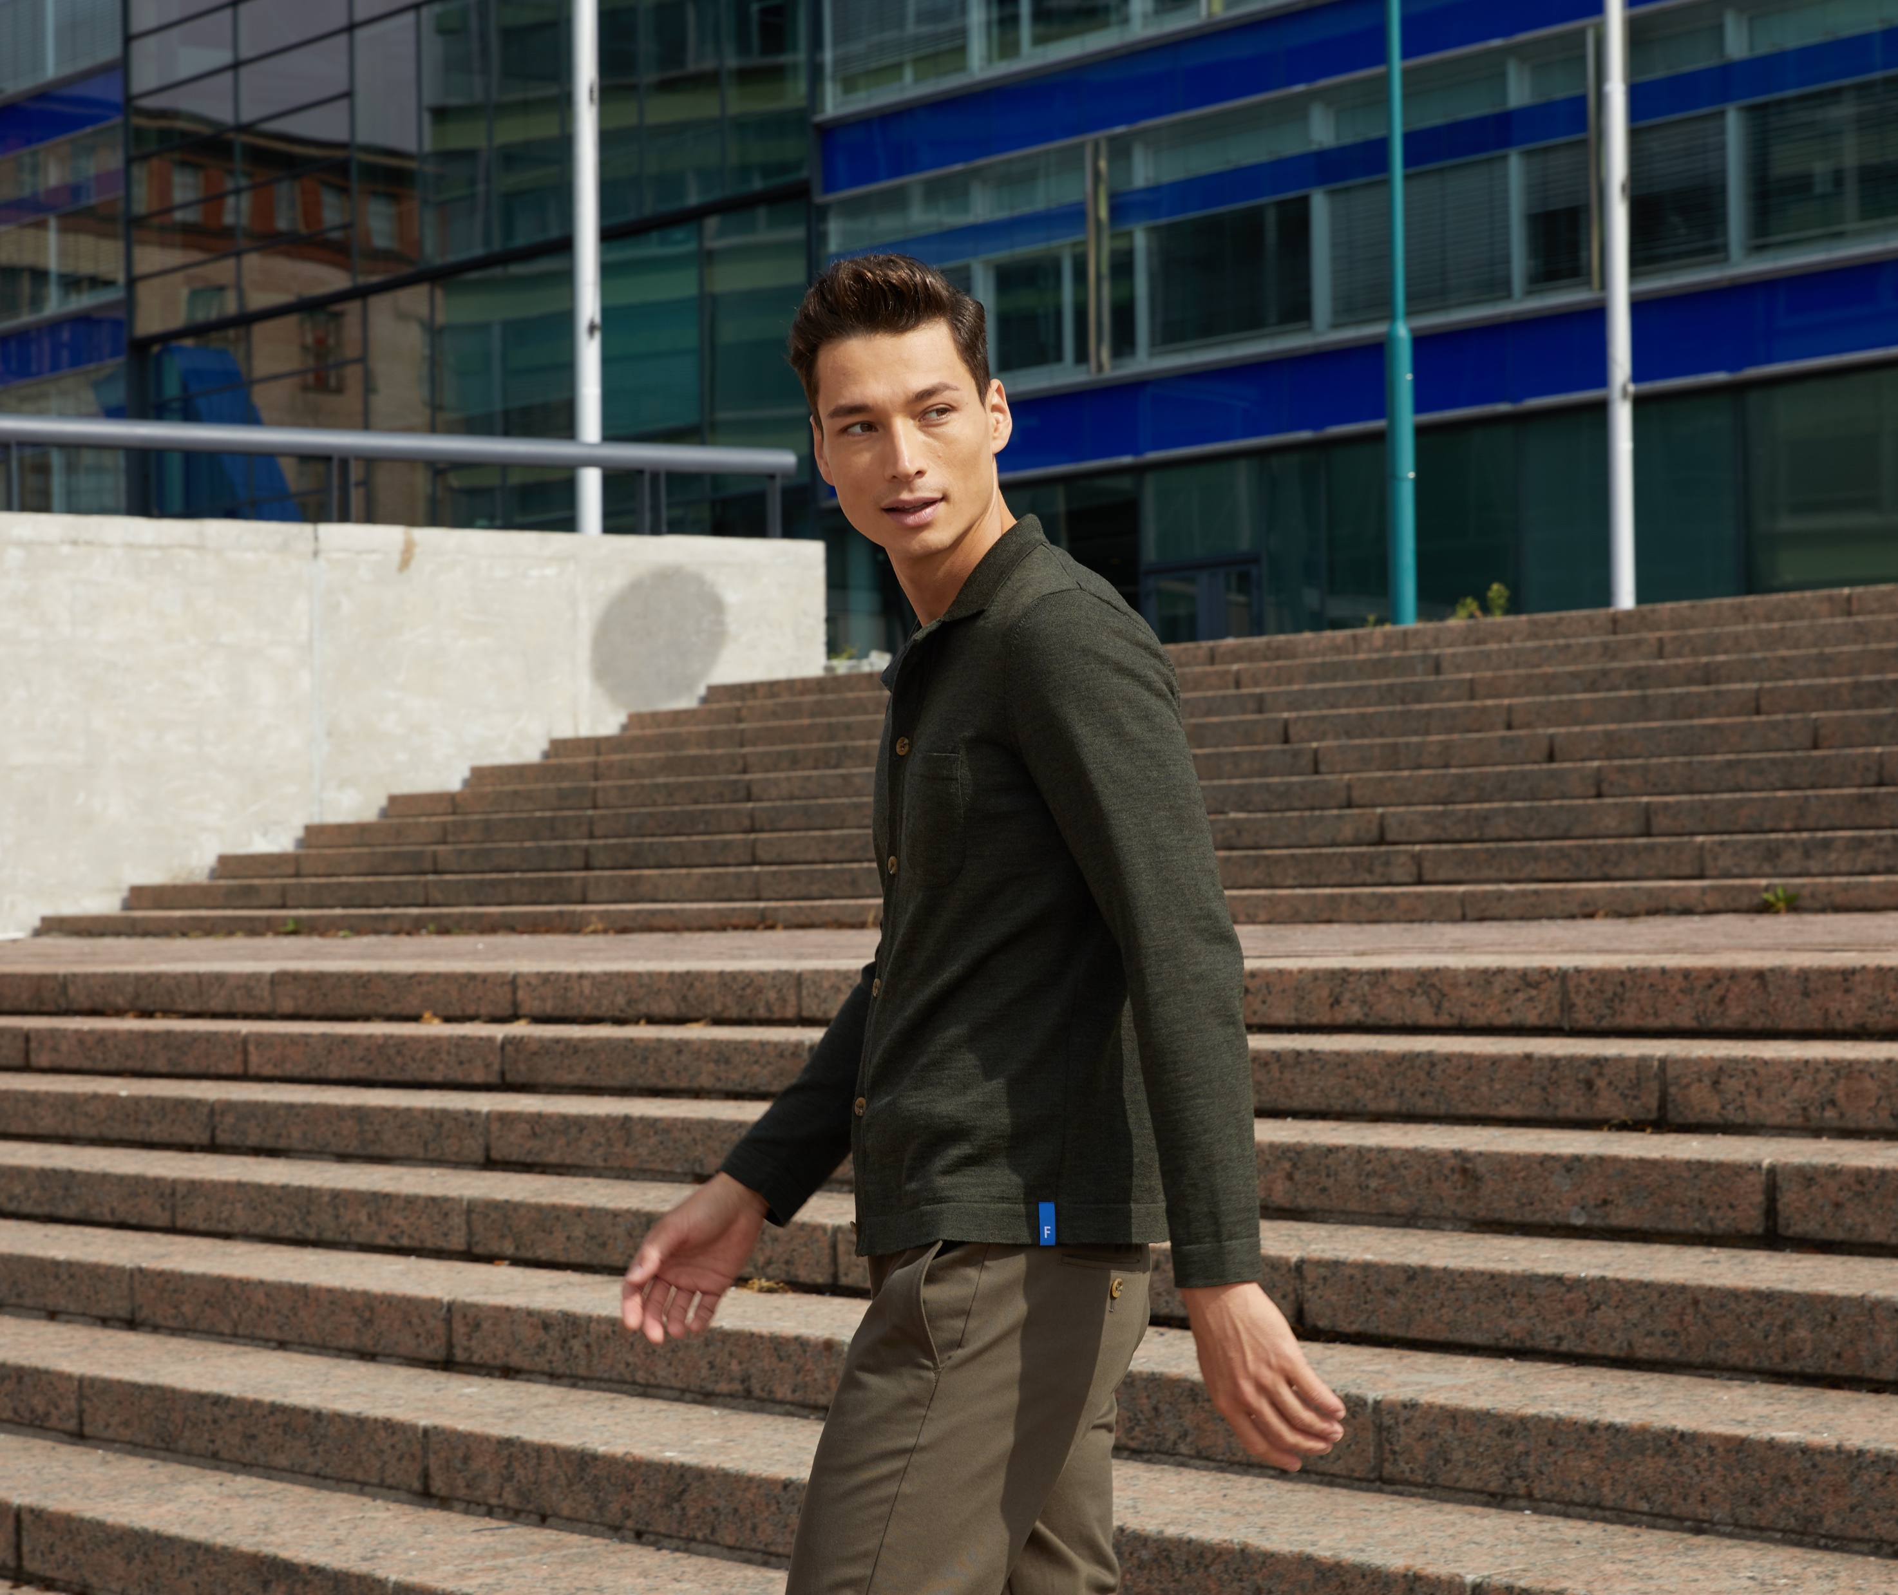
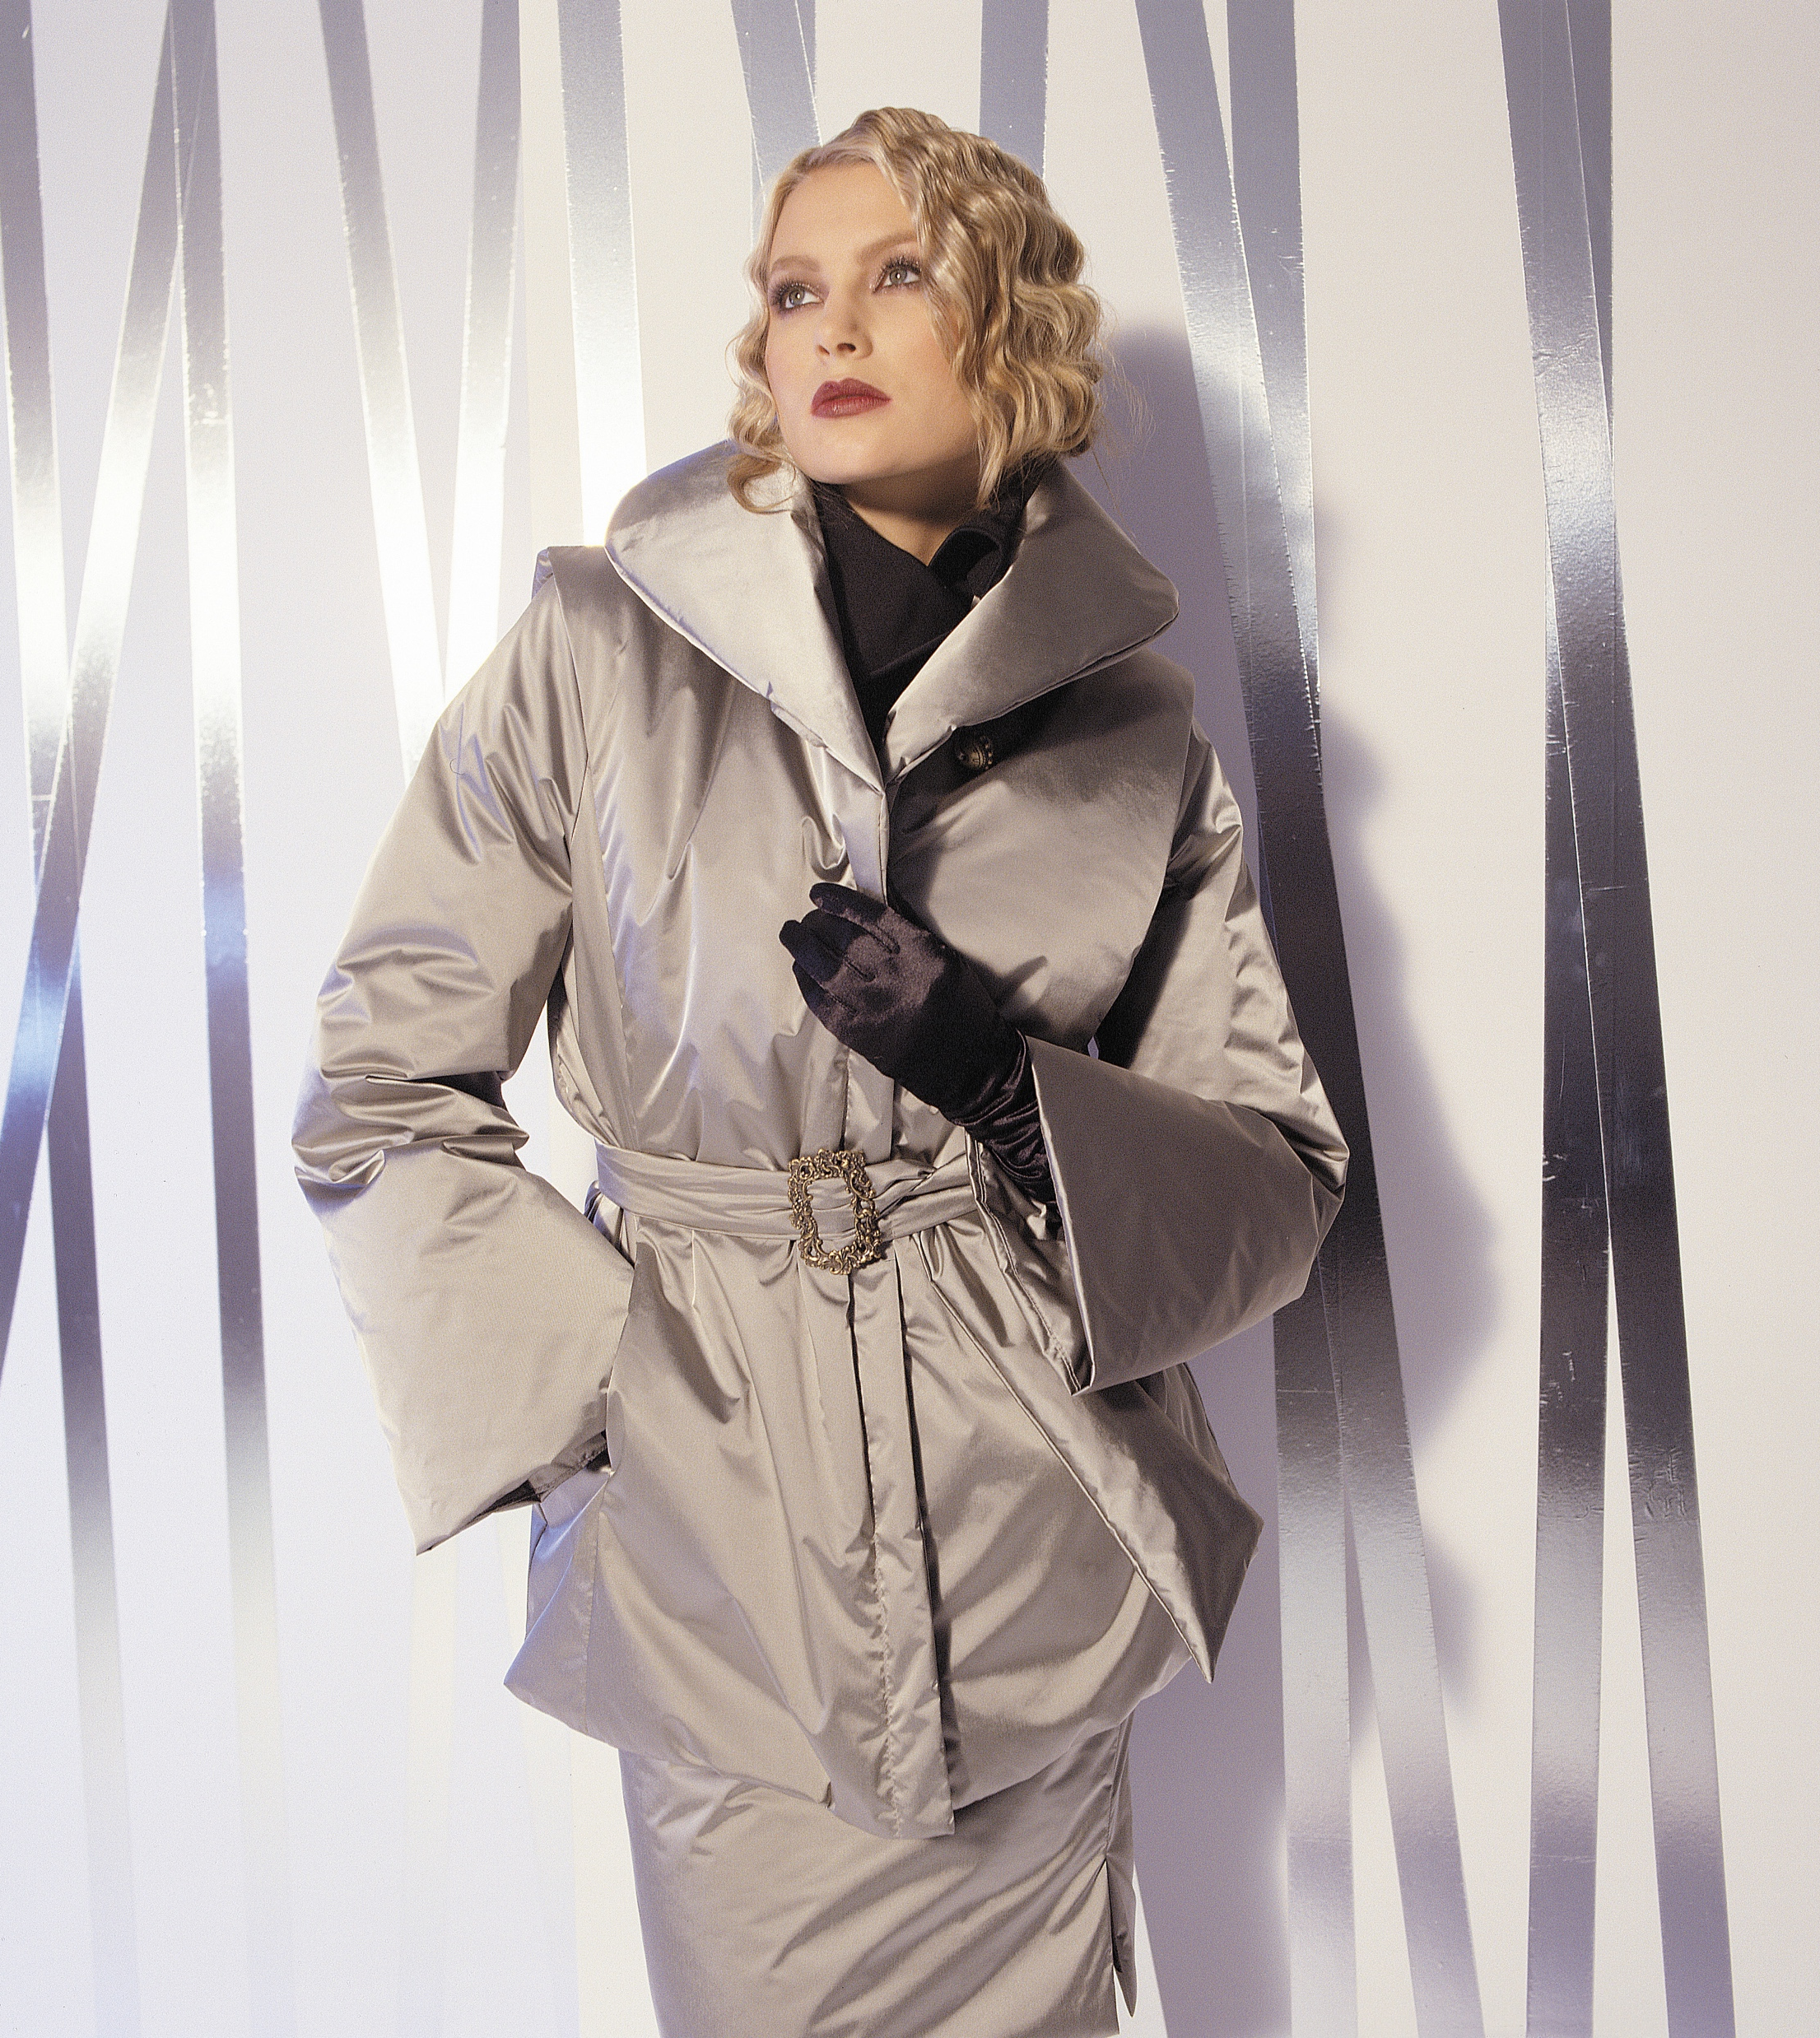
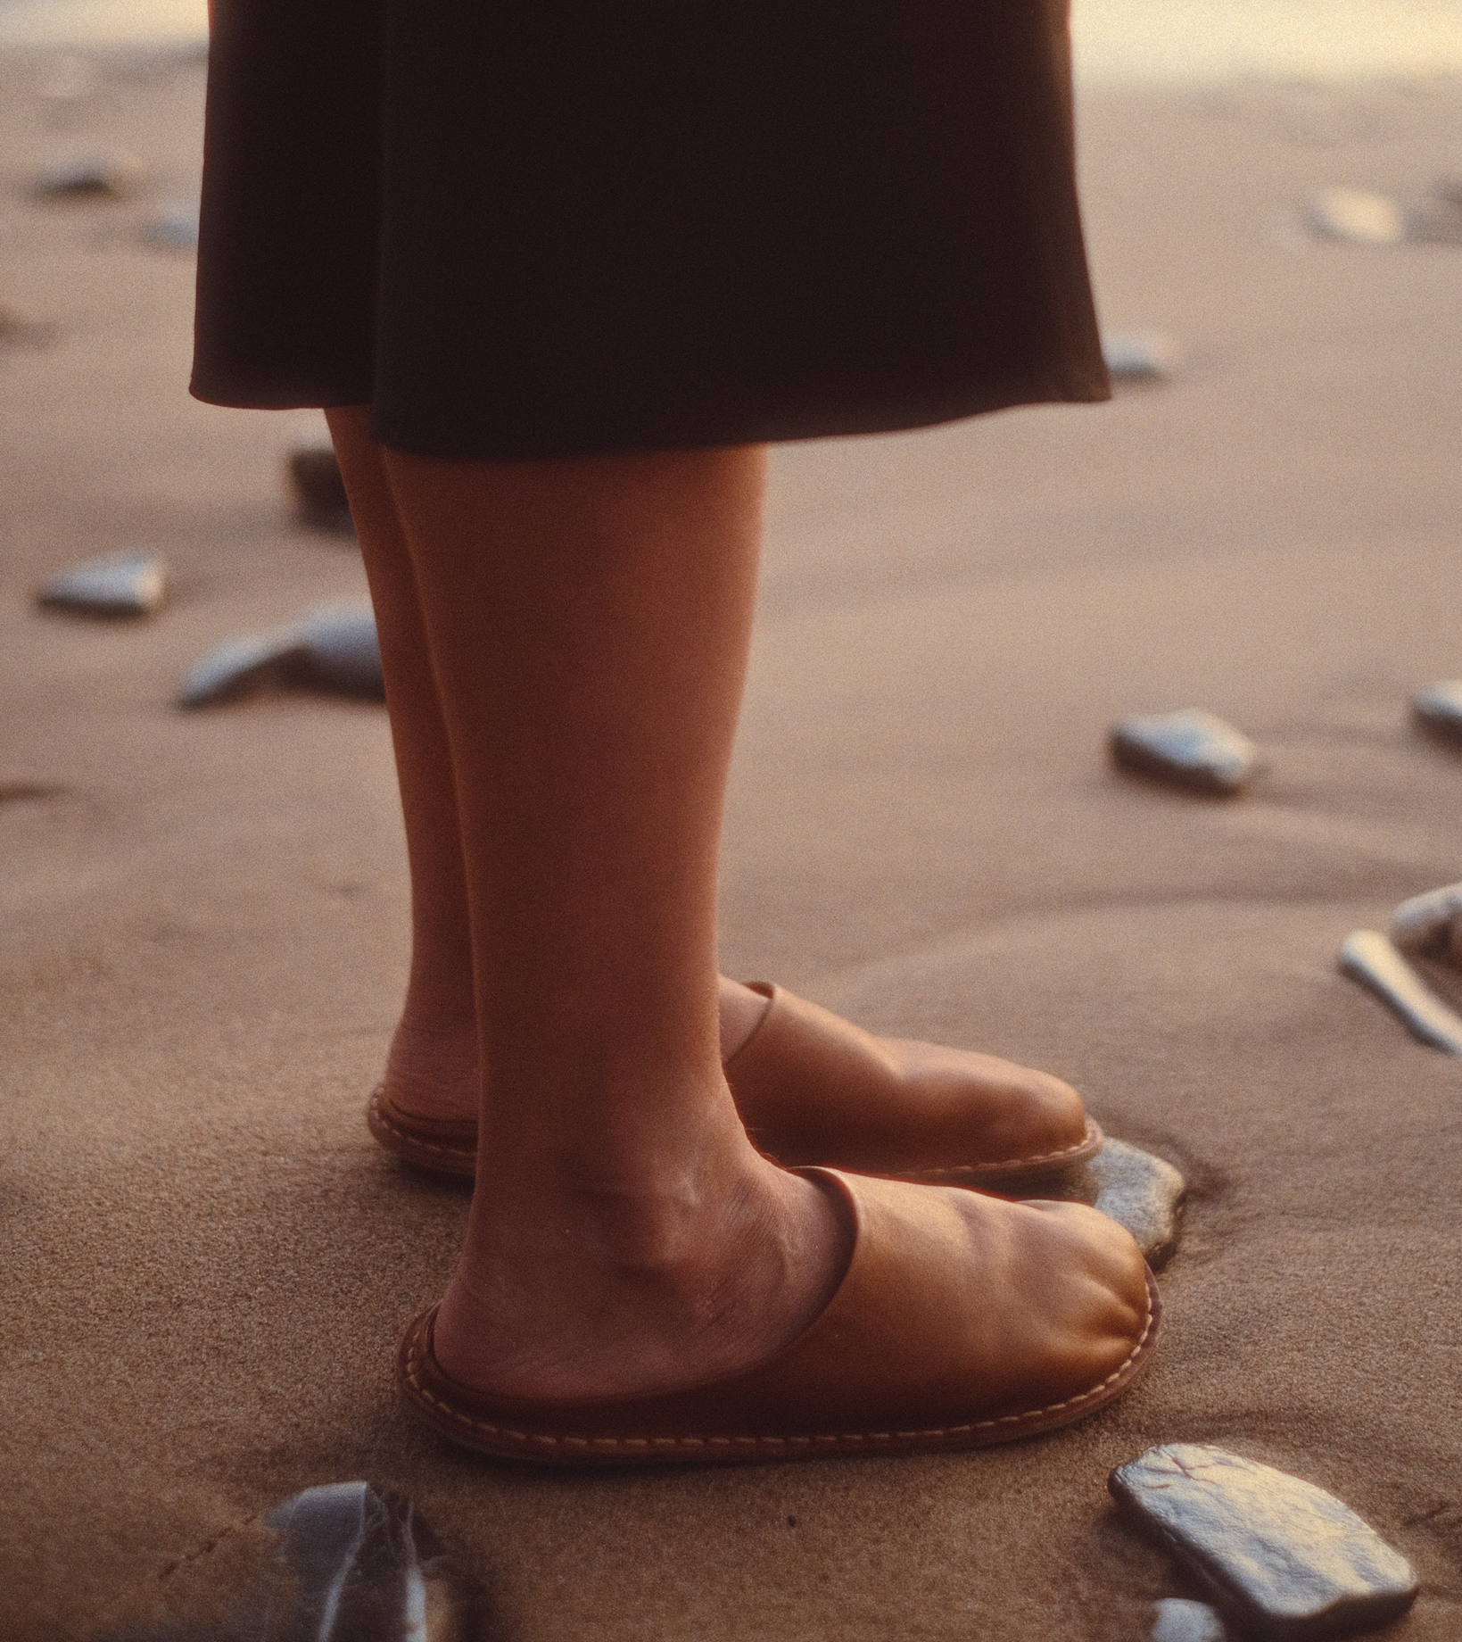
Icons across generations.
10 COMMON THREADS OF FINNISH FASHION
1
2
3
4
5
6
7
8
9
10
Maija Isola
is one of the great Finnish textile designers and her "Unikko" design is one of the most iconic Finnish patterns. Isola worked as Marimekko's head designer for 38 years and was also a talented painter.
FRENN AW25, Helsinki 2025.
Photo: Eeva Suutari
Unikko by Maija Isola, Marimekko.
Jukka Rintala for Joutsen, 2006.
Photo: Ari Lyijynen
Photo: VIBAe Shoes
Notes:
From Maija Isola, Vuokko Nurmesniemi and other great names of the previous decades, to their modern contemporaries such as Johanna Gullichsen, Klaus Haapaniemi or FRENN's Jarkko Kallio and Antti Laitinen, the world of Finnish textile design has gathered inspiration from nature, classic elegance and timeless style.
Jackie Kennedy wore Marimekko in the 60s on the cover of Sports Illustrated, and for example Swedish royals have worn Ril's and Andiata for their special occasions.
The president of Finland Alexander Stubb has recently been seen in his FRENN suit.
These icons of Finnish textile and fashion are a significant factor in building the country brand of Finland.

Slide 10
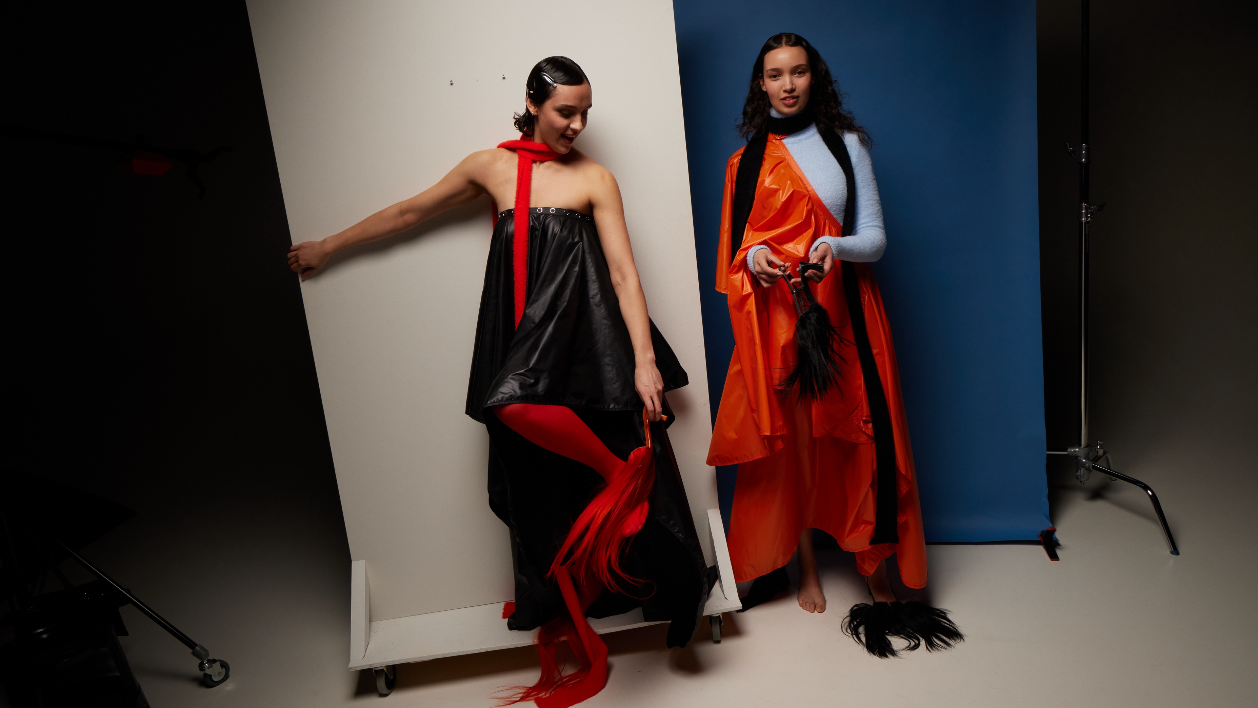
5/10
A model country in
design education.
Camilla Naukkarinen 2025.
Photo: Sofia Kulianu

Slide 11
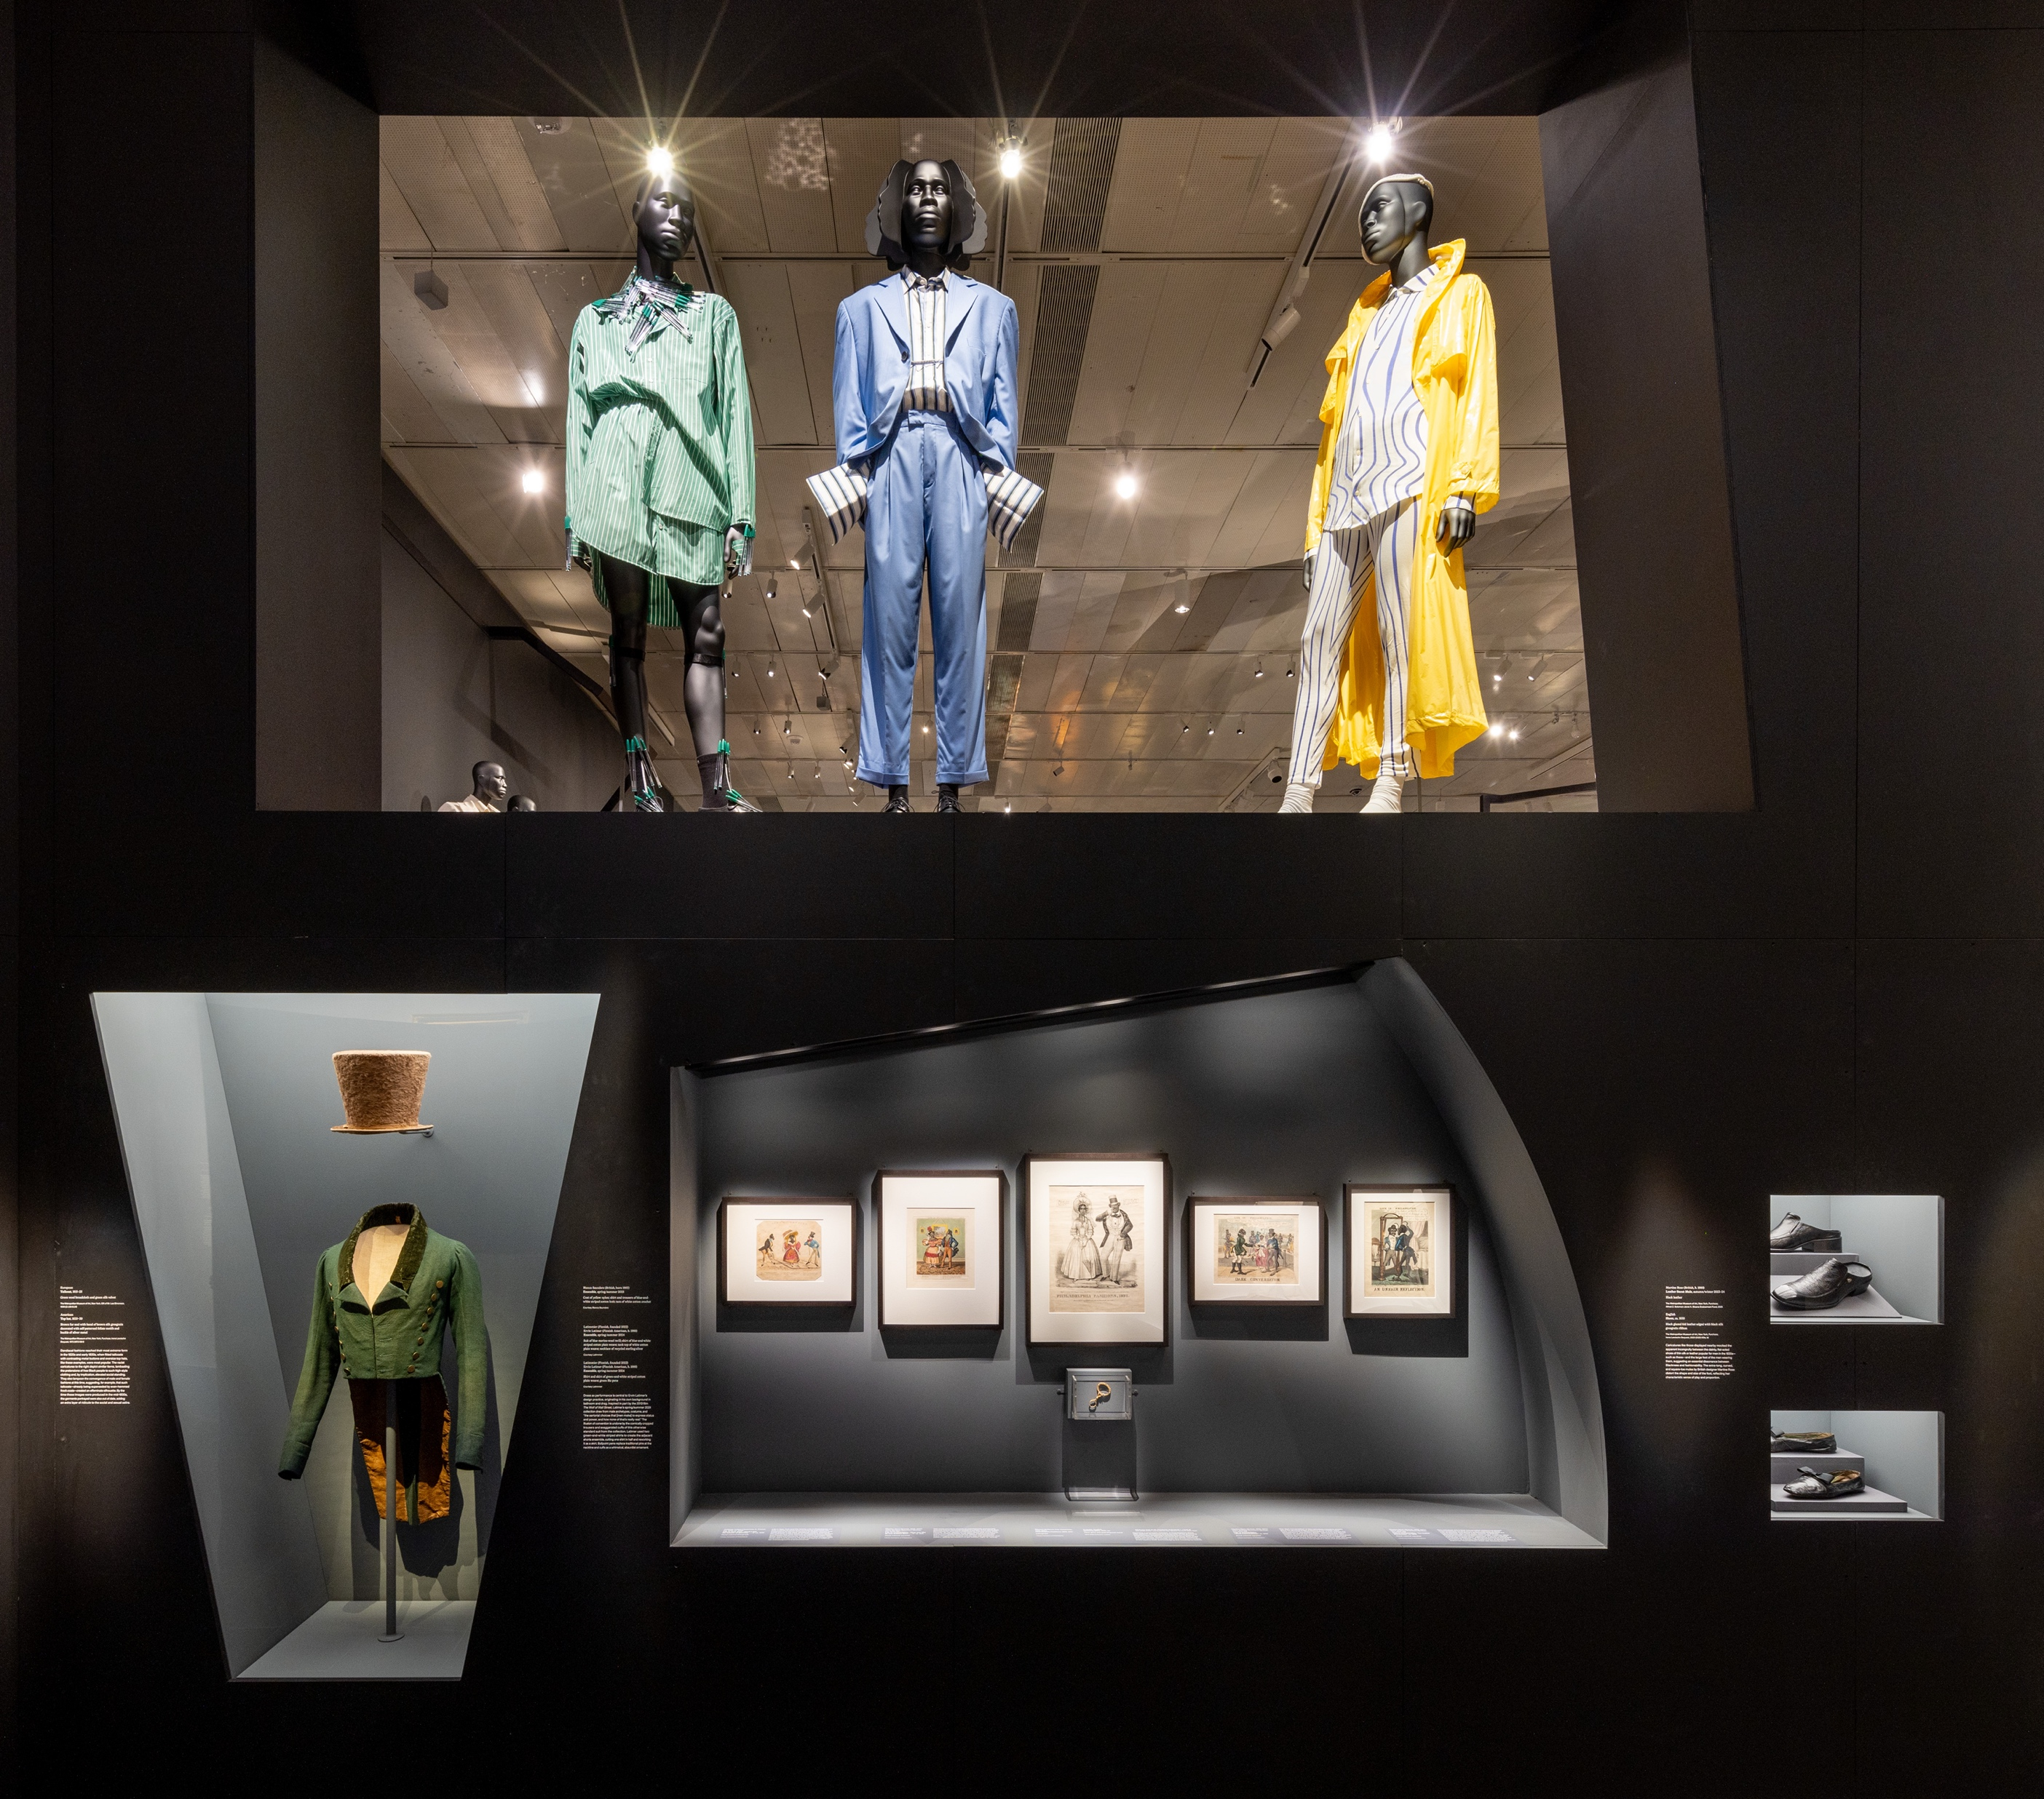
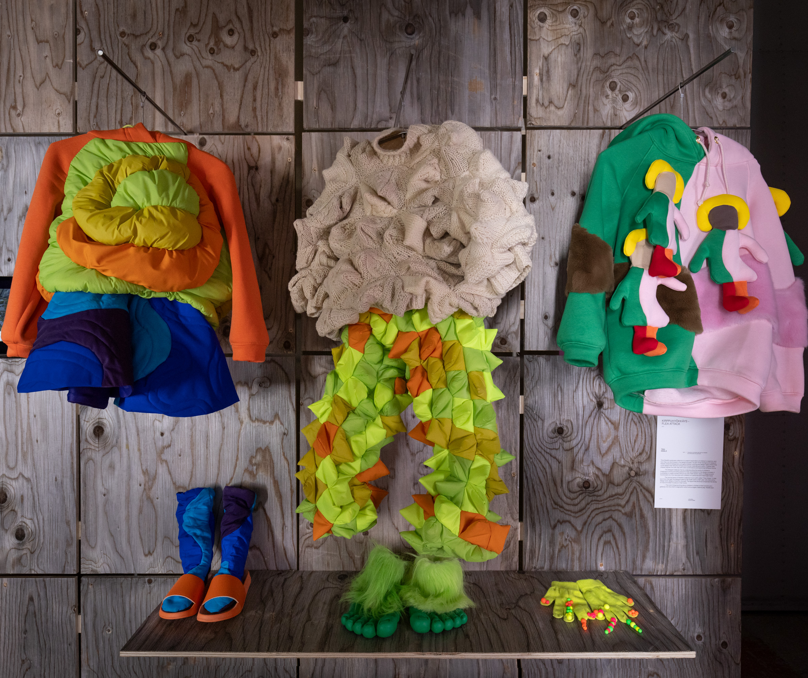
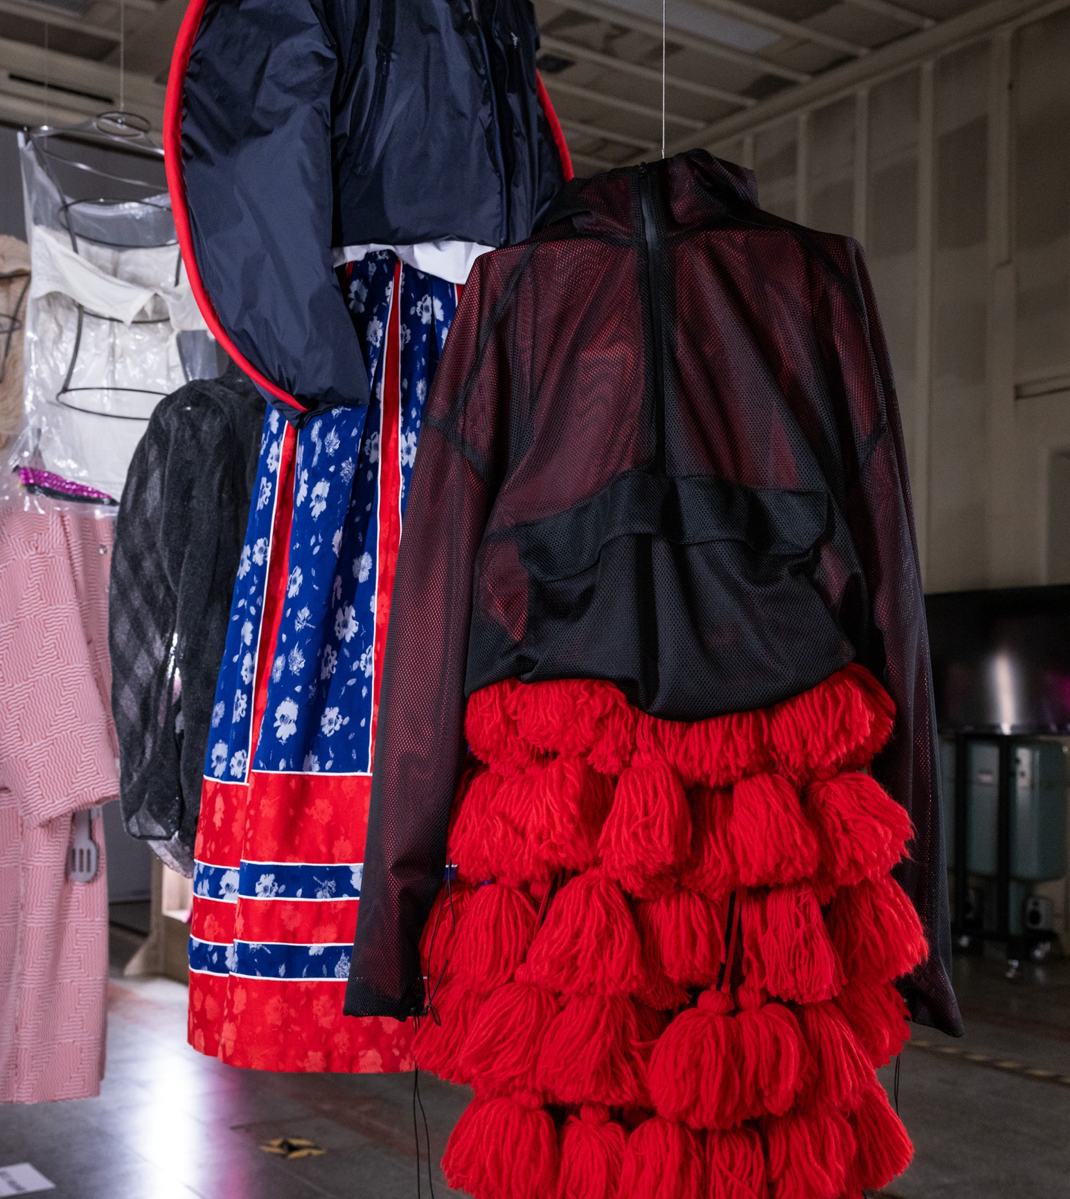
A model country in design education.
10 COMMON THREADS OF FINNISH FASHION
1
2
3
4
5
6
7
8
9
10
Aalto University’s School of Arts, Design and Architecture is regularly ranked among the world’s top 10–15 in design by the QS World University Rankings.
Latimmier SS24 ensembles by Ervin Latimer, Metropolitan Museum of Art, New York.
Photo: Metropolitan Museum of Art.
Tiina Nissilä 2024.
Photo: Paavo Lehtonen
Lauri Greis 2024.
Photo: Paavo Lehtonen
Notes:
Many Finnish students and alumni have won or placed highly in prestigious fashion competitions such as the Hyères Festival, Designer’s Nest, Redress Design Award, and the Talent Competition (Première Vision).
Some of the hot names in recent years have been Ervin Latimer, Jimi Särmö, Petra Lehtinen, Lauri Greis, Sini Saavala, Jenny Hytönen and Sofia Ilmonen.
This success has continued for a long time, especially since the 2010s. After the WTC 2012, international recognition grew > expansion followed. In 2017, Aalto received an award from the LVMH group for fashion education.
Education: Since the founding of Aalto University, research has gained a stronger foothold > the university invests in research. Multidisciplinary education has also been strengthened (e.g., Shimmer Wood).

Slide 12
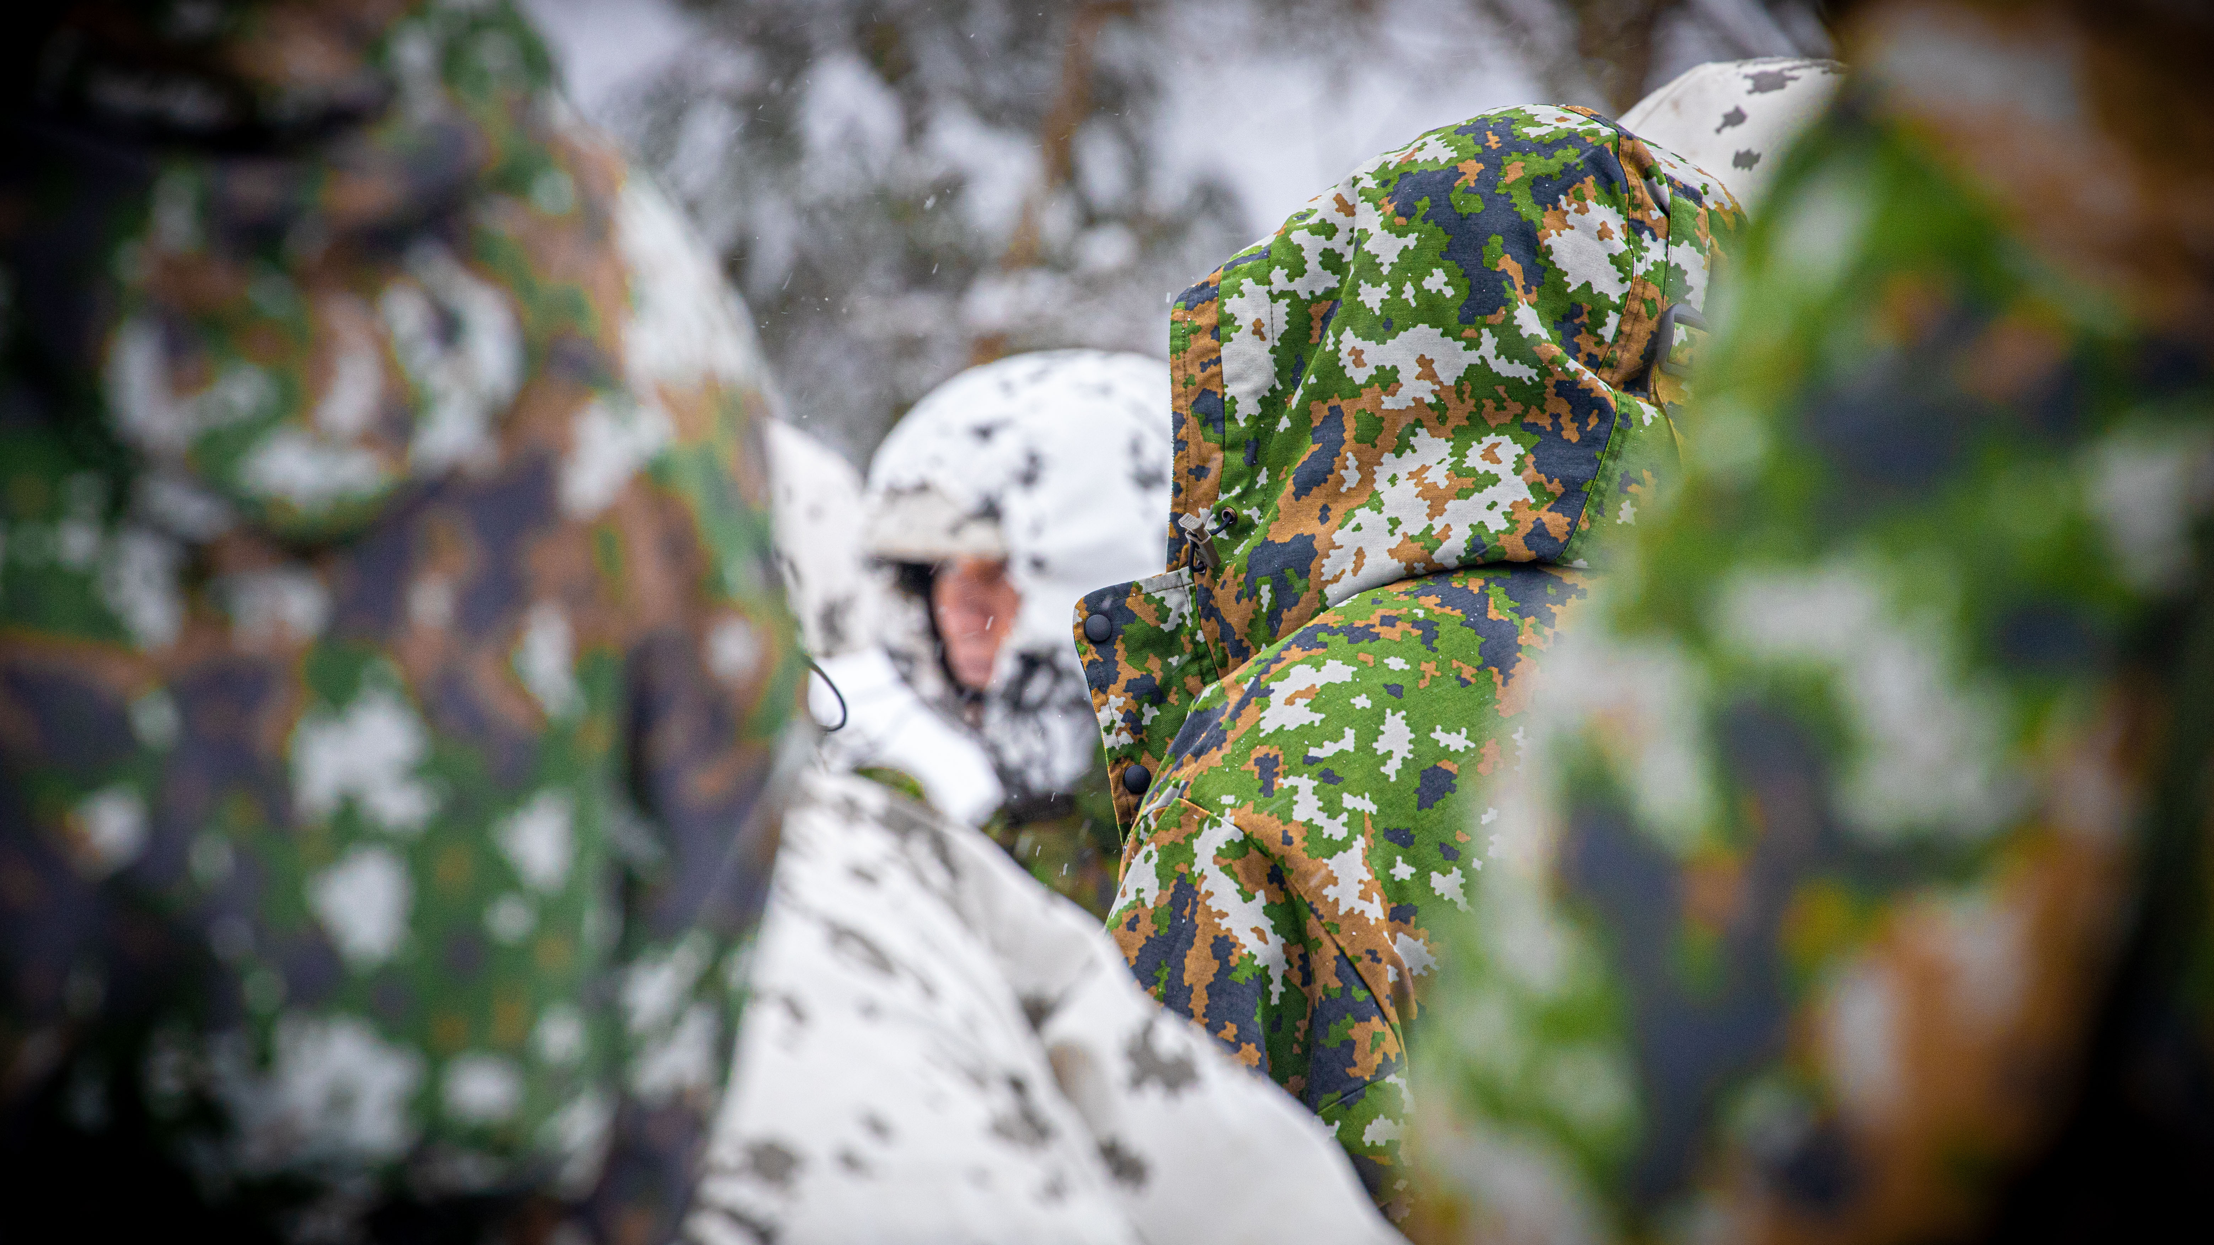
6/10
Protecting individuals and
independence with every
fibre of our being.
Photo: Gabriel Walkeajärvi / The Finnish Defence Forces

Slide 13
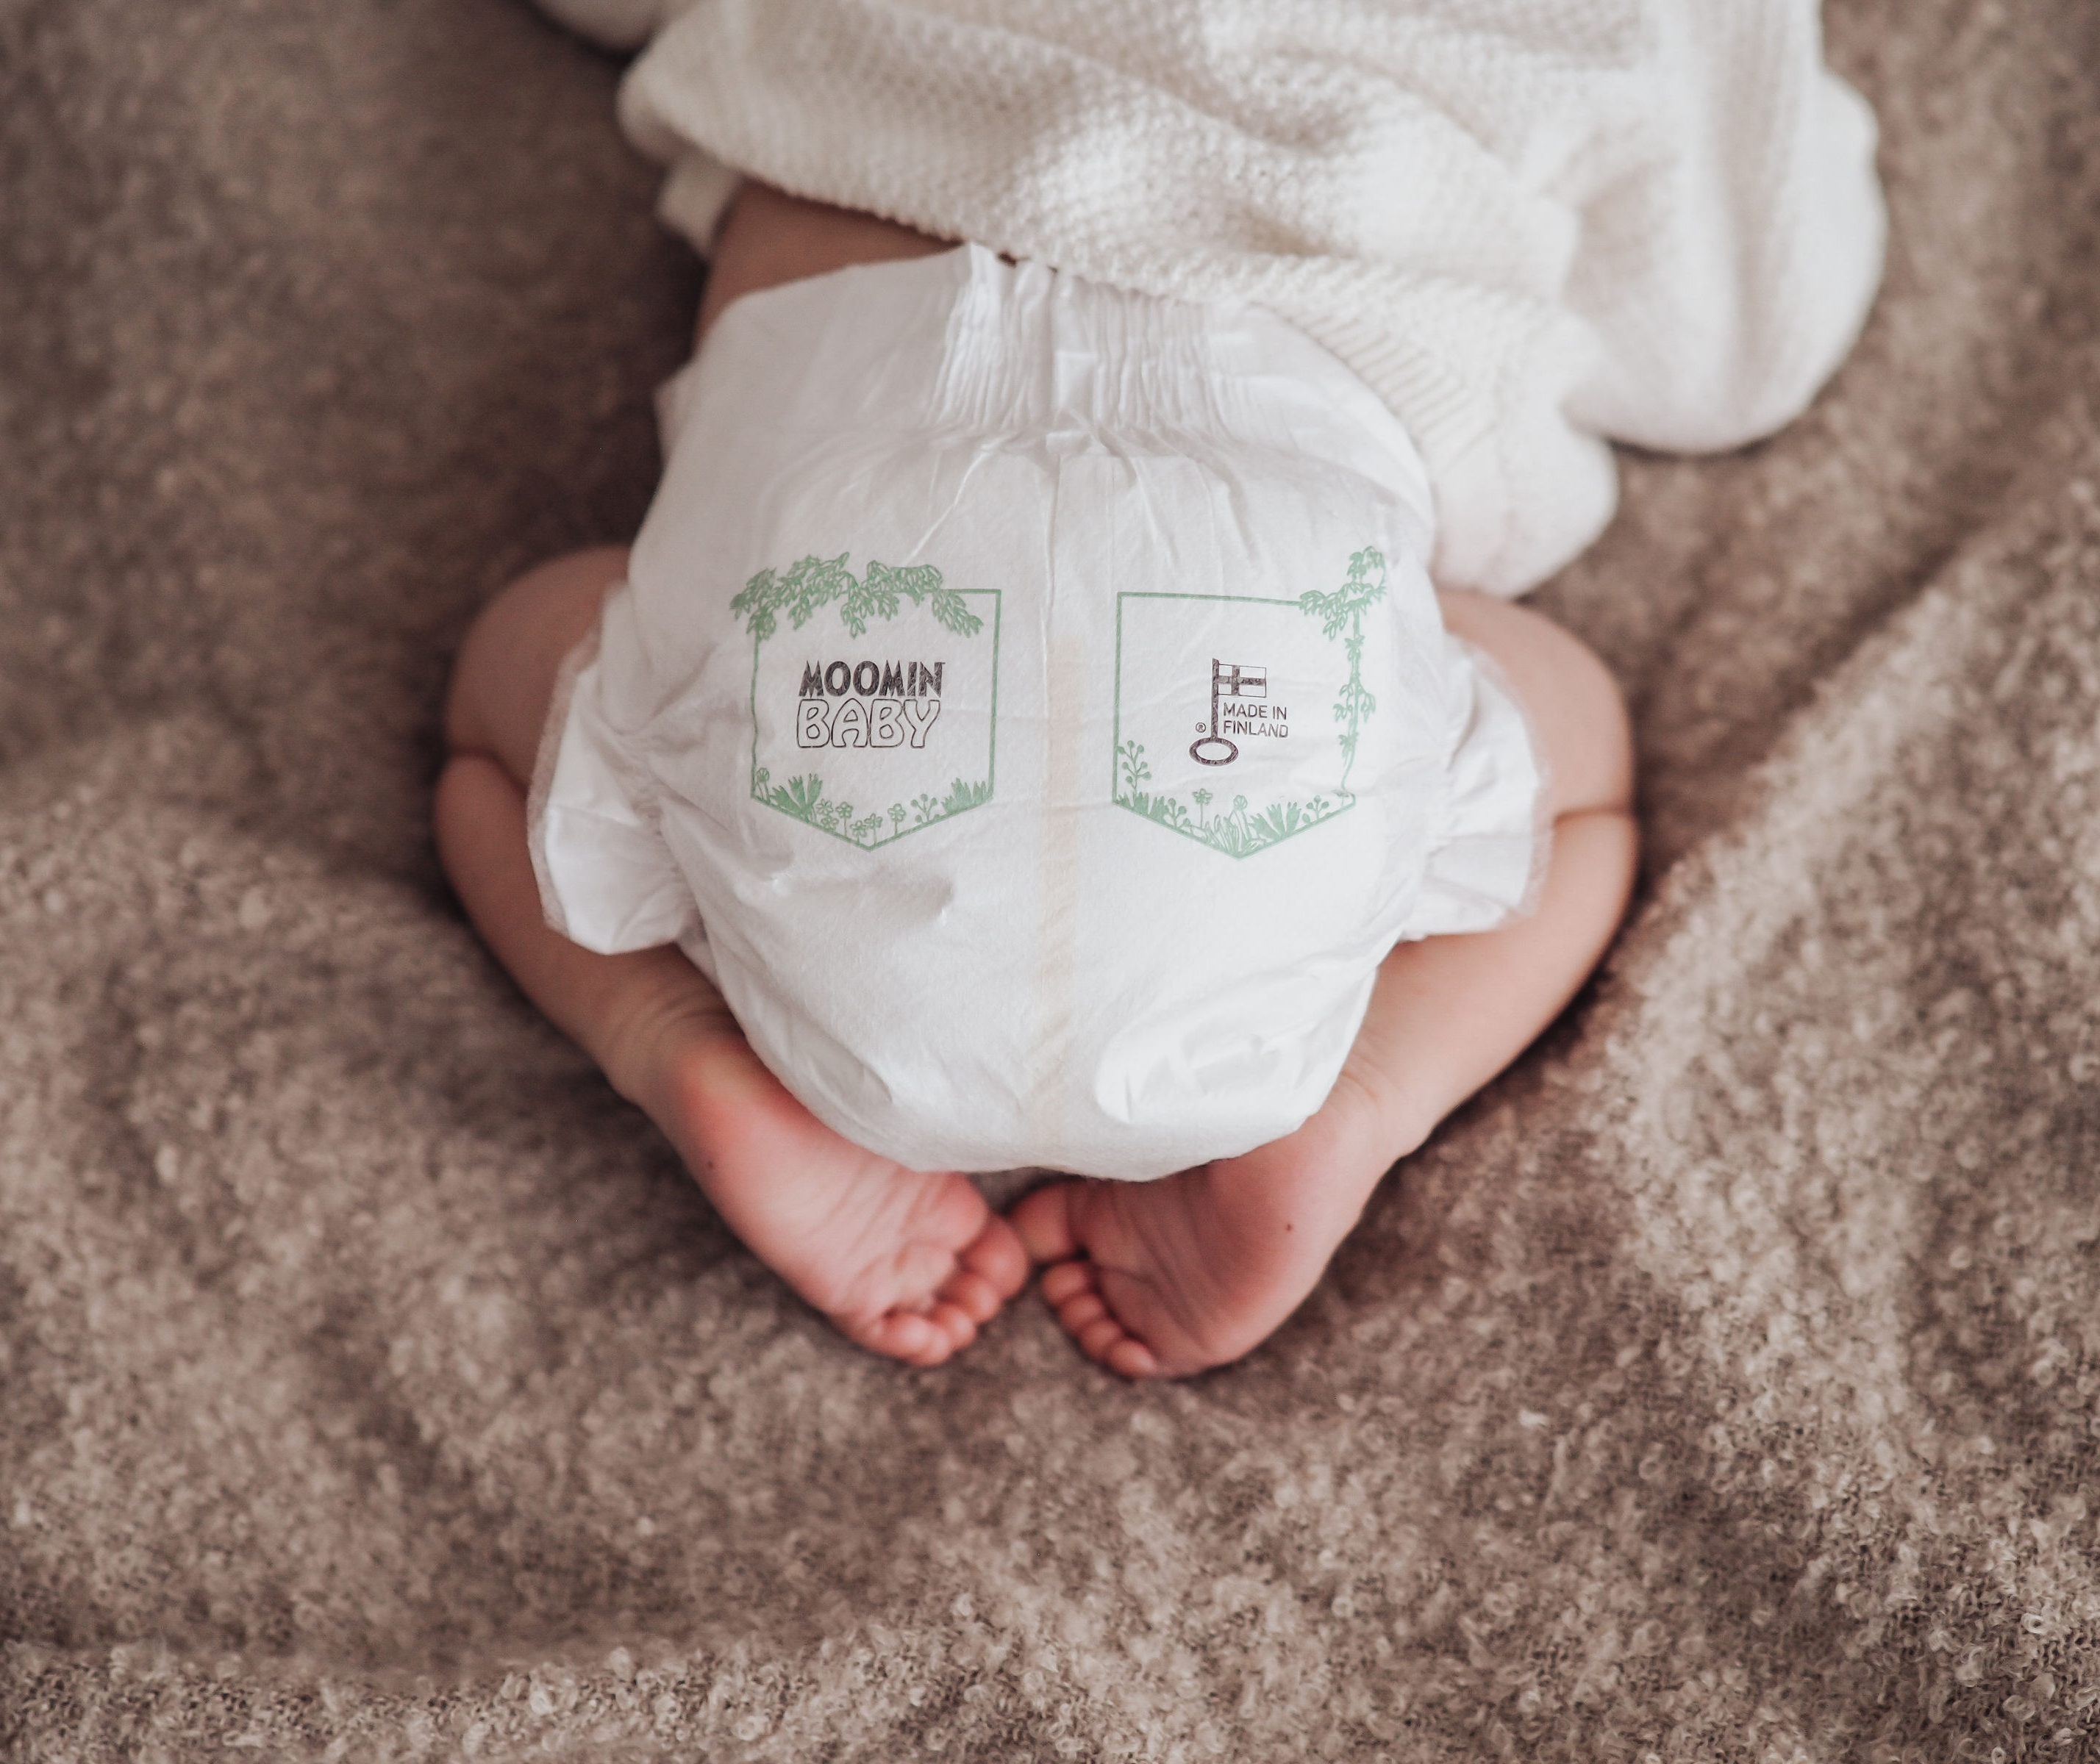
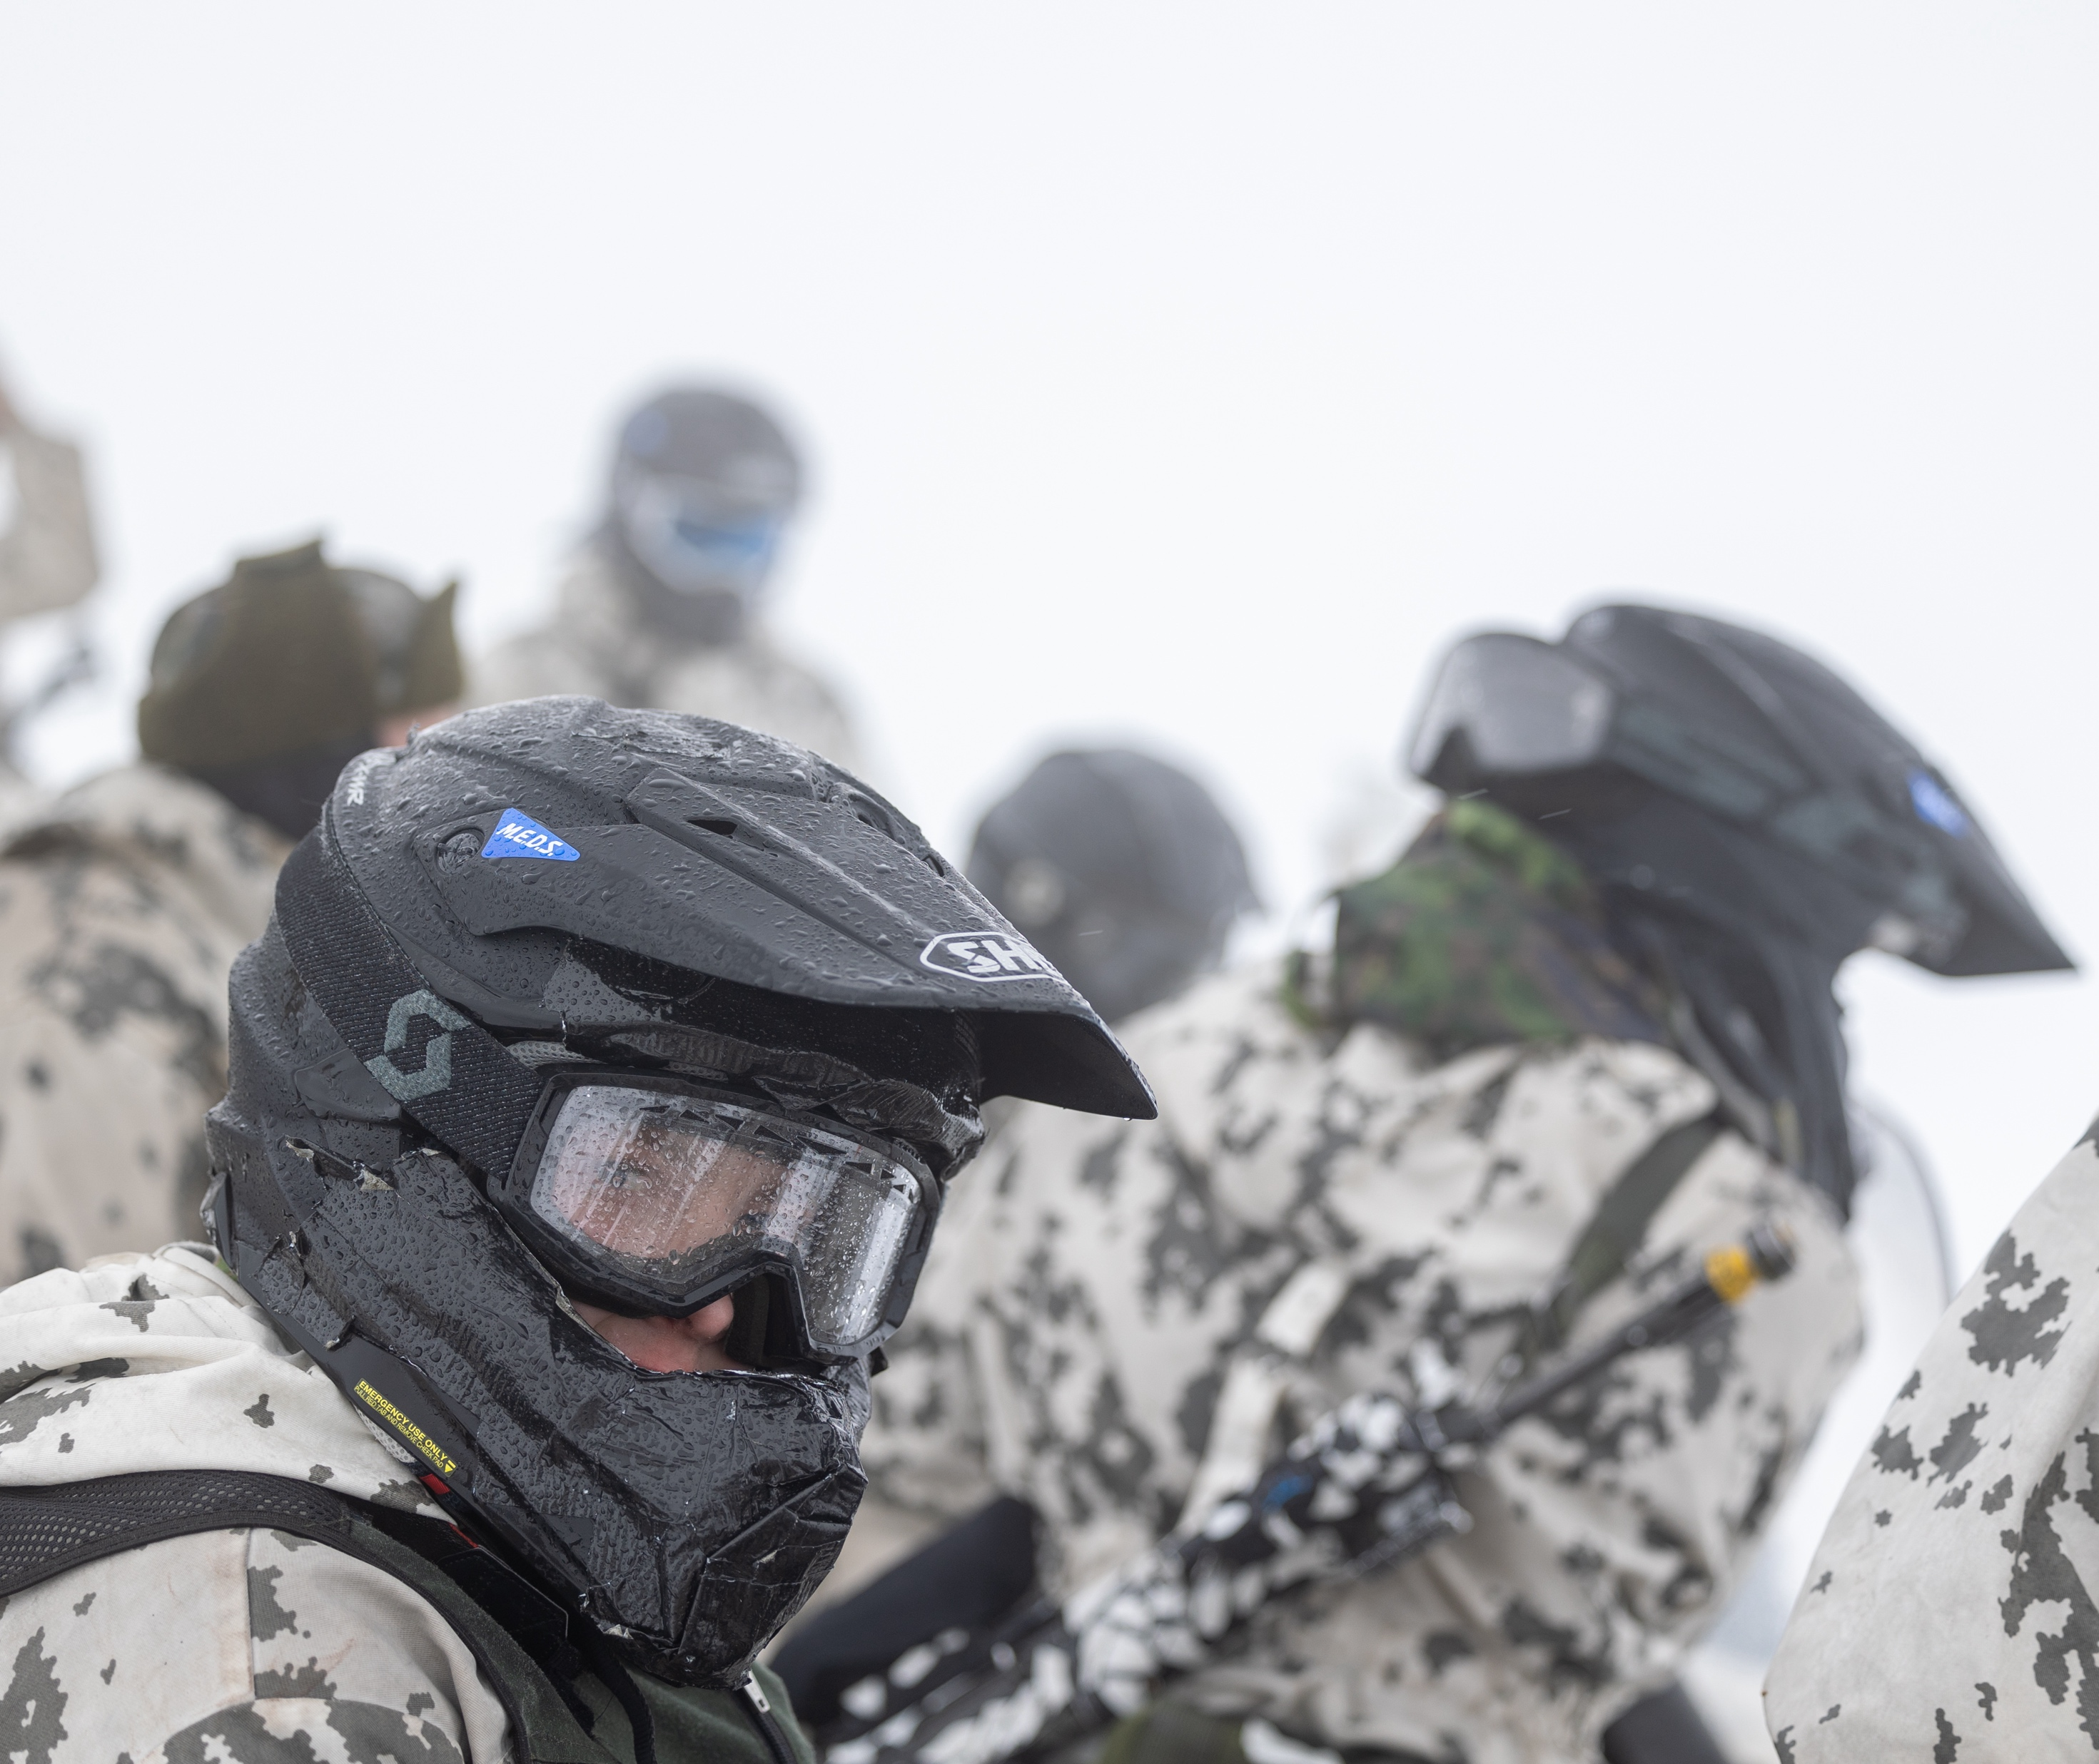
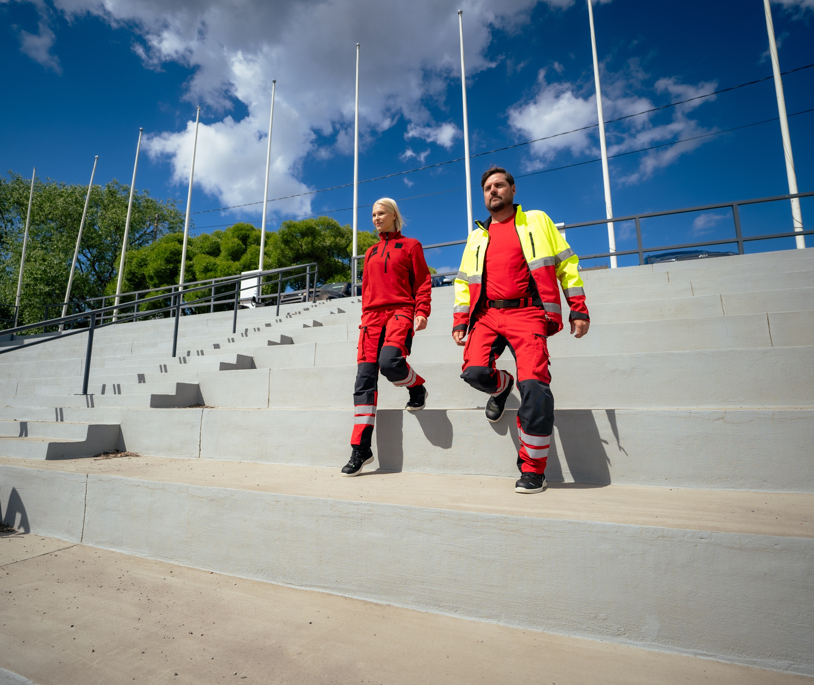
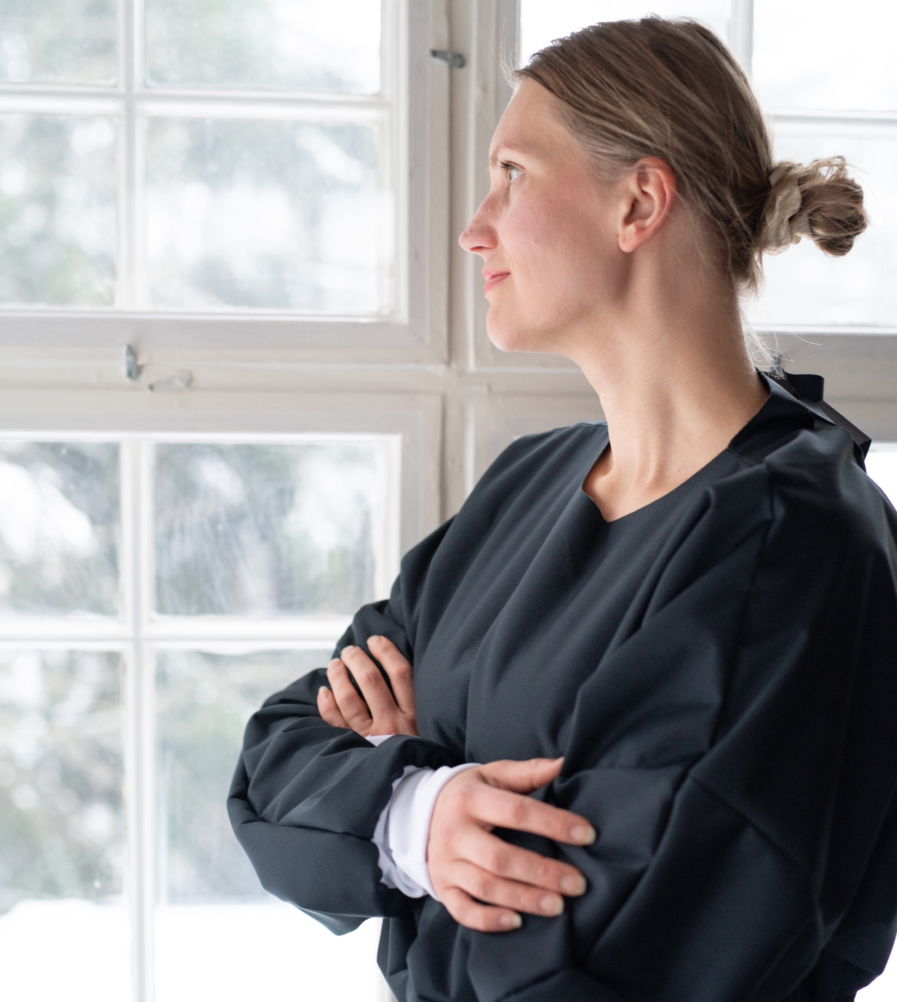
Protecting individuals and independence with every fibre of our being.
10 COMMON THREADS OF FINNISH FASHION
1
2
3
4
5
6
7
8
9
10
Starting from birth,
Finnish textile products provide a protective layer between people and
the world.
Photo: Elias Harinen / The Finnish Defence Forces
Moomin Baby diapers, Delipap Oy 2025.
Photo: Rosalina Aholainen
Photo: Image Wear 2024
Tella, 2020.
Photo: Kati Saari
Notes:
Different types of textiles play a significant role in ensuring security of supply. In times of crisis, the availability and quality of textiles and equipment related to life, health, and defense preparedness are essential.
Finnish textile companies such as Image Wear, Tella and Ursuit manufacture protective gear for our Defence Forces, the security industry, Police Department, healthcare and emergency service personnel.
The Finnish Defence Forces’ Combat Snow Suits were a key element in defending our independence during the Winter War 1939-1940.
Thanks to the work and efforts of Finnish textile companies they were also able to quickly produce protective overalls and masks for healthcare workers during the Covid pandemic.
The textile industry also produces diapers – one of the first things on a human being’s skin.

Slide 14
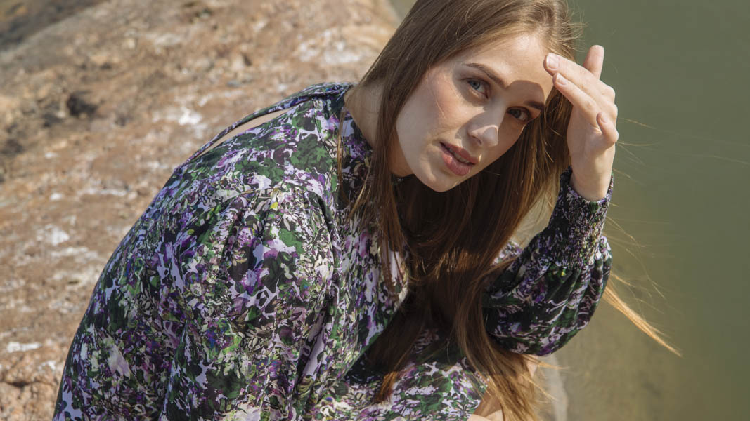
7/10
Finnish sisu gives our people
and design durability.
Kaiko AW25 Collection. Photo: Anna Salmisalo

Slide 15
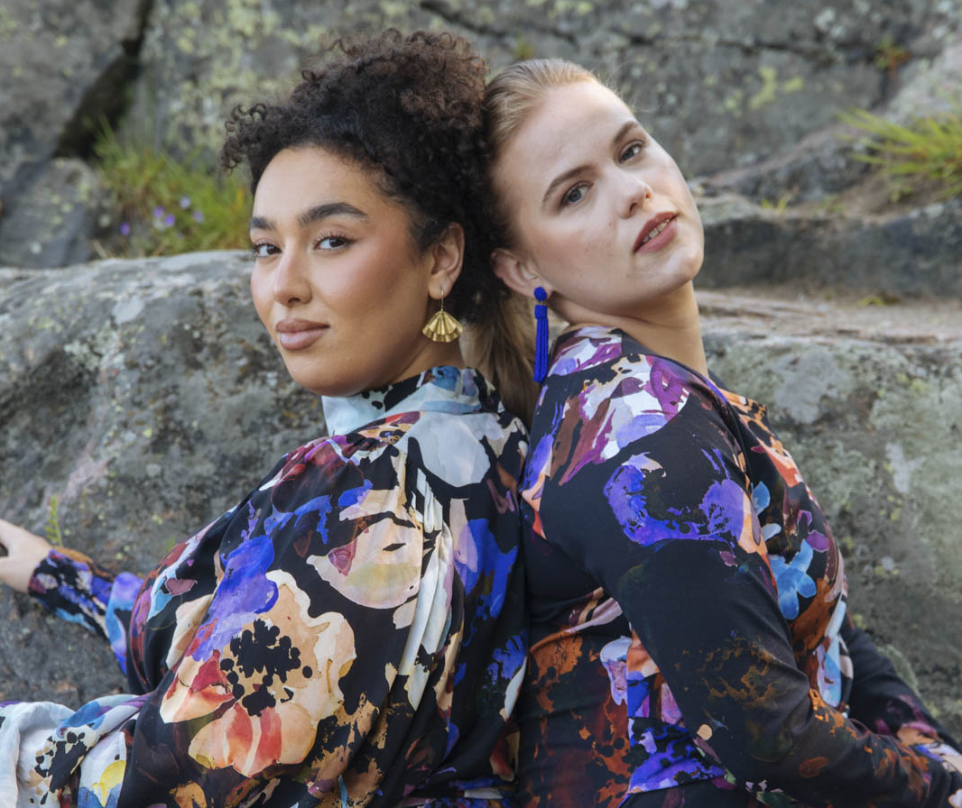
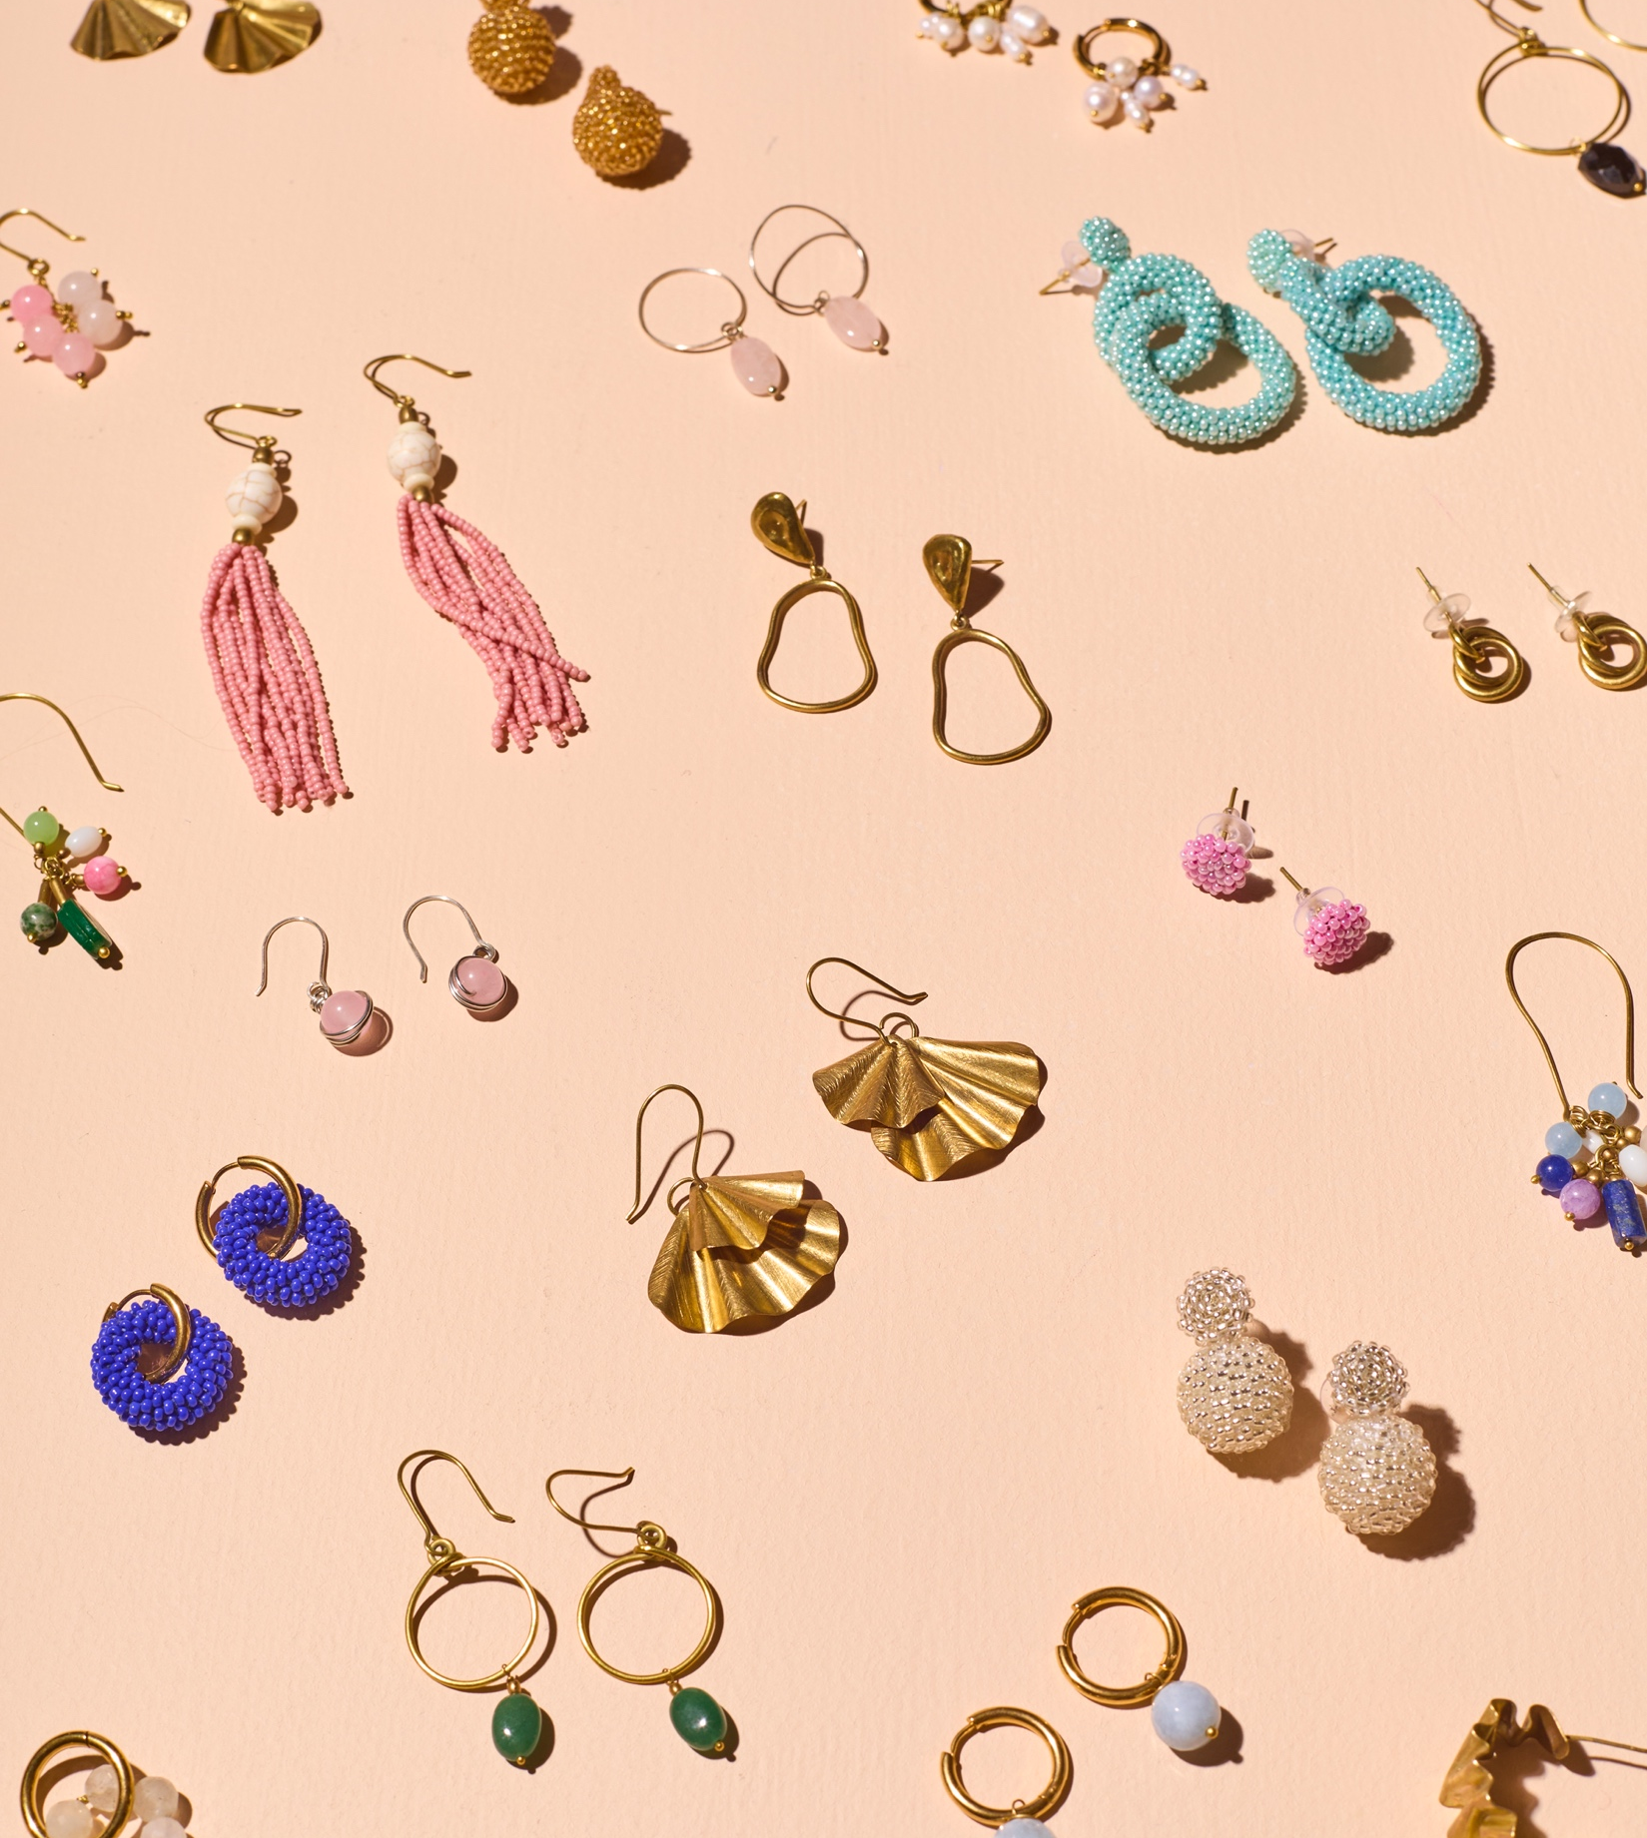
Finnish sisu gives our people and design durability.
10 COMMON THREADS OF FINNISH FASHION
1
2
3
4
5
6
7
8
9
10
“Look, you are either born brave or forced to be. I’m amused by the new and the unexpected. The impossible, especially, and the hard.”
- Armi Ratia
Founder and CEO of Marimekko
Companies such as Marimekko, Luhta, Finlayson, Nanso and Novita have survived and reinvented themselves through decades of domestic and international shifts.
Kaiko AW25 Collection.
Photo: Anna Salmisalo
Kaiko, Empowering earrings Collection
Photo: Kaiko earrings
Notes:
Some of the most successful Finnish textile companies have survived through recessions, losing production to low-cost countries and/or competing with companies that operate in low-cost countries, increasing legislation, and wars and other geopolitical shifts.

Slide 16
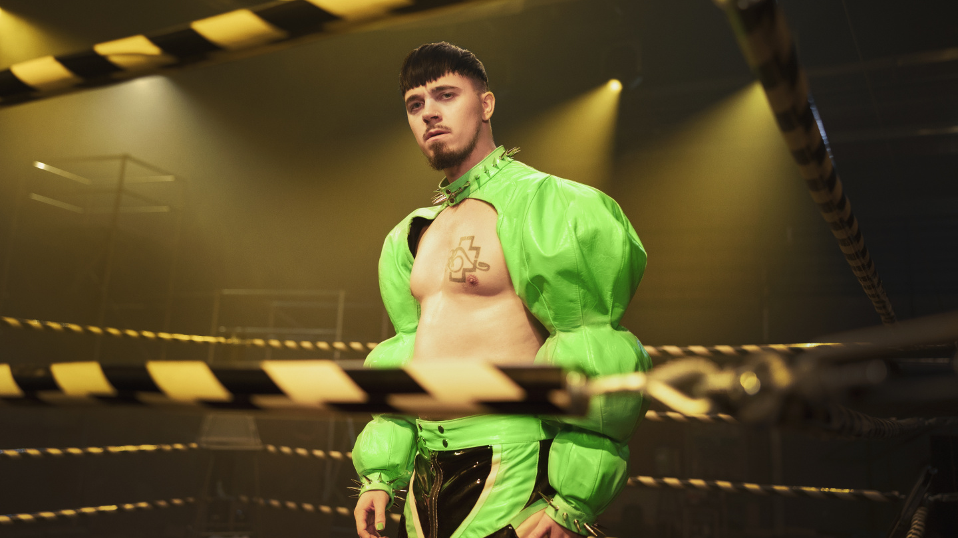
8/10
Come as you are –
feel free to blend in
or stand out.
Photo: Nelli Kenttä / Yleisradio, 2023

Slide 17
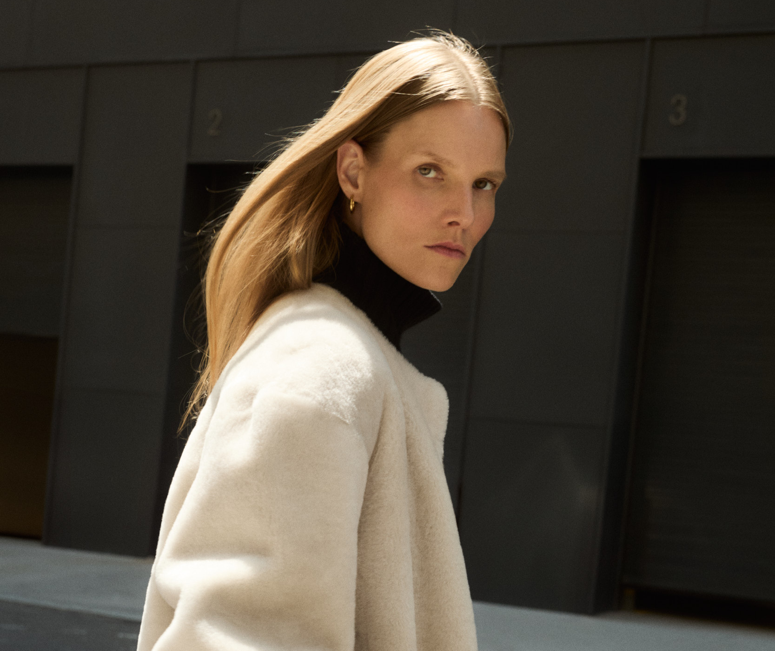
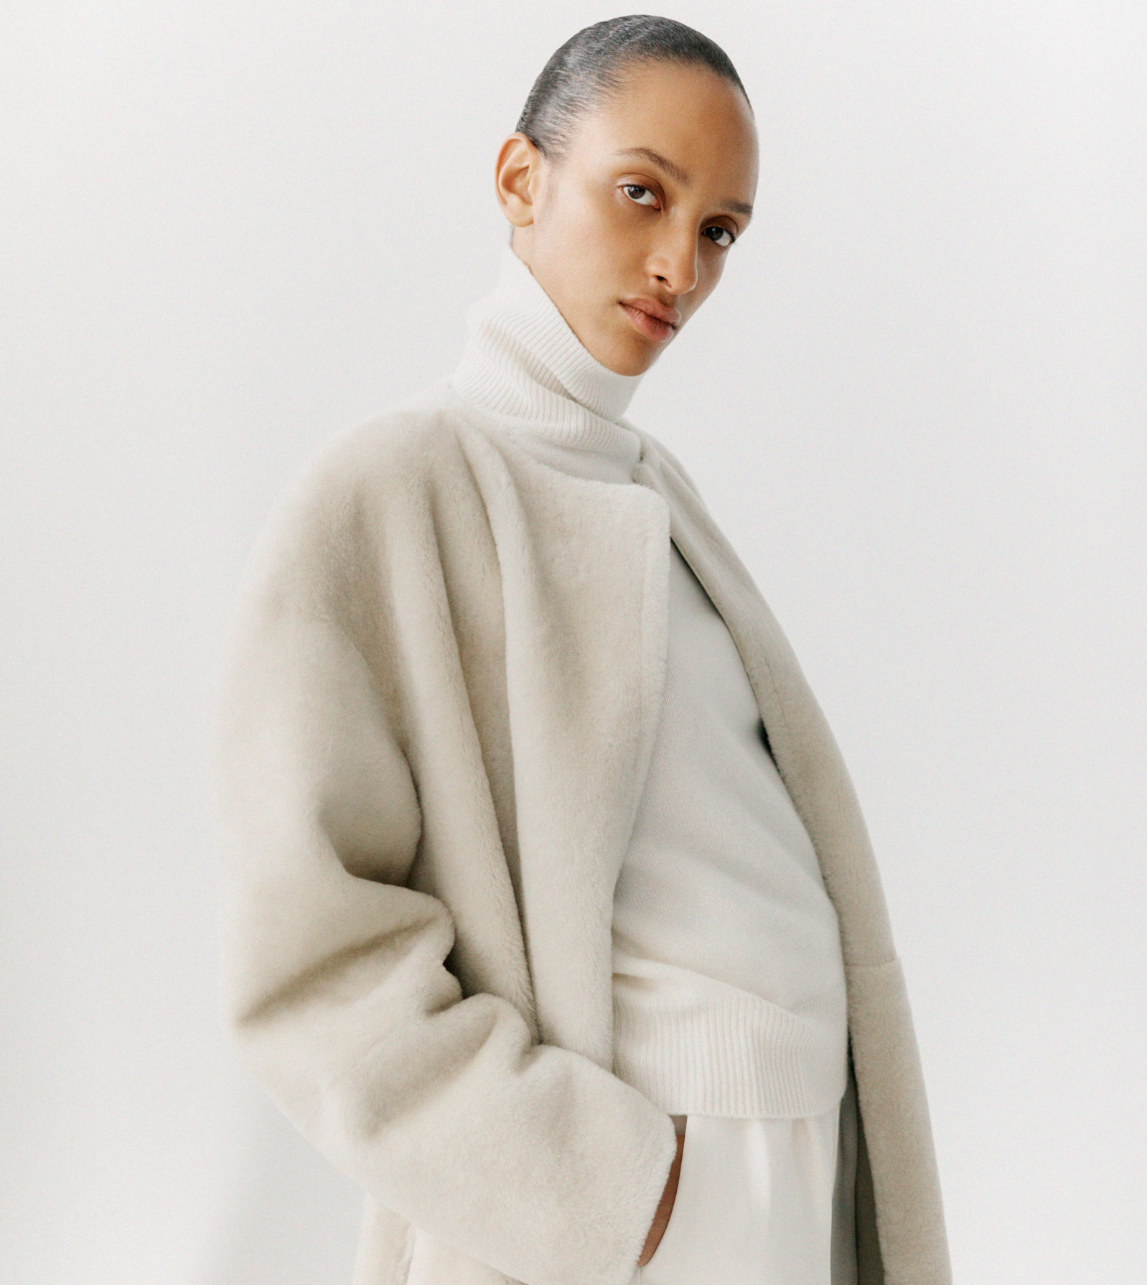
Come as you are – feel free to blend in or stand out.
10 COMMON THREADS OF FINNISH FASHION
1
2
3
4
5
6
7
8
9
10
In Finland it is perfectly acceptable to dress in all black, shades of grey or
in full living colour.
Finnish fashion is a combination of functionality and creativity.
Almada Label FW25 collection.
Photo: Kulesza Pik
Almada Label FW25 collection.
Photo: Sebastian Johansson
Notes:
Nearly half of Finns (47.8%) consider the price-quality ratio to be an important factor in their purchase decisions. This suggests that while quality is valued, people are not willing to pay any price for it — it must be within a reasonable range.
An affordable price is the next most popular factor influencing clothing purchases, chosen by a total of 40.7% of respondents.
The next most important factors in choosing clothes are practicality (35.3%) and comfortable-feeling materials (32.6%). High quality (24%), suitability for various situations (21.4%), and durability/longevity of the product (20.2%) are also considered relatively important characteristics. Following these are factors such as promotional pricing (17.5%) and the use of natural fibers (15.1%).
Source: SUOMALAISET VAATEMUODIN KULUTTAJINA Vaatteiden ostopäätöksiin vaikuttavat tekijät ja asenteet
Nelli Reuna
Maisterintutkielma Sosiologia, Yhteiskuntatieteiden ja filosofian laitos Humanistis-yhteiskuntatieteellinen tiedekunta, Jyväskylän yliopisto, kevät 2020 download

Slide 18
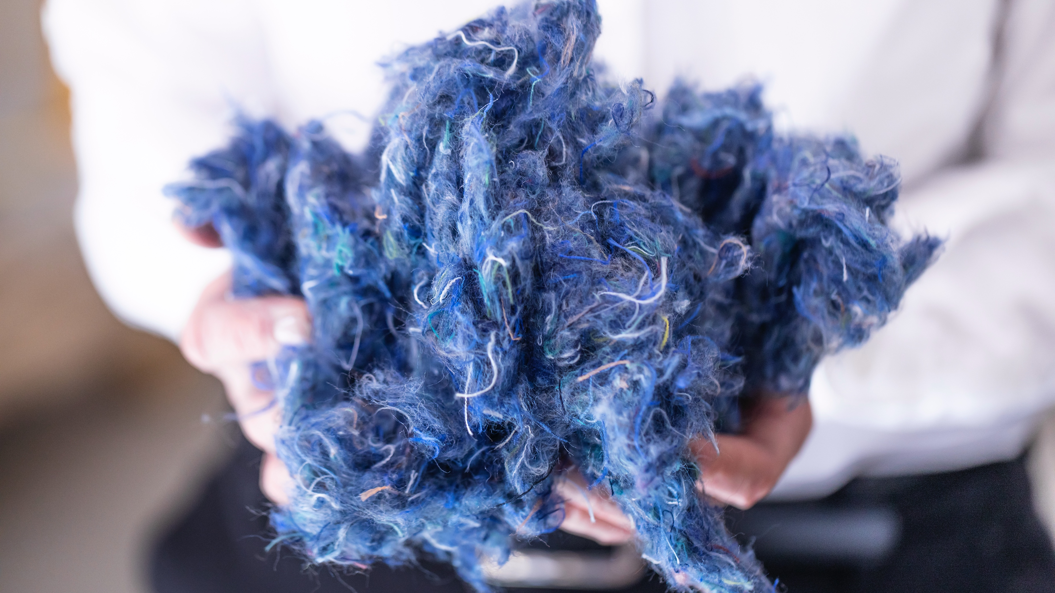
9/10
We never think twice about
reusing resources.
Photo: Rester

Slide 19
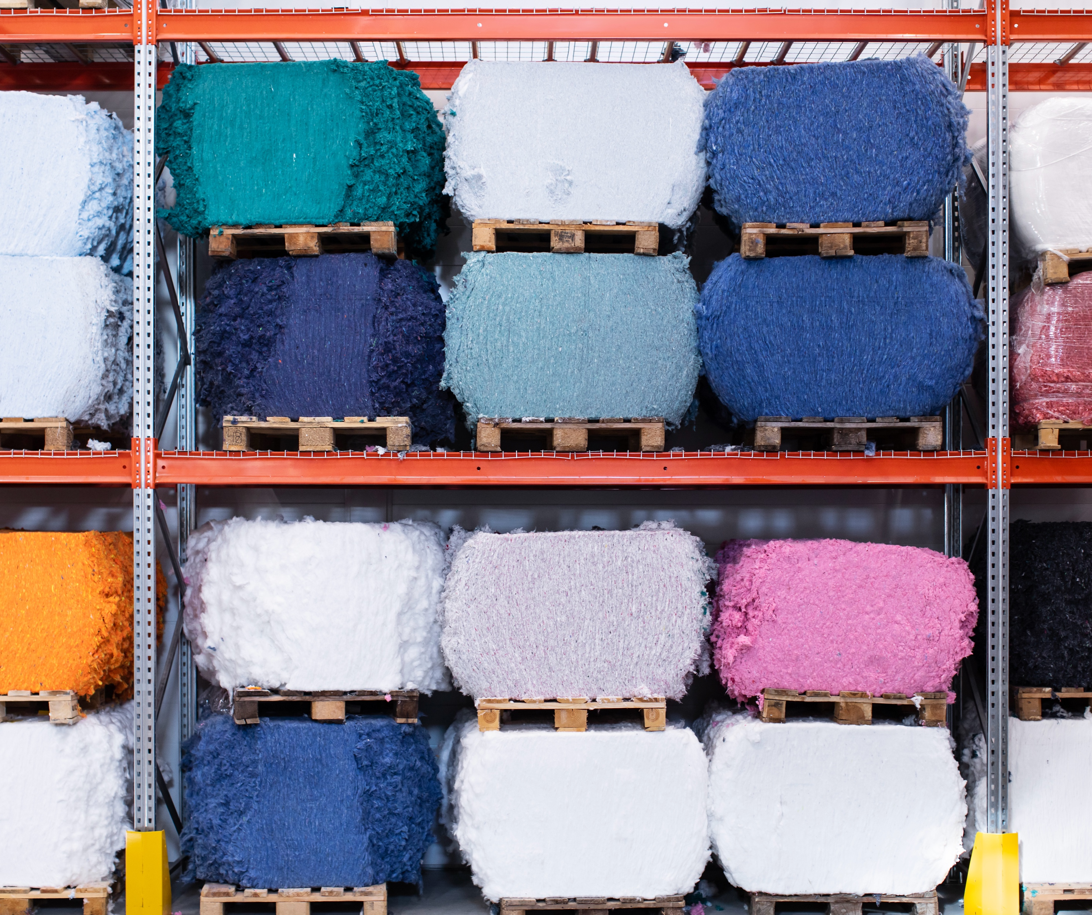
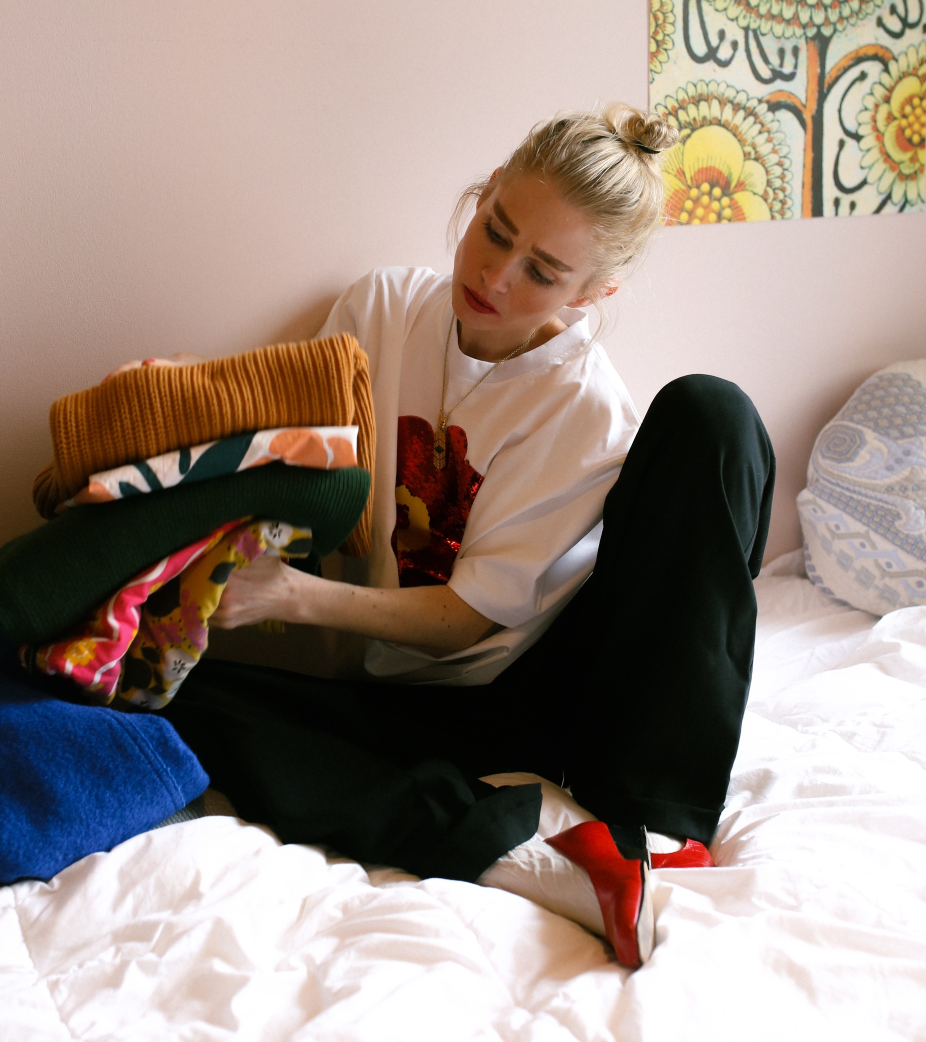
We never think twice about reusing resources.
10 COMMON THREADS OF FINNISH FASHION
1
2
3
4
5
6
7
8
9
10
Finland is one of the leading markets for second hand products and pioneered the EU regulation on Separate Collection of Textile Waste.
Photo: Rester
Photo: Ninyes
Notes:
Finland adopted the EU-wide Separate Collection of Textile Waste regulation two years in advance in 2023 (mandatory in the EU from 2025)
In Finland 44% of discarded domestic textiles and clothes is sorted into separate collection of textile waste.​ (Tekstiilivirrat Suomessa –selvitys, ​Suomen Ympäristökeskus, SYKE 2019)
The secondhand market in Finland was estimated to be 895 million euros in 2023 (by Finnish Commerce Federation, Kaupan liitto)
The second hand market in Finland increased fivefold from 2023 to 2024 – reusing clothes and other items is a way of life.

Slide 20
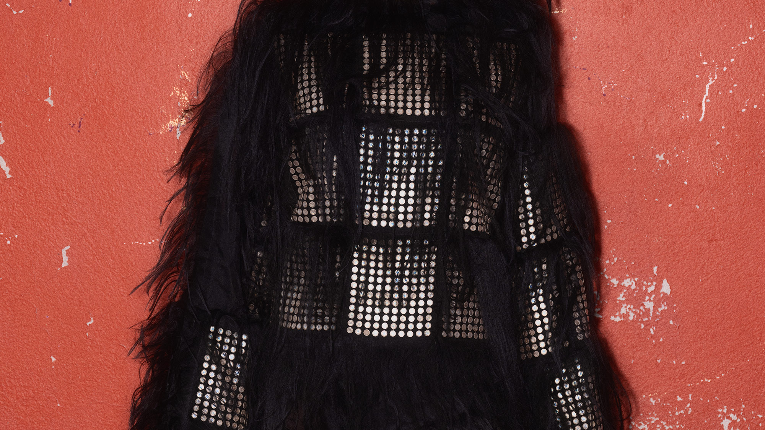
10/10
A tight-knit duo of
technology and nature.
Shimber. Photo: Juho Huttunen, 2024

Slide 21
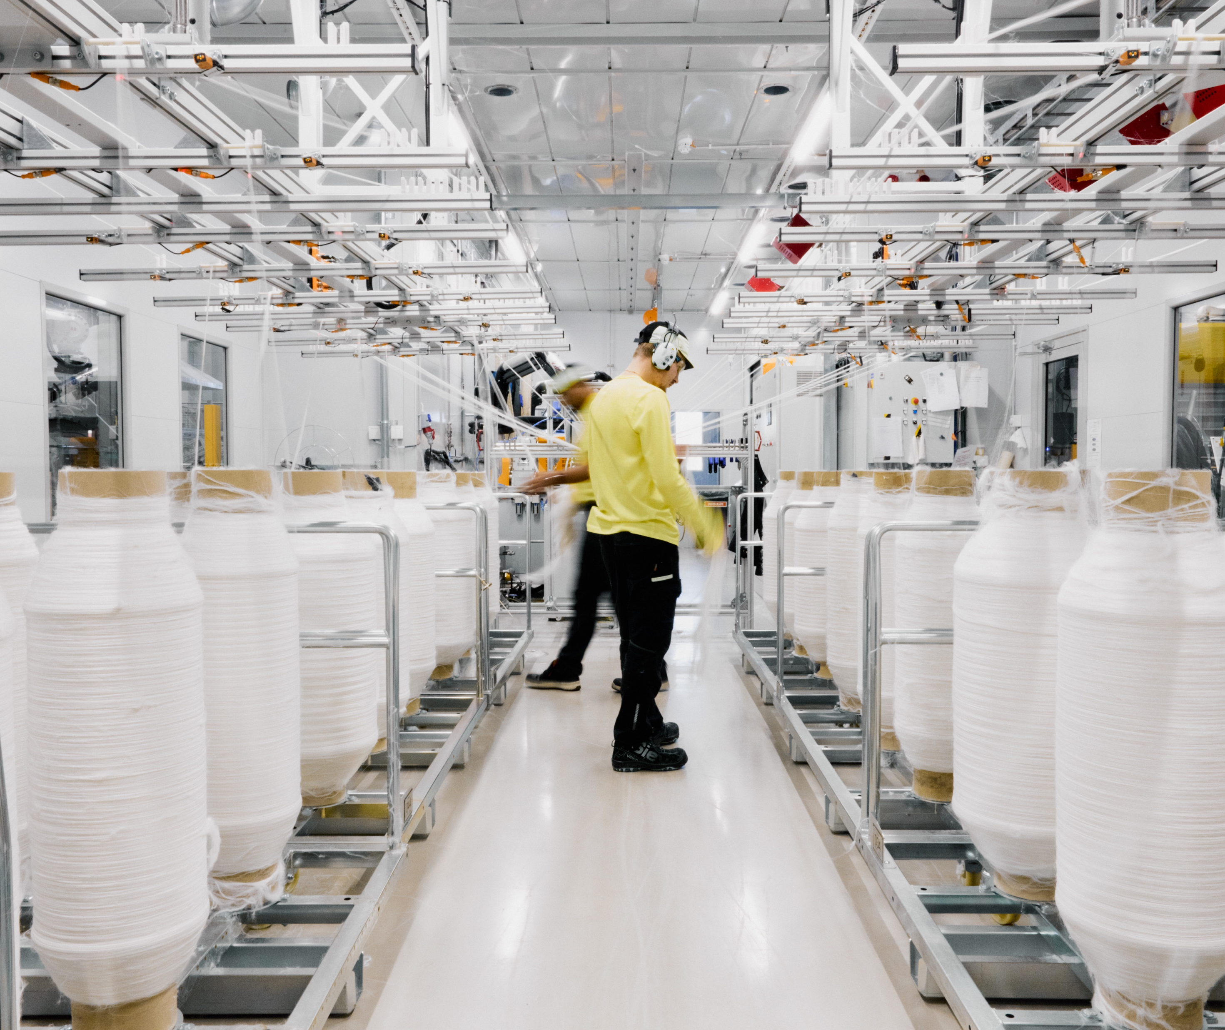
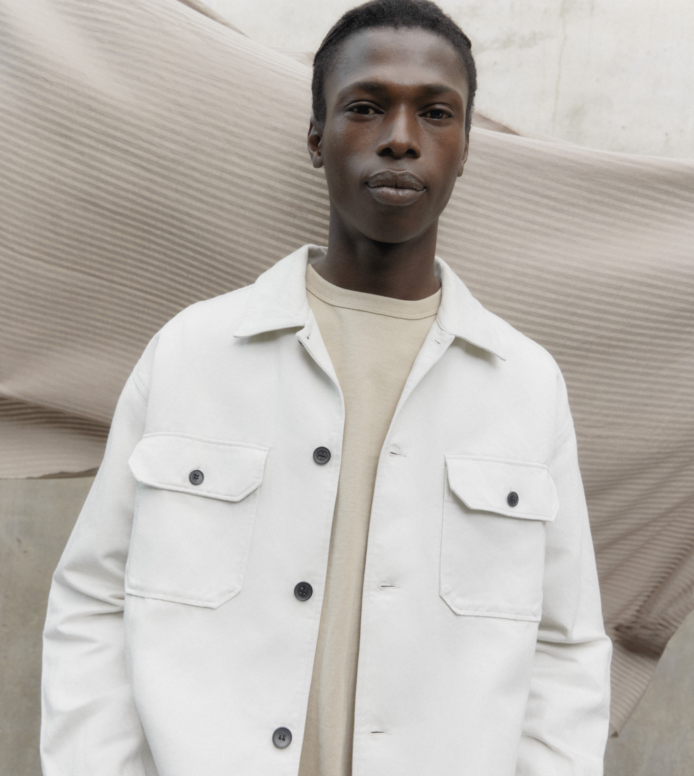
A tight-knit duo of technology and nature.
10 COMMON THREADS OF FINNISH FASHION
1
2
3
4
5
6
7
8
9
10
Leave it to the Finns to create textile fibres from wood
Finnish research on biomaterials—especially wood and cellulose—has produced innovations that have world-changing potential when it comes to textile production and its environmental impact.
Spinnova's production.
Photo: Spinnova
ARKET’s overshirt in sustainable SPINNOVA® blend.
Photo: Spinnova
Notes:
Infinited Fibre’s Infinna fibre is a virgin-quality textile fiber regenerated 100% from textile waste. When finally worn out, clothes and textiles made with Infinna™ can be recycled with other textile waste, enabling textile circularity.
SPINNOVA® is a novel fibre which is blended with other preferred fibres to make yarn and fabrics. The fibre can be integrated into innovative and conventional textile processing methods, such as those used in cotton processing.
The fibre properties, look, and feel are comparable to those of natural cellulosic fibres, such as cotton, while reducing odour intensity compared to cotton. SPINNOVA® fibre can be produced from wood pulp or waste, such as leather, textile, or agricultural cropping waste, without harmful dissolving chemicals

Slide 22
11/10
11/10
An extra skylight
with views to
common ground.
Epilogue

Slide 23
Epilogue
10 COMMON THREADS OF FINNISH FASHION
1
2
3
4
5
6
7
8
9
10
11
Photo: xxx
Any note
can be written here.
This is a place for
more detailed information.
You can use this page to highlight connections between Finnish cinema and your country, shared projects, or even interesting upcoming events.
Notes:
Tähän osioon voi koota vastaanottajan ja tilanteen mukaan personoitavia asioita, toki elokuvakulman huomioiden.

Slide 24
No loose threads.
Are you ready to weave a new story with us?

