Slide 1
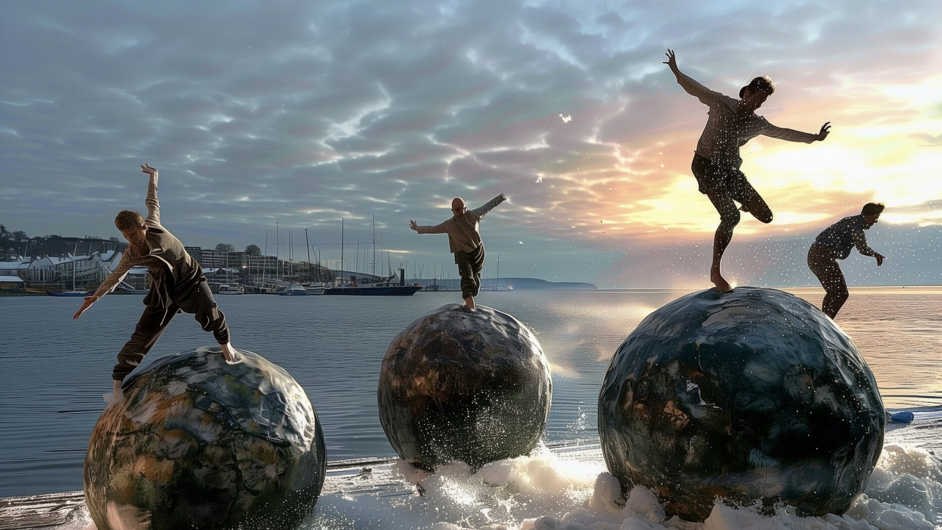

THE FINNISH DANCE SCENE IN EIGHT STEPS
Ismo Dance Company: Anybody's Architecture, Water Spirits, 2024
Sculpture: Alicja Kwade
Photo: Ismo-Pekka Heikinheimo

Slide 2
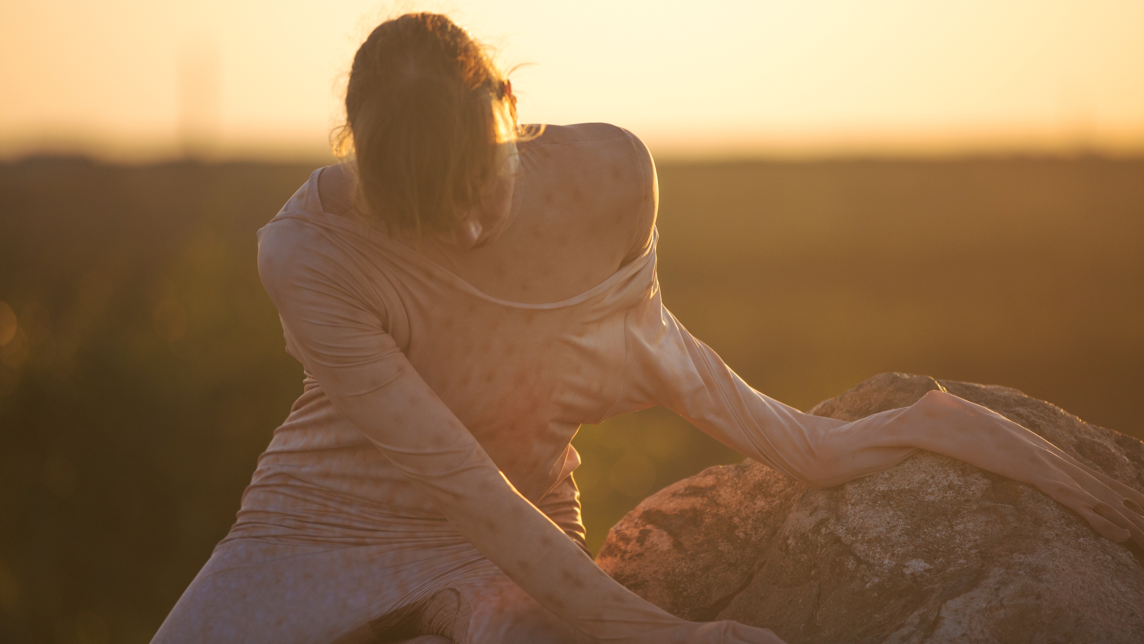
1/8
Nature choreographs us.
Wauhaus: A Great Mess, 2021. Photo: Katri Naukkarinen

Slide 3
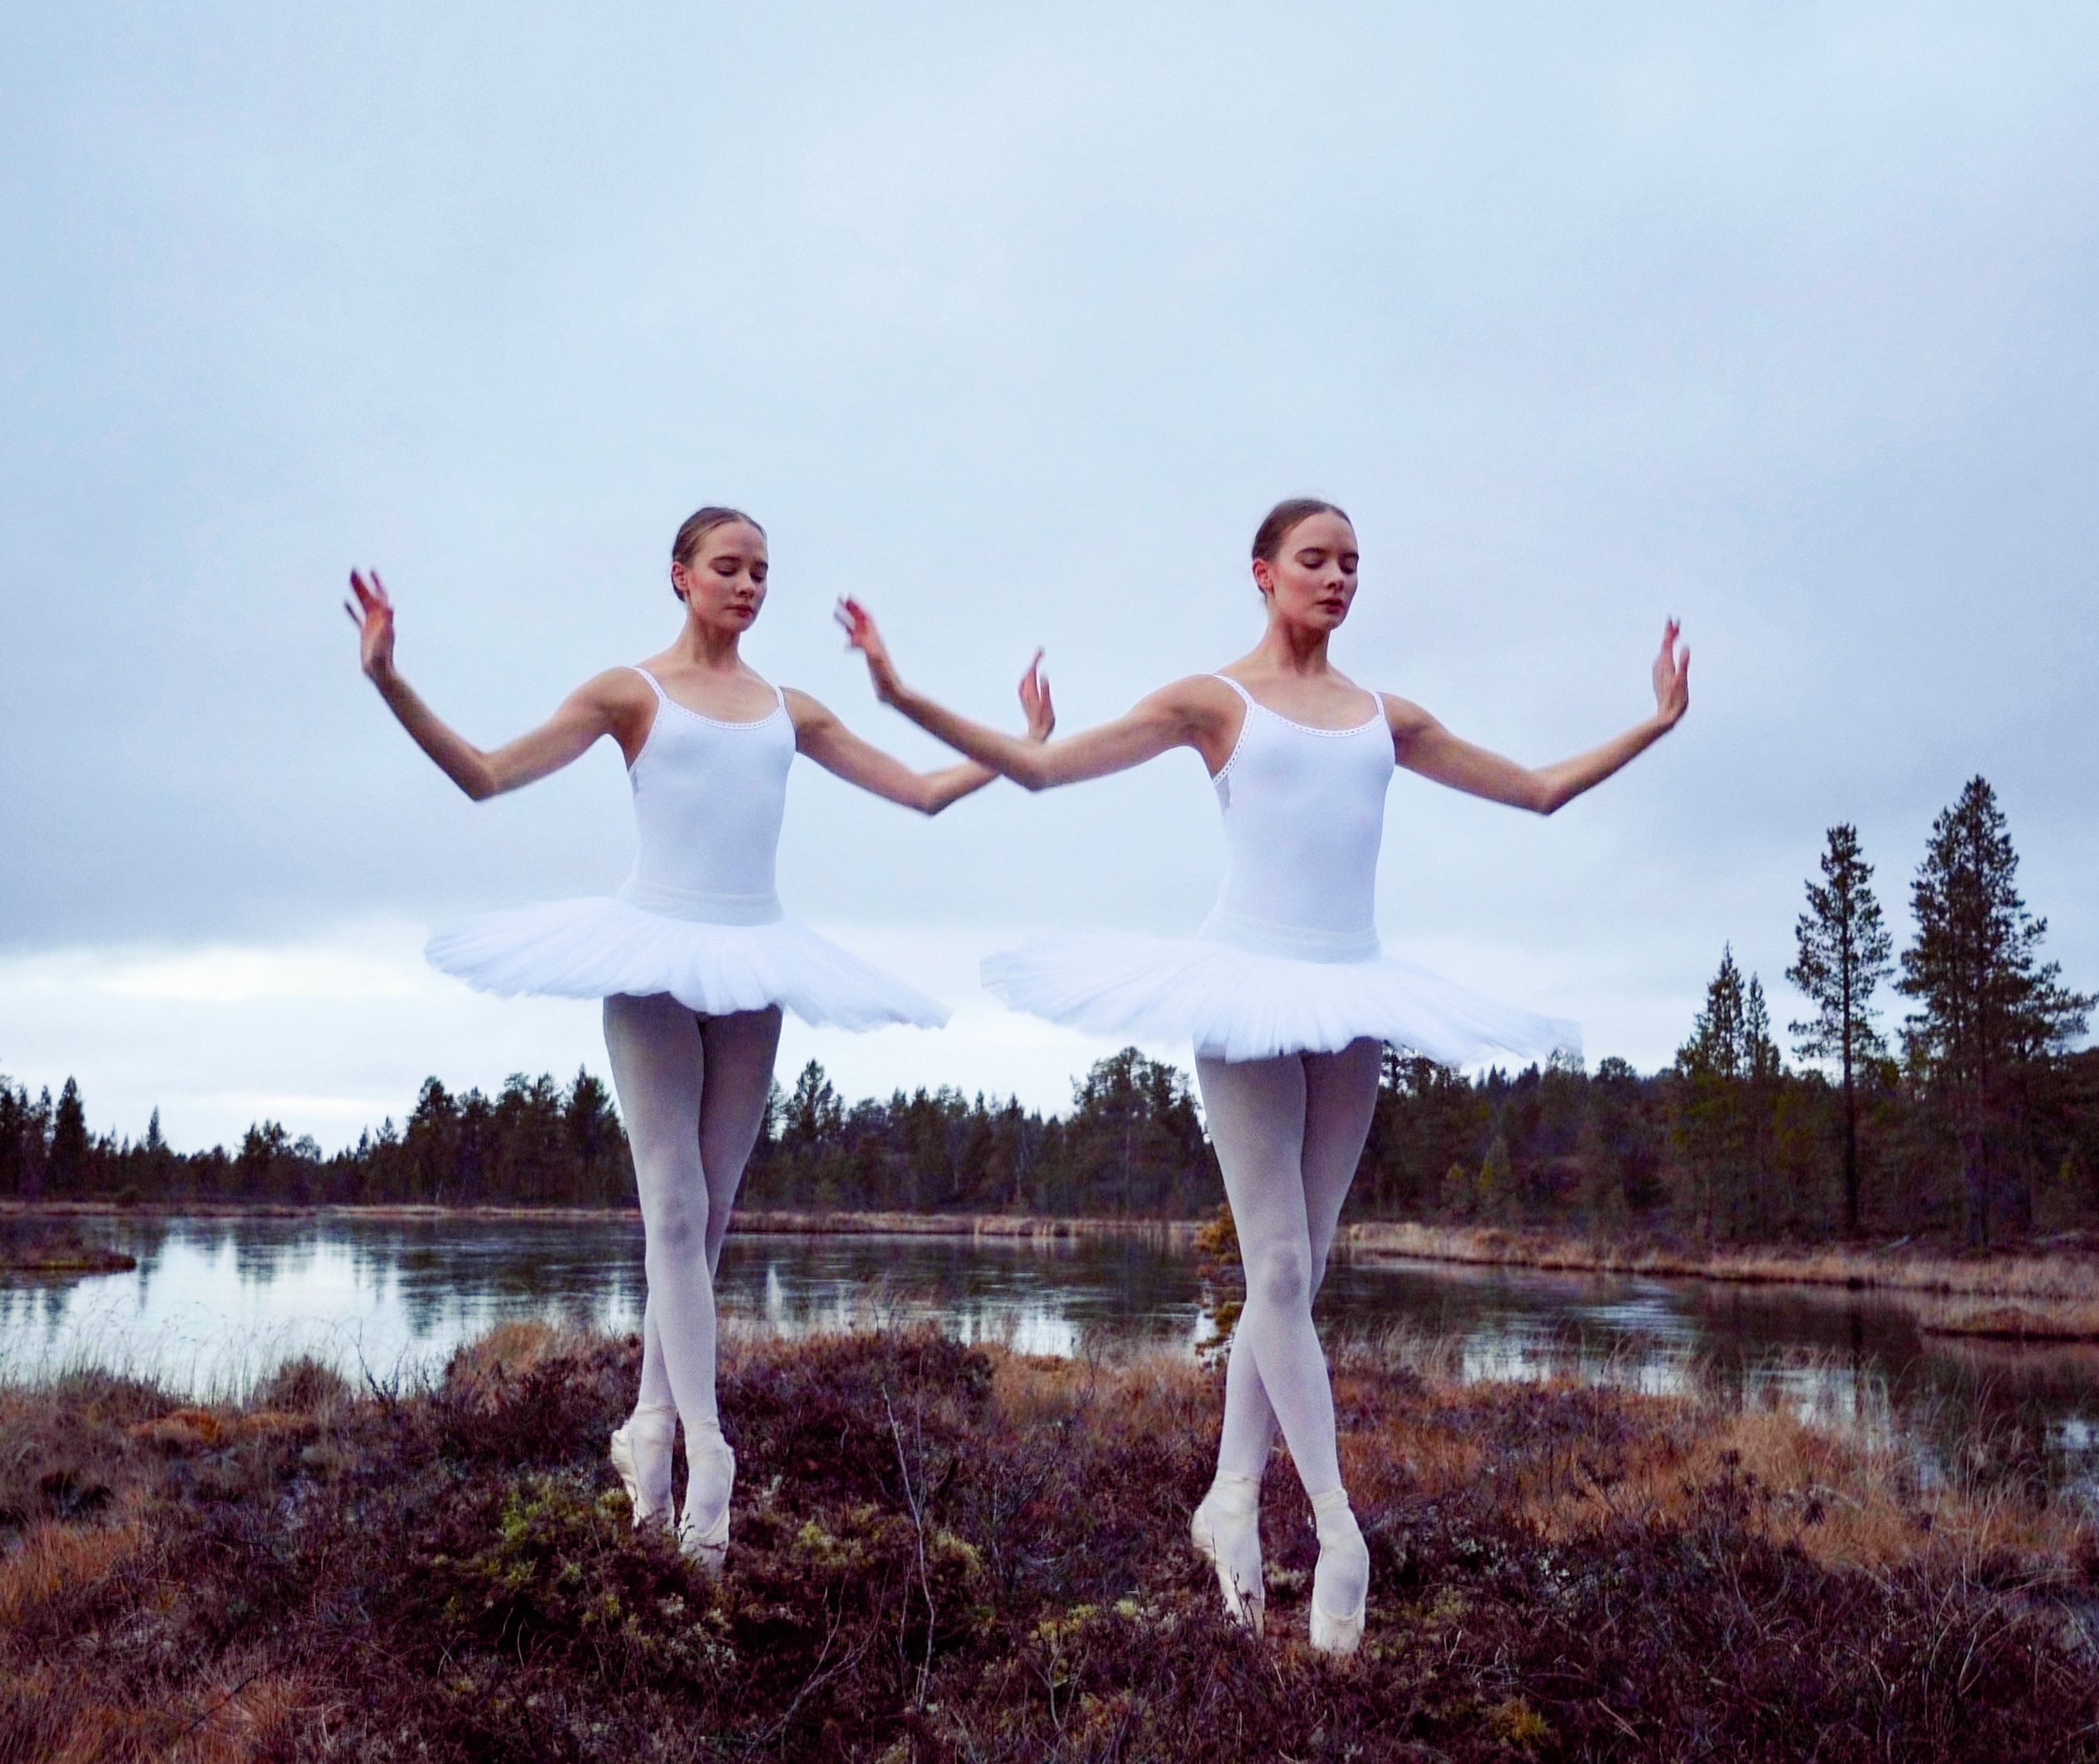
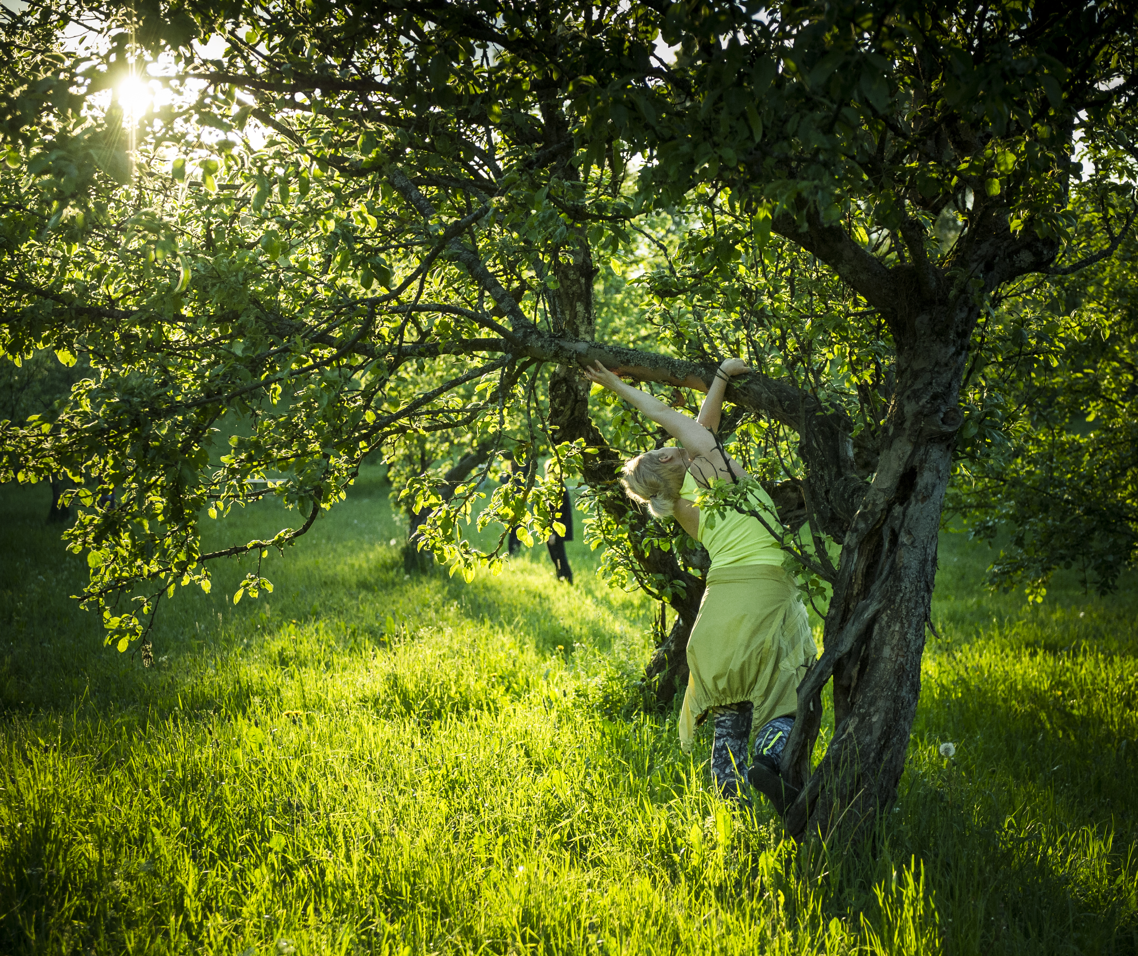
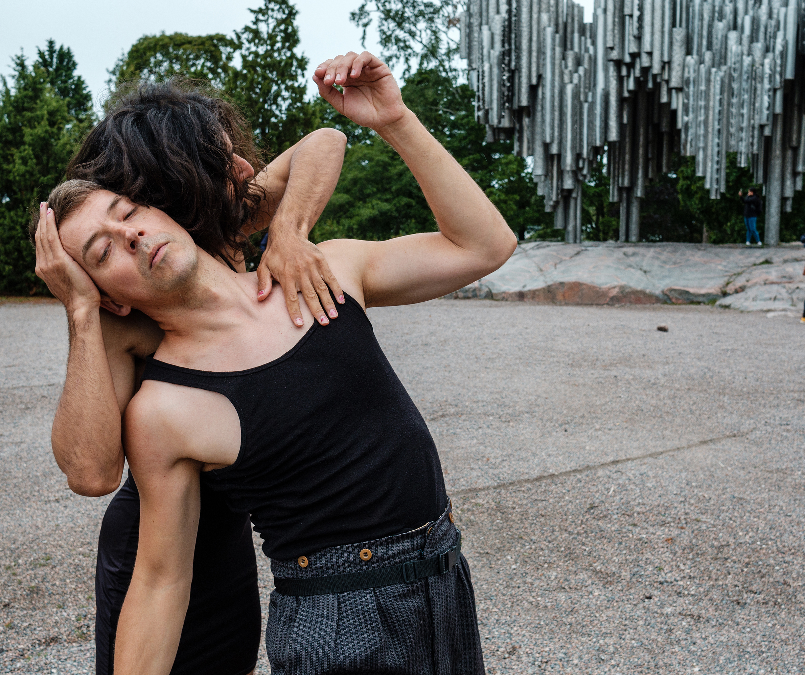
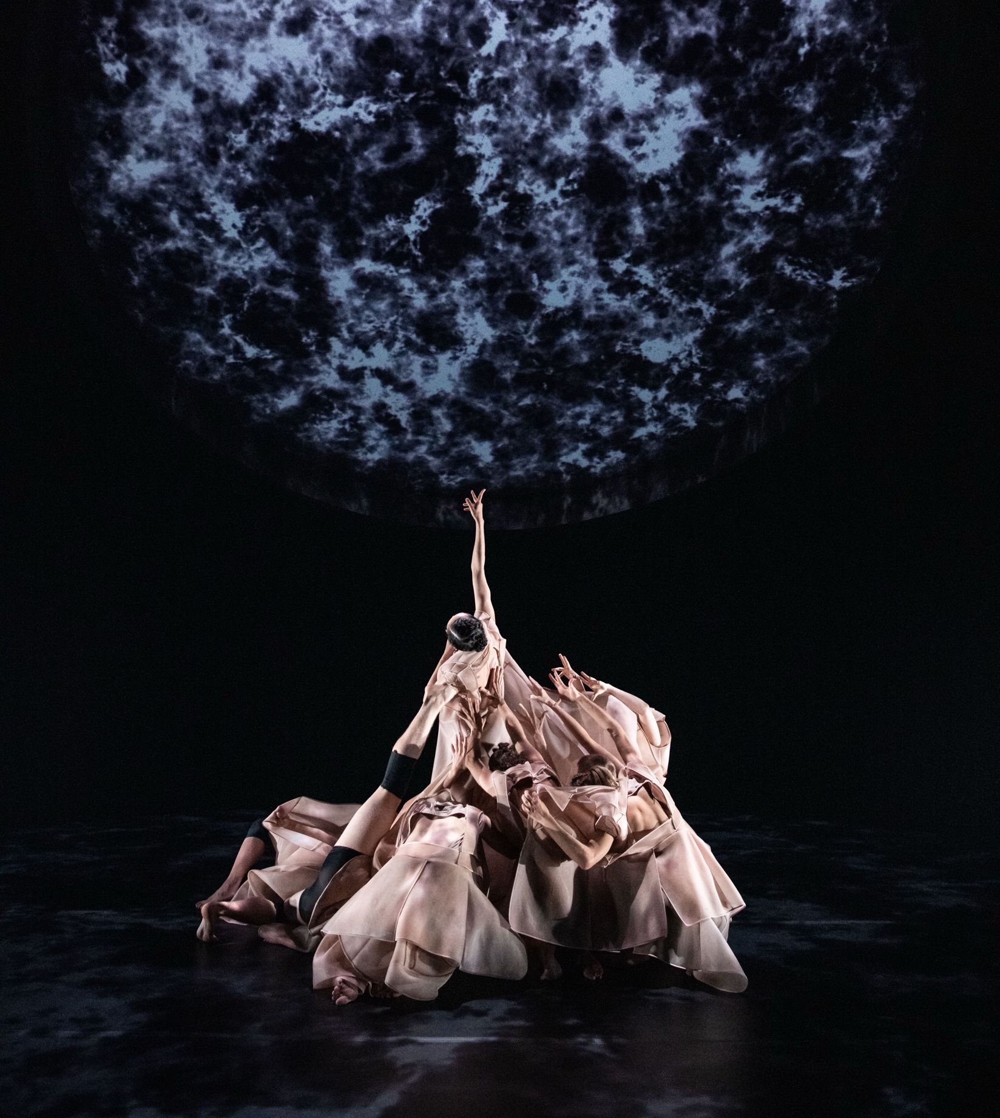
Nature choreographs us.
FINNISH DANCE IN EIGHT STEPS
1
2
3
4
5
6
7
8
Finnish dance is shaped by the rhythms and extremes of nature.
Visually, thematically and physically.
Still image from Marja Helander's short film Birds in the Earth, in Sámi ‘Eatnavuloš Lottit’, 2018. Dancers: Biret and Gáddjá Haarla Pieski. Photo: Mauri Lähdesmäki
Sari Palmgren: Aidatut unelmat (Fenced Dreams), 2018. Photo: Uupi Tirronen
Kira Riikonen & Tuukka Jukola: Cycle City, 2021. Photo: Matti Kilponen, Zodiak – Centre For New Dance
Tero Saarinen's work Transit combines Sebastian Fagerlund's music with Tuomas Norvio's sound design and a video installation by artist duo IC-98. Photo: Kai Kuusisto
Notes:
In Finland, nature isn’t just scenery – it’s an active element in dance. The intimate relationship with nature is one of the emotional backbones of Finnish dance – it’s about sensing, not showing off.
Many choreographers create site-specific performances, where bodies and landscapes form a dialogue. Nature also appears on stage through materials, symbols and ecological themes. Works explore climate change, biodiversity and our fragile coexistence with other species.

Slide 4
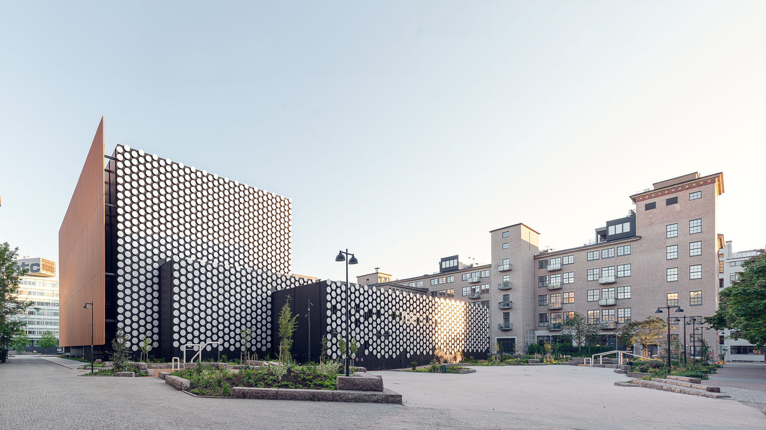
2/8
Finland dances from North to South.
Dance House Helsinki was inaugurated in 2022. Photo: Hannu Rytky
Notes:
Dance House Helsinki, opened in 2022, is a new home for Finnish contemporary dance. Yet in Finland, dance is not just a capital-city phenomenon. Artists create and perform from the southern archipelago to the northern fells. A state-funded structure supports this decentralisation, with public grants and regional dance centres.
The Finnish National Ballet has been active since 1922, making it one of Europe’s first national companies.
There are eight vocational or university-level institutions offering professional dance education in different parts of the country.
Since 1980, Dance Info Finland (now part of Circus & Dance Info Finland) has supported the sector through statistics, international networks and communications.

Slide 5
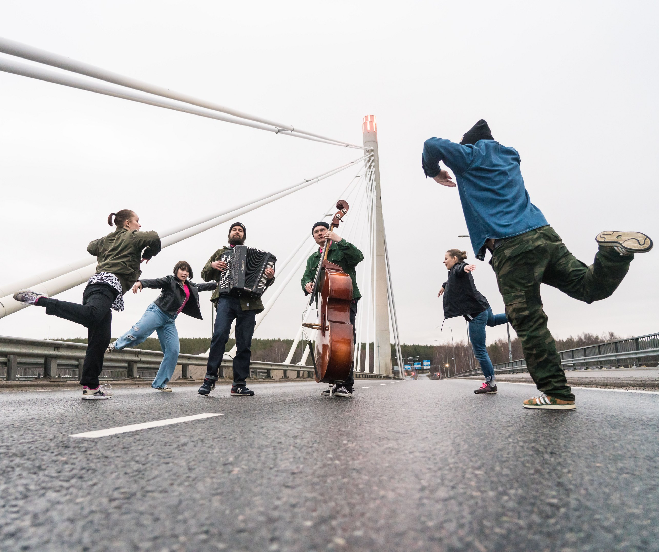
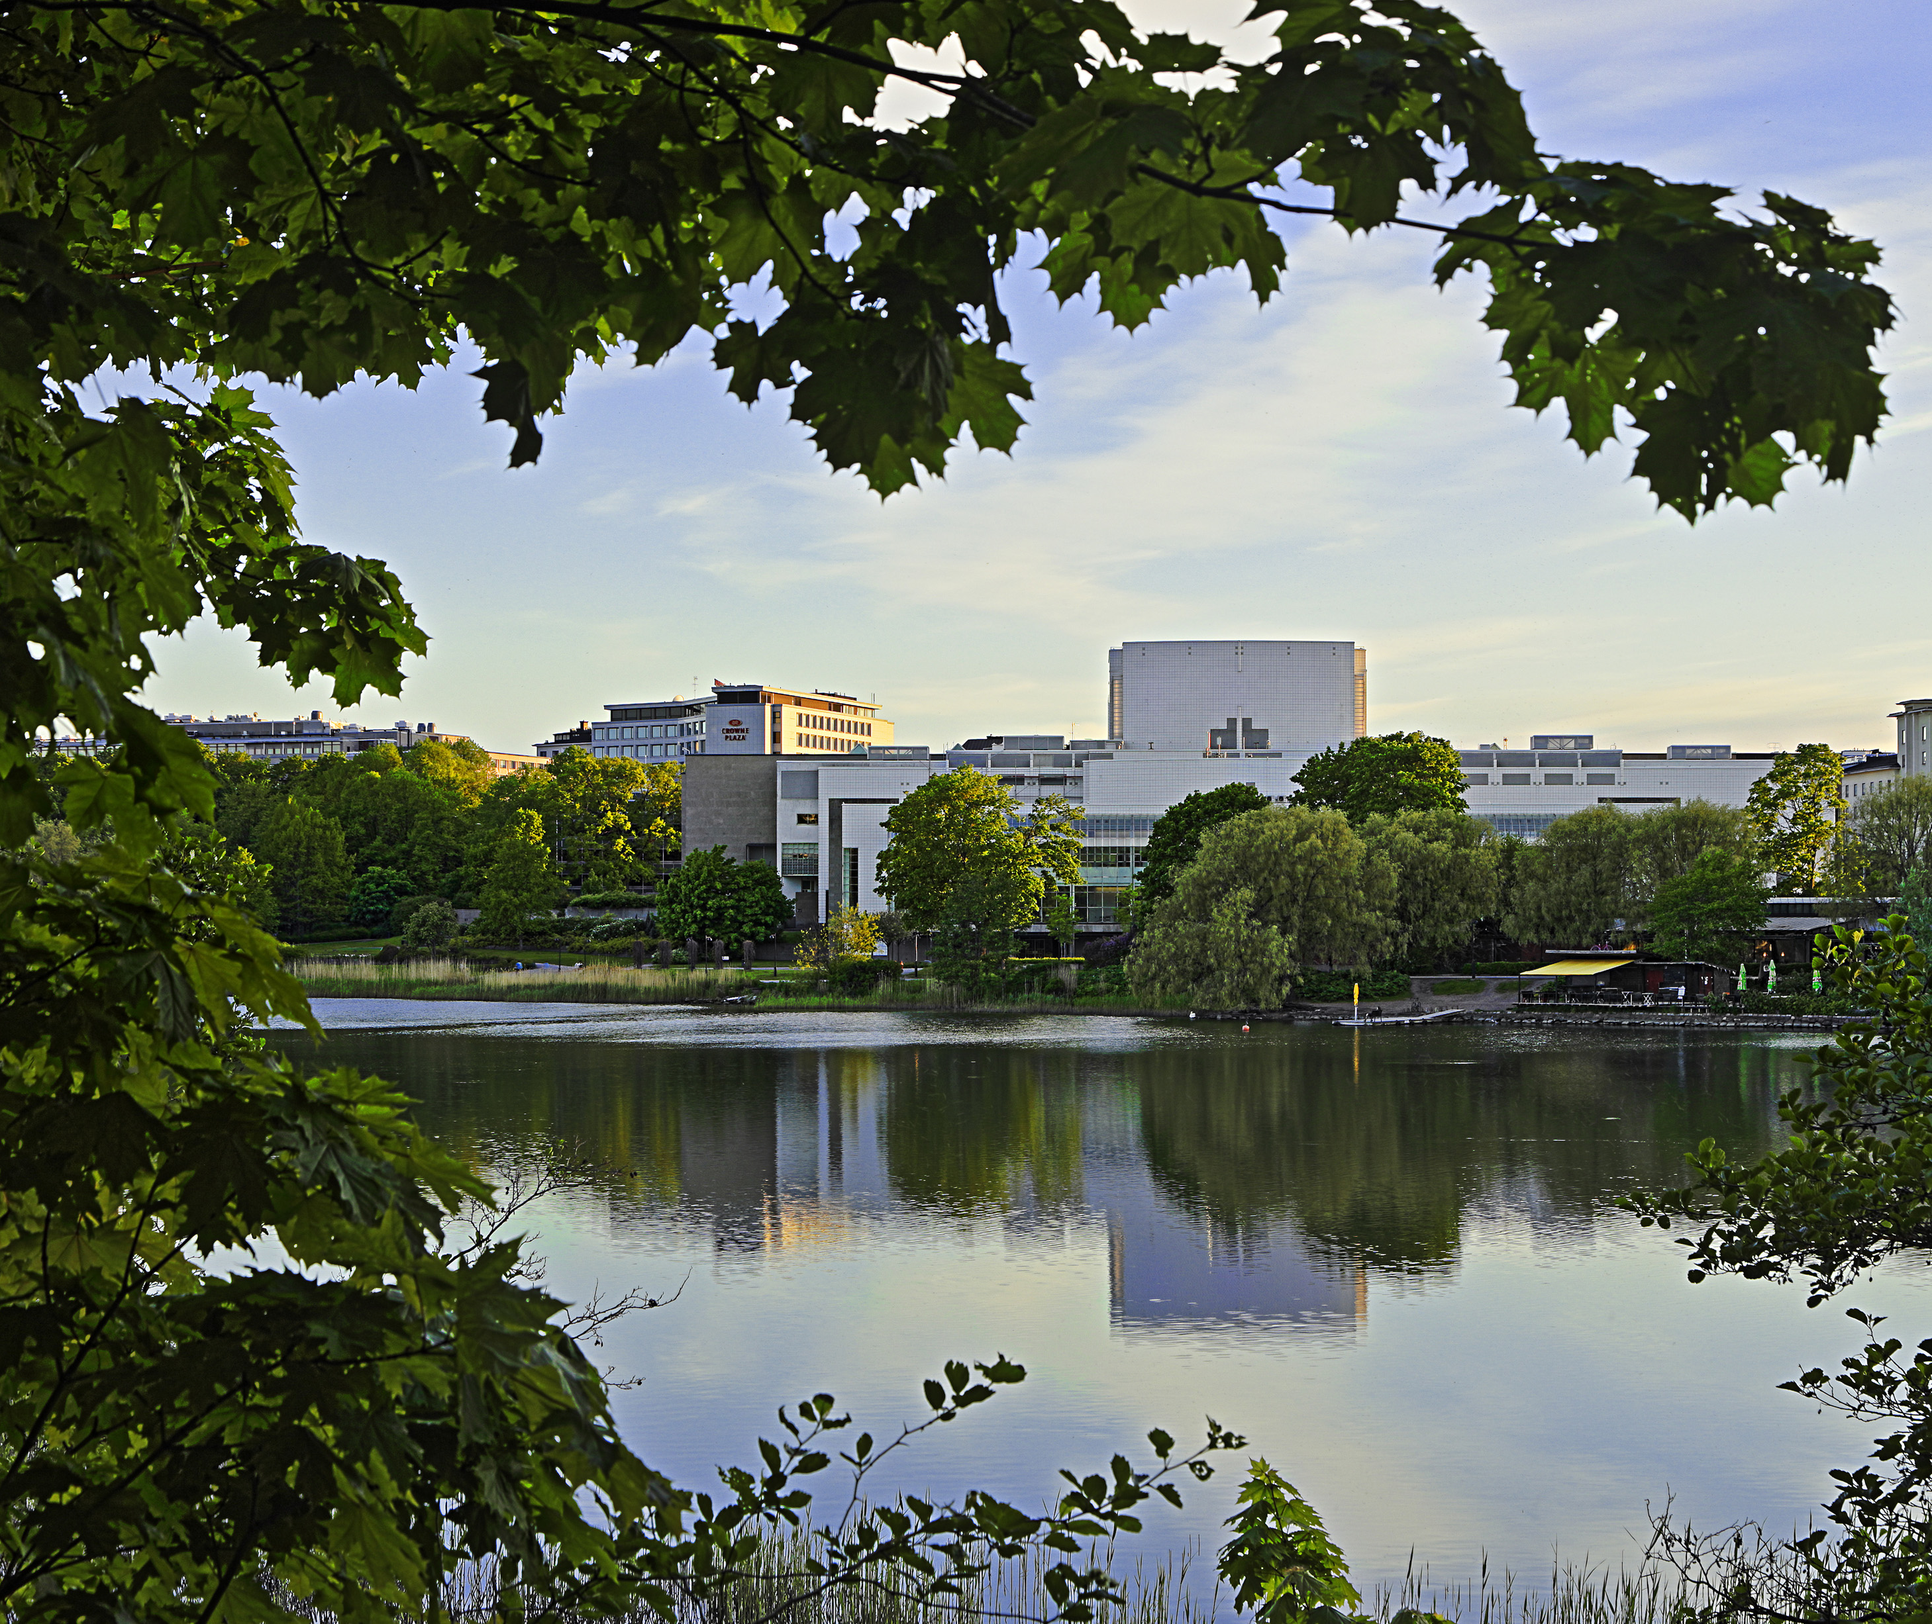
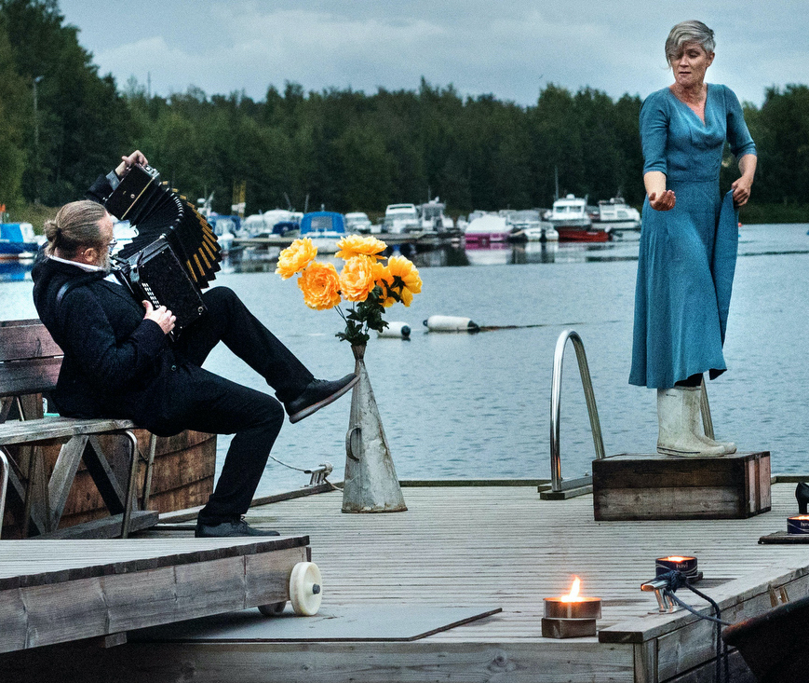
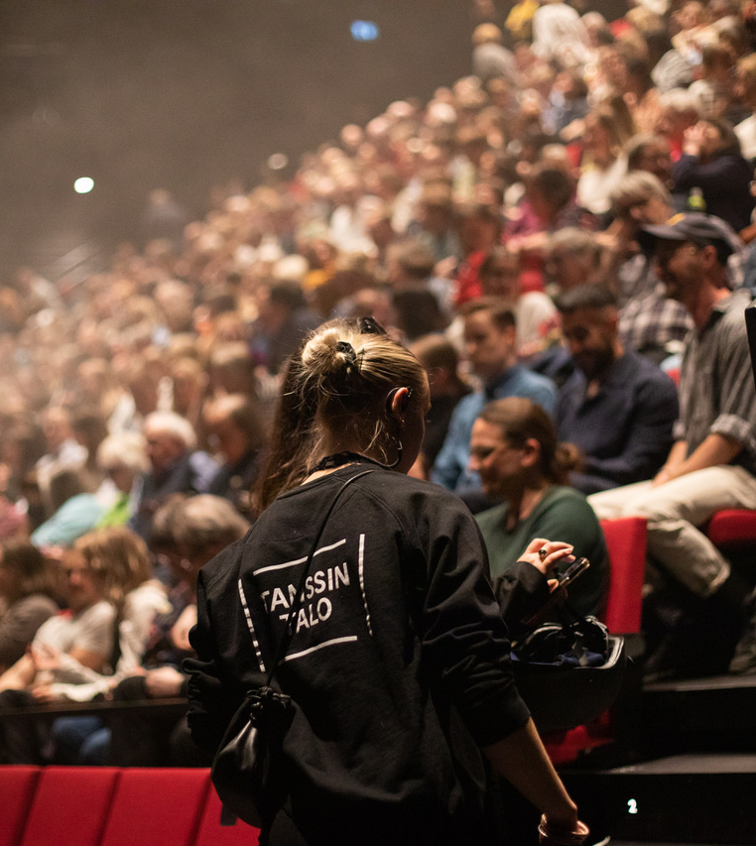
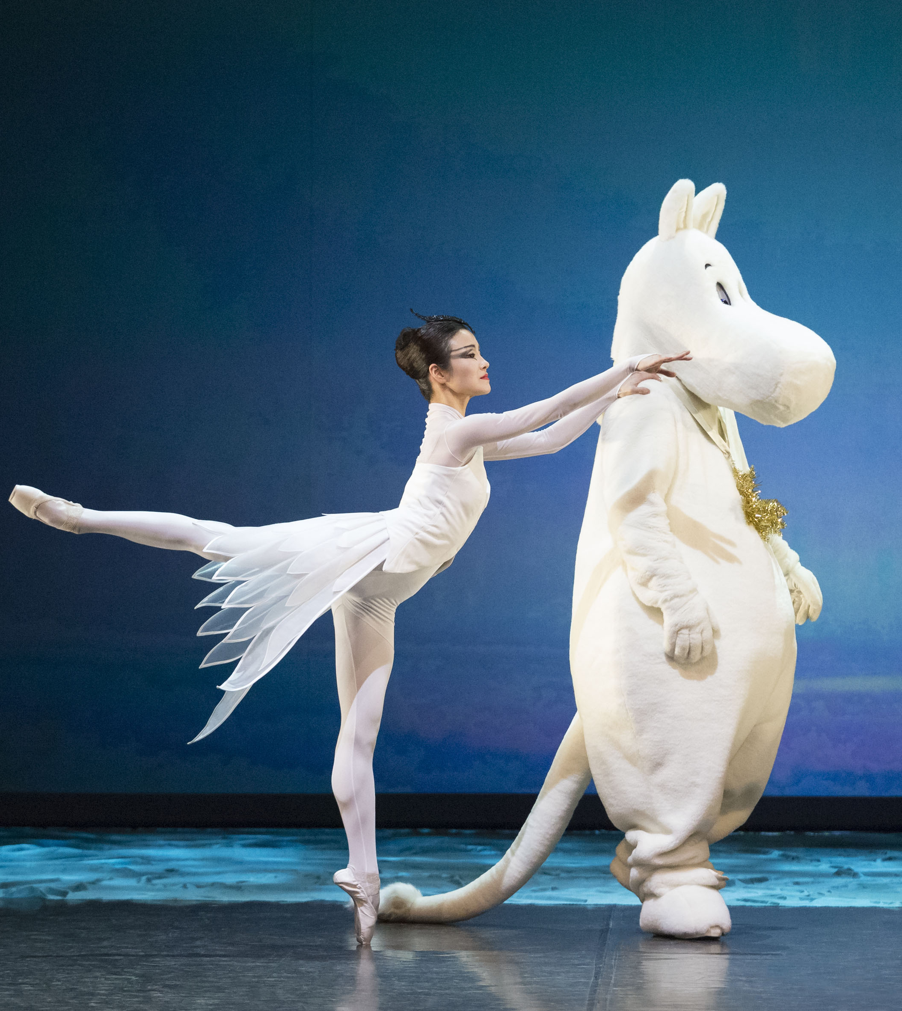
Finland dances from North to South.
FINNISH DANCE IN EIGHT STEPS
1
2
3
4
5
6
7
8
Nothing stops us from dancing – not even the cold of
the Arctic Circle.
Finland is a vast and sparsely populated country, and yet, professional dance is still available everywhere.
Dance theater Tsuumi organizes traditional rural evenings throughout Finland, featuring improvised dance performances. Photo: Clas-Olav Slotte
Finnish National Opera and Ballet at Töölönlahti Bay. Photo: Heikki Tuuli
Finland’s northernmost dance theatre, Rimpparemmi, is located in Rovaniemi, Lapland. Image from Sillat (Bridges) short dance film, 2021. Photo: Antti Kurola
Dance House Helsinki audience. Photo: Annukka Pakarinen
Moomin and the Comet is a ballet created for the Finnish National Ballet by Anandah Kononen, 2015. Photo: Mirka Kleemola
Notes:
Dance House Helsinki, opened in 2022, is a new home for Finnish contemporary dance. Yet in Finland, dance is not just a capital-city phenomenon. Artists create and perform from the southern archipelago to the northern fells. A state-funded structure supports this decentralisation, with public grants and regional dance centres.
The Finnish National Ballet has been active since 1922, making it one of Europe’s first national companies.
There are eight vocational or university-level institutions offering professional dance education in different parts of the country.
Since 1980, Dance Info Finland (now part of Circus & Dance Info Finland) has supported the sector through statistics, international networks and communications.

Slide 6
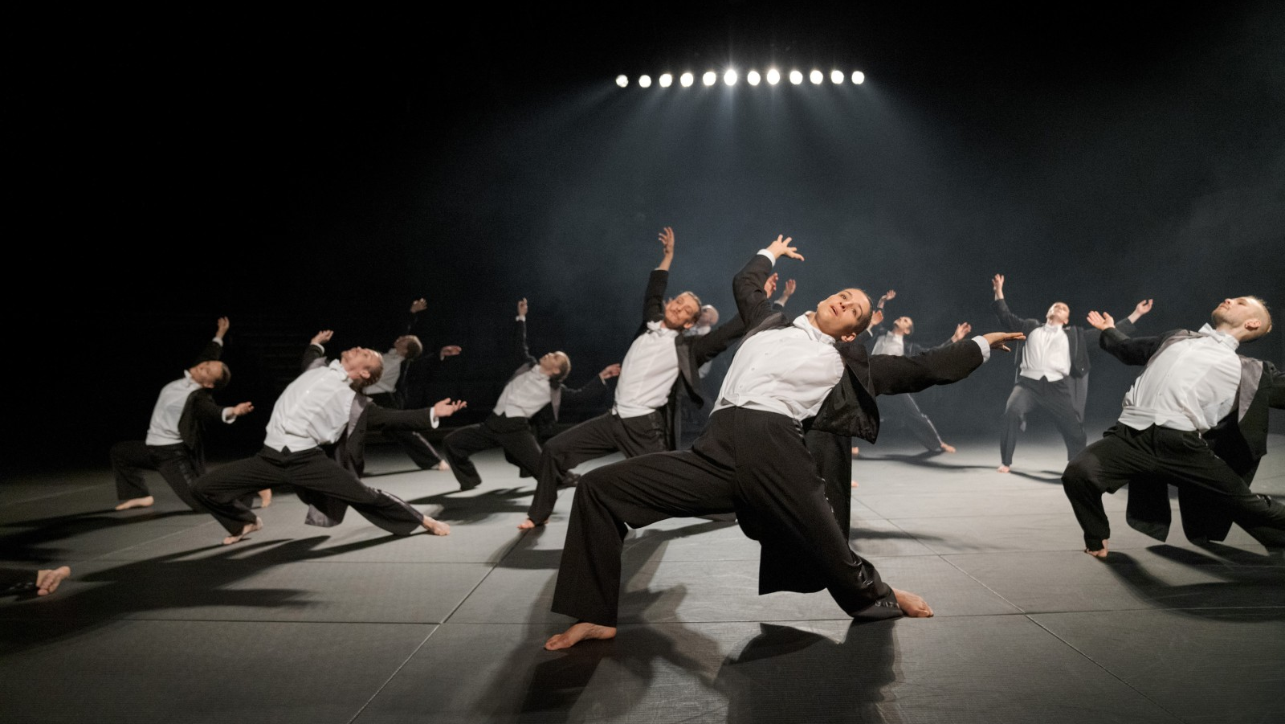
3/8
Finnish dance has no rules.
Helsinki Dance Company & Kinetic Orchestra: Silence, 2024. Photo: Petra Tiihonen
Notes:
Finnish contemporary dance is known for its clarity of movement and commitment to physical expression. It can be fast, demanding and acrobatic – as in Kinetic Orchestra’s thrilling works – or delicate and meditative, like in Milla Koistinen’s flowing choreographies that also set huge silk fabrics in motion.
The focus is not on impressing, but on expressing. Even the subtlest gestures hold weight. Finnish dance culture embraces modesty and authenticity, and this shows in movement: no flourish is unnecessary.

Slide 7
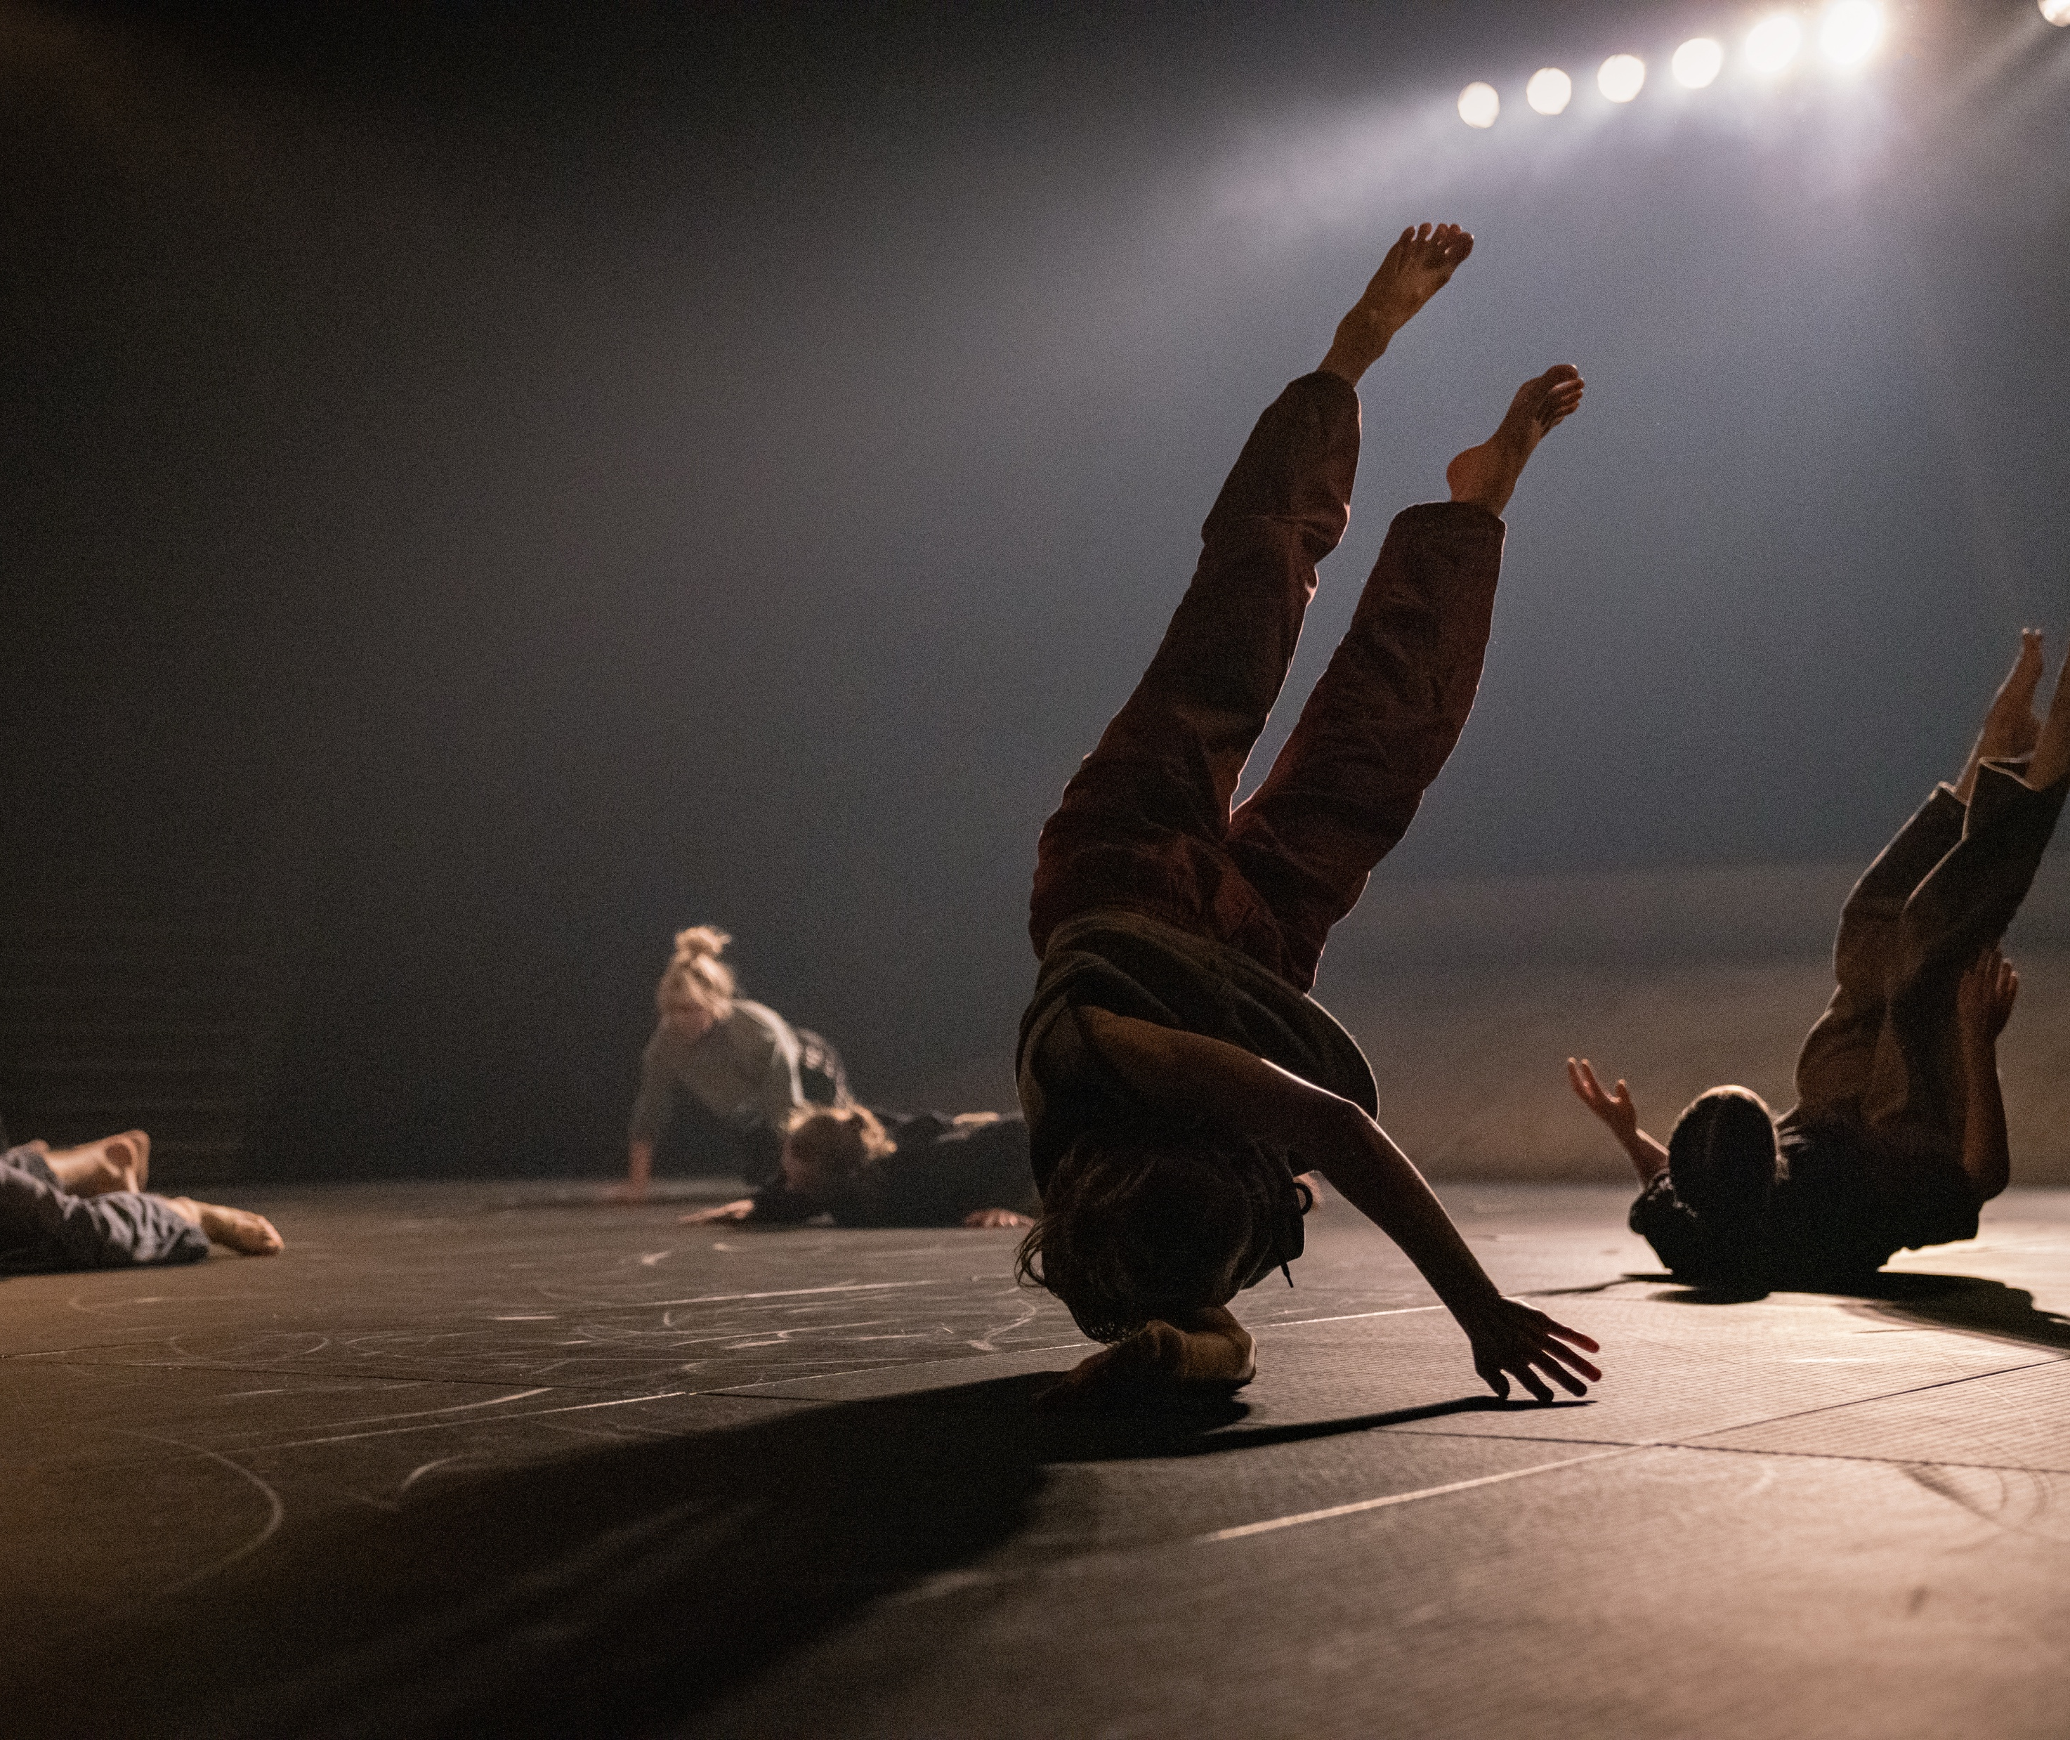
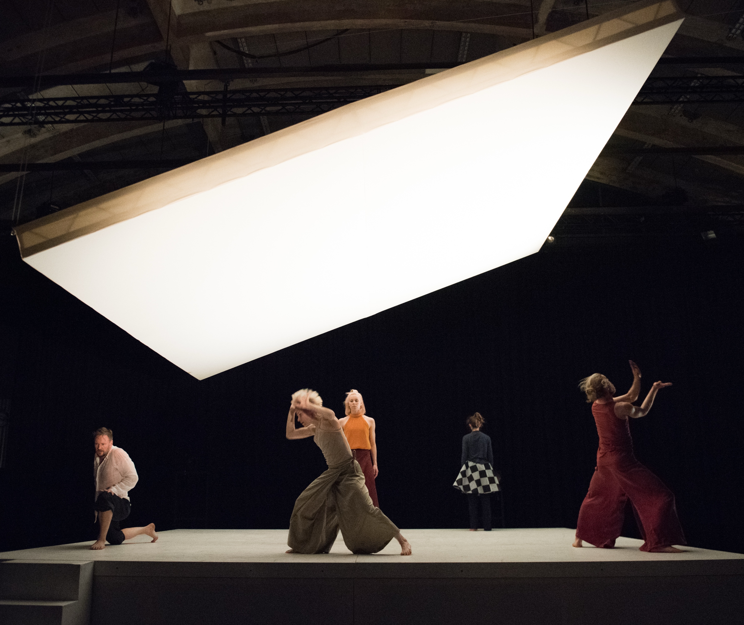
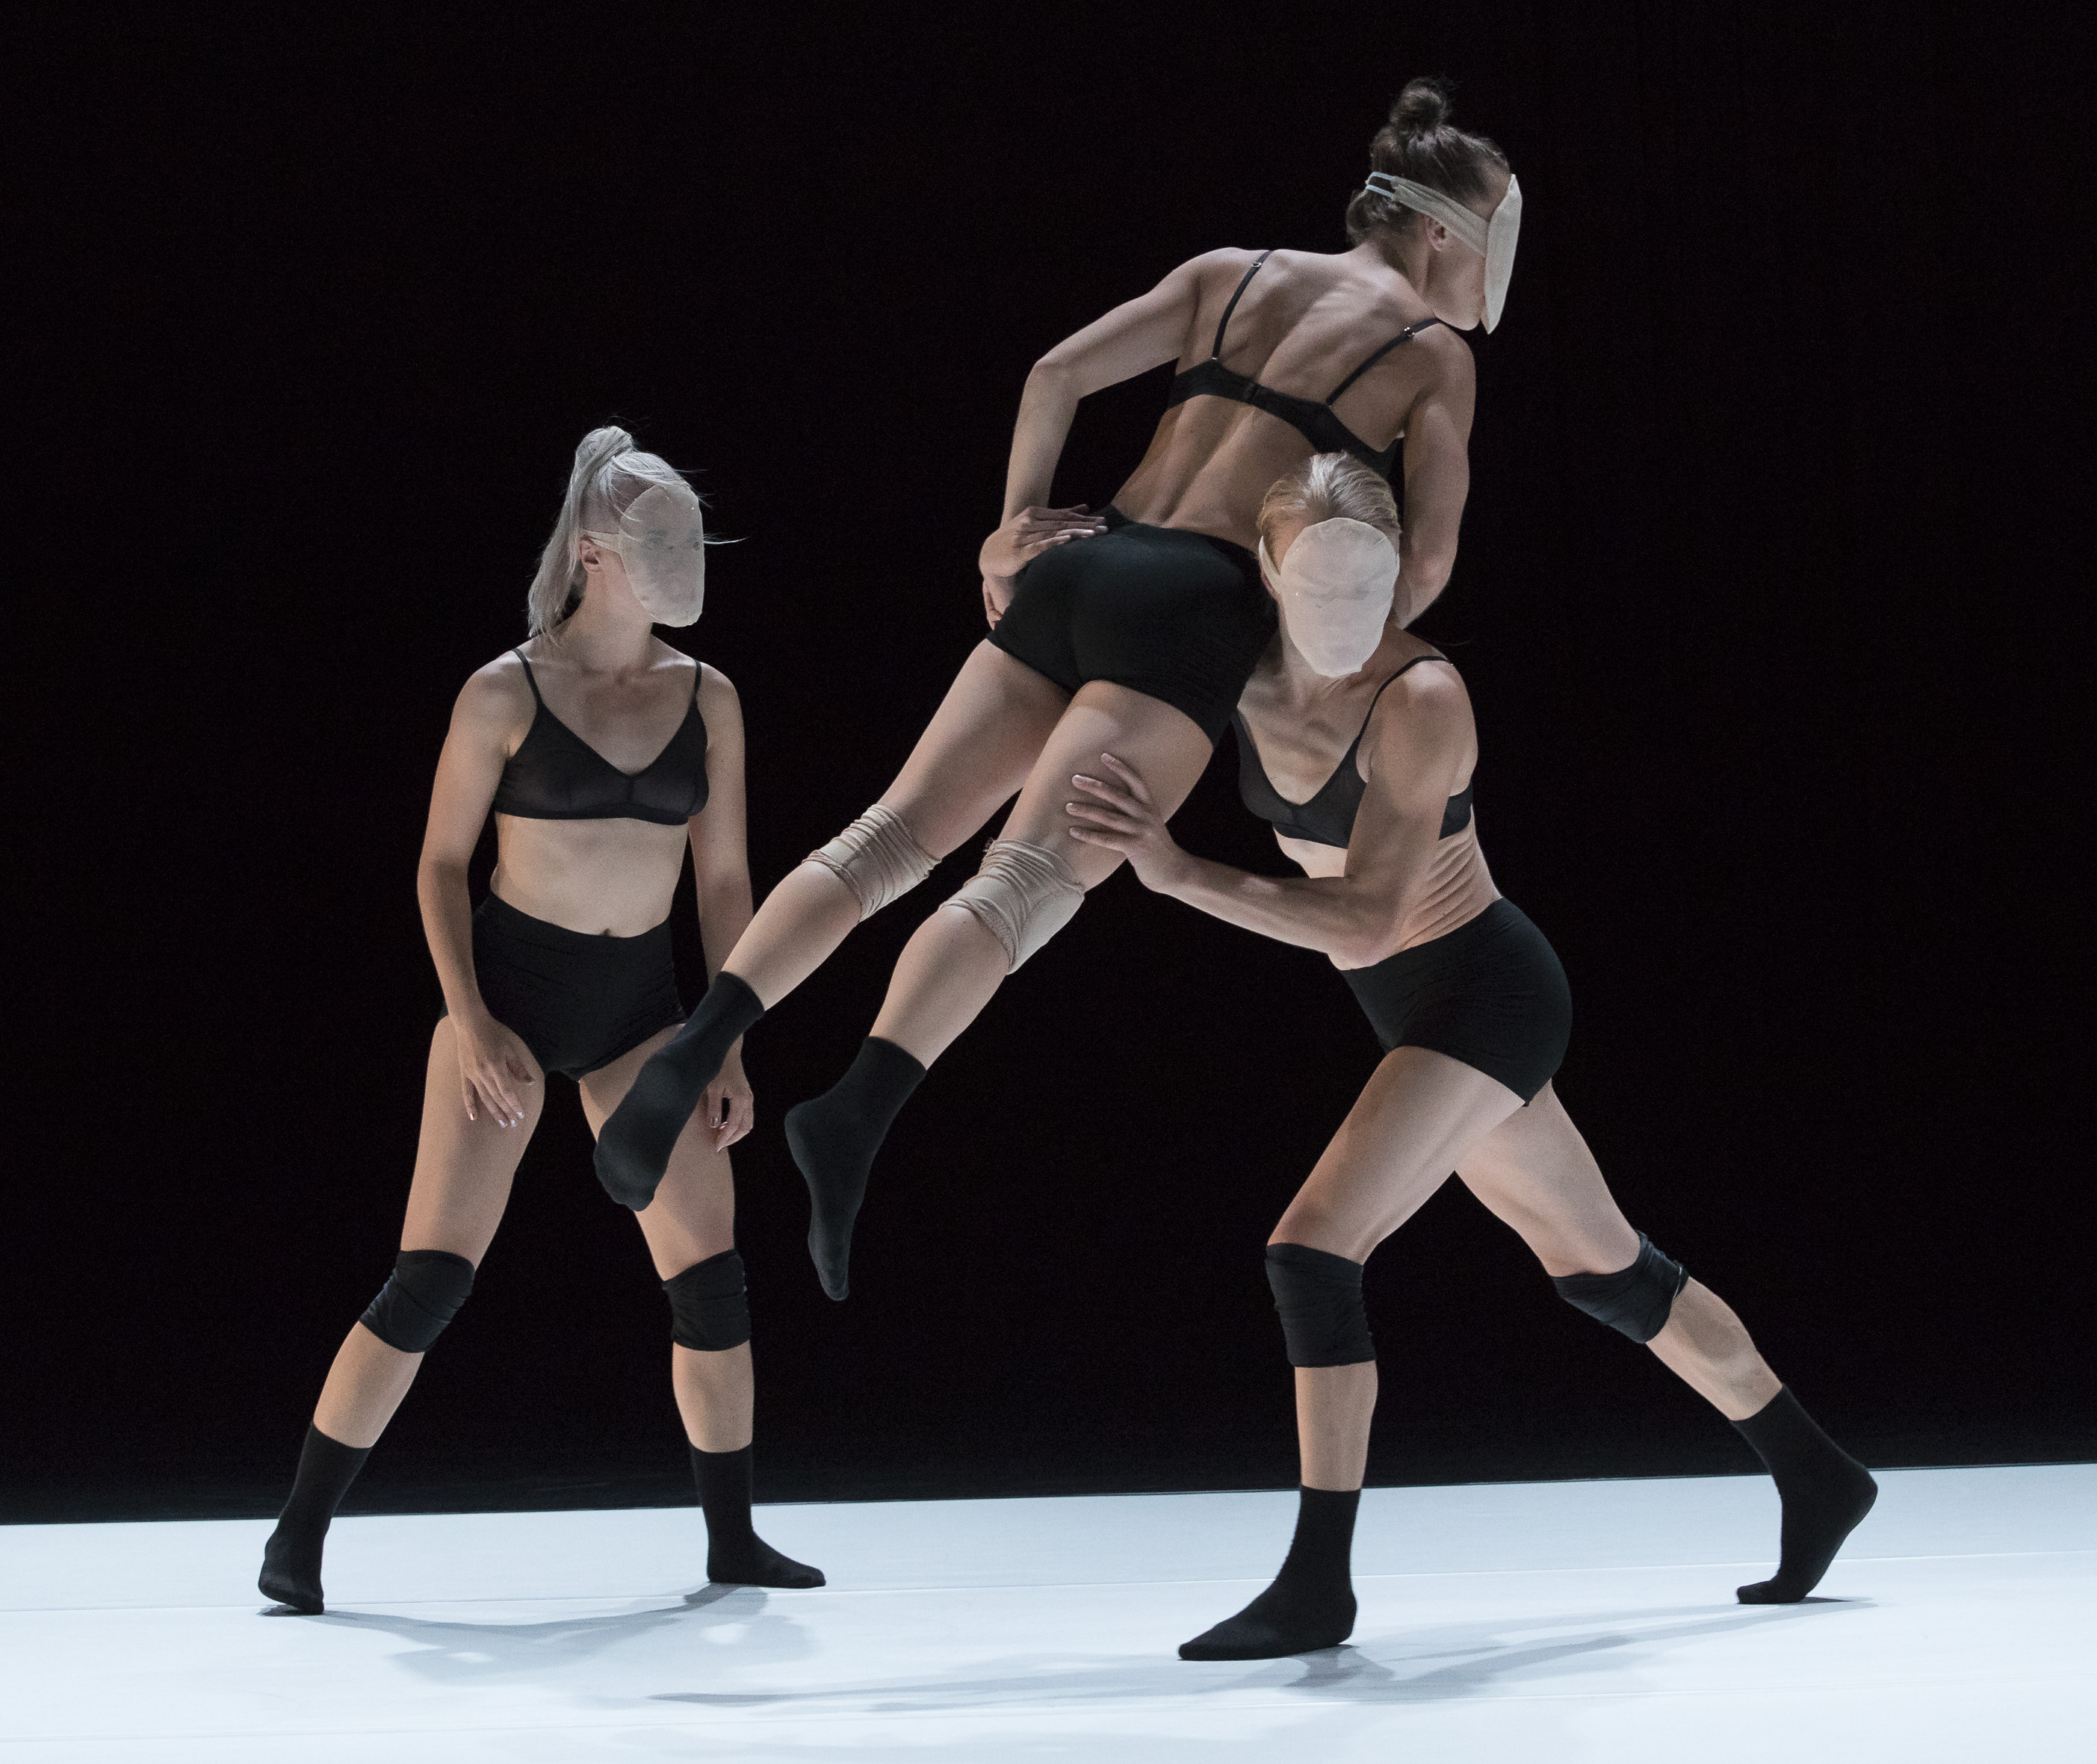
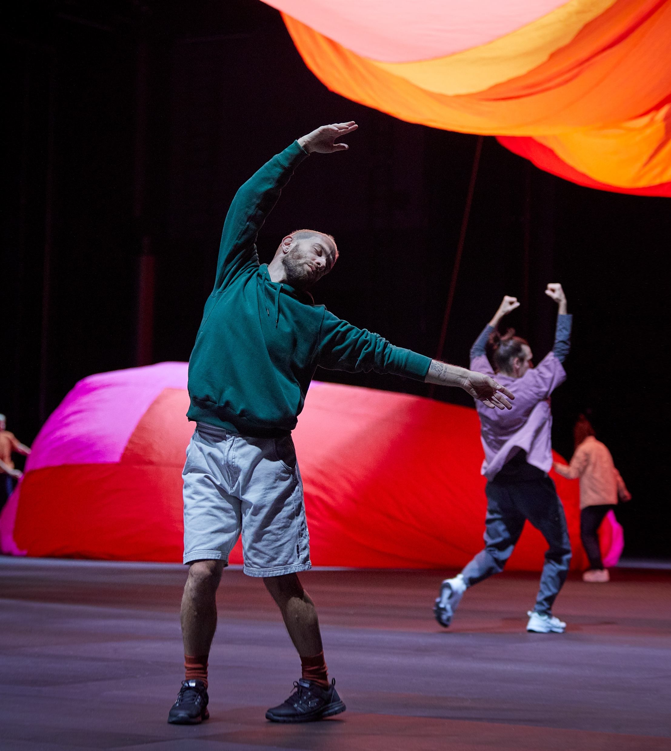
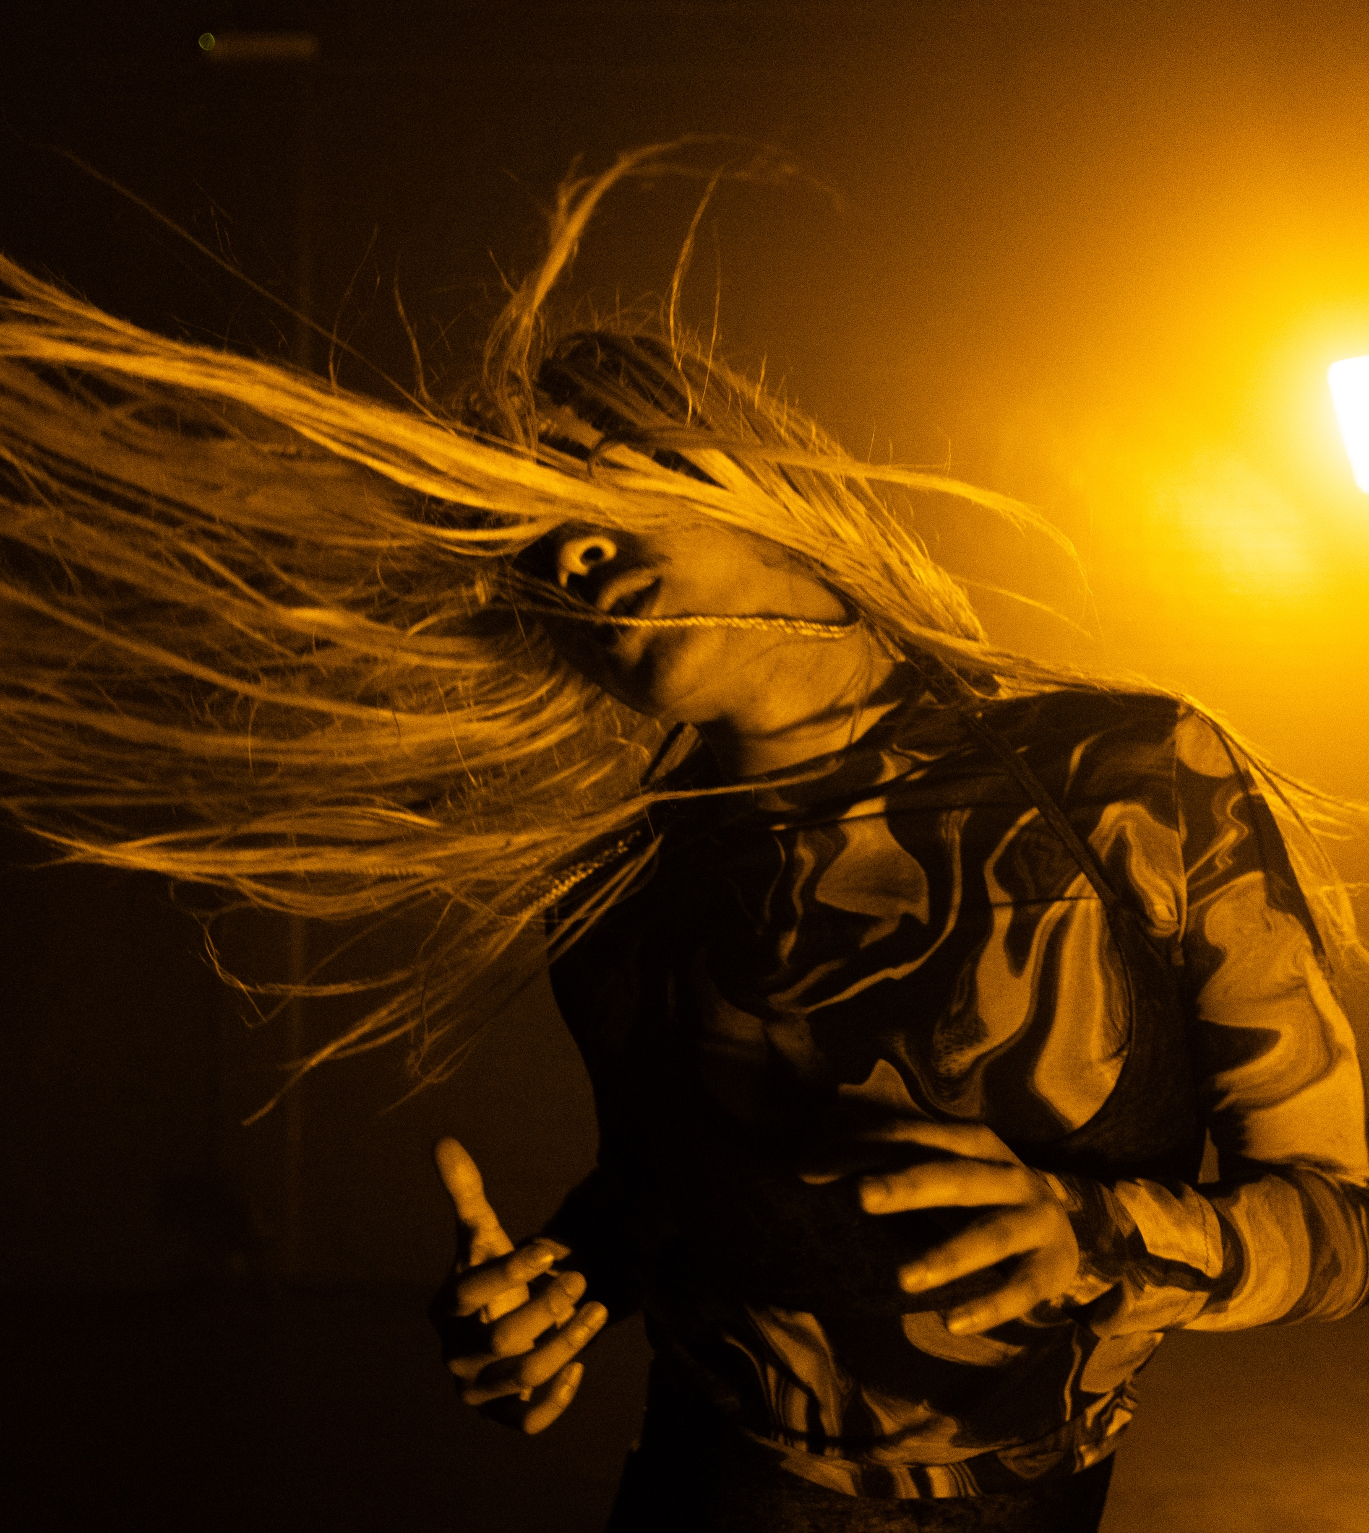
Finnish dance has no rules.
FINNISH DANCE IN EIGHT STEPS
1
2
3
4
5
6
7
8
Finland never had a royal court, so we were free from the shackles of classical dance tradition
– we embraced honesty and
physicality instead.
Petri Kekoni Company: 369, 2019. Photo: Pasi Orrensalo
Susanna Leinonen Company: NASTY, 2018. Photo: Mirka Kleemola
Helsinki Dance Company & Kinetic Orchestra: Gravity, 2023. Photo: Petra Tiihonen
Milla Koistinen: Magenta Haze, 2022. Photo: Ilkka Saastamoinen, Dance House Helsinki
Alen Nsambu: Neon Beige, 2024. Photo: Aino Kontinen, Zodiak – Centre For New Dance.
Notes:
Finnish contemporary dance is known for its clarity of movement and commitment to physical expression. It can be fast, demanding and acrobatic – as in Kinetic Orchestra’s thrilling works – or delicate and meditative, like in Milla Koistinen’s flowing choreographies that also set huge silk fabrics in motion.
The focus is not on impressing, but on expressing. Even the subtlest gestures hold weight. Finnish dance culture embraces modesty and authenticity, and this shows in movement: no flourish is unnecessary.

Slide 8
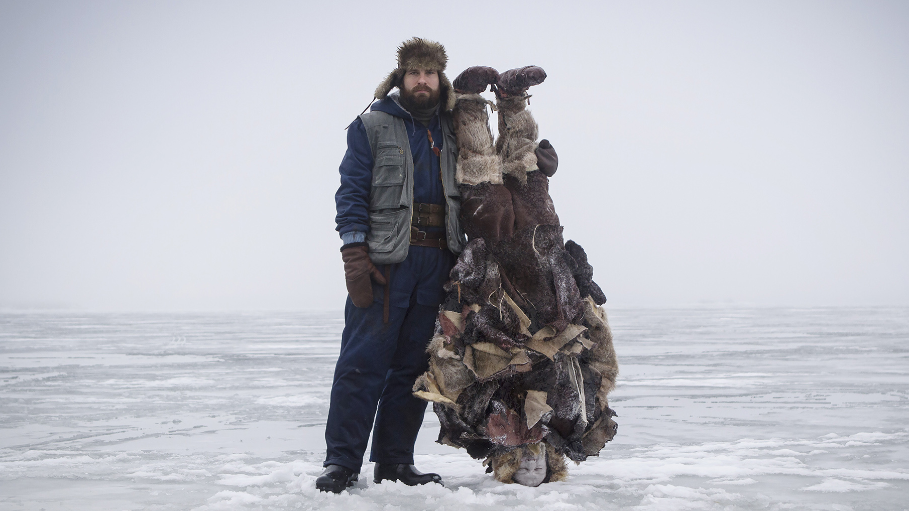
4/8
Hooray, odd, wild and wonderfully weird!
From the dance short film Cold Storage, 2016. Dir. Thomas Freundlich, chor. Valtteri Raekallio. Photo: Thomas Freundlich
Notes:
What makes Finnish dance so vibrant is its openness to surprise. Artists often work at the intersection of dance, performance and visual art.
Since Finnish dance does not carry a strong classical heritage, there is room for experimentation. That freedom results in highly personal and original works – from Valtteri Raekallio’s filmic storytelling, to Elina Pirinen’s emotionally charged stage presence and Wauhaus’s industrial excavators turned into dancers.
You never quite know what to expect – and that’s part of the thrill.

Slide 9

Notes:
What makes Finnish dance so vibrant is its openness to surprise. Artists often work at the intersection of dance, performance and visual art.
Since Finnish dance does not carry a strong classical heritage, there is room for experimentation. That freedom results in highly personal and original works – from Valtteri Raekallio’s filmic storytelling, to Elina Pirinen’s emotionally charged stage presence and Wauhaus’s industrial excavators turned into dancers.
You never quite know what to expect – and that’s part of the thrill.

Slide 10
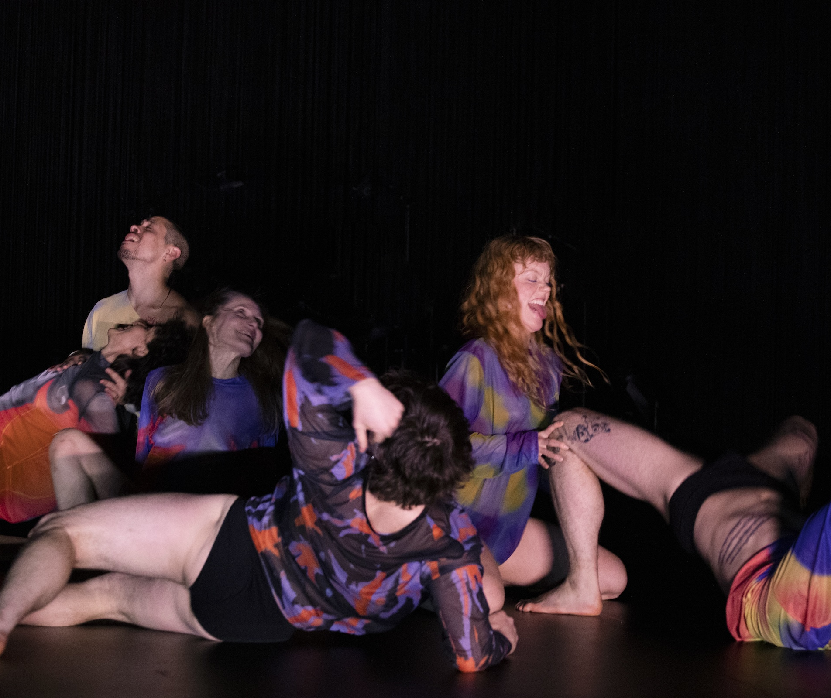
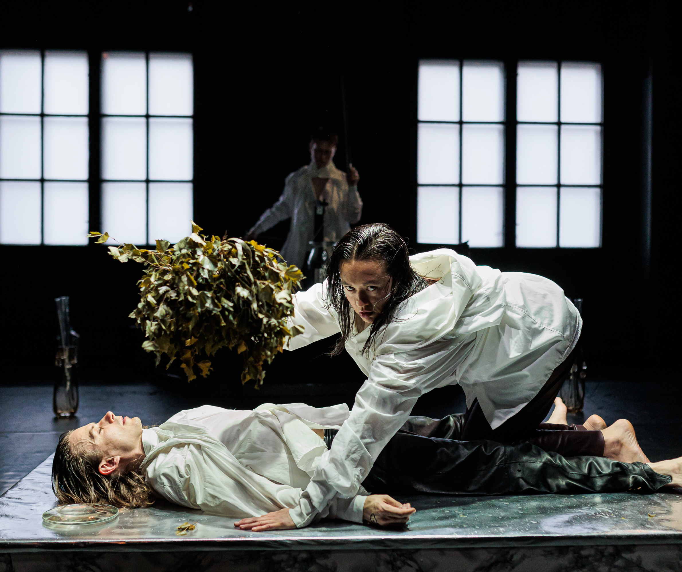
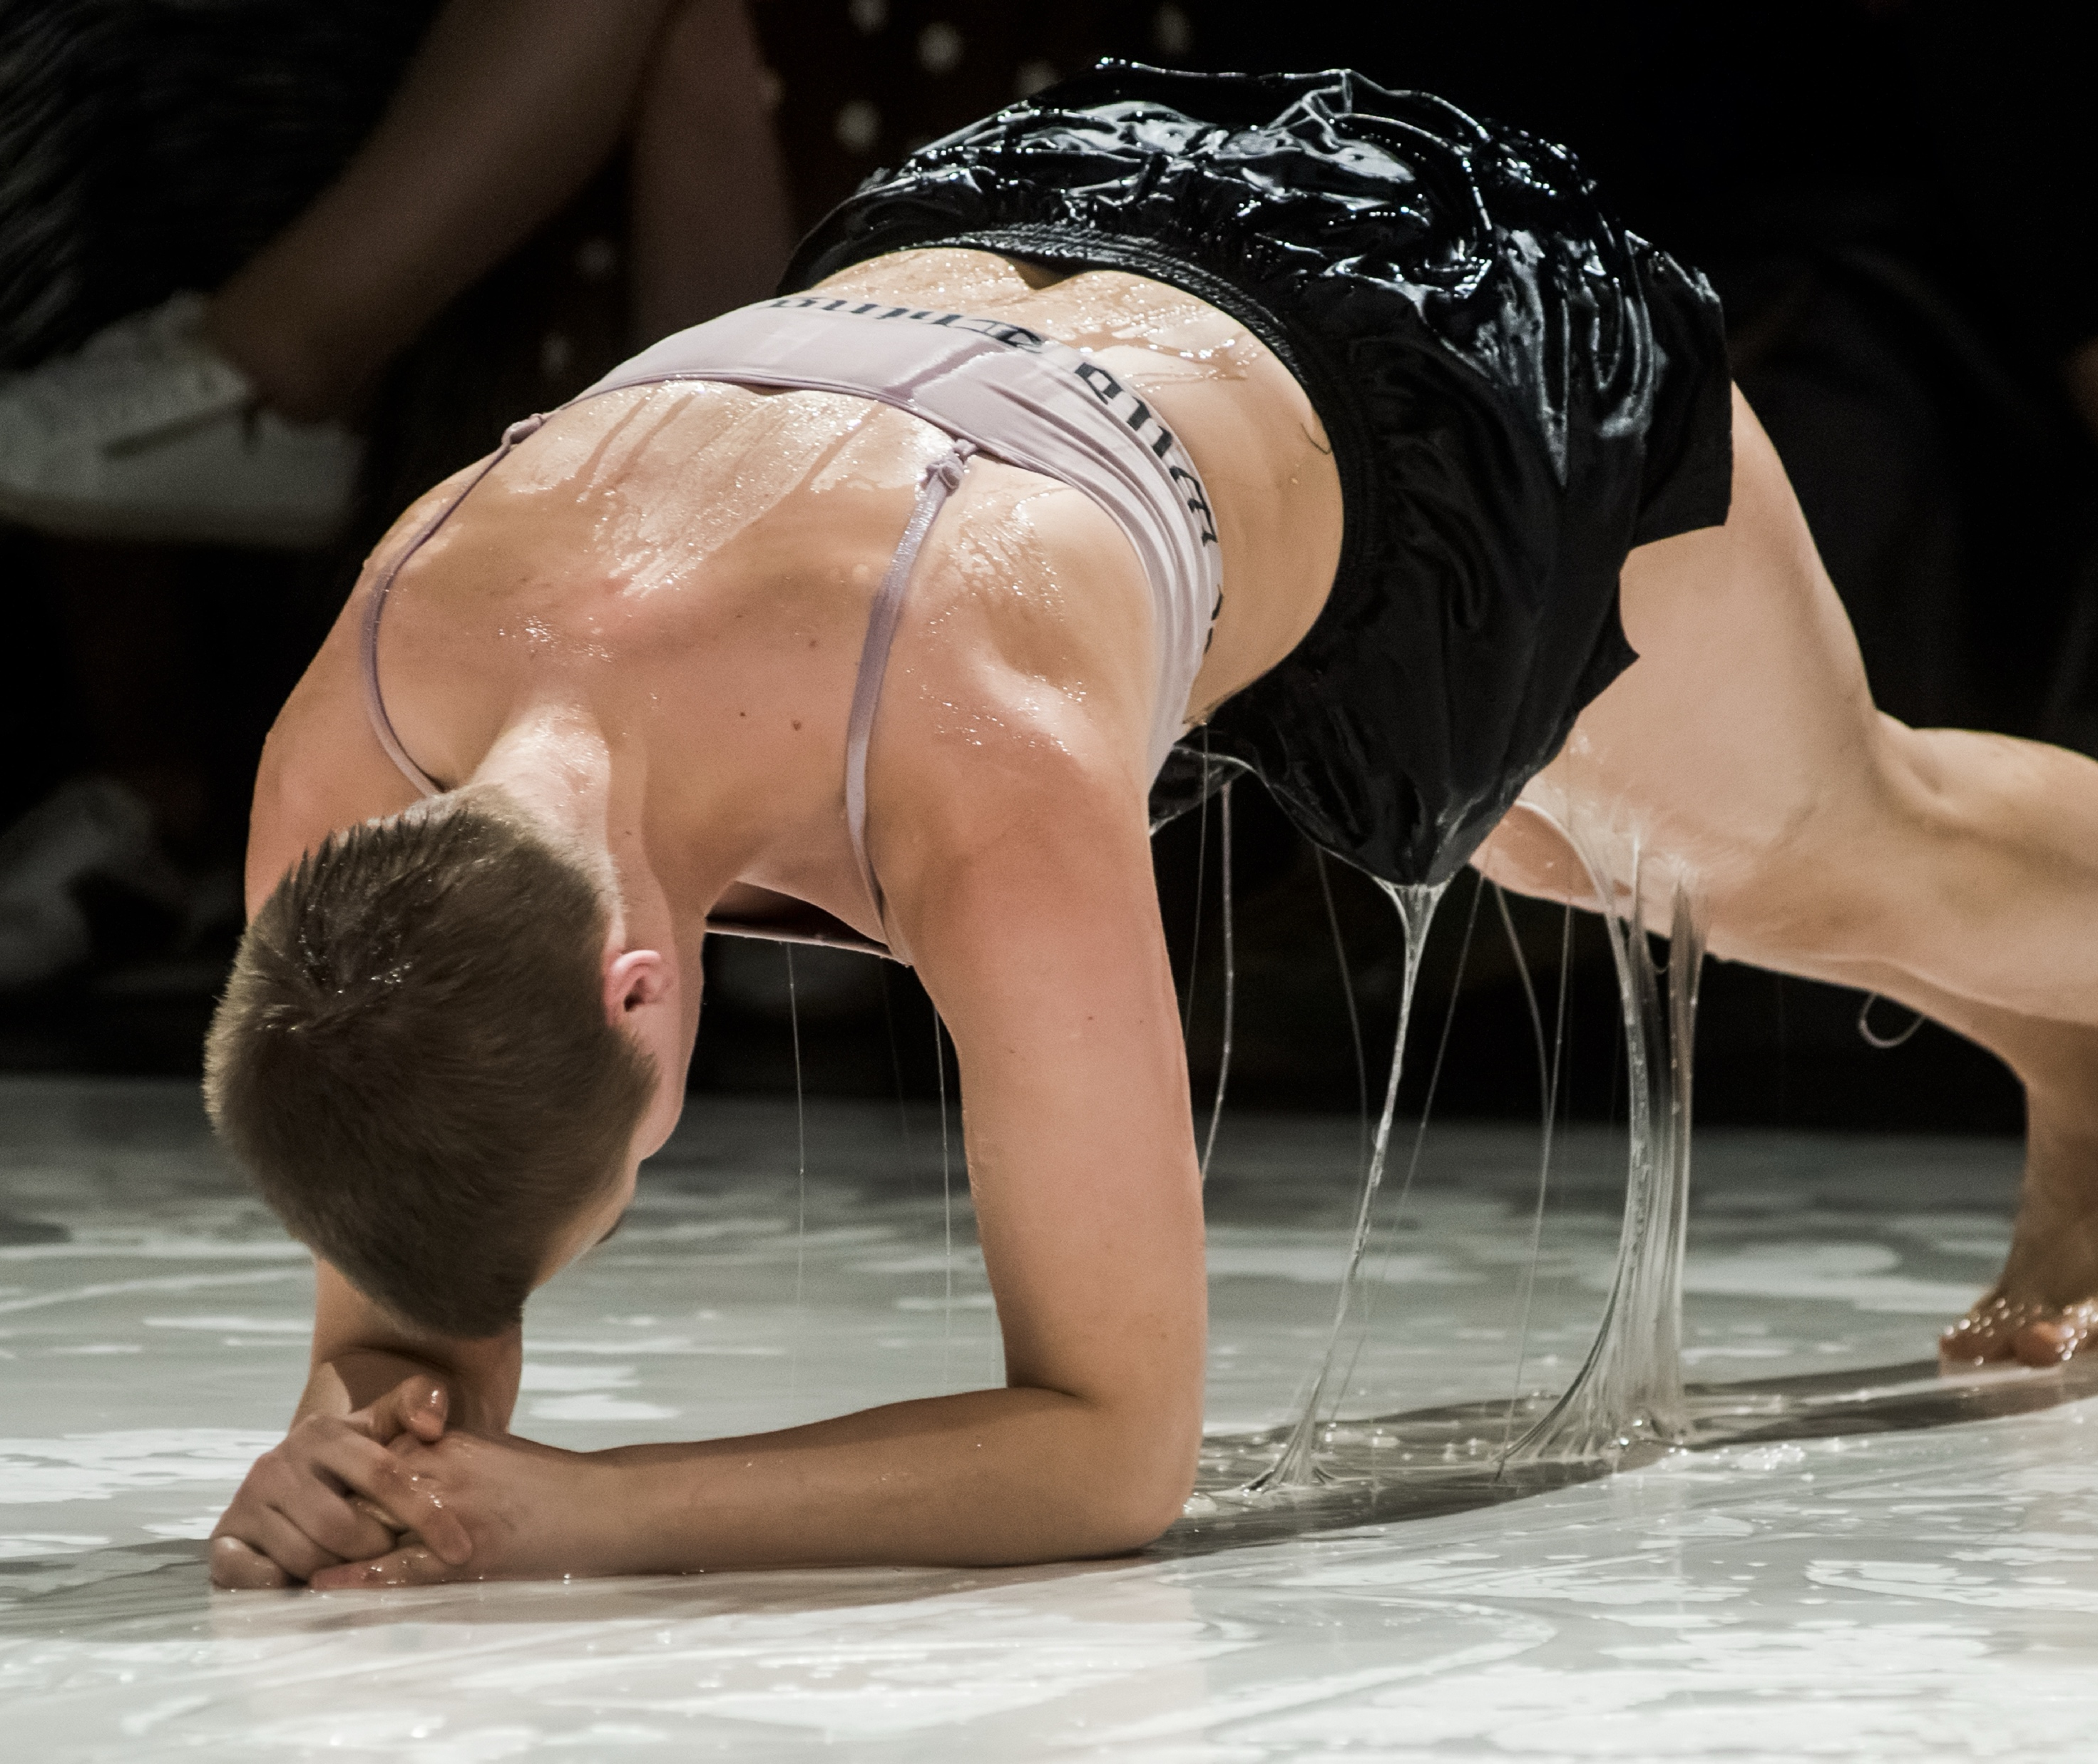
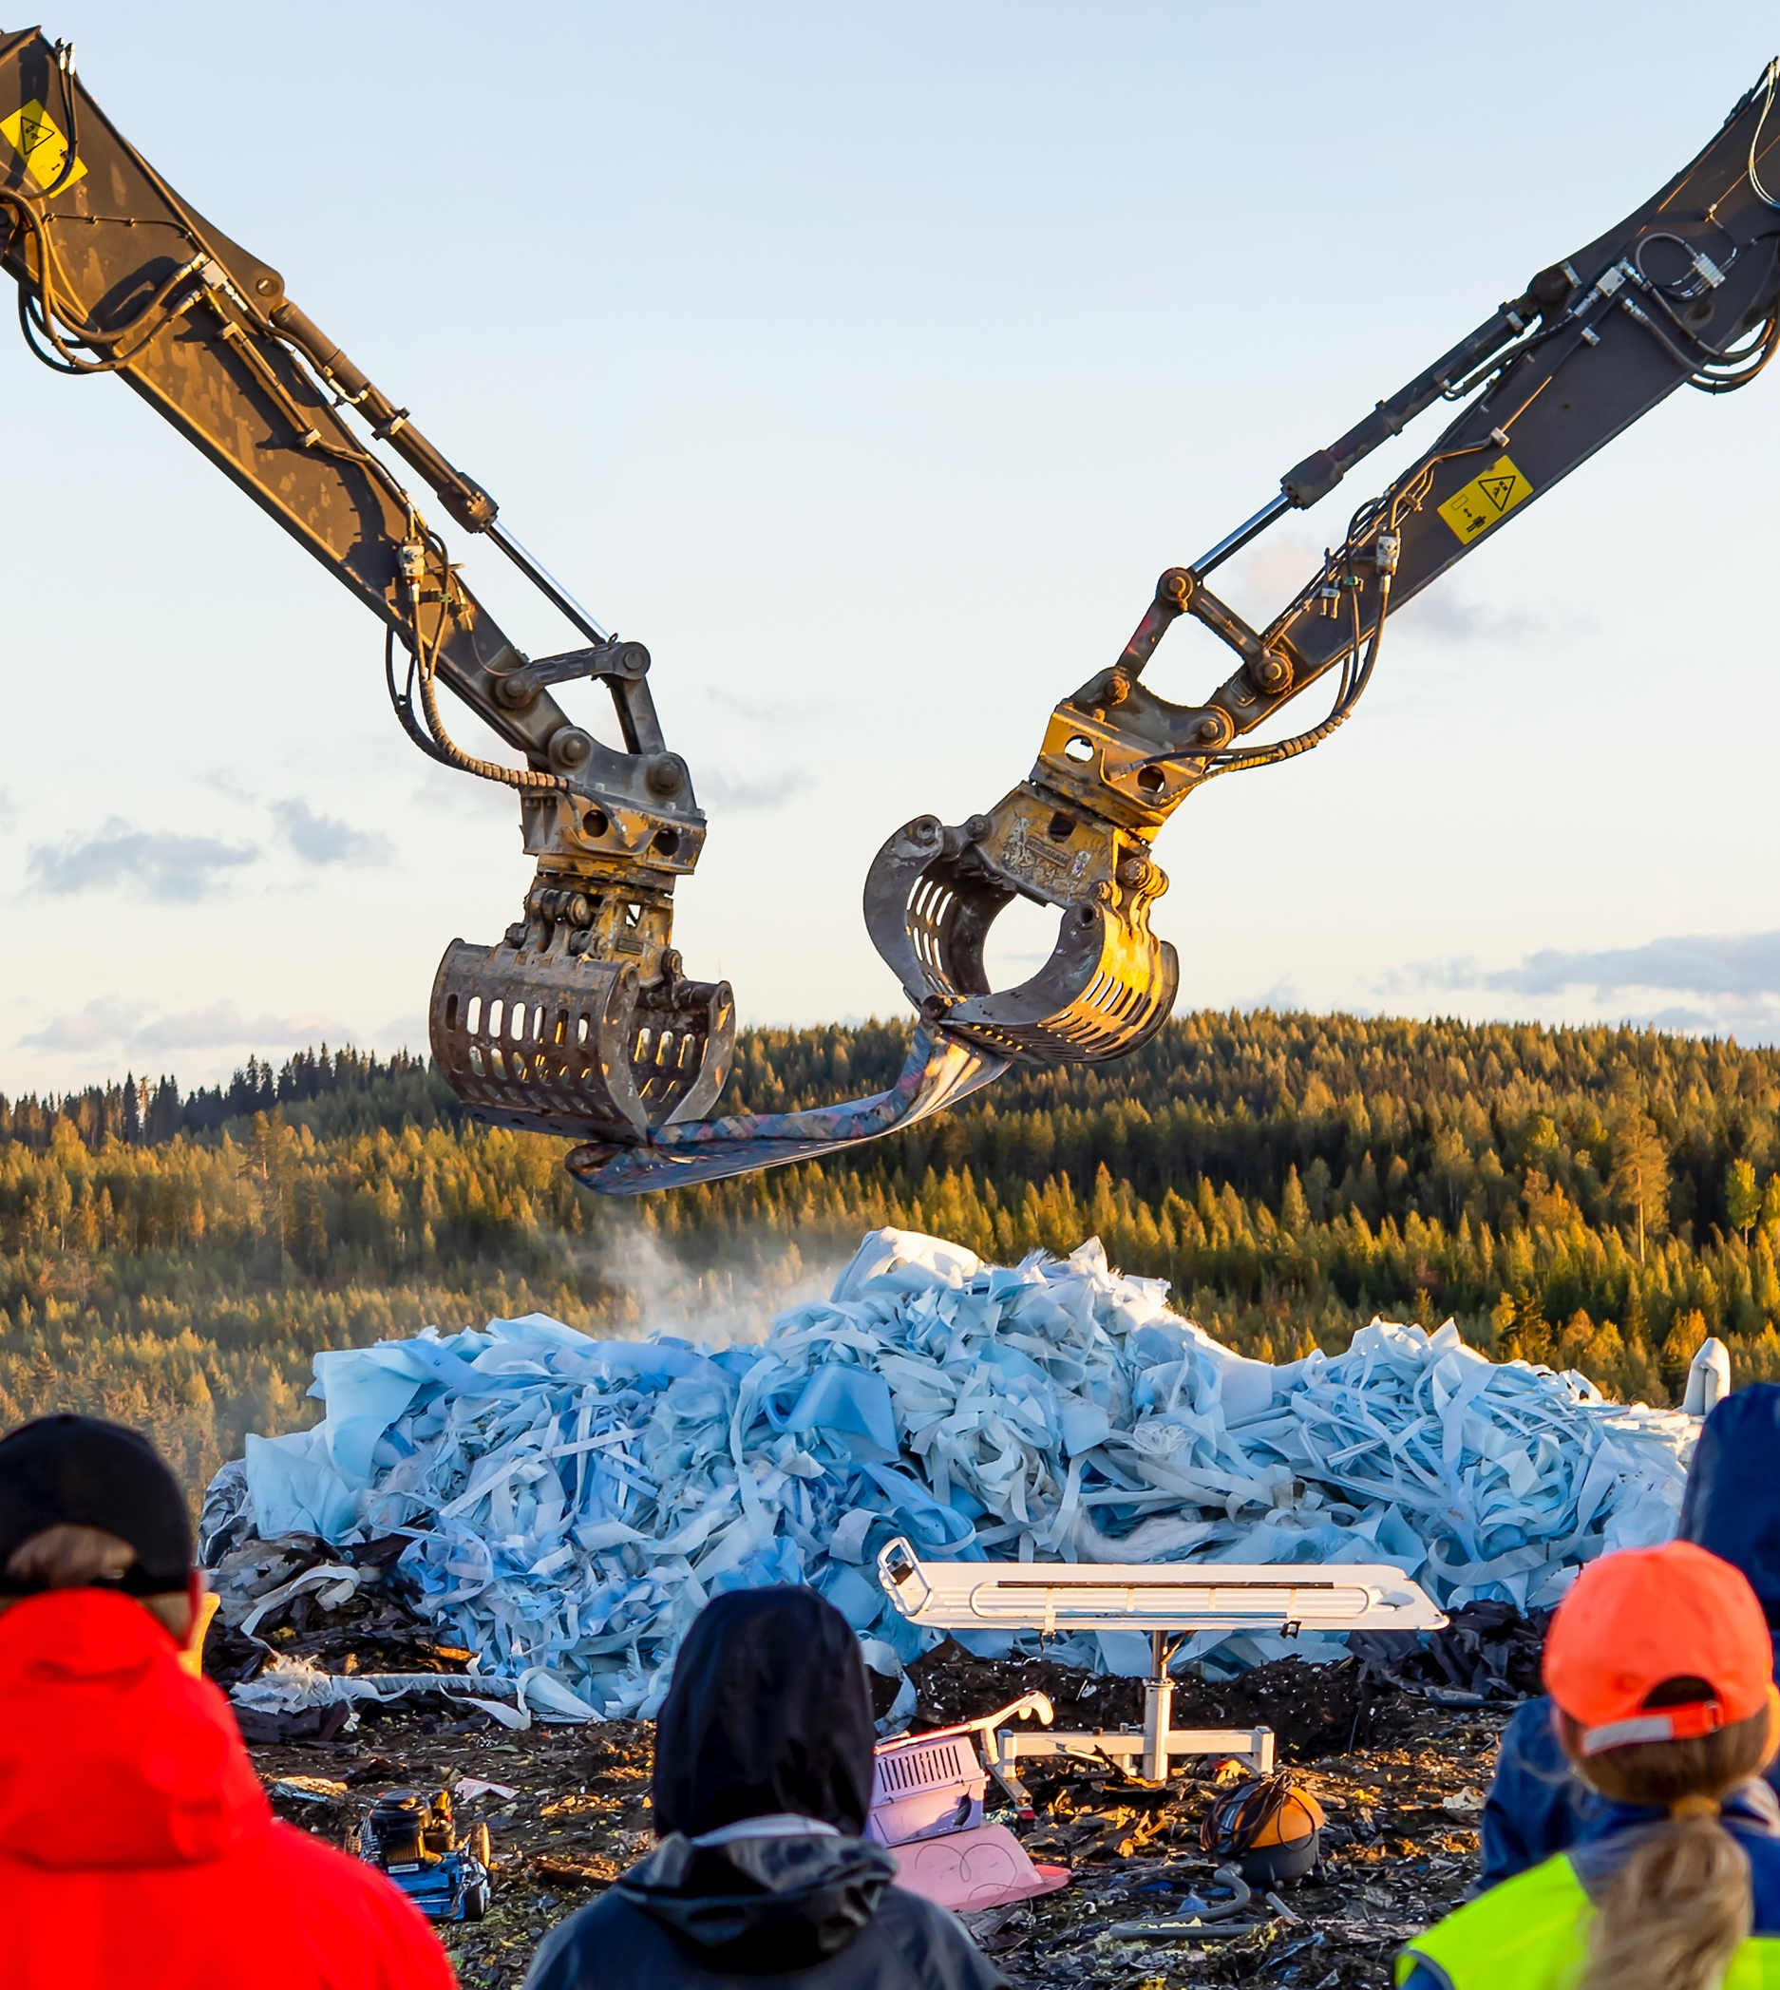
Hooray, odd, wild and wonderfully weird!
FINNISH DANCE IN EIGHT STEPS
1
2
3
4
5
6
7
8
Finnish choreographers are bold explorers.
They dissolve boundaries, styles, logic – and even gravity.
Wauhaus: Fluids, Baltic Dance Platform 2019. Photo: Dmitri Matvejev
Mikko Niemistö: Glass Eyes, 2025. Photo: Jussi Ulkuniemi, Zodiak – Centre for New Dance
Elina Pirinen: Mortal Tropical Dances, 2023. Photo: Venla Helenius, Zodiak / Dance House Helsinki
Wauhaus: A Great Mess, a site-specific performance, 2018. Photo: Pekka Mäkinen
Notes:
What makes Finnish dance so vibrant is its openness to surprise. Artists often work at the intersection of dance, performance and visual art.
Since Finnish dance does not carry a strong classical heritage, there is room for experimentation. That freedom results in highly personal and original works – from Valtteri Raekallio’s filmic storytelling, to Elina Pirinen’s emotionally charged stage presence and Wauhaus’s industrial excavators turned into dancers.
You never quite know what to expect – and that’s part of the thrill.

Slide 11
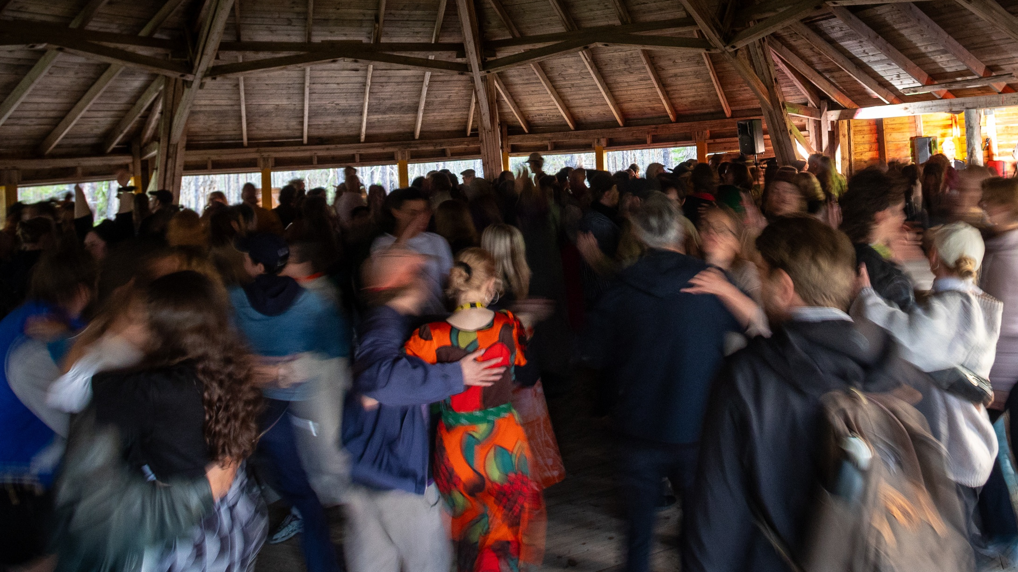
5/8
Dance belongs to every body.
Dance Pavilion at Midnight Sun Film Festival in Sodankylä. Photo: Sami Sorasalmi
Notes:
From big cities to the smallest towns, Finland has over 80 schools offering basic education in dance as part of the national arts education system. This means that children and youth can pursue dance seriously no matter where they live.
And it doesn’t stop there. Finland embraces the idea that dance is for everyone – regardless of age, background or physical ability. So-called Dance Ambassadors might dance hand-in-hand with a bedridden patient, or you might see wheelchair dance as part of a performance.
Whether it’s a senior group in a care home or teenagers in a street dance crew, dance creates well-being.

Slide 12
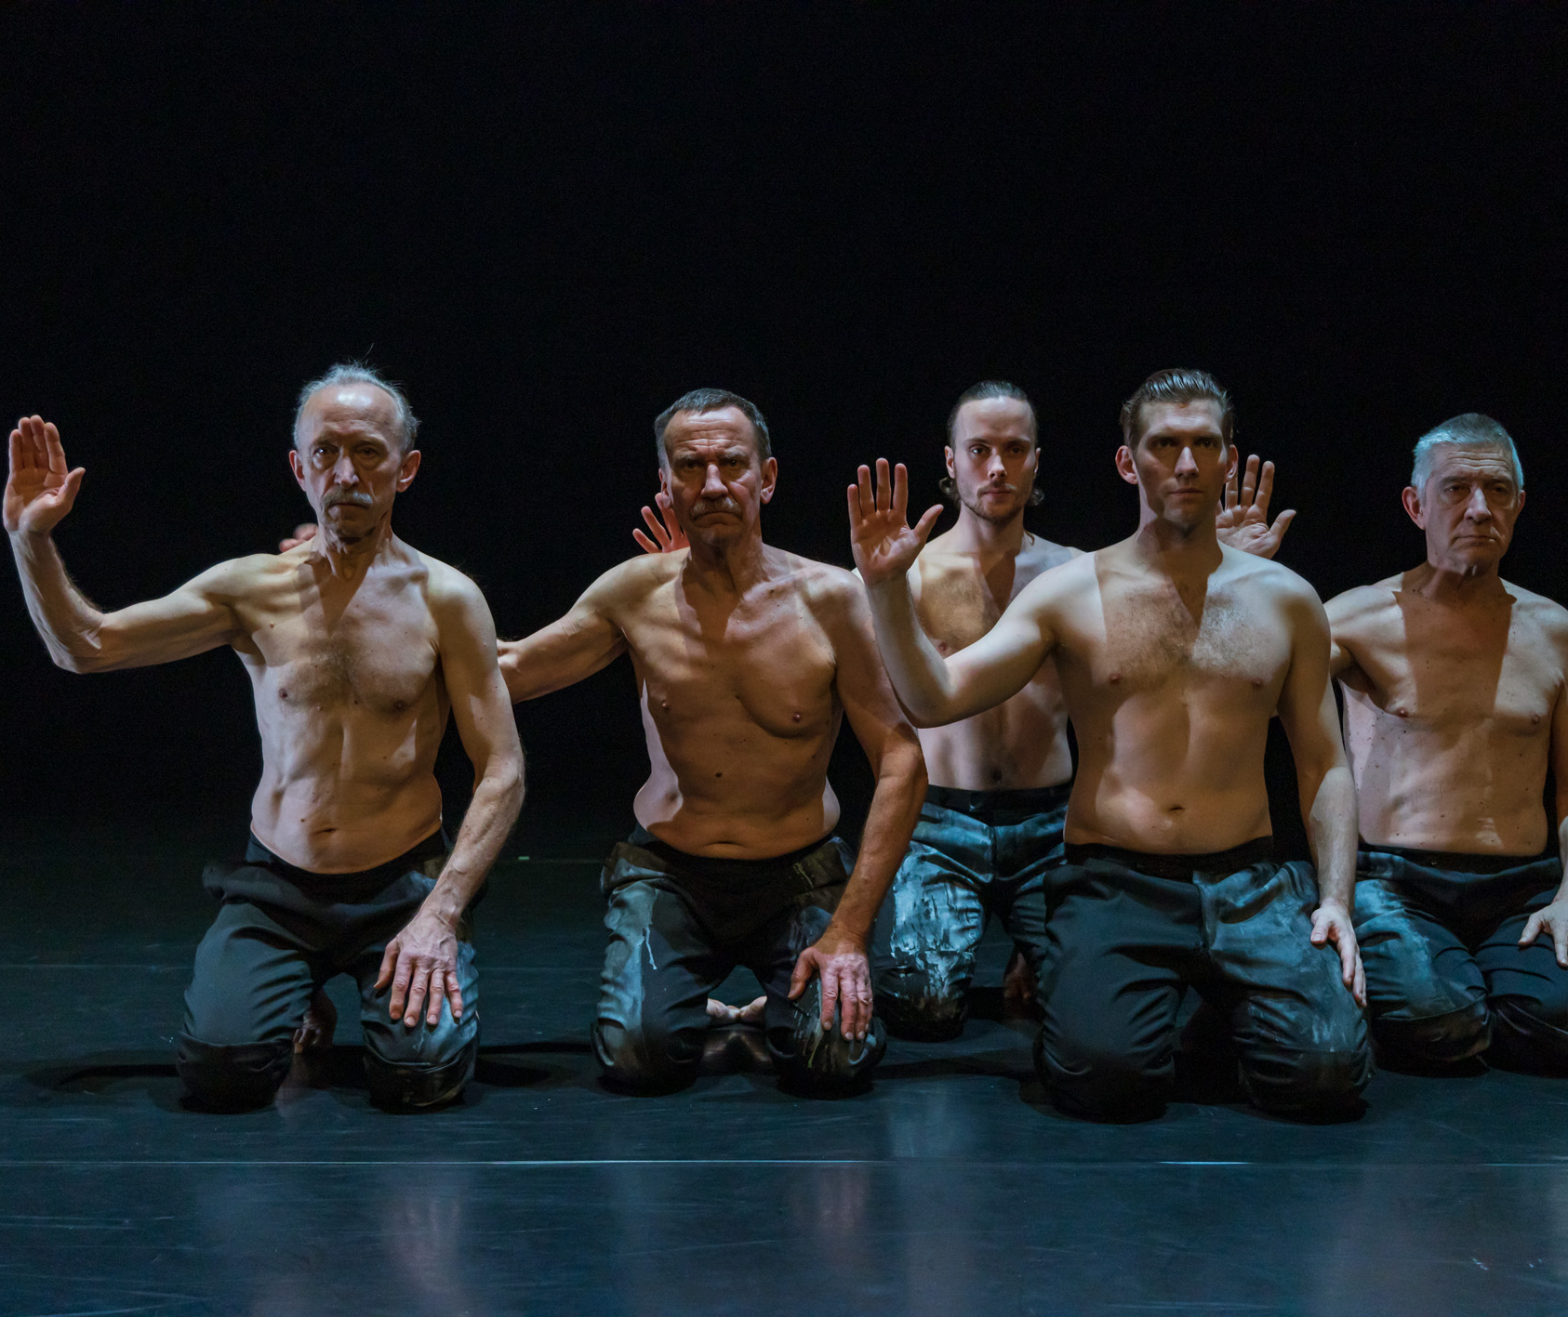
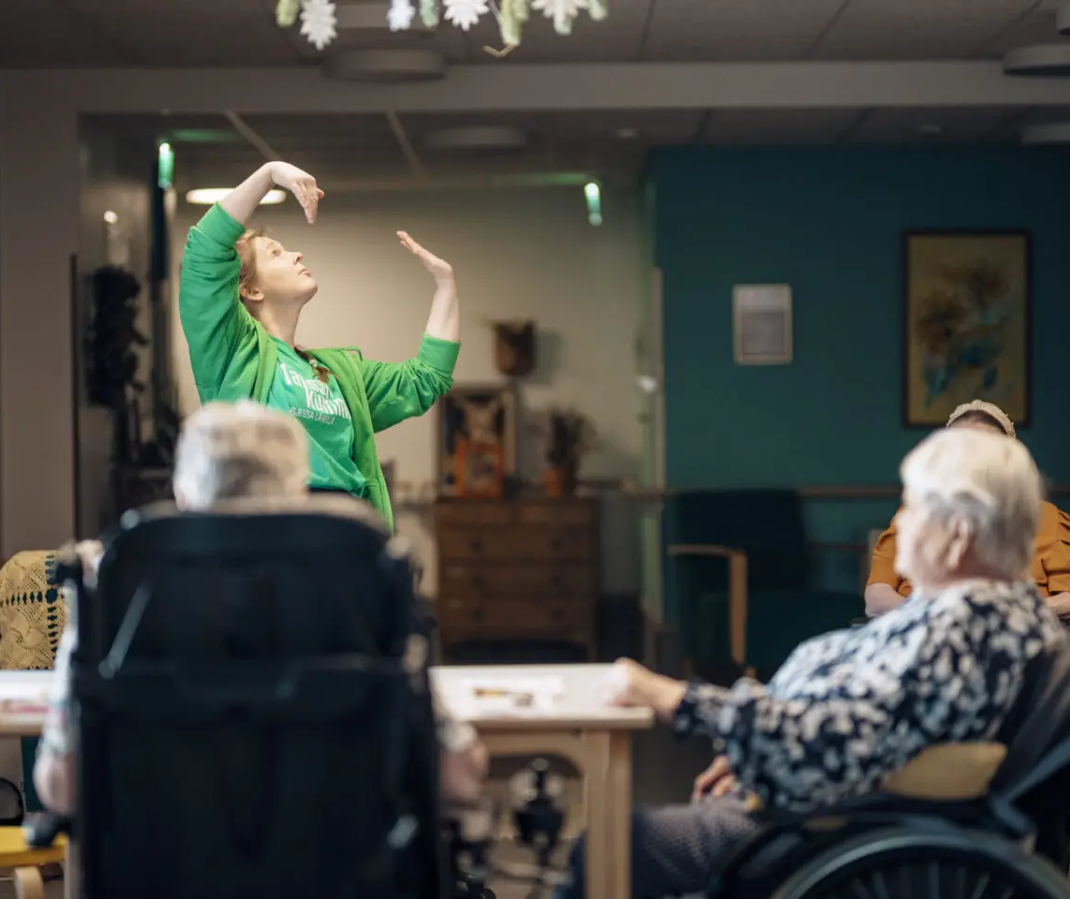
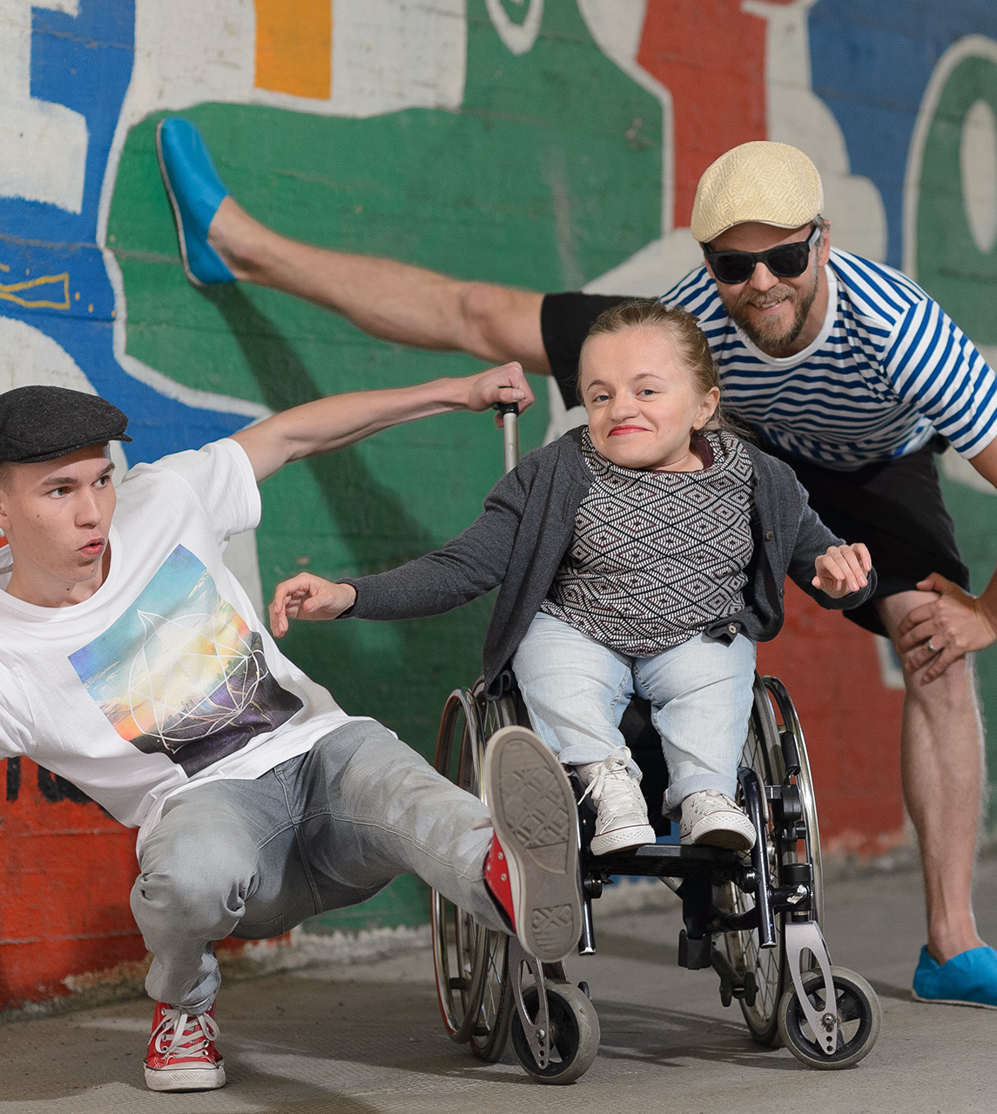
Dance belongs to every body.
FINNISH DANCE IN EIGHT STEPS
1
2
3
4
5
6
7
8
People of all ages and abilities are welcome on stage.
Professional performances often include amateurs and already retired dancers.
Susanna Leinonen Company’s large artistic projects promote cultural activities of elderly people. The Roots involved both professional dancers and senior citizens. Photo: Sakari Viika
Dance Ambassadors (Tanssikummit) take dance to nursing homes, for example. Photo: Eino Ansio
Dancing Finland Campaign, celebrating the 100 years of independence in Finland, showed that dance belongs to everyone. Photo: KST
Notes:
• From big cities to the smallest towns, Finland has over 80 schools offering basic education in dance as part of the national arts education system. This means that children and youth can pursue dance seriously no matter where they live.
• And it doesn’t stop there. Finland embraces the idea that dance is for everyone – regardless of age, background or physical ability. So-called Dance Ambassadors might dance hand-in-hand with a bedridden patient, or you might see wheelchair dance as part of a performance.
• Whether it’s a senior group in a care home or teenagers in a street dance crew, dance creates well-being.

Slide 13
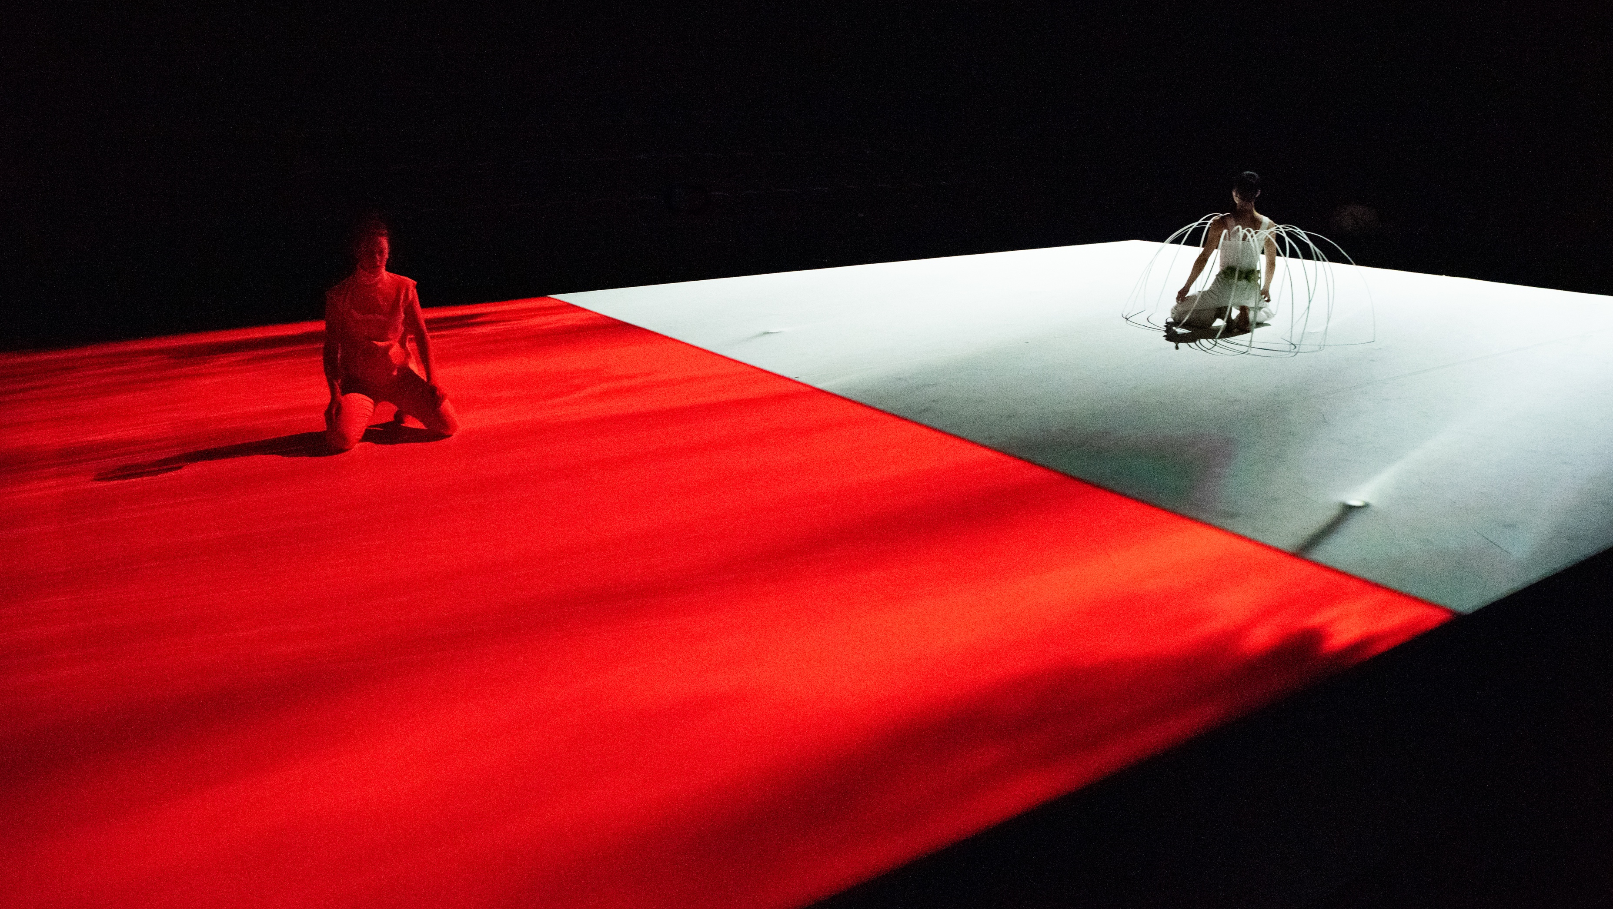
6/8
We put light and sound in the spotlight.
Johanna Nuutinen uses new technologies in her work Skin Hunger, providing a unique viewing experience through a binaural soundscape. Johanna Nuutinen: Skin Hunger, 2023. Photo: Kai Kuusisto
Notes:
There’s a strong design culture in Finland, and it also shows in dance. The higher education system trains choreographers alongside sound and lighting designers, resulting in cohesive, atmospheric productions.
Minimalist aesthetics and poetic lighting are signature traits. New technologies – projections, sensors, immersive sound – are used thoughtfully, often to explore emotional or philosophical layers.
The long Finnish winters and bright summers seem to create a unique sensitivity to space, light and rhythm.

Slide 14
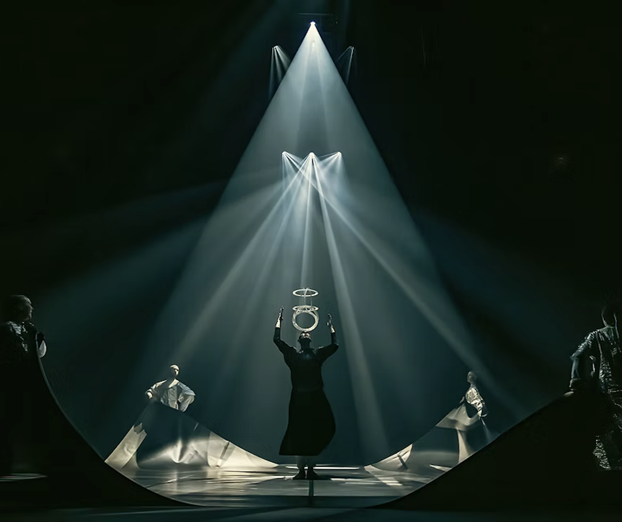
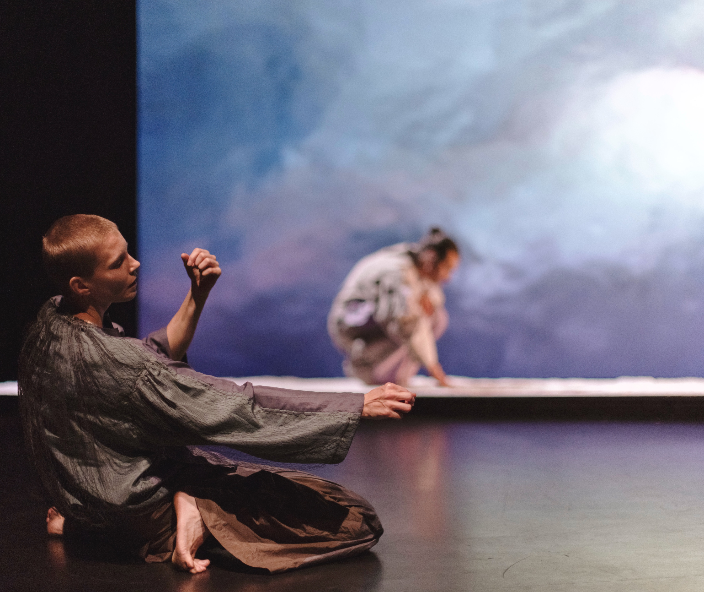
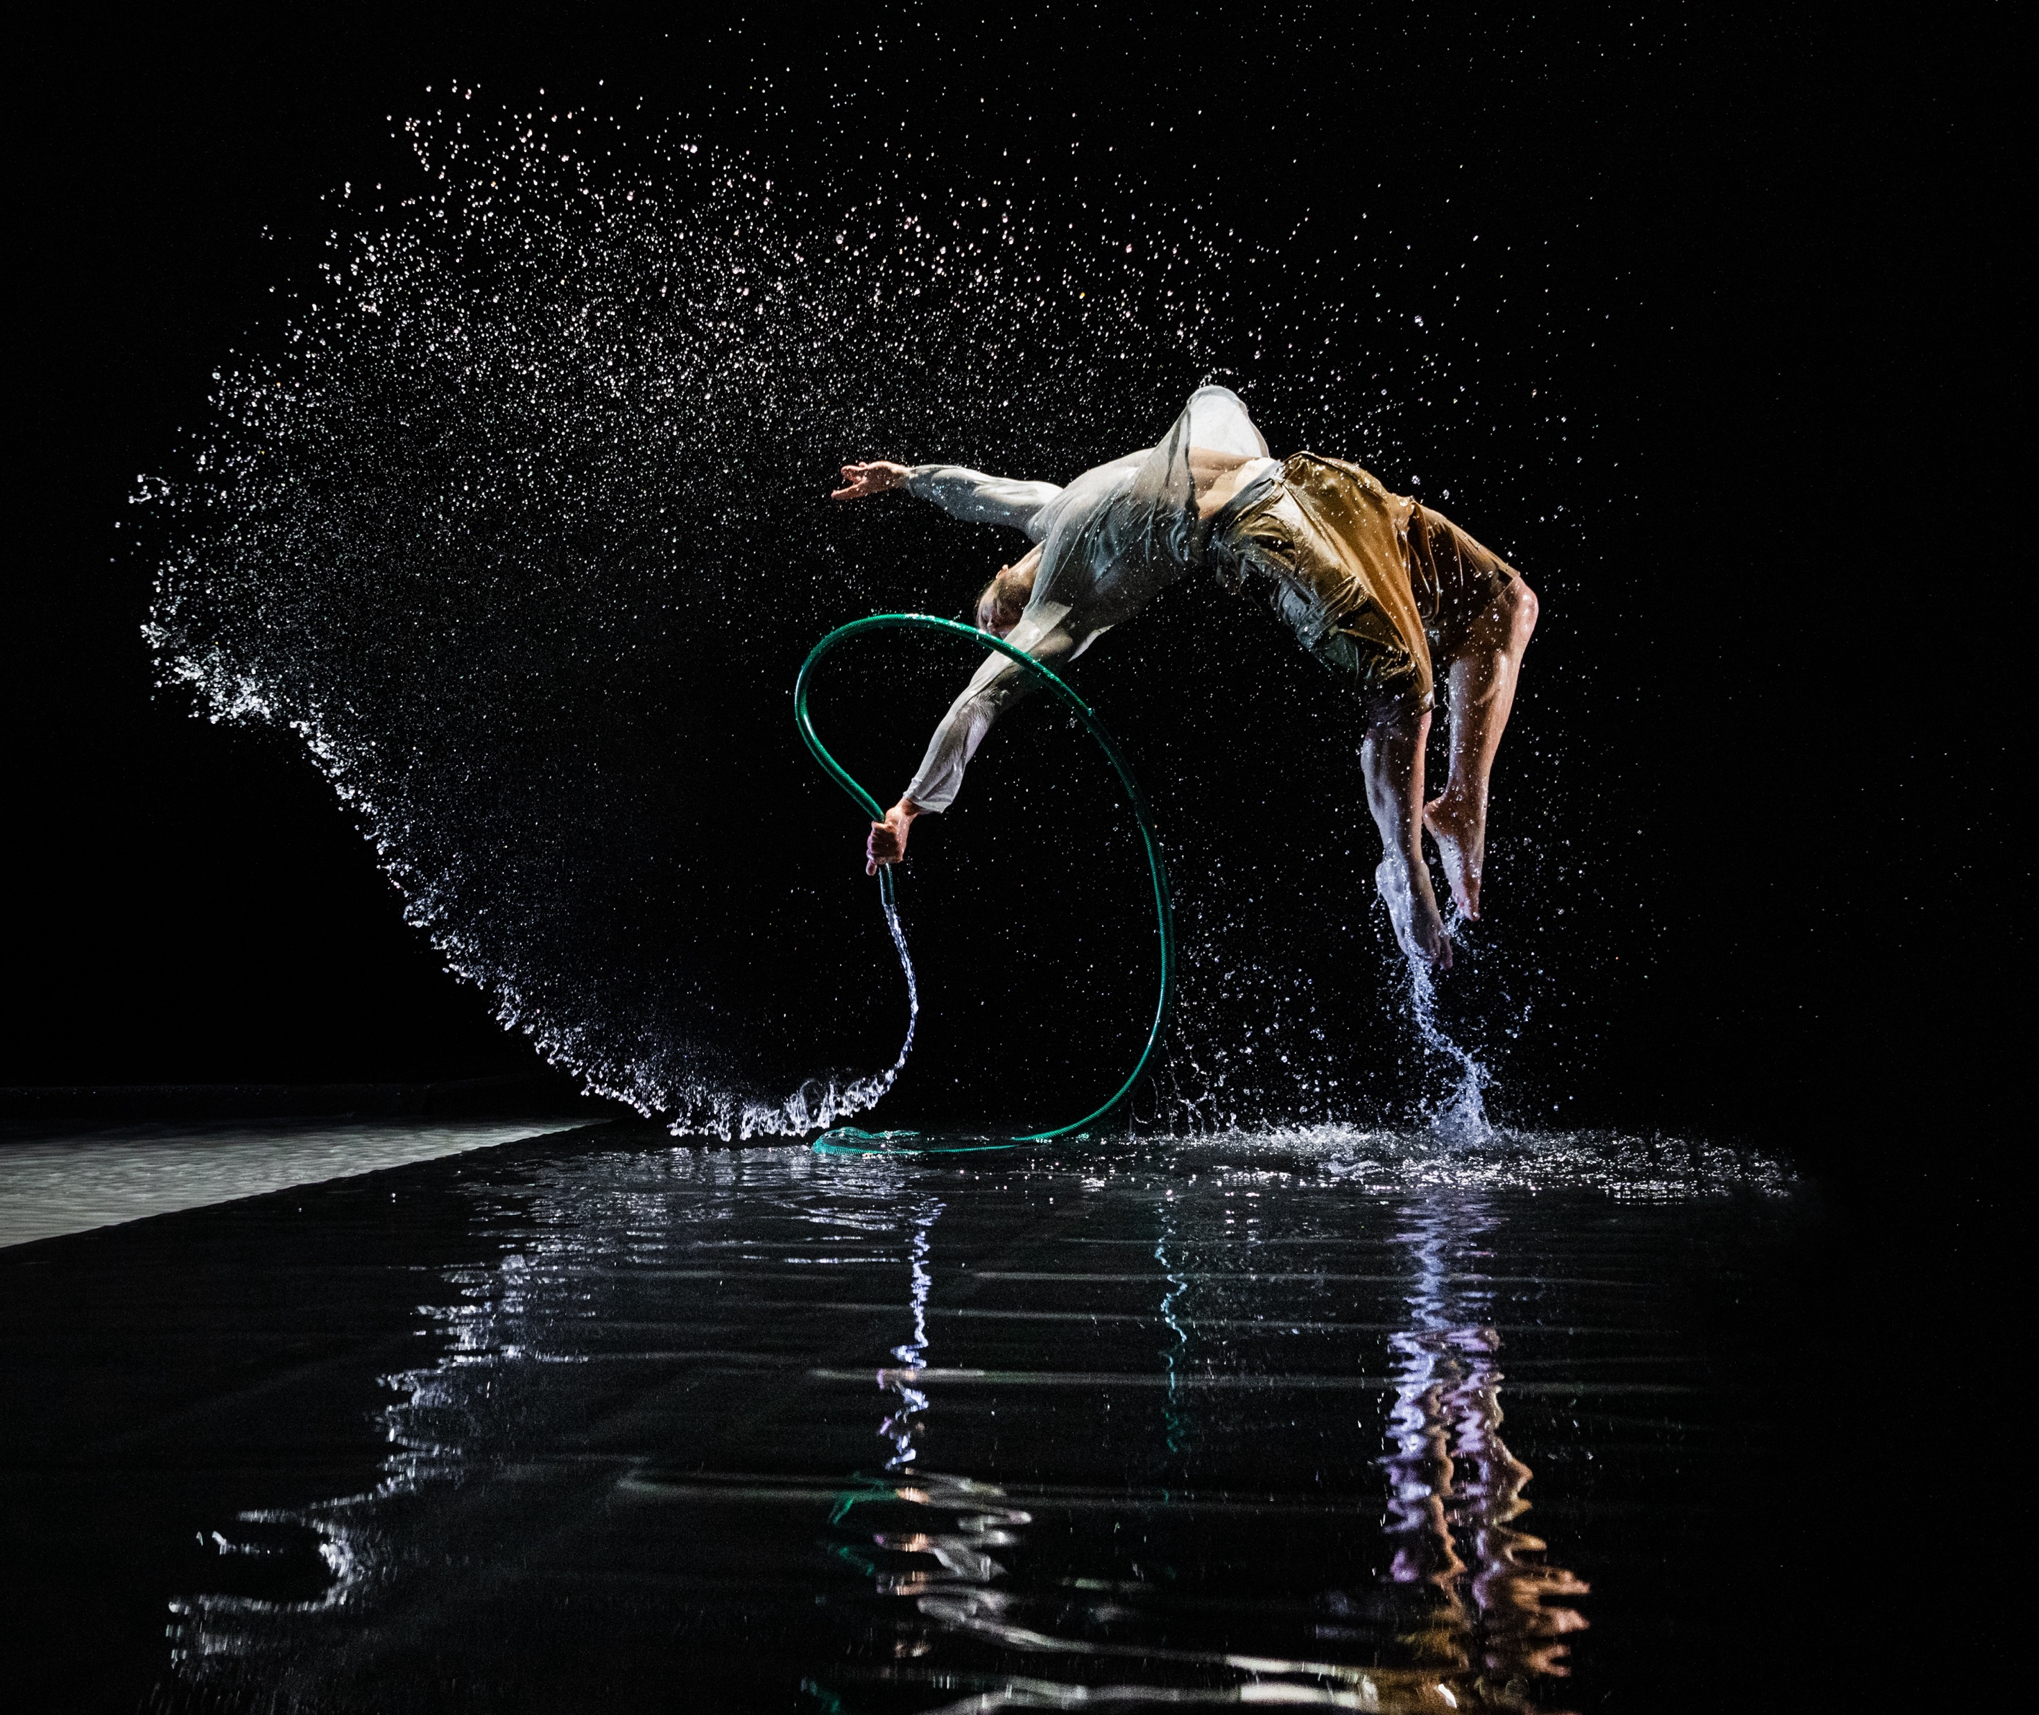
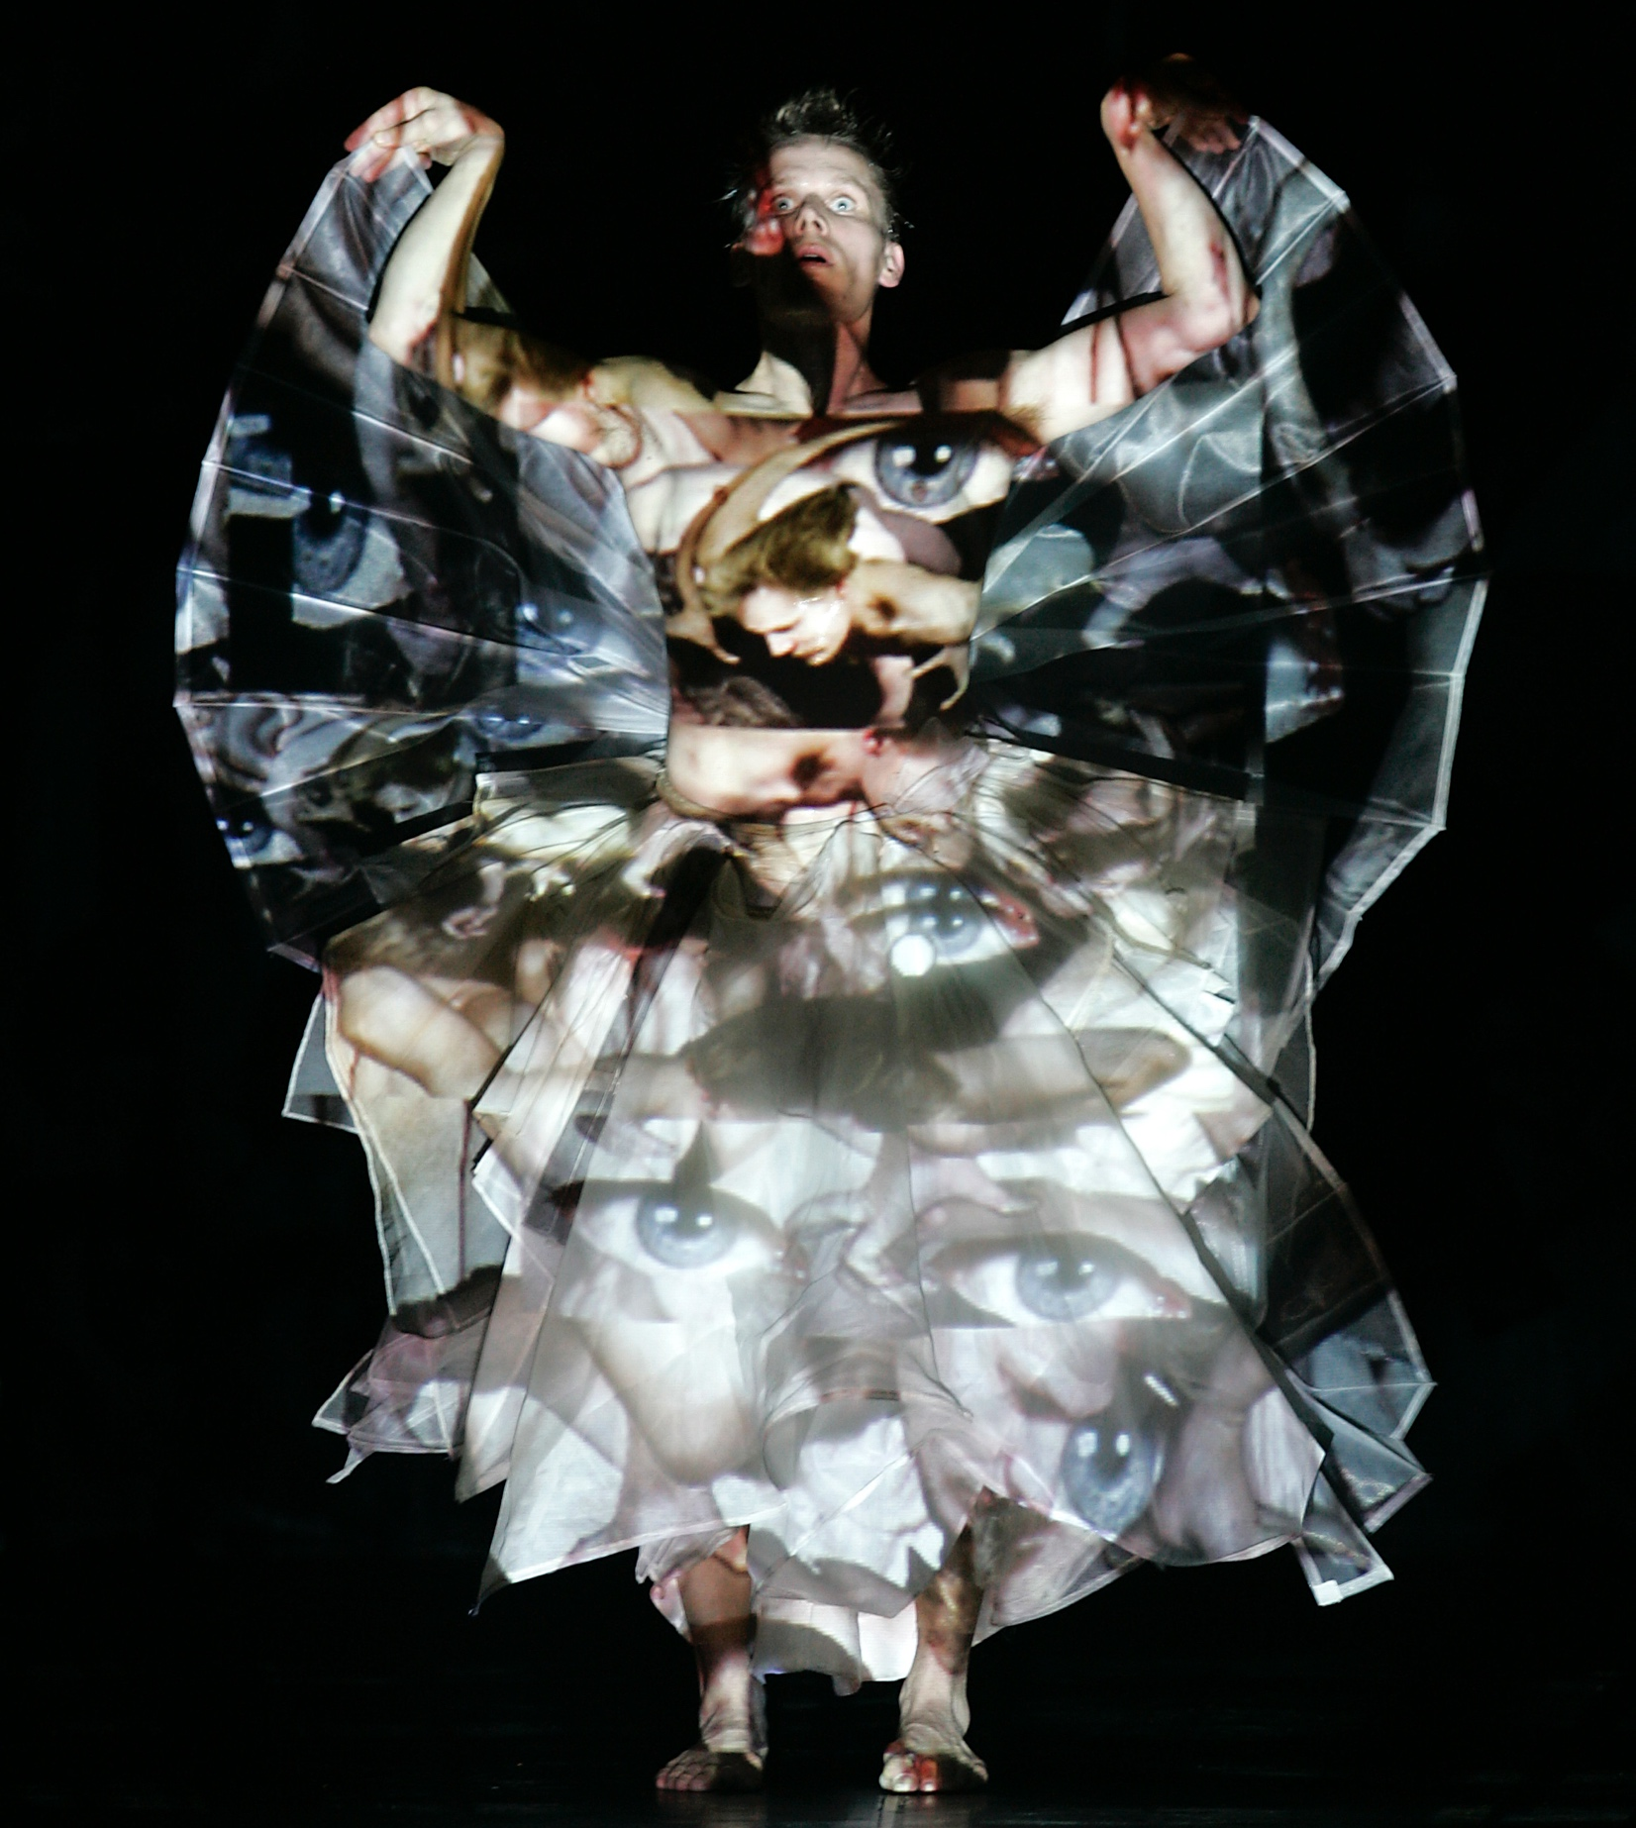
We put lighting and sound in the spotlight.
FINNISH DANCE IN EIGHT STEPS
1
2
3
4
5
6
7
8
Visual design is an essential element in Finnish dance.
Lighting, sound and costume design are crafted at the highest level.
Visually striking, MimoArt Company’s Pipes & Hoses (2024) is a spectacle with a stage filled with 2,000 litres of water. Photo: Kai Kuusisto
Tero Saarinen Company & TTT theatre: Macbeth, 2024. Photo: Mikki Kunttu
Broas & Nyberg: Designing the End, 2021. Photo: Sanna Lehto
Tero Saarinen's HUNT (2002) is considered one of the most significant contemporary interpretations of Stravinsky's The Rite of Spring. Photo: Laurent Philippe
Notes:
There’s a strong design culture in Finland, and it also shows in dance. The higher education system trains choreographers alongside sound and lighting designers, resulting in cohesive, atmospheric productions.
Minimalist aesthetics and poetic lighting are signature traits. New technologies – projections, sensors, immersive sound – are used thoughtfully, often to explore emotional or philosophical layers.
The long Finnish winters and bright summers seem to create a unique sensitivity to space, light and rhythm.

Slide 15
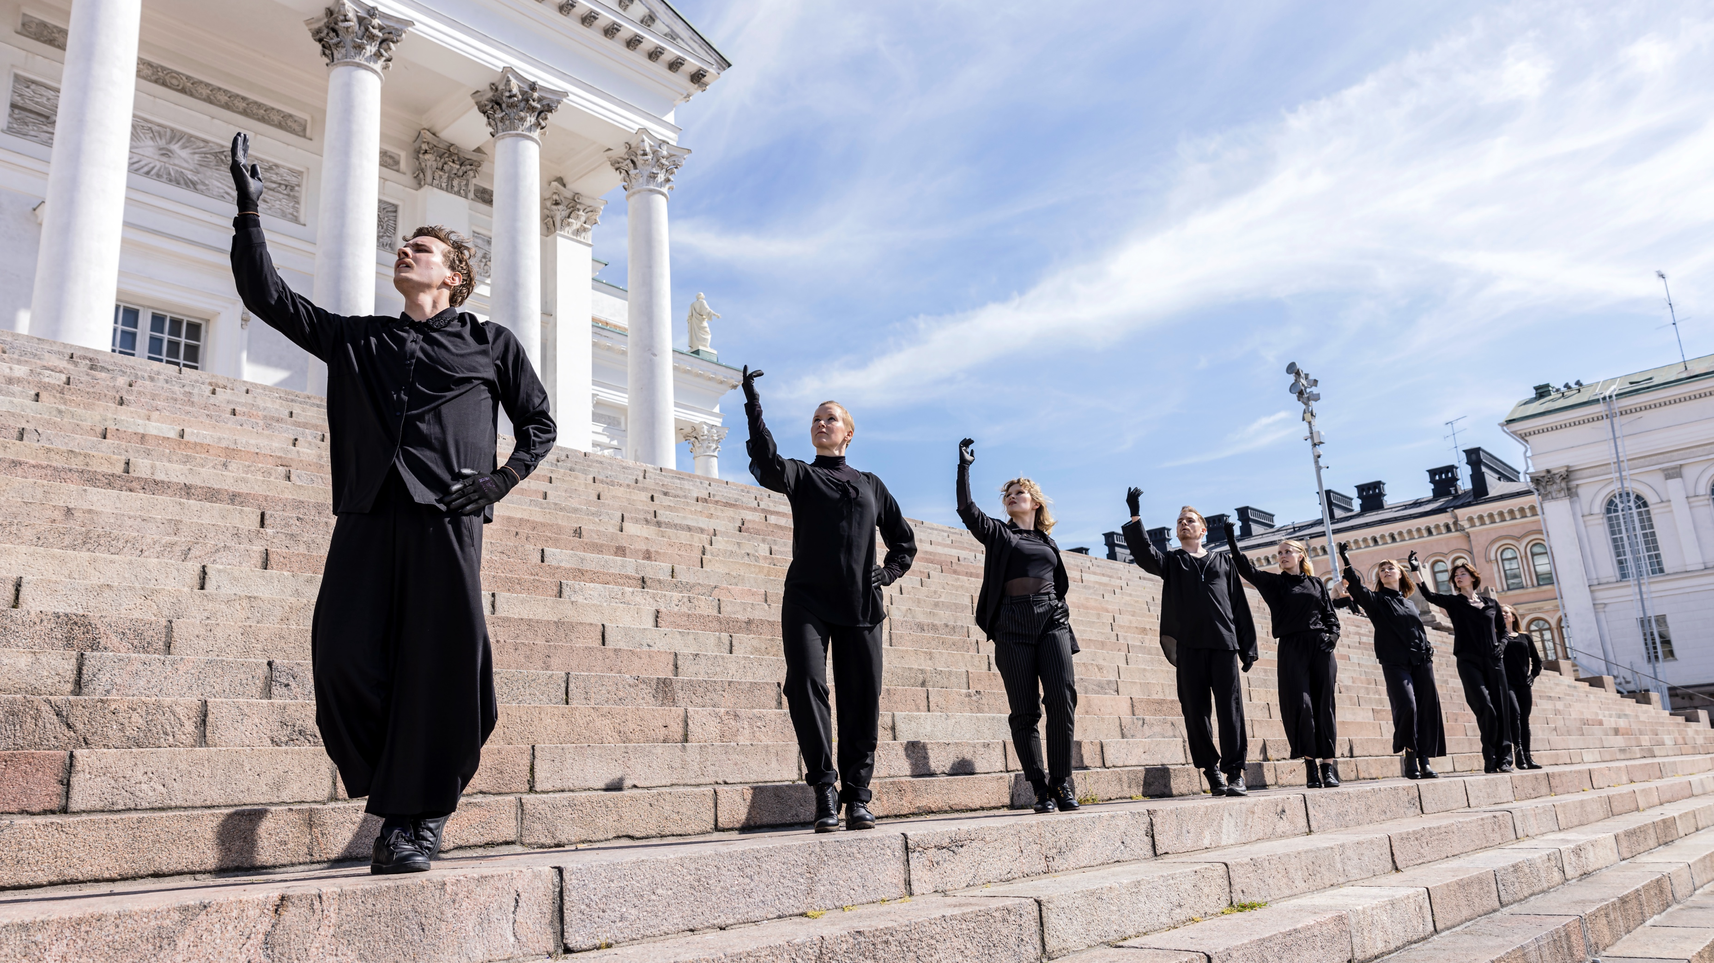
7/8
It’s not just dance. It’s a conversation between art forms.
Ismo Dance Company: Anybody's Architecture, Senate Square Stairs in Helsinki, 2022. Photo: Minna Hatinen
Notes:
Multidisciplinary work is a defining feature of Finnish dance. Artists collaborate across art forms, creating performances that feel like living sculptures, sonic journeys or visual feasts.
Live music often accompanies dancers, and site-specific works transform unexpected spaces – like an abandoned oil tank. Urban performances interact with architecture and invite passers-by into the art.
This blending reflects the complexity of our world – and reaches audiences seeking depth and new forms.

Slide 16
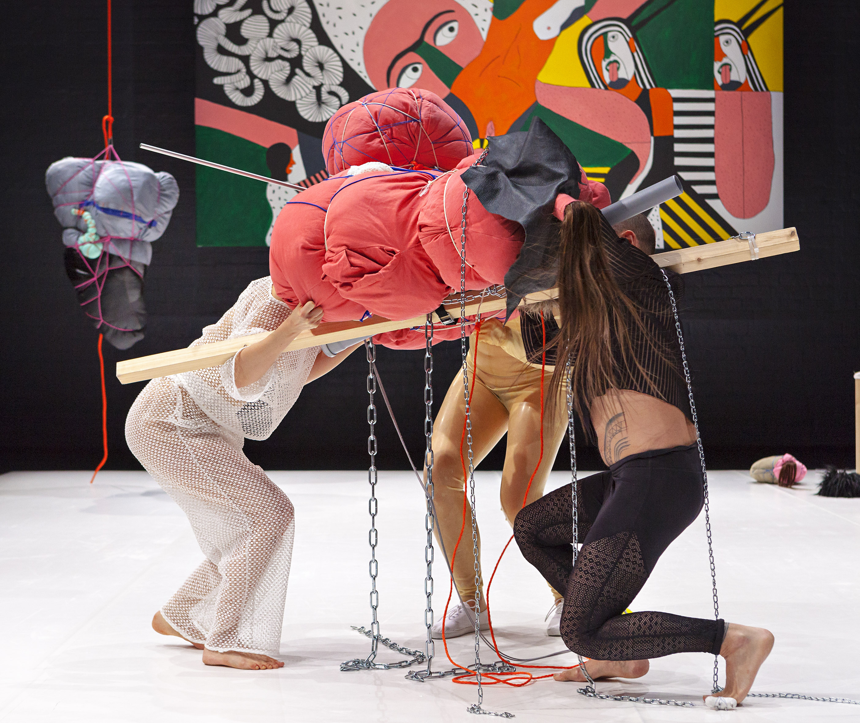
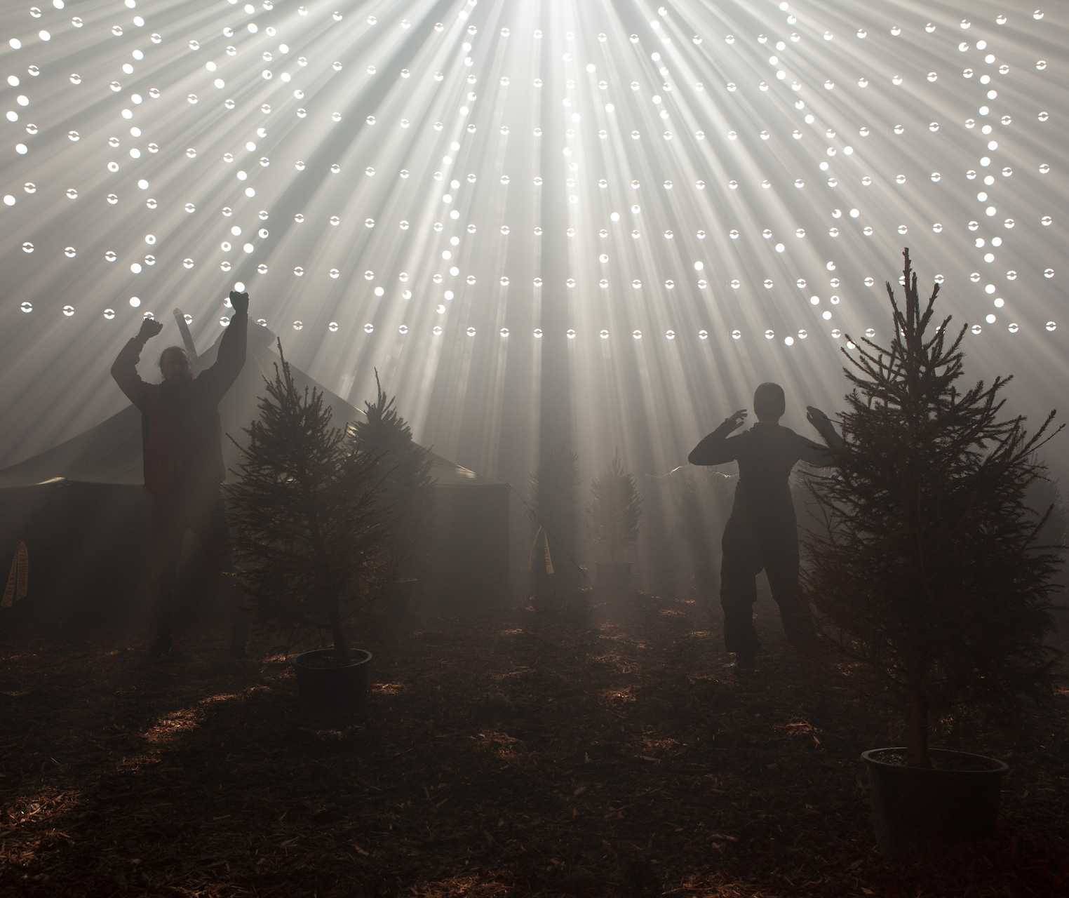
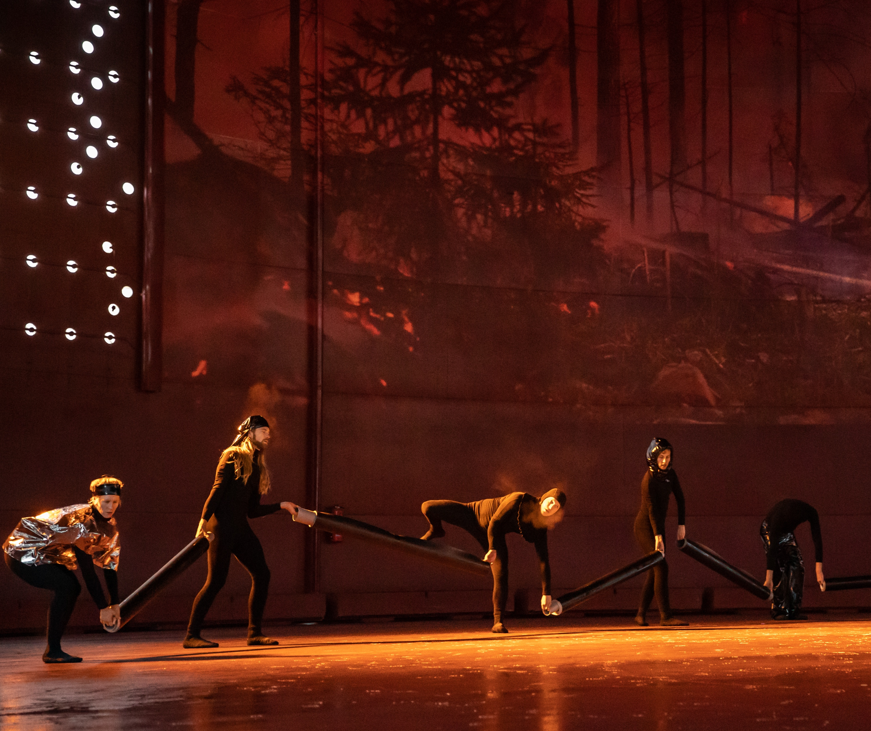
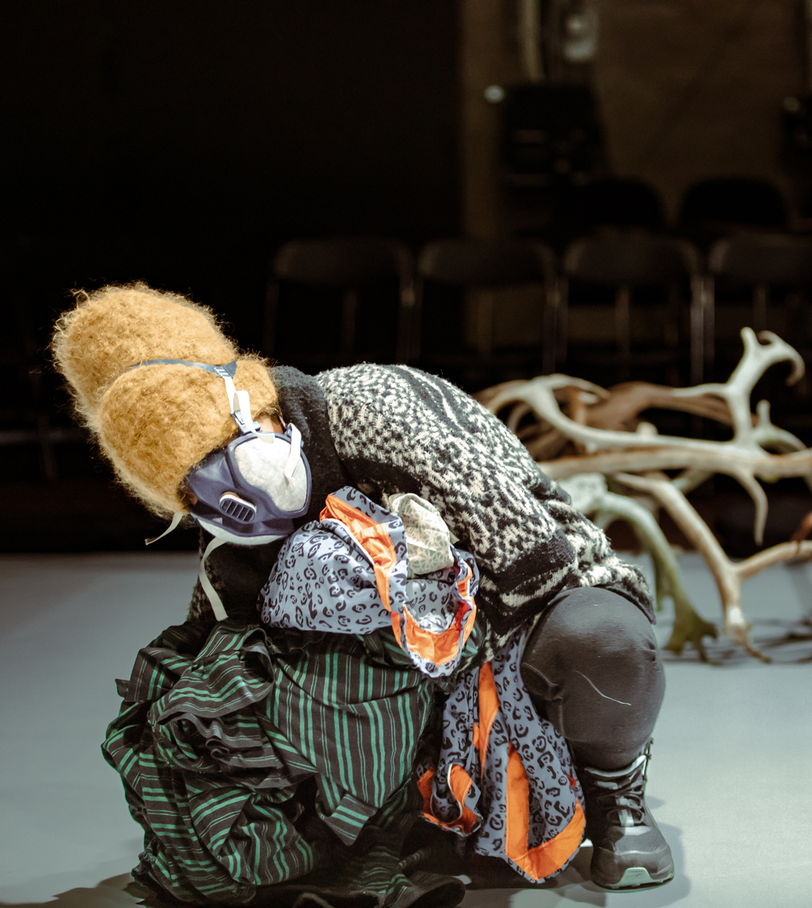
It’s not just dance. It’s a conversation between art forms.
FINNISH DANCE IN EIGHT STEPS
1
2
3
4
5
6
7
8
Finnish dance embraces collaboration with other art forms.
Genres blend and boundaries become invitations.
Valtteri Raekallio: Uraanilamppu – based on Harry Salmenniemi’s short stories, 2021. Photo: Valtteri Raekallio / Zodiak – Centre for New Dance
Lehtovaara & Ahtila & Hietanen: Nature Untitled, 2022. Photo: Sinem Kayacan / Zodiak – Centre for New Dance
Sonja Jokiniemi: Blab, 2017. Photo: Simo Karisalo / Zodiak - Centre for New Dance
Pauliina Feodoroff: Matriarchy. Photo: Sinem Kayacan / Zodiak - Centre for New Dance
Notes:
Multidisciplinary work is a defining feature of Finnish dance. Artists collaborate across art forms, creating performances that feel like living sculptures, sonic journeys or visual feasts.
Live music often accompanies dancers, and site-specific works transform unexpected spaces – like an abandoned oil tank. Urban performances interact with architecture and invite passers-by into the art.
This blending reflects the complexity of our world – and reaches audiences seeking depth and new forms.

Slide 17

8/8
Finnish dance celebrates strong female voices.
Janina Rajakangas & working group: Venus, 2022. Photo: Tani Simberg
Notes:
Finnish dance is shaped by women. From Sanna Kekäläinen’s embodied politics to Sonya Lindfors’ activism and Elina Pirinen’s raw energy to Janina Rajakangas giving voice to teen-age girls on stage – women lead in artistry, institutions and innovation.
Zodiak, one of Finland’s most important contemporary dance centres, was founded by women. Many Finnish female choreographers are deeply engaged with social issues, identity and power, making their voices both aesthetic and political.

Slide 18
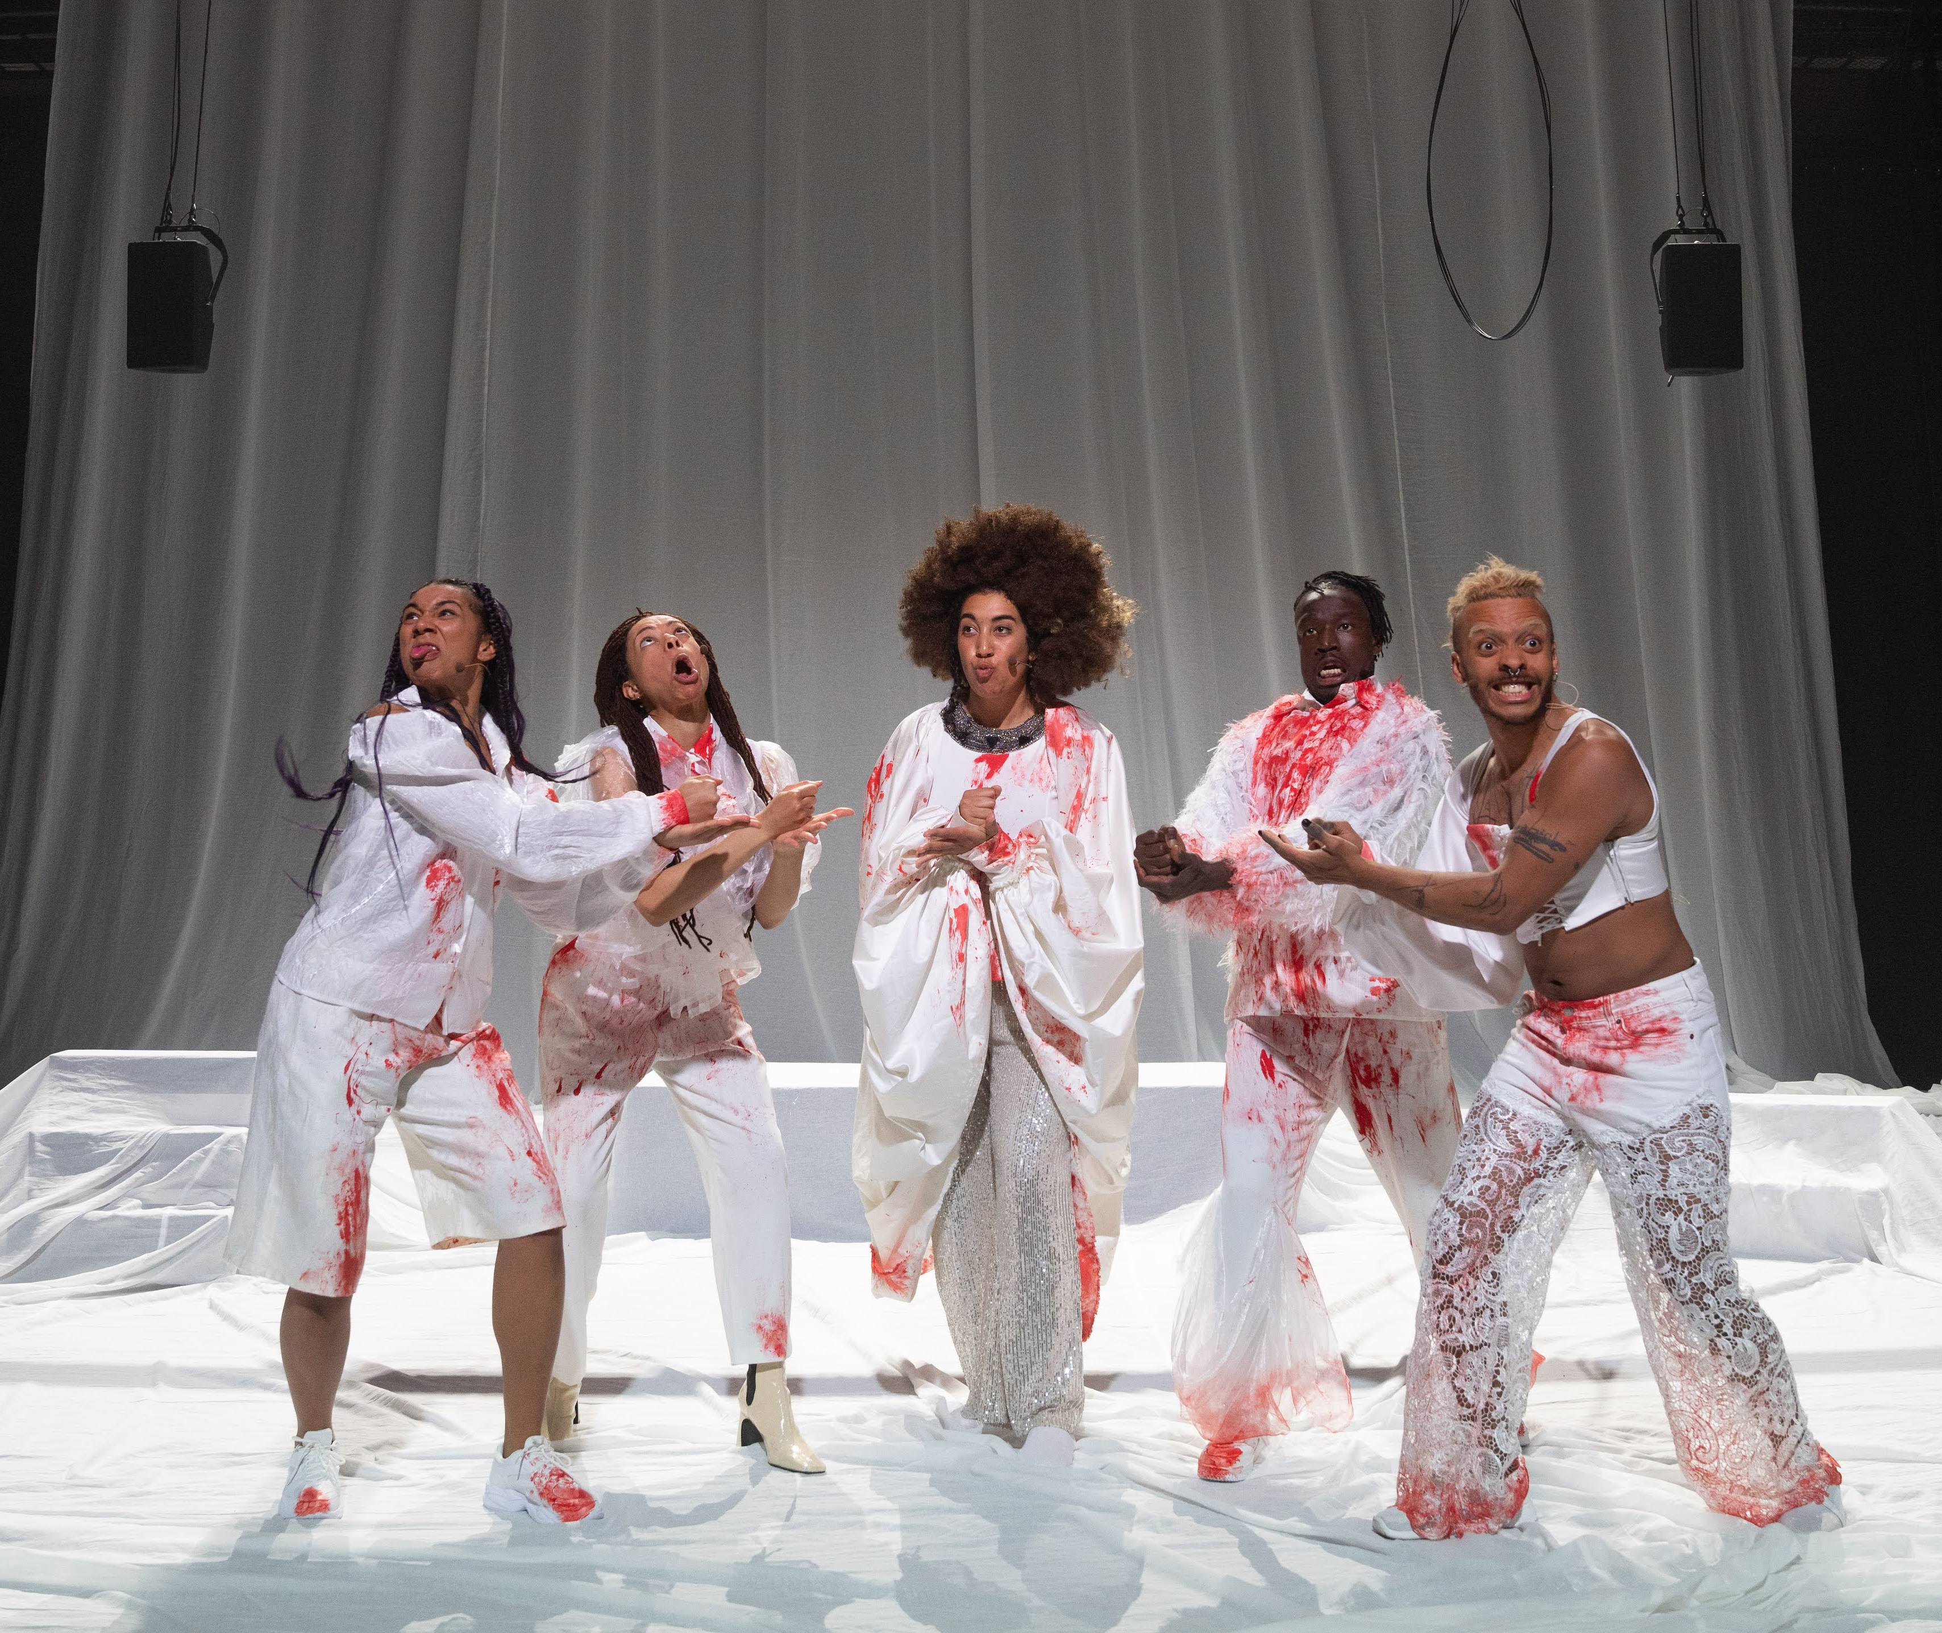
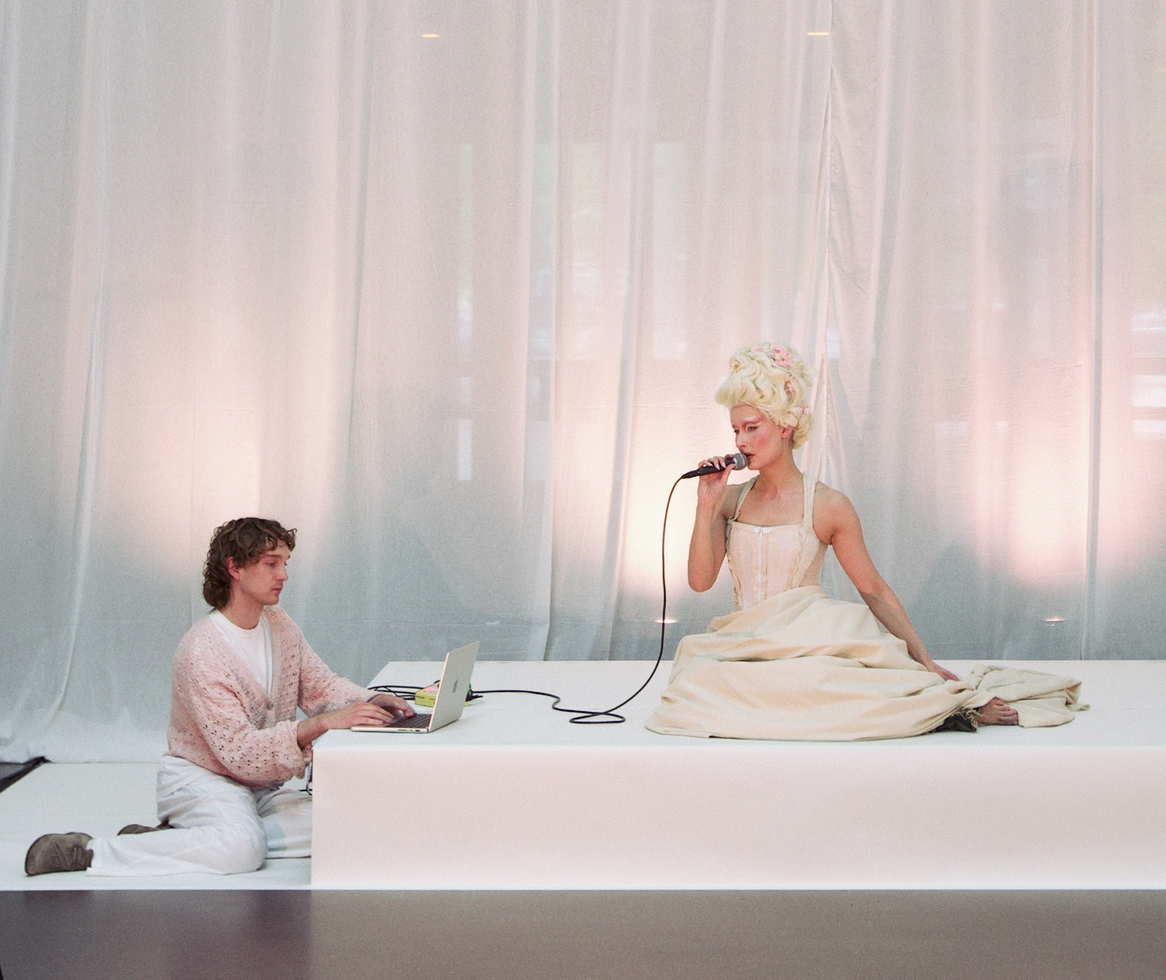
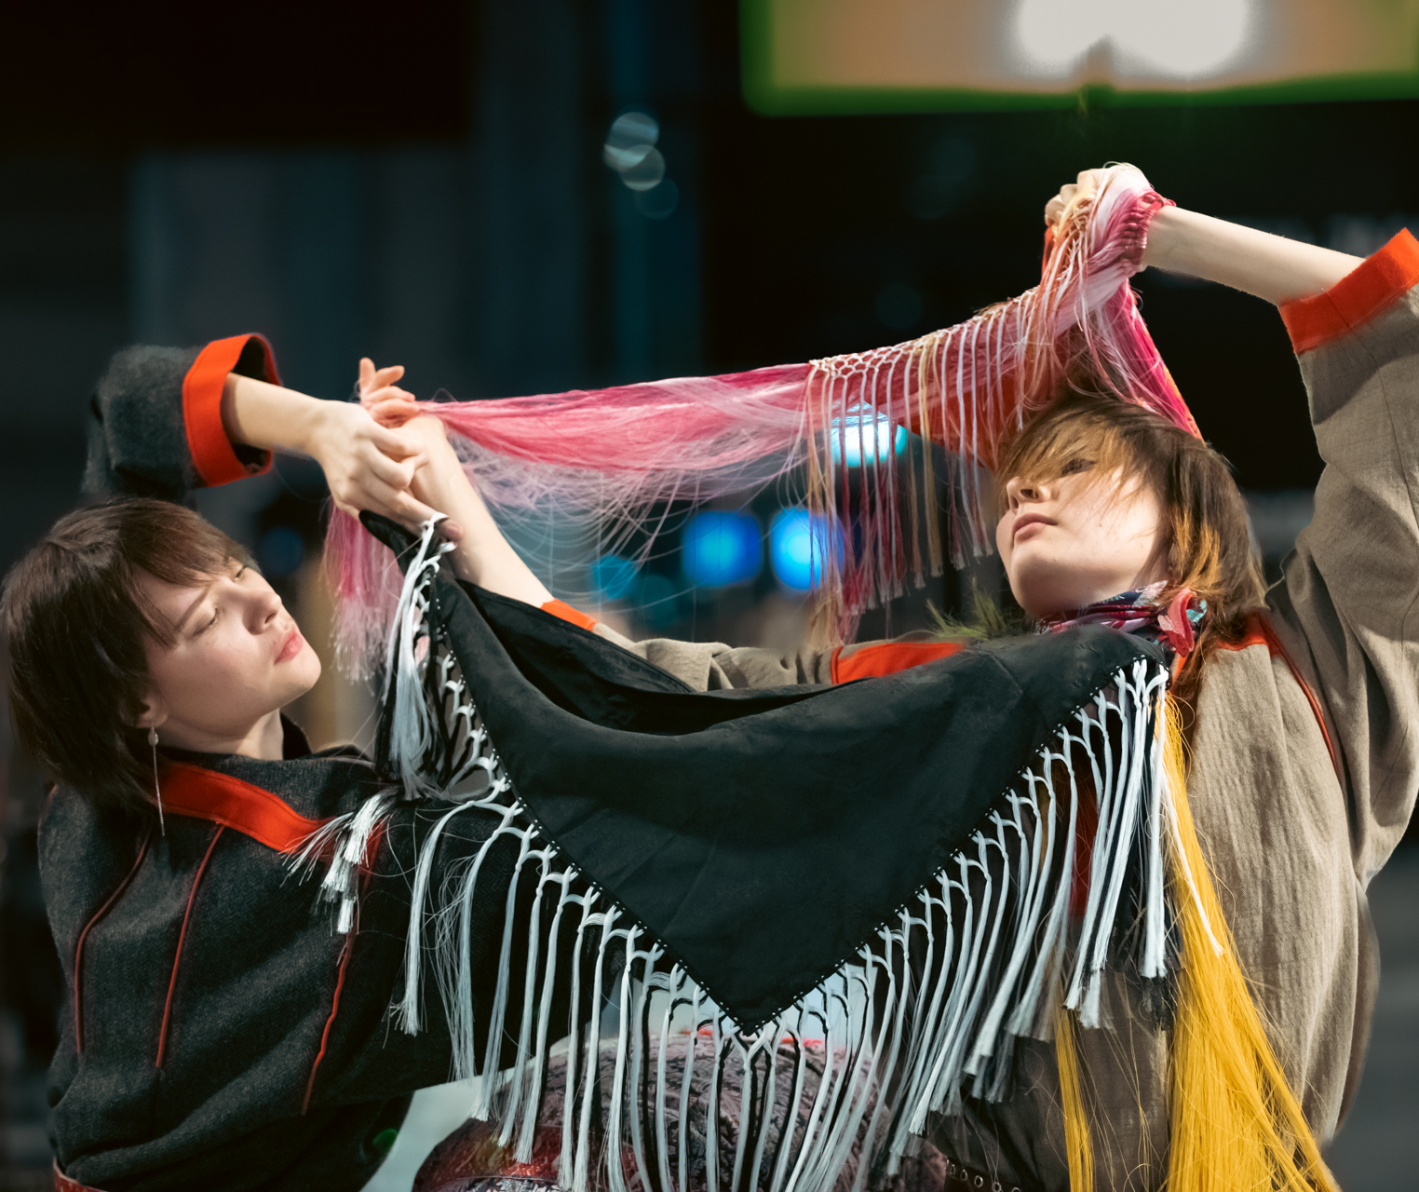
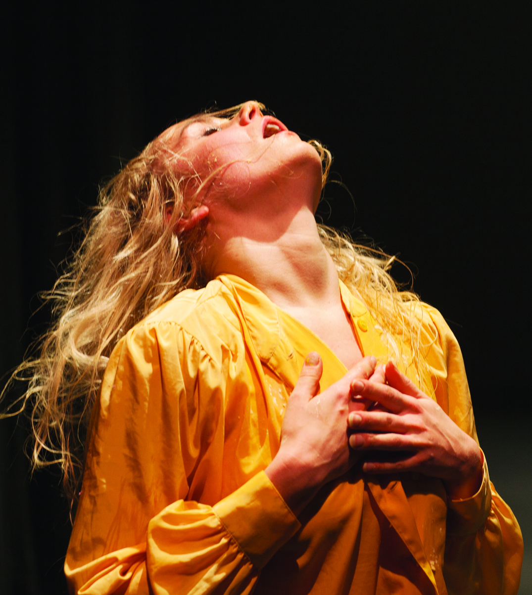
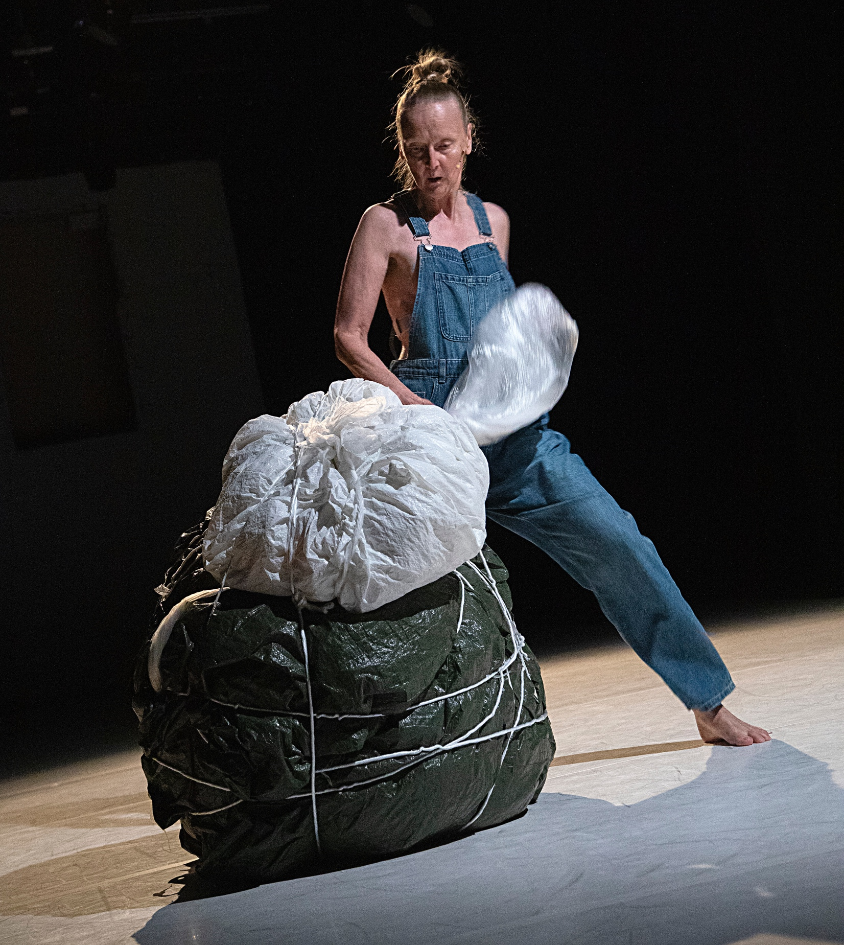
Finnish dance celebrates strong female voices.
FINNISH DANCE IN EIGHT STEPS
1
2
3
4
5
6
7
8
In Finnish dancing, women are much more than just beautiful
They are active subjects who think and act for themselves, creating political art about the (sometimes ugly) truths of this world.
Pauliina Feodoroff: Matriarchy. The performance was also presented at Venice Biennale 2022. Photo: Sinem Kayacan / Zodiak - Centre for New Dance
Sonya Lindfors: ONE DROP, 2023. Photo: Tuukka Ervasti
Elina Pirinen: Personal Symphonic Moment. Photo: Timo Wright / Zodiak - Centre for New Dance, 2013.
Tiia Kasurinen: Songbird, 2025. Photo: Saara Taussi
Sanna Kekäläinen was one of the founders of Zodiak - Center for New Dance, in 1986.
Kekäläinen & Company: A Friend from Ethiopia, 2025. Photo: Harri Hinkka.
Notes:
Finnish dance is shaped by women. From Sanna Kekäläinen’s embodied politics to Sonya Lindfors’ activism and Elina Pirinen’s raw energy to Janina Rajakangas giving voice to teen-age girls on stage – women lead in artistry, institutions and innovation.
Zodiak, one of Finland’s most important contemporary dance centres, was founded by women. Many Finnish female choreographers are deeply engaged with social issues, identity and power, making their voices both aesthetic and political.

Slide 19
11/10
9/8
An extra skylight
with views to
common ground.
The Final Bow

Slide 20
The Final Bow.
FINNISH DANCE IN EIGHT STEPS
1
2
3
4
5
6
7
8
9
Any note
can be written here.
This is a place for
more detailed information. You can use this page to highlight connections between Finnish dance and your country, shared projects, or even interesting upcoming events.
Photo: xxx
Notes:
Tähän osioon voi koota vastaanottajan ja tilanteen mukaan personoitavia asioita, toki tanssikulman huomioiden.

Slide 21
The show is over. Shall we take the next steps together?

