Slide 1

MAKING HAPPINESS HAPPEN
Photo: Julia Kivelä / Helsinki Partners
FINLAND’S COUNTRY BRAND STRATEGY

Slide 2
A well-established country brand strengthens Finland’s global position and long-term success – from diplomacy and trade to travel and talent attraction. It builds trust in Finland’s capabilities, increases visibility, and offers resilience in a changing world. In good times, it opens doors; in challenging times, it offers protection.

Slide 3
Building and maintaining a strong country brand requires consistent messaging and across-the-board alignment nationally. Finland’s country brand strategy aims to ensure that decision-makers, stakeholders in all sectors, and everyone contributing to Finland’s story share a clear understanding of Finland’s key strengths and narrative. This helps support and guide both promotion and policy, and safeguards Finland’s role and relevance in a rapidly changing world.

Slide 4
With the six building blocks contained in this strategy, we position Finland as a country that makes happiness happen – both at home and internationally.

Slide 5
1. THE CORE MESSAGE
Finland makes happiness happen
Finland is built on trust, equality, freedom, andfunctionality. Life is well designed for living, solutions are smart and sustainable, and people have the space — and permission — to be themselves. This is how happiness happens: not by accident, but by design.

Slide 6
2. WHAT FINLAND VALUES
Equality and freedom
Fairness and the freedom to live a life that reflects who you are. Trust and reliability
A way of working and living where words match actions, and people trust each other and institutions.
Creativity and curiosity
A culture of open-minded exploration and discovery.
Nature and balance
A lifestyle shaped by nature and a pace of living that leaves room for your own priorities.
Frame what Finland offers as people-first, purposeful, and made to support both everyday life and innovative ideas.

Slide 7
3. WHAT FINLAND OFFERS
Responsible real-world impact
Smart, sustainable and meaningful solutions that put people first and make a difference where it counts.
Simplicity, surprise and sauna
A lifestyle that supports balance, embraces quirkiness, and finds happiness in everyday experiences.
Freedom to grow
A safe and open environment where ideas matter more than titles, and taking a risk doesn’t mean going it alone.
Tools for what’s next
Education, curiosity and competence to meet change with confidence, and play a part in shaping the future.
Show these values in action — not just in words, but in how things are done.

Slide 8
4. HOW FINLAND COMMUNICATES
By being honest and approachable Speak with integrity and warmth. Avoid exaggeration and hype. With character Clear doesn’t mean dull; wit and a touch of the unexpected go a long way. By substance over spin Be informative, and focus on usefulness and purpose. With many voices Represent Finland through diverse people, perspectives and places.
Communicate with substance, transparency, and confidence.
Dare to be playful, and deliver on your promises.

Slide 9
5. HOW FINLAND CONNECTS
By telling real stories Relatable stories and human perspectives spark connection. Inspire more than just admiration – inspire discovery. With culture that resonates Culture creates meaning, builds recognition, and helps Finland connect emotionally. Use it to express Finland’s identity in ways words alone can’t. By making it relevant Show people how Finland fits into what they care about. Connection happens when people see why something matters to them. Through collaboration Finland’s brand is not a campaign, it’s a long-term relationship. Instead of just presenting Finland, look for shared goals and build partnerships.
Create connection by inviting, not insisting. Be relevant and relatable, and leave a lasting impression with culture.

Slide 10
6. FINLAND’S STORY IS YOURS
Make it personal Finland’s story becomes real when it’s made personal. Build on the shared story and make it your own. Make an impression Every encounter is a chance to show what Finland stands for. Your words, actions and ideas help shape how the world sees us. Make it real Show how Finland’s perspective helps you work better, connect more meaningfully, or do things differently. You are the proof. Make the most of it Finland’s values and strengths are there to support you and your message. Use what Finland has to offer for your benefit.
Telling Finland’s story is a shared responsibility — and a shared opportunity. We know Finland and what it stands for,so it’s up to us to tell it right.

Slide 11
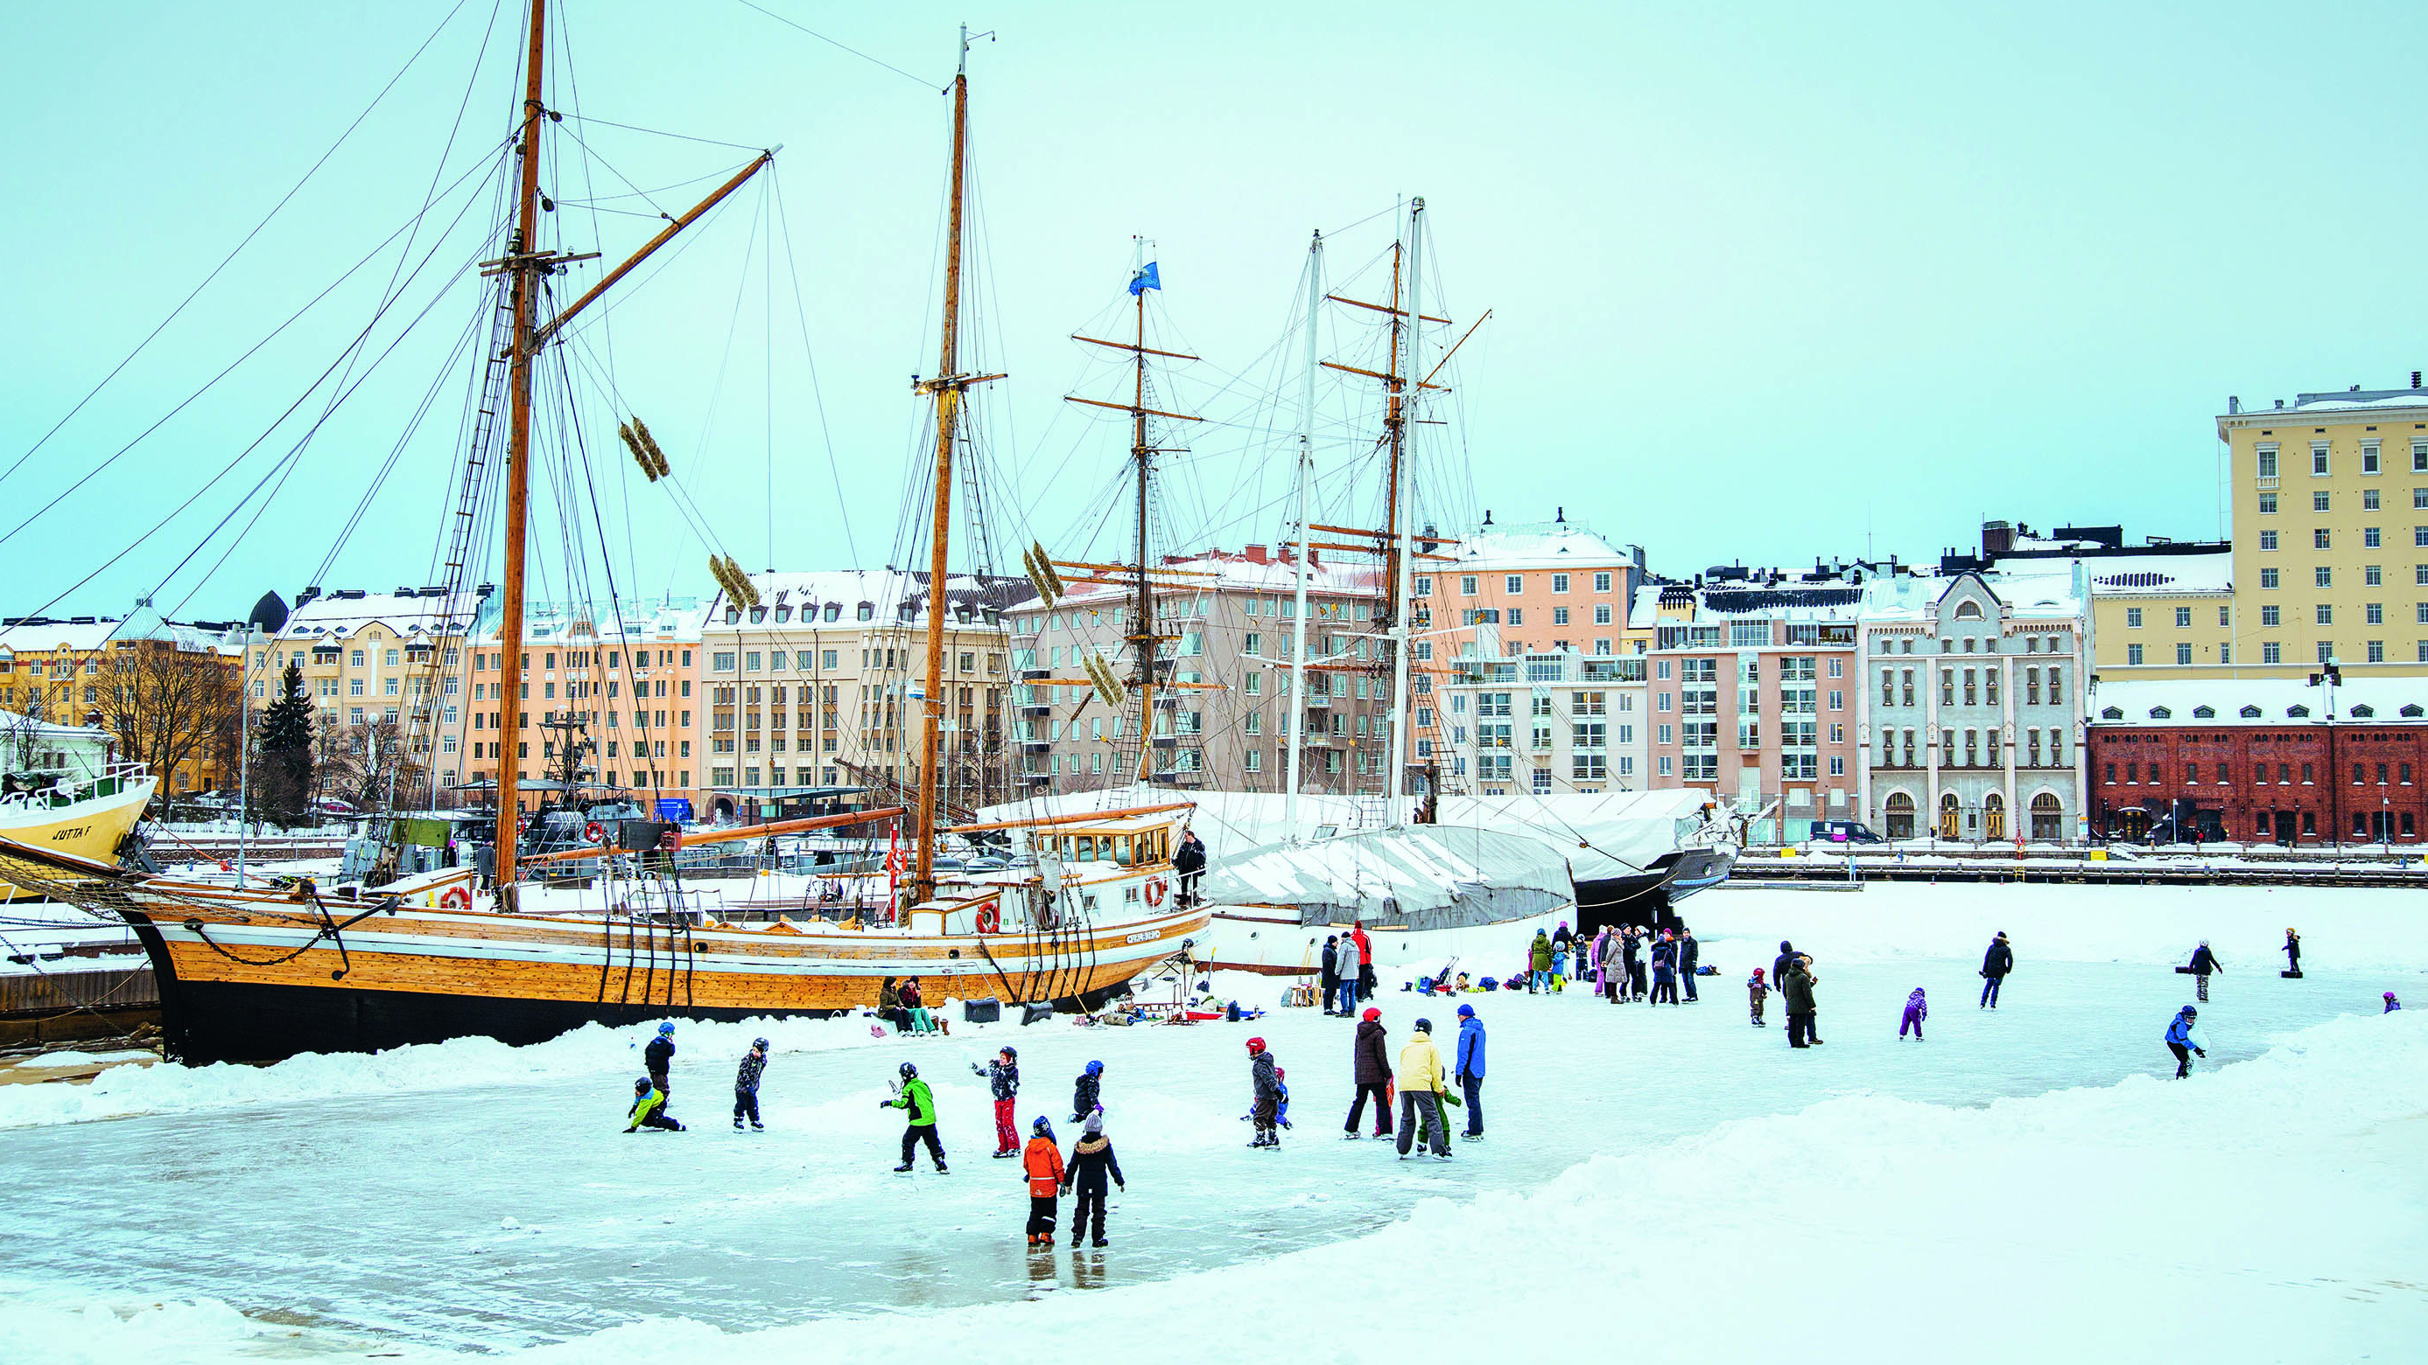
Finland Promotion Board www.finland.fi
Photo: Jussi Hellsten / Helsinki Partners

