Slide 1
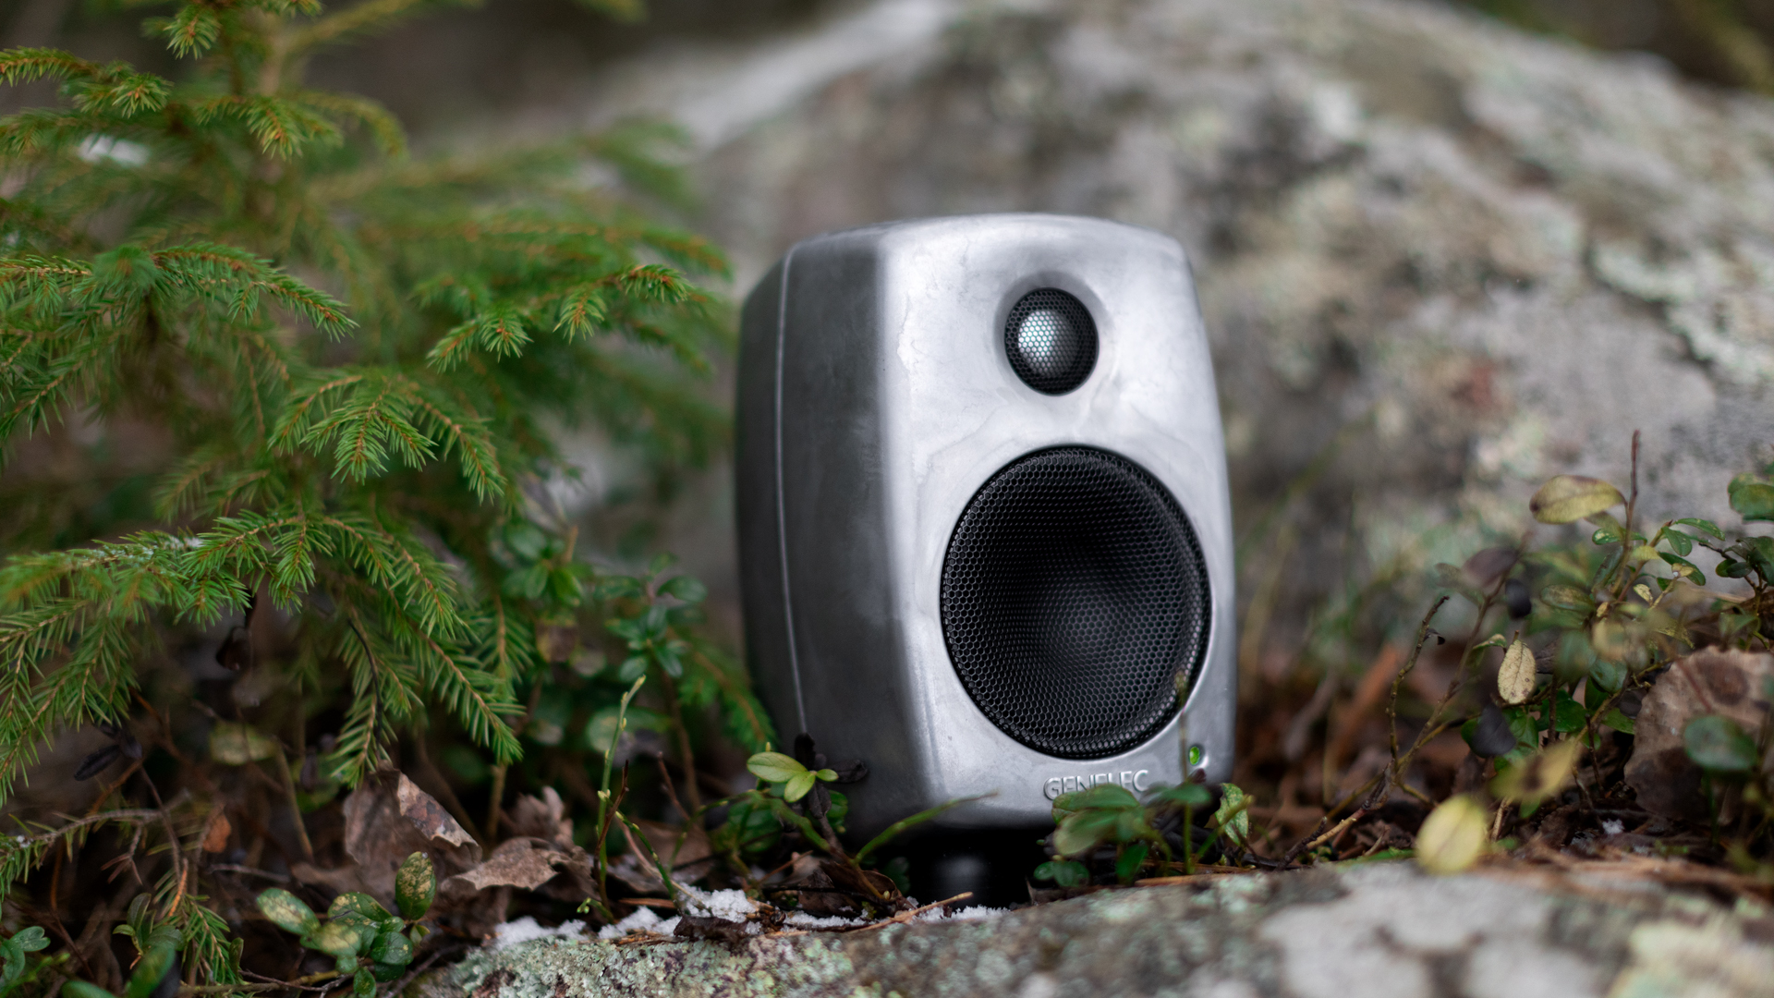

10 PATTERNS OF
FINNISH DESIGN
Photo: Genelec

Slide 2
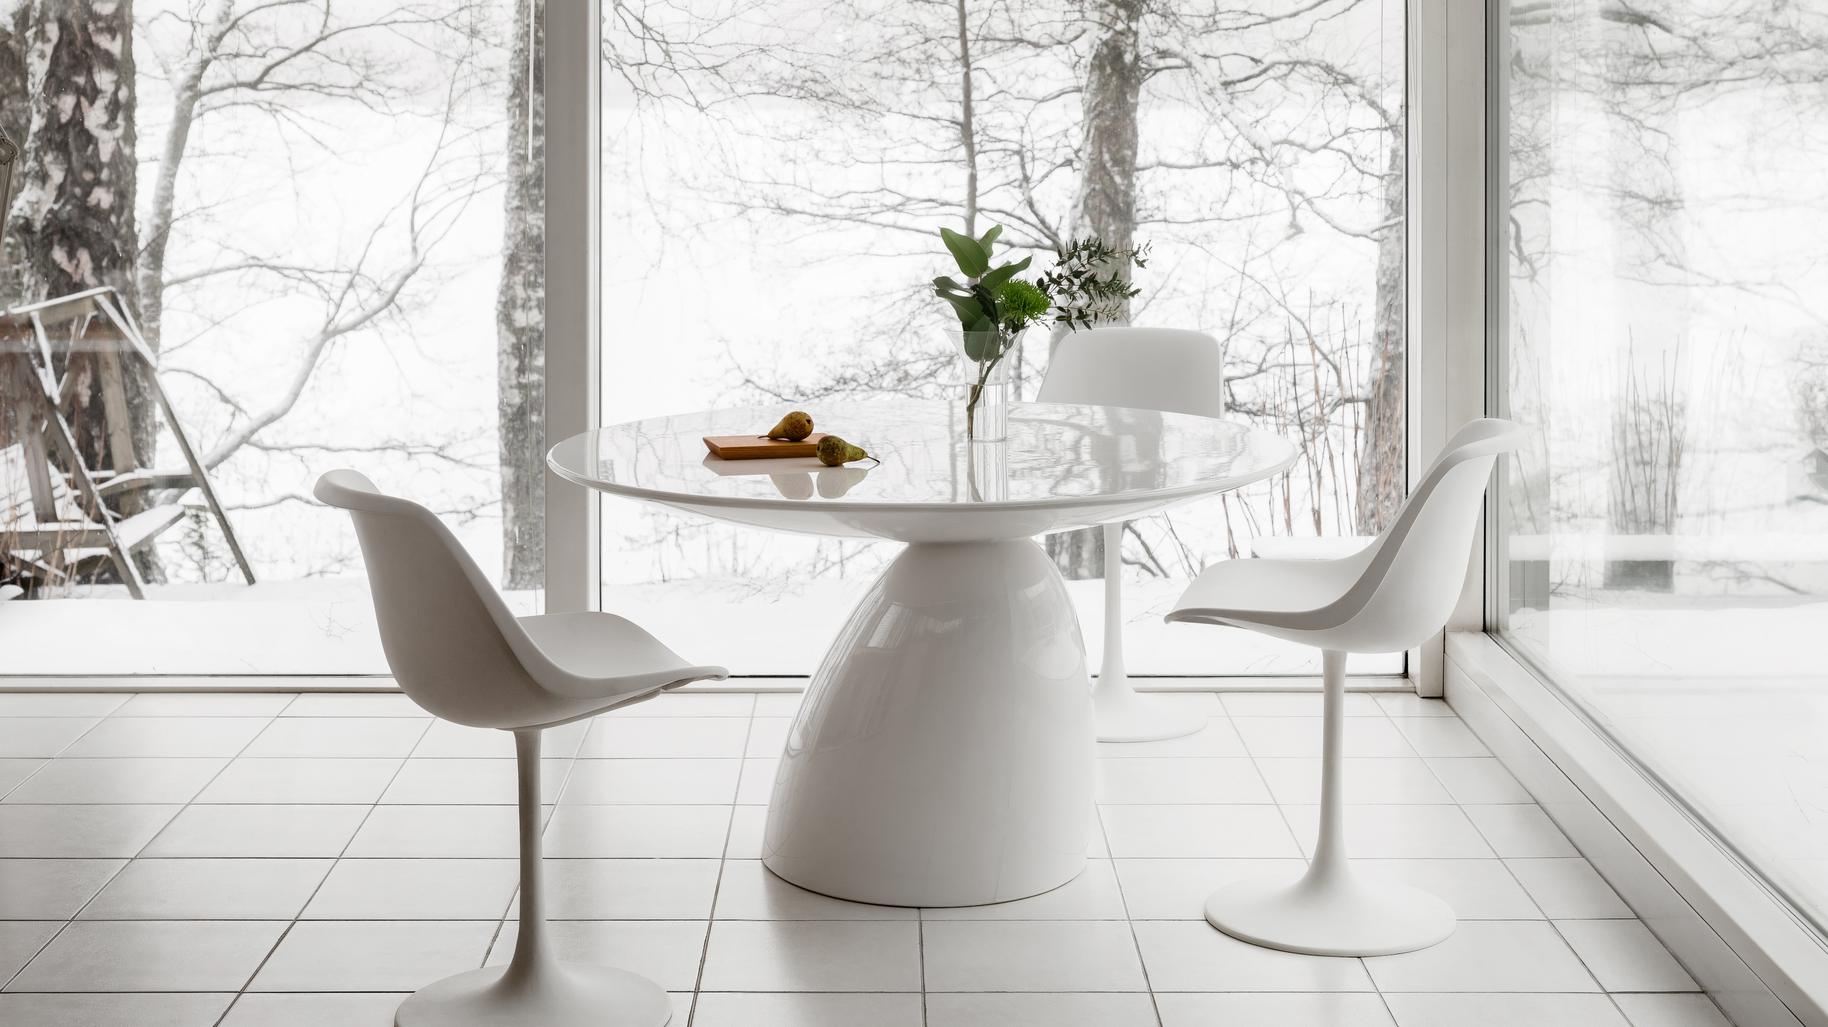
1/10
Finimalism: The essence of
Finnish design
Parabel table (1993) by Eero Aarnio, one of Finland’s most renowned designers, whose work is defined by a deep curiosity for
materials and form. “A new material gives a new form,” he says. Photo: Eero Aarnio Originals

Slide 3
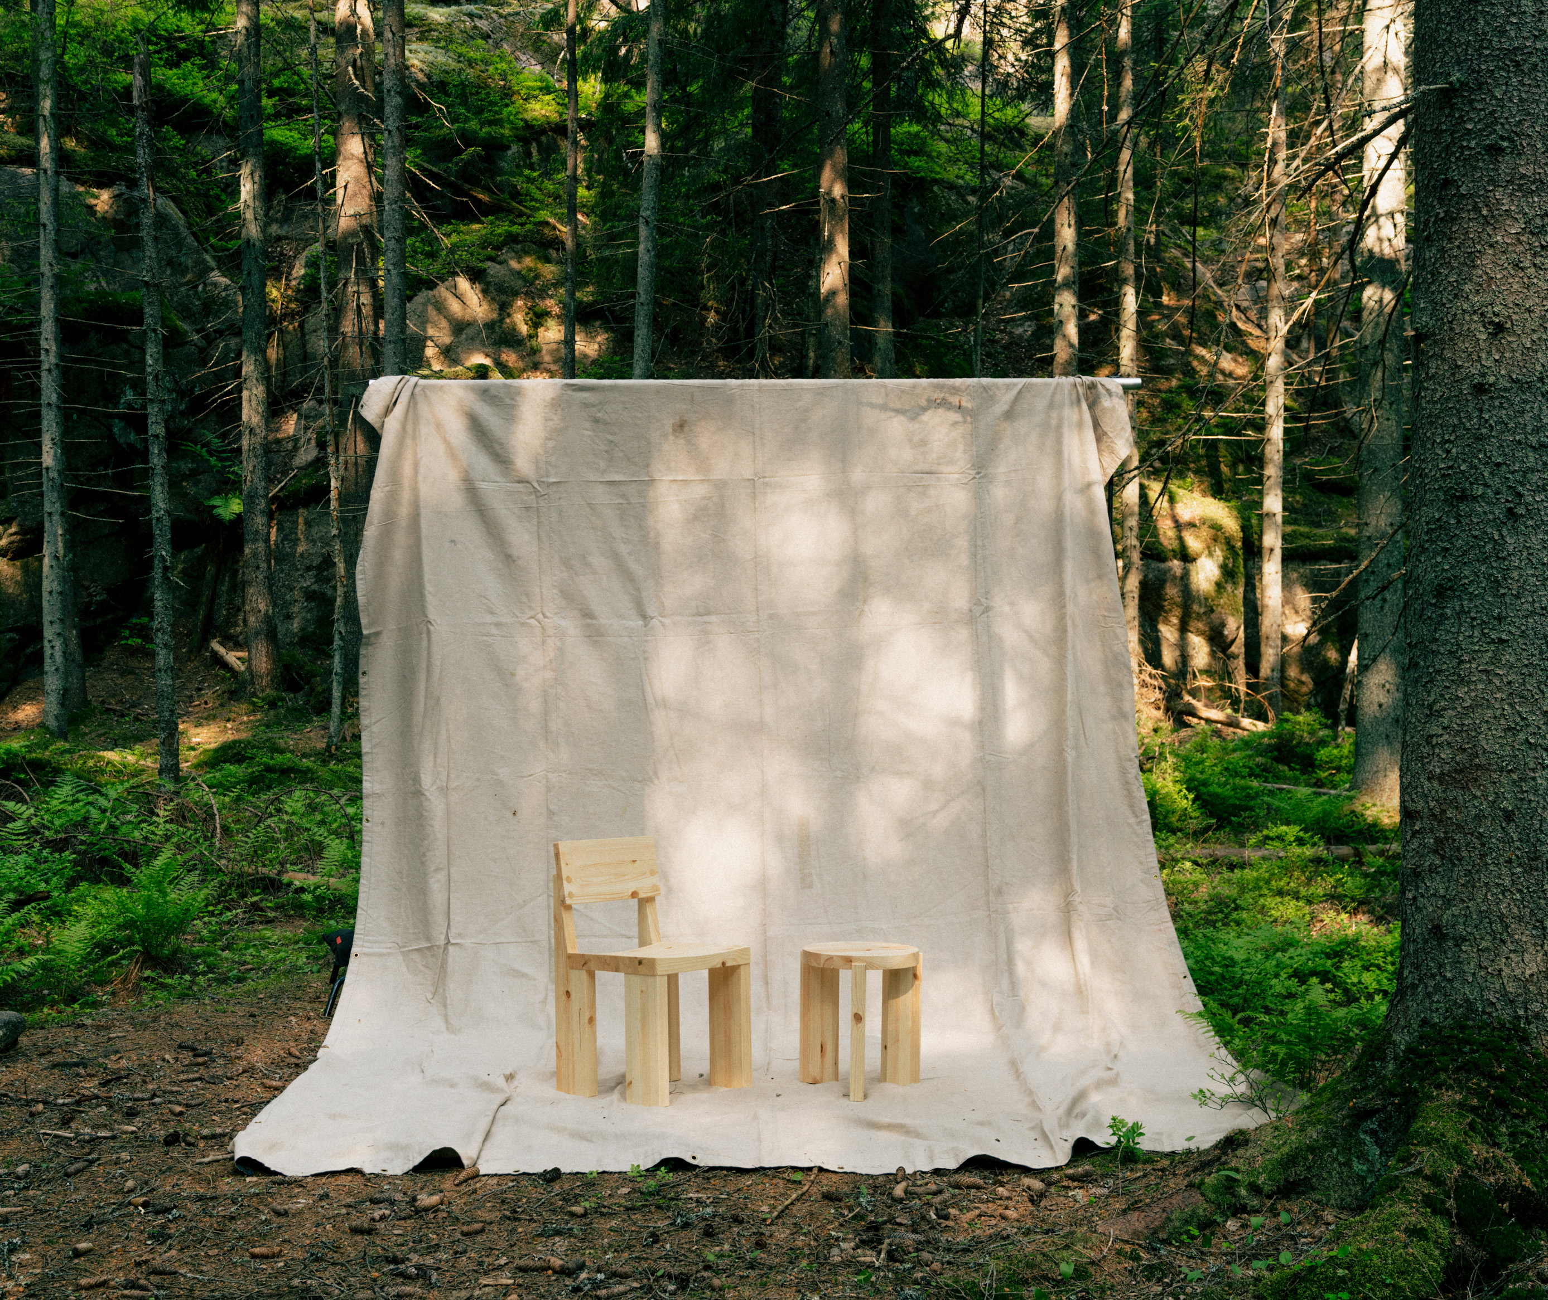
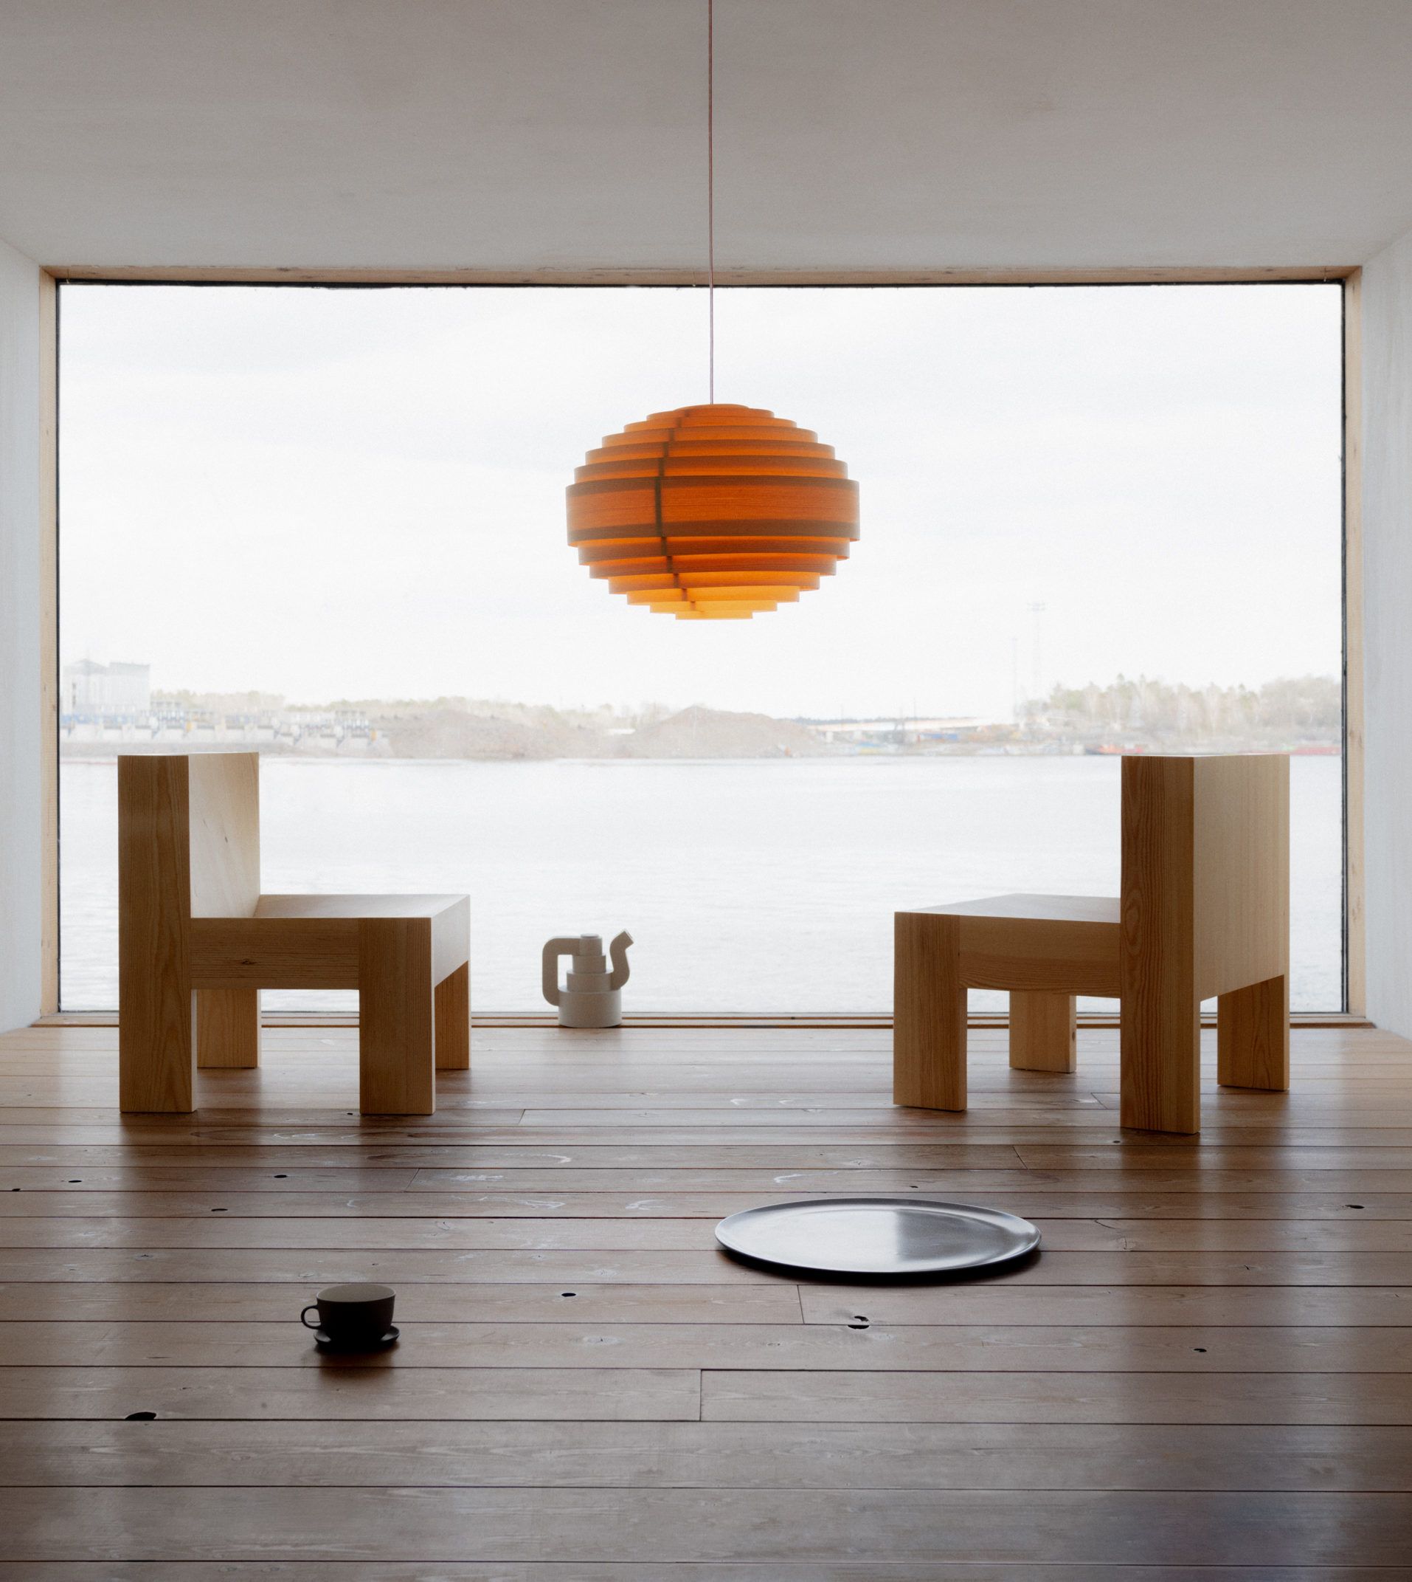
Finimalism: The essence of Finnish design
10 PATTERNS OF FINNISH DESIGN
1
2
3
4
5
6
7
8
9
10
More with less
Finnish design is often described as minimalistic. But Finimalism goes beyond how things look. It’s a mindset. Simple in form, timeless in design – made in Finland for endless ways of living.
Photo: Jussi Puikkonen / Vaarnii
Vaarnii is a furniture company that makes brutal and sophisticated objects from
a single natural raw material; Finnish pine by local craftspeople and factories in Finland.
Photo: Jussi Puikkonen / Vaarnii
Notes:
While Finnish Design is often minimalist in style, and at its core it's not about aesthetics – it's a mindset. Finimalism is about making more with less, guided by purpose, clarity, and respect for resources. This gives Finnish Design its quiet strength, timeless appeal and lasting impact.

Slide 4
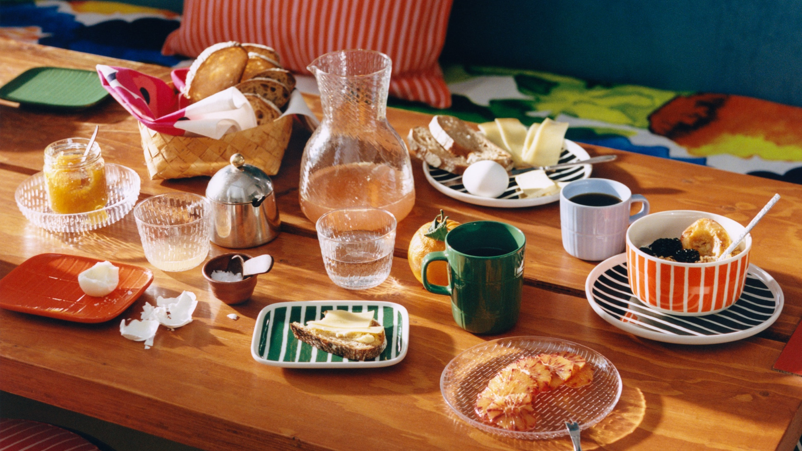
2/10
Finnish design is
made to be used
Marimekko, a beloved Finnish design company, is known for its bold patterns and colors.
Photo: Mikael Niemi. Courtesy of Marimekko.

Slide 5
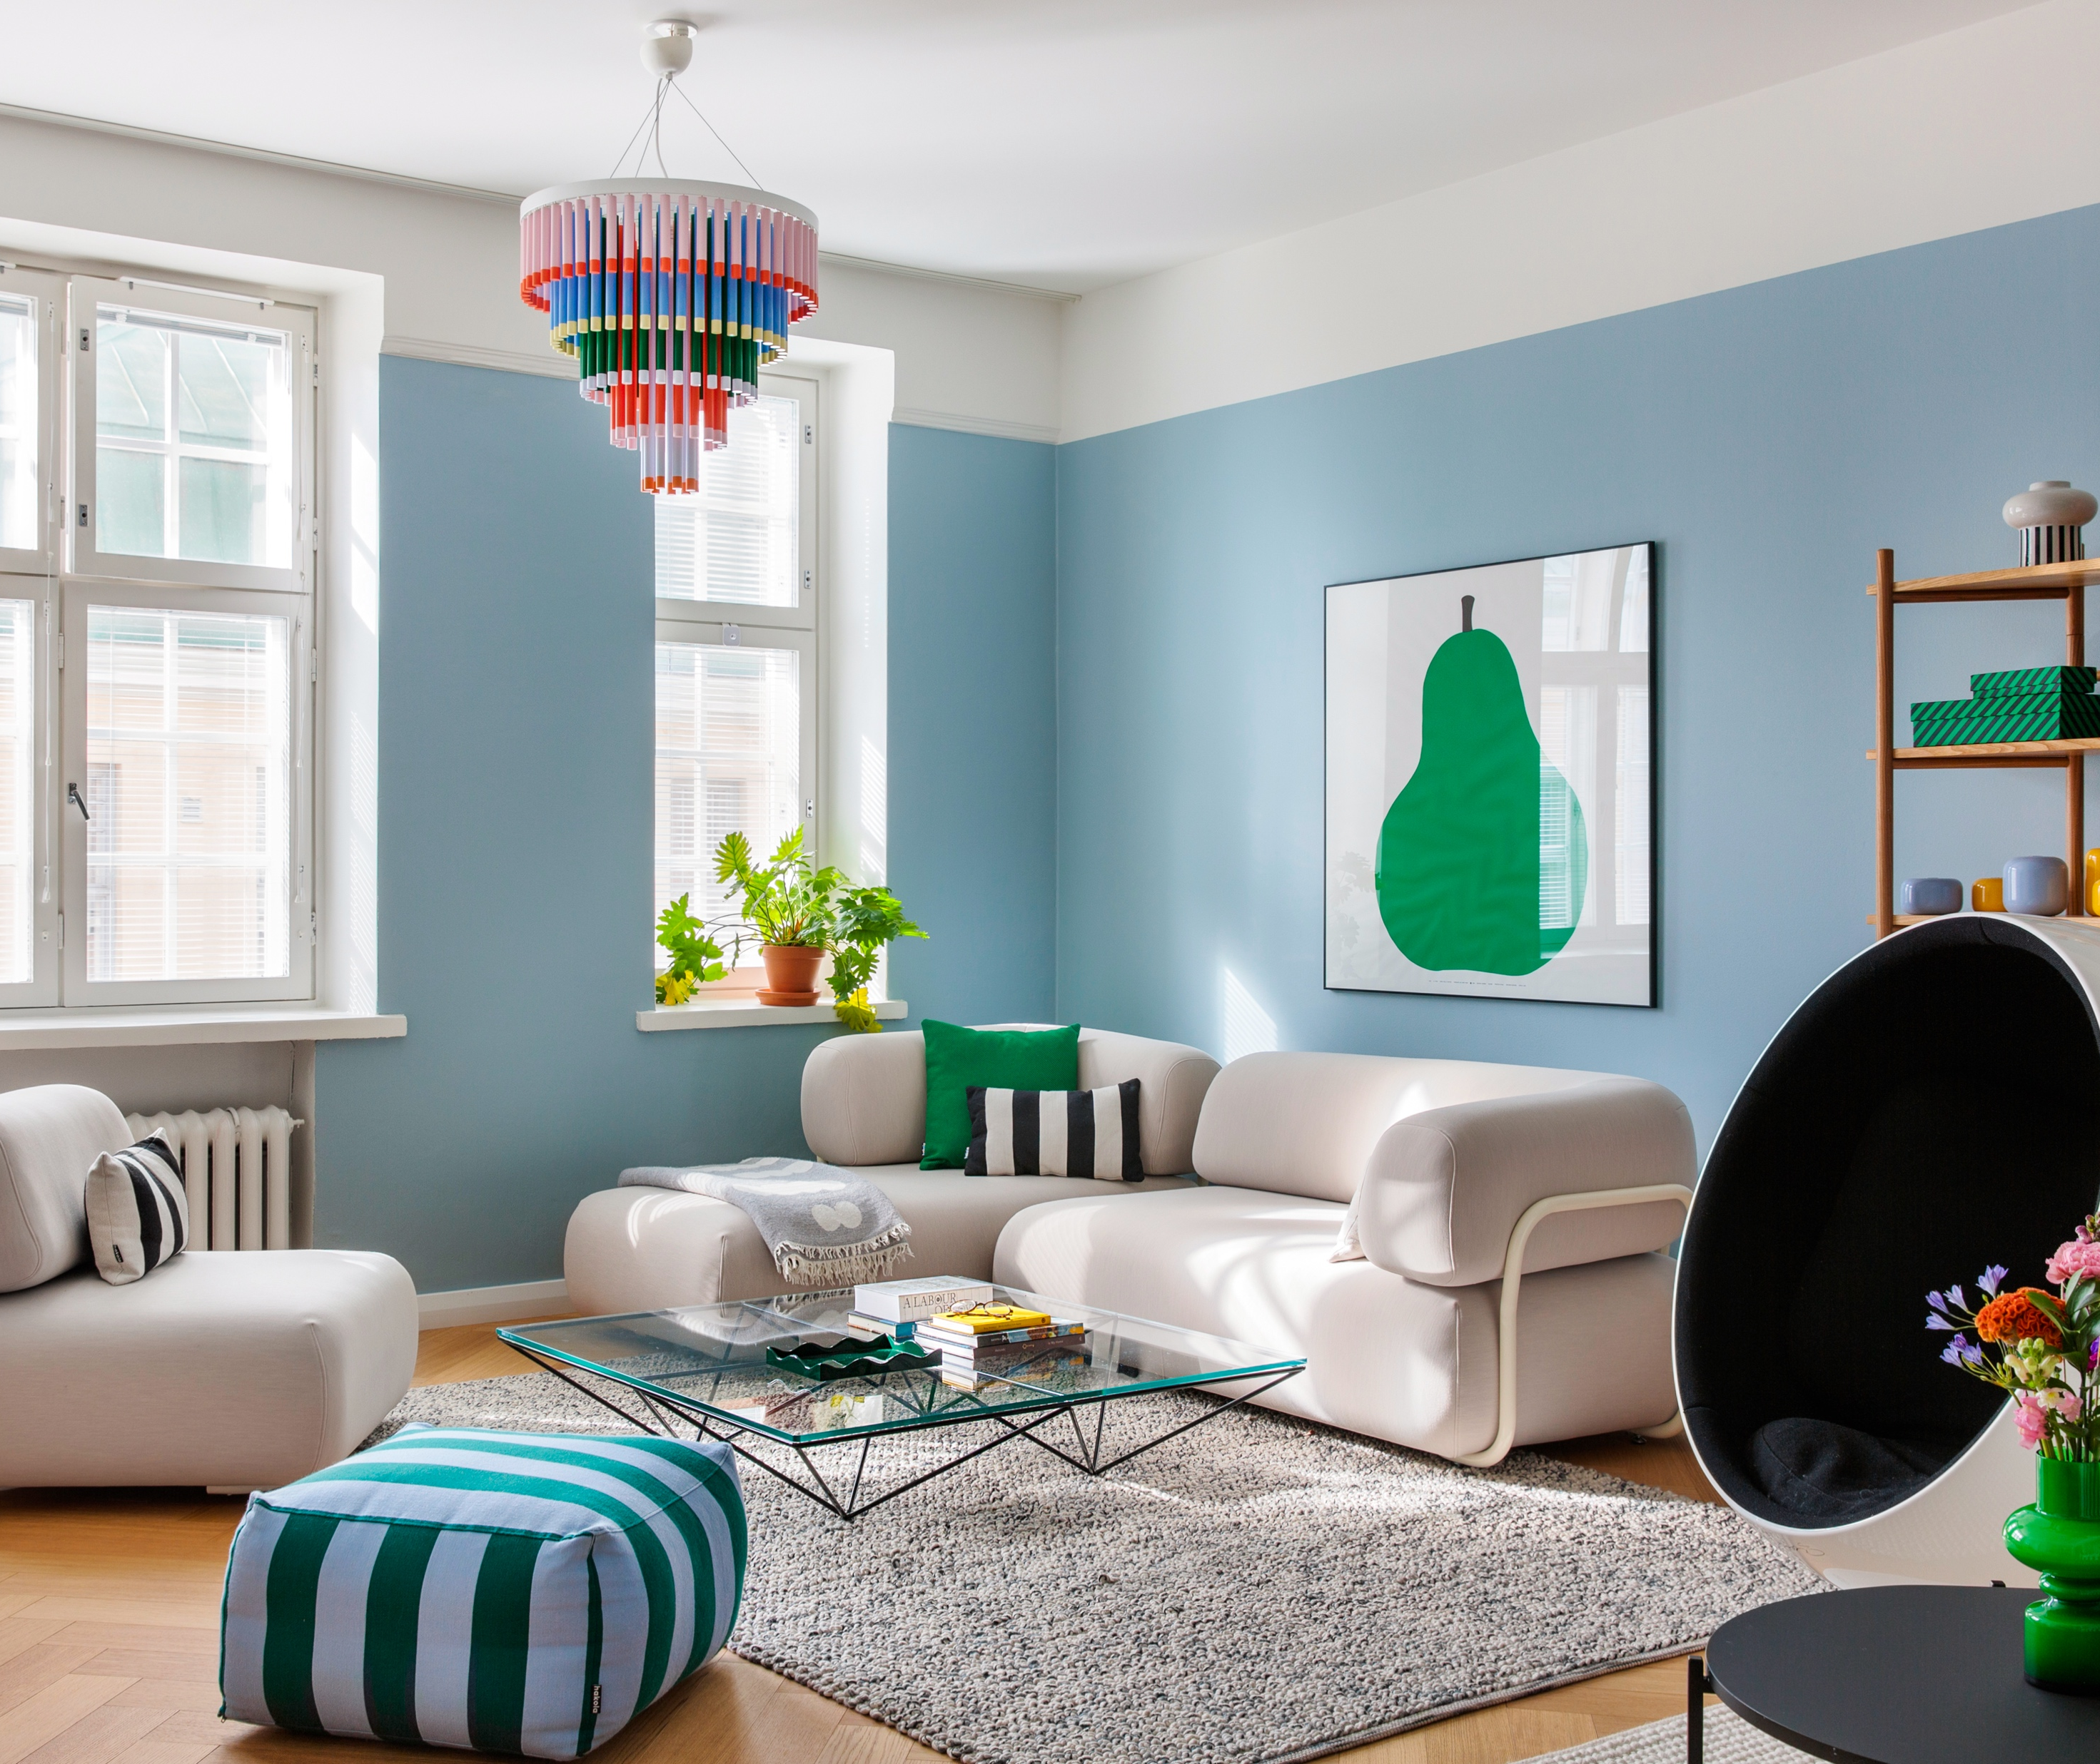
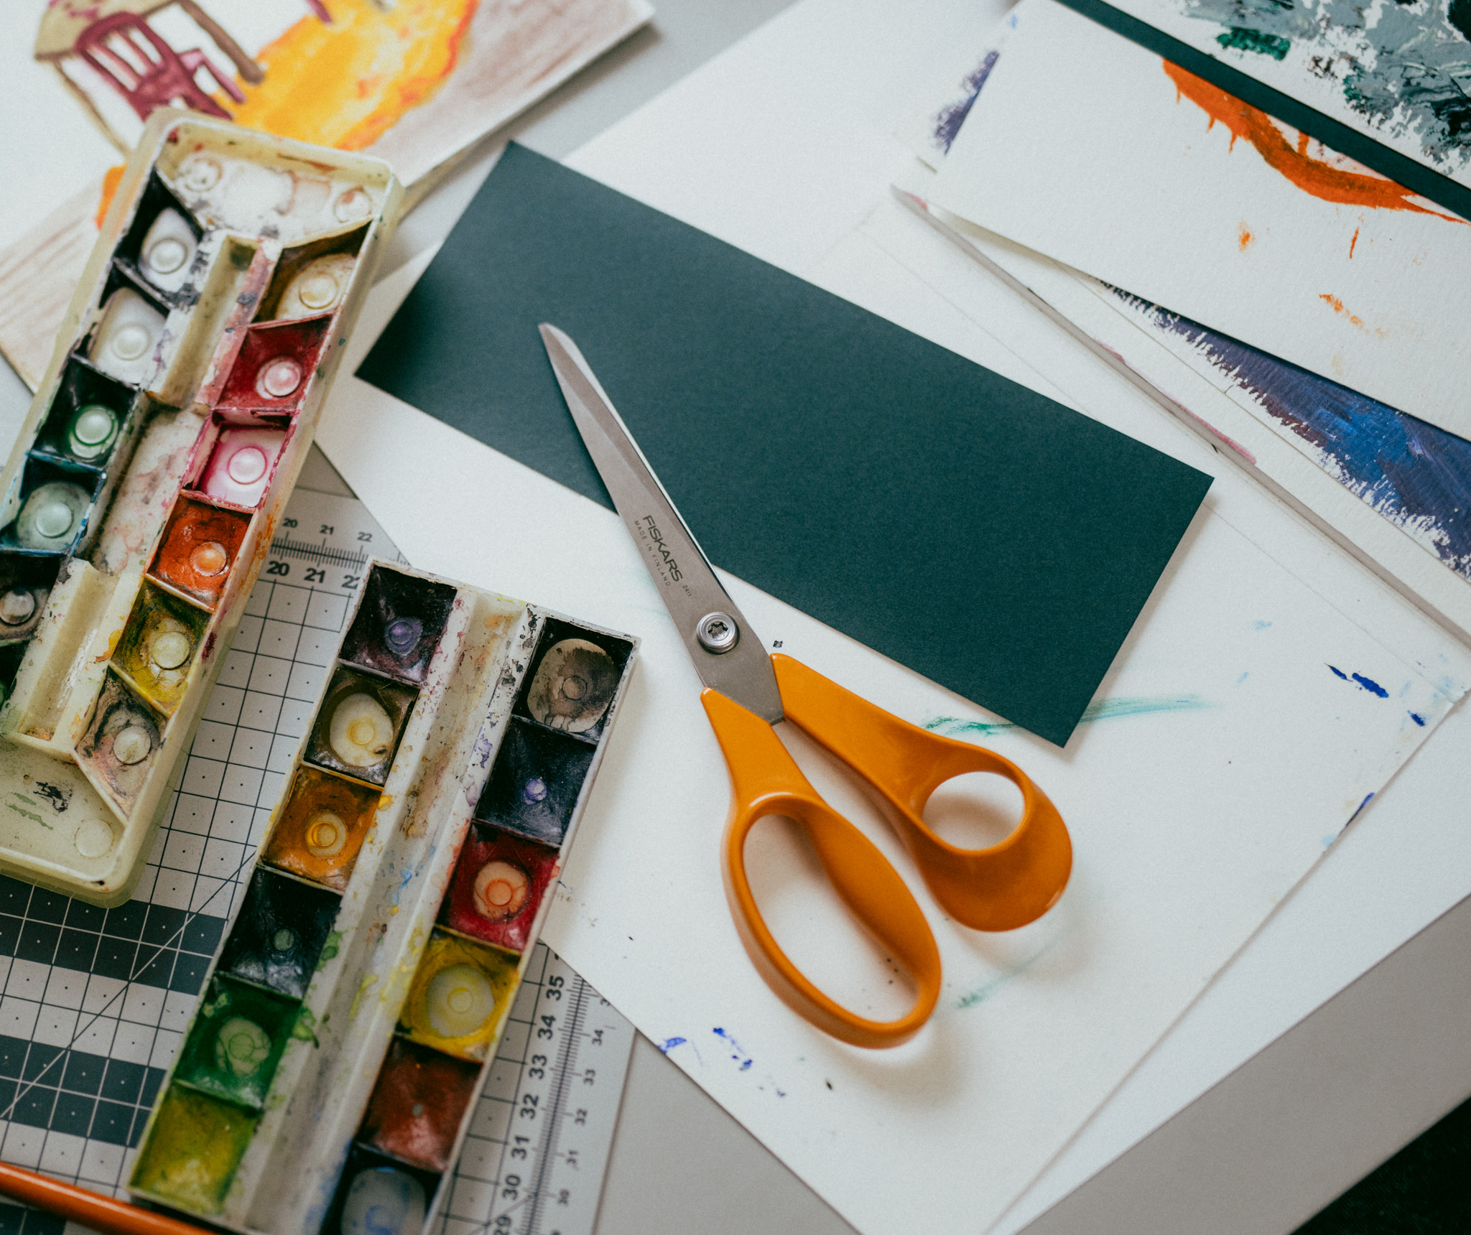
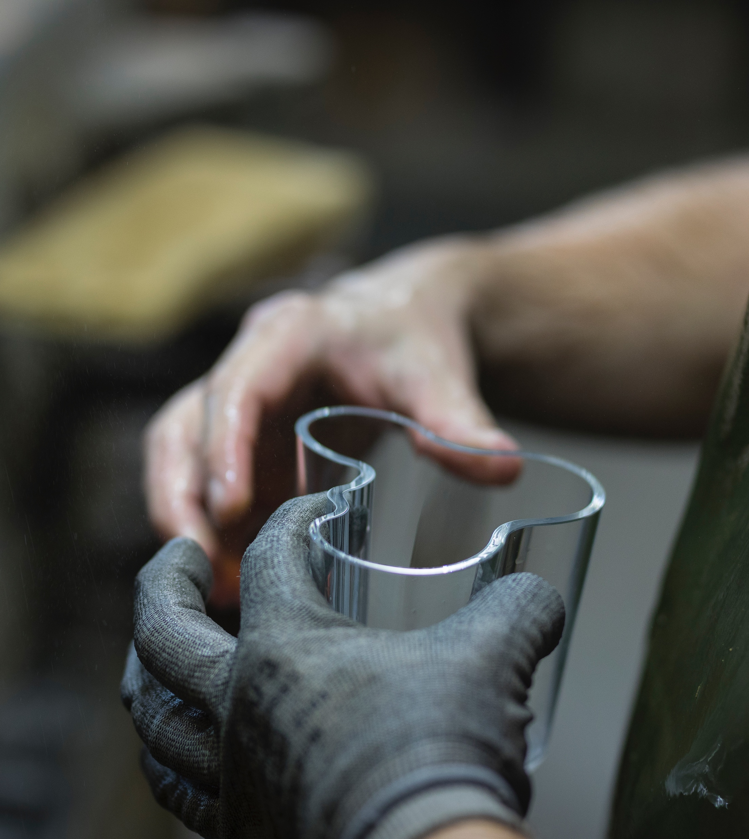
Finnish design is made to be used
10 PATTERNS OF FINNISH DESIGN
1
2
3
4
5
6
7
8
9
10
Our most famous designs are everyday objects used and loved all over the world
From nearly every home in Finland to over a billion pairs sold worldwide, Fiskars’ iconic orange scissors have been shaping everyday life since 1967.
Photo: Fiskars Finland Oy Ab
Photography by Suvi Kesäläinen for Hakola – a family-owned furniture company known for its bold use of colour.
Designed by Alvar Aalto in 1936, the Aalto vase has become an internationally recognised icon
of Finnish modernism, found in homes, exhibitions and collections around the world. Photo: Iittala
Notes:
Think of the world’s most famous orange-handled Fiskars scissors, the iconic Aalto stool, Marimekko print or timeless Arabia ceramics. These classics aren’t just admired – they’re used daily in homes, workplaces, and public spaces all over the world.
Many of these designs have reached remarkable scale and longevity. Some have been produced for decades, even generations – and in the case of Fiskars, over a billion pairs of its iconic scissors have been sold worldwide, since their introduction in 1967. Together, they reflect a distinctly Finnish approach: creating objects that are practical, durable, and designed to be lived with.
Many of these designs have reached remarkable scale and longevity. Some have been produced for decades, even generations – and in the case of Fiskars, over a billion pairs of its iconic scissors have been sold worldwide, since their introduction in 1967. Together, they reflect a distinctly Finnish approach: creating objects that are practical, durable, and designed to be lived with.

Slide 6

3/10
Here's an icebreaker: We know how
to design in, on and around water
Polaris icebreaker, designed for the challenging conditions of the Baltic Sea. About 80% of the world’s icebreakers are designed in Finland.
Photo: Flying Focus / Arctia

Slide 7

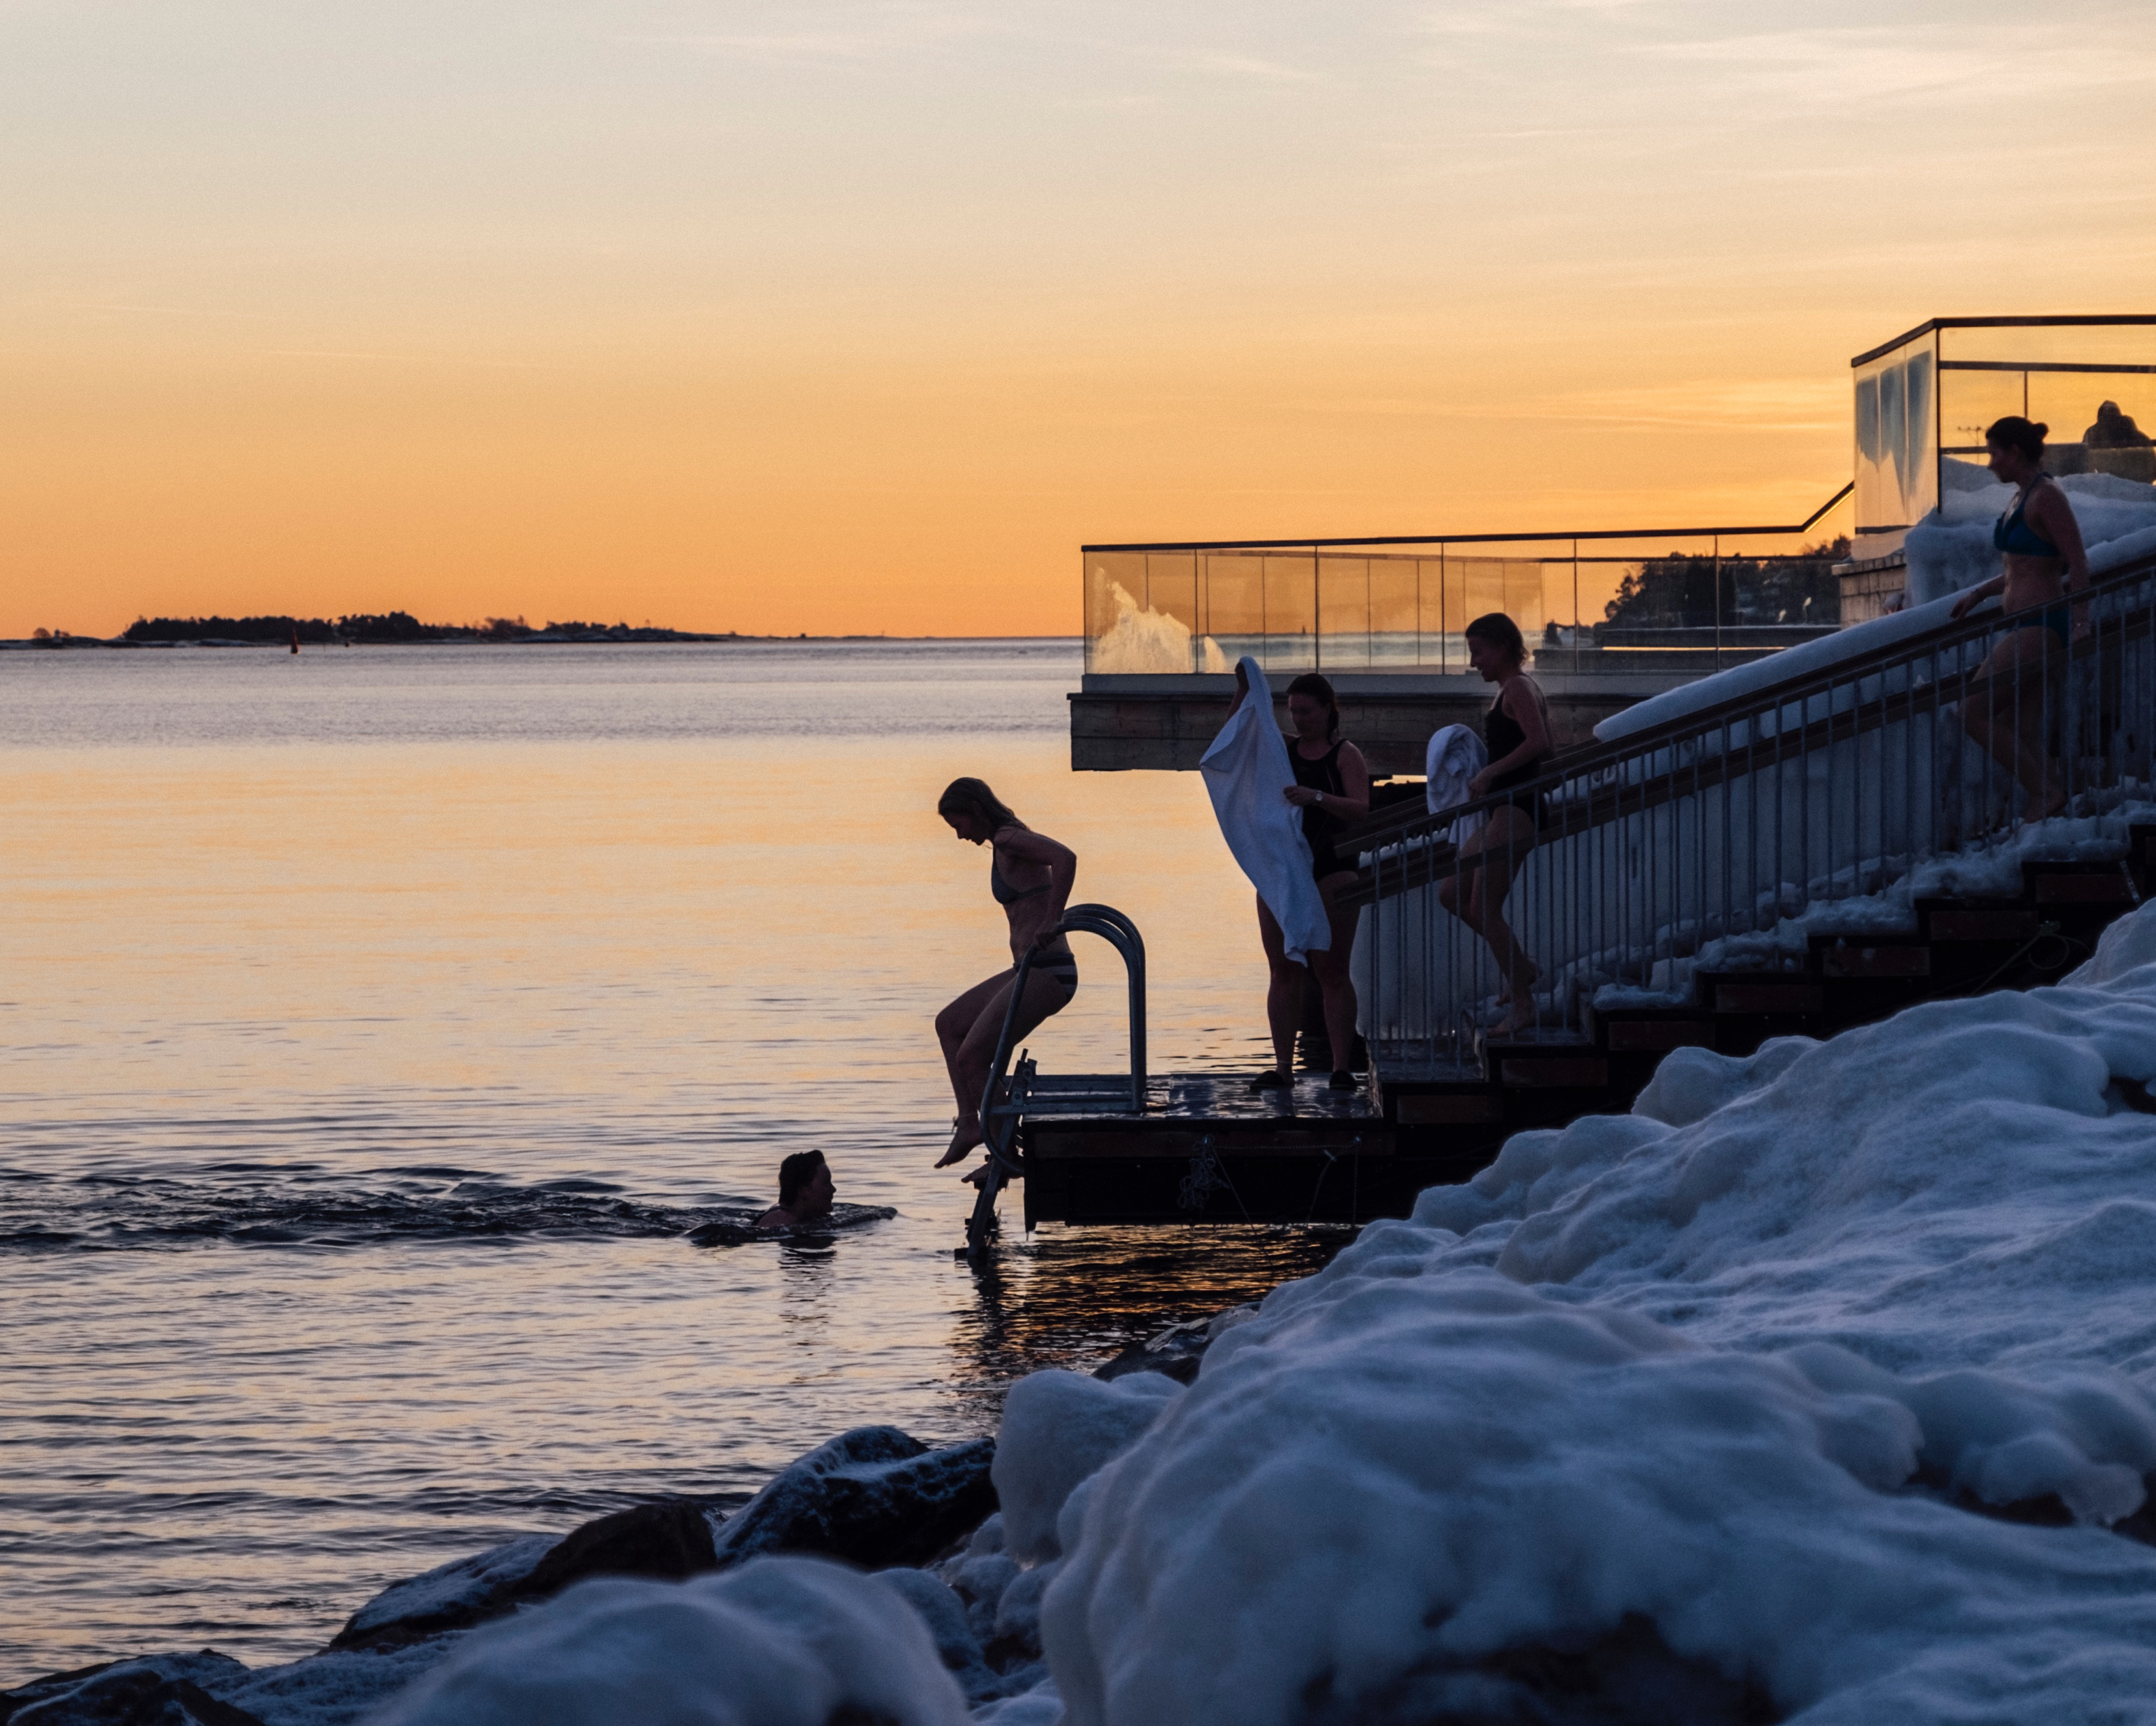
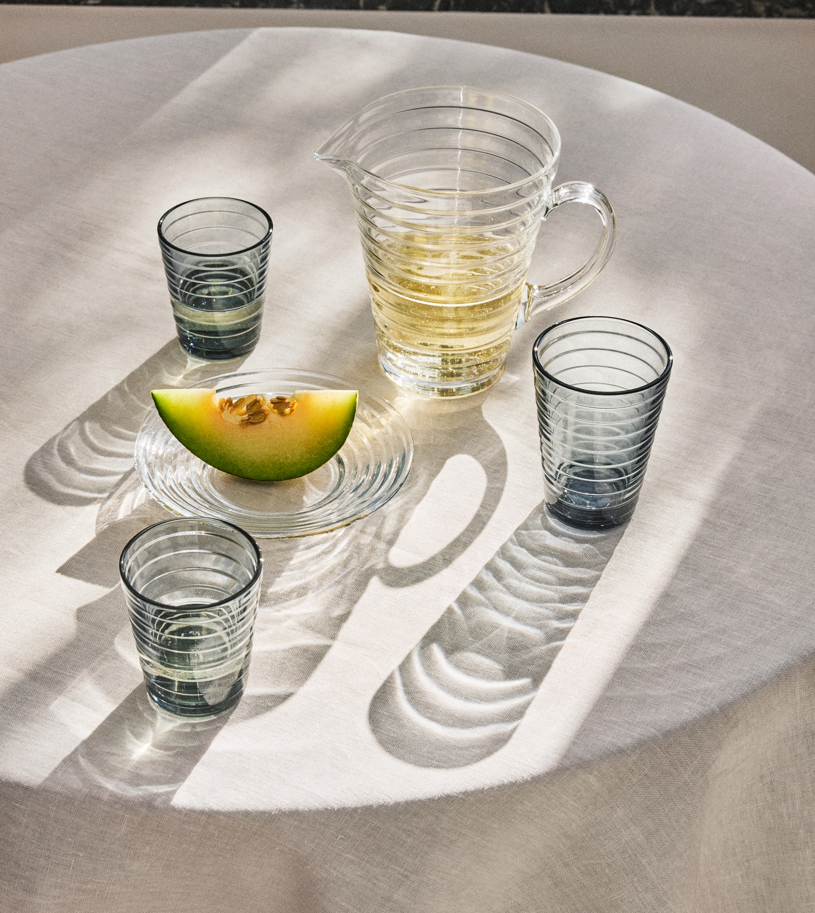
Here's an icebreaker: We know how to design in, on and around water
10 PATTERNS OF FINNISH DESIGN
1
2
3
4
5
6
7
8
9
10
Living with the elements made us experts in water
Finland has 188 000 lakes, 31 000 kilometers of shoreline and an archipelago of 81 000 islands. From wooden sailboats to maritime engineering, from ship design and navigation systems to fishing gear, weather-resistant apparel, and world-famous glassware — water runs deep in Finnish design.
Axopar – a Finnish-designed boat brand known for multifunctional boats that
combine Scandinavian simplicity with a spirit of adventure. Photo: Axopar
Löyly, Helsinki — a public sauna designed by Avanto Architects and Joanna Laajisto Creative Studio, where design
meets nature and the sea is part of the experience, all year round. Photo: Kuvatoimisto Kuvio Oy / Helsinki Partners
The Aino Aalto glassware (1932) is inspired by ripples on water and designed for
everyday use – a timeless classic of Nordic modernism, still in production by Iittala.
Photo: Anton Sucksdorff / Iittala
Notes:
When the nature is your teacher and water surrounds you, design follows the rhythm of the elements. In Finland – the land of 188,000 lakes, an extensive coastline and a vast archipelago – living with water has shaped a wide spectrum of expertise: from wooden boats and maritime engineering to navigation systems, weather-resistant apparel and material innovation. Today, around 80 % of the world’s icebreakers are designed in Finland.
Polaris, designed for the demanding conditions of the Baltic Sea, represents the forefront of this expertise – a multifunctional icebreaker capable of oil spill response, emergency towing and rescue operations year-round.
This deep connection to water also appears in everyday objects. The Aino Aalto glassware series (1932), inspired by ripples on water, translates a natural phenomenon into a simple, functional form. Once considered radically minimal, it has become a timeless classic of Nordic modernism – still in production today.

Slide 8
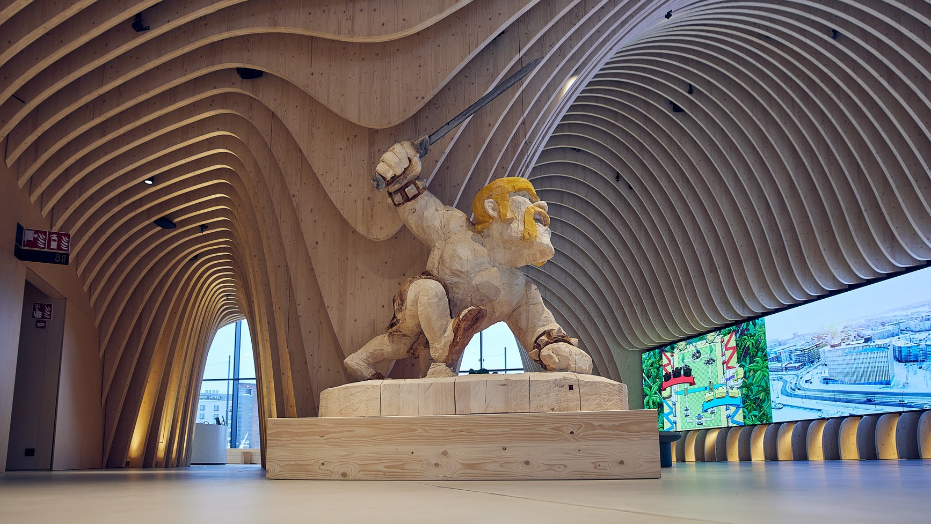
4/10
Game-changing digital design
Supercell’s headquarters in Wood City, Jätkäsaari, Helsinki – designed to create the “best working conditions in the world”.
Architecture: Anttinen Oiva Architects. Interiors: Firm 151, Futudesign, and Fyra.
Photo: Pasi Salminen / Supercell

Slide 9
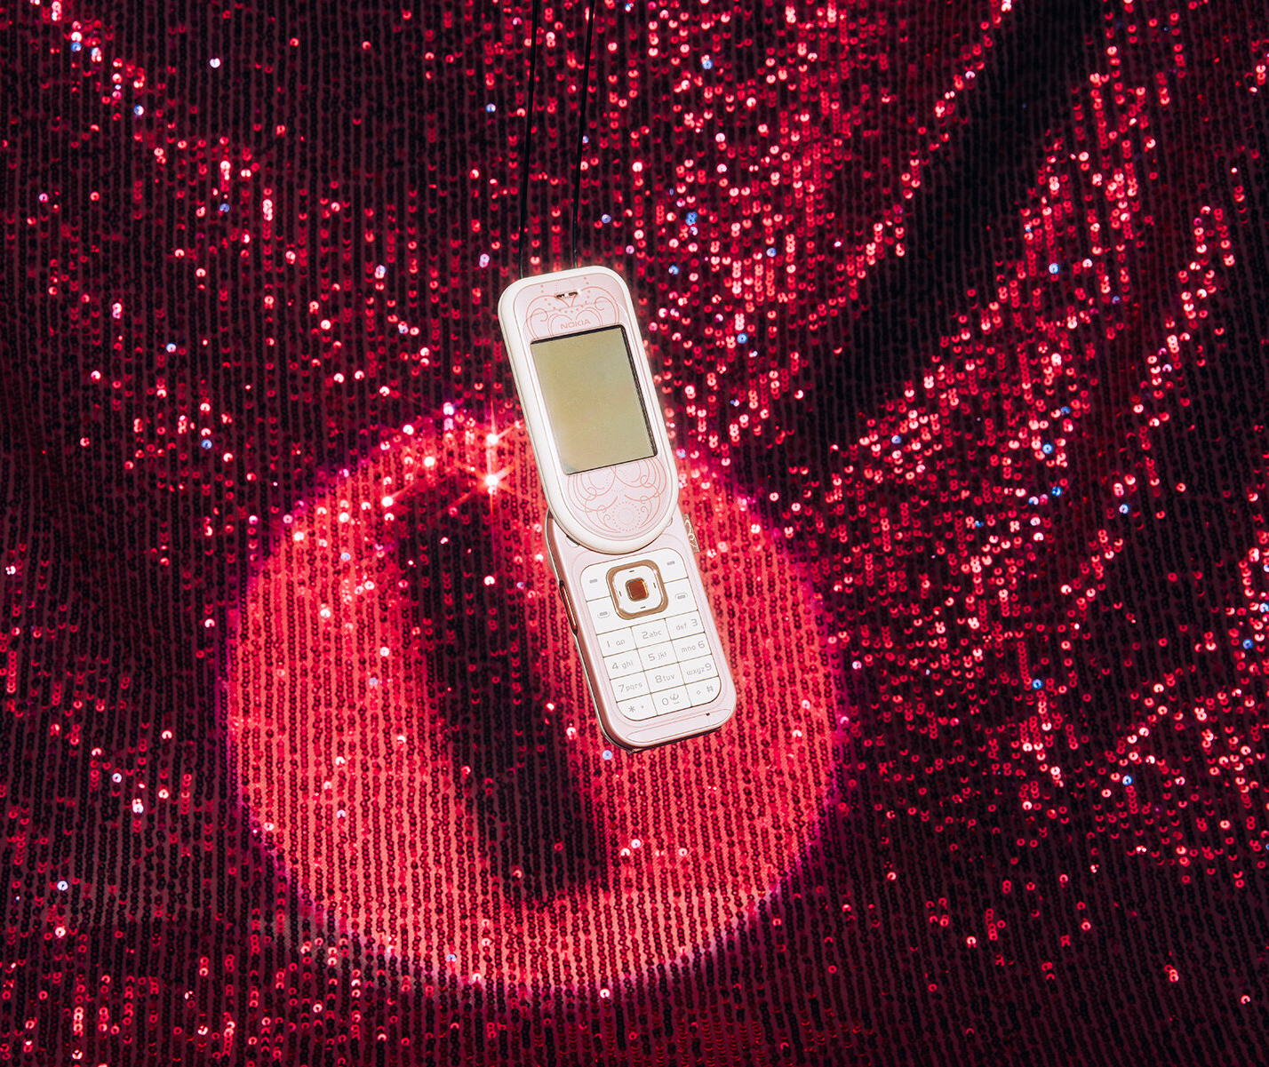
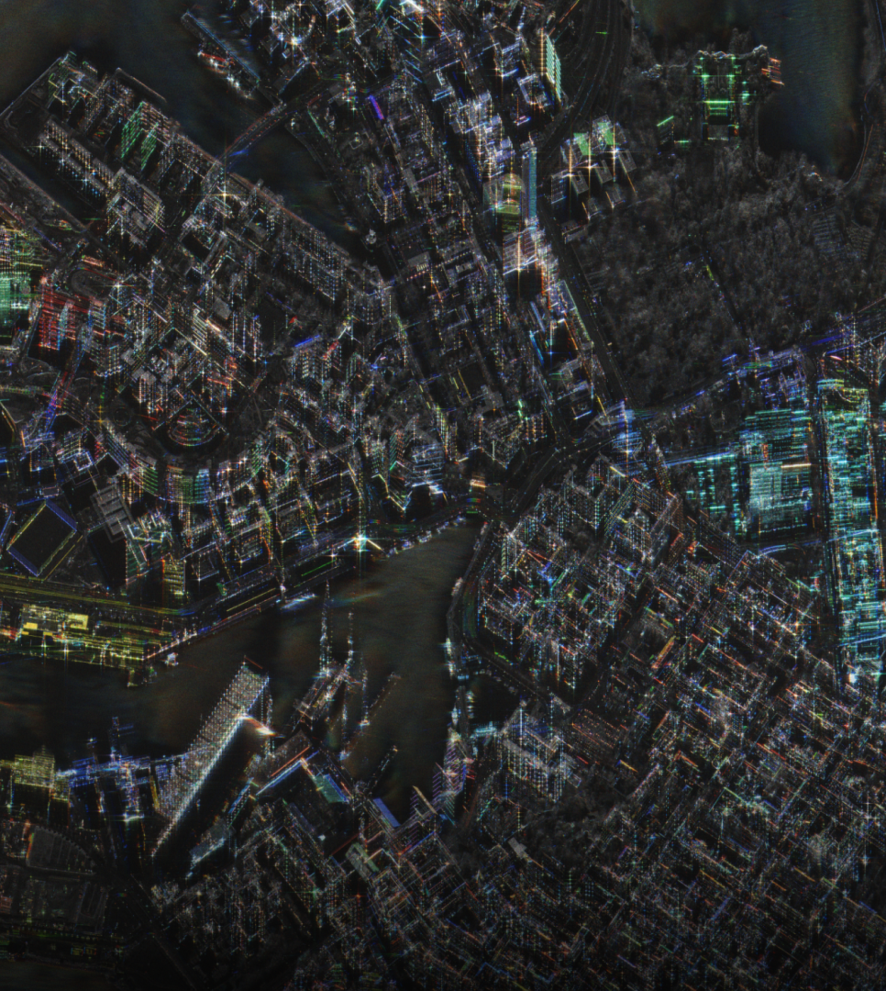
Game-changing digital design
10 PATTERNS OF FINNISH DESIGN
1
2
3
4
5
6
7
8
9
10
Nokia set the tone
In the highly competitive global field of digital design, Finland has established a reputation for innovation, functionality, and bold creativity.
Now digital design companies like Supercell, Remedy, and Iceye are taking it to the next level – all the way to space.
The Nokia Design Archive – Opening the door to two decades of Nokia’s inner workings, a new online
portal brings never-before-seen material to the public.Photo: Aleksi Poutanen / Aalto University
Helsinki, Finland – captured by ICEYE’s high-resolution radar satellite.
Photo: ICEYE
Notes:
Finland’s strength in digital design didn’t emerge overnight – it builds on a strong legacy.
Nokia set the tone. Its pioneering approach to mobile technology and design didn’t just change how the world communicates – it placed Finnish design and technology firmly on the global map. At its core was a distinctive design DNA: user-focused thinking, clarity, and the courage to innovate.
That legacy continues today in a new generation of digital companies. From gaming studios like Supercell, Remedy and Rovio to space-tech innovators like ICEYE, Finnish companies are taking design-driven thinking into new domains – even beyond our planet.
Digital design is now one of Finland’s fastest-growing creative sectors. It spans gaming, mobile applications, service design, UX and UI, as well as AI and emerging technologies. In a highly competitive global field, Finland has built a reputation for combining functionality with bold creativity.
***
Discover the Nokia Design Archive – free and open to all, online. It reveals the visions that transformed how we connect, through never-before-seen sketches, photographs, videos and interviews from the mid-90s to 2017. Step inside Nokia Mobile Phones and see how design ideas shaped our world.

Slide 10
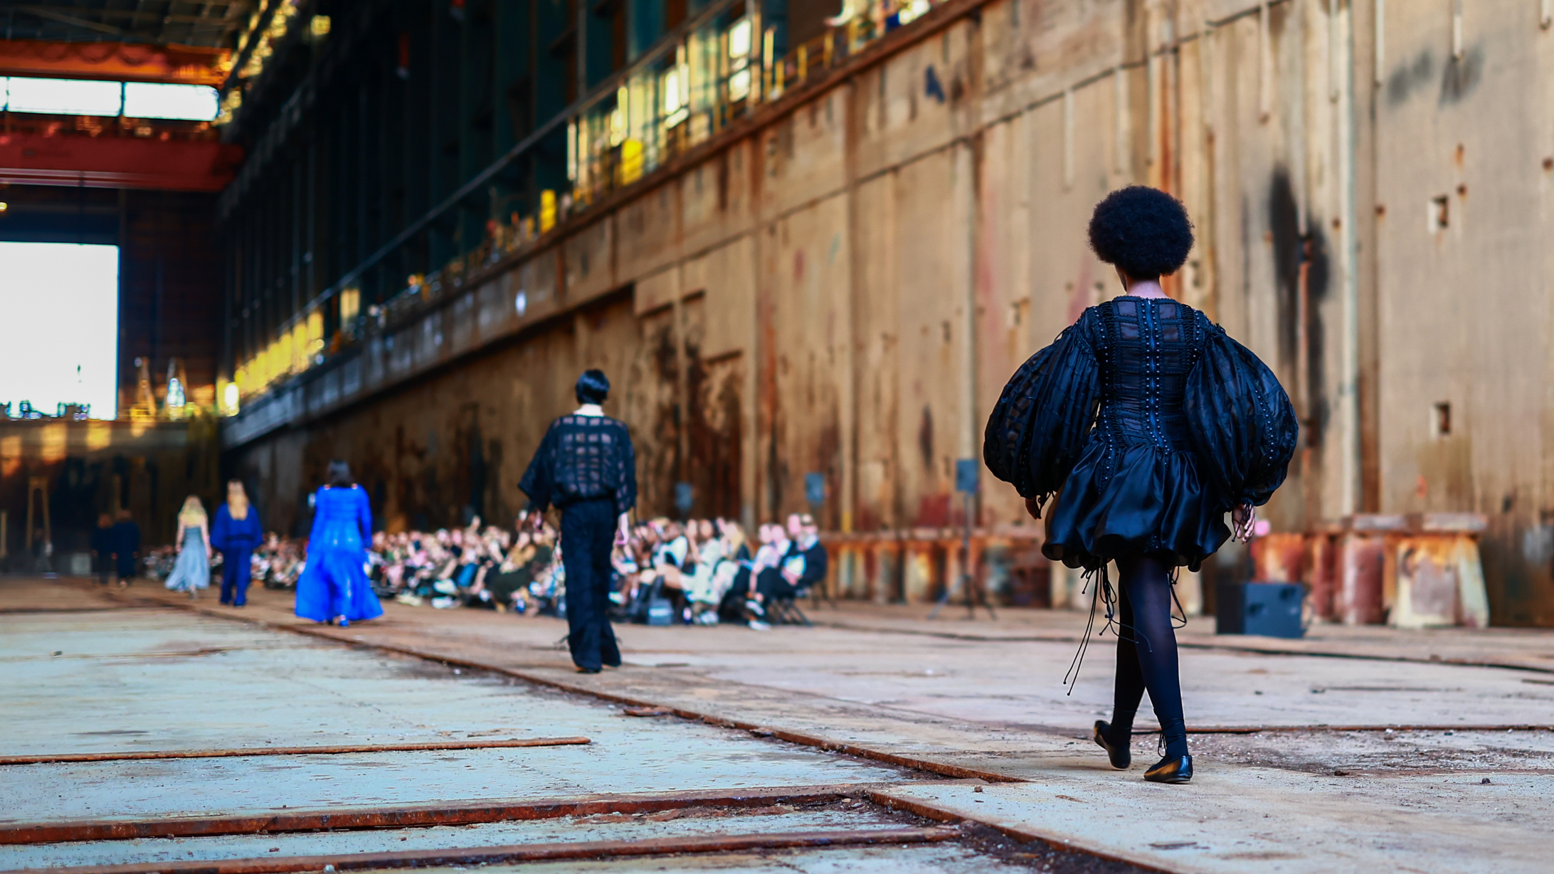
5/10
Finnish education
never goes out of style
Every May, Fashion in Helsinki showcases emerging talents in Finnish fashion,
many from Aalto University and LAB Institute of Design and Fine Arts.
Photo: Fashion in Helsinki

Slide 11
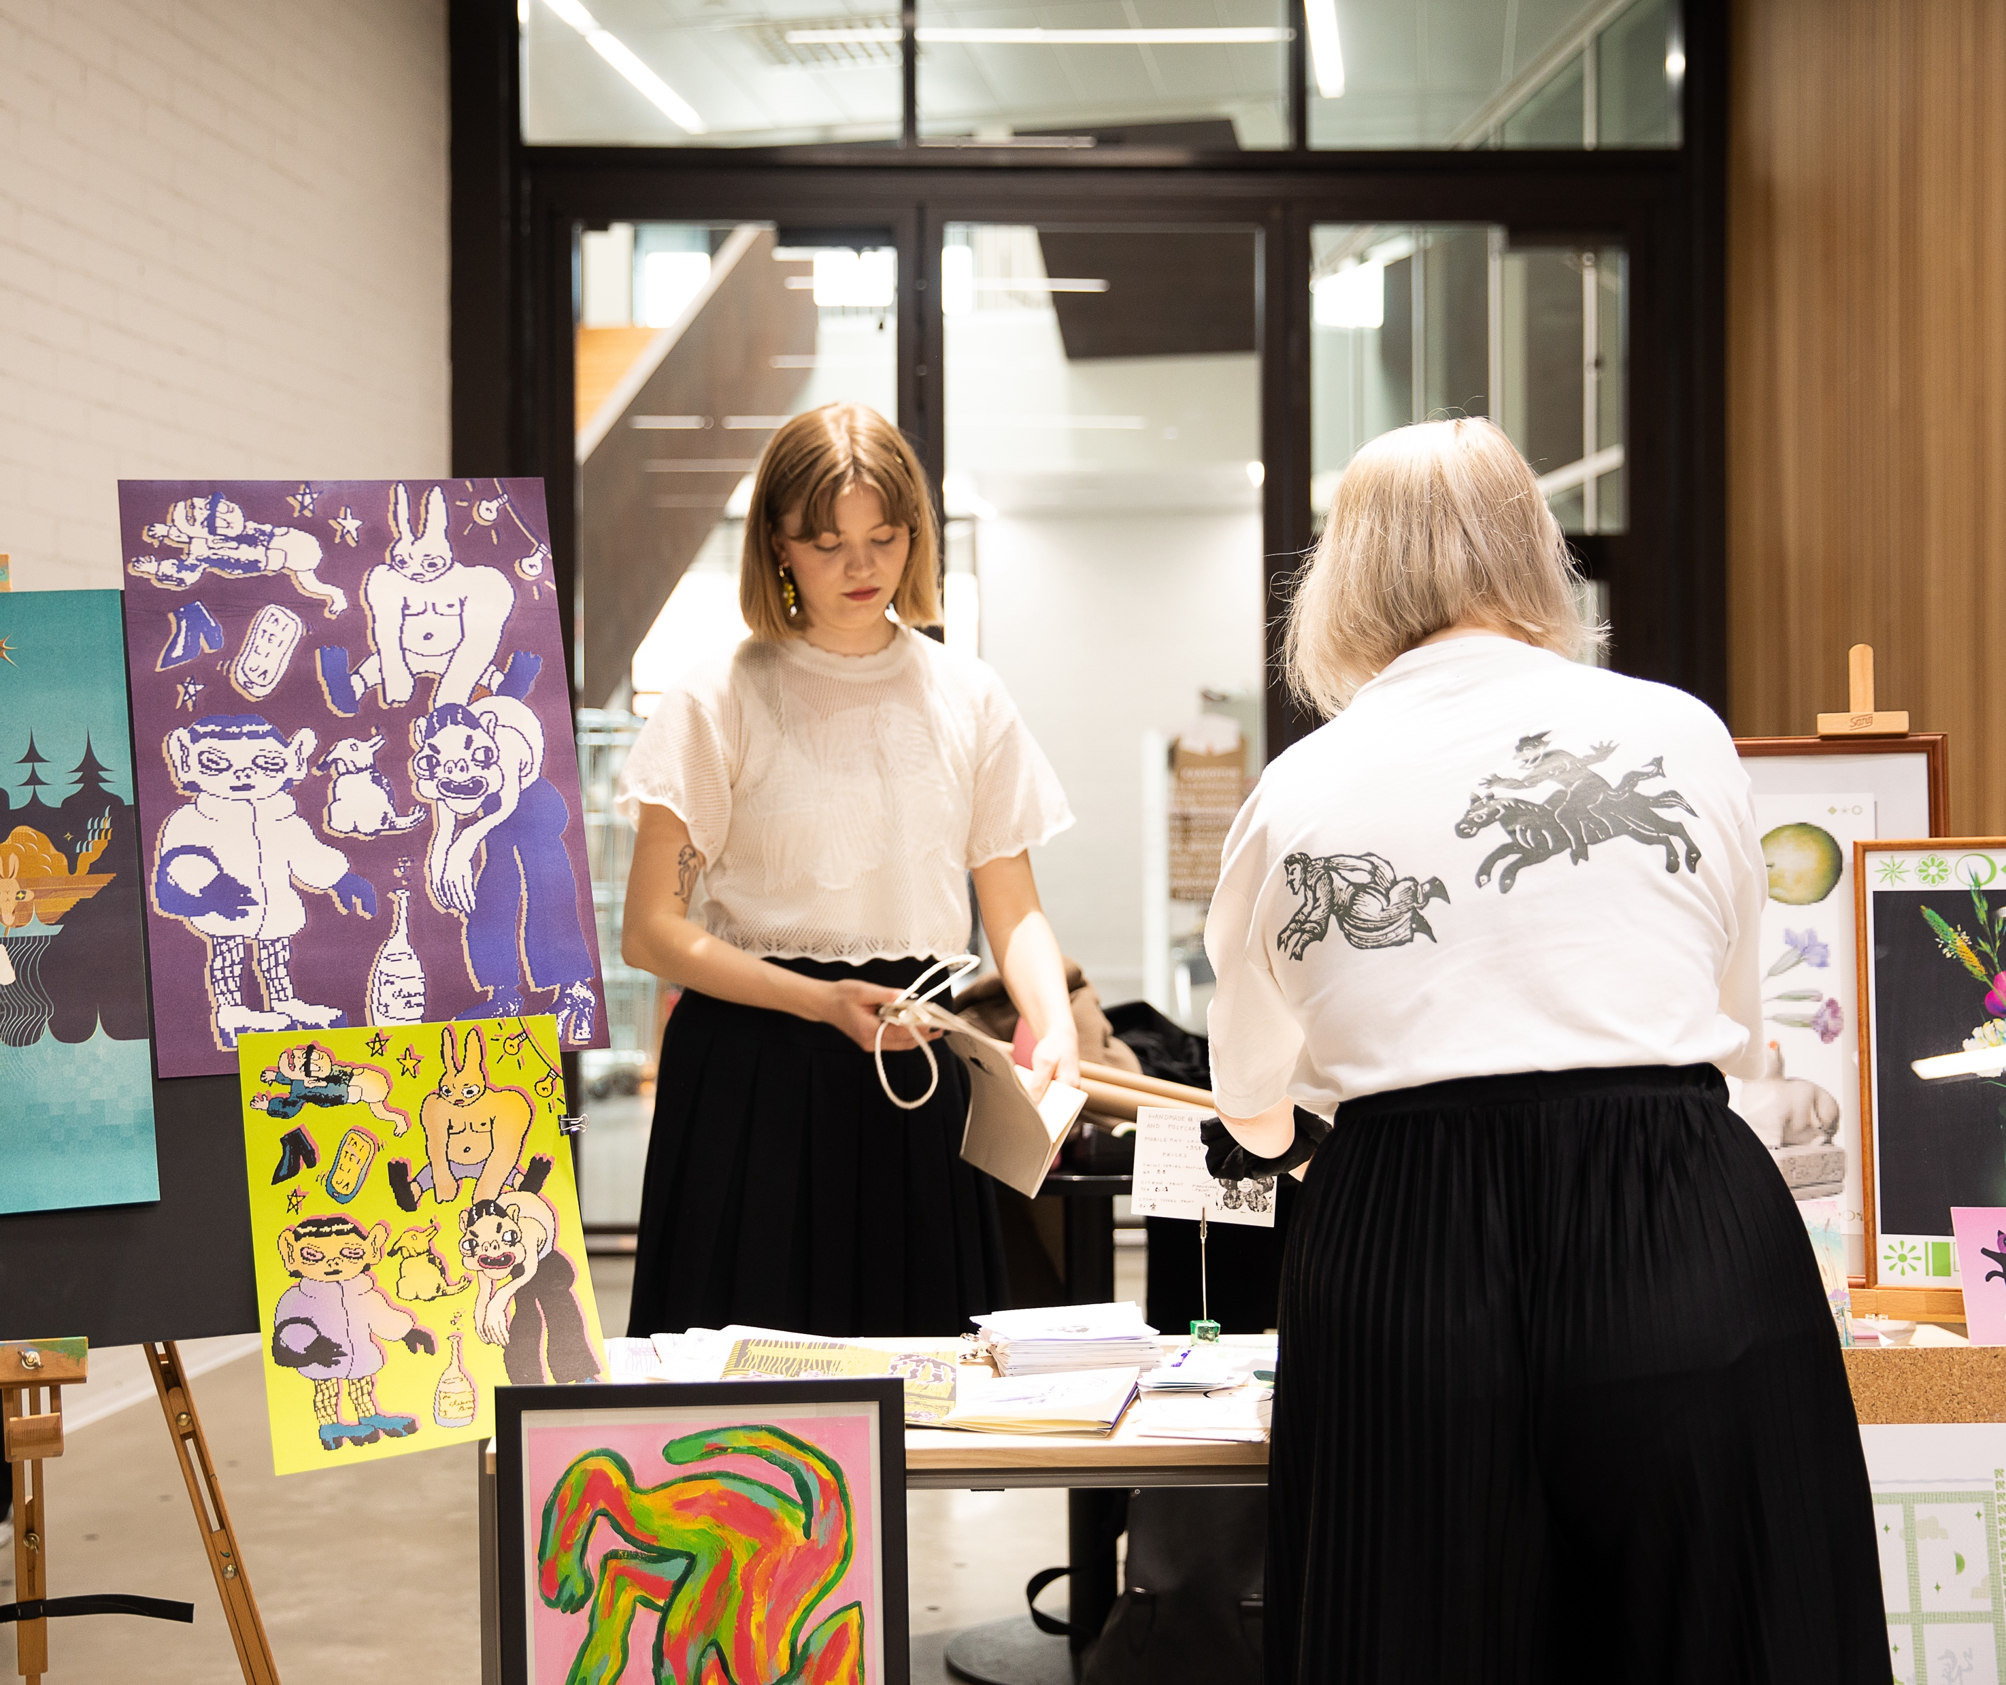
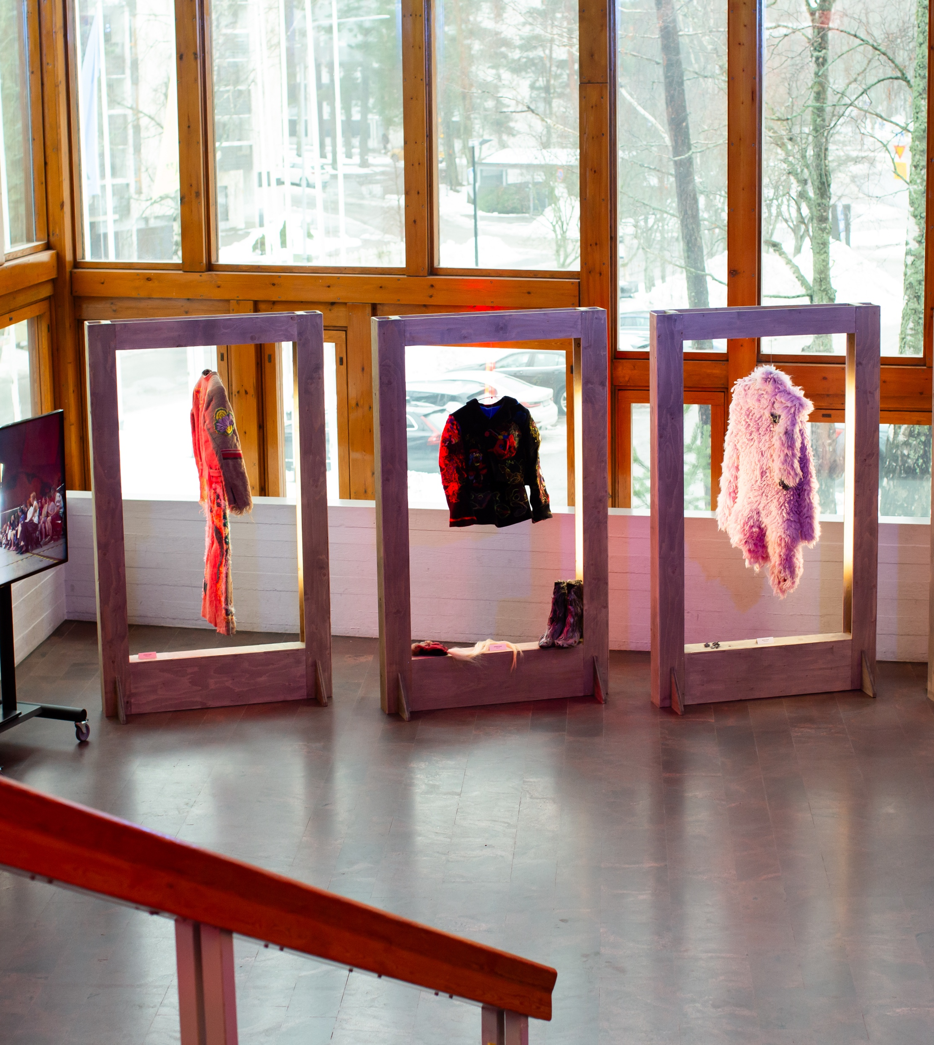
World-class design education
fuels the future
World-class design education fuels the future
10 PATTERNS OF FINNISH DESIGN
1
2
3
4
5
6
7
8
9
10
World-class
design education
fuels the future
Aalto University’s School of Arts, Design and Architecture consistently ranks among the world’s best. This reflects a broader Finnish approach to design education, grounded in craft and hands-on learning.
Photo: Erica Nyholm / Aalto University
Photo: Pinja Valja / Aalto University
Notes:
In Finland, design education is deeply rooted in craft. This means learning by doing - working with materials, understanding their properties, and developing a hands-on relationship with form and function. Whether working with wood, textiles, ceramics or digital tools, the process builds a deep understanding of how ideas take shape in the real world.
This approach is not limited to universities. It reflects a broader Finnish education culture, where practical skills, creativity and problem-solving go hand in hand.
At Aalto University’s School of Arts, Design and Architecture - consistently ranked among the world’s best - this tradition continues in a contemporary context, combining craftsmanship with research, technology and critical thinking.
This mindset is also visible in fashion, where students and alumni have gained international recognition, including top prizes at Hyères.

Slide 12
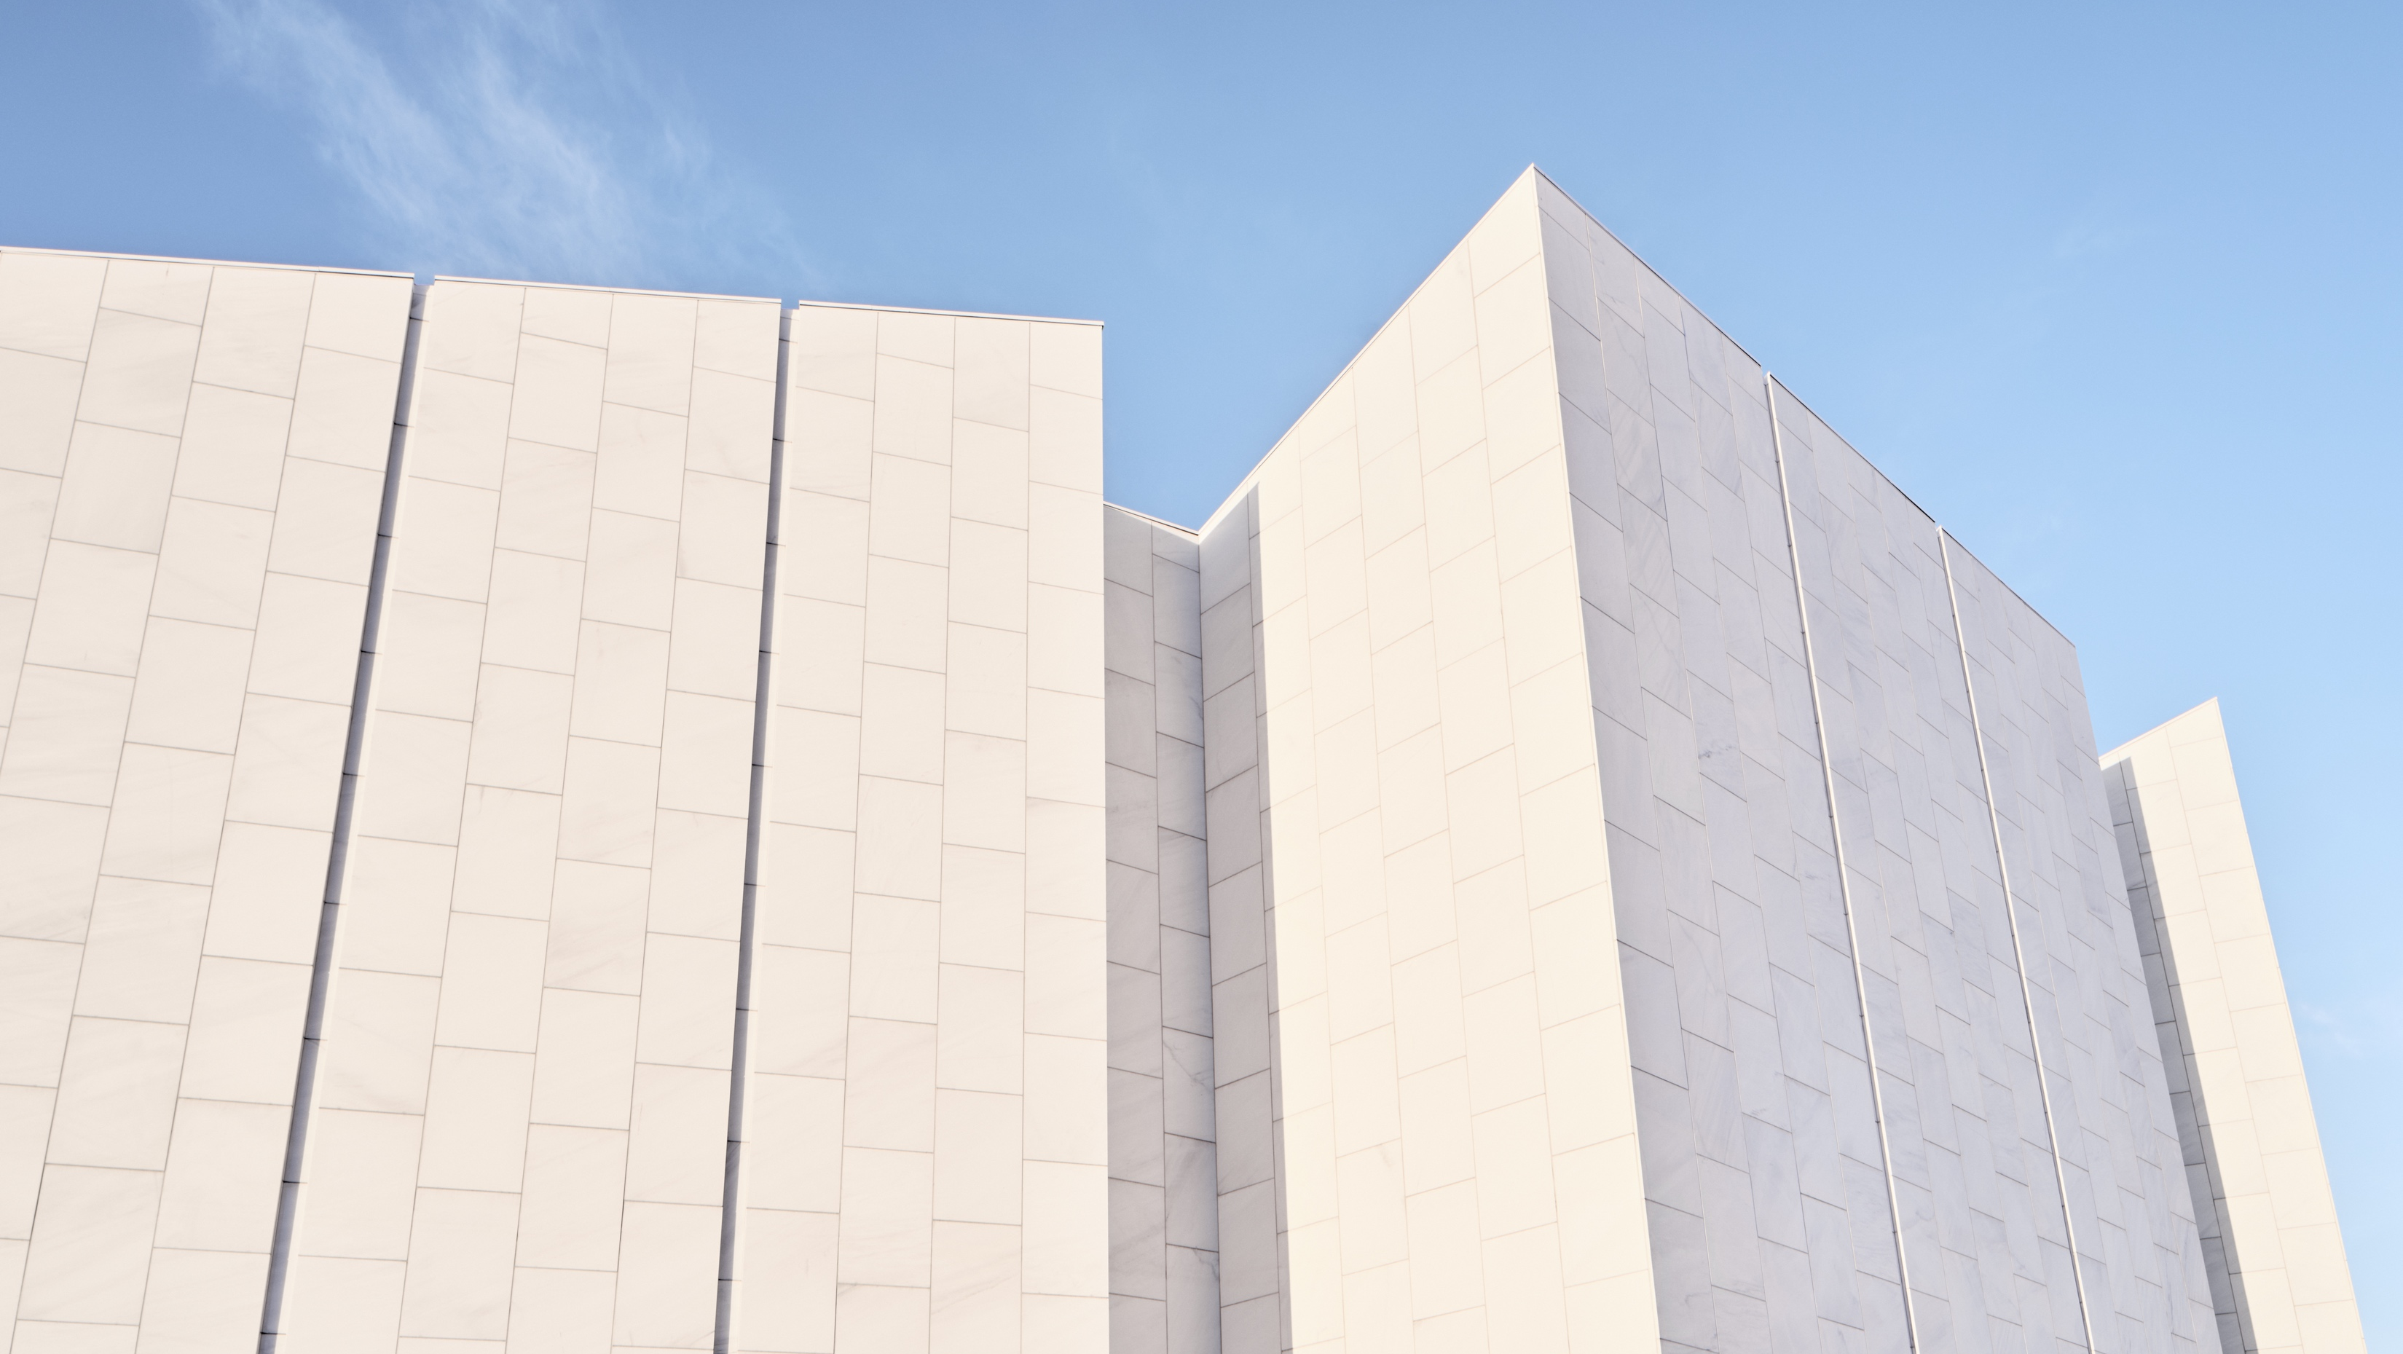
6/10
Past forward:
The Aalto spirit
Finlandia Hall by Alvar Aalto was conceived as a national symbol of Finland – a total work of art
where everything from architecture to furniture and details was designed by Aalto and his studio.
Photo: Tuomas Uusheimo / Finlandia Hall

Slide 13
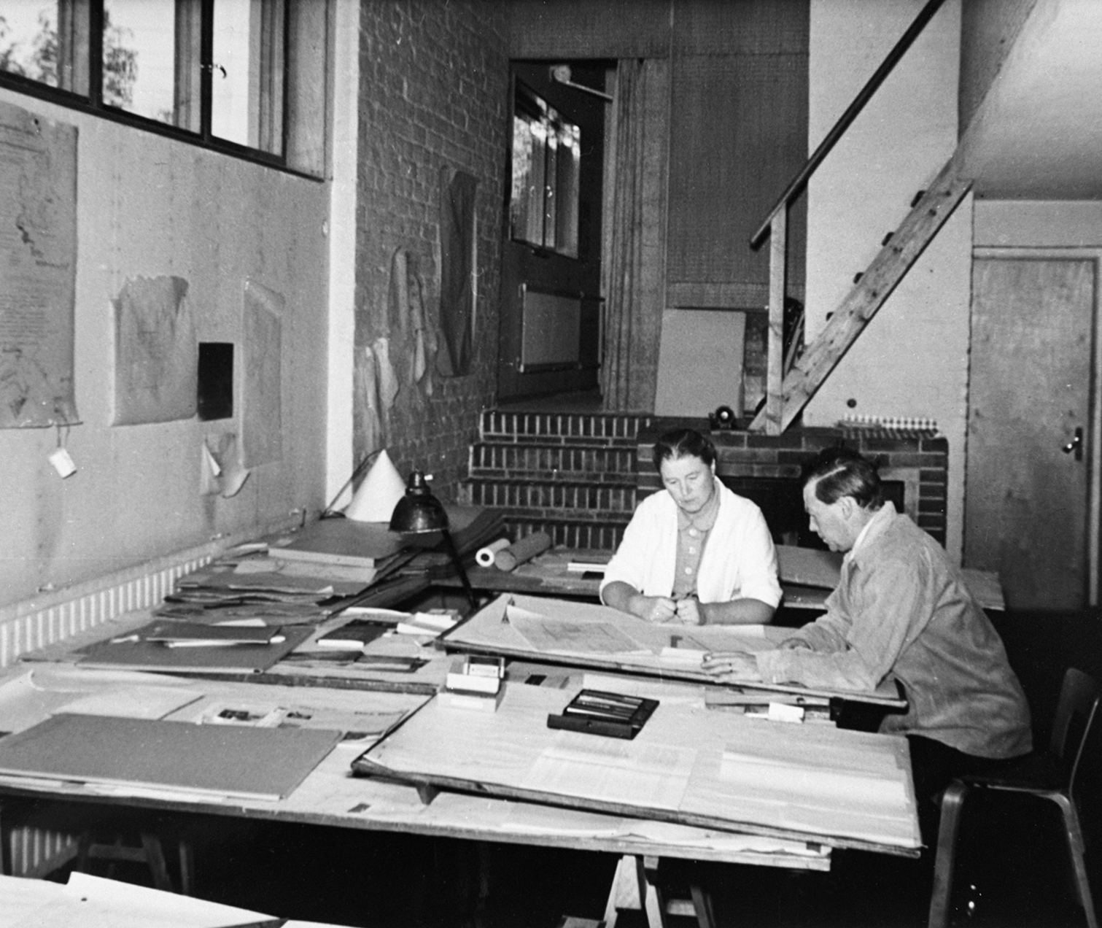
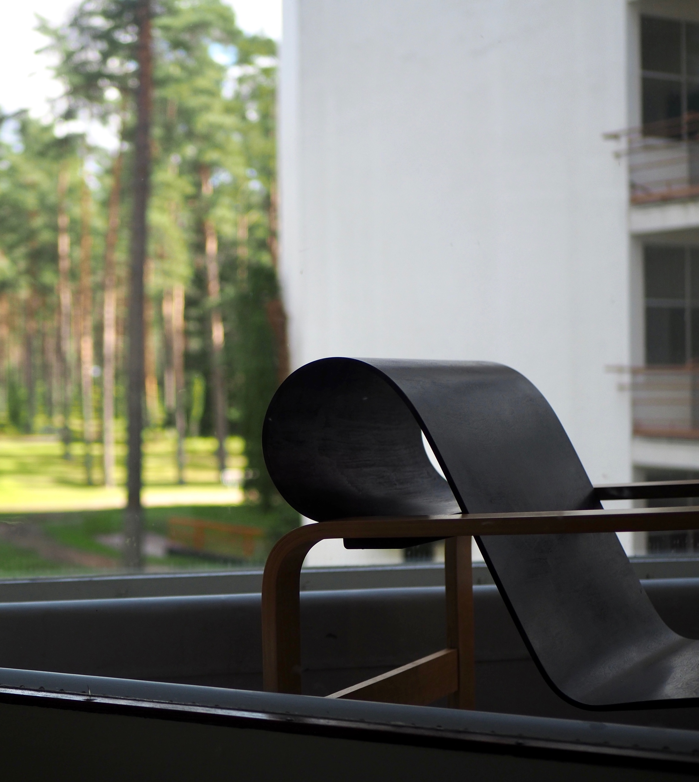
Past forward: The Aalto spirit
10 PATTERNS OF FINNISH DESIGN
1
2
3
4
5
6
7
8
9
10
One story. Three Aaltos. Design, embedded in everyday life.
Modern Finnish design is the shared work of
Alvar Aalto, Aino Aalto and Elissa Aalto – Aino shaped its beginning, Elissa ensured its continuity.
At its core: human-centered design – the Aalto spirit, where light, material and function come together in quiet harmony with daily life.
Aino and Alvar Aalto in their studio. They worked as equal partners in a seamless and deeply symbiotic collaboration,
often making it impossible to distinguish who designed what. Photo: Alvar Aalto Foundation
Designed by Alvar Aalto in 1928 for the Paimio Tuberculosis Sanatorium, the Paimio armchair
is considered one of his masterpieces. Its form combines beauty and function – the angle of
the chair was designed to ease patients’ breathing. Photo: Anna Rusi / Archinfo
Notes:
If you need to know just a few names in Finnish design, know Alvar Aalto, Aino Aalto and Elissa Aalto.
Aino and Alvar were not just collaborators, but equal partners – shaping a new kind of design thinking together. Their work extended far beyond individual objects or buildings: it wove design into the fabric of everyday life, from homes and factories to hospitals and libraries.
Researchers have noted that in many of their works, it is difficult to distinguish who designed what. Rather than working separately, they developed ideas together – shaping a shared design language and a more human, humane version of modernism. It was a vision of society – one where design serves people, supports well-being, and feels naturally present.
Today, we call this the Aalto spirit: a way of designing where light, material and function come together in quiet harmony with daily life.
***
While Alvar Aalto is widely recognised for iconic buildings, Aino’s contribution was equally significant. She brought a strong social awareness to their work and emphasized that the goal of design was not luxury, but a beautiful everyday life. Her work included interiors, kitchens, kindergartens, and healthcare environments – all grounded in functionality, care, and the needs of people.
After Aino, Elissa Aalto continued this work – ensuring that the Aalto vision did not end, but evolved and carried forward into new contexts and generations.
***
As Alvar Aalto once said, “Finland is the home of the sauna; it is almost the only genuinely Finnish cultural phenomenon.”
More about the thoughts, works and lives of Alvar, Aino and Elissa Aalto – and about the broader story of Finland – can be discovered in the renewed exhibition at Finlandia Hall in Helsinki.

Slide 14
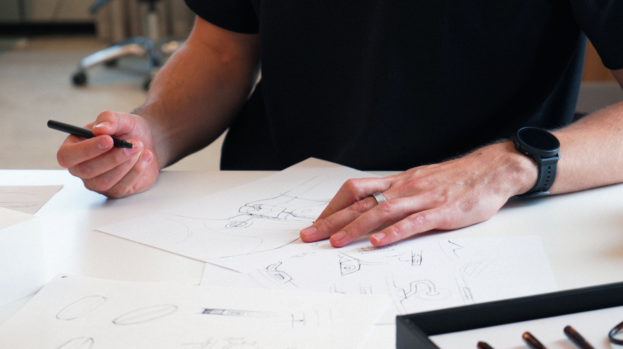
7/10
Where design and
technology unite
Photo: IXI

Slide 15
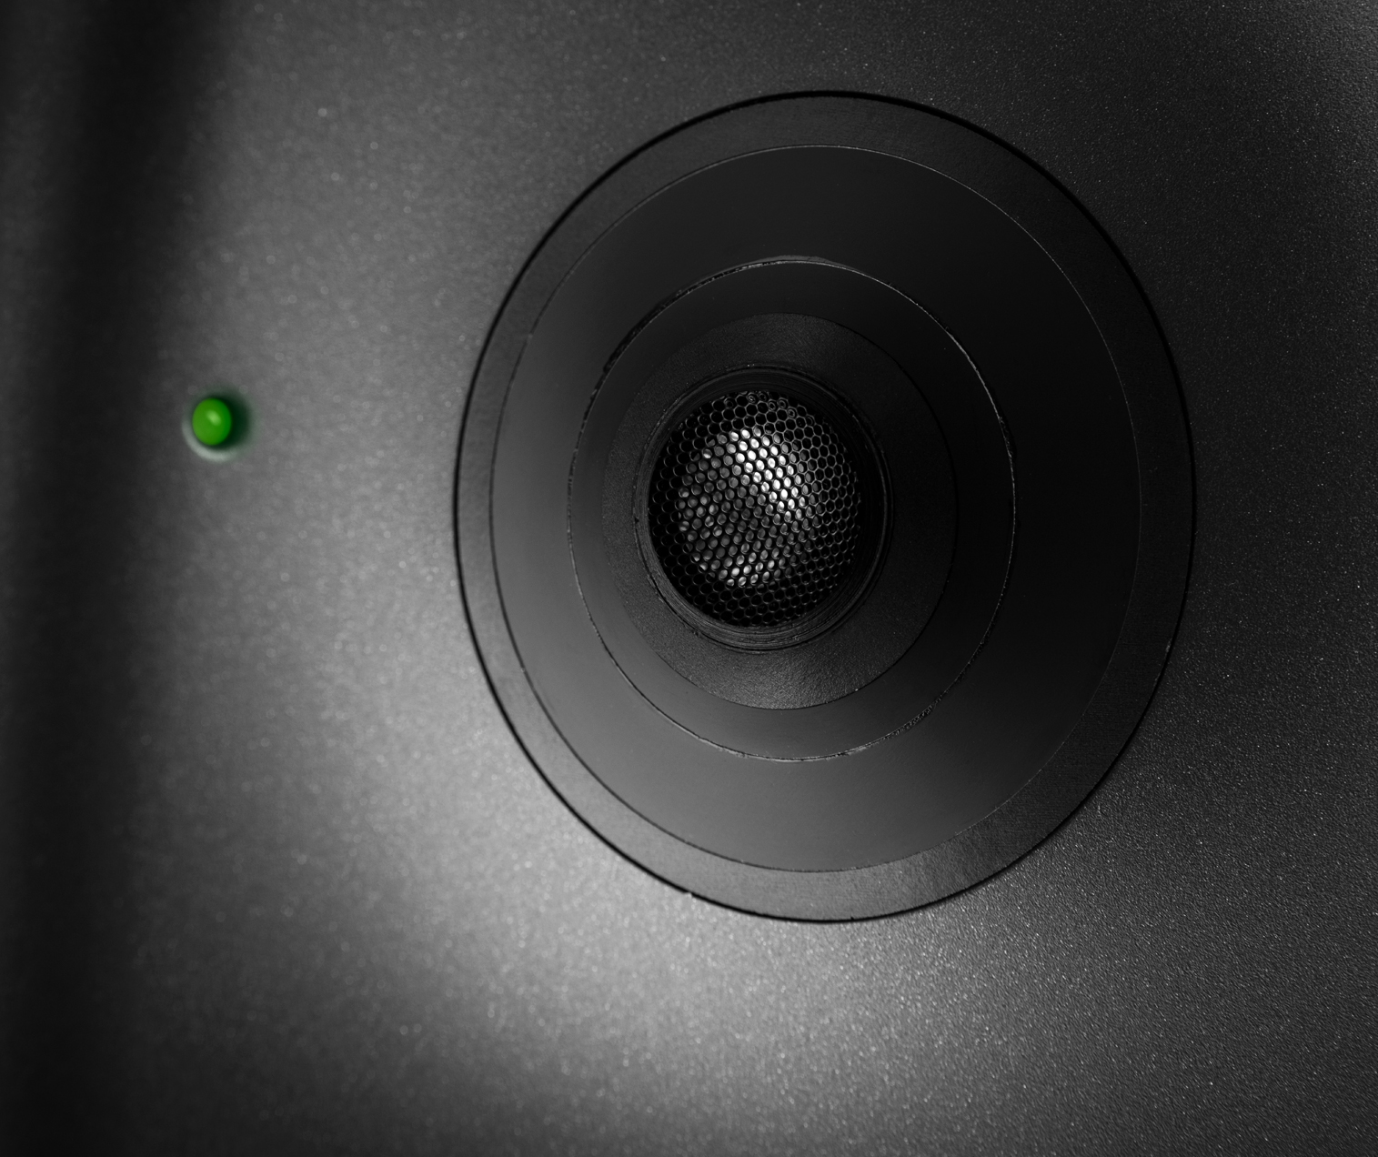
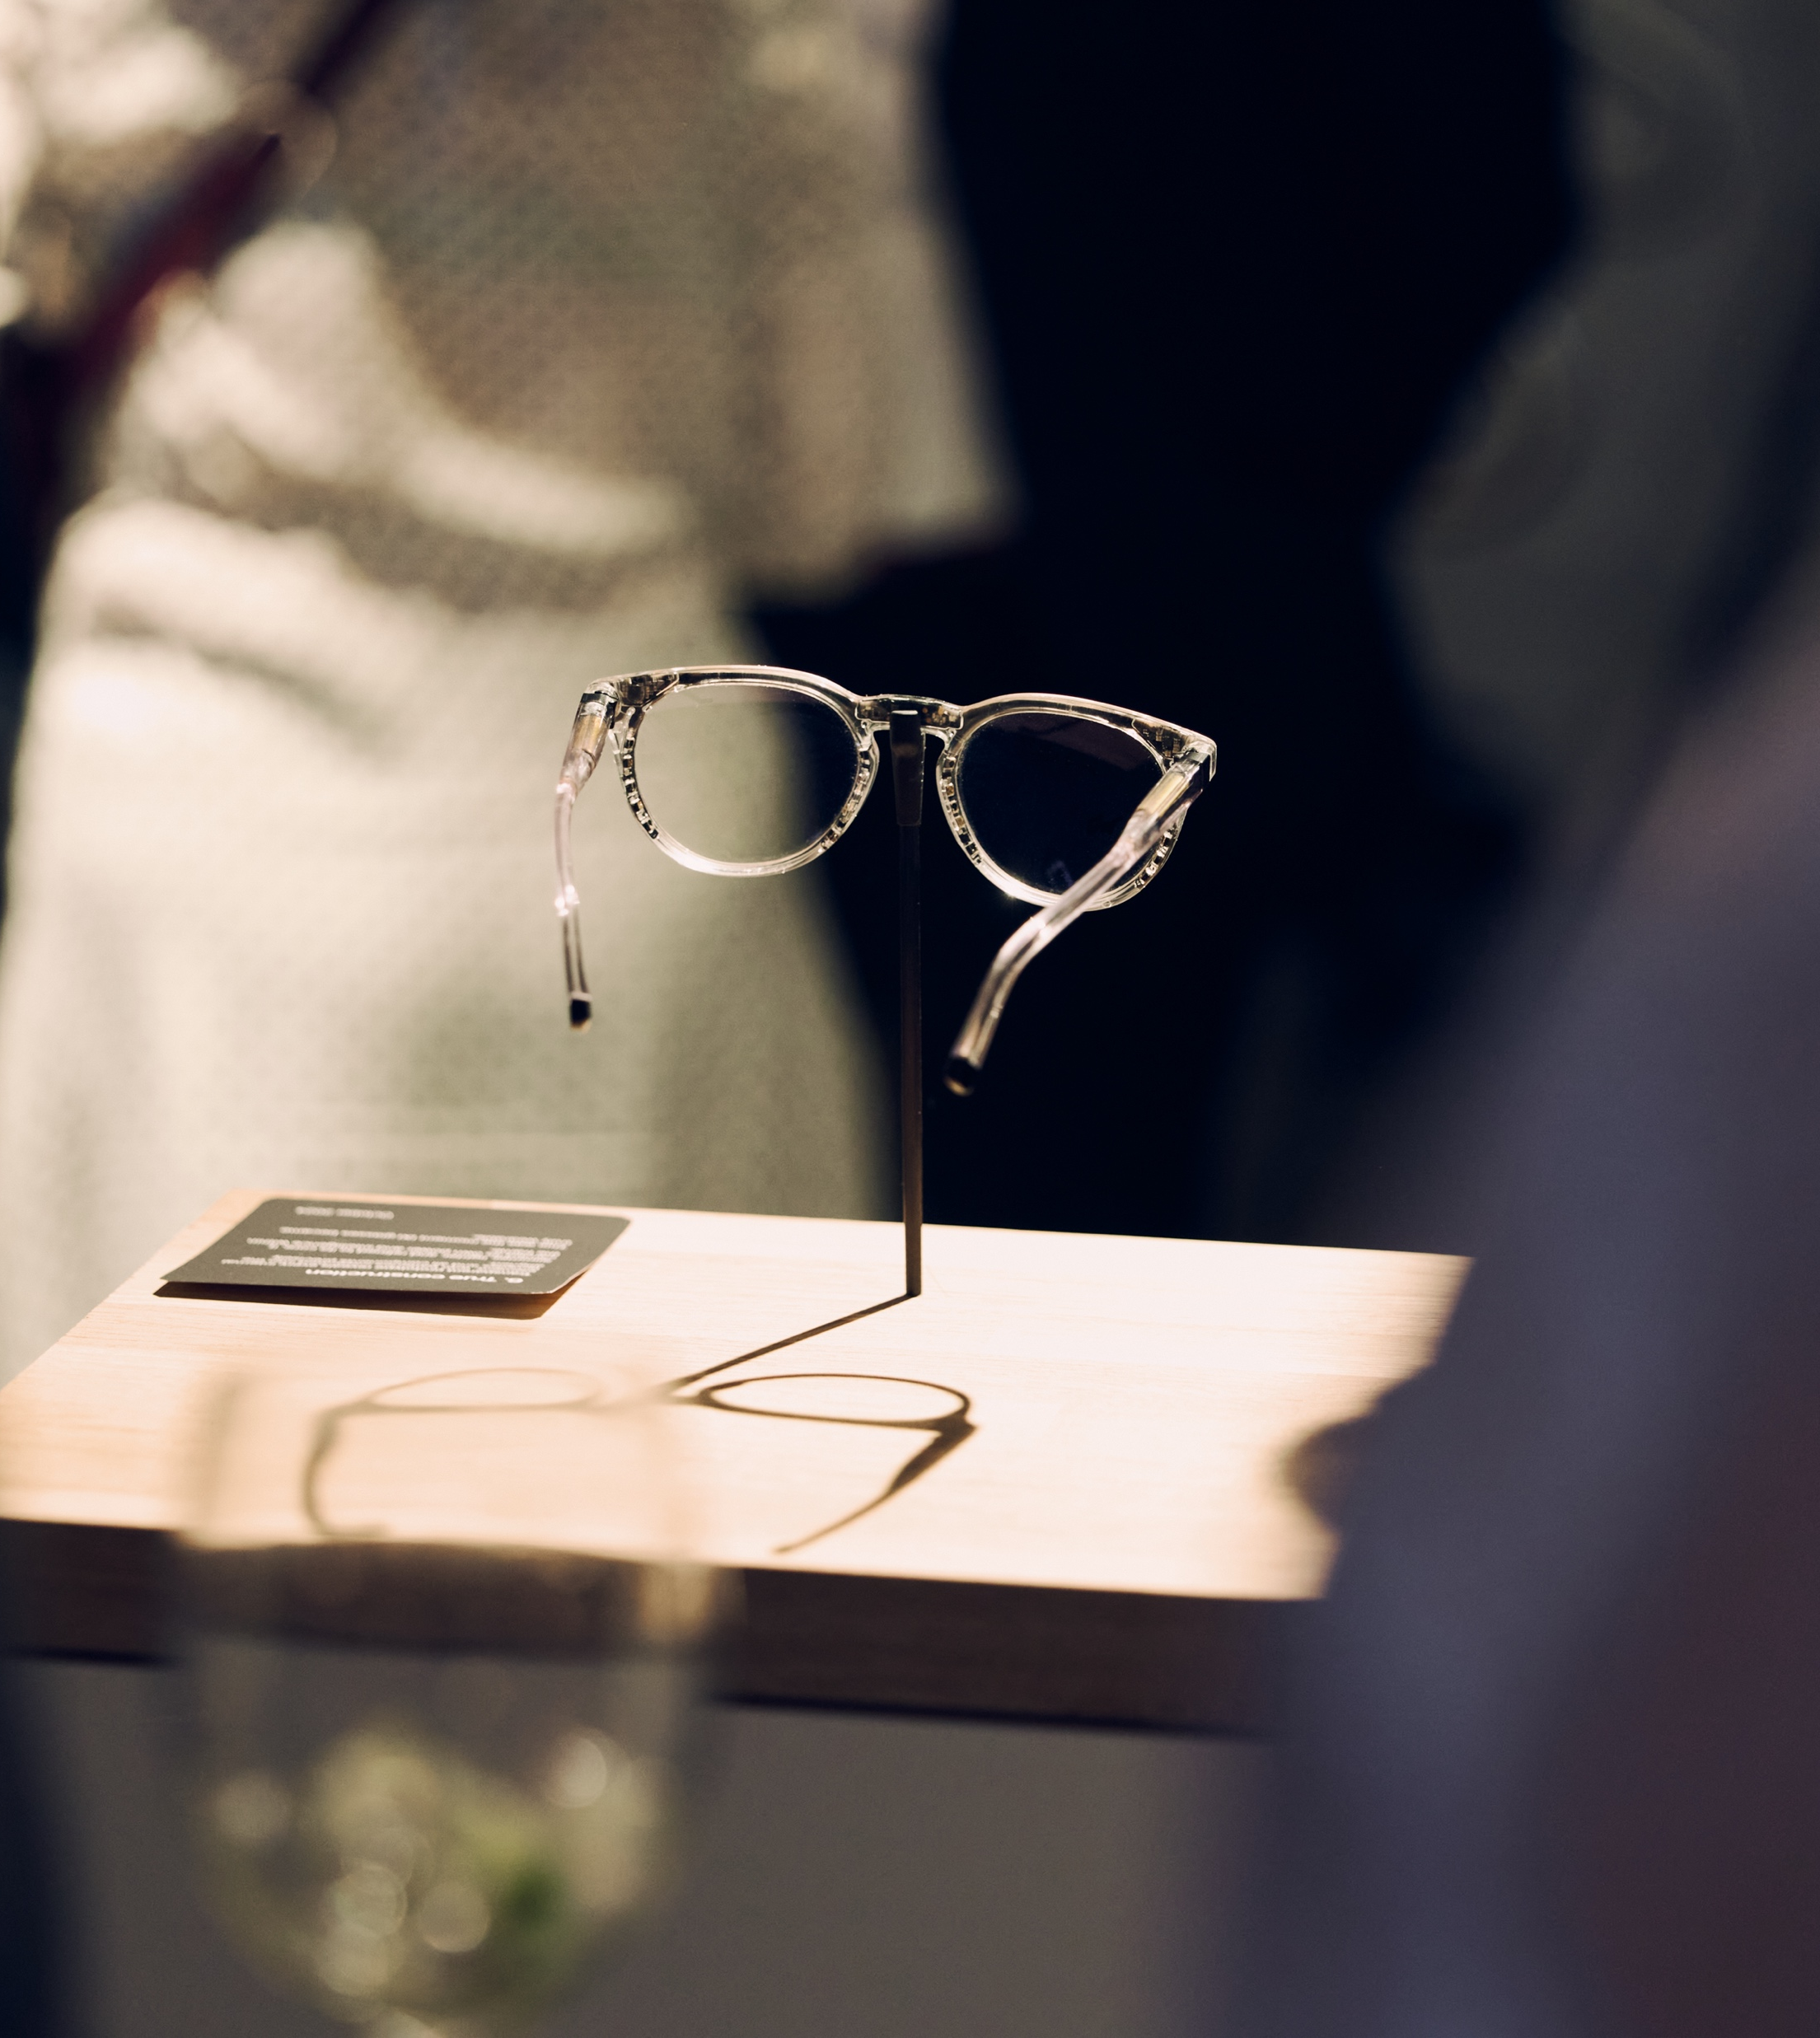
Where design and technology unite
10 PATTERNS OF FINNISH DESIGN
1
2
3
4
5
6
7
8
9
10
Finnish design
is driven by
how things work
It can be autofocusing eyewear, a ring that monitors your health, or a robot that delivers your groceries. In Finland, world-class creativity is inseparable from technical innovation. Soon, you’ll see this even more clearly...
Genelec is built on a foundation of respect and pure passion for truthful sound. “The quality of our solutions
has always been extremely important to us, and that is why our designs last for decades.” Photo: Genelec
IXI is developing the world’s first autofocus eyeglasses.
Eyewear that focuses as fast as your eyes do. Photo: IXI
Notes:
At the heart of Finnish design, there is a simple idea: how things work in real life – and this naturally brings design and technology together.
This mindset is deeply embedded in the Finnish design – in innovations that emerge at this intersection.
Take Oura, for example: a ring that combines advanced health technology with refined, wearable design.
Or the emerging startup IXI, developing what could become the world’s first autofocus eyeglasses – merging optics, real-time eye tracking and design.
In Finland, world-class creativity and technological innovation go hand in hand. Design doesn’t just shape how things look – it defines how they work, and how they fit into our lives.

Slide 16
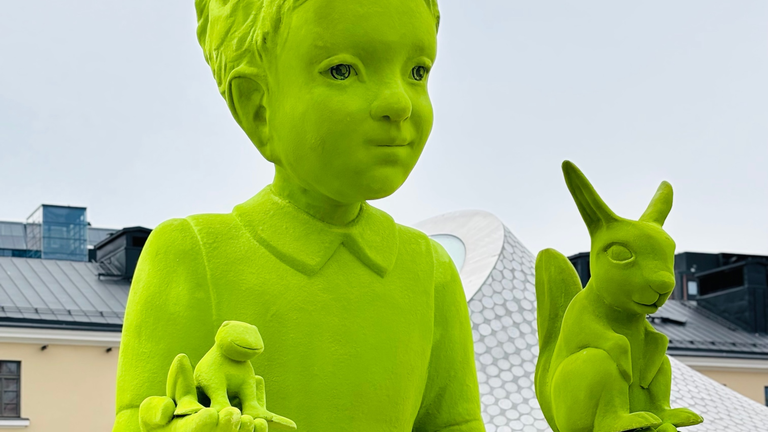
8/10
Recipe for happiness?
Artwork: Moss people by Kim Simonsson, Amos Rex collection.
Photo: Joseph Harwood / Helsinki Partners.

Slide 17
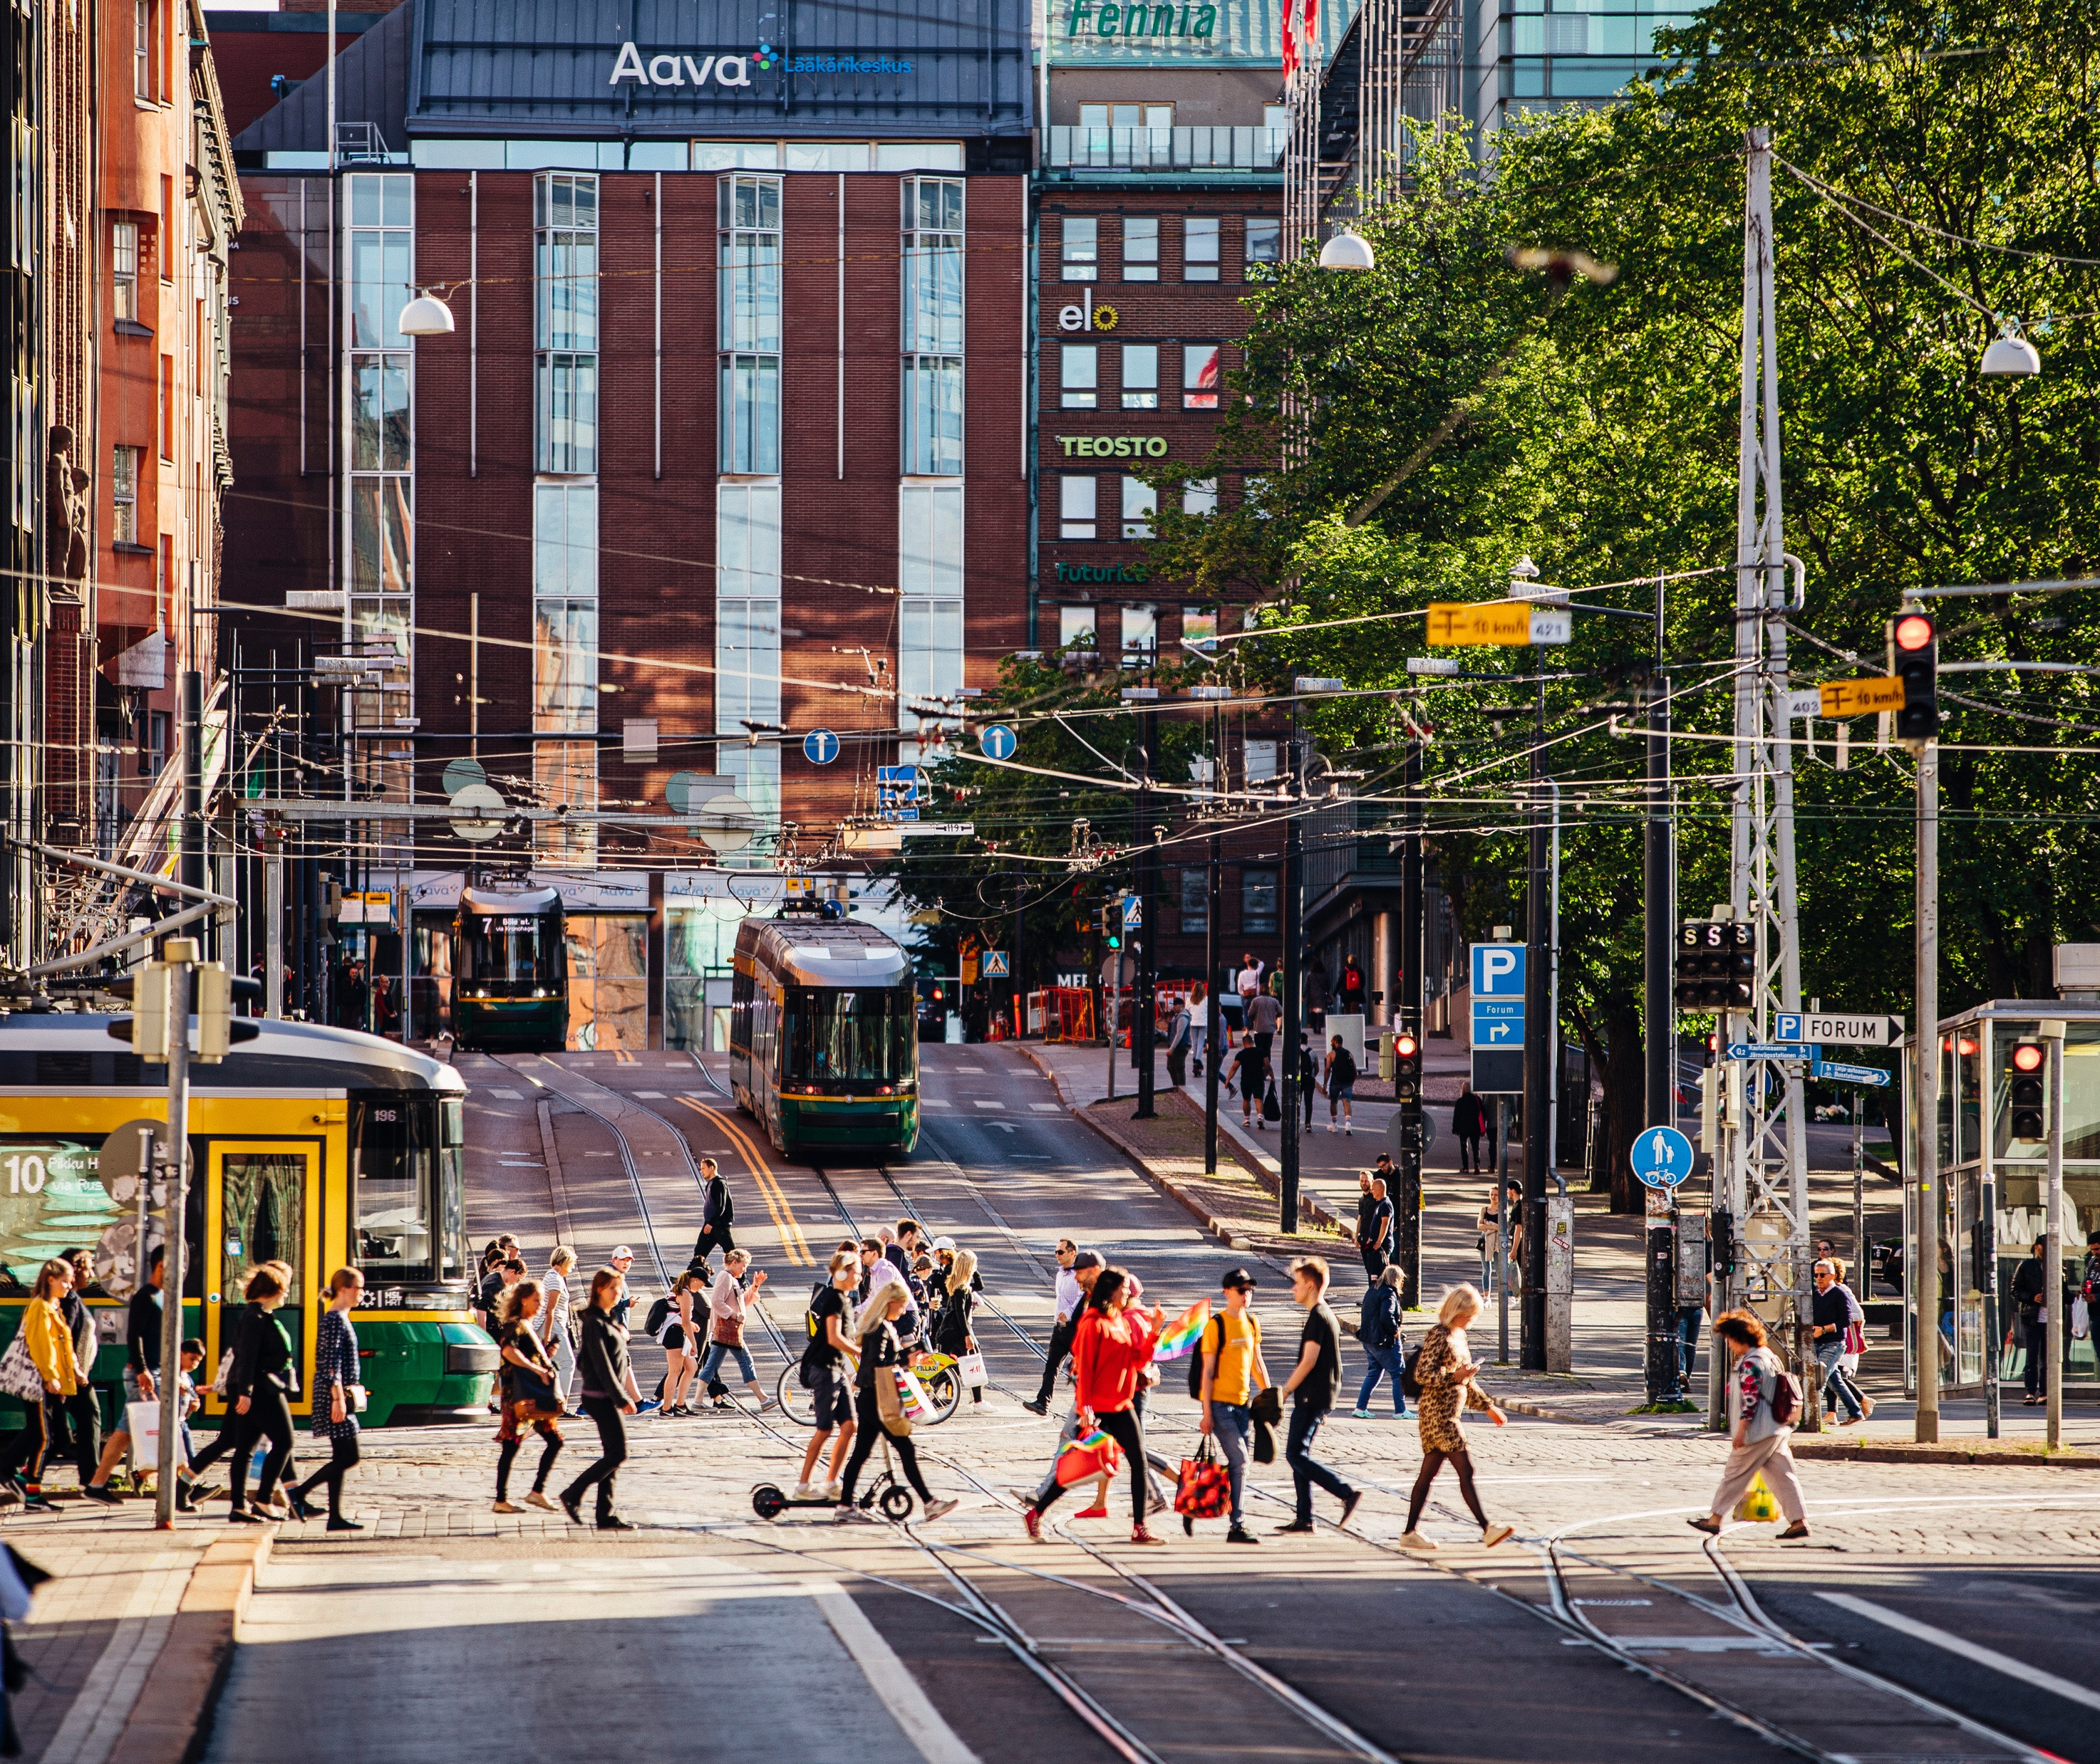
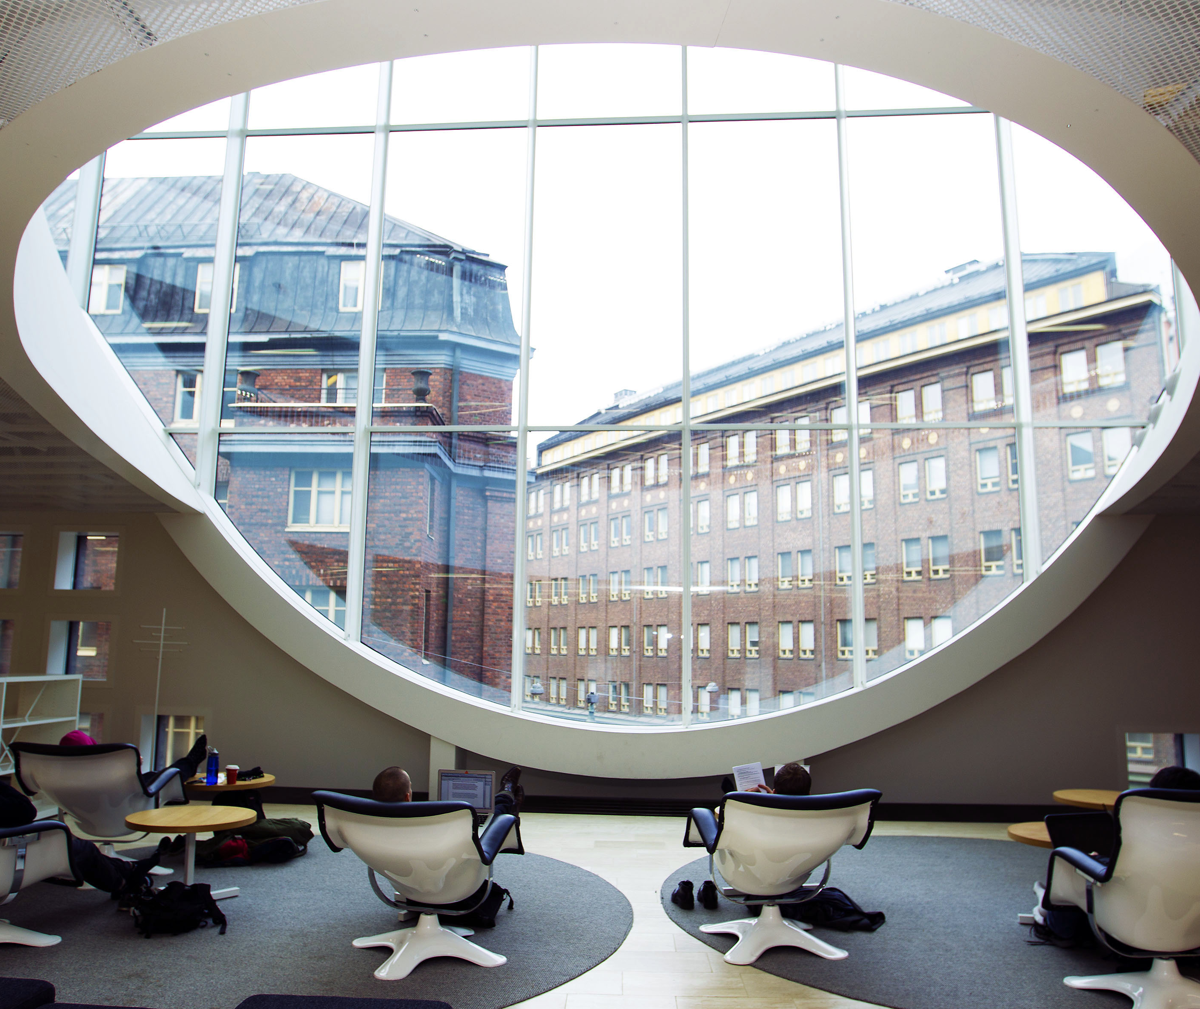
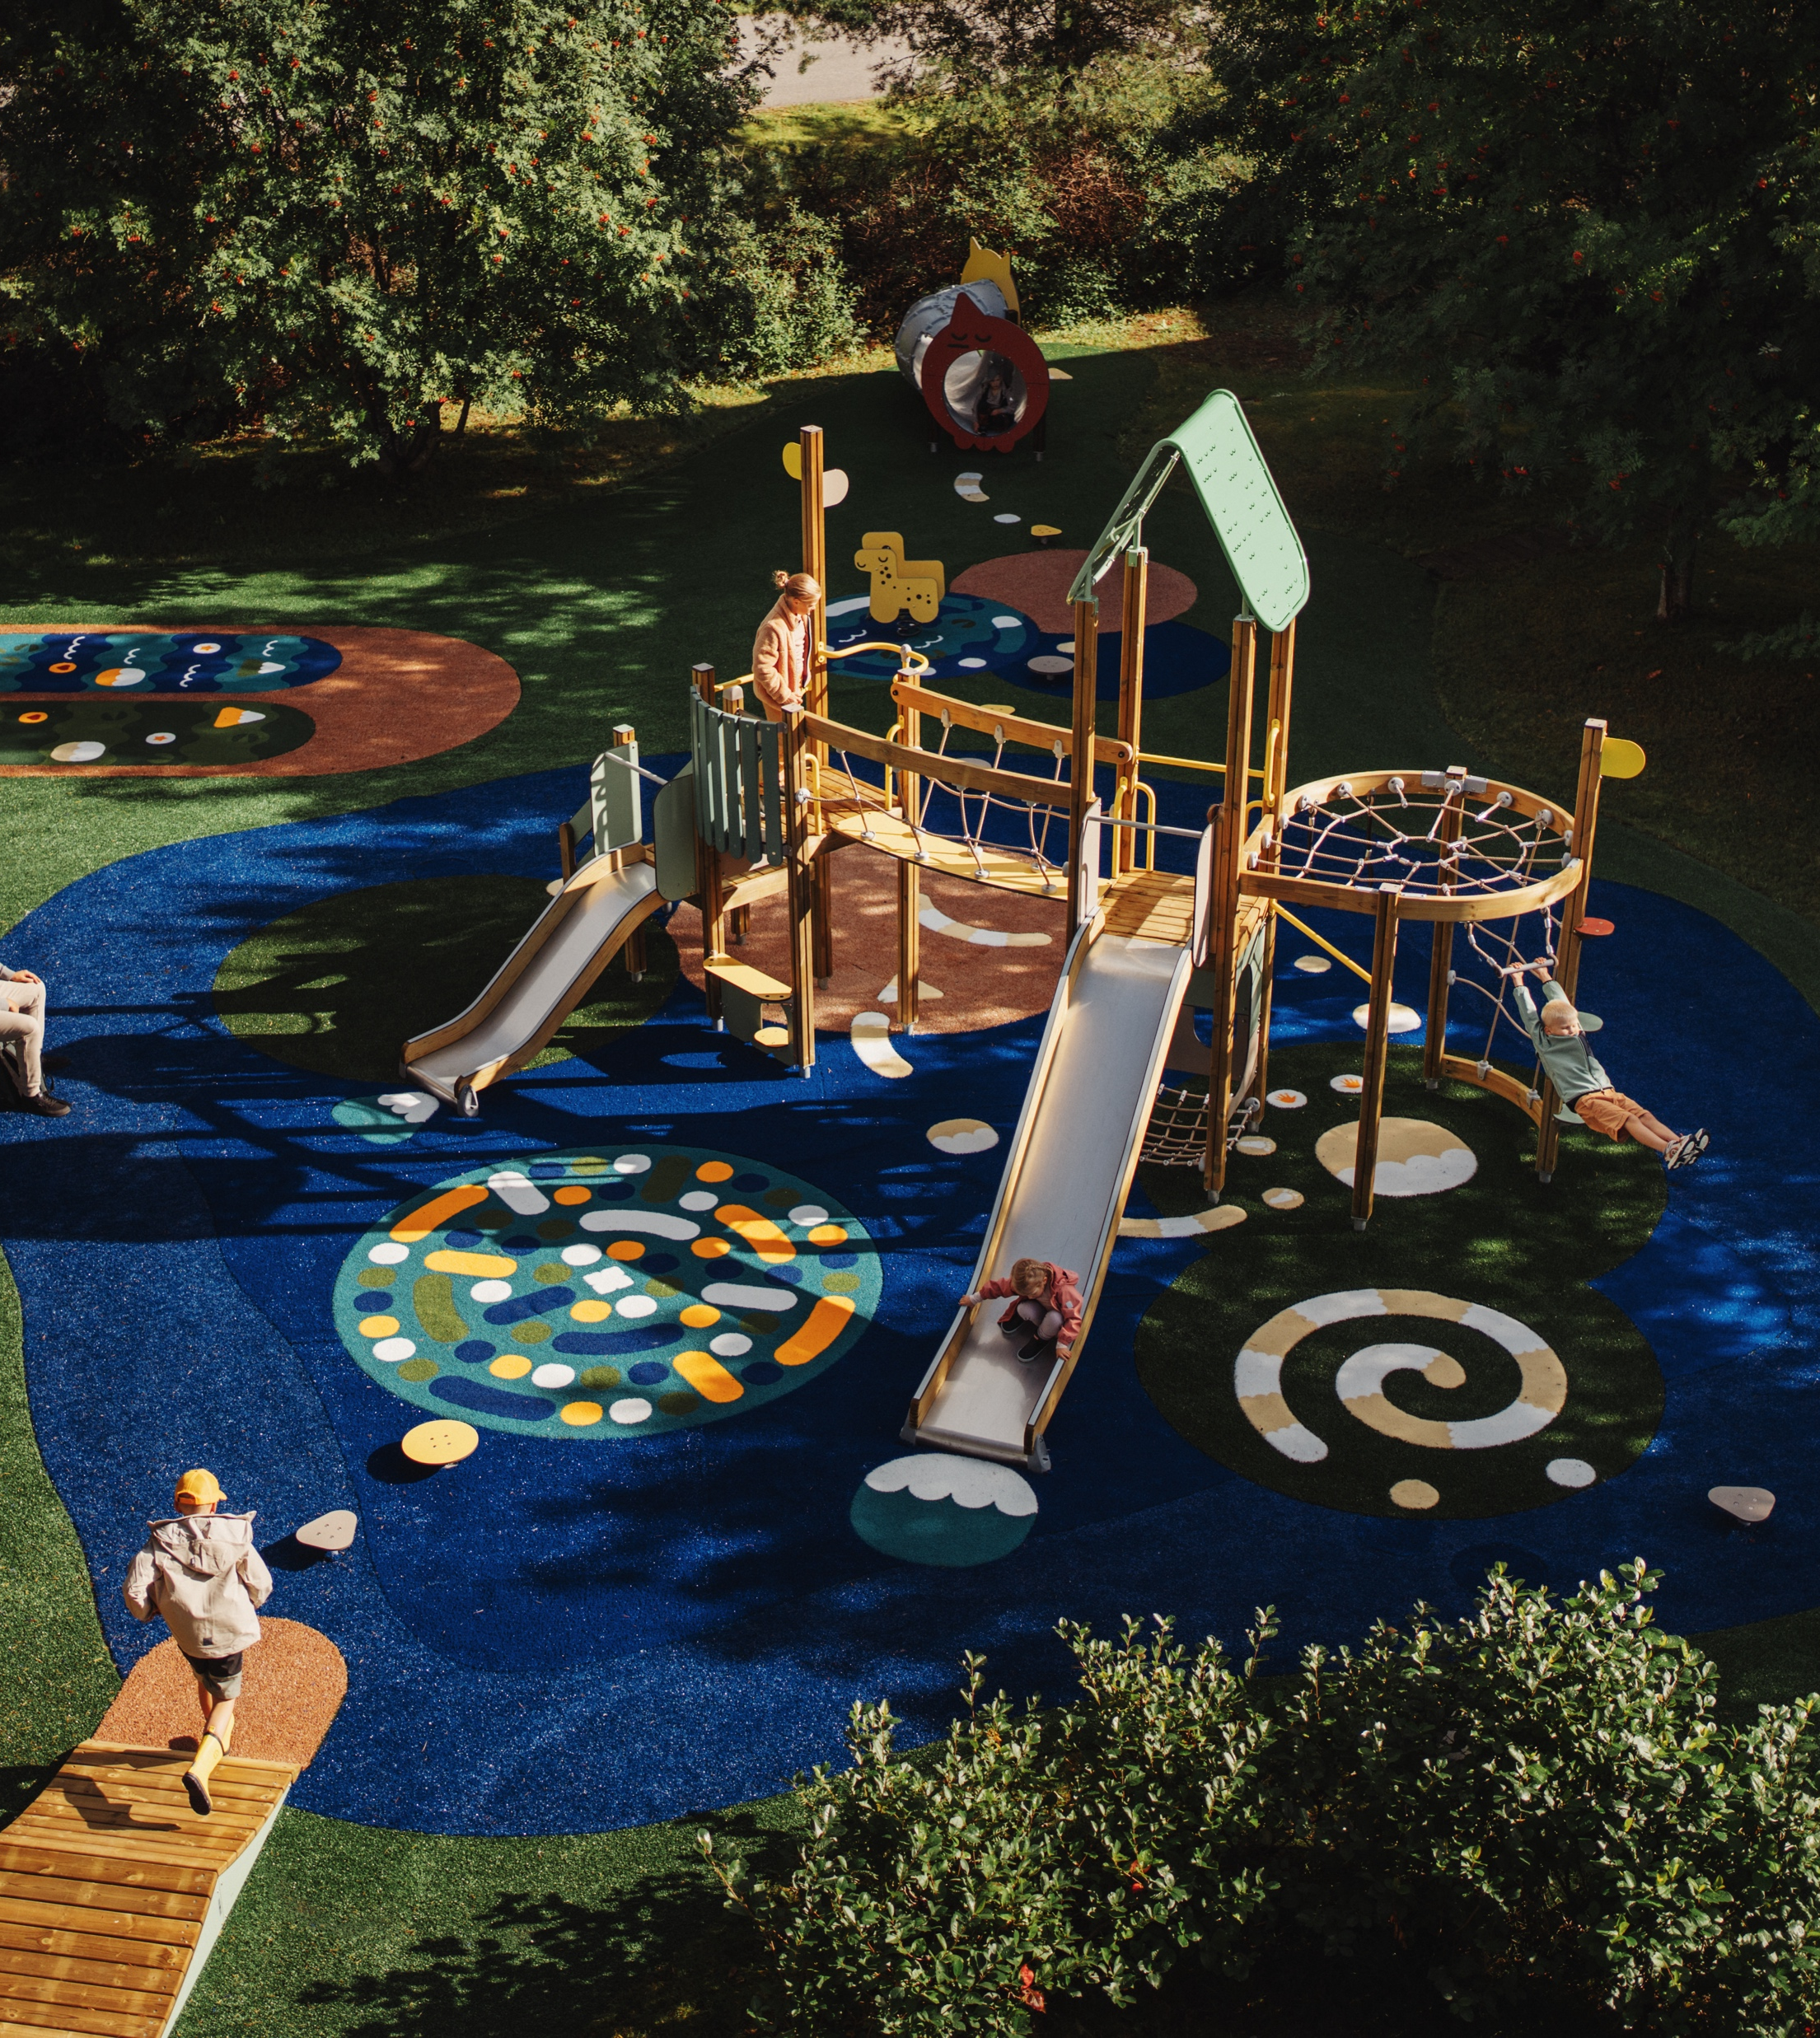
Recipe for happiness
10 PATTERNS OF FINNISH DESIGN
1
2
3
4
5
6
7
8
9
10
Design thinking
shapes everyday life
in Finland
From playgrounds and everyday objects to public services, functional design thinking is embedded in Finnish society. Perhaps that’s why Finland has been named the world’s happiest country ninth time in a row.
Helsinki University Main Library (Kaisa House), designed by Anttinen Oiva Architects – with Yrjö Kukkapuro’s
Karuselli chair (1964), an icon of Finnish design known for its organic form and ergonomic innovation.
Photo: Linda Tammisto / Helsinki Partners
Photo: Jussi Hellsten / Helsinki Partners
Lappset playground – designed to spark joy, imagination and active play.
Photo: Lappset
Notes:
From playgrounds and everyday objects to public services, functional design thinking is embedded in Finnish society. Perhaps that’s why Finland has been named the world’s happiest country multiple times in the UN World Happiness Report.
This raises an interesting question: can happiness be designed?
In Finland, design is not something separate – it is part of everyday life. We see it in open, accessible libraries, in public spaces, and in the objects we use from childhood to old age. We sit on the same Artek chairs in kindergarten and in retirement homes.
In this way, design and happiness become lifelong experiences – shaped by functionality, accessibility and a human-centered approach.

Slide 18
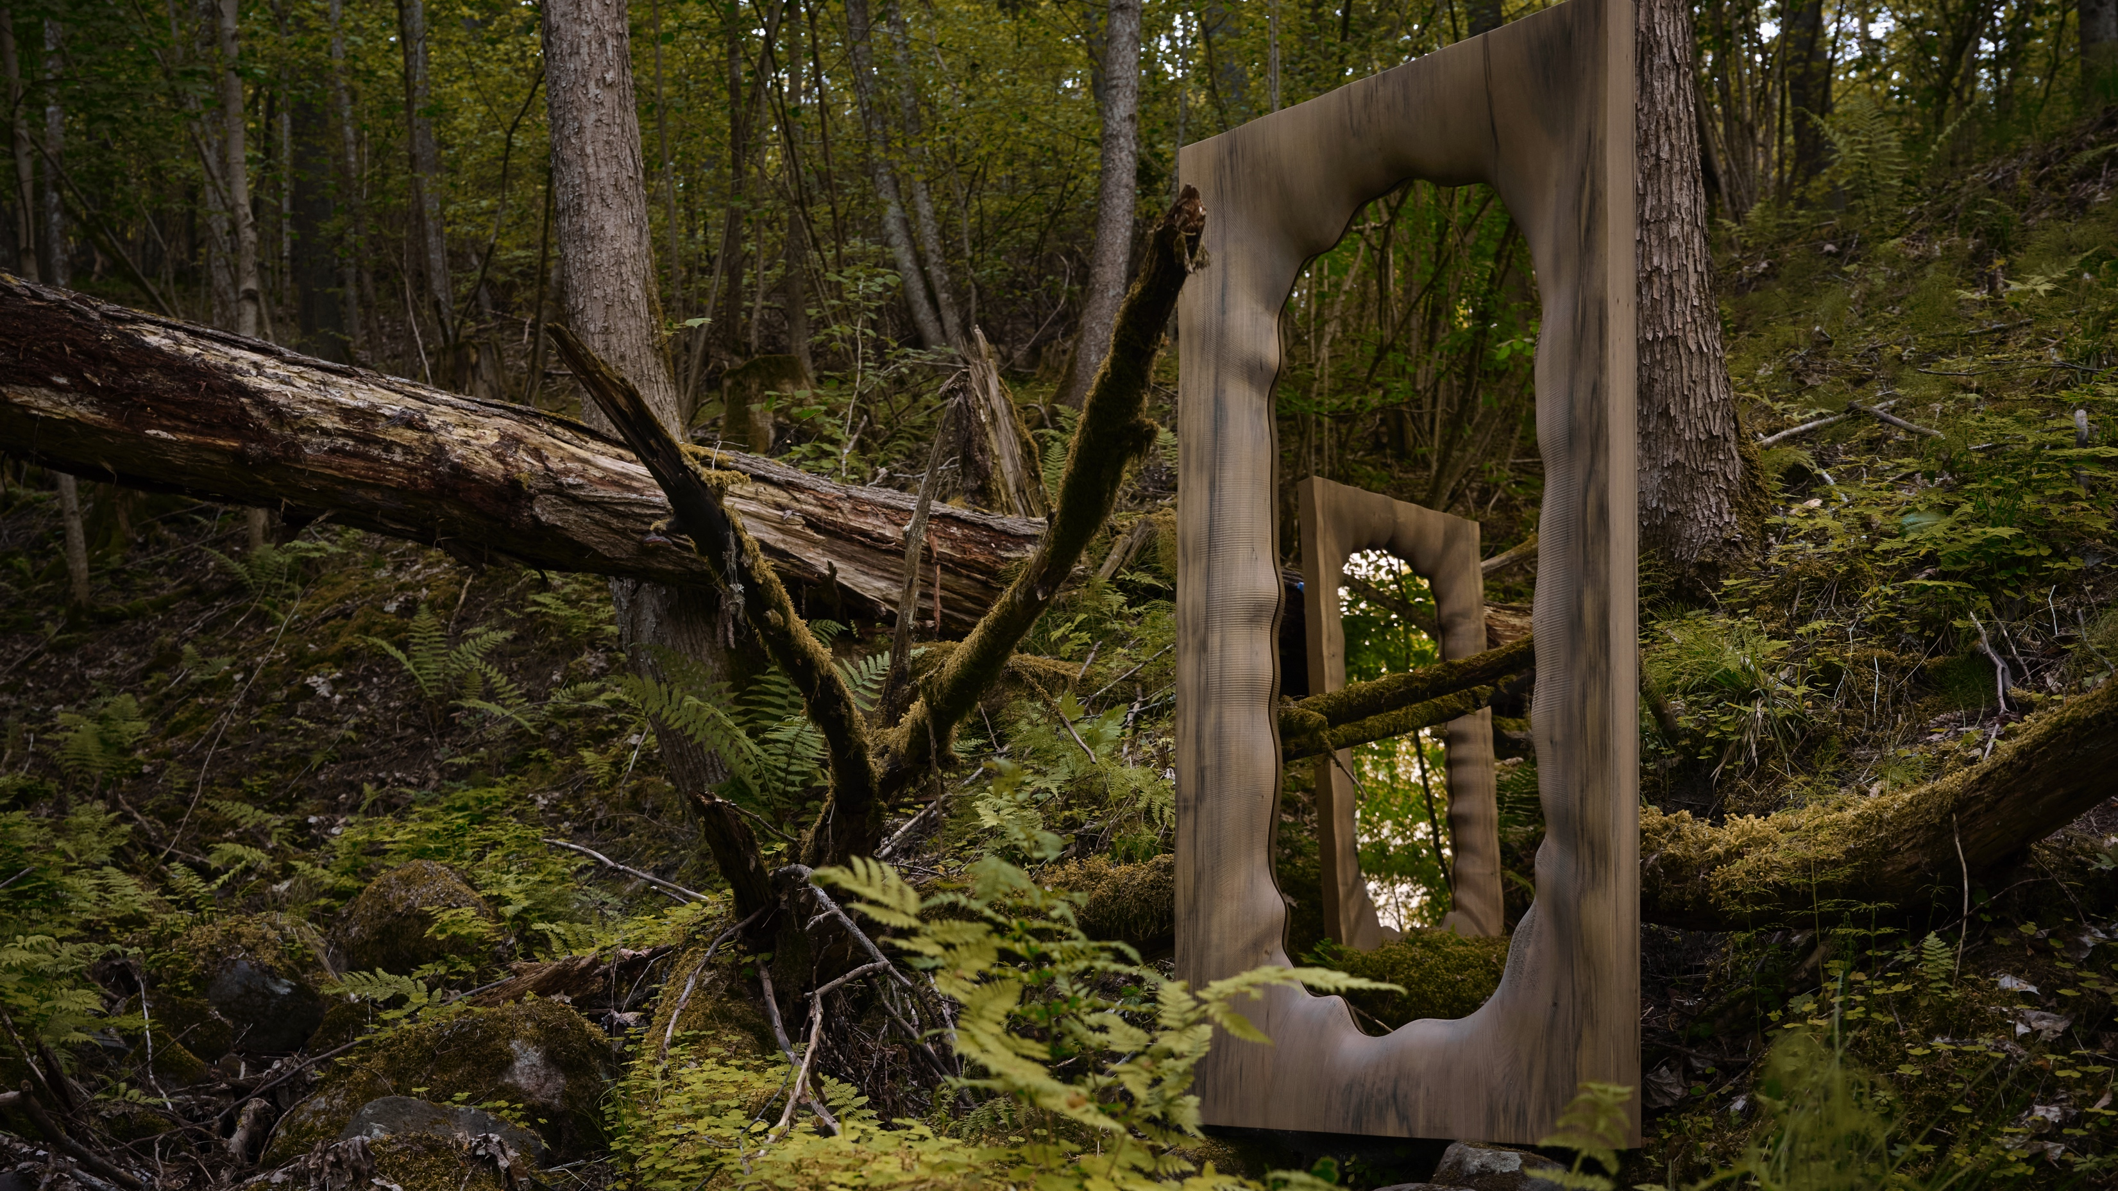
9/10
We see the forest
and the trees
Antrei Hartikainen, an award-winning Finnish master cabinetmaker and designer, explores
the diverse possibilities of wood through form, technique and expression. Photo: Ville Vappula for Antrei Hartikainen

Slide 19
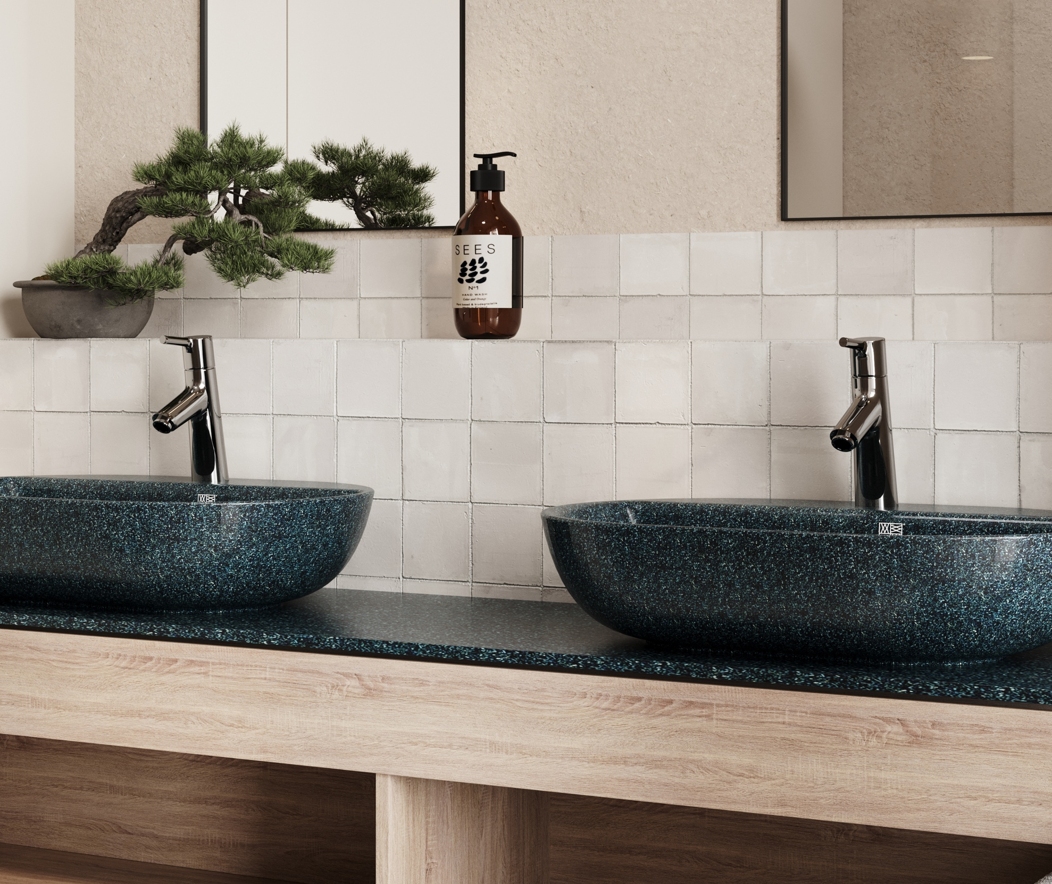
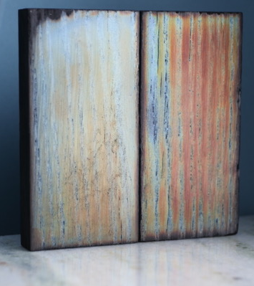
We see the forest and the trees
10 PATTERNS OF FINNISH DESIGN
1
2
3
4
5
6
7
8
9
10
Finnish design draws inspiration – and materials – from nature
Yes. These sinks are wooden. Wood is not just material for a chair or a table. It is a muse and a mentor. Natural materials are a sustainable choice that reflects our deep connection to nature.
Woodio leverages its substantial innovation in forest technology for interior design expertise. Its waterproof wood composite
can replace ceramics and other high-carbon footprint materials in bathroom interiors. Photo: Woodio
Shimber is an iridescent coating made from wood that not only redefines aesthetics in fashion
and luxury but also opens new frontiers in sustainable surfaces for design and architecture.
Photo: Shimber
Notes:
Wood is the material that warms our winters, shapes our homes, and brings the quiet rhythm of the forest into everyday life.
In Finnish design, wood is never just a material – it’s a collaborator. It reflects a way of thinking shaped by our environment: long winters, limited resources, and a close relationship with nature. These conditions have taught us to value durability, resourcefulness and respect for materials.
Sustainability, in this context, is not a separate goal. It is embedded in the way things are made – using materials wisely and creating objects that are meant to last.
Today, this mindset continues to shape Finnish design. From timeless wooden objects to new material innovations, the same principles apply: simplicity, longevity, and a balance between people, materials and the environment.

Slide 20
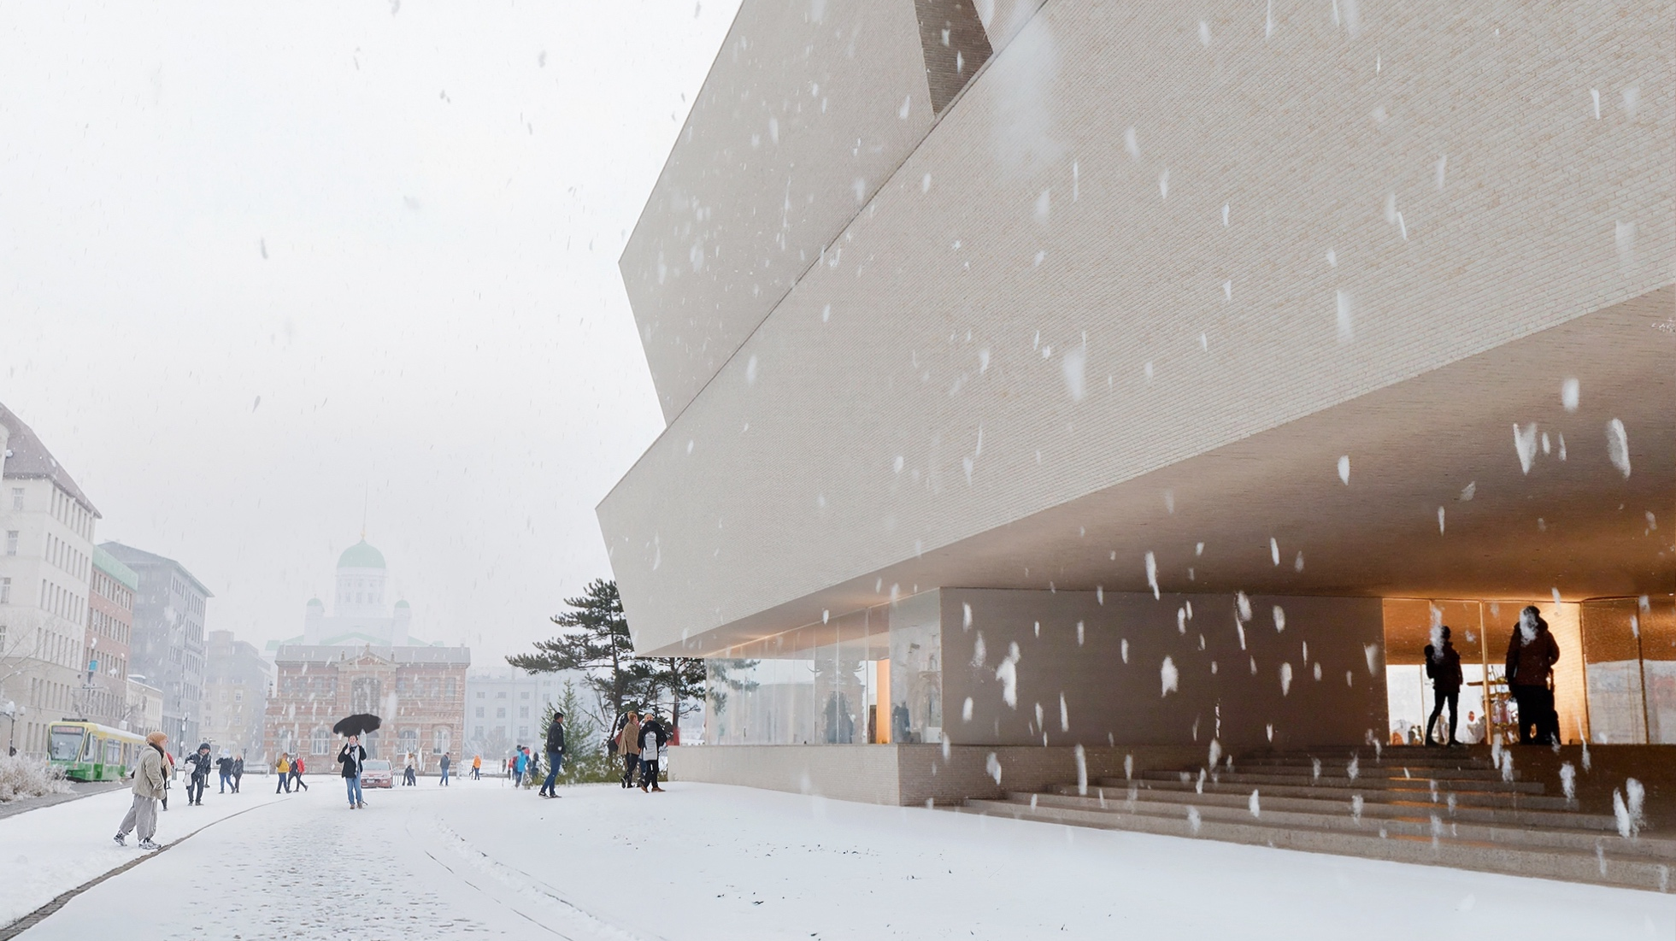
10/10
In spring, fall, and even winter
– design is always in season
Photo: JKMM Architects

Slide 21
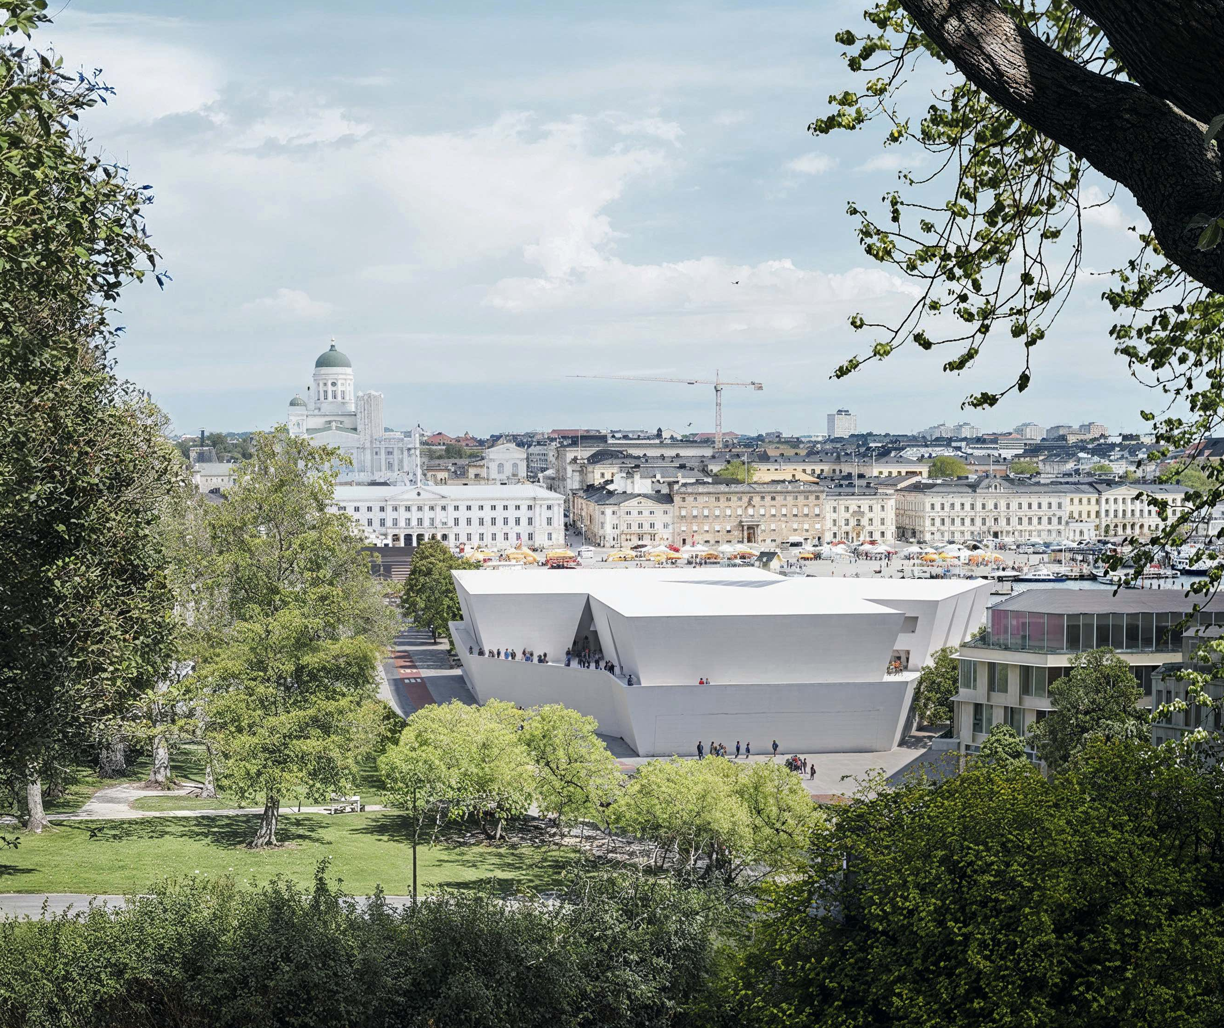
In spring, fall, and even winter – design is always in season
10 PATTERNS OF FINNISH DESIGN
1
2
3
4
5
6
7
8
9
10
A new design and architecture museum opens in Helsinki in 2030
– and before that you can experience Finnish design at events all year round!
Photo: JKMM Architects. JKMM Architects won the international competition for Finland’s
new Museum of Architecture and Design with “Kumma,” chosen from 624 proposals worldwide.
Notes:
Opening in the heart of Helsinki in 2030, the museum will celebrate Finnish design’s roots and future – and invite everyone to join the journey.
But you don’t have to wait until then: one of the best times to explore Finnish design is every September, when Helsinki Design Week, the Nordic region’s largest interior fair Habitare, and Aalto University’s Designs for a Cooler Planet exhibition all take place — and the calendar doesn’t stop there: from Fashion in Helsinki in May to Slush in November, Finland breathes design all year round. Welcome!

Slide 22
11/10
11/10
An extra skylight
with views to
common ground.
Epilogue

Slide 23
Epilogue
10 PATTERNS OF FINNISH DESIGN
1
2
3
4
5
6
7
8
9
10
11
Any note
can be written here.
This is a place for
more detailed information.
You can use this page to highlight connections between Finnish cinema and your country, shared projects, or even interesting upcoming events.
Photo: xxx
Notes:
Tähän osioon voi koota vastaanottajan ja tilanteen mukaan personoitavia asioita, toki design-kulman huomioiden.

Slide 24
Let’s take a seat and talk about how to shape the future, together.

