Slide 1
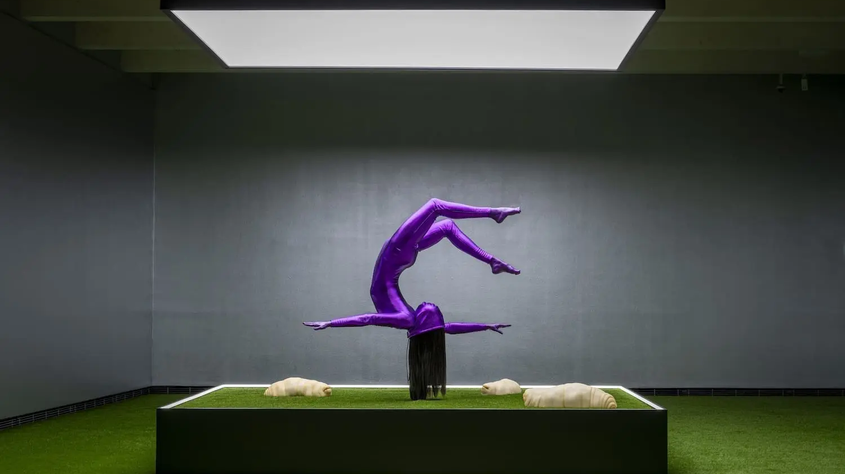

10 HIGHLIGHTS OF
FINNISH CONTEMPORARY ART
Moment (2023). Anna Estarriola.
Photo: Sampo Linkoneva – Serlachius Museums
Notes:
Finland’s contemporary art scene embraces everything from flagship art institutions to commercial galleries and experimental, grassroots art initiatives. There are over 3,000 professional visual artists, more than 60 art museums, and numerous galleries packed into this northern country. Also, there are over 50 international artist residencies in Finland – the most in the world relative to the population.

Slide 2
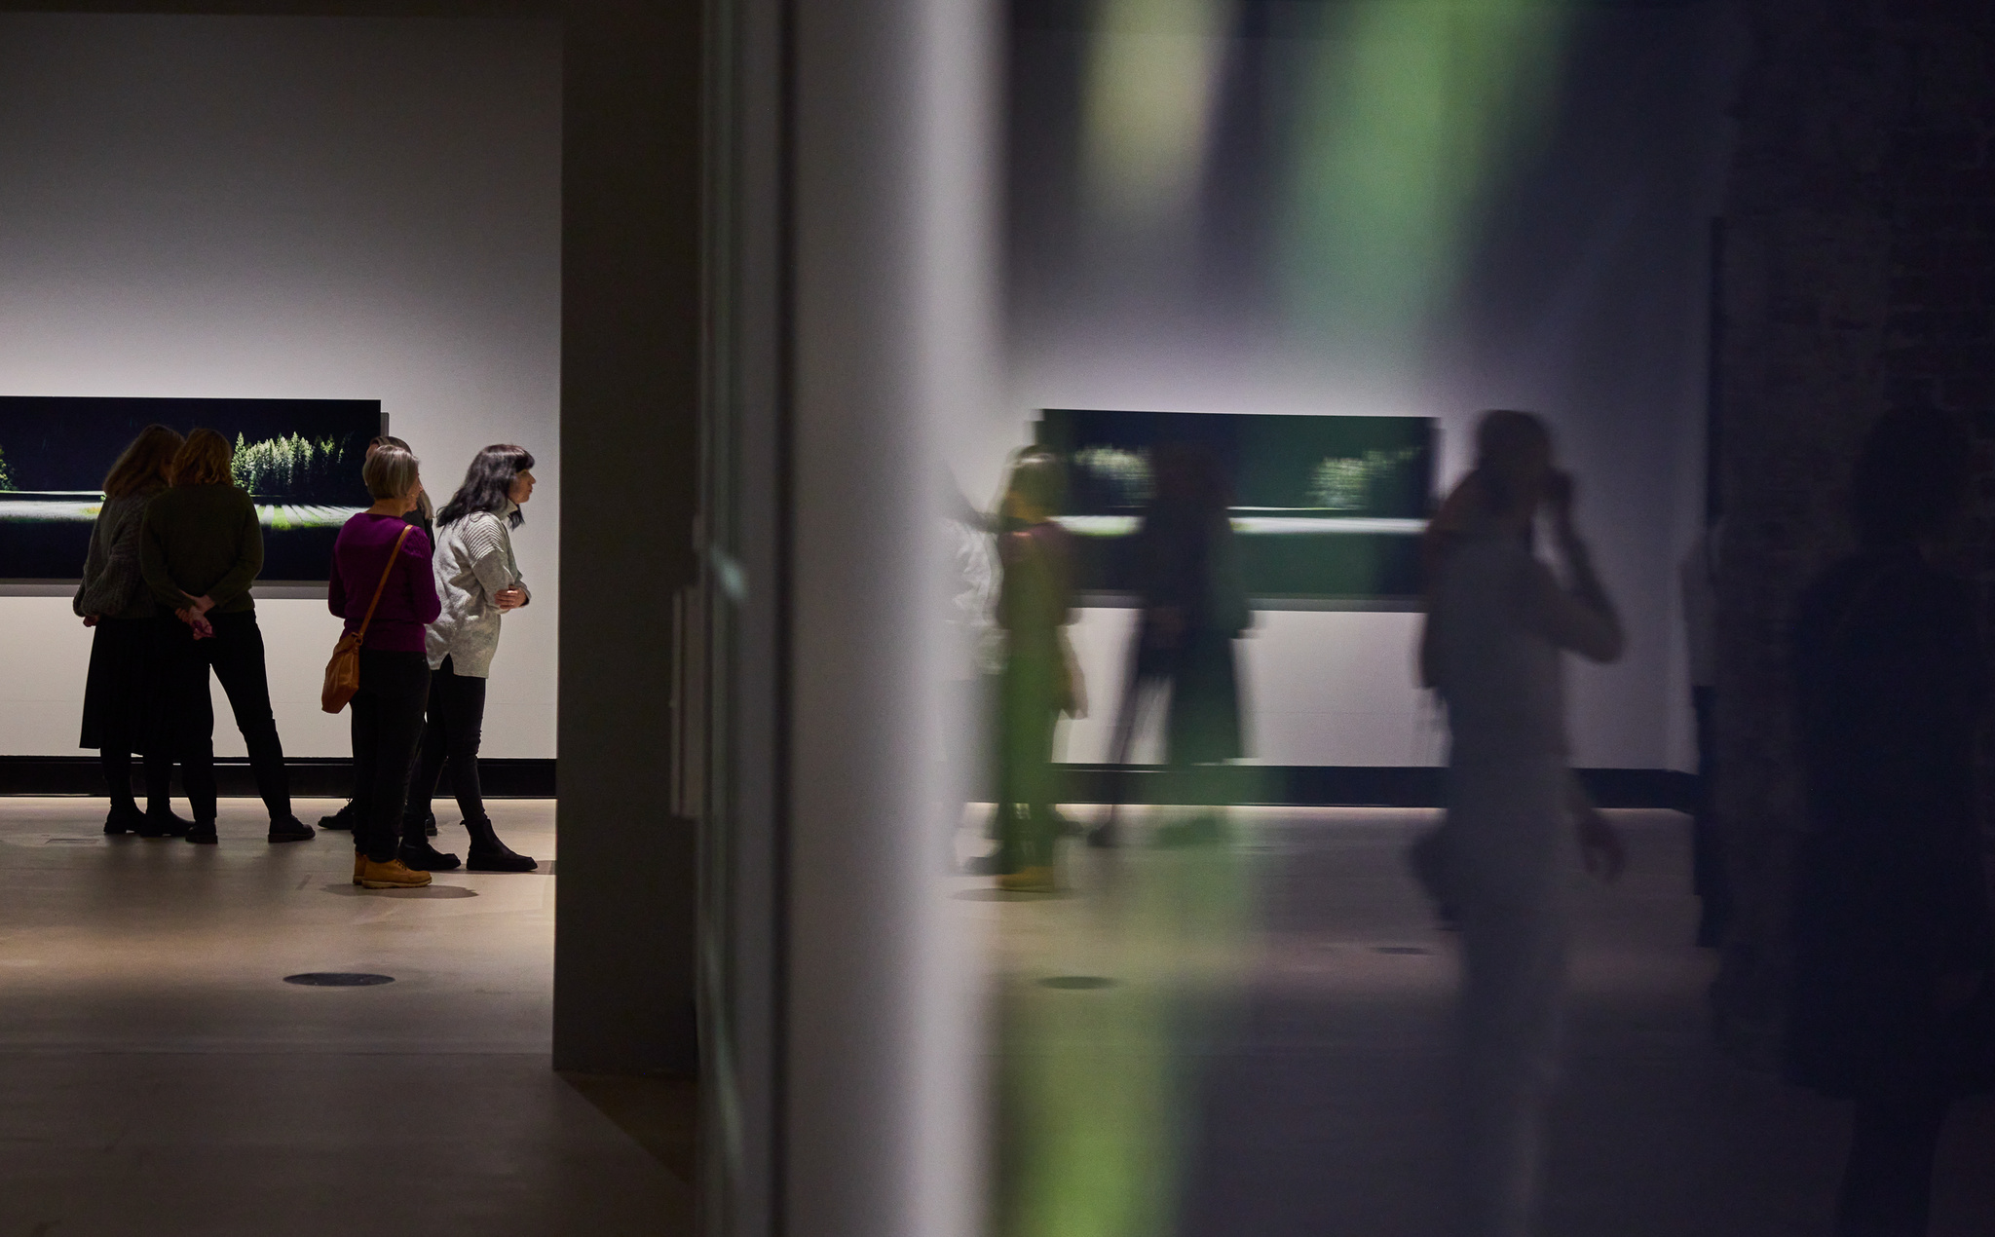
1/10
Finnish museum scene is
exhibiting record numbers
Malva. Photo: Tommi Mattila

Slide 3
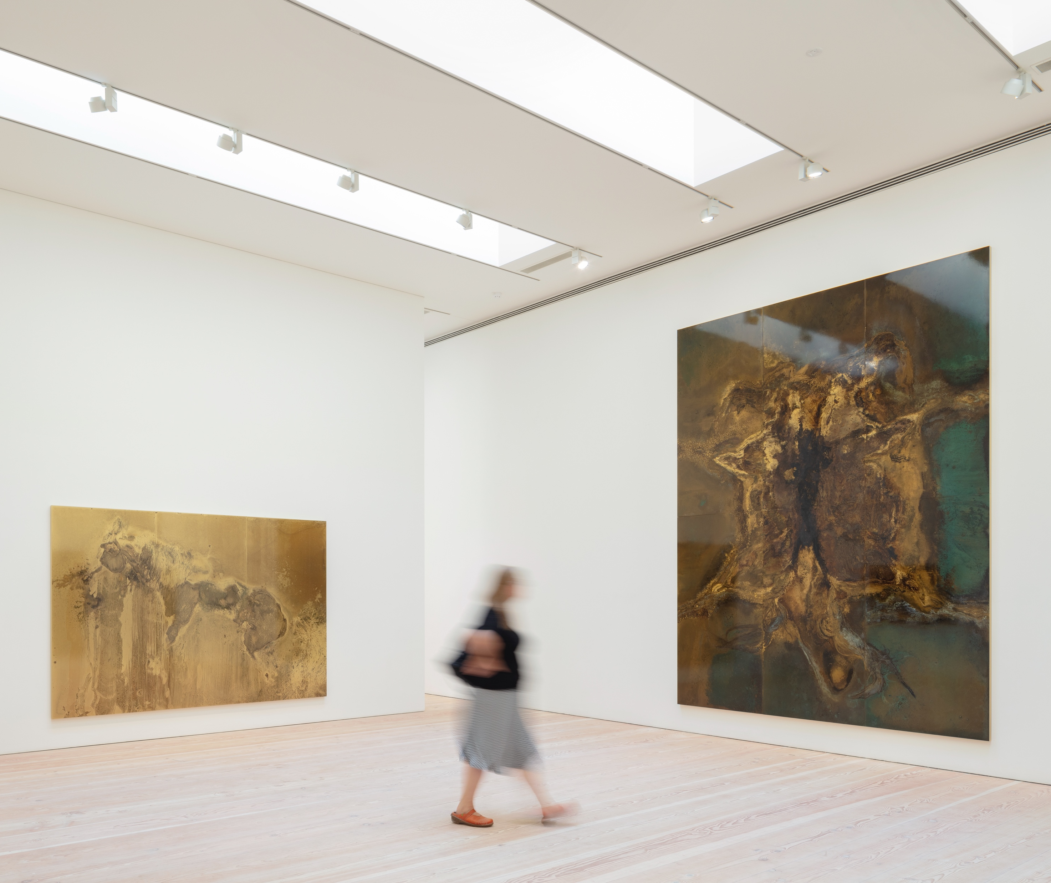
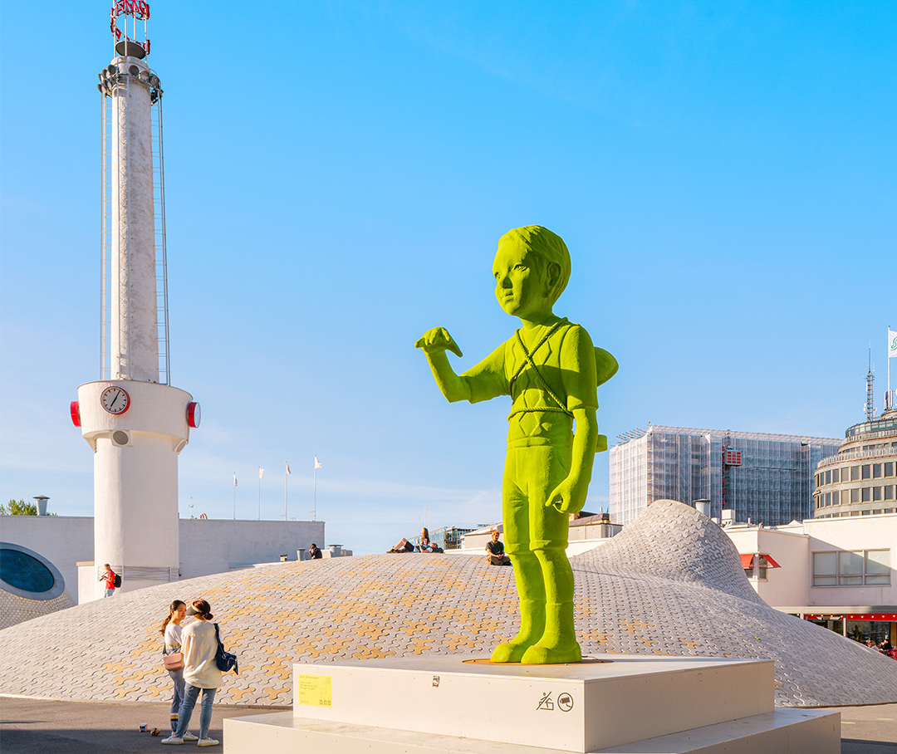
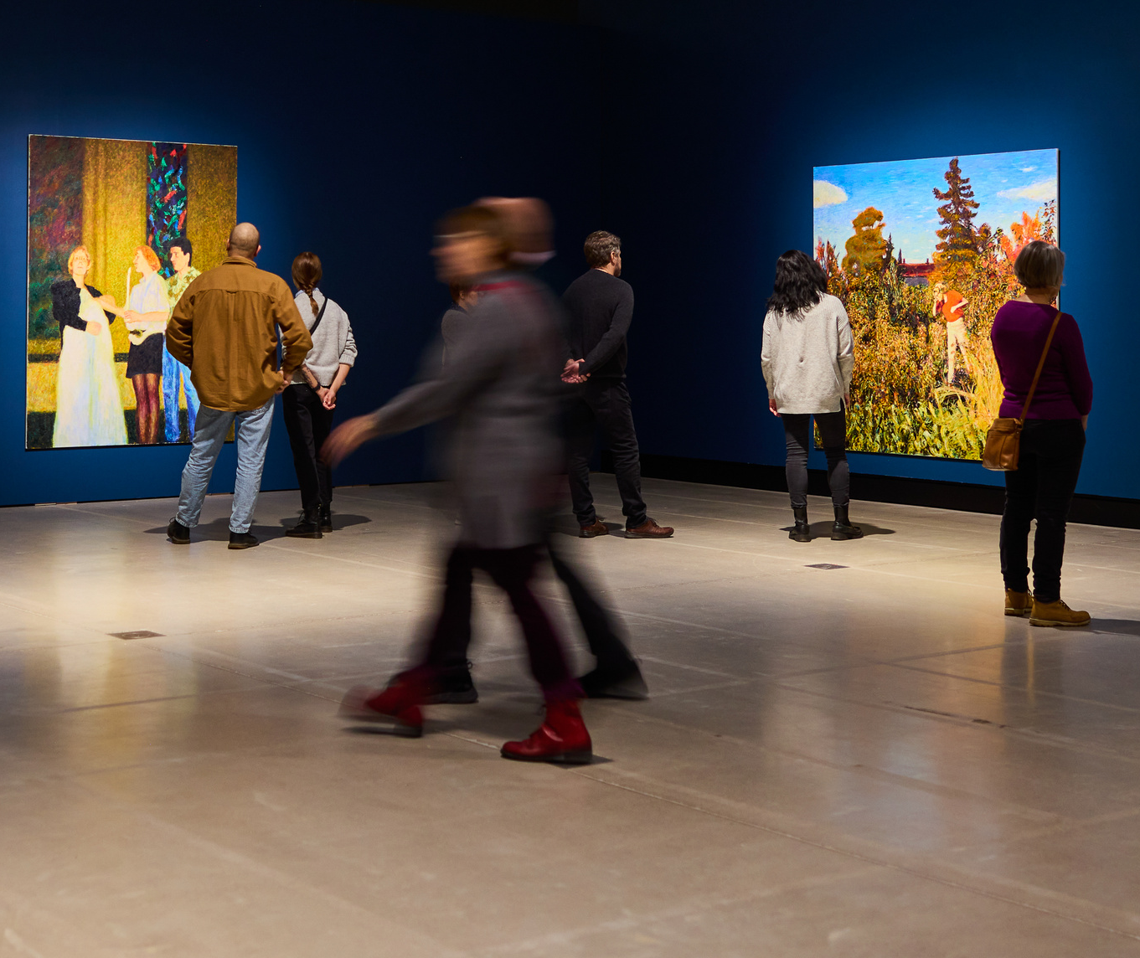
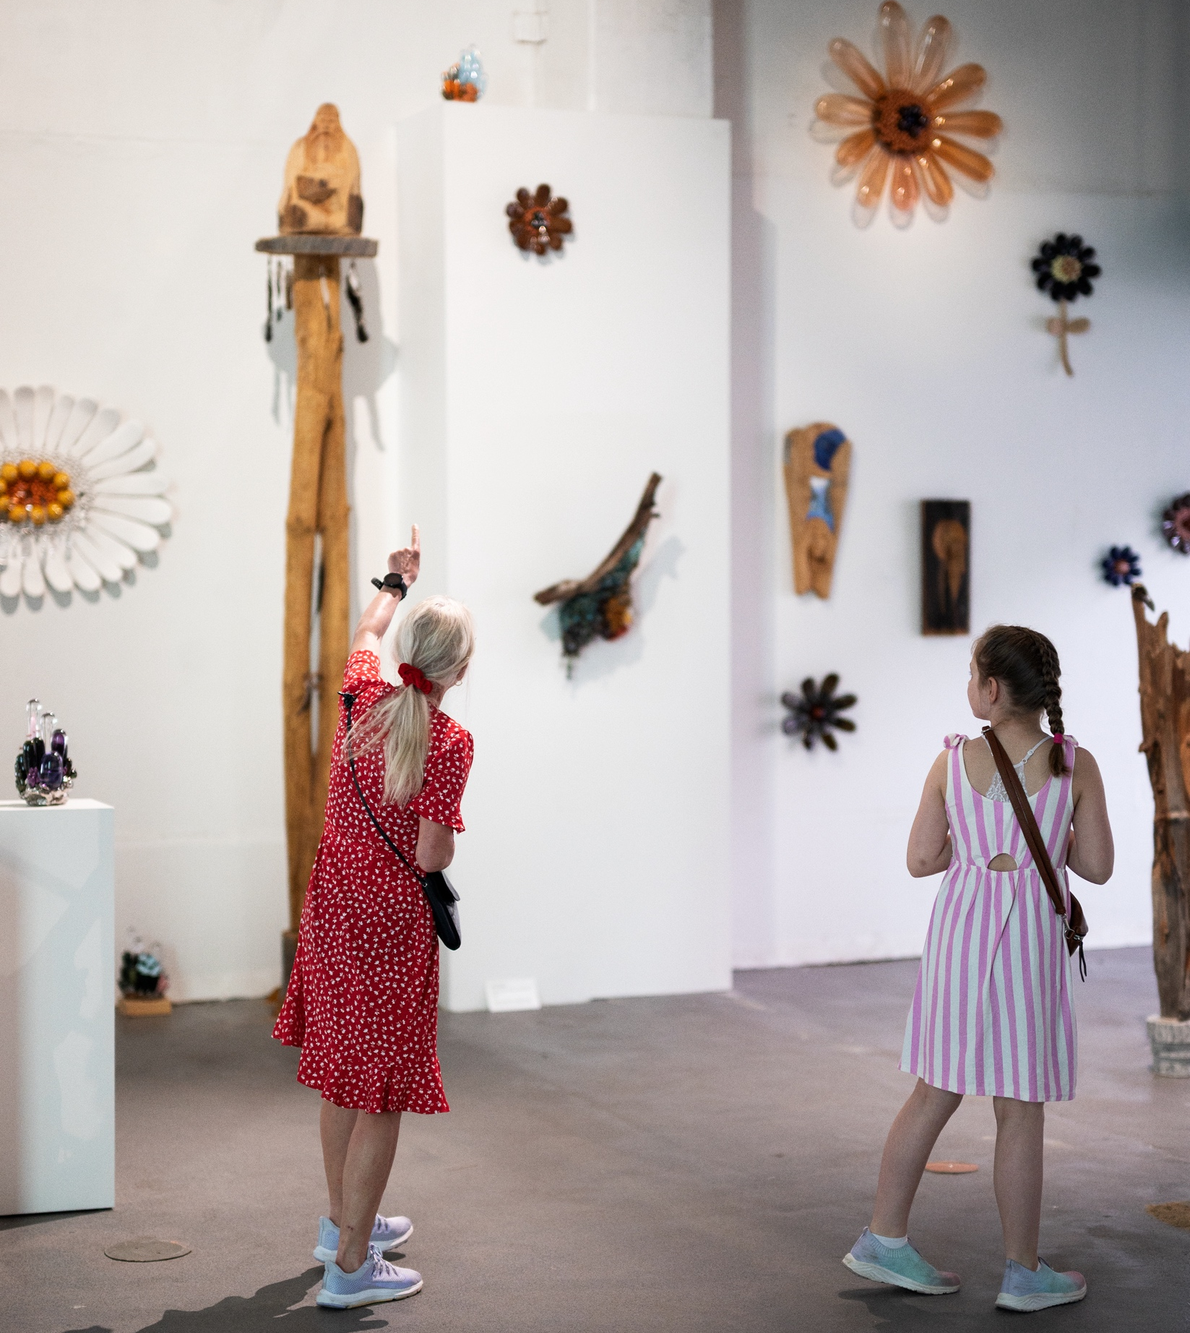
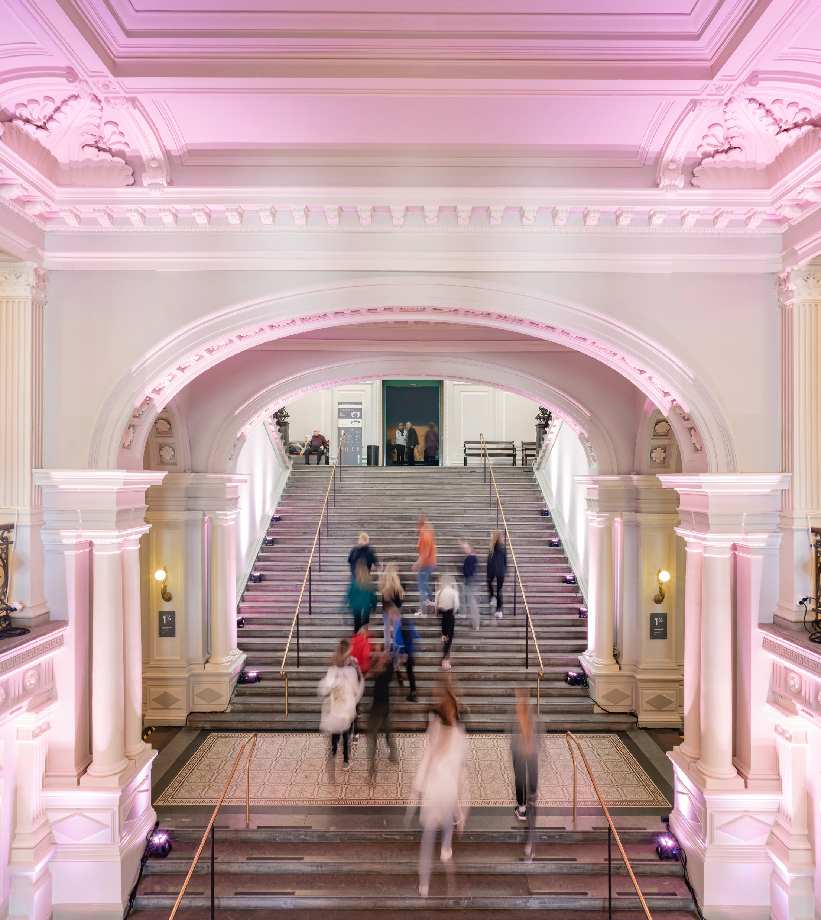
Finnish museum scene is exhibiting record numbers
10 HIGHLIGHTS OF FINNISH CONTEMPORARY ART
1
2
3
4
5
6
7
8
9
10
Finnish art museums are more popular than ever.
After the launch of the Museum Card in 2015 museum visits have increased by over 30%.
Exhibition view of Ilkka Halso, Layered Landscapes, at Malva – Lahti Museum of Art in 2024–2025.
Photo: Tommi Mattila, Malva
Exhibition view of Toni R. Toivonen, Beautiful landscapes inside dead bodies, at Galerie Forsblom, Helsinki, in 2018.
Photo: Angel Gil, Galerie Forsblom © Kuvasto
Kim Simonsson, Lightbringer, 2022, at the exhibition Moss Giants at Amos Rex Art Museum in 2024.
Photo: Mika Huisman, Amos Rex. © Kuvasto
Manta.
Photo: Marko-Marin
Ateneum.
Photo: Finnish National Gallery / Aleks Talve
Notes:
Finnish art museums are more popular than ever, with more than 3 million visits yearly.
Contemporary art museums have lately strengthened their foothold, especially in Helsinki, Finland’s capital. The city centre has a cluster of art museums: Amos Rex, Kiasma Museum of Contemporary Art, Ateneum Art Museum, and Helsinki Art Museum, Taidehalli/Kunsthalle and Sinebrycoff art museum.
There are nearly 70 art museums in Finland, and many of them, such as the established Serlachius Museums in Mänttä, or newcomers Chappe in Tammisaari and Malva in Lahti, are popular regional attractions.
Another success is the Museum Card, which was launched in 2015 and has since pushed museum visitor numbers to record levels: in the last decade from 6,6 to 8,7 million visitors annually. It allows cardholders to visit over 300 participating museums across the country for an annual fee of 80 euros. Nowadays, nearly half of the paid museum visits are made with the Museum Card.

Slide 4
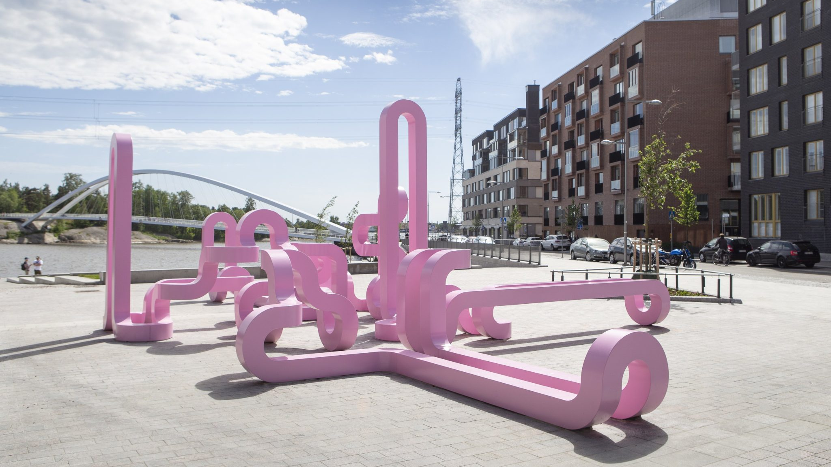
2/10
The public demands
for public art
Jacob Dahlgren, Early One Morning, Eternity Sculpture, 2019, City of Helsinki Art Collection. ©
Photo: Maija Toivanen, HAM Helsinki Art Museum © Kuvasto

Slide 5
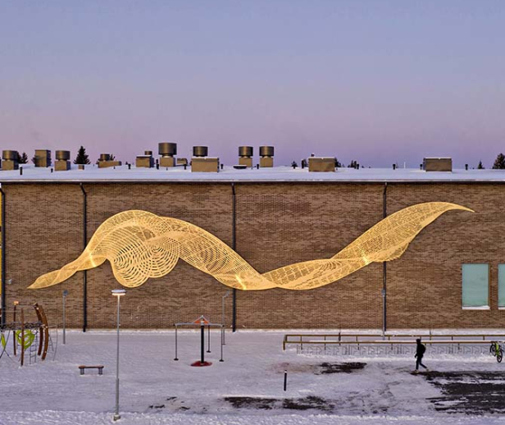
The public demands for public art
10 HIGHLIGHTS OF FINNISH CONTEMPORARY ART
1
2
3
4
5
6
7
8
9
10
Our percent-for-art principle funds public art for municipalities
and 47% of Finns are prepared to allocate even more tax revenue for public art.
Minna Kangasmaa, Homage to Flowing Waters, 2020. Kiiminkipuisto School, Oulu. Collection of Oulu Art Museum / City of Oulu.
Photo: Mika Friman © Kuvasto
Notes:
Public art makes art accessible to every citizen. Finland is known for the percent-for-art principle, which funds public art for municipalities. Public artworks are commissioned by the state, municipalities, and private businesses for public spaces, office buildings, schools, outdoors, and shopping malls, to name a few. Public art competitions are very popular among contemporary artists, which leads to high-quality public artworks created by professionals.
Public art brings art into people’s everyday environments and makes public spaces and the built environment more attractive. Commissioning public artworks provides artists with valuable work opportunities while increasing the accessibility of art. Public art in cities and municipalities is important for residents. A survey by the Arts Promotion Centre shows that 72% of Finnish people want art in their everyday environment, and up to 47% are prepared to allocate more tax revenue for commissioning public art.

Slide 6
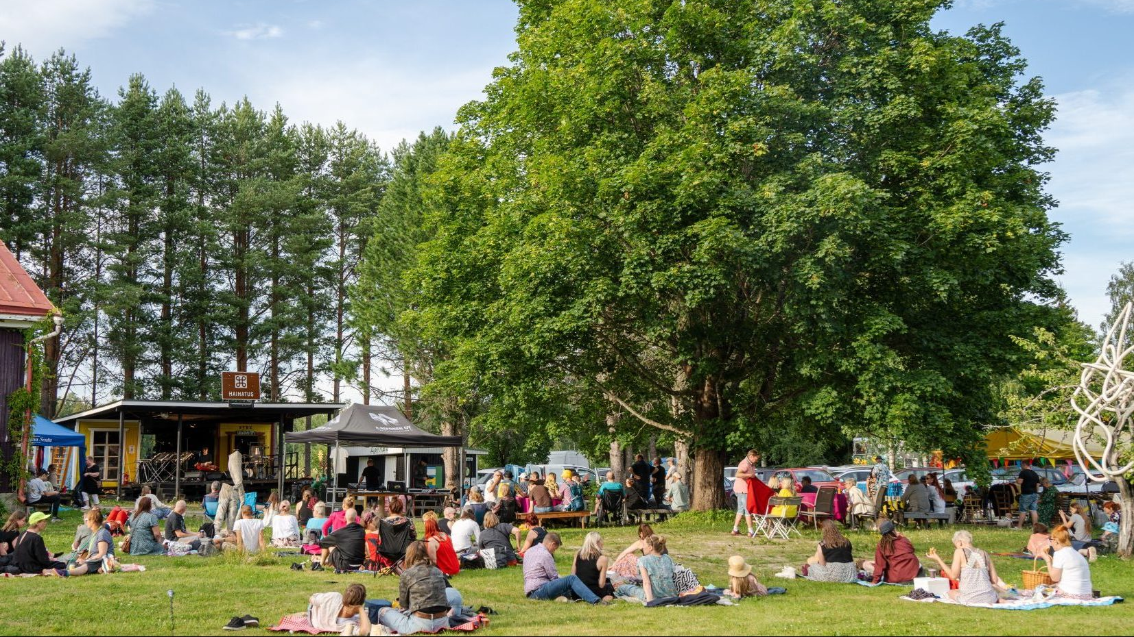
3/10
Art exhibitions are the
centerpiece of Finnish summer
Haihatus Art Center hosts an annual summer exhibition in Joutsa.
Photo: Timo Anttila

Slide 7
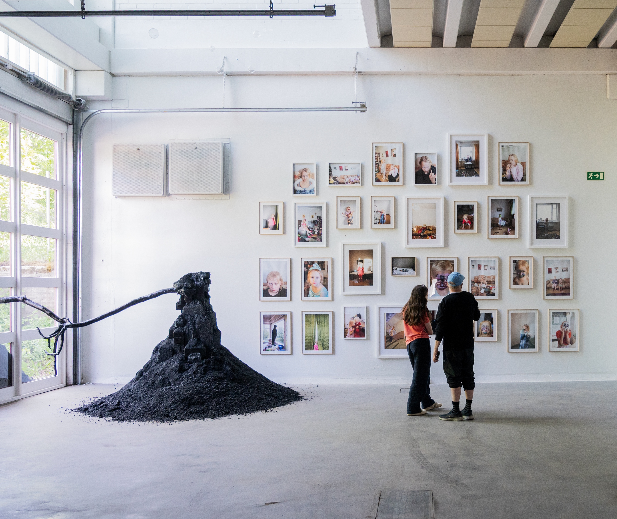
Art exhibitions are the centerpiece of Finnish summer
10 HIGHLIGHTS OF FINNISH CONTEMPORARY ART
1
2
3
4
5
6
7
8
9
10
In the summertime, lots of exhibitions and historical sites open to the audience.
Mäntän Kuvataideviikot. Photo: Marko Marin
Notes:
Take a road trip to the Finnish countryside and enjoy some art while you’re at it! In the summertime, dozens of regional art exhibitions open to the audience, often in remote countryside locations. Summer exhibitions are a vital part of the Finnish art ecosystem. Some of the traditional summer exhibitions have a decade-long history, such as the established Mänttä Art Festival, first organised in 1993, and Art Center Purnu, dating back to 1967. Purnu, located at the summer atelier of sculptor Aimo Tukiainen (1917–1996), even has a traditional smoke sauna for art-loving visitors to relax after the exhibition tour. Newer events such as Haihatus Art Festival, Art Ii Biennale, and Fiskars Art & Design Biennale complement the summer exhibition map.
Often located in unique settings of nature and historical sites, the summer exhibitions attract thousands of visitors annually. While roadtripping, pop into some old manor houses also housing art exhibitions like Laukko Manor, Wiurila Manor, or Art Center Salmela. A peculiar destination is also the Parikkala Sculpture Park, founded by self-taught artist Veijo Rönkkönen.
A counterpart for summer exhibitions is popular light art festivals, such as Lux Helsinki, illuminating dark winter days.

Slide 8
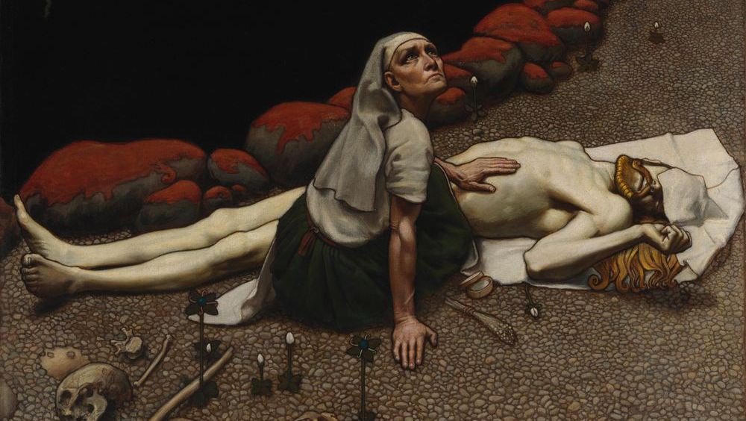
4/10
Painting a picture of
Finnish national identity
Akseli Gallen-Kallela, Lemminkäinen's Mother, 1897. Finnish National Gallery Collection / Ateneum Art Museum, Antell collections.
Photo: Hannu Pakarinen, Finnish National Gallery

Slide 9
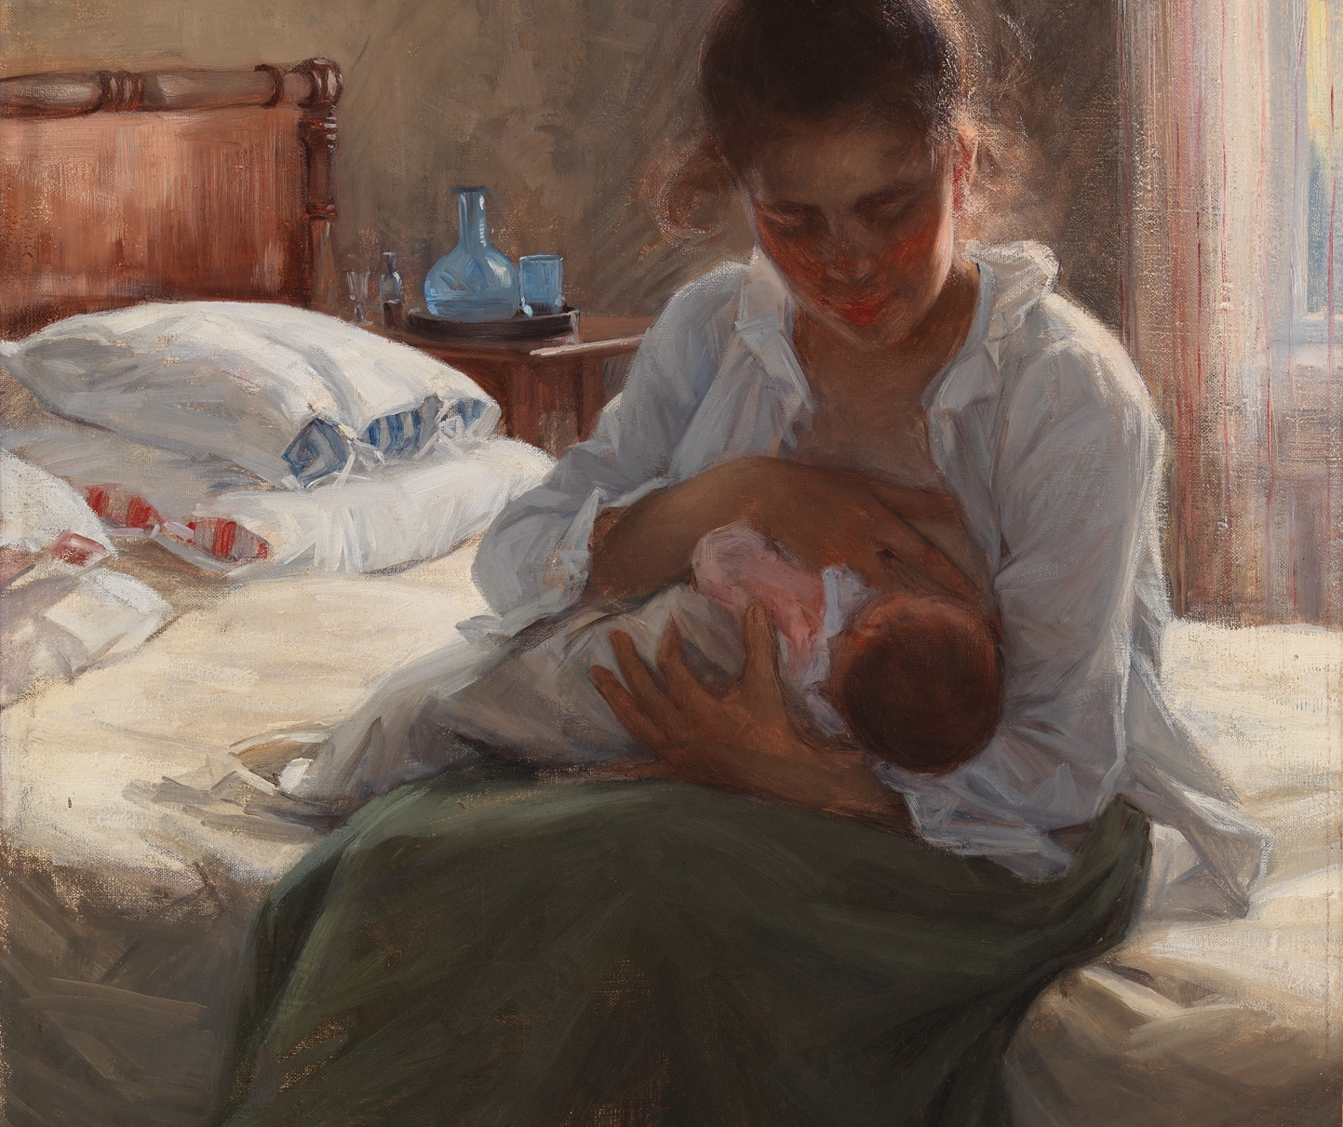
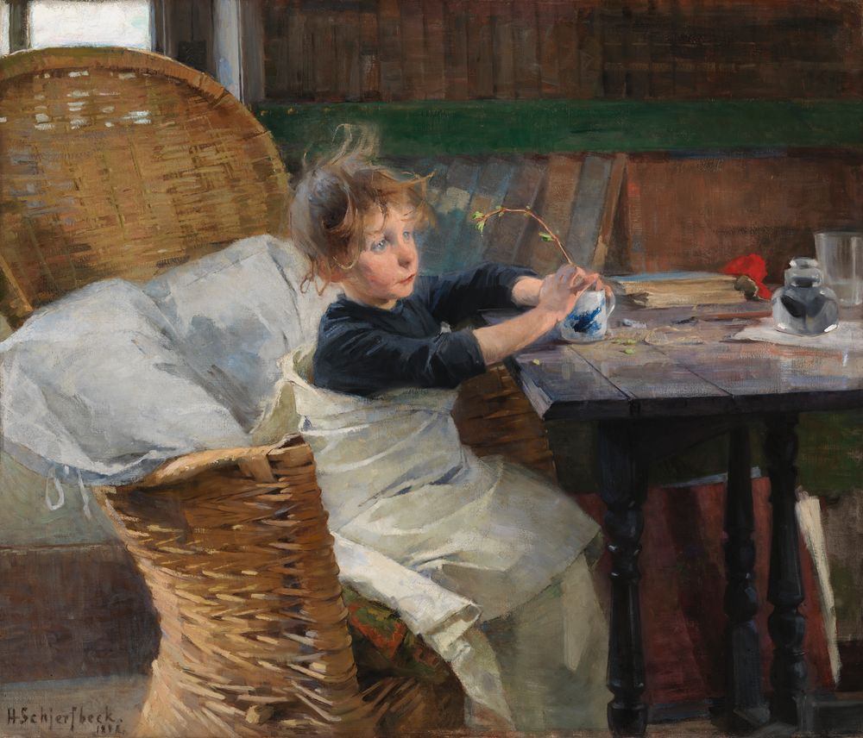
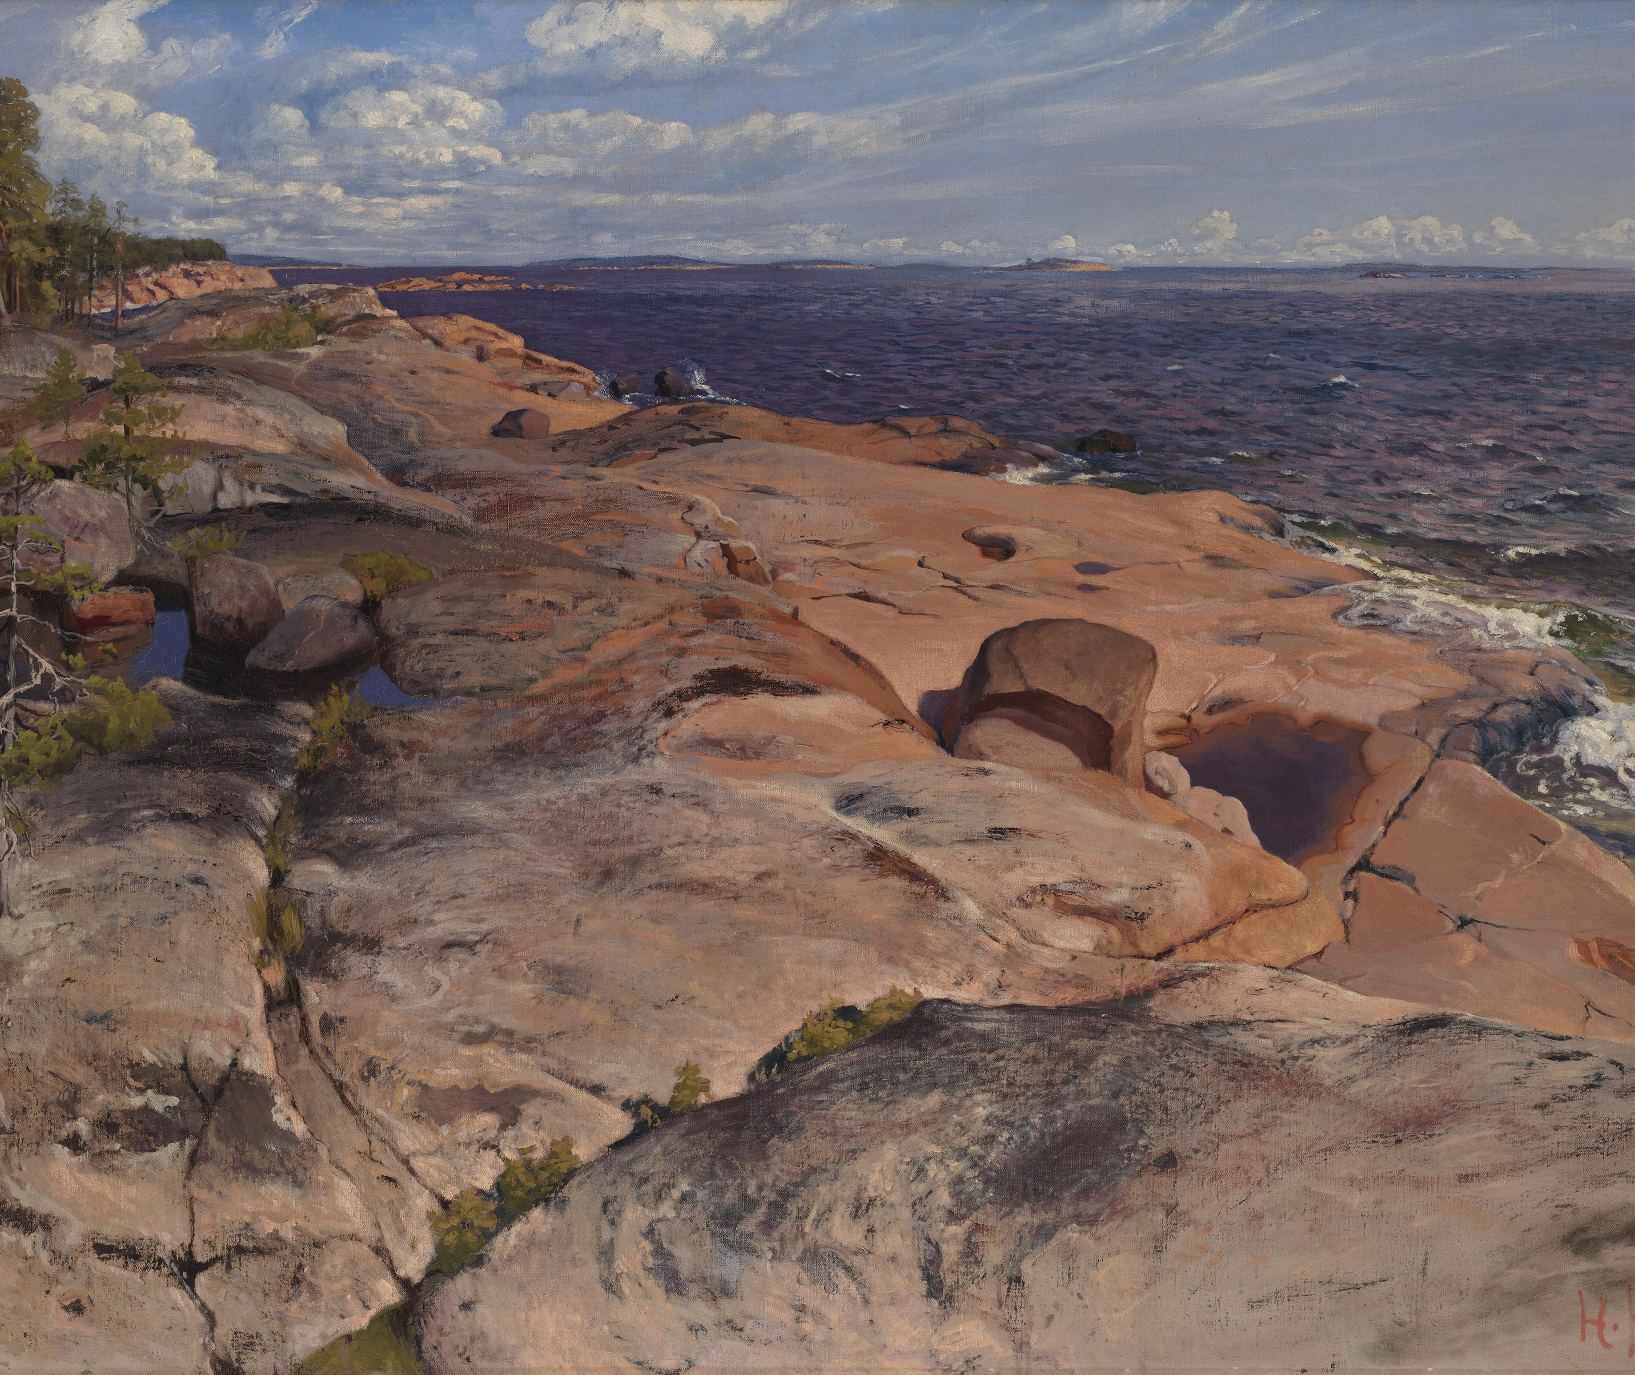
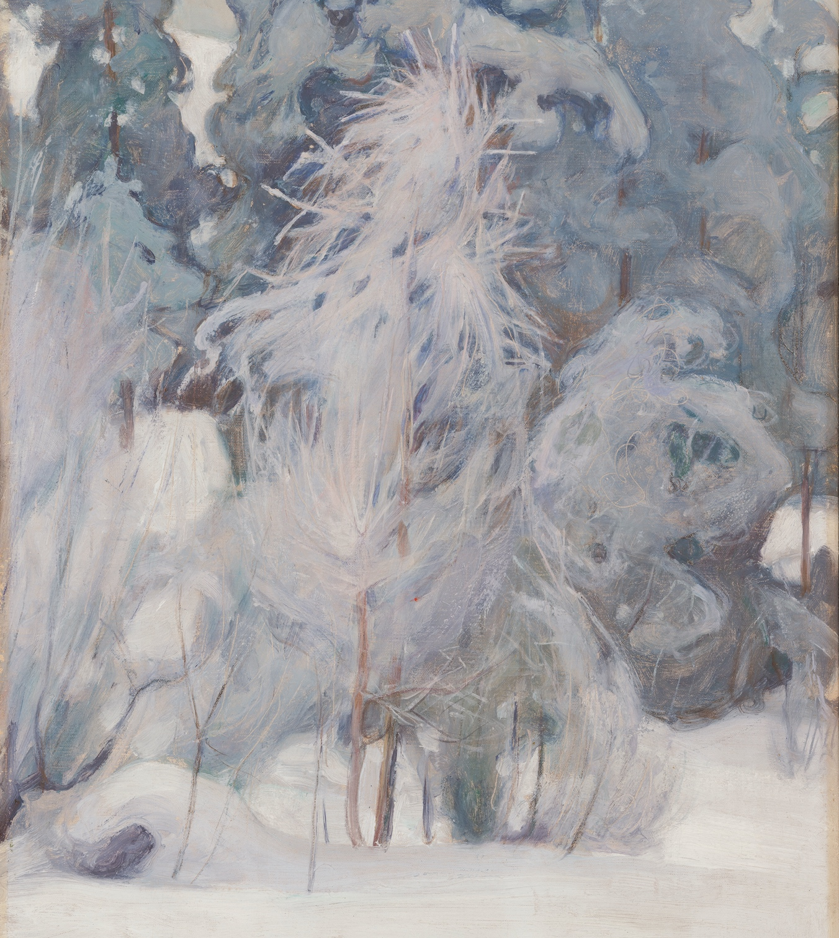
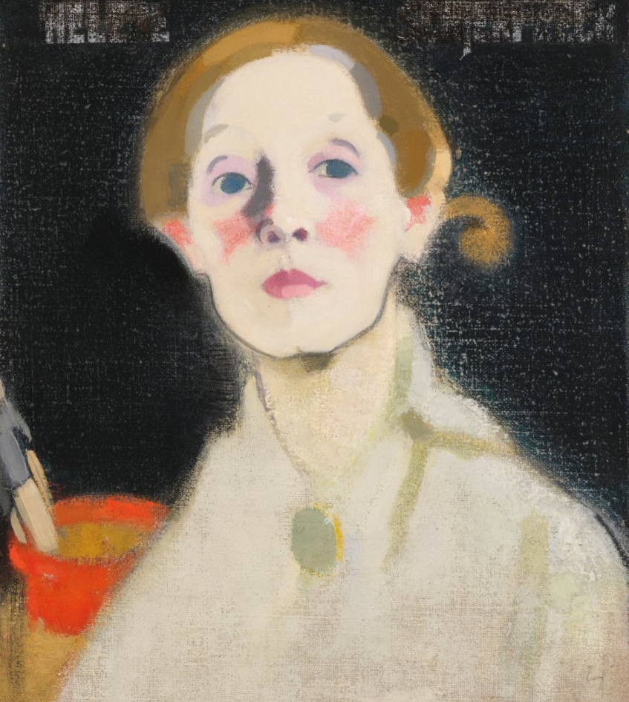
Painting a picture of Finnish national identity
10 HIGHLIGHTS OF FINNISH CONTEMPORARY ART
1
2
3
4
5
6
7
8
9
10
The Golden Age of Finnish art
drew inspiration from our nature and national epic Kalevala.
Coastal cliffs at Villinki (1890’s). Helmi Biese.
Photo: Finnish National Gallery / Jenni Nurminen
Mother (1893). Elin Danielson-Gambogi. Photo: Finnish National Gallery / Hannu Pakarinen
Toipilas (1888). Helene Schjerfbeck.
Photo: Jenni Nurminen
Talvimaisema (1899). Pekka Halonen.
Photo: Ateneumin taidemuseo
Self-portrait (1912). Helene Schjerbeck.
Photo: Finnish National Gallery / Yehia Eweis
Notes:
At the turn of the 20th century, fine art played a major role in building Finland’s national identity while under the rule of the Russian Empire. During this period, ‘the golden age of Finnish art’, painters drew inspiration from Finnish nature and the national epic, The Kalevala. Trained in Paris, the art capital of the day, Finnish artists such as Akseli Gallen-Kallela, Pekka Halonen, and Albert Edelfelt helped the nation establish an independent sense of identity for the first time.

Slide 10
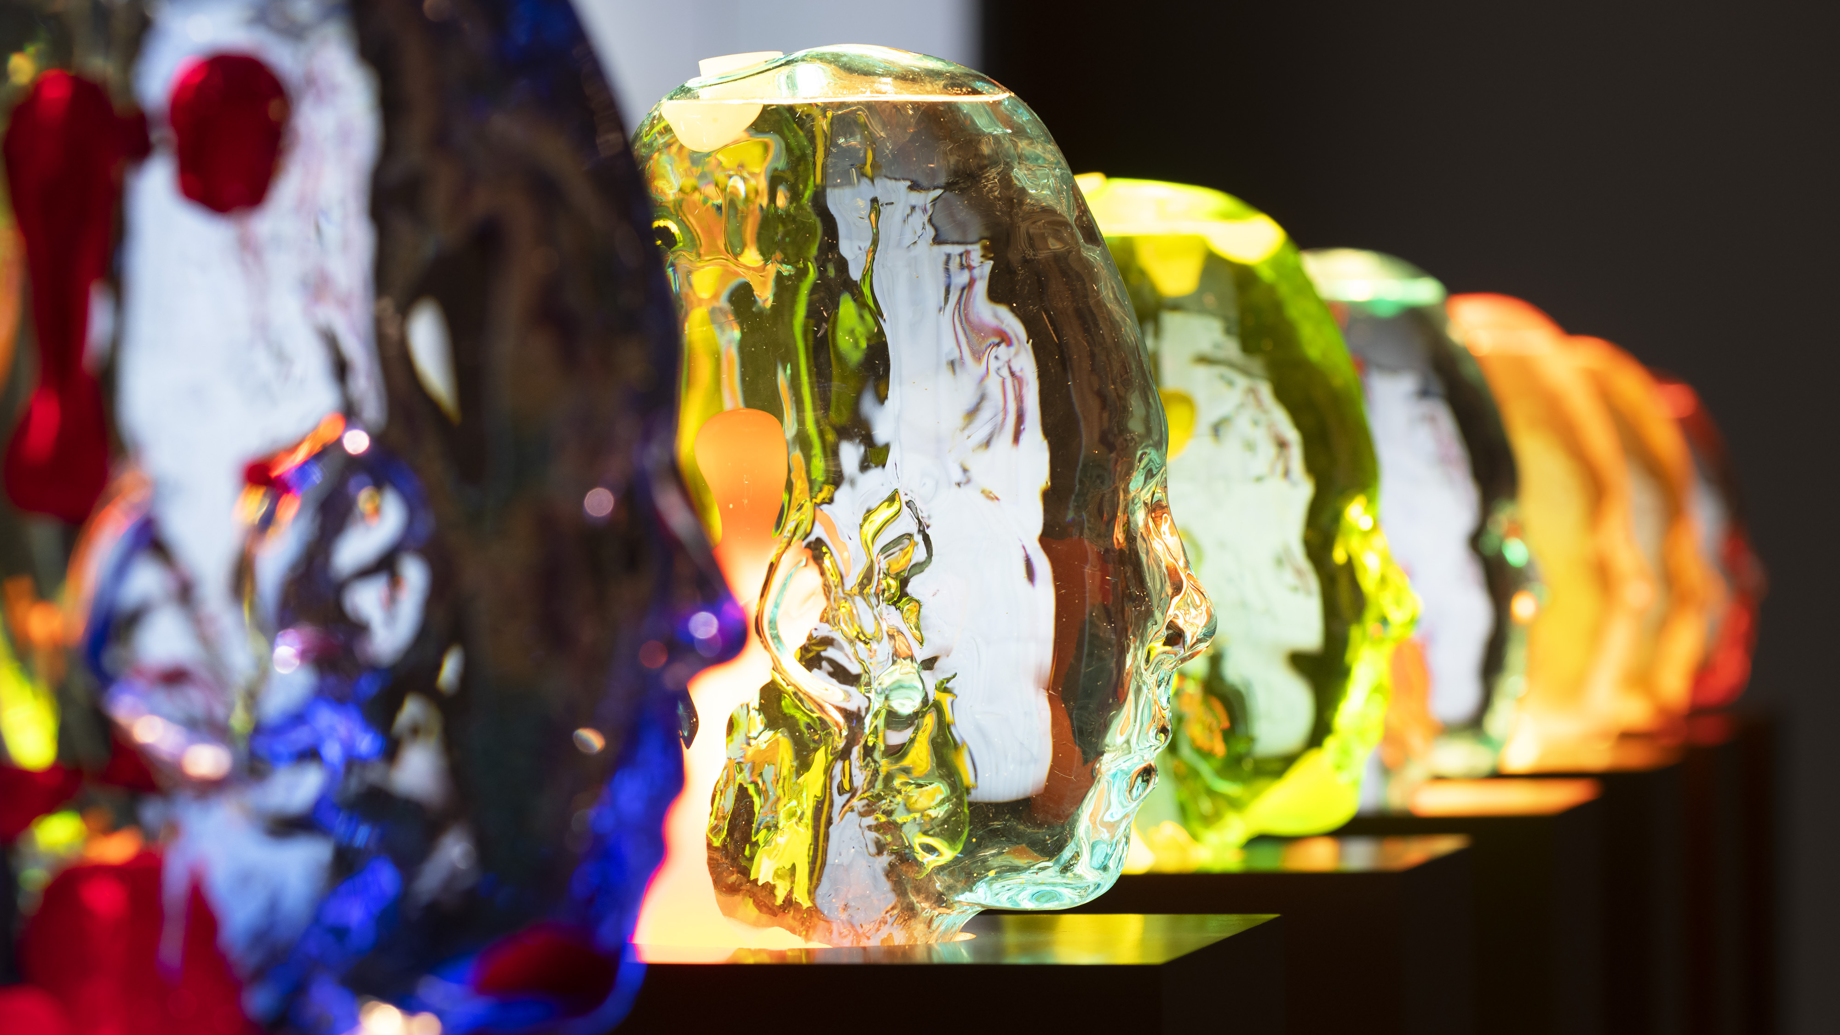
5/10
Contemporary artists
thinking outside the frame
Magma (2019) as part of Mud Muses at Moderna Museet. Jenna Sutela.
Photo: Theresa Hahr

Slide 11
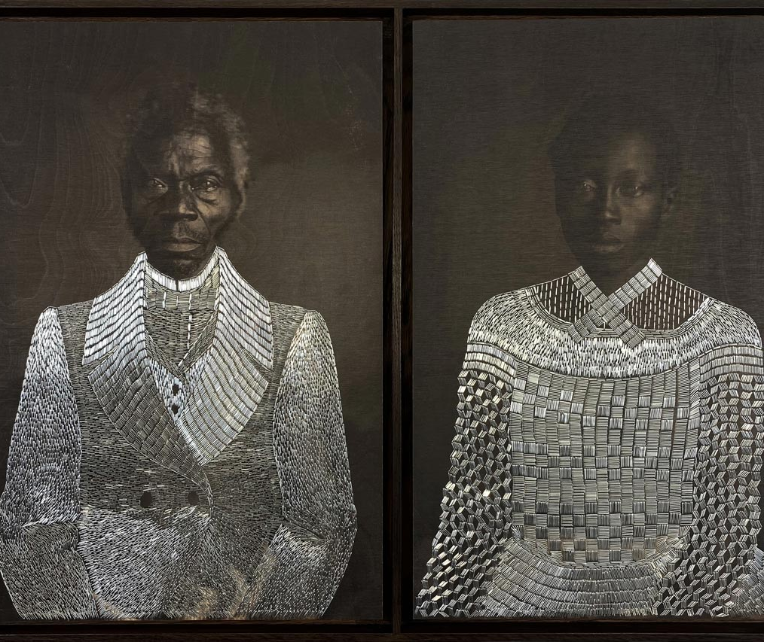
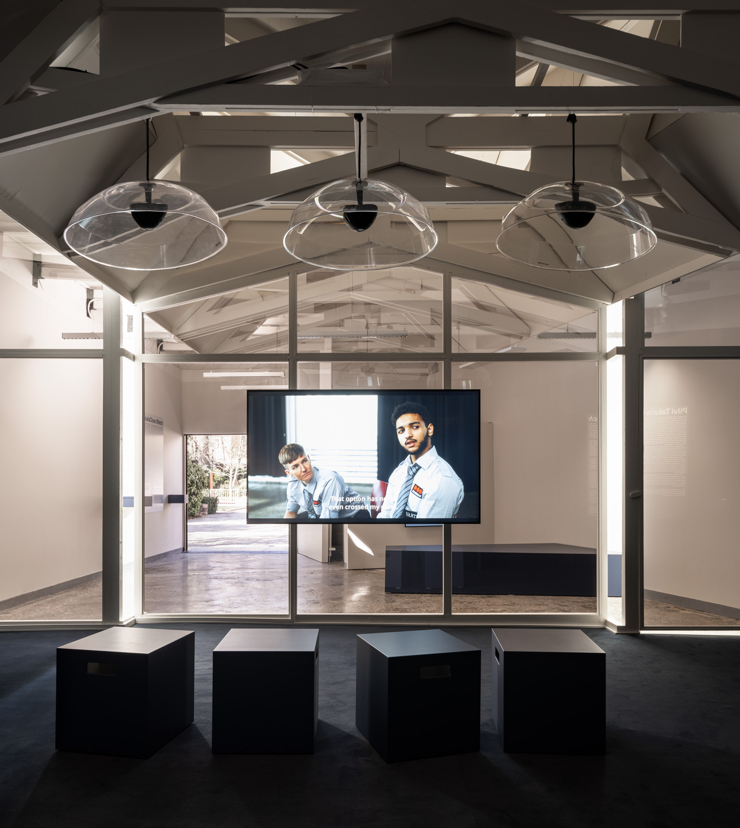
Contemporary artists thinking outside the frame
10 HIGHLIGHTS OF FINNISH CONTEMPORARY ART
1
2
3
4
5
6
7
8
9
10
The Finnish artistic community is vibrant
in terms of techniques, artists, and subjects.
Tailoring Freedom – Renty and Delia (2021). Sasha Huber.
Photo: Tamara Lanier
Close Watch (2022) at Venice Biennale 2022. Pilvi Takala.
Photo: Ugo Carmeni
Notes:
Internationally, Finnish contemporary art is known especially for media art, photography, and the use of new technologies. From the younger generation of internationally renowned names, Pilvi Takala is known for her performative video work disrupting social situations; Jenna Sutela for incorporating AI, sound, and living organisms into her mixed-media work; and Hans Rosenström for creating unique site-specific sound works.
But those do not give the whole picture—Finland also has a very strong painting and sculpture tradition, with artists like Kaarina Kaikkonen, Kim Simonsson, Heikki Marila, or the younger generation’s Alma Heikkilä and Emma Ainala.
Today, the Finnish artistic community is growing constantly more diverse, and Finland-based artists address a broad agenda of global issues, such as transcultural experiences. The growing scene of artists with an international background, such as textile artists Kholod Hawash and Vidha Saumya, or video artist Sepideh Rahaa, has further enriched the Finnish art scene and contemporary art discourse.

Slide 12
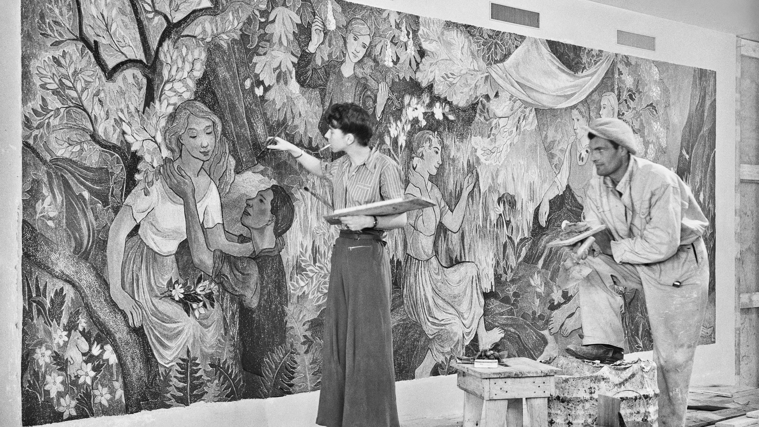
6/10
Groundbreaking figures
Tove Jansson painting 'Party in the Countryside', 1947, wall painting at Helsinki City Hall.
Photo: Foto Roos, Helsinki City Museum

Slide 13
Groundbreaking figures
10 HIGHLIGHTS OF FINNISH CONTEMPORARY ART
1
2
3
4
5
6
7
8
9
10
There have always been strong characters known for their powerful character designs.
Photo: TOM OF FINLAND FOUNDATION
Notes:
For many, Finland brings to mind Moomins. And while we are very fond of the lovely creatures, their creator, Tove Jansson (1914–2001) was an artist with many talents: she was a painter, author, illustrator, and comic artist. Jansson is still one of the best-known and celebrated Finnish artists abroad. Her artistic legacy and self-reliant way of life are rooted deeply in the Finnish culture scene and celebrated regularly in exhibitions, movies, novels, and theatre plays.
Another groundbreaking figure in Finnish art history and Tove’s contemporary was Touko Laaksonen (1920–1991), better known by his pseudonym Tom of Finland. Laaksonen is known for his masculinized representation of the male figure, and he heavily influenced late 20th-century gay culture. During his time, Laaksonen’s drawings spread across the globe, fueling real-world liberation movements. Since then, Tom of Finland has been the subject of numerous museum exhibitions in Finland and abroad.

Slide 14
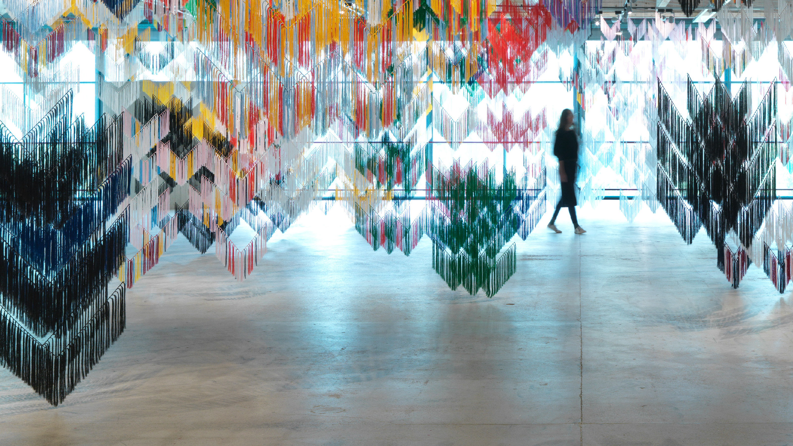
7/10
Sámi artists
drawing attention
Outi Pieski, Falling Shawls, 2017. Čuolmmadit at EMMA– Espoo Museum of Modern Art.
Photo: Ari Karttunen / EMMA – Espoo Museum of Modern Art © Kuvasto

Slide 15
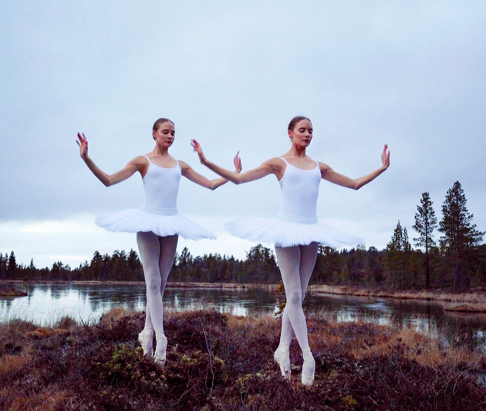
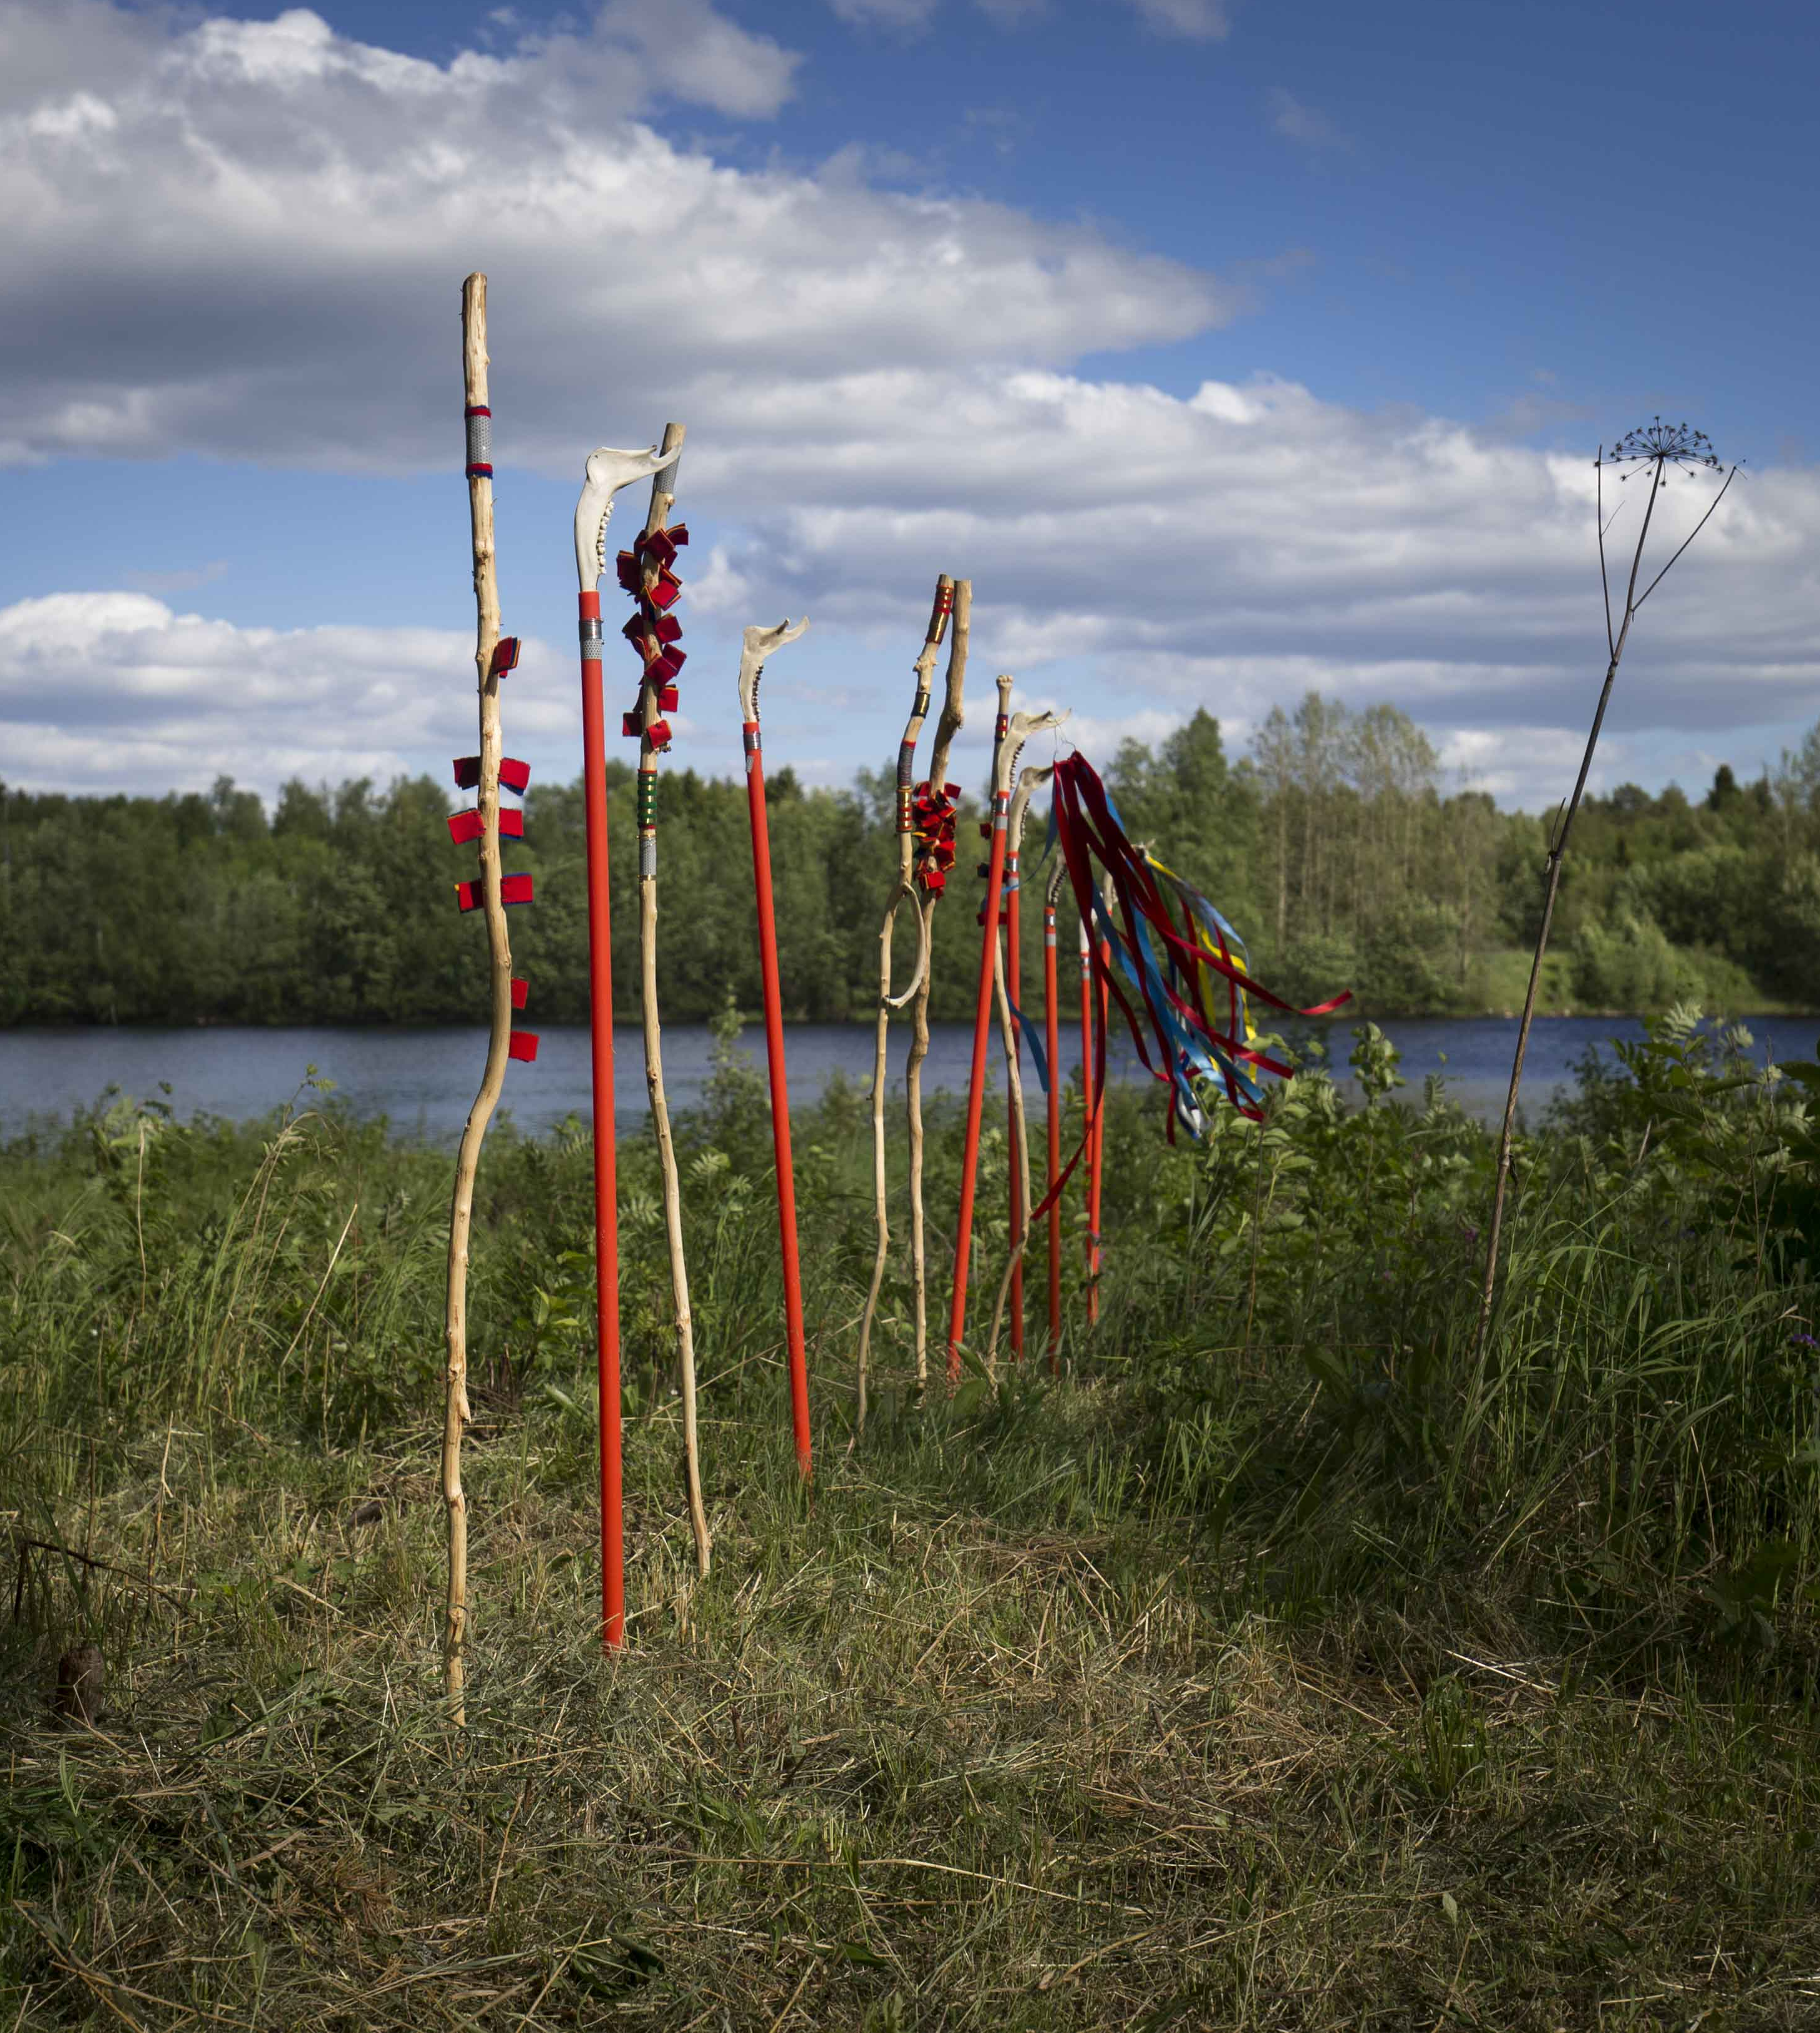
Sámi artists drawing attention
10 HIGHLIGHTS OF FINNISH CONTEMPORARY ART
1
2
3
4
5
6
7
8
9
10
In 2024, the Sámi Museum Siida was chosen as the European Museum of the Year.
Marja Helander, Eatnanvuloš lottit – Birds in the Earth, 2017.
The Finnish National Gallery Collection / Museum of Contemporary Art Kiasma.
Photo: Finnish National Gallery © Kuvasto
Forewalkers (2016). Jenni Laiti.
Photo: Antti J. Leinonen
Notes:
In recent years, Sámi art has been the subject of significant international interest. Sámi artists such as Outi Pieski, Matti Aikio, Jenni Laiti, and Marja Helander address in their art issues related to Sámi culture: the history and future of the Sámi people, the rights of indigenous peoples, and their relationship with nature and ancestral lands.
Duodji, the traditional Sami handicraft, encompasses a wide range of crafts, such as textiles and beadwork, leather items, woodwork, birch bark, bone, as well as objects and jewellery with silver decorations. Purpose of use, material knowledge, and family connection are significant for traditional Sami handicrafts. Duodji is also visible in many contemporary Sámi artists’ work.
The Sámi Museum Siida, located in Inari, in the Finnish part of Sápmi, stores, researches, and showcases Sámi culture in Finland. In 2024, Siida was chosen as the European Museum of the Year.

Slide 16
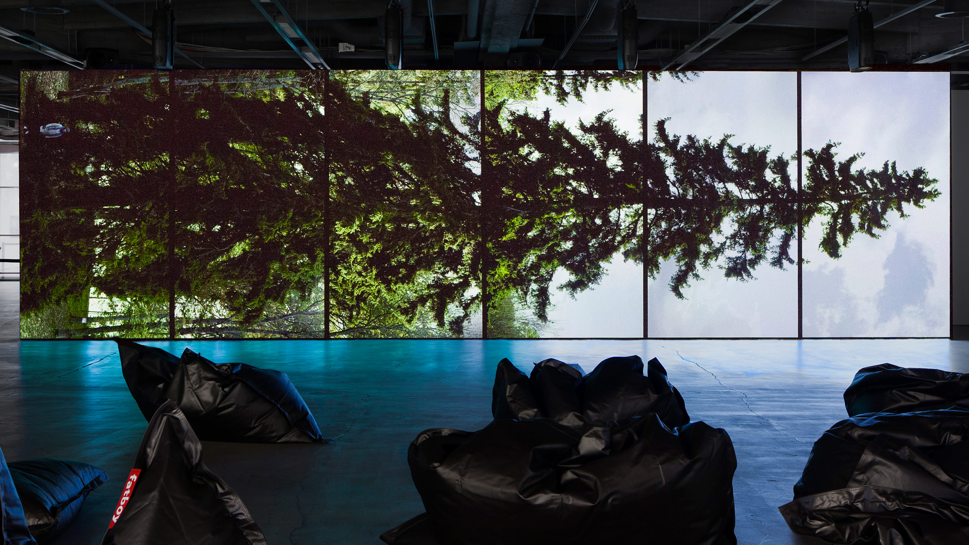
8/10
Women are makers, not muses
Eija-Liisa Ahtila, Horizontal, 2011. Saastamoinen Foundation Art Collection / EMMA – Espoo Museum of Modern Art.
Photo: Ari Karttunen / EMMA – Espoo Museum of Modern Art © Kuvasto

Slide 17
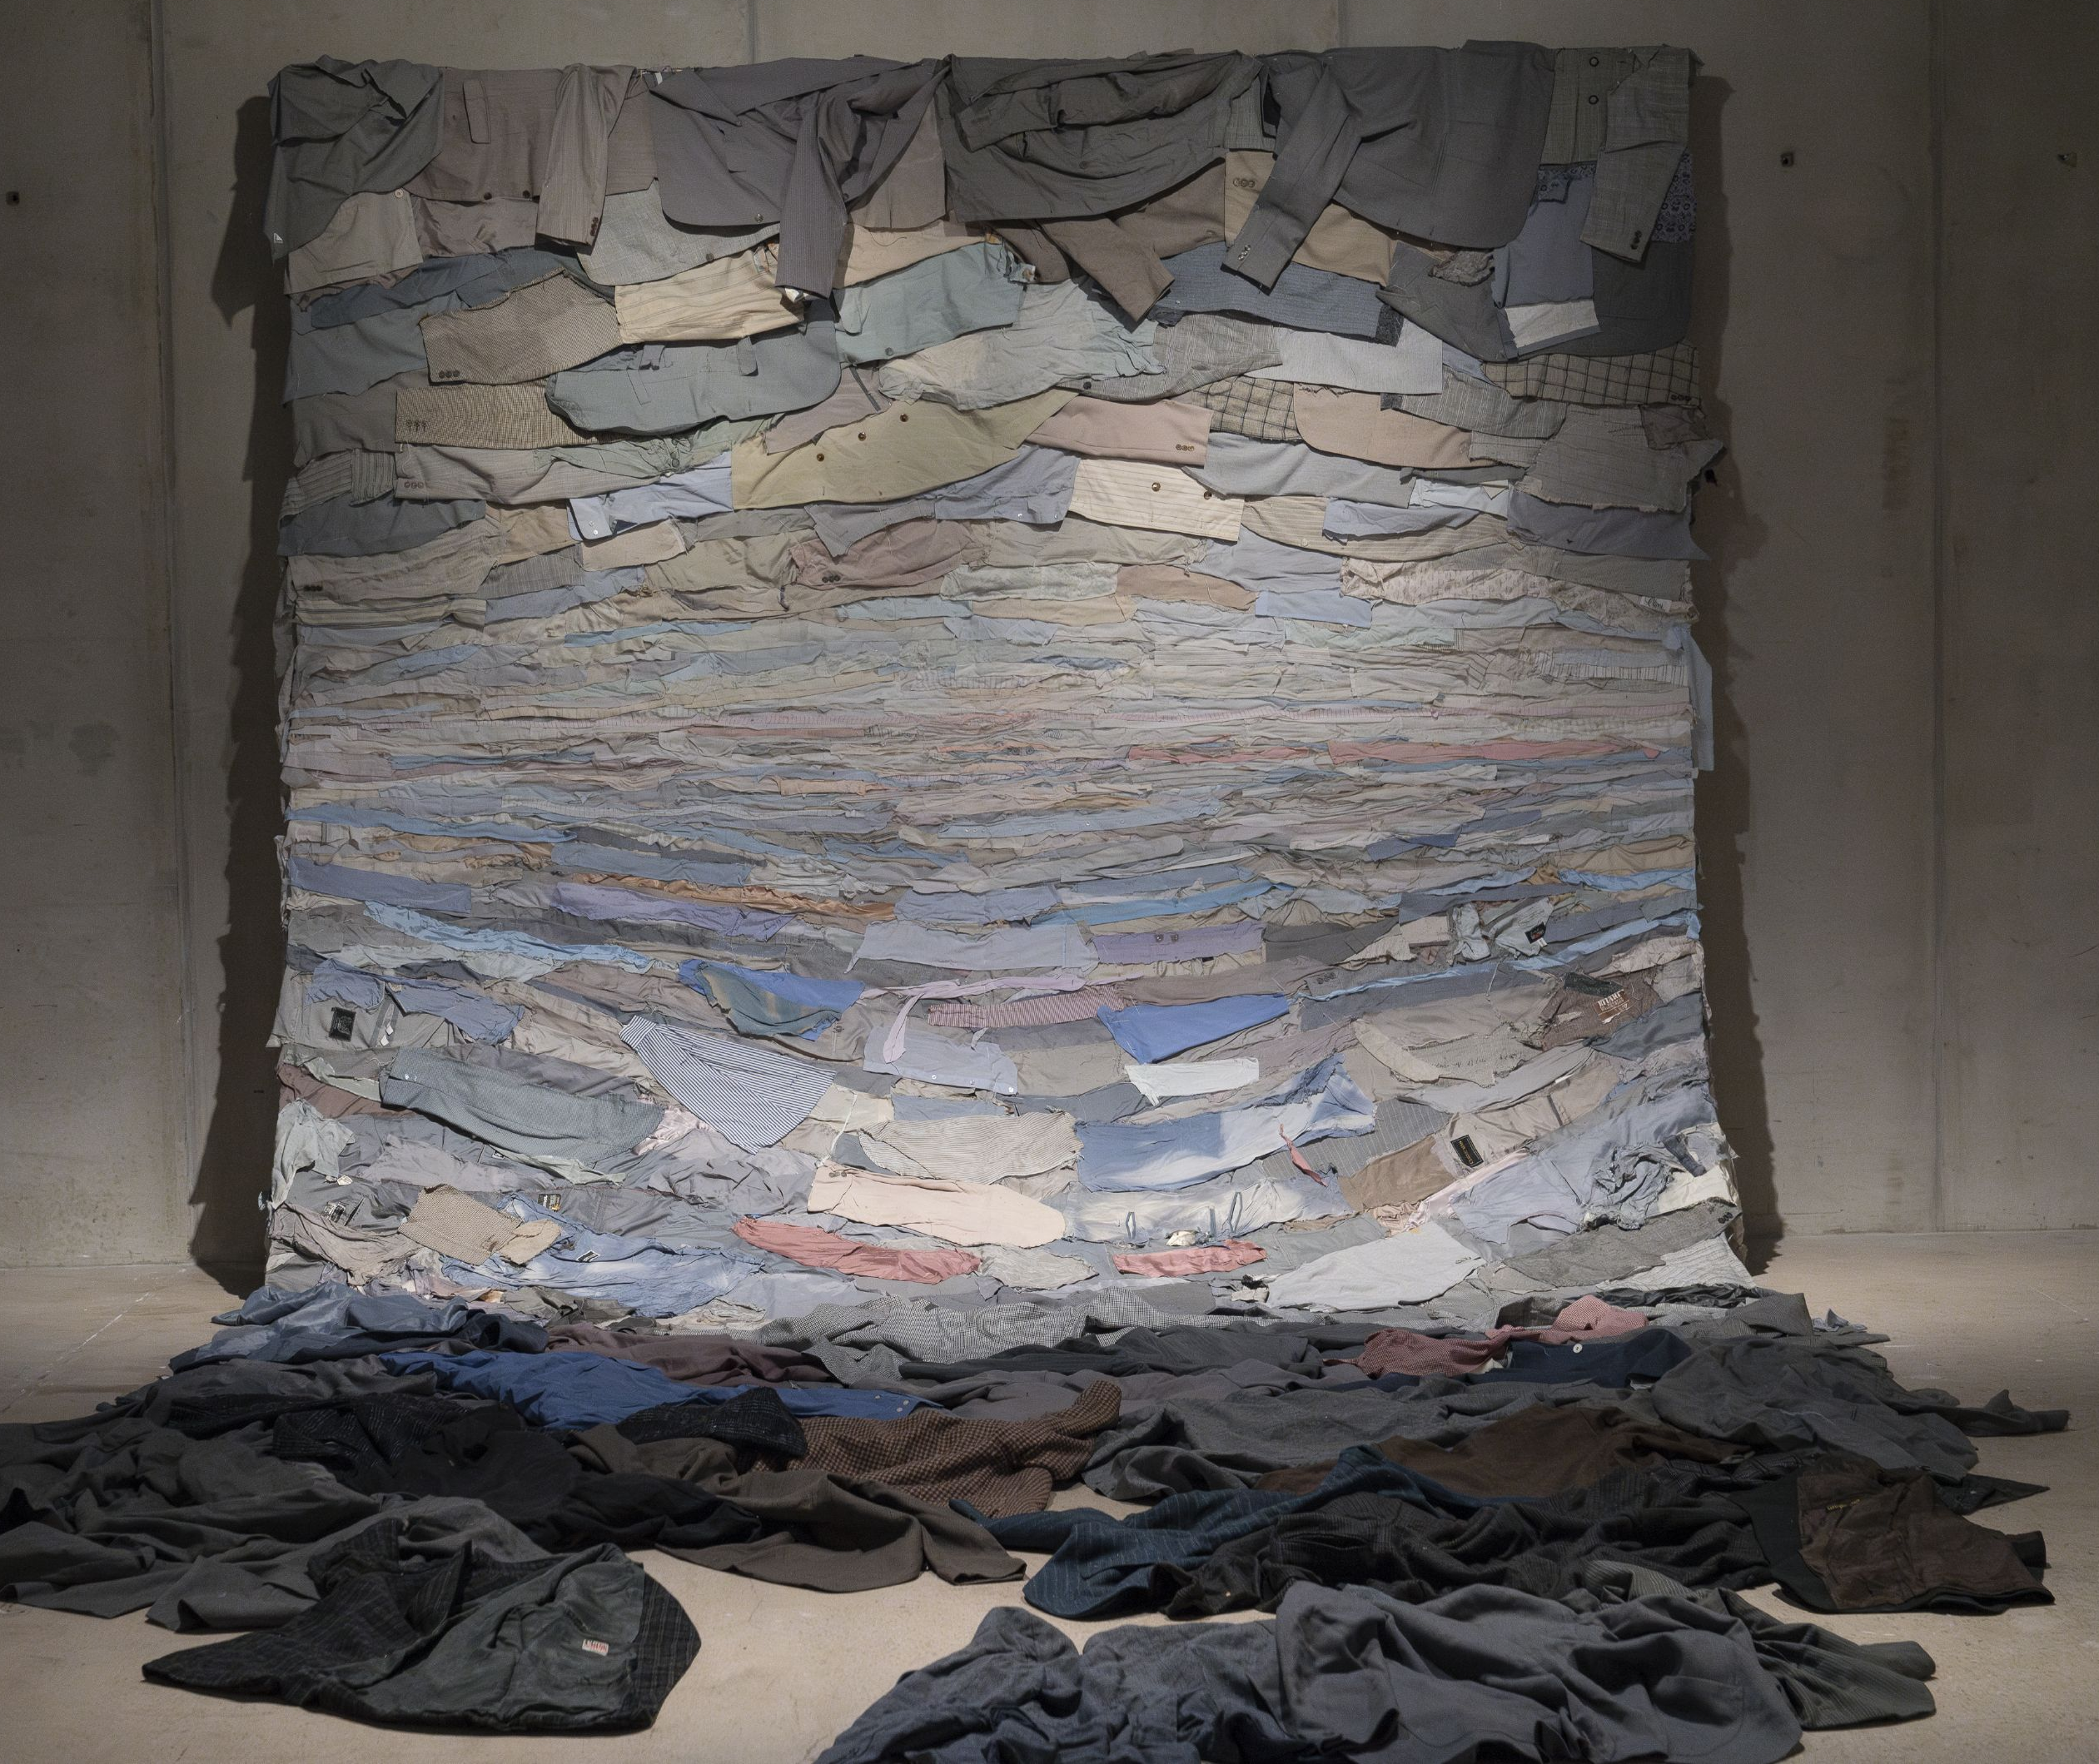
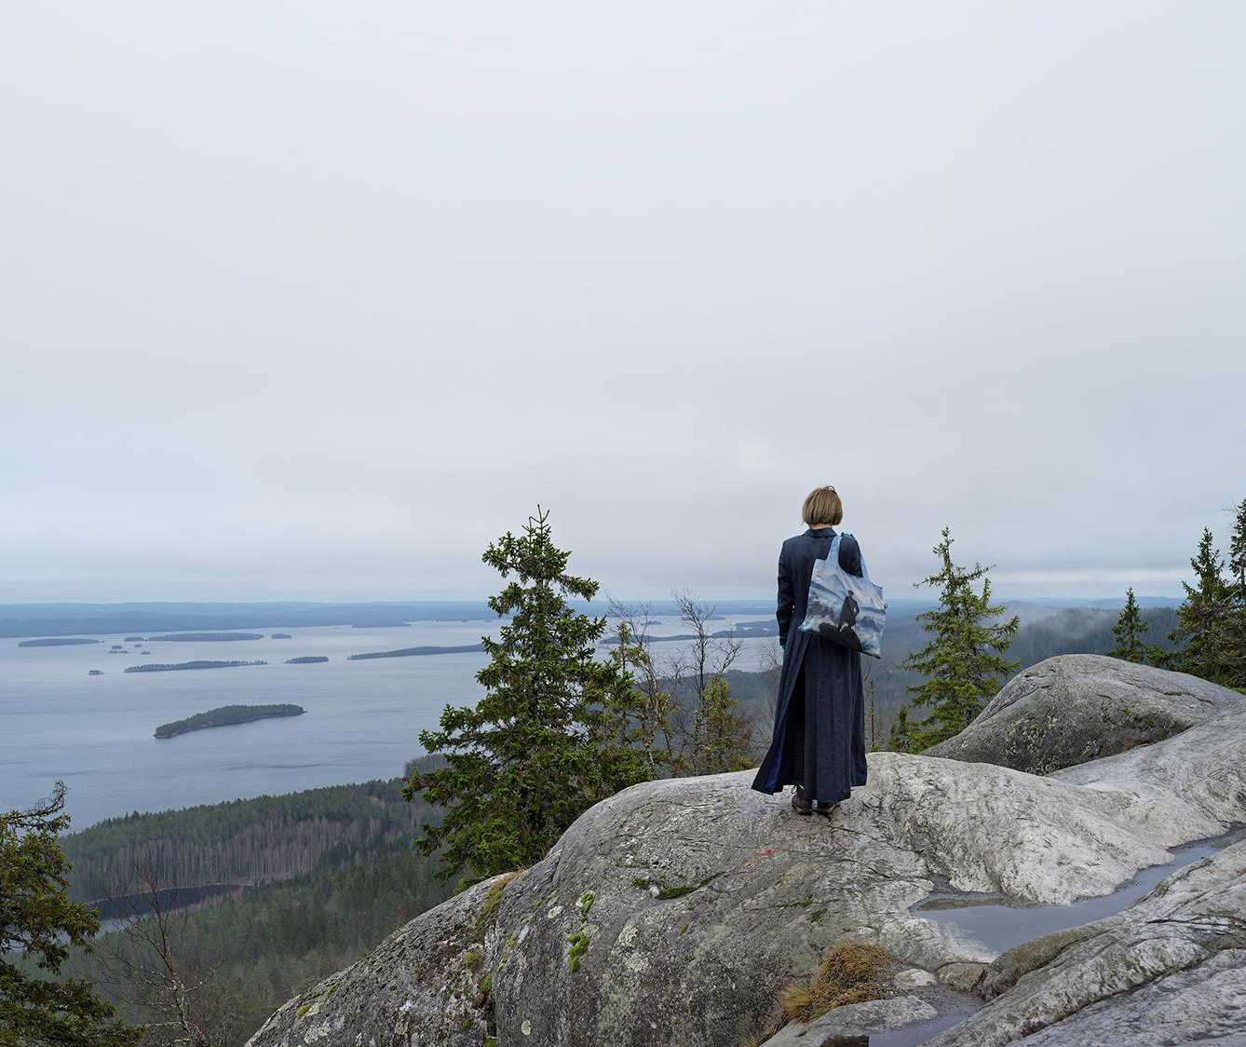
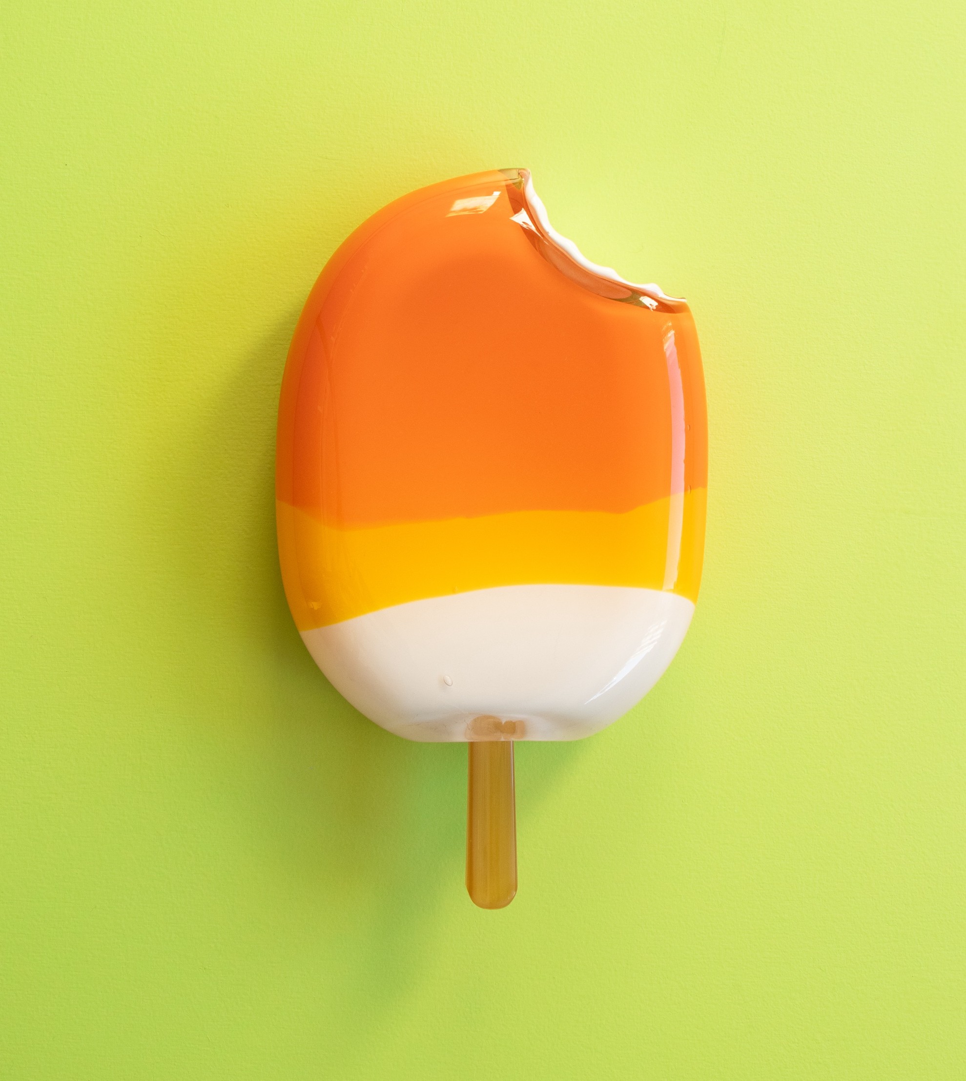
Women are makers, not muses
10 HIGHLIGHTS OF FINNISH CONTEMPORARY ART
1
2
3
4
5
6
7
8
9
10
Most Finnish artists are female
and many of them explore identity and womanhood through their art.
Kaarina Kaikkonen, And the emptiness rested, 2005–2013. Arte Povera – A New Chapter exhibition at
EMMA – Espoo Museum of Modern Art. Saastamoinen Foundation Art Collection.
Photo: Ari Karttunen, EMMA © Kuvasto
Elina Brotherus, Wanderlust, 2020. The European Parliament Art Collection. © Kuvasto
Photo: Paula Pääkkönen
Notes:
Among the best-known names in Finnish contemporary art are media art pioneer Eija-Liisa Ahtila, sculptor and conceptual artist Maaria Wirkkala, and sculptor and installation artist Kaarina Kaikkonen – all women. Internationally renowned photographers Elina Brotherus, Iiu Susiraja, and emerging Emma Sarpaniemi also explore themes of identity and womanhood through unconventional and sometimes humorous portraits.
The majority of Finnish artists are female, which is partly explained by a tradition of gender equality in education and the long legacy of independent female artists starting with painters Ellen Thesleff and Helene Schjerfbeck (1862–1946). Schjerfbeck can be counted among the great modernists in Western art, and she was one of the leading artists in Finland during her lifetime. Today’s strong women painters – Anna Tuori, Rauha Mäkilä and Mari Sunna, to mention a few – follow in their footsteps.

Slide 18
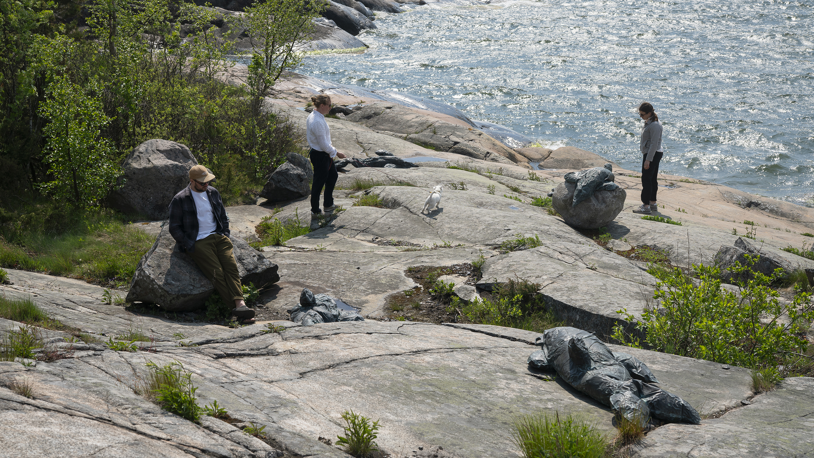
9/10
Our art is deeply rooted
in our environment
Sara Bjarland, Stranding, 2025. Helsinki Biennial 2025, Vallisaari Island.
Photo: HAM / Helsinki Biennial / Sonja Hyytiäinen

Slide 19
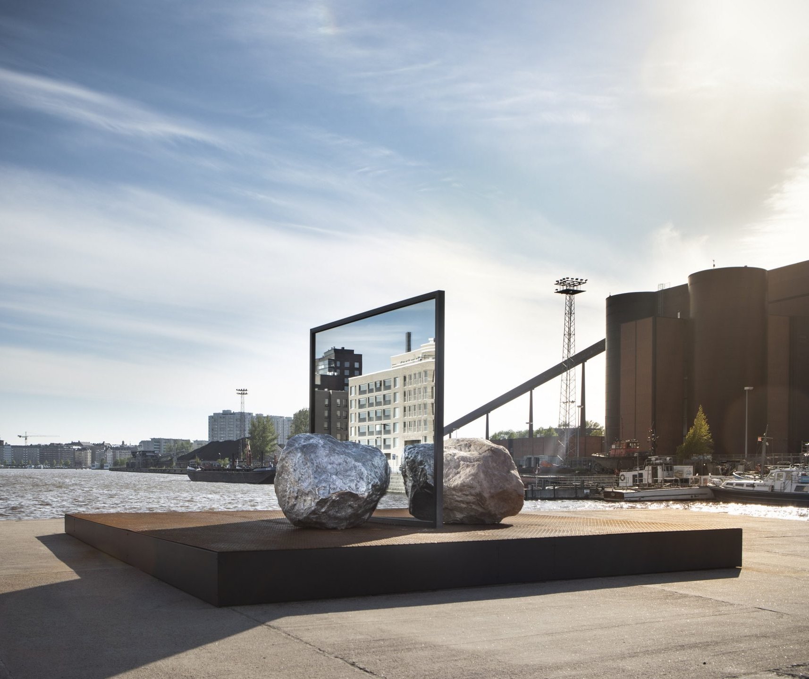
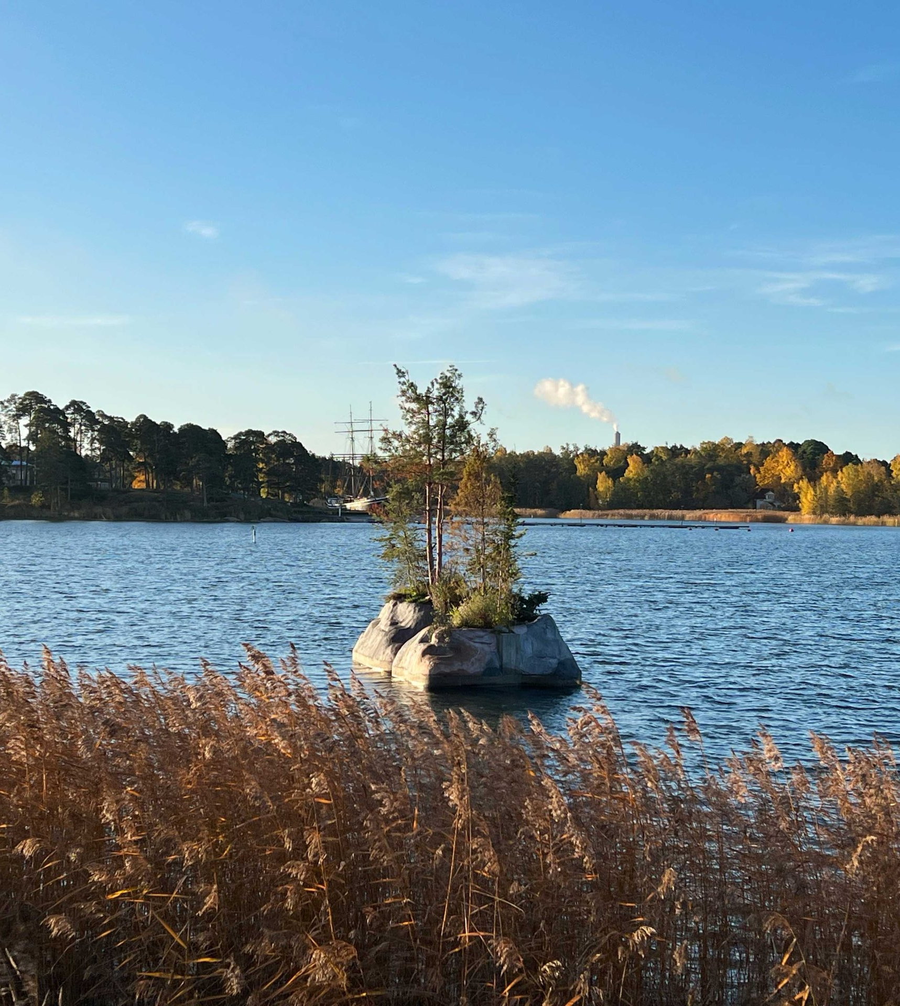
Our art is deeply rooted in our environment
10 HIGHLIGHTS OF FINNISH CONTEMPORARY ART
1
2
3
4
5
6
7
8
9
10
In Finnish contemporary art, nature and its state is always on display.
Artists highlight nature in their work by using natural materials and addressing current concerns such as the ecological crisis and loss of biodiversity.
Big Be-Hide (2019). Alicja Kwade.
Photo: HAM / Maija Toivanen
Kelluva Saari (2019). Raimo Saarinen.
Photo: Niko Tiainen
Notes:
Finnish art has its roots in a particular socio-cultural and geographical context. The northern climate and the iconic landscapes of forests and lakes continue to influence Finnish artists, not to mention the solitude, culture of silence, black humour, and melancholy quintessentially characteristic of the Finnish mentality.
In recent years, questions of the ecological crisis and loss of biodiversity have also appeared at the forefront of contemporary artists’ work. Nature is also present in many artists’ work physically: using wood, clay, leaves, living organisms, water, and other natural materials is typical for many Finnish contemporary artists.
The recently launched major art event, Helsinki Biennial, focuses strongly on ecological sustainability. Located partly on a picturesque Vallisaari Island, a nature preservation area with blossoming hills and wartime fortresses, the Biennale considers ecological aspects, both on the thematic and practical levels.

Slide 20
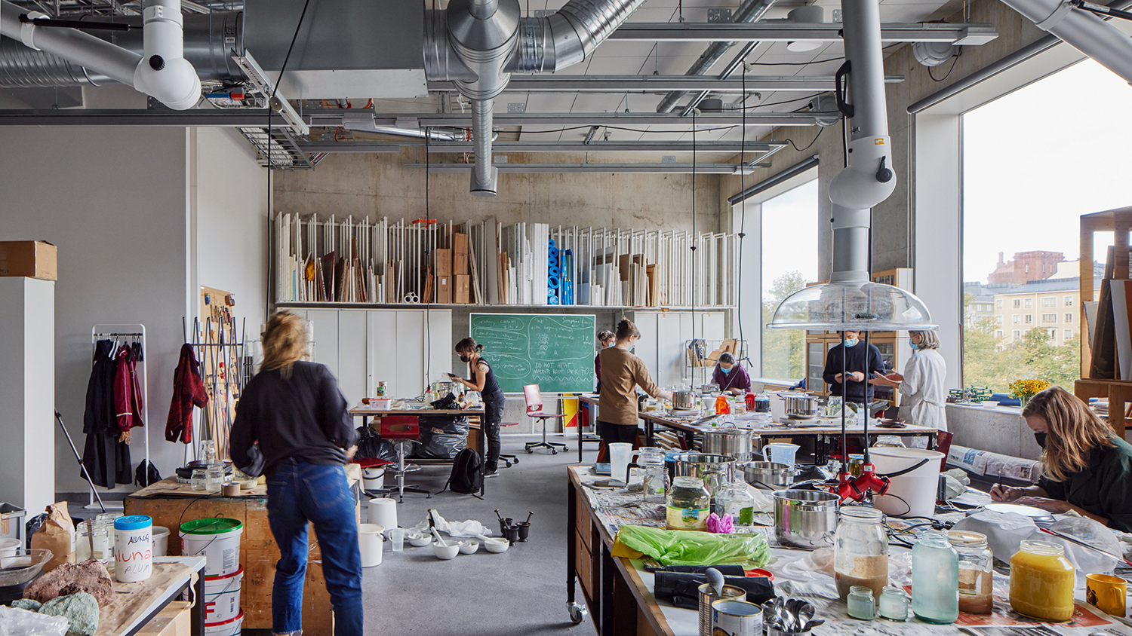
10/10
World-class art
education system
Kuvataideakatemia.
Photo: Tuomas Uusheimo

Slide 21
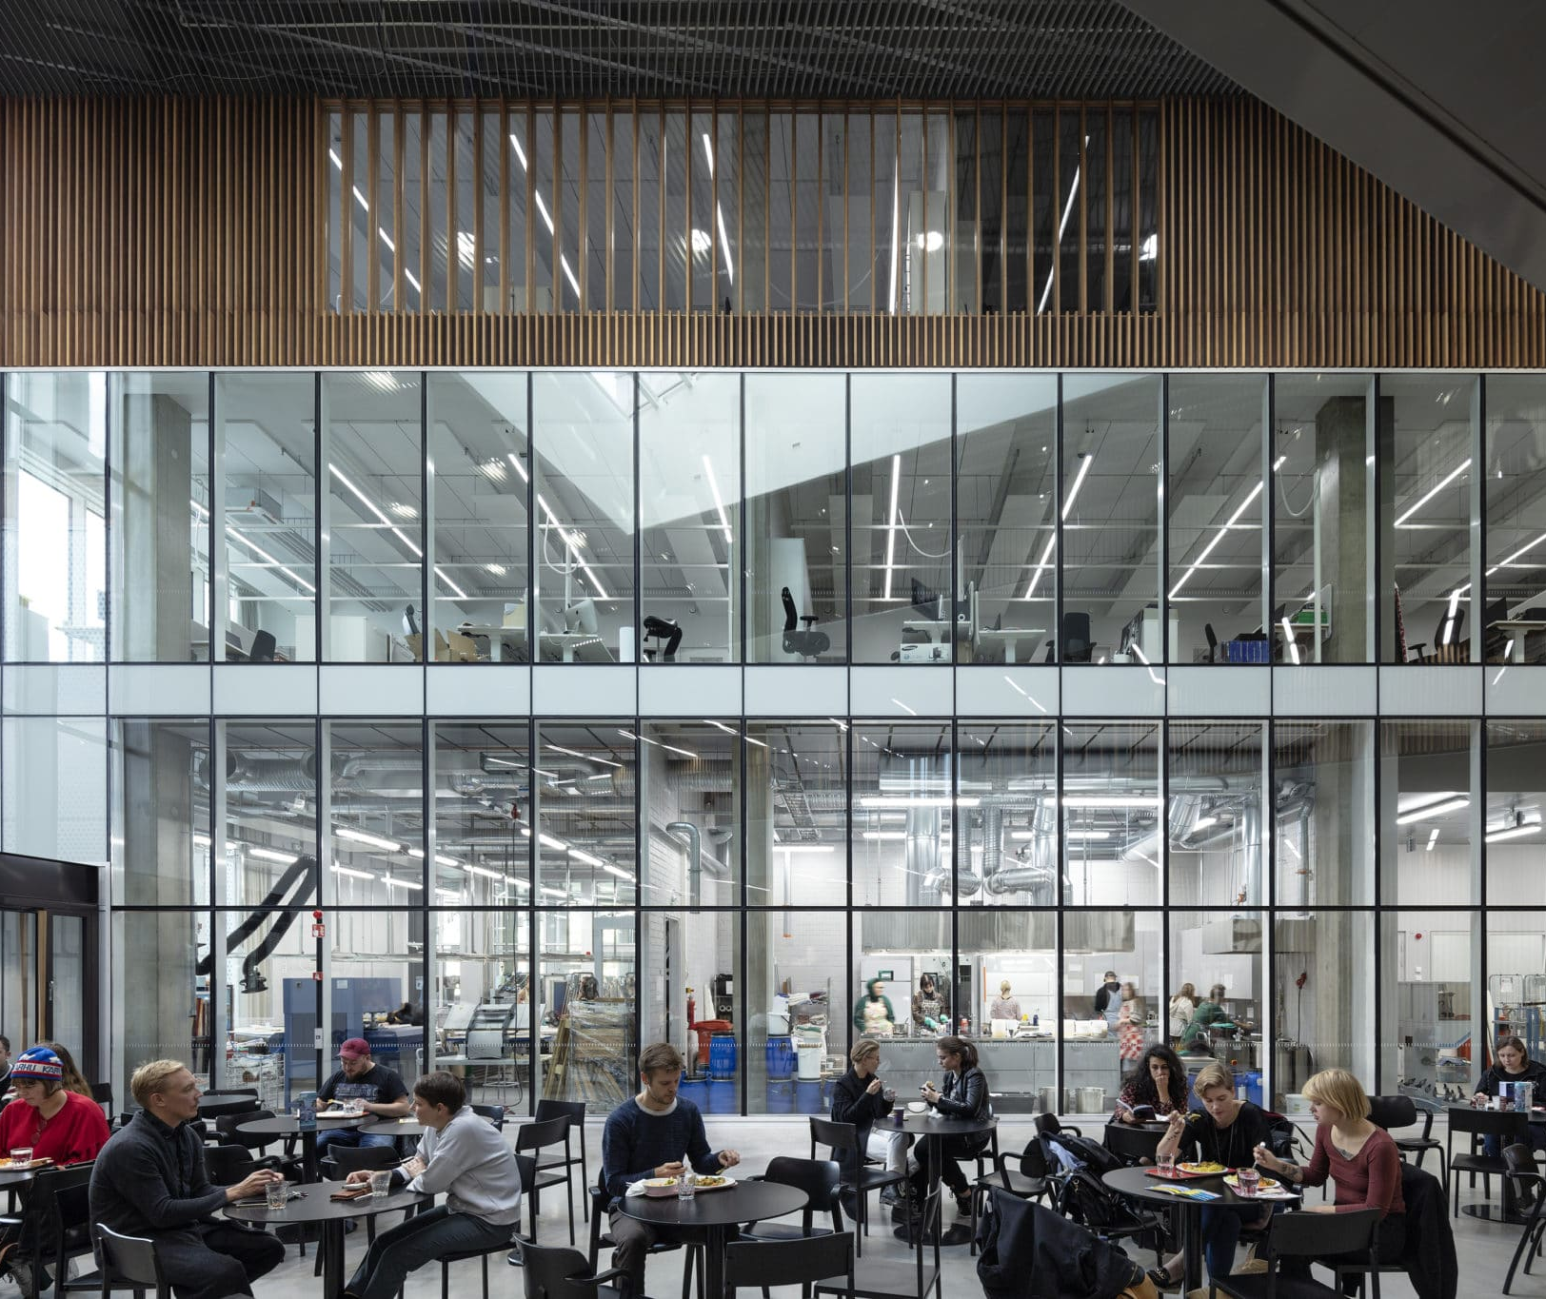
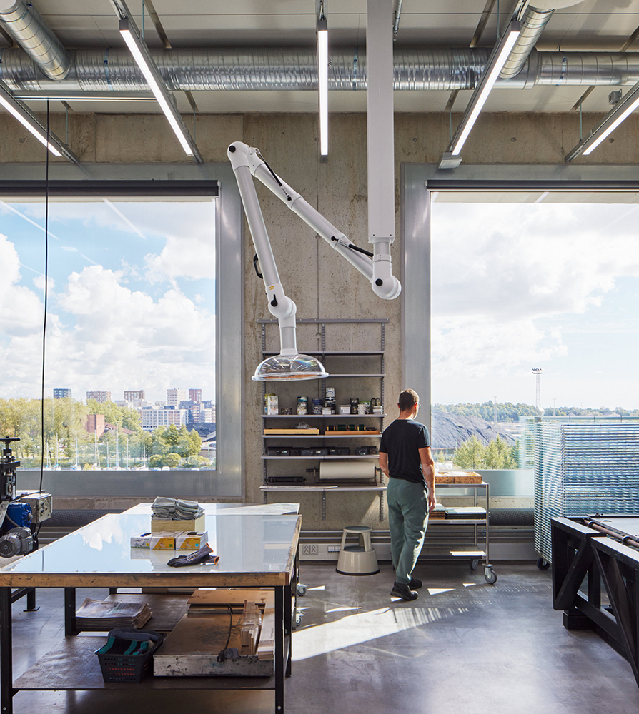
World-class art education system
10 HIGHLIGHTS OF FINNISH CONTEMPORARY ART
1
2
3
4
5
6
7
8
9
10
Finnish professional artists are highly educated.
Public education provides children and students with the skills to apply for further education at top-ranking universities.
Väre Building – Aalto University School of Arts, Design and Architecture in Otaniemi, Espoo, 2018. Designed by Verstas Architects.
Photo: Andreas Meichsner
Kuvataideakatemia.
Photo: Tuomas Uusheimo
Notes:
Finland is known for an extensive and accessible public art education system, provided primarily for children and young people on an extracurricular basis. Basic education in the different fields of art provides students with the skills to express themselves as well as the ability to apply for further education in the art field.
The flourishing Finnish art scene is largely to the credit of the art education system that has been well-funded, as well as a relatively healthy grants system that secures working opportunities for hundreds of artists every year. Finnish professional artists are highly educated. The Academy of the Fine Arts at Uniarts Helsinki and the Aalto University School of Arts, Design and Architecture offer top-ranking higher education in the arts.

Slide 22
11/10
11/10
An extra skylight
with views to
common ground.
Epilogue

Slide 23
Epilogue
10 HIGHLIGHTS OF FINNISH CONTEMPORARY ART
1
2
3
4
5
6
7
8
9
10
11
Photo: xxx
Any note
can be written here.
This is a place for
more detailed information. You can use this page to highlight connections between Finnish cinema and your country, shared projects, or even interesting upcoming events.
Notes:
Tähän osioon voi koota vastaanottajan ja tilanteen mukaan personoitavia asioita, toki elokuvakulman huomioiden.

Slide 24
Feeling inspired? Let’s create the next masterpiece in collaboration.

