Slide 1
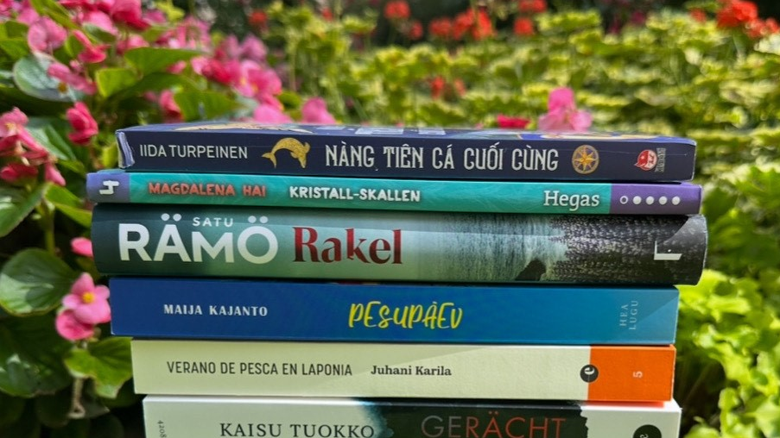

FINNISH LITERATURE IN 10 CHAPTERS
Photo: Finnish Literature Exchange

Slide 2
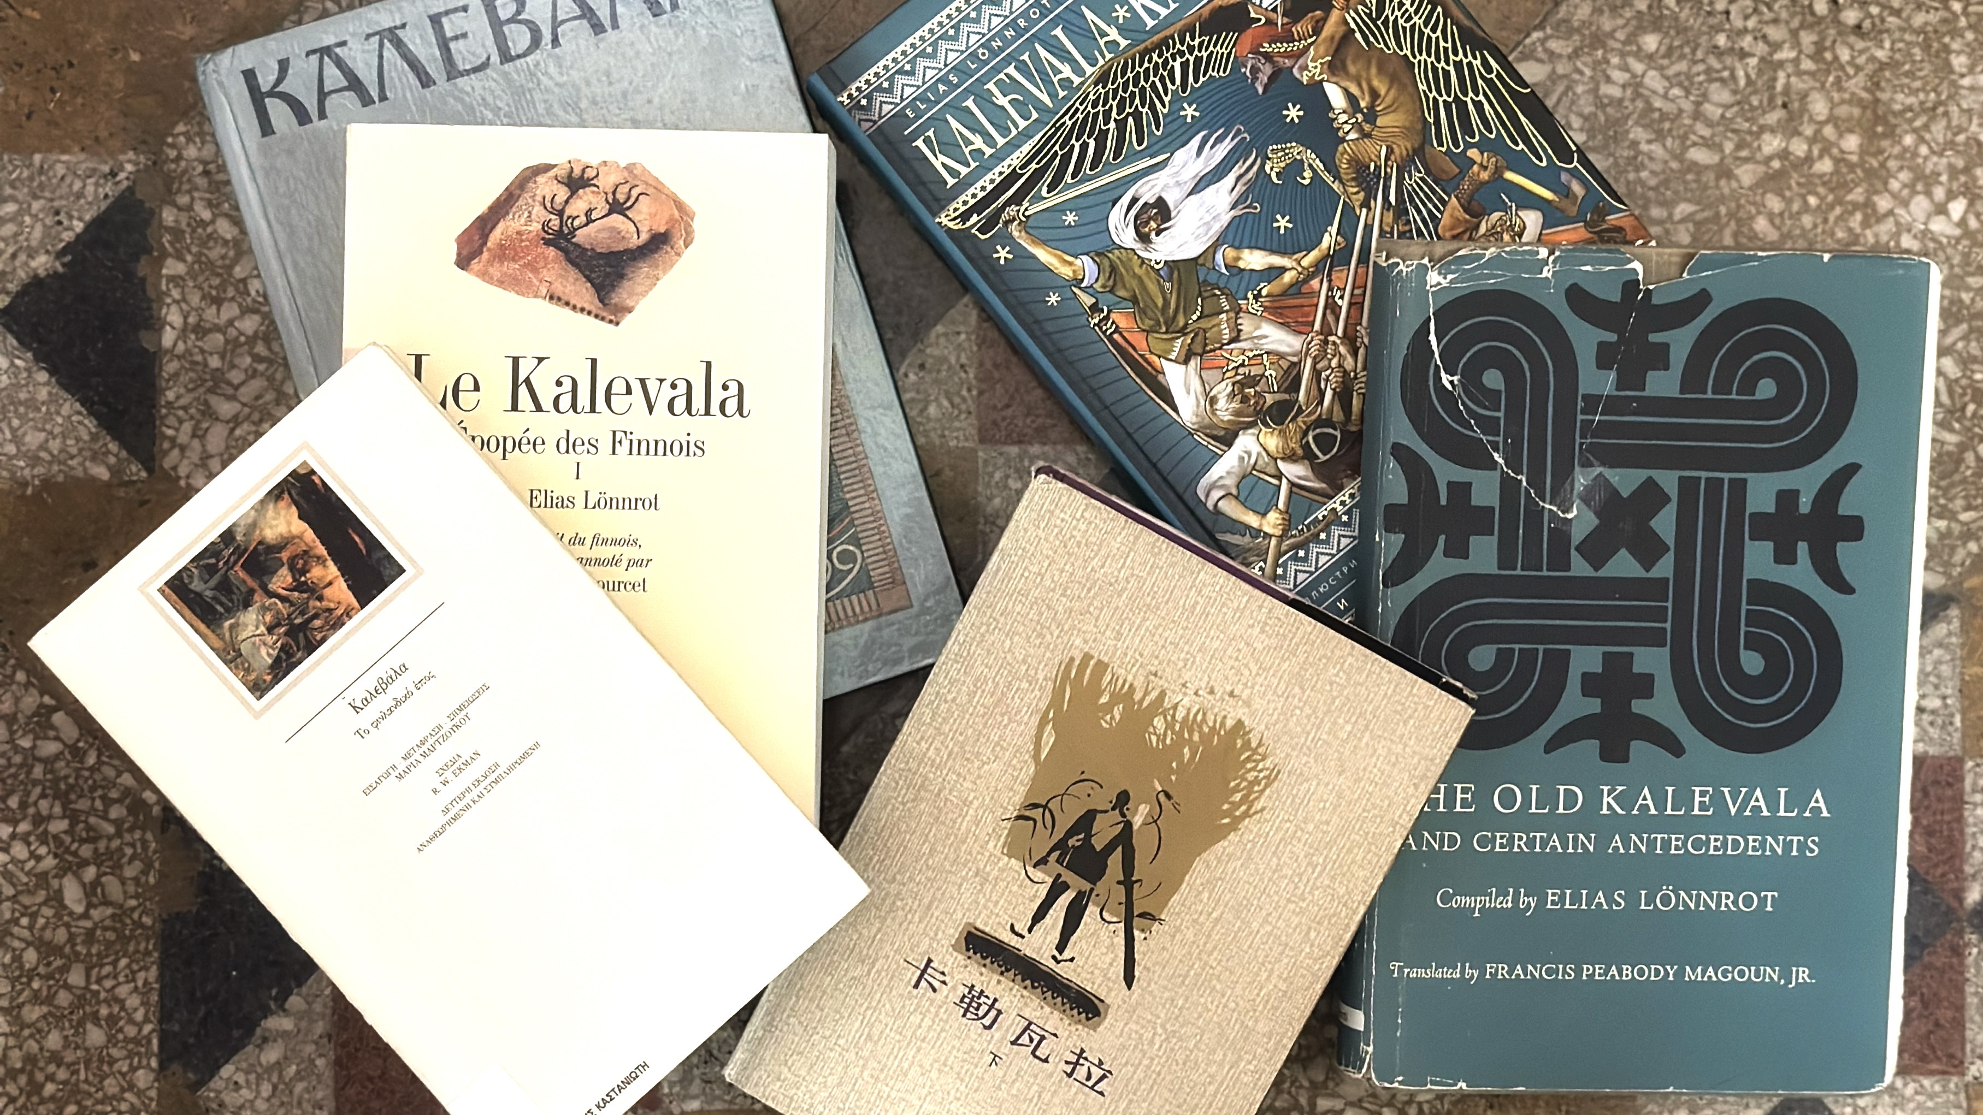
1/10
Our story begins
with Kalevala
Photo: Hannele Jyrkkä

Slide 3
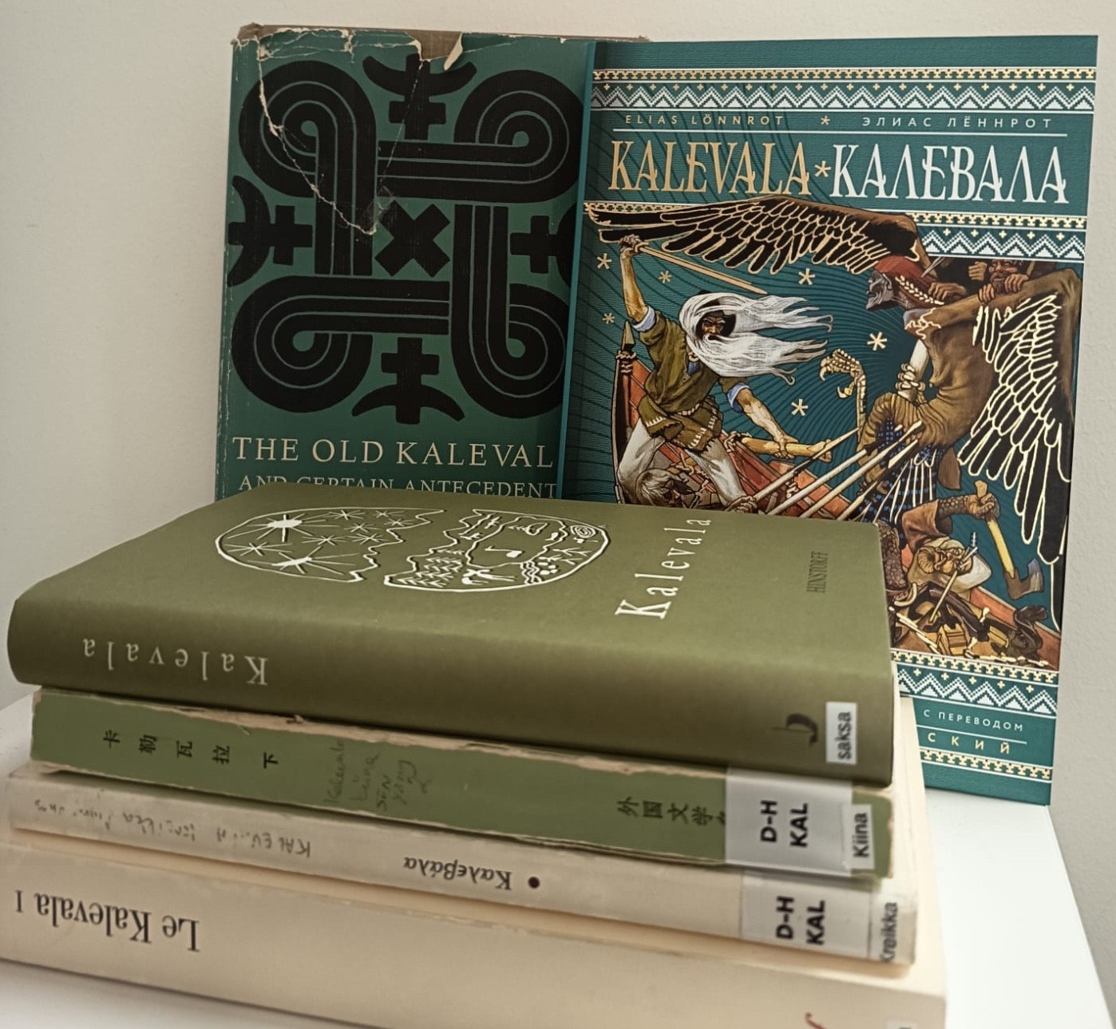
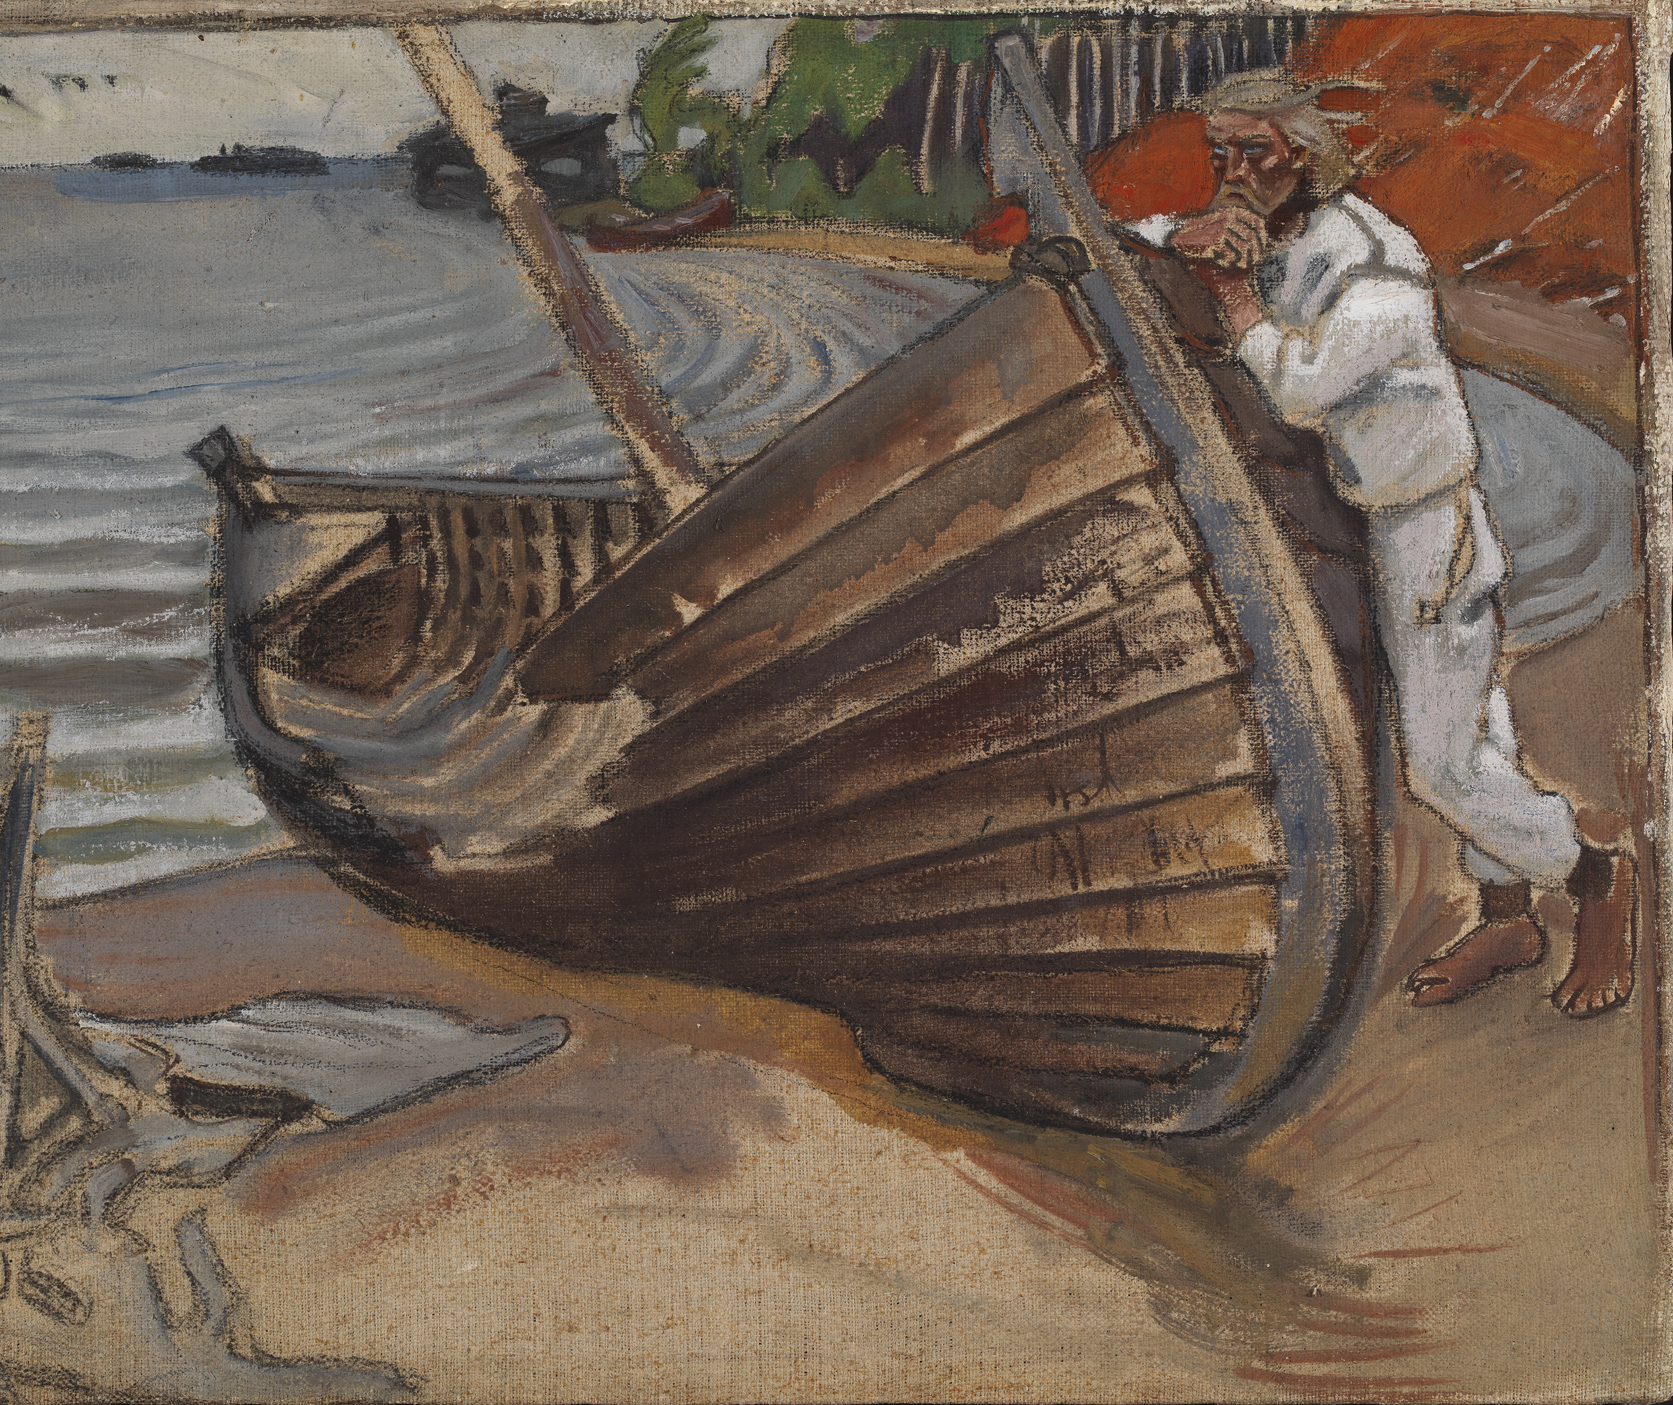
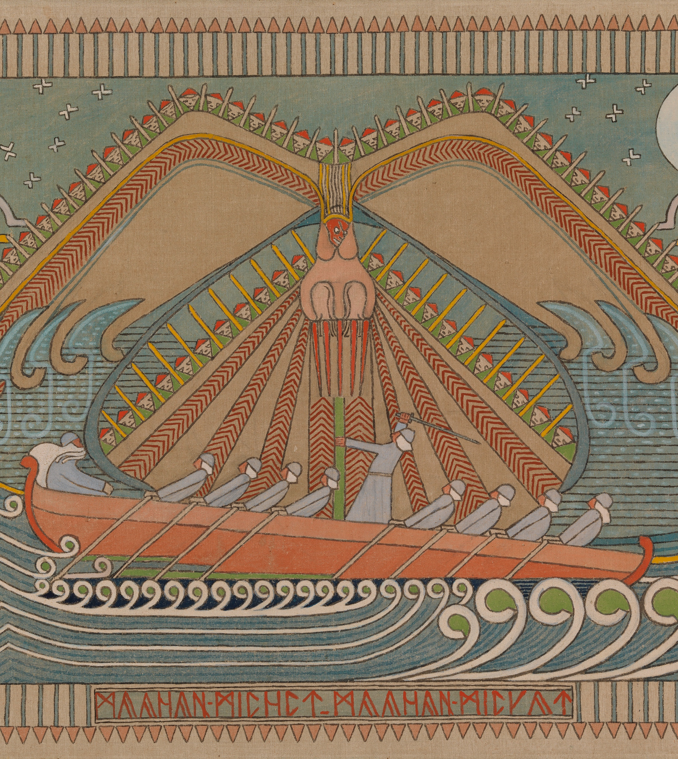
Our story begins with Kalevala
FINNISH LITERATURE IN 10 CHAPTERS
1
2
3
4
5
6
7
8
9
10
One national epic
– 56 translations
Kalevala by Elias Lönnrot is the most translated Finnish book of all time, and it even inspired some of J.R.R. Tolkien's most famous works.
The Lamenting Boat (1906) by Akseli Gallen-Kallela.
Photo: Hannu Pakarinen / Finnish National Gallery
Photo: Finnish Literature Exchange
The Defence of the Sampo (1910–1912) by Joseph Alanen.
Photo: Jenni Nurminen / Finnish National Gallery
Notes:
Published in 1835, the national epic Kalevala remains the most translated Finnish book of all time. It has been translated into 56 languages.
Compiled by Elias Lönnrot, the Kalevala has served as inspiration for countless other works of art. The most recent examples in literature are Emmi Itäranta’s fantasy novel Snowsinger (2025), which recreates the story of Louhi from Finnish mythology, and Sami Makkonen’s Kalevala Anniversary Edition comic book (2025).
The Kalevala has also inspired numerous paintings by Akseli Gallen-Kallela, poems by Eino Leino, compositions by Jean Sibelius, the Kullervo opera by Aulis Sallinen, the Kullervo dance piece by Tero Saarinen, and modern Kalevala illustrations by Hannu Väisänen.

Slide 4
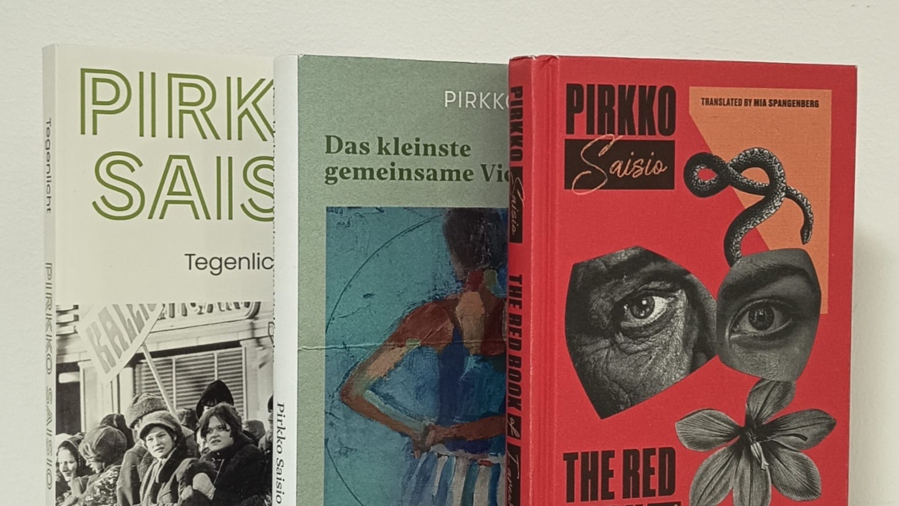
2/10
A world of classics and
modern classics
Photo: Finnish Literature Exchange

Slide 5
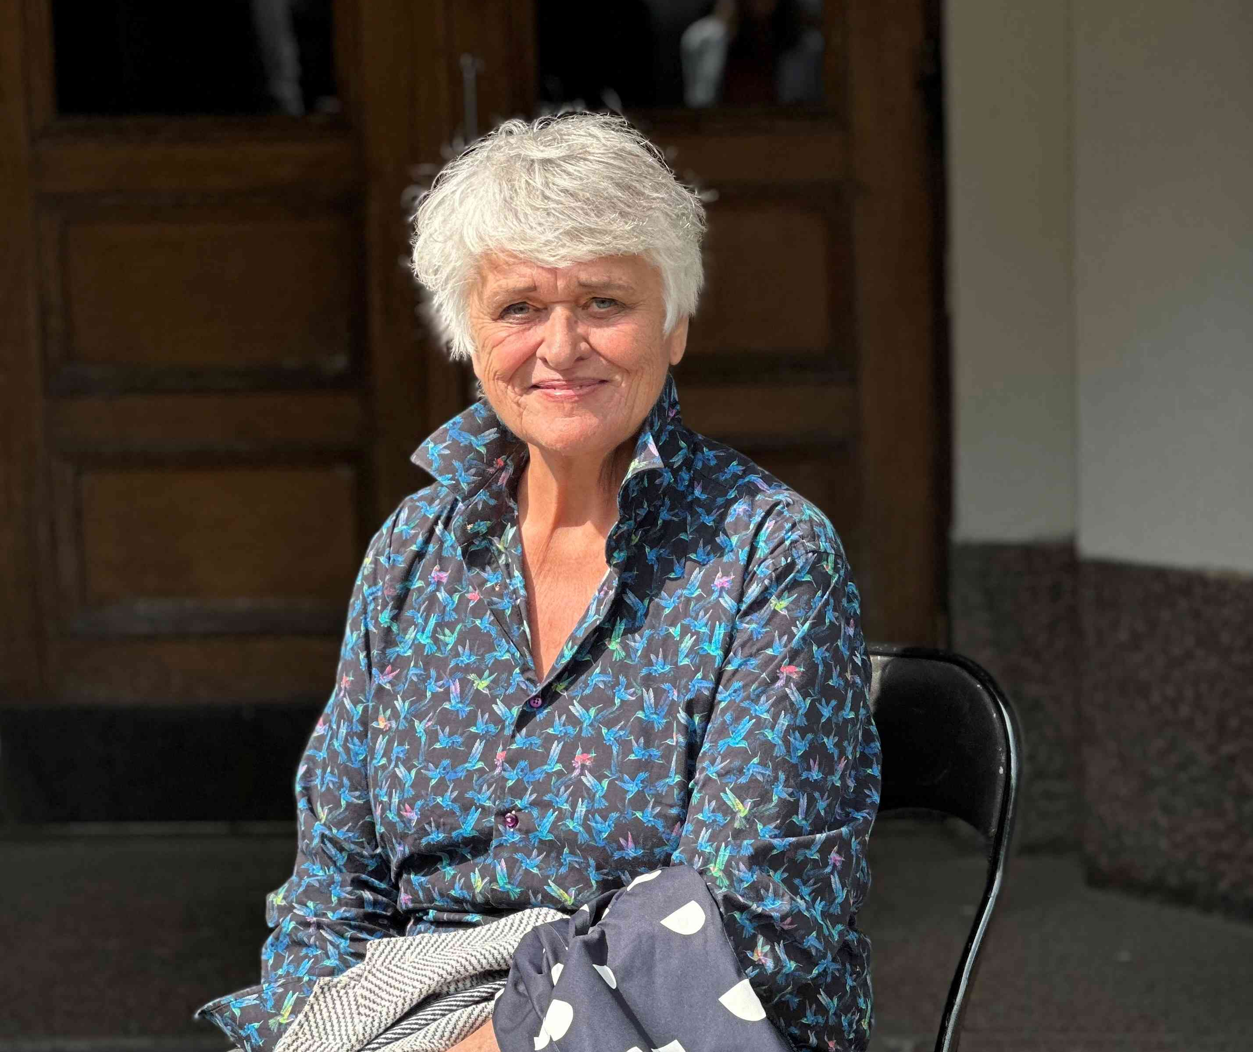
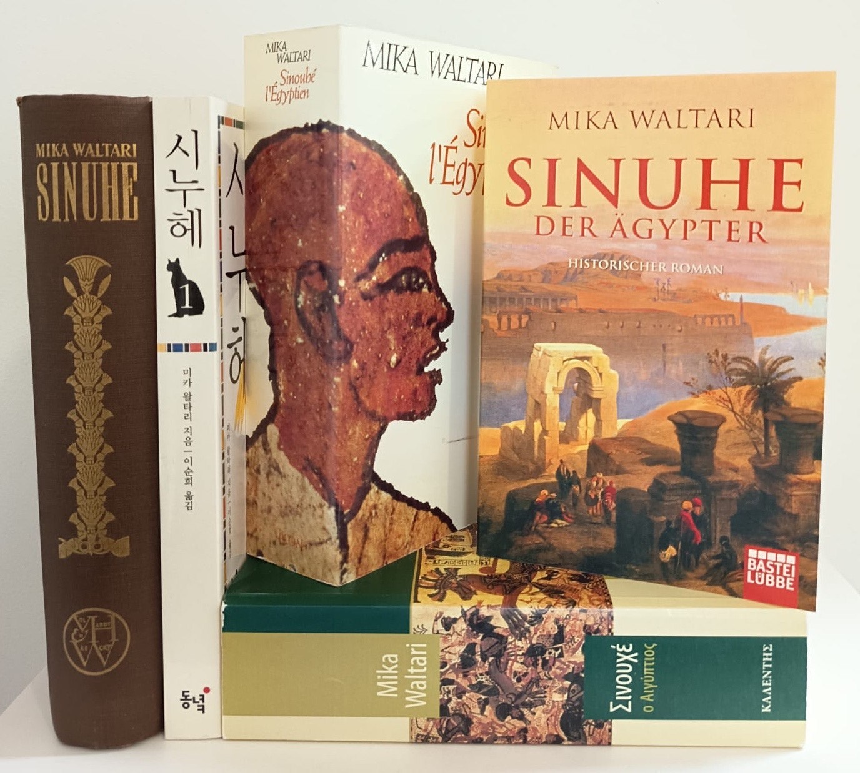
A world of classics and modern classics
FINNISH LITERATURE IN 10 CHAPTERS
1
2
3
4
5
6
7
8
9
10
Finnish classics still attract worldwide interest decades after release.
Pirkko Saisio.
Photo: Hannele Jyrkkä
Photo: Finnish Literature Exchange
Notes:
Mika Waltari's historical novel Sinuhe, the Egyptian became an international success immediately after its publication in 1945. This classic novel, which deals with the intersections of science and religion, has been translated into 42 languages.
Finnish classics are also attracting wider interest around the world. For example, Aleksis Kivi’s The Seven Brothers (1870) has been published in 35 languages, and Sally Salminen’s Katrina (1936) in 22 languages. Recently, interest in Finnish classics has also been sparked by Anni Blomqvist’s Maja from Stormskär series (1968–), which is about to be published in French, among other languages. The only Finnish Nobel Prize winner in Literature is Frans Emil Sillanpää (1888–1964). He received the prize in 1939 ‘for his profound understanding of his country's rural population and for the artistic quality with which he has depicted their way of life and their relationship with nature.’
Other modern classics of international acclaim include Arto Paasilinna’s The Year of the Hare (1975), which has been translated into more than 30 languages, and Pirkko Saisio’s Helsinki trilogy (1998, 2000 & 2003), which has been sold to more than ten language territories and published in the world-famous Penguin Modern Classics series.
Worldwide interest in both older and newer Finnish literature is evident in the numbers: every year, over 400 translations of Finnish literature are published worldwide in over 40 languages.
Most translated authors in 2024 were Timo Parvela (22, children and young adult literature), Tove Jansson (16, fiction and children and young adult literature), Sofi Oksanen (15, fiction), Satu Rämö (14, fiction, crime), and Magdalena Hai (12, children and young adult literature).
Most translated books in 2024 were Same River, Twice by Sofi Oksanen, Tangled Roots by Maria Turtschaninoff, A Giraffe’s Heart is Unbelievably Large by Sofia & Amanda Chanfreau, Hildur by Satu Rämö, and The Moose Paradox by Antti Tuomainen.
Most translated languages in 2024 were Estonian (59), German (44), Danish (40), Polish (32), and French (29).

Slide 6
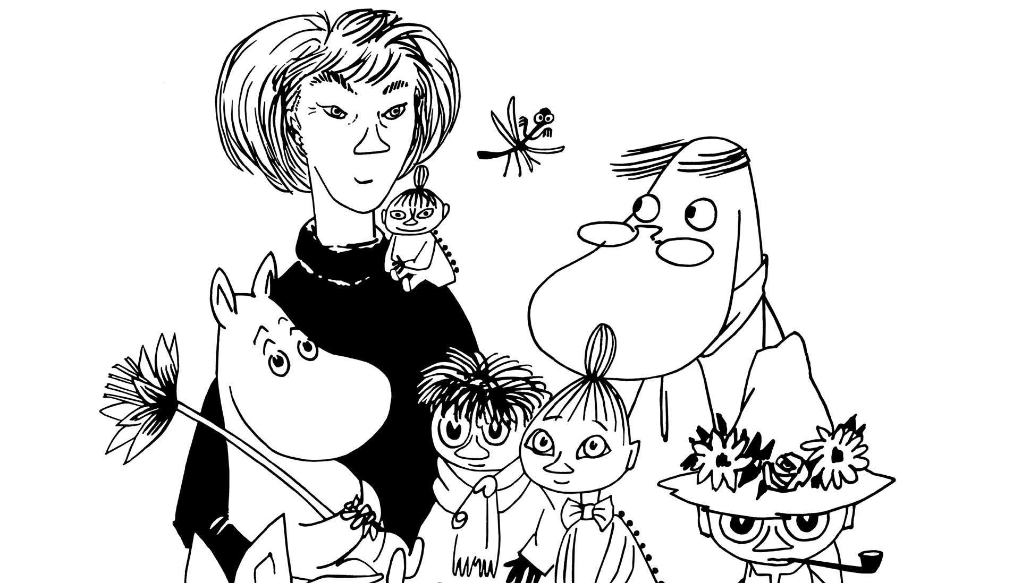
3/10
The Moomins might be 80 years old,
but they still make the news
Photo: Moomin Characters

Slide 7
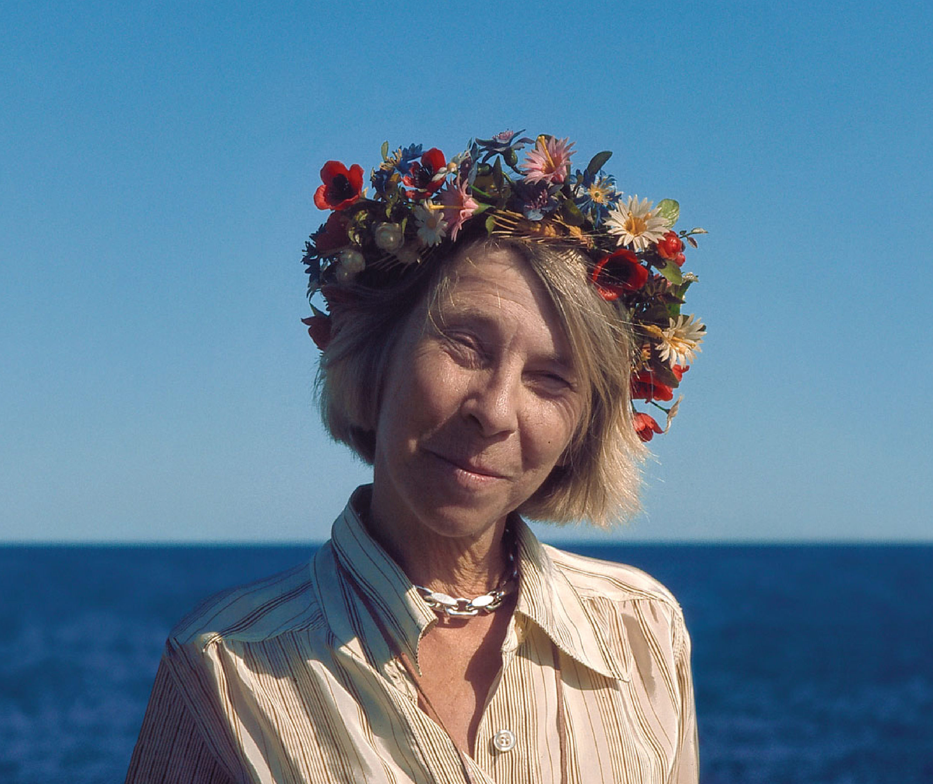
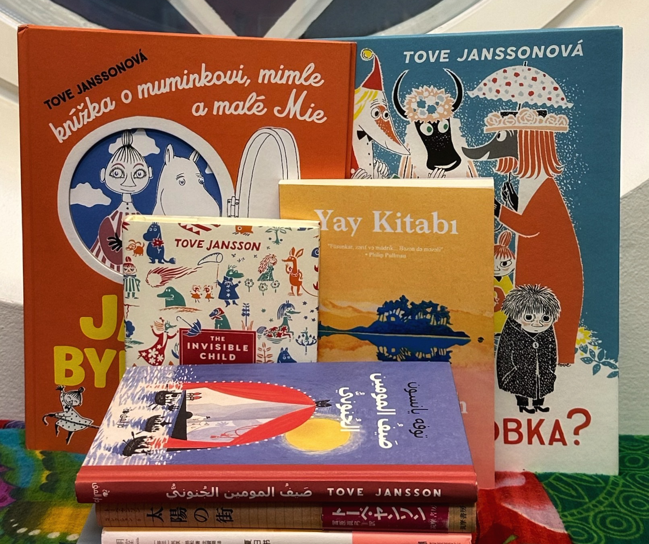
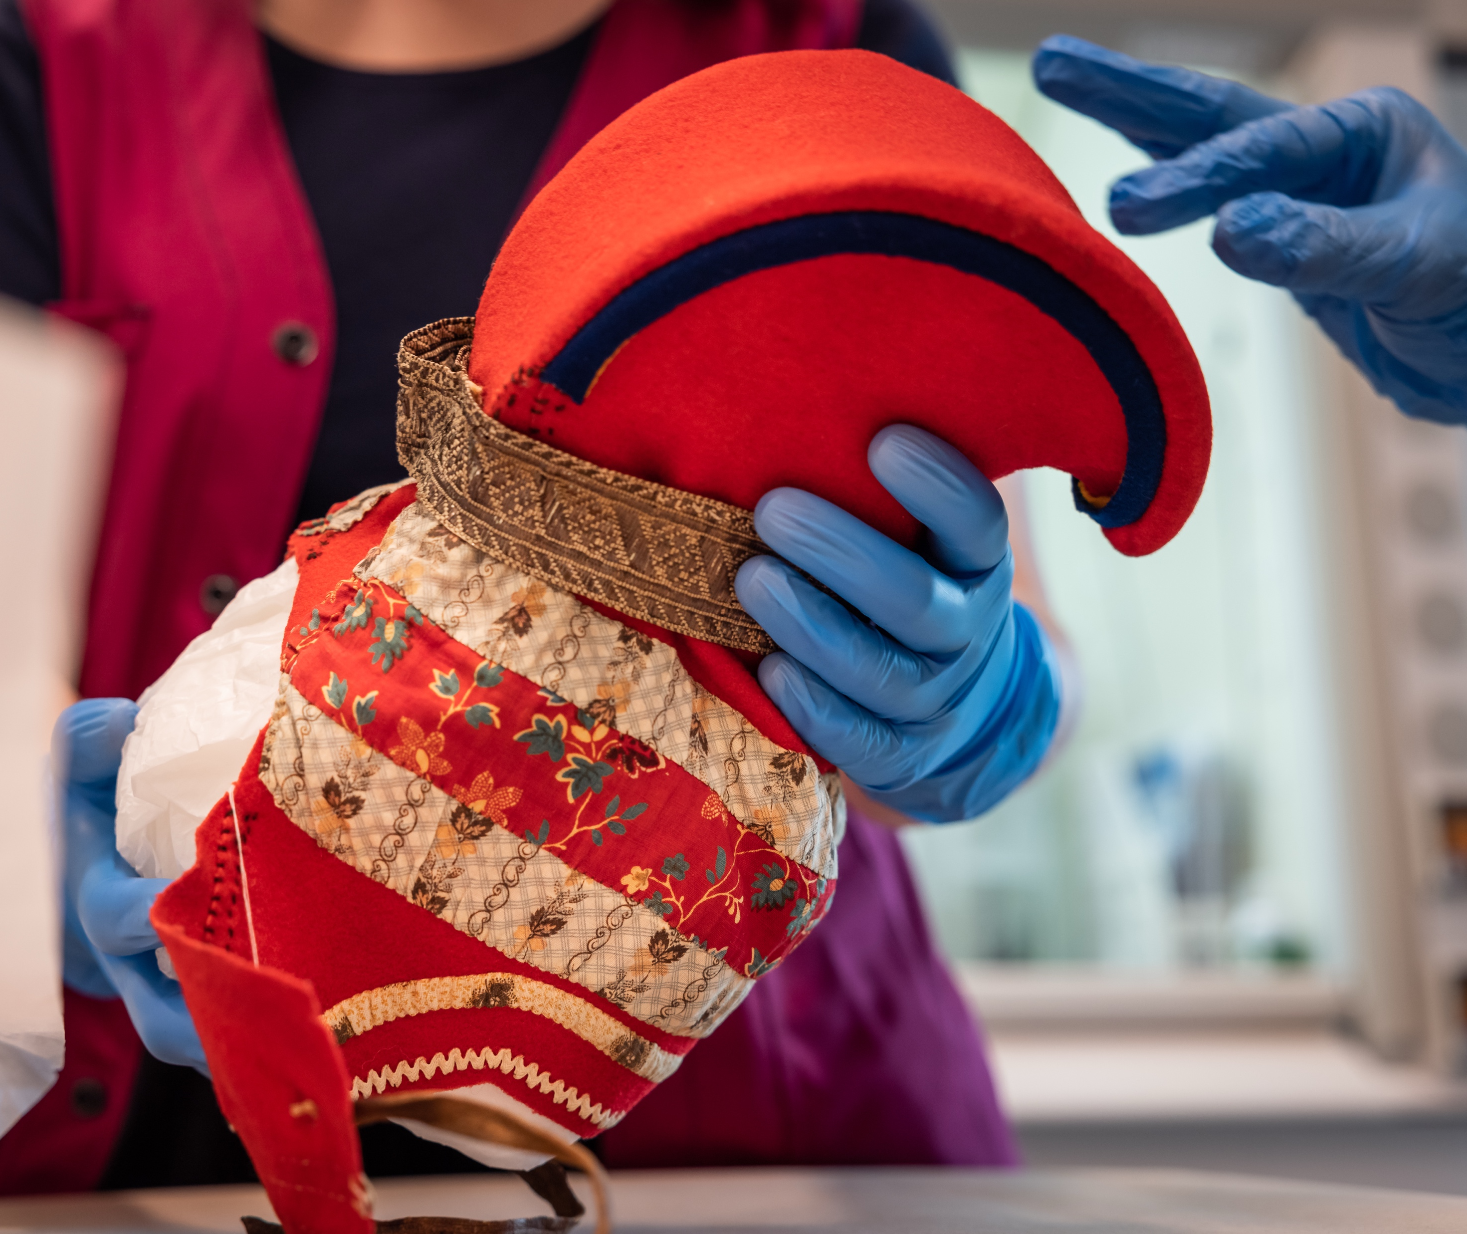
The Moomins might be 80 years old, but they still make the news
FINNISH LITERATURE IN 10 CHAPTERS
1
2
3
4
5
6
7
8
9
10
A real main
character
Every year international media publishes nearly 1,000 articles about Tove Jansson’s work.
Homecoming (2023), by Suvi West and Anssi Kömi, focuses on the repatriation of Sámi objects from European museums. Photo: Ville-Riiko Fofonoff / Vaski Filmi.
Tove Jansson.
Photo: Per Olov Jansson
Photo: Finnish Literature Exchange
Notes:
Celebrating their 80th anniversary in 2025, the Moomins are famous all over the world thanks to Tove Jansson’s books and comics, as well as animations and movies based on her books. Tove Jansson published a total of 35 works, which have been translated into 50 languages. Her famous novel The Summer Book (1972), for example, has been translated into 33 languages. The Summer Book was also adapted into a film in 2024, starring Glenn Close.
In international media, both Tove Jansson and the Moomins are absolute perennial favorites. Every year, nearly 1,000 articles on Jansson’s work appear in international media worldwide.

Slide 8
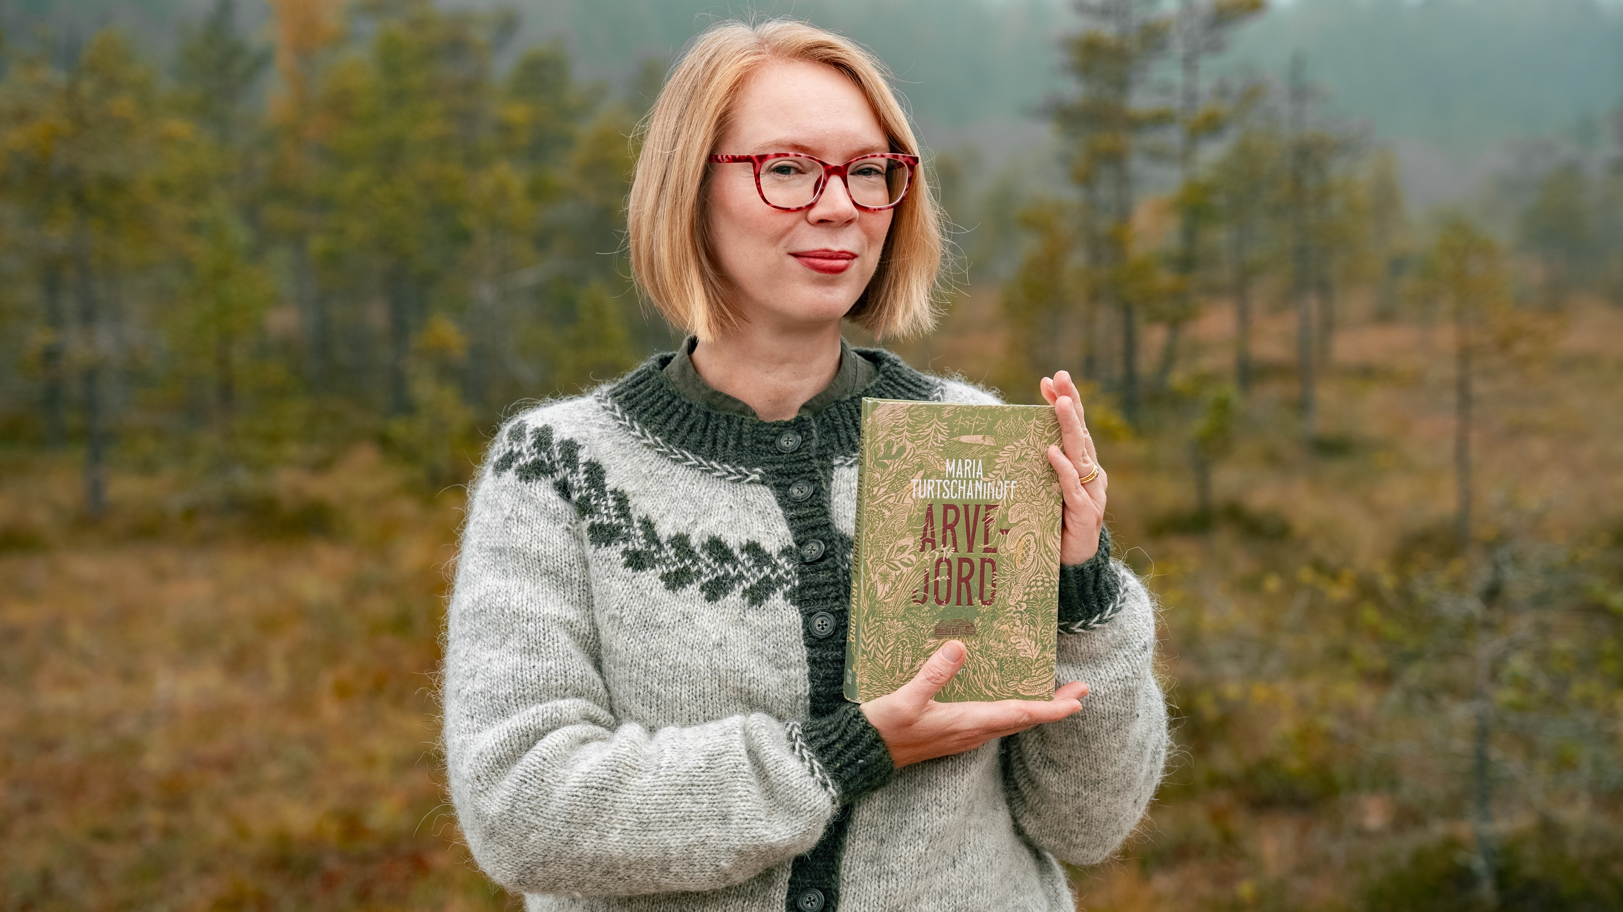
4/10
The land of a thousand lakes
and many native languages
Maria Turtschaninoff. Photo: Juho Sallinen

Slide 9
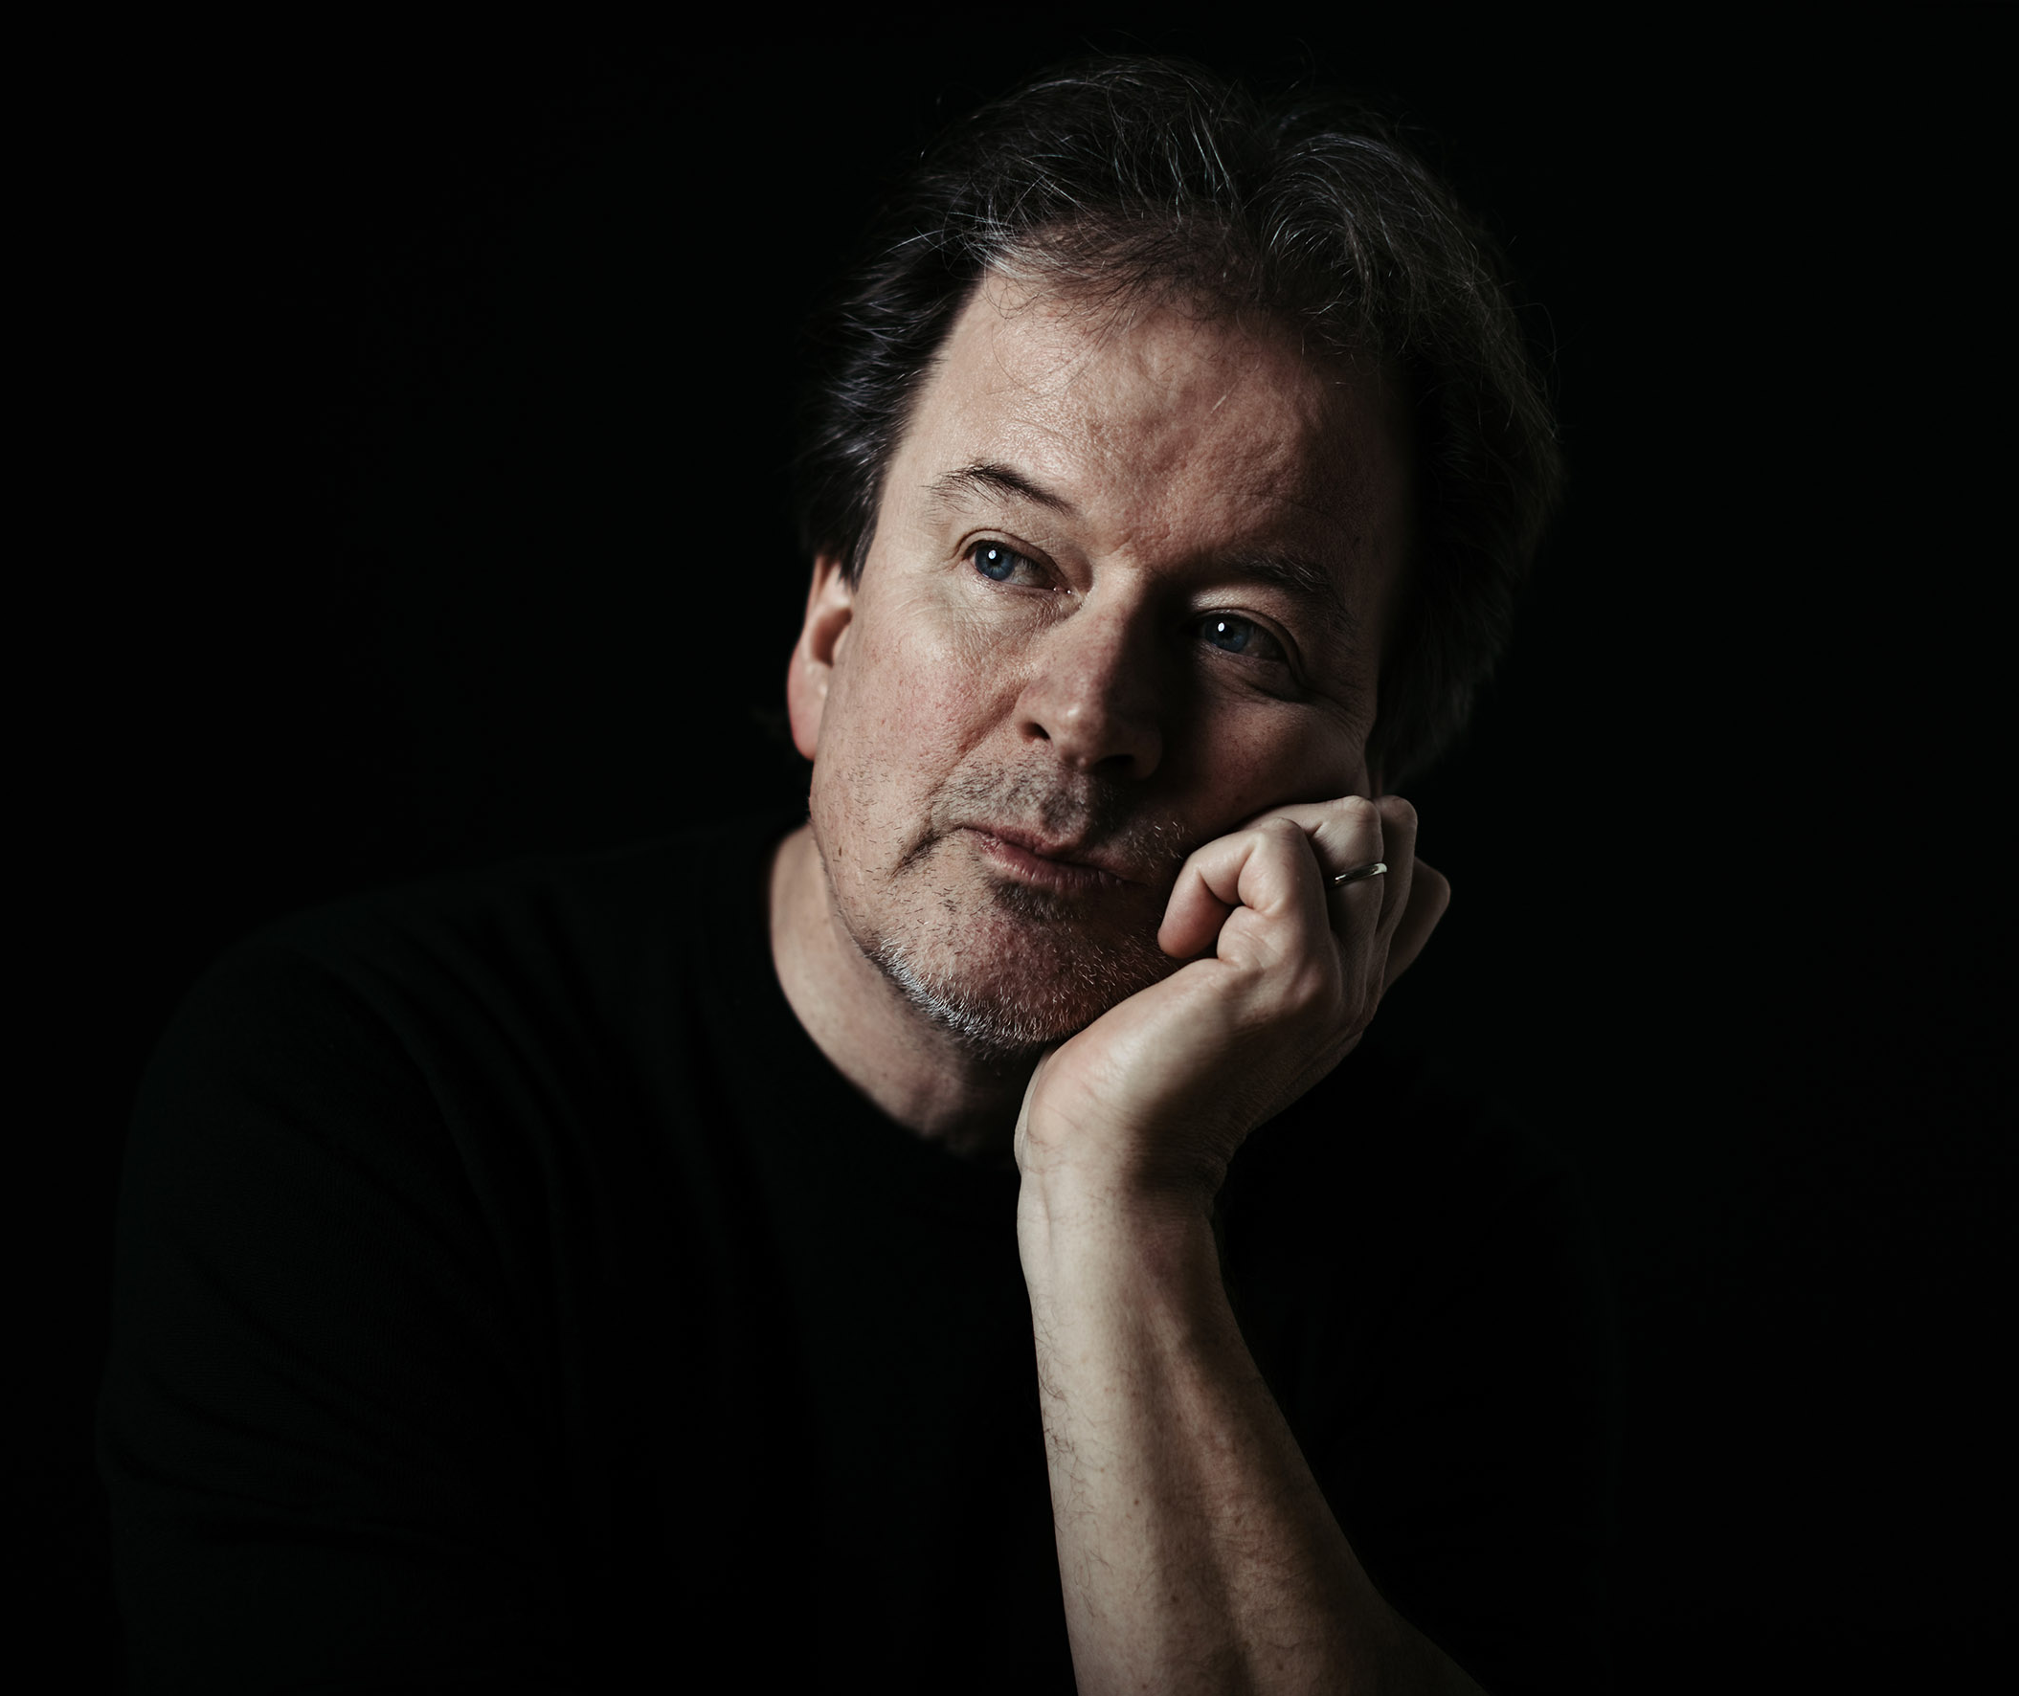
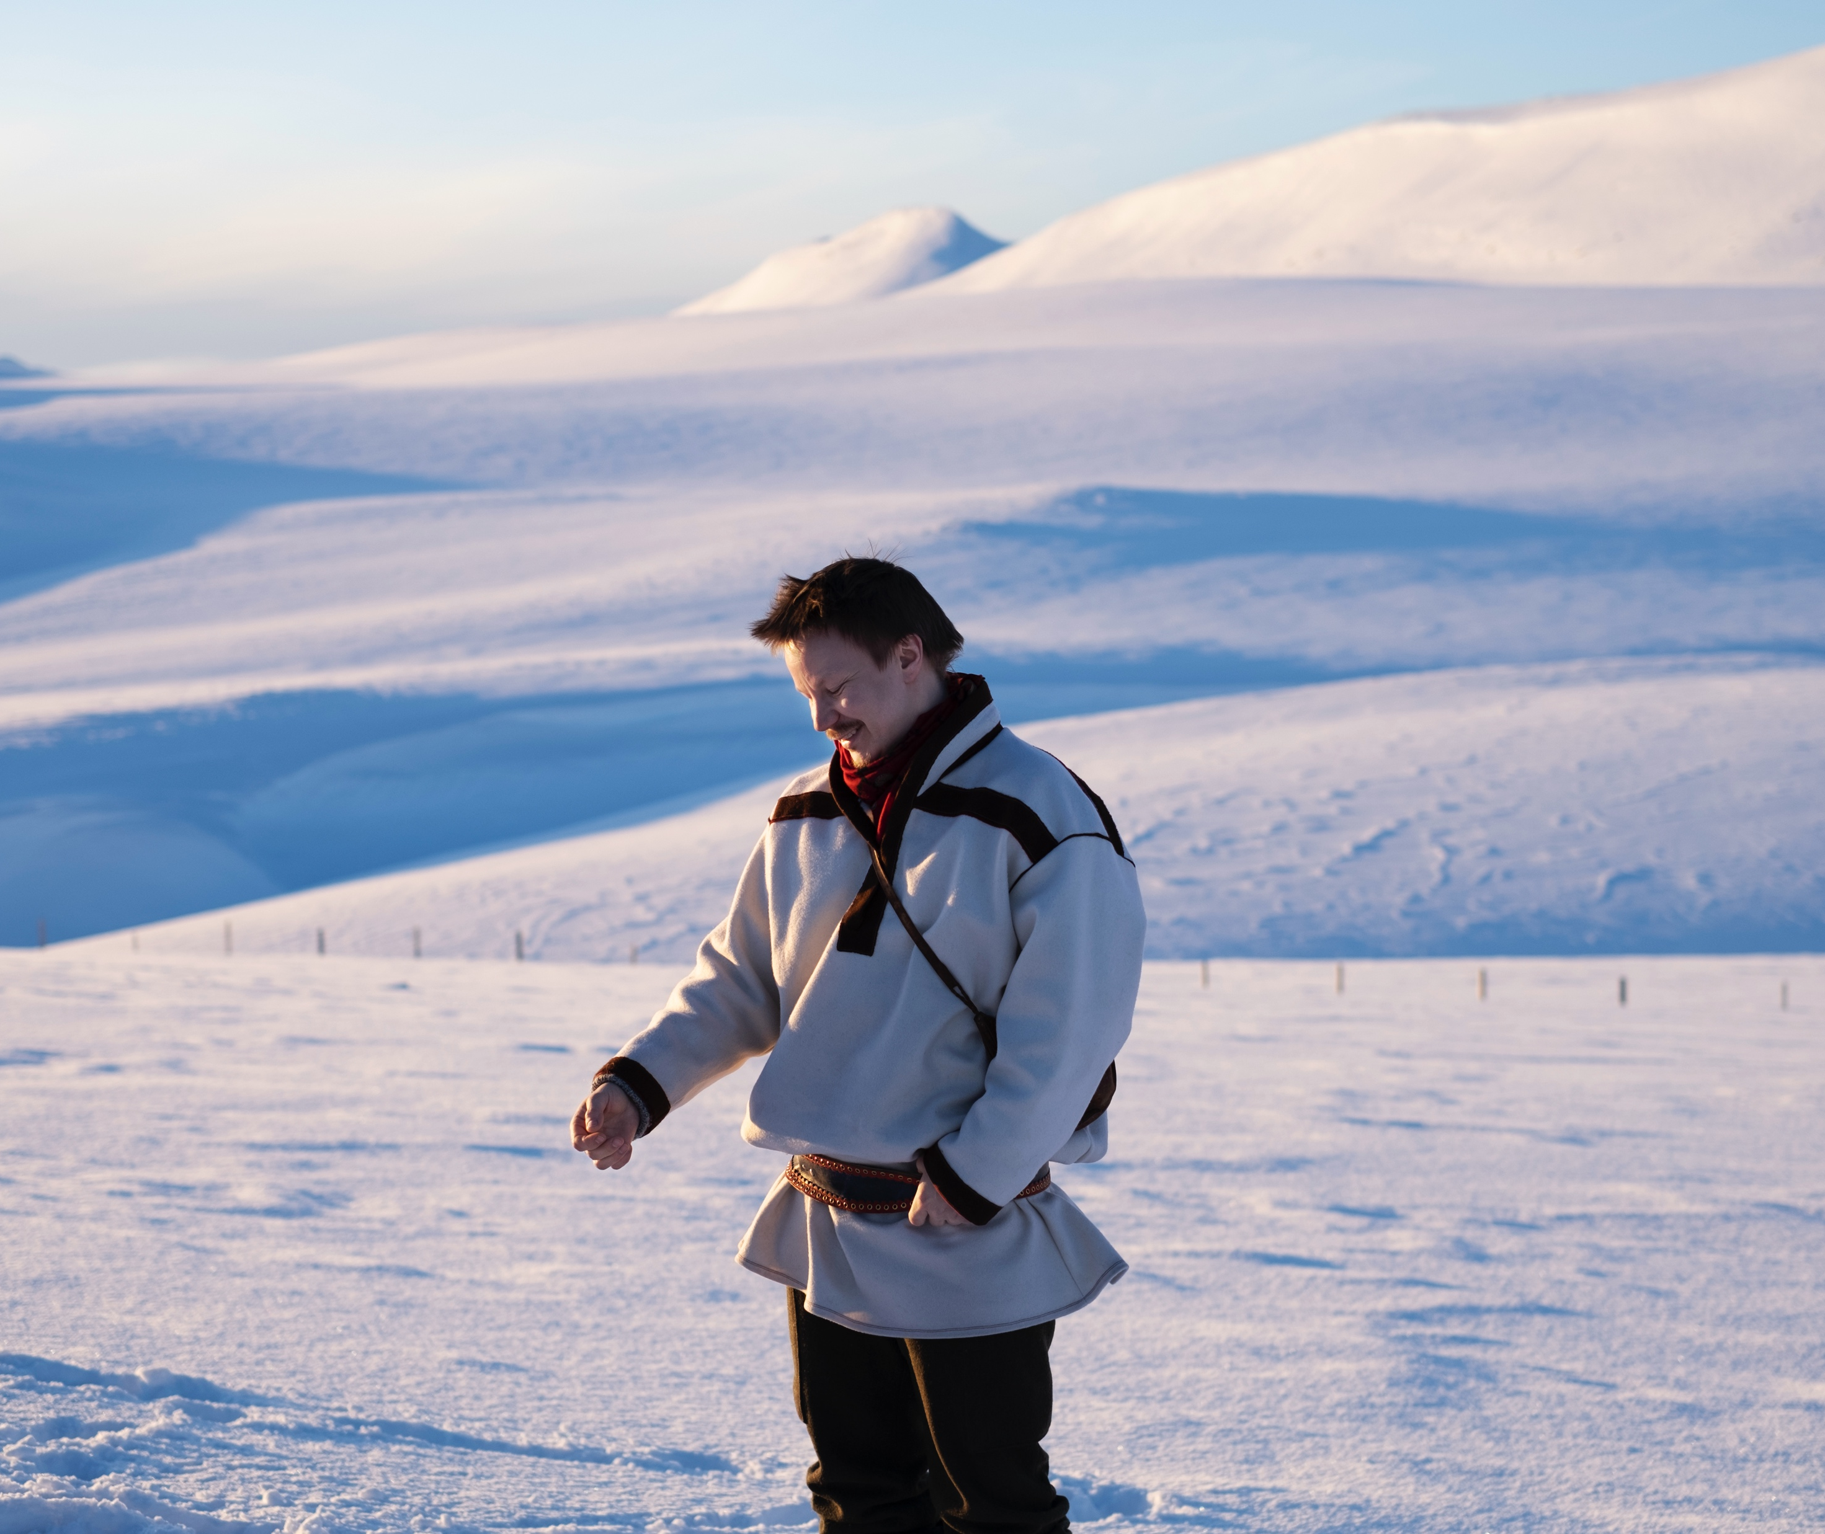
The land of a thousand lakes and many native languages
FINNISH LITERATURE IN 10 CHAPTERS
1
2
3
4
5
6
7
8
9
10
Finnish literature is not written just in Finnish but also in Finland Swedish and Sámi.
Homecoming (2023), by Suvi West and Anssi Kömi, focuses on the repatriation of Sámi objects from European museums. Photo: Ville-Riiko Fofonoff / Vaski Filmi.
Kjell Westö.
Photo: Niklas Sandström
Niillas Holmberg.
Photo: Lada Suomenrinne
Notes:
Finnish literature also encompasses works written in Finland Swedish and Sámi. In the past five years, a total of 327 works of Finland Swedish literature were translated into 40 different languages.
The most successful contemporary Finland-Swedish authors include Tove Jansson, Kjell Westö and Maria Turtschaninoff, whose works have been translated into 23 languages respectively. Turtschaninoff’s multi-award-winning novel Tangled Roots (2022) tells the story of a Finland-Swedish family, illustrating how Finland’s forests and marshlands connect family members across centuries.
The best-known and most widely translated Sámi-language author is Niillas Holmberg, who also works as an actor and musician.

Slide 10
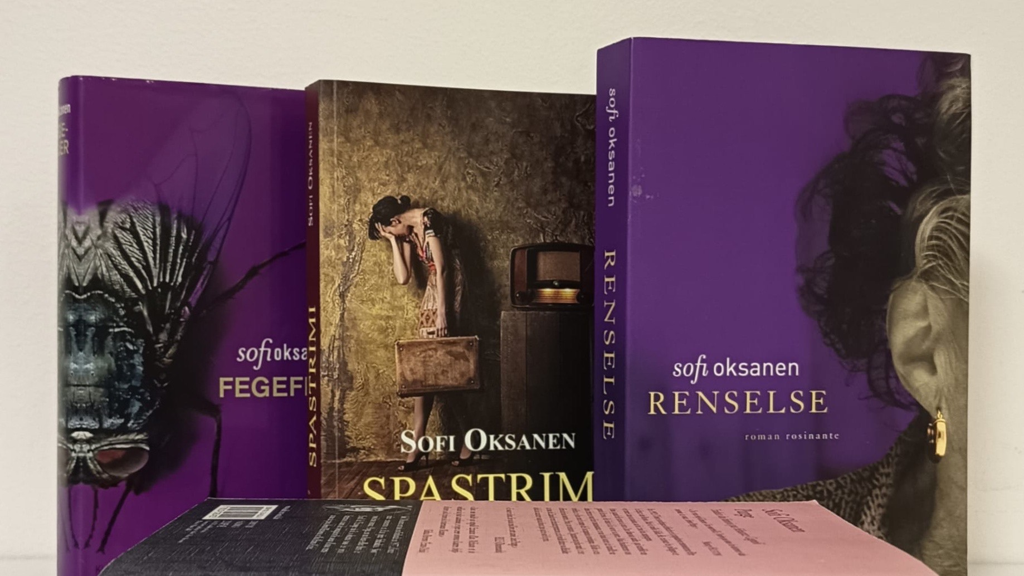
5/10
Reading is a quiet hobby, but
some things need to be said out loud
Photo: Finnish Literature Exchange

Slide 11

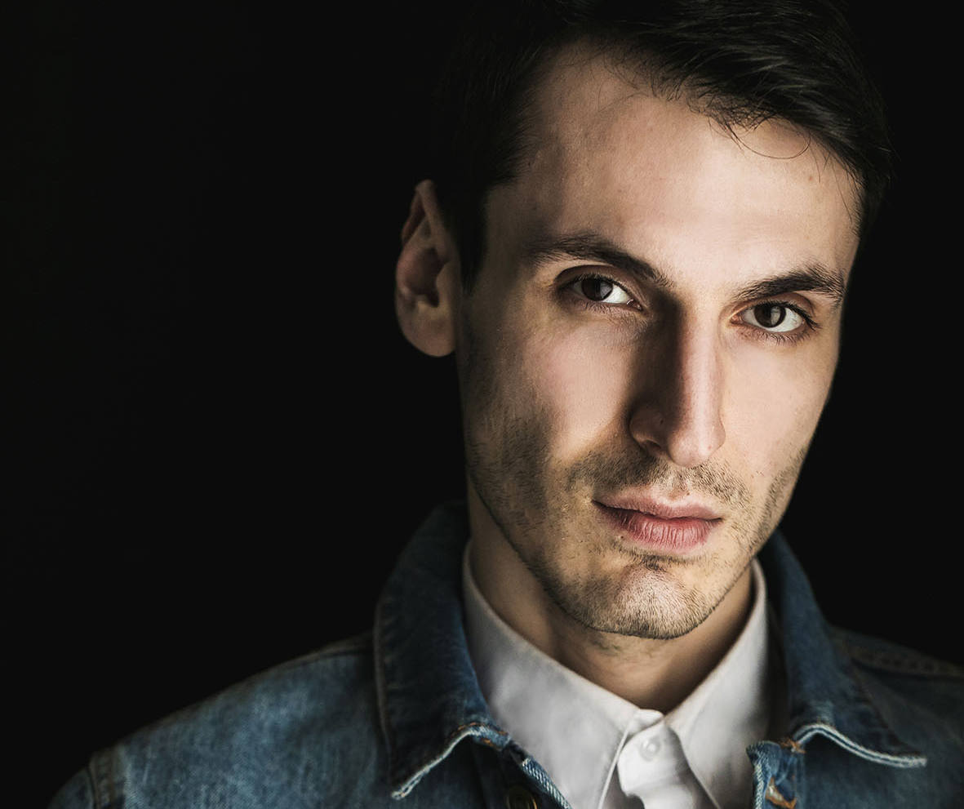
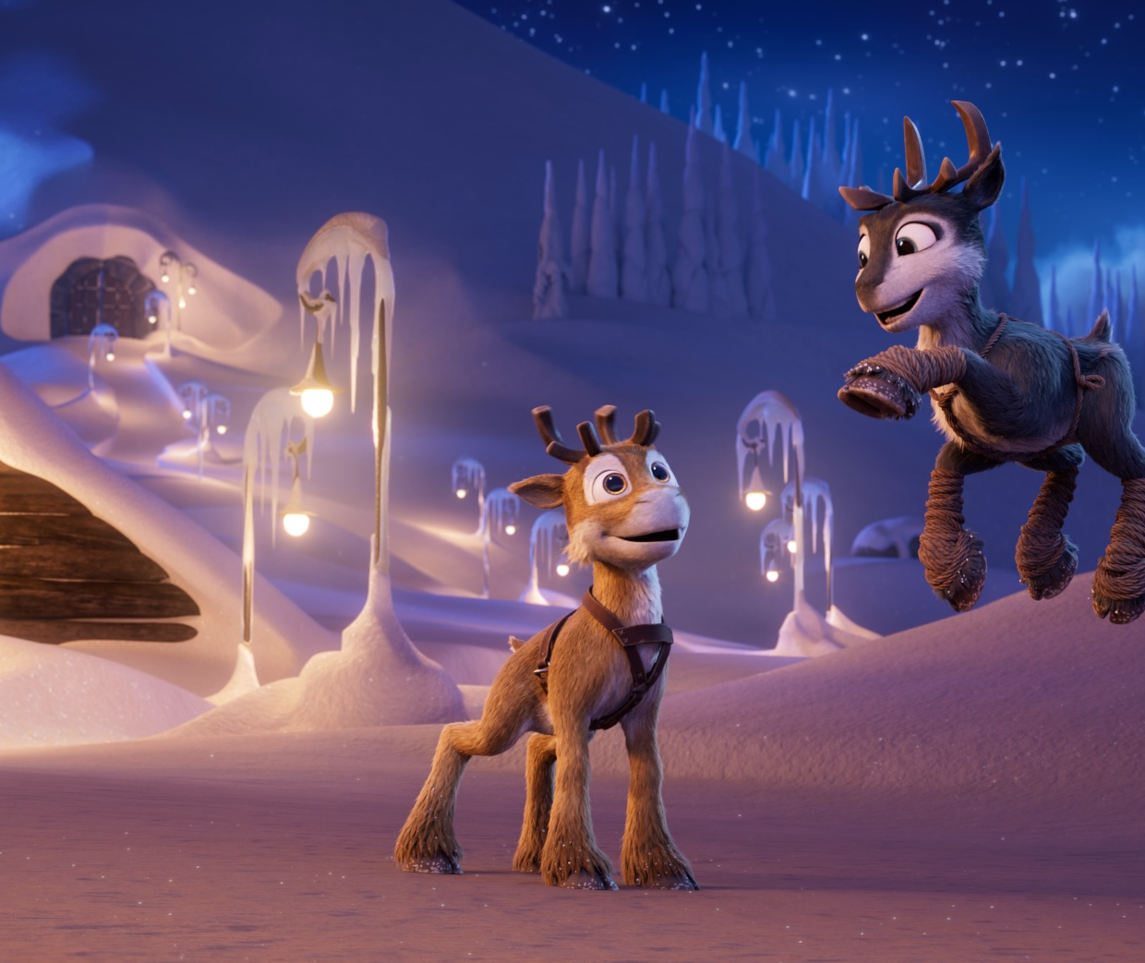
Reading is a quiet hobby, but some things need to be said out loud
FINNISH LITERATURE IN 10 CHAPTERS
1
2
3
4
5
6
7
8
9
10
Powerful voices
Finland has many outspoken, internationally successful authors who deal with difficult topics such as violence against women.
Pajtim Statovci. Photo: Jonne Räsänen
Sofi Oksanen.
Photo: Toni Härkönen
Niko: Beyond the Northern Lights (2024) by Kari Juusonen and Jørgen Lerdam. Photo: Anima Vitae, Cinemaker.
Notes:
One of Finland’s most internationally acclaimed authors is Sofi Oksanen, whose award-winning novel Purge (2008) gave rise to a new boom in Finnish literature around the world. Having won over ten awards, the novel has been translated into 39 languages. Her newest work, a hard-hitting political commentary essay collection titled Same River, Twice: Putin's War on Women (2023) has already been translated into 14 languages, with more publications on the way. A total of 161 translations of her works have been published to date.
Other strong, outspoken, and internationally successful authors include Kari Hotakainen (28 languages), Selja Ahava (25 languages), Rosa Liksom (25 languages), Tommi Kinnunen (21 languages), Katja Kettu (19 languages), Riikka Pulkkinen (18 languages), Monika Fagerholm (17 languages) and Pajtim Statovci (17 languages).

Slide 12

6/10
Is truth stranger than fiction? Finnish authors
know how to make both interesting.
Matias Riikonen. Photo: Hannele Jyrkkä

Slide 13
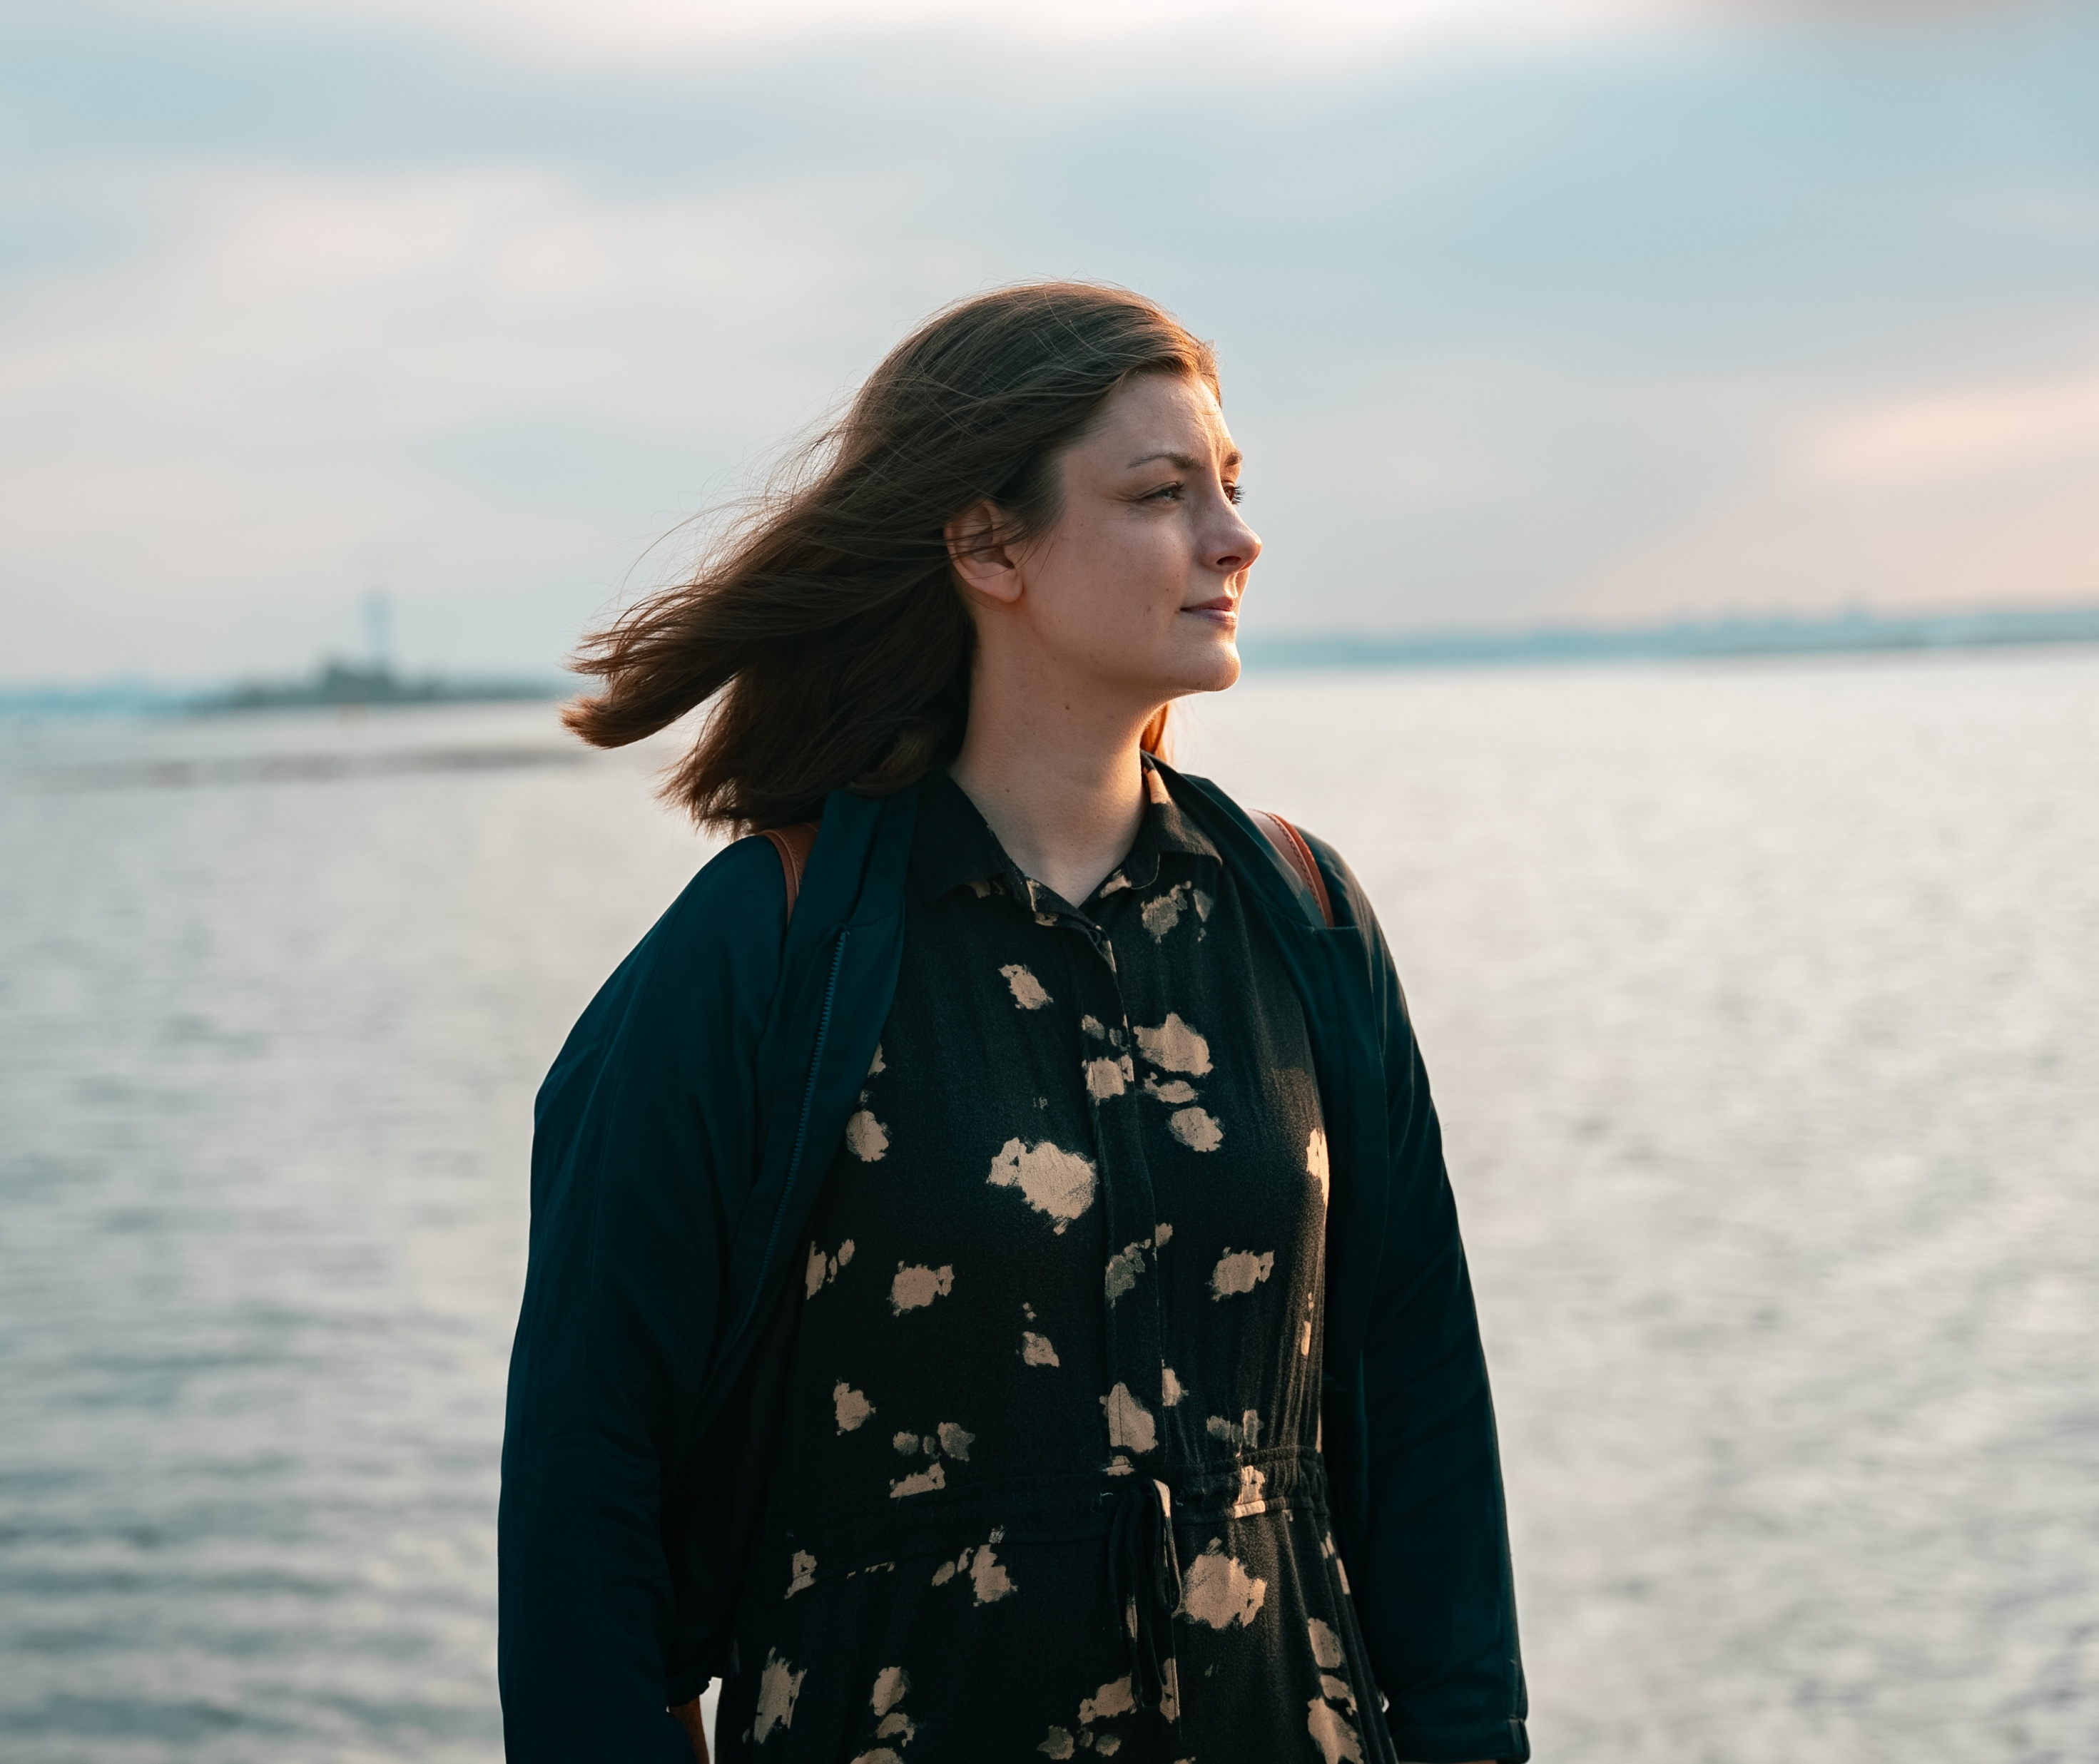
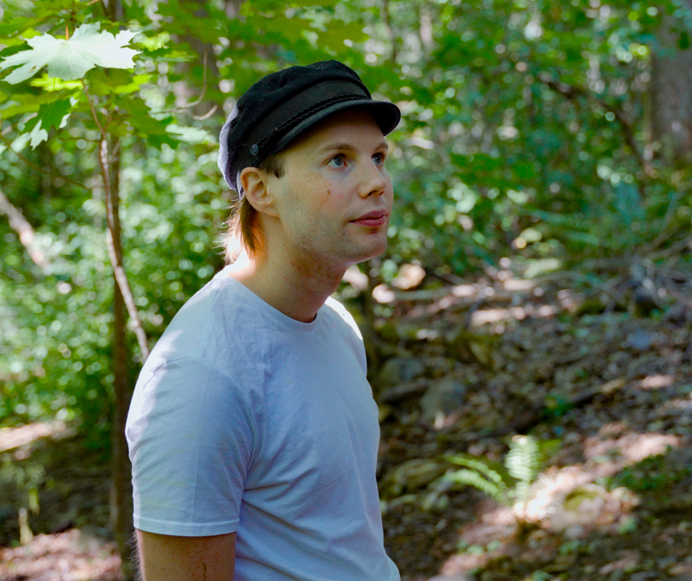
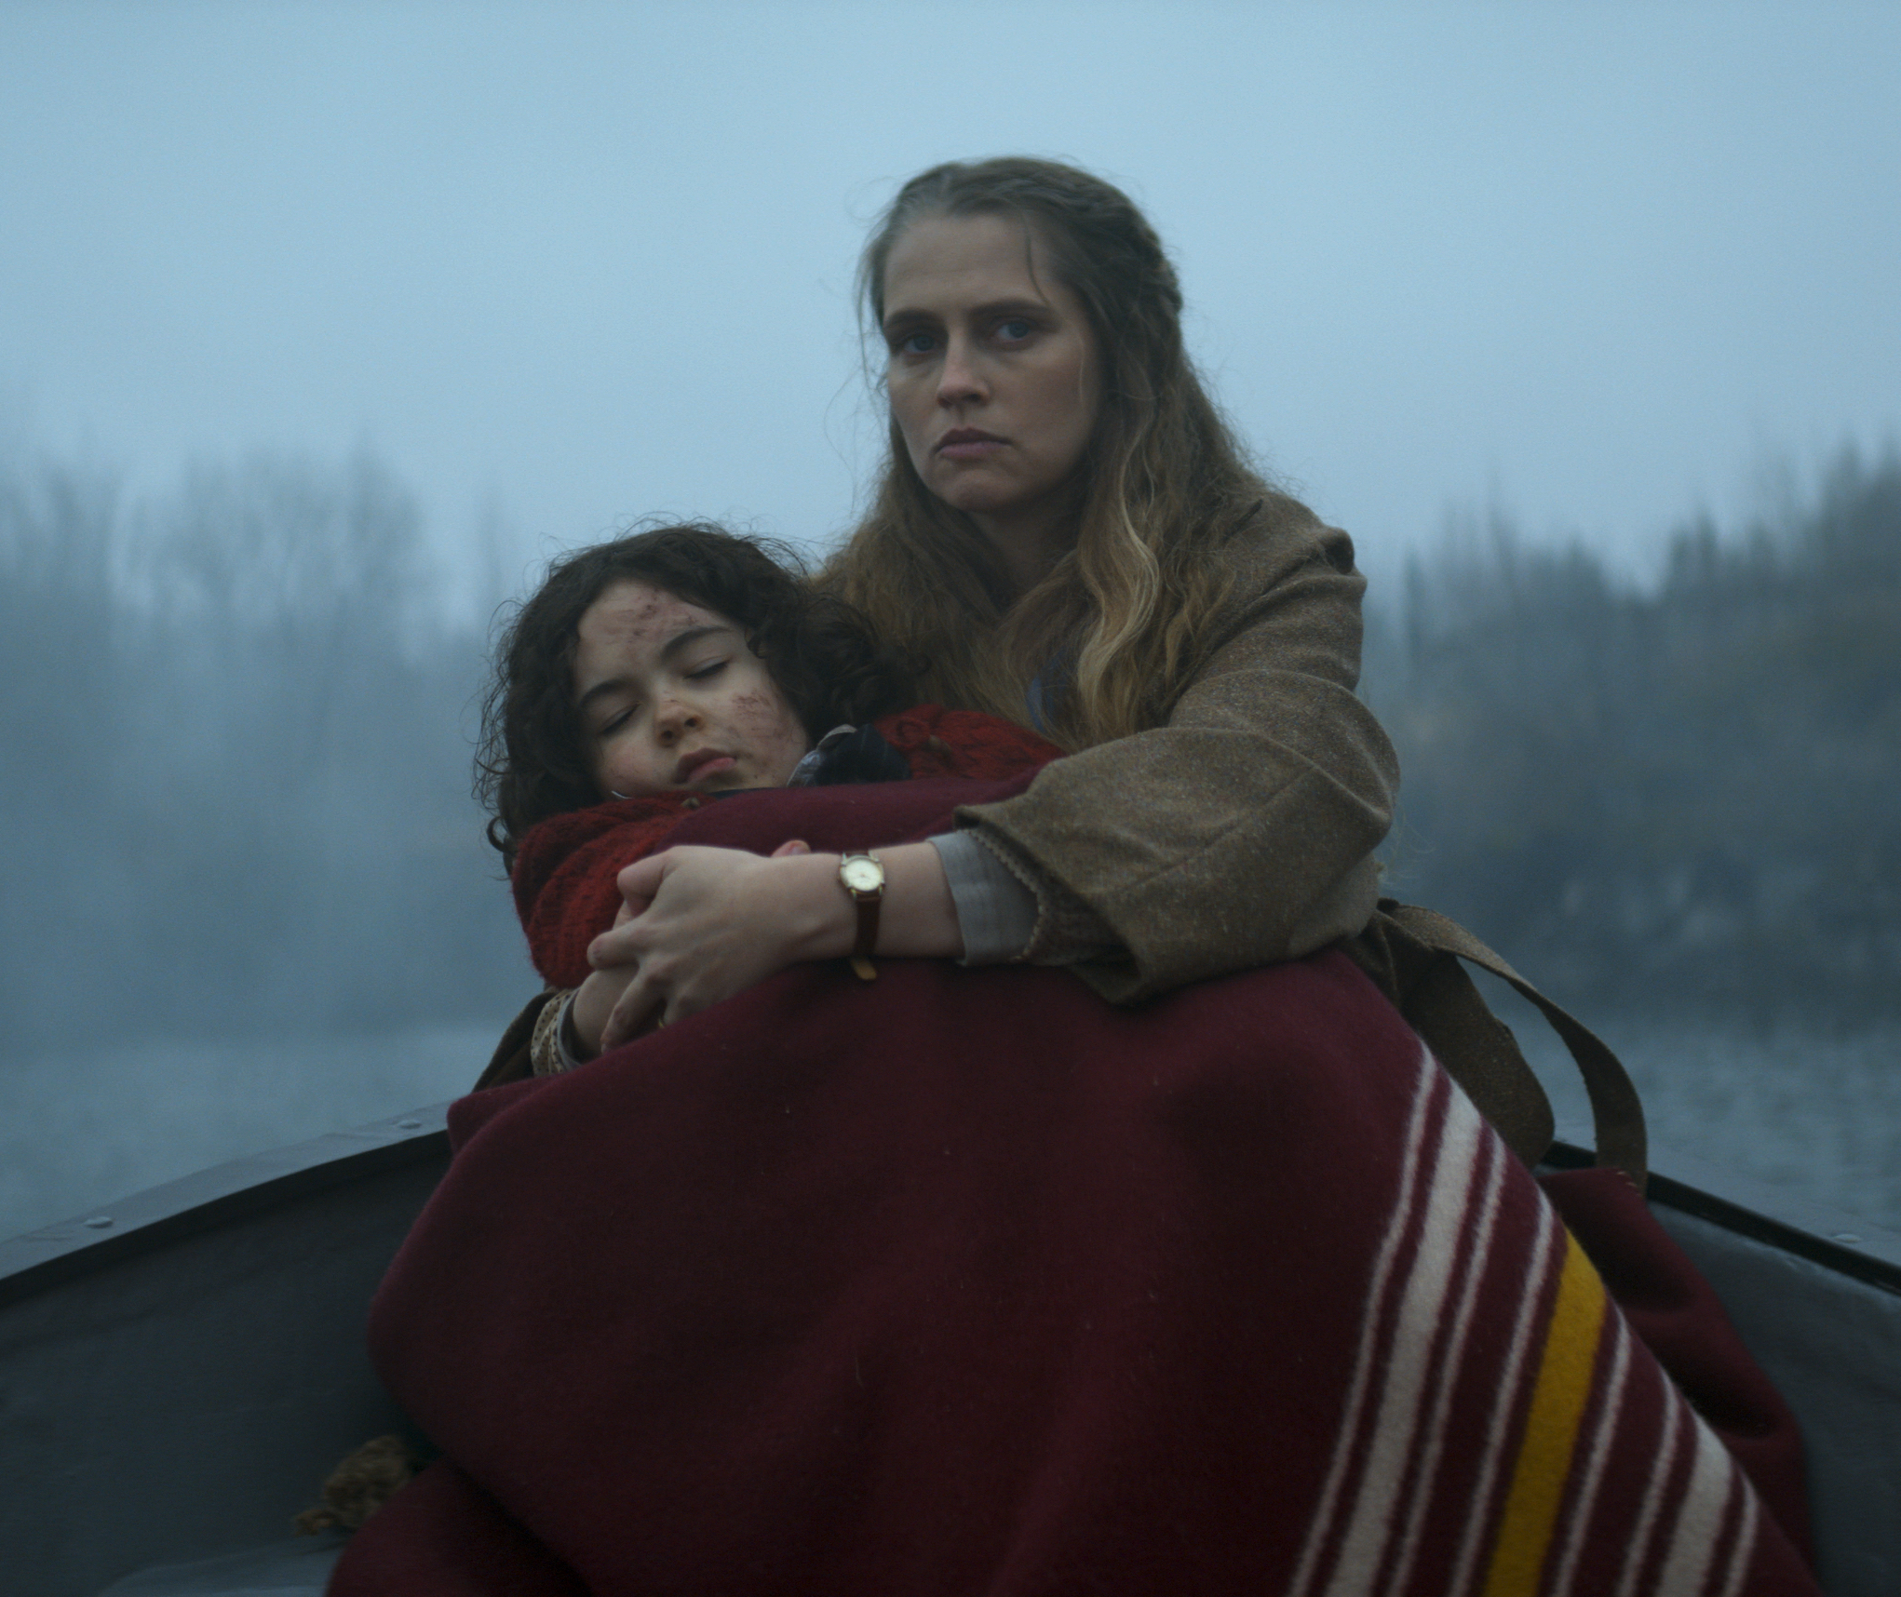
Is truth stranger than fiction? Finnish authors know how to make both interesting.
FINNISH LITERATURE IN 10 CHAPTERS
1
2
3
4
5
6
7
8
9
10
Lost species and forgotten women
Fiction or not, contemporary Finnish literature is really thought-provoking and eye-opening. For example, Iida Turpeinen masterfully combines fact and fiction in her novel Elolliset, the result of seven years of research.
The Twin (dir. Taneli Mustonen, 2022) was shot in English, and made it to the box office charts in many South American countries. Photo: Daniel Lindholm / Don Films.
Matias Riikonen. Photo: Juho Sallinen
Iida Turpeinen.
Photo: Juho Sallinen
Notes:
The latest international star of Finnish literary fiction is Iida Turpeinen, whose novel Beasts of the Sea (2023) has already been sold to 28 different language territories. Turpeinen’s debut novel illustrates how humans have exploited nature throughout history, leading to the extinction of many species.
The relationship between humans and nature is also masterfully depicted by Matias Riikonen in his award-winning novel Matara (2021). Both authors have a gift for exploring the human-nature relationship in a way that can fundamentally change the reader's perception of our connection to the natural world. Contemporary Finnish literature offers a wealth of fresh and thought-provoking perspectives on our relationship with nature, both in its present state and what its future might hold.
Finnish narrative non-fiction is also very popular. Mia Kankimäki’s The Women I Think About at Night (2018) combines personal narrative and researched material to portray forgotten exceptional women from throughout history. The translation rights to this non-fiction work have been sold to 18 language territories. Katja Pantzar’s books on the Finnish concept of sisu have been sold to a few dozen language territories as well. Tiina Raevaara’s non-fiction book on the dream of immortality, A Short History of Eternal Life (2024), is one of this year’s non-fiction favourites around the world.

Slide 14
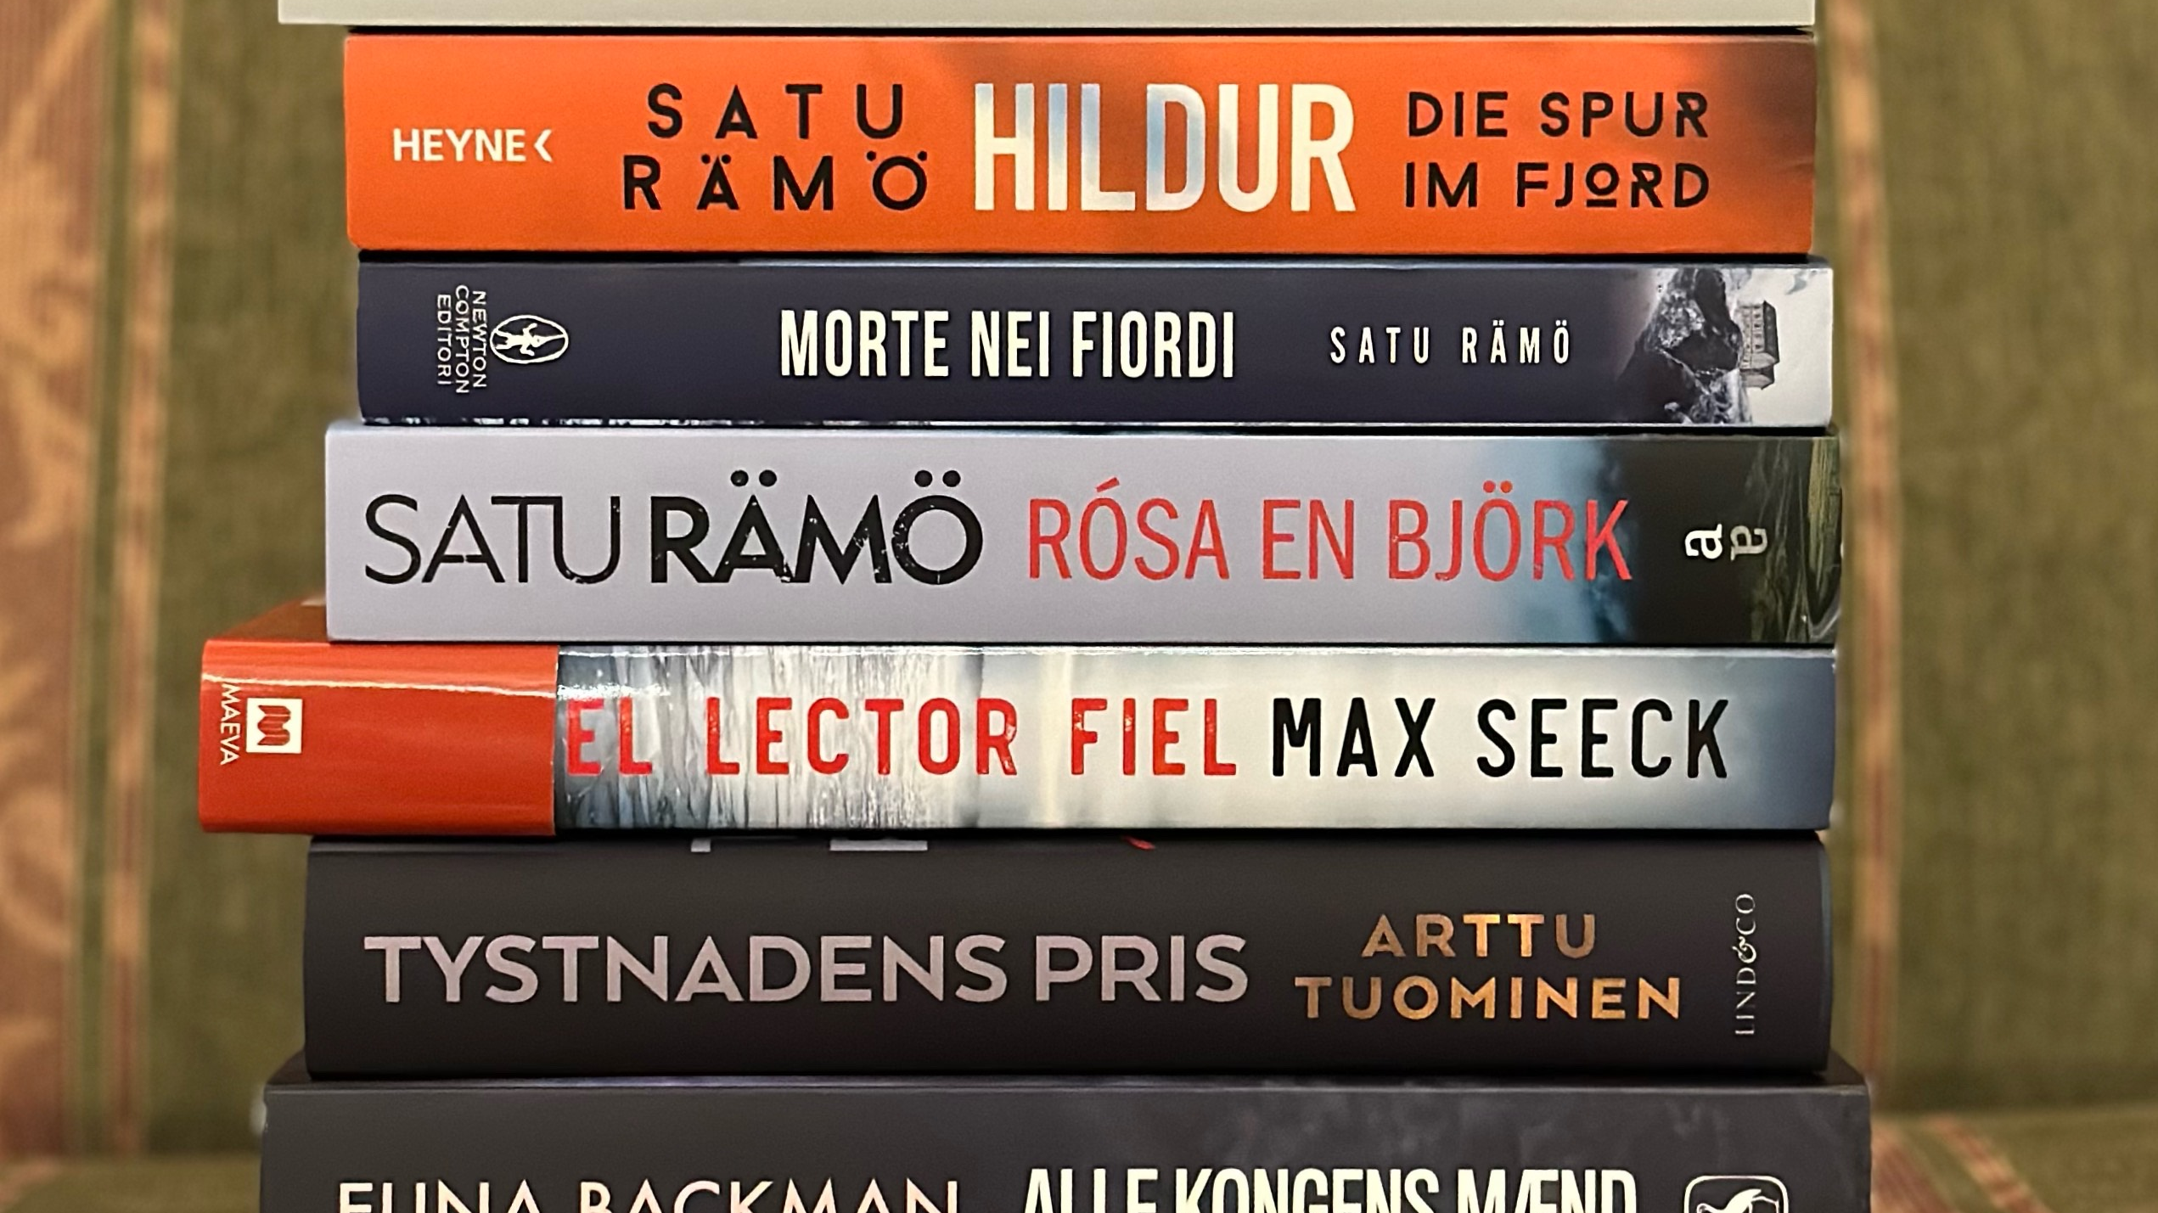
7/10
Take a shot on
Finnish crime fiction
Photo: Finnish Literature Exchange

Slide 15
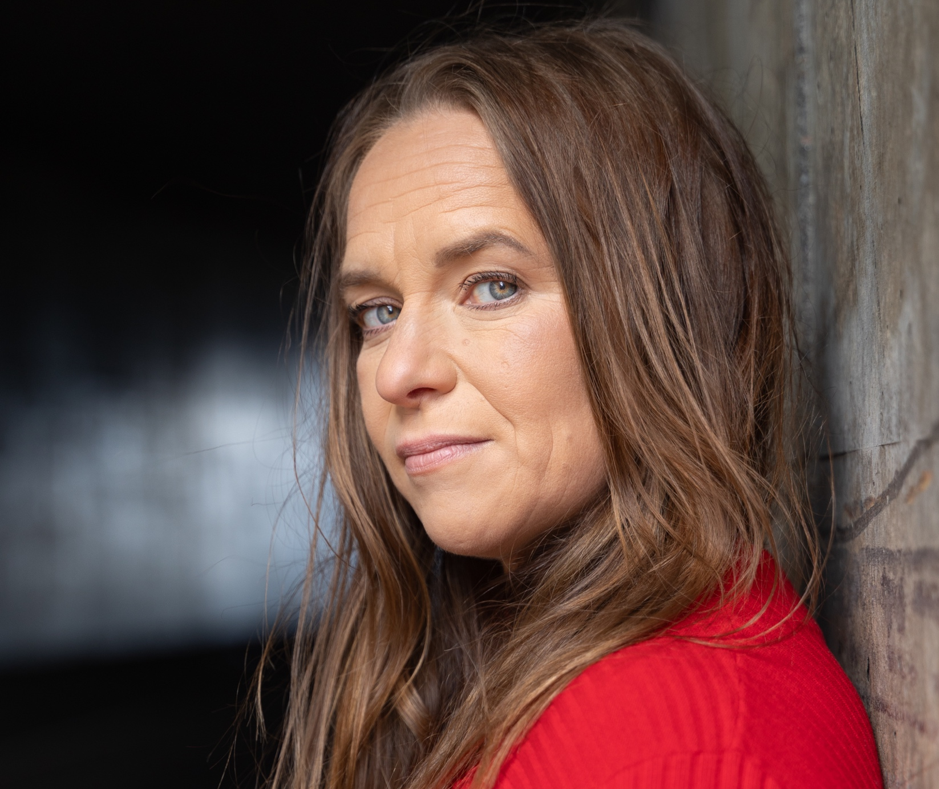
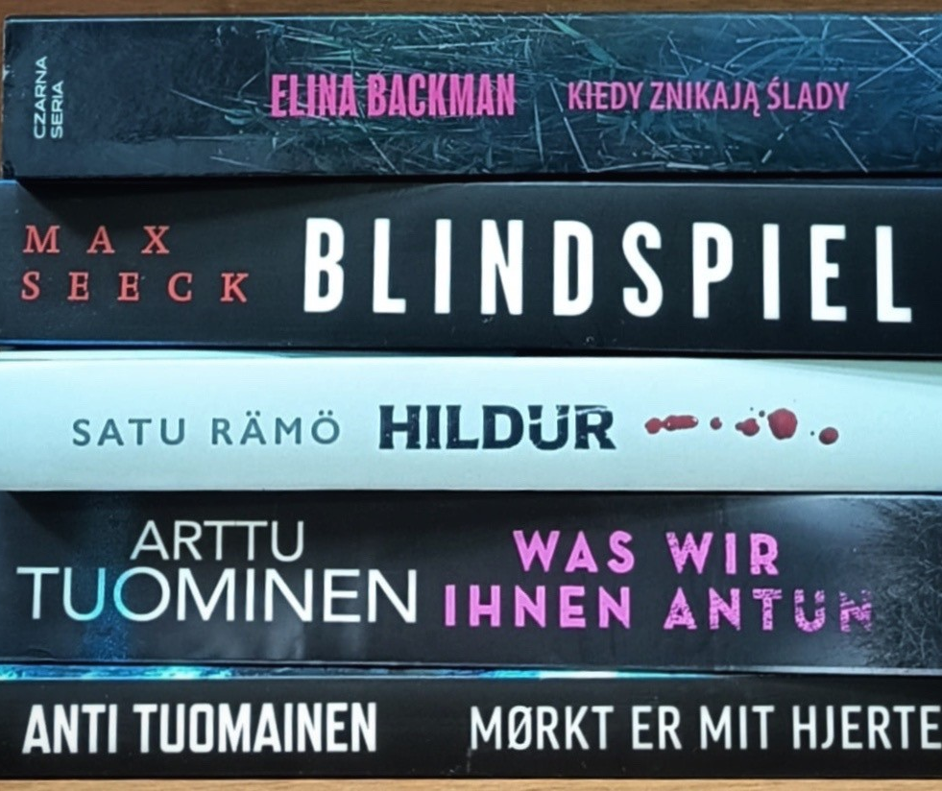
Take a shot on Finnish crime fiction
FINNISH LITERATURE IN 10 CHAPTERS
1
2
3
4
5
6
7
8
9
10
Fin-Noir
/ˈfɪn nwɑːr/
A Finnish take on Nordic Noir, known for its dark and realistic style.
Photo: Finnish Literature Exchange
Satu Rämö. Photo: Bjorgvin Hilmarsson
Notes:
Finnish crime novels are exploding in popularity around the world—so much so that it has been called a Fin-Noir boom! The translation rights to Satu Rämö’s Iceland-based Hildur series (2022–) have now been sold for almost 30 language territories, and the books have sold over a million copies worldwide. A Finnish-Icelandic TV series based on the Hildur books is also in the works.
The list of the most translated authors of all time includes the Finnish crime writers Antti Tuomainen (with 107 translations) and Max Seeck (with 88 translations to 32 different languages, the most translations for any Finnish contemporary adult fiction writer in 2020–2025). Other current crime writers making waves abroad include Arttu Tuominen, Elina Backman, Eva Frantz, Martta Kaukonen and A.M. Ollikainen.

Slide 16
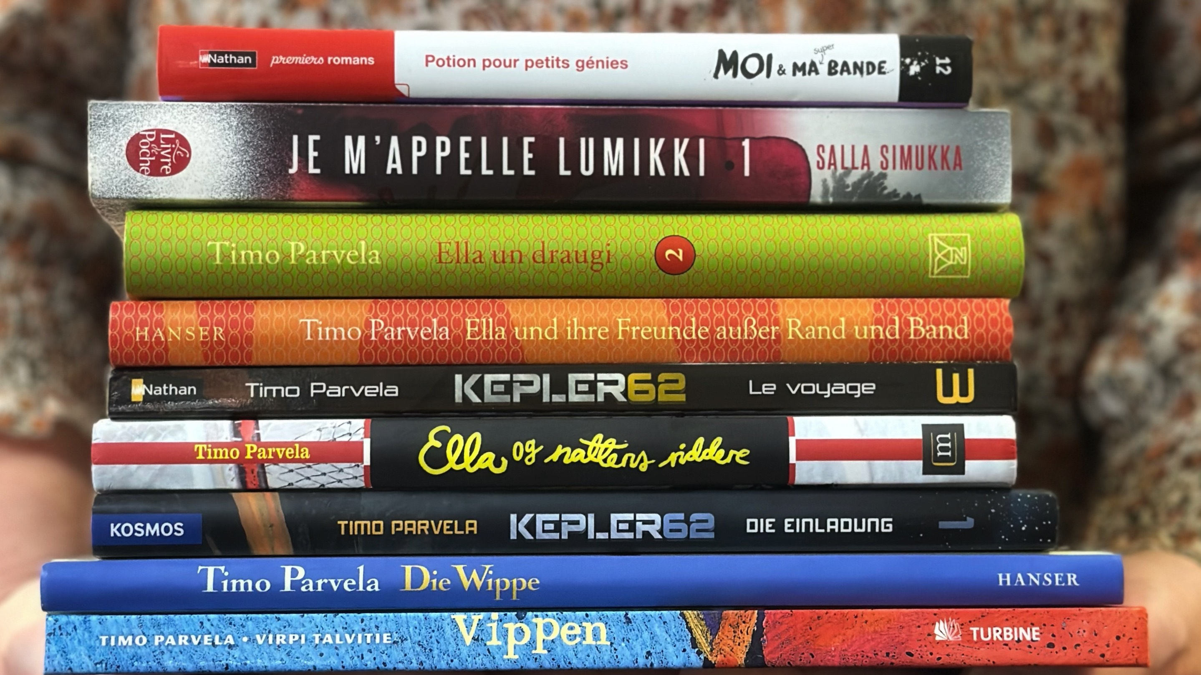
8/10
Children are literally the future,
and that’s why we promote their literacy
Photo: Finnish Literature Exchange

Slide 17

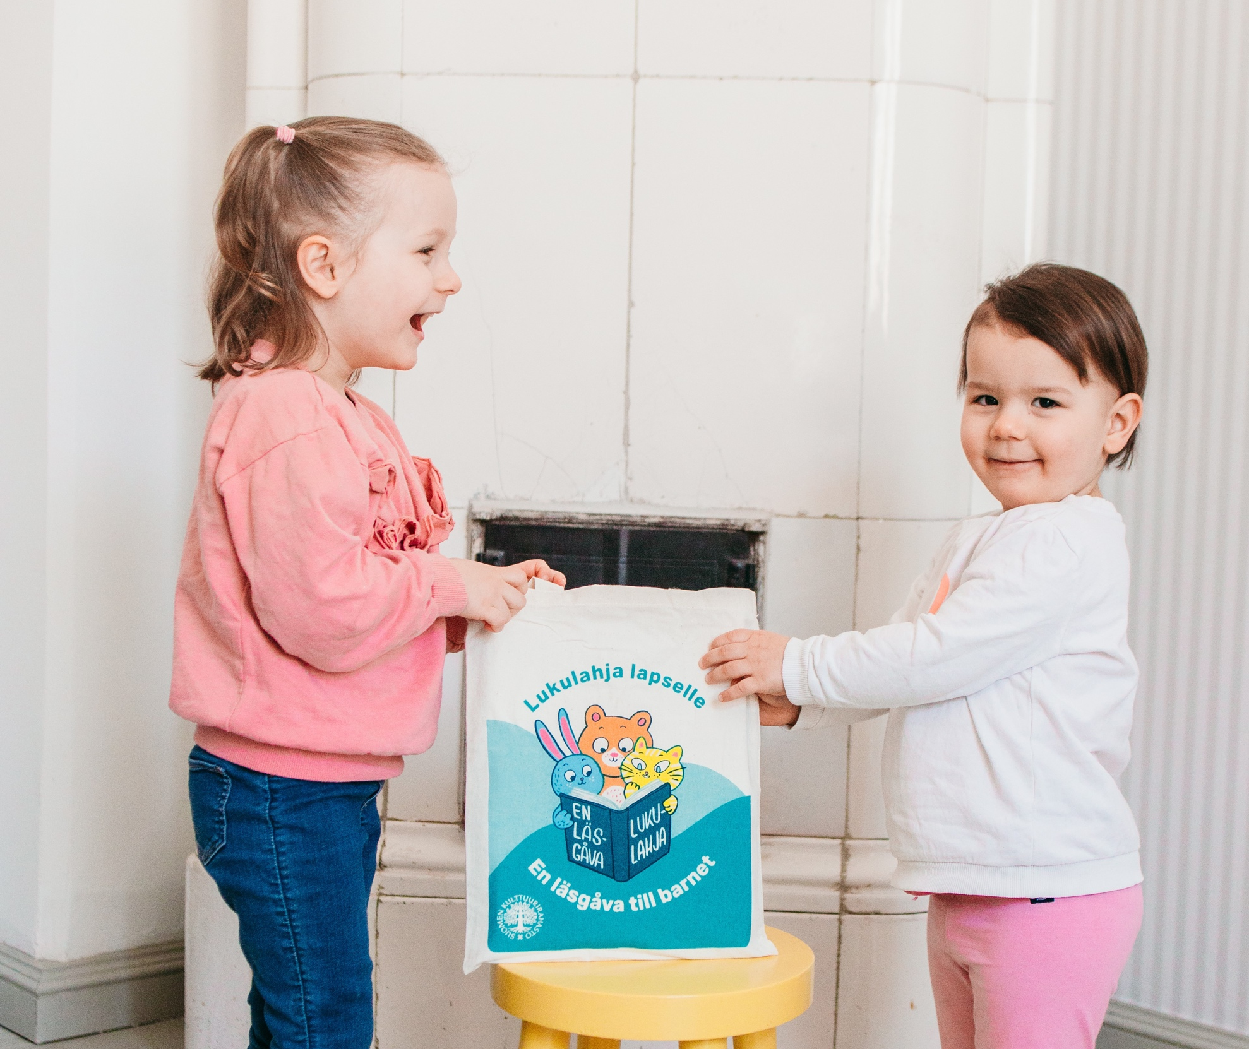
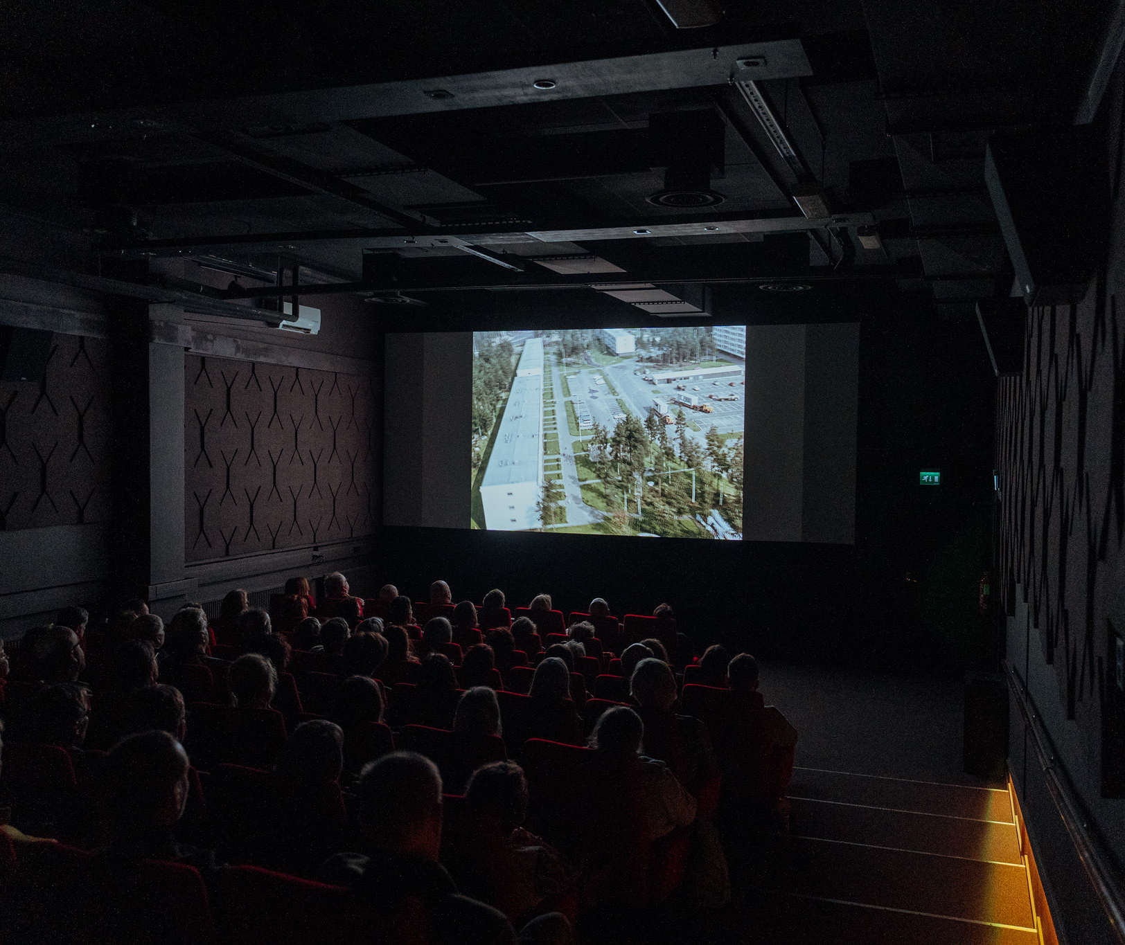
Children are literally the future, and that’s why we promote their literacy.
FINNISH LITERATURE IN 10 CHAPTERS
1
2
3
4
5
6
7
8
9
10
Finland is one of the most literate countries in the world. Not because we are just gifted, but because we are gifted books.
The Finnish maternity package includes a picture book, and our parental clinics distribute free book bags, just to make sure every family and child has equal early opportunities to read.
Arthouse Cinema Niagara in Tampere is located in an old industrial area. Photo: Kimmo Siniluoto / Tampere Film Festival.
Photo: Kela
Photo: Kela
Notes:
When we talk about Finland being one of the most literate countries in the world, it’s important to understand that it is largely the result of long-term, deliberate public policy that treats reading as a basic right rather than a privilege.
One concrete example of this is the Finnish maternity package for all expecting parents who want it, regardless of income. Alongside essential baby items, the package includes a picture book. This sends a clear message from the very beginning of a child’s life: books and reading matter, and they belong in every home.
In addition to this, Finland’s public health clinics, which nearly all families regularly visit during early childhood, distribute free book bags to parents. These book bags typically include age-appropriate books and guidance on reading aloud, helping parents support early literacy even before a child can read independently.
(Finnish children’s and young adult literature is also popular internationally, because Finnish authors and illustrators deal with all kinds of themes impressively and boldly in their books – whether it’s difficult topics like the death of a loved one, or what climate change means from the perspective of young readers. The most widely translated Finnish author of children and young adult books is Timo Parvela, whose nearly 70 books have been translated into 36 different languages. There are over 300 published translations in total. Salla Simukka’s young adult books have also been translated into 38 languages. The children’s series by Sinikka and Tiina Nopola also continue to capture the interest of readers around the world.
Finland also has a strong tradition of illustrators. For example, Mauri Kunnas’ 50+ works have been translated into 35 languages. His most popular title is Santa Claus (1995). Aino Havukainen and Sami Toivonen’s Tatu and Patu children’s books have been translated into nearly 30 languages. One of the most internationally renowned Finland-Swedish illustrators and authors is Linda Bondestam, who has received numerous awards for her work.
Today, nearly half of Finland's literary export revenue comes from the sale of translation rights for children's and young adult literature.)

Slide 18
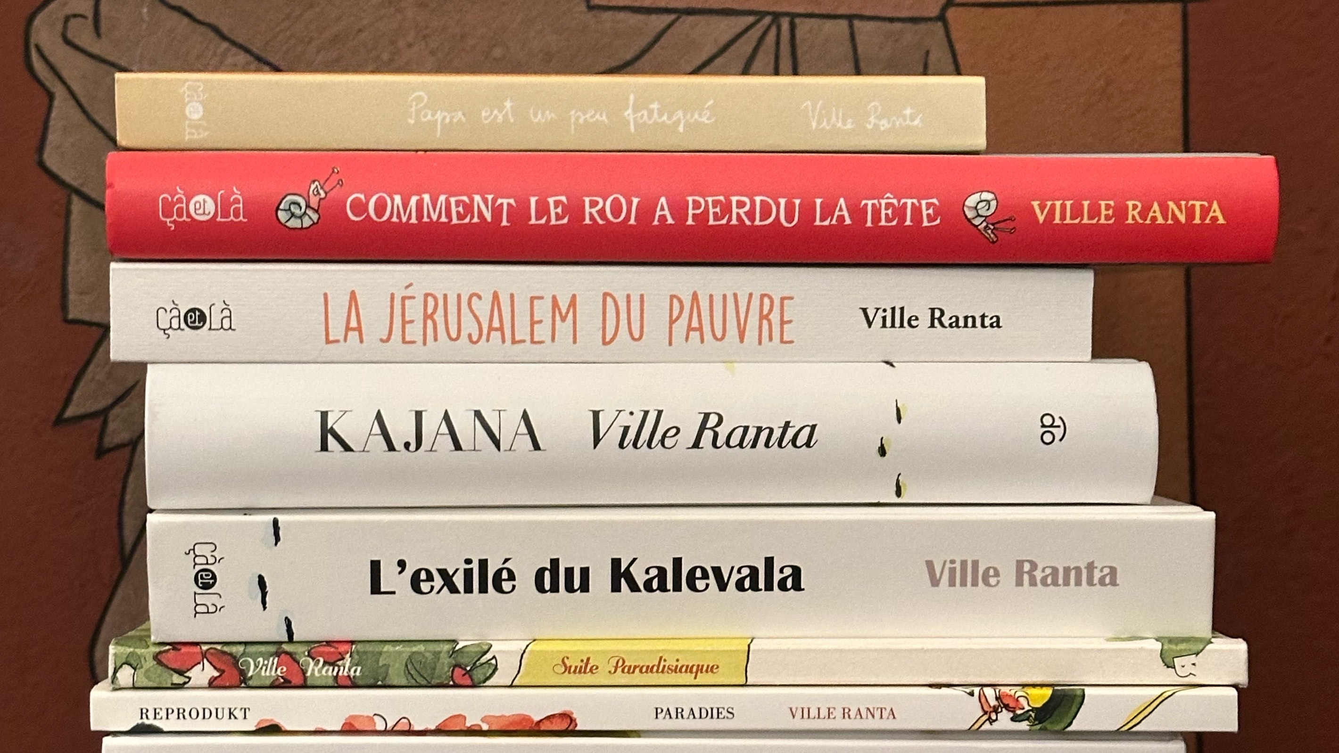
9/10
Skillful handling of
drawing tools and topics
Photo: Finnish Literature Exchange

Slide 19
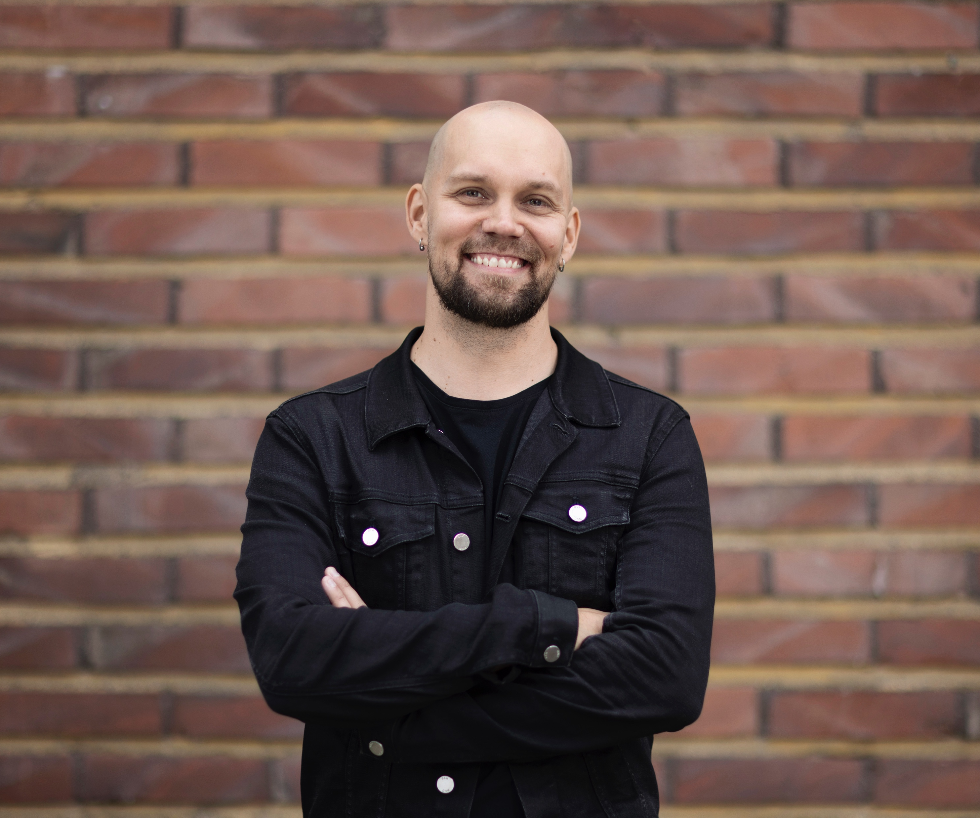
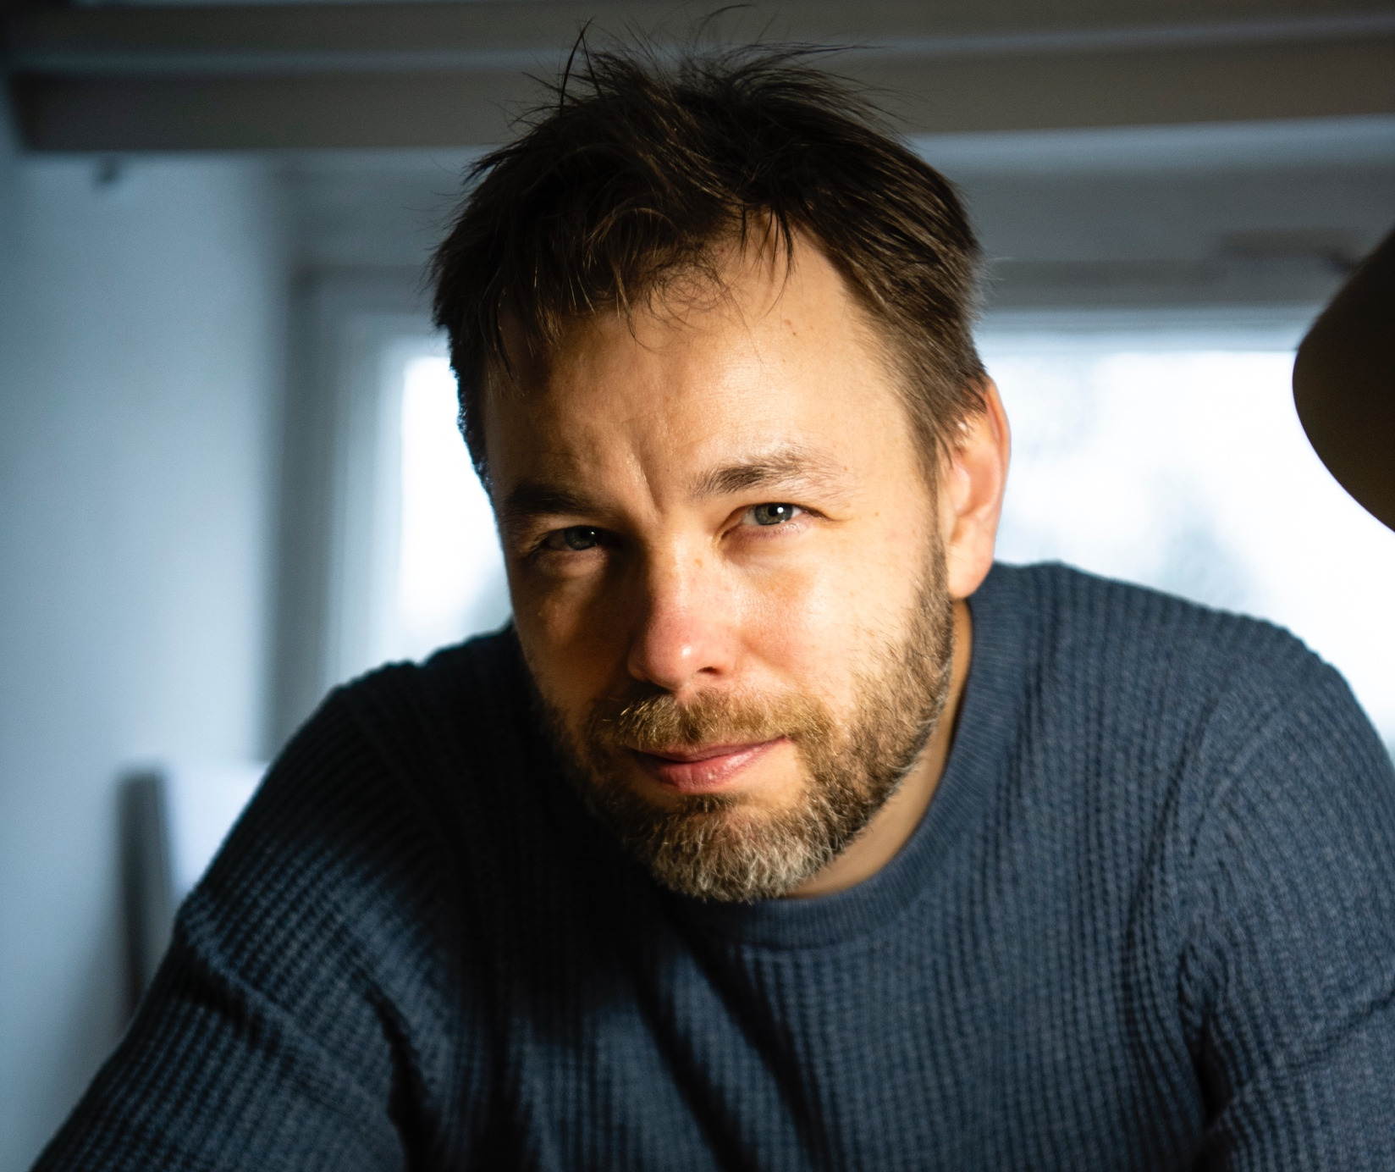
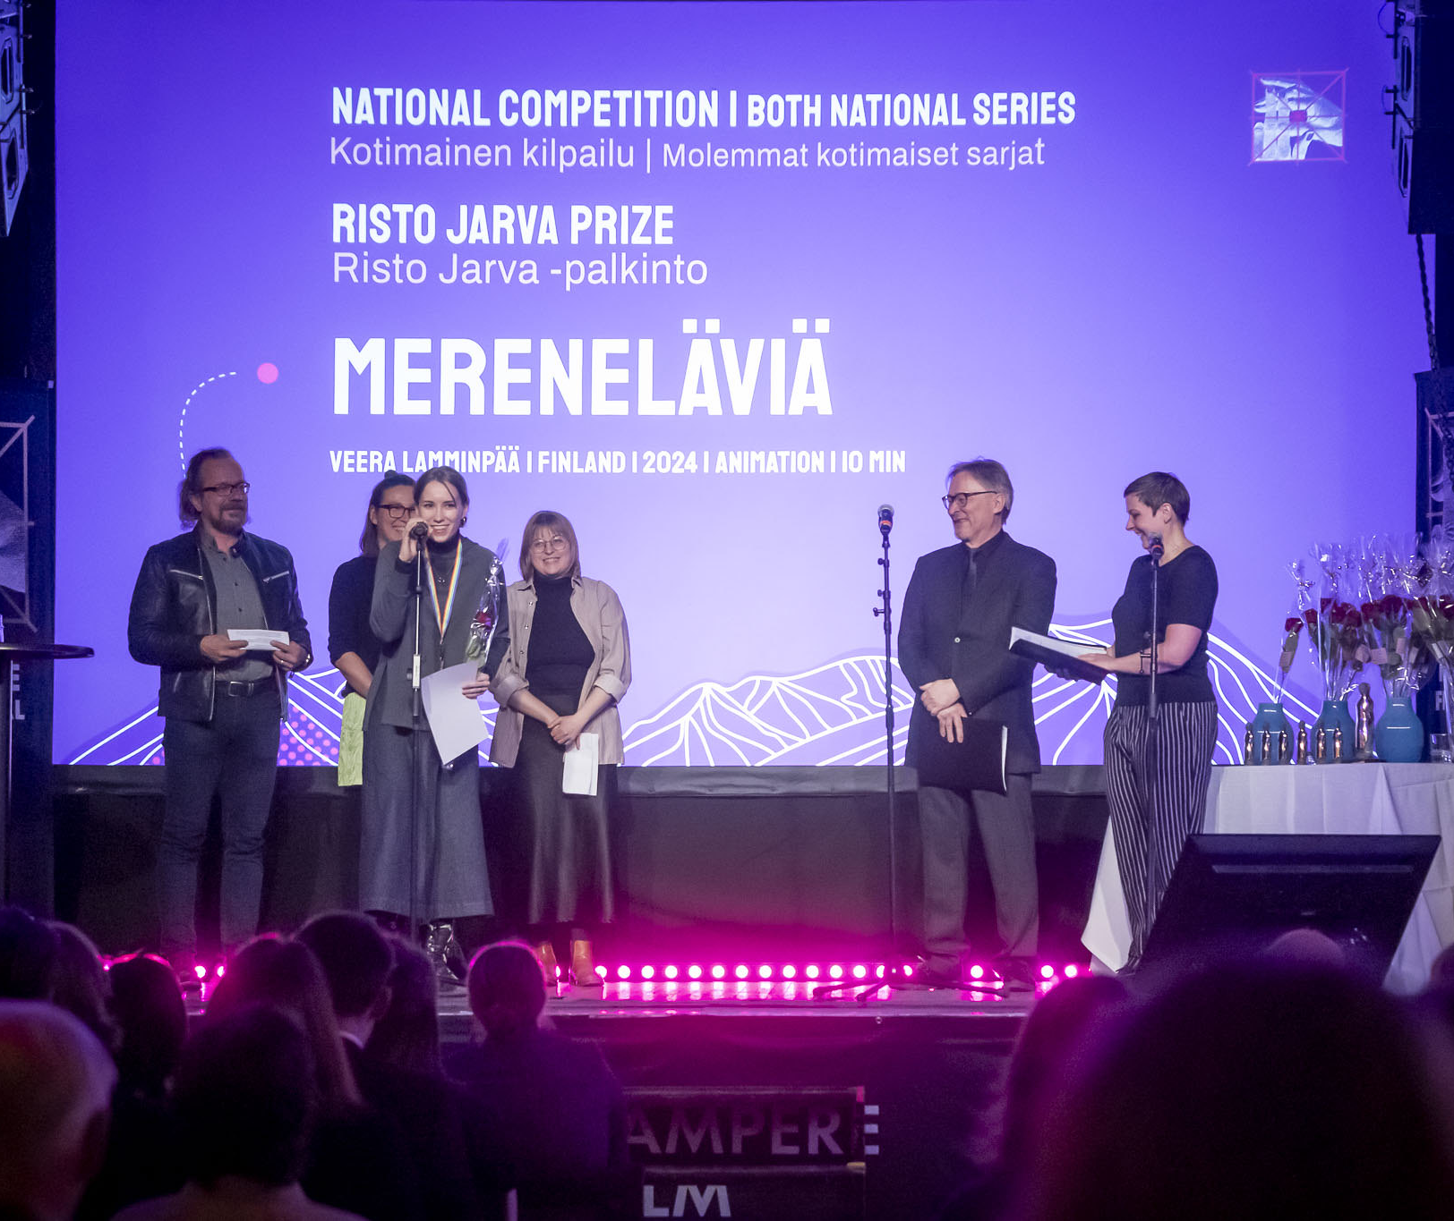
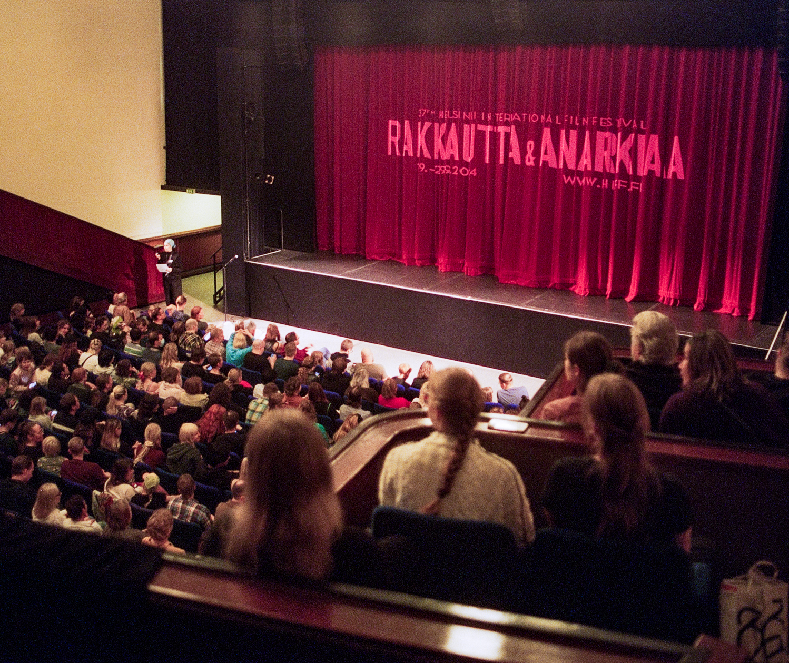

Skillful handling of drawing tools and topics
FINNISH LITERATURE IN 10 CHAPTERS
1
2
3
4
5
6
7
8
9
10
Appreciated
by true comic connoisseurs
Prominent Finnish comic book artists are particularly popular in French and German speaking countries known for their good taste.
Tampere Film Festival awards the best Finnish and international films. Fish River Anthology (Mereneläviä) won several awards in 2025. Photo: Erika Dahlström-Dezonne / Tampere Film Festival.
Screening at the 2024 Helsinki International Film Festival – Love & Anarchy. Photo: Joonas Parviainen / Helsinki International Film Festival.
Ville Ranta.
Photo: Veikko Somerpuro
JP Ahonen.
Photo: Marjaana Malkamäki
Tympeät tytöt – Luokkakipuja (2025) by Riina Tanskanen
Notes:
Over the last five years, around 50 translations of Finnish comics have been published in over 20 different languages. Prominent comic book artists in Finland, such as Ville Ranta, are particularly popular in French- and German-speaking Europe.
Riina Tanskanen is also a well‑known Finnish comic book artist, recognized for her feminist and socially critical works. Her works explore, among other things, the lives of girls from remote areas and their relationships to capitalism, money, and class. Her book Luokkakipuja was the best-selling comic book in Finland in 2025. It won the Tulenkantaja Award, which promotes internationalization, and the Adlibris Award, and was also nominated for the Comic Finlandia Award.
Other well-known Finnish comic book authors include JP Ahonen, Hanneriina Moisseinen, Tommi Musturi, and Tiitu Takalo.

Slide 20
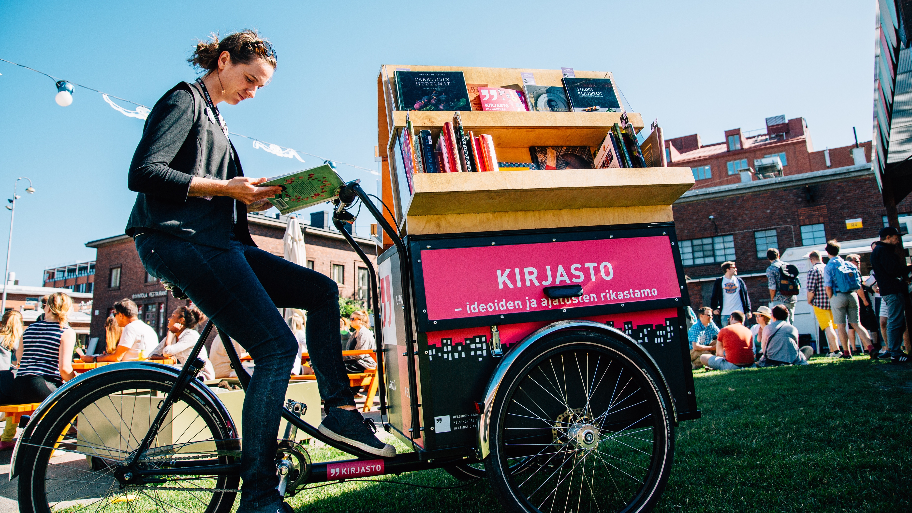
10/10
One card, endless knowledge
and entertainment
Photo: Jussi Hellsten

Slide 21
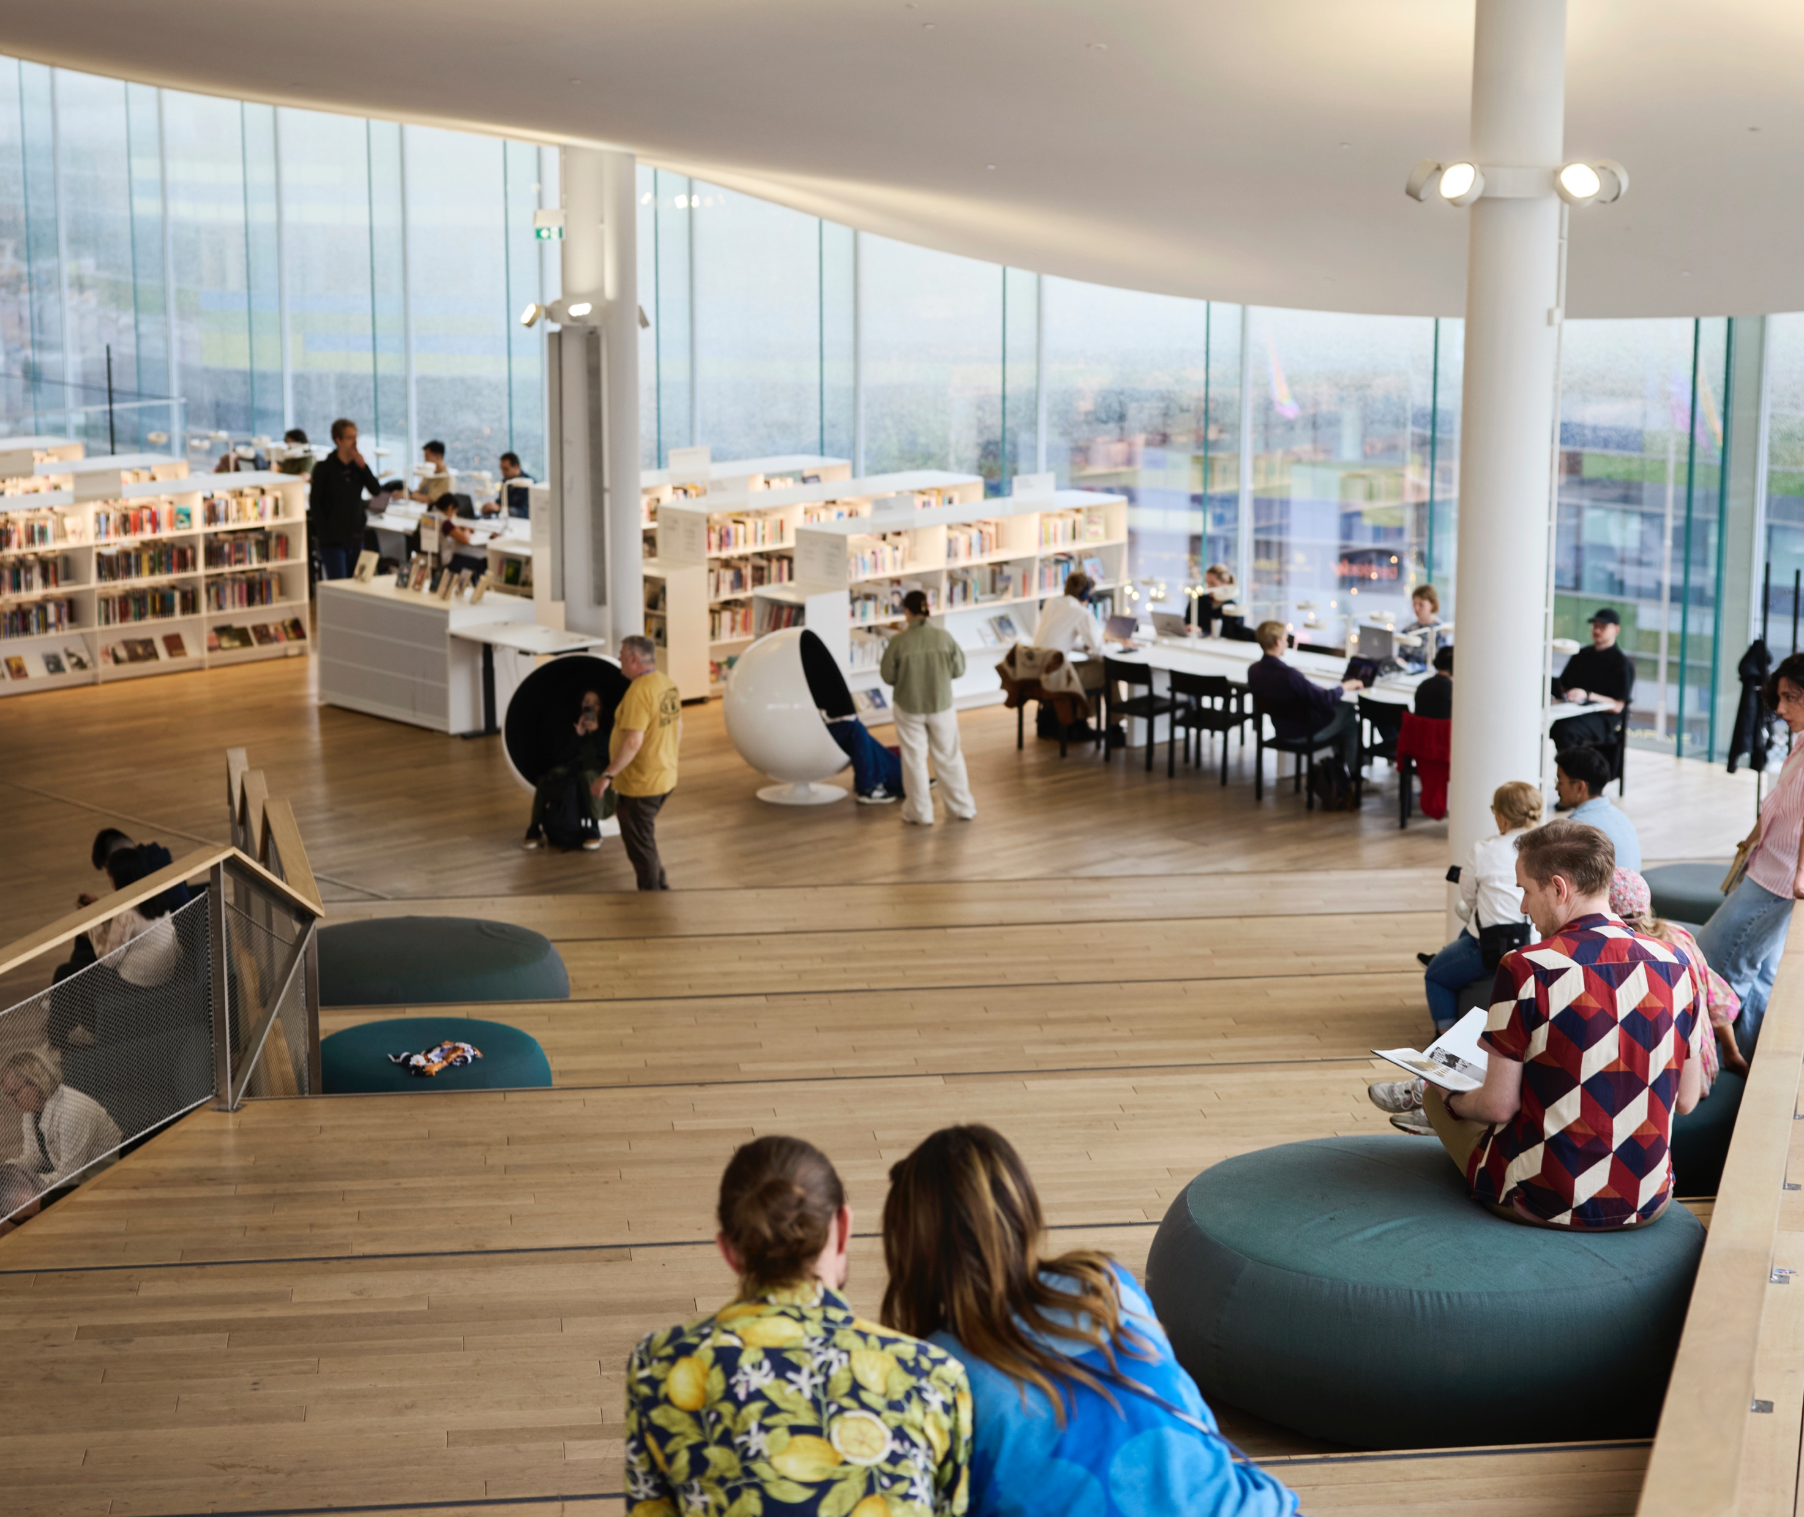
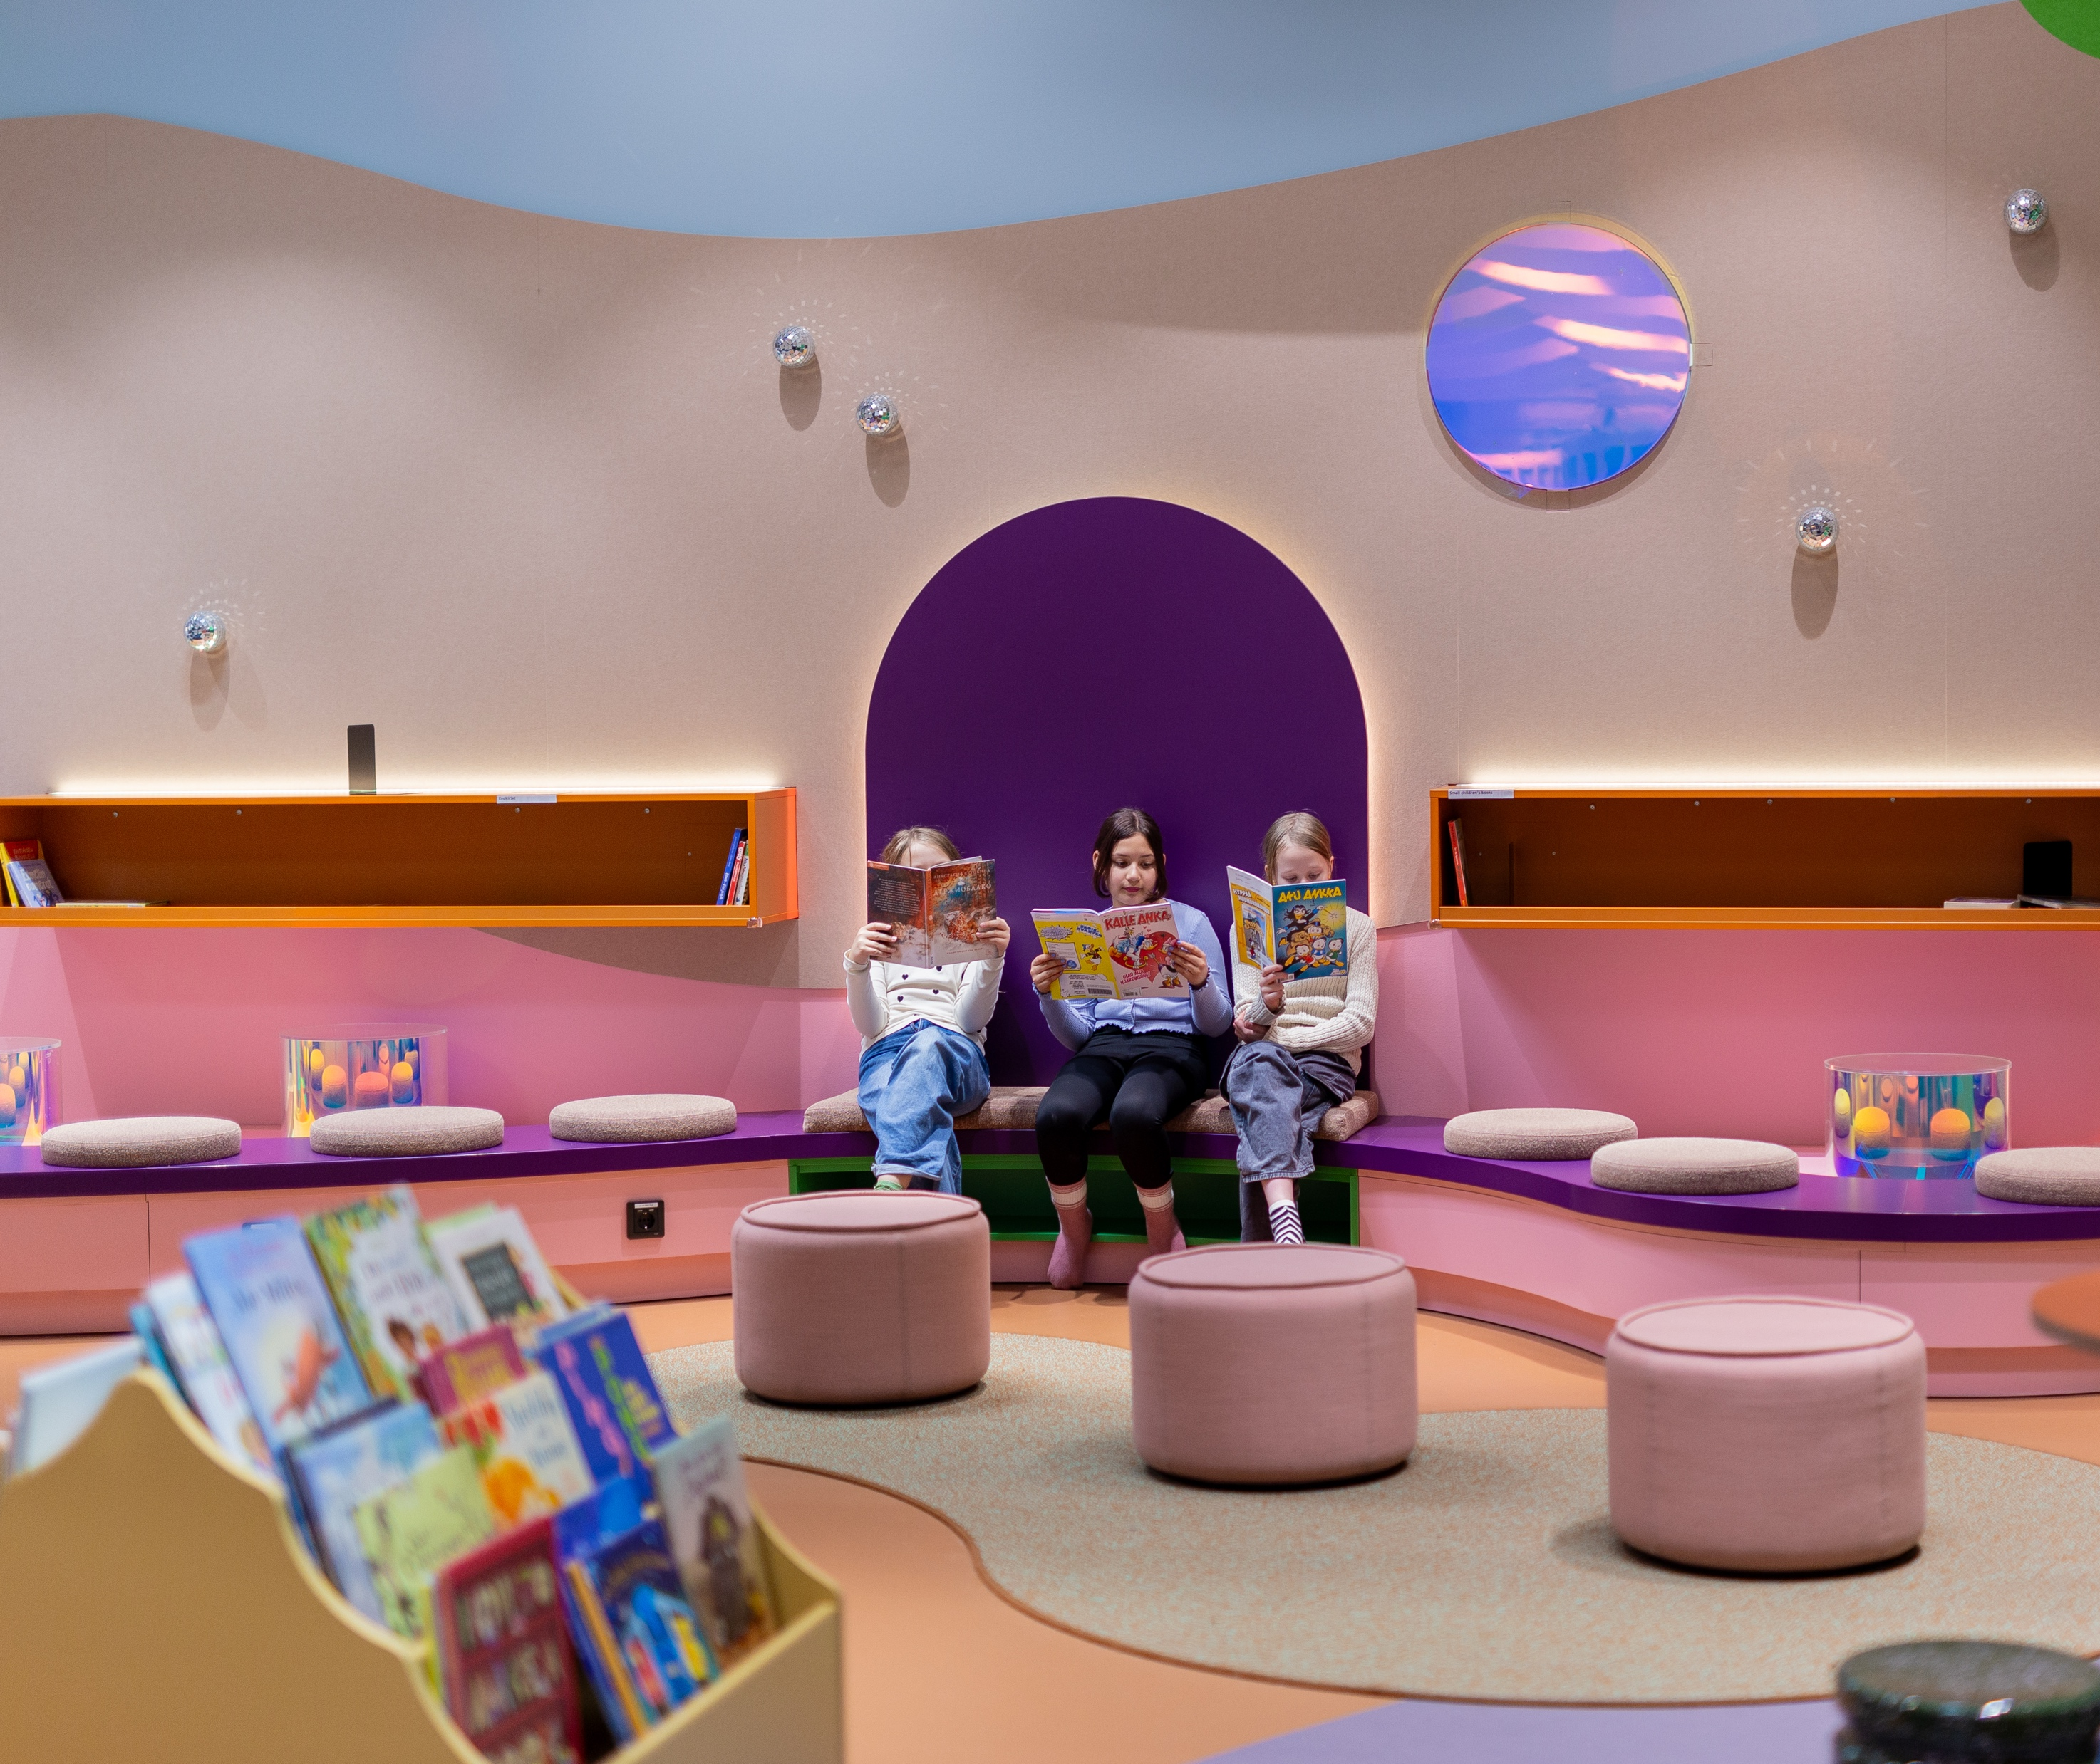
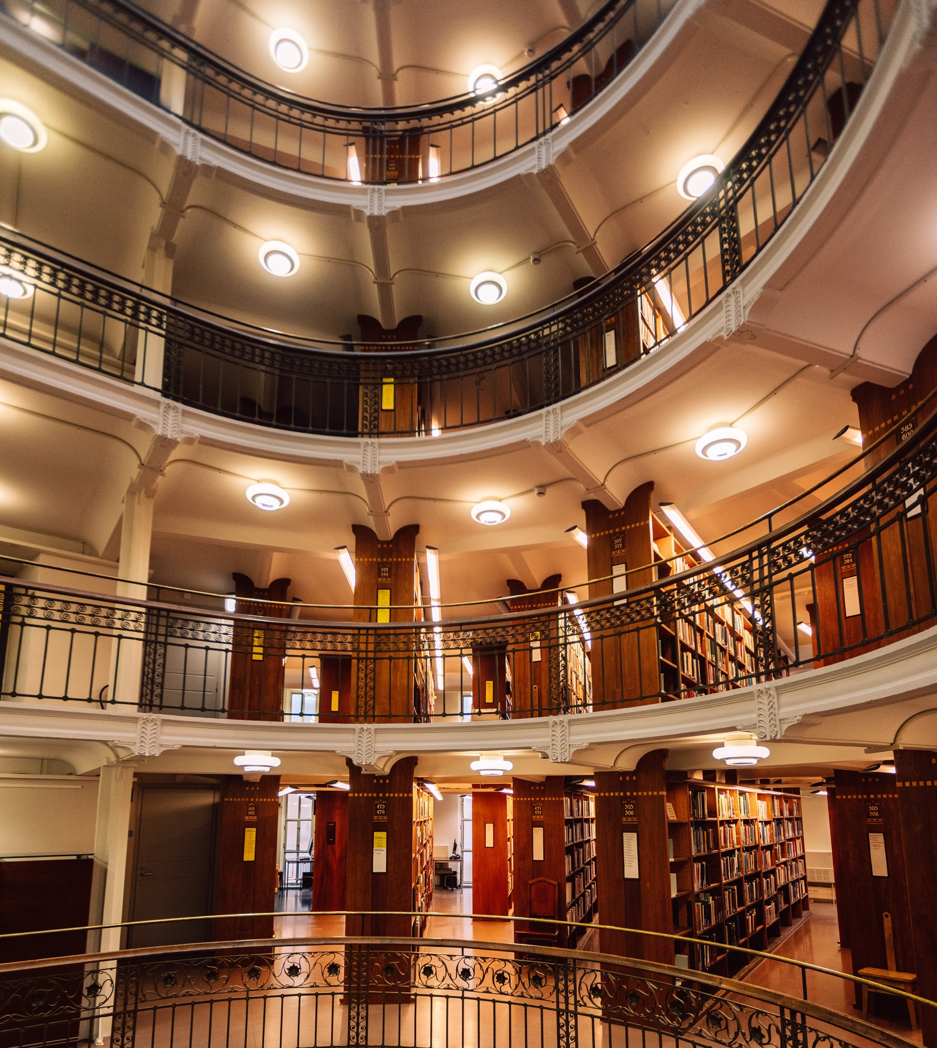
One card, endless knowledge and entertainment
FINNISH LITERATURE IN 10 CHAPTERS
1
2
3
4
5
6
7
8
9
10
Every Finn is entitled to a free library card and the use of free library services. And if there’s no library in sight? Just sit tight, one will drive by soon!
Mobile libraries bring free library services to areas without a library of their own, often making stops at schools and daycare centres in addition to their regular routes to bring joy to children.
Kalasatama Library.
Photo: Daniel Leiviskä
Helsinki Central Library Oodi.
Photo: Marjaana Malkamäki
Rikhardinkatu Library Photo: Jarvis Lawson
Notes:
In Finland, public libraries are funded through taxes and are considered a core public service, similar to schools or healthcare.
All residents are entitled to a free library card, which allows them to borrow books, magazines, films, music, and digital materials such as video games at no cost. This applies equally to children and adults, and library cards are often one of the first ‘official’ cards a child receives, reinforcing the idea that access to knowledge is a normal part of everyday life.
Finland also ensures that libraries are accessible even in sparsely populated or remote areas. In addition to permanent library buildings, many regions operate mobile libraries, often called library buses or library cars. These vehicles follow regular routes and bring books and other materials directly to schools, neighbourhoods, and rural communities that might otherwise have limited access to cultural services.
Beyond lending materials, Finnish libraries function as community spaces. They offer quiet places to read and study, host events such as story times and lectures, and provide access to computers and the internet. Some libraries even offer facilities for making and recording music, playing video games, and practising 3D printing or sewing. By removing financial and practical barriers to reading and learning, the free library system helps ensure that literacy and information access are shared public resources rather than individual advantages.

Slide 22
11/10
11/10
An extra skylight
with views to
common ground.
Epilogue

Slide 23
Epilogue
FINNISH LITERATURE IN 10 CHAPTERS
1
2
3
4
5
6
7
8
9
10
11
Photo: xxx
Any note
can be written here.
This is a place for
more detailed information. You can use this page to highlight connections between Finnish cinema and your country, shared projects, or even interesting upcoming events.
Notes:
Tähän osioon voi koota vastaanottajan ja tilanteen mukaan personoitavia asioita, toki elokuvakulman huomioiden.

Slide 24
Hoping for a sequel? Let’s come up with the next plot twist together.

