Slide 1

FINNISH FOOD CULTURE
IN 10 SERVINGS
Photo: Ministry of Agriculture and Forestry of Finland

Slide 2
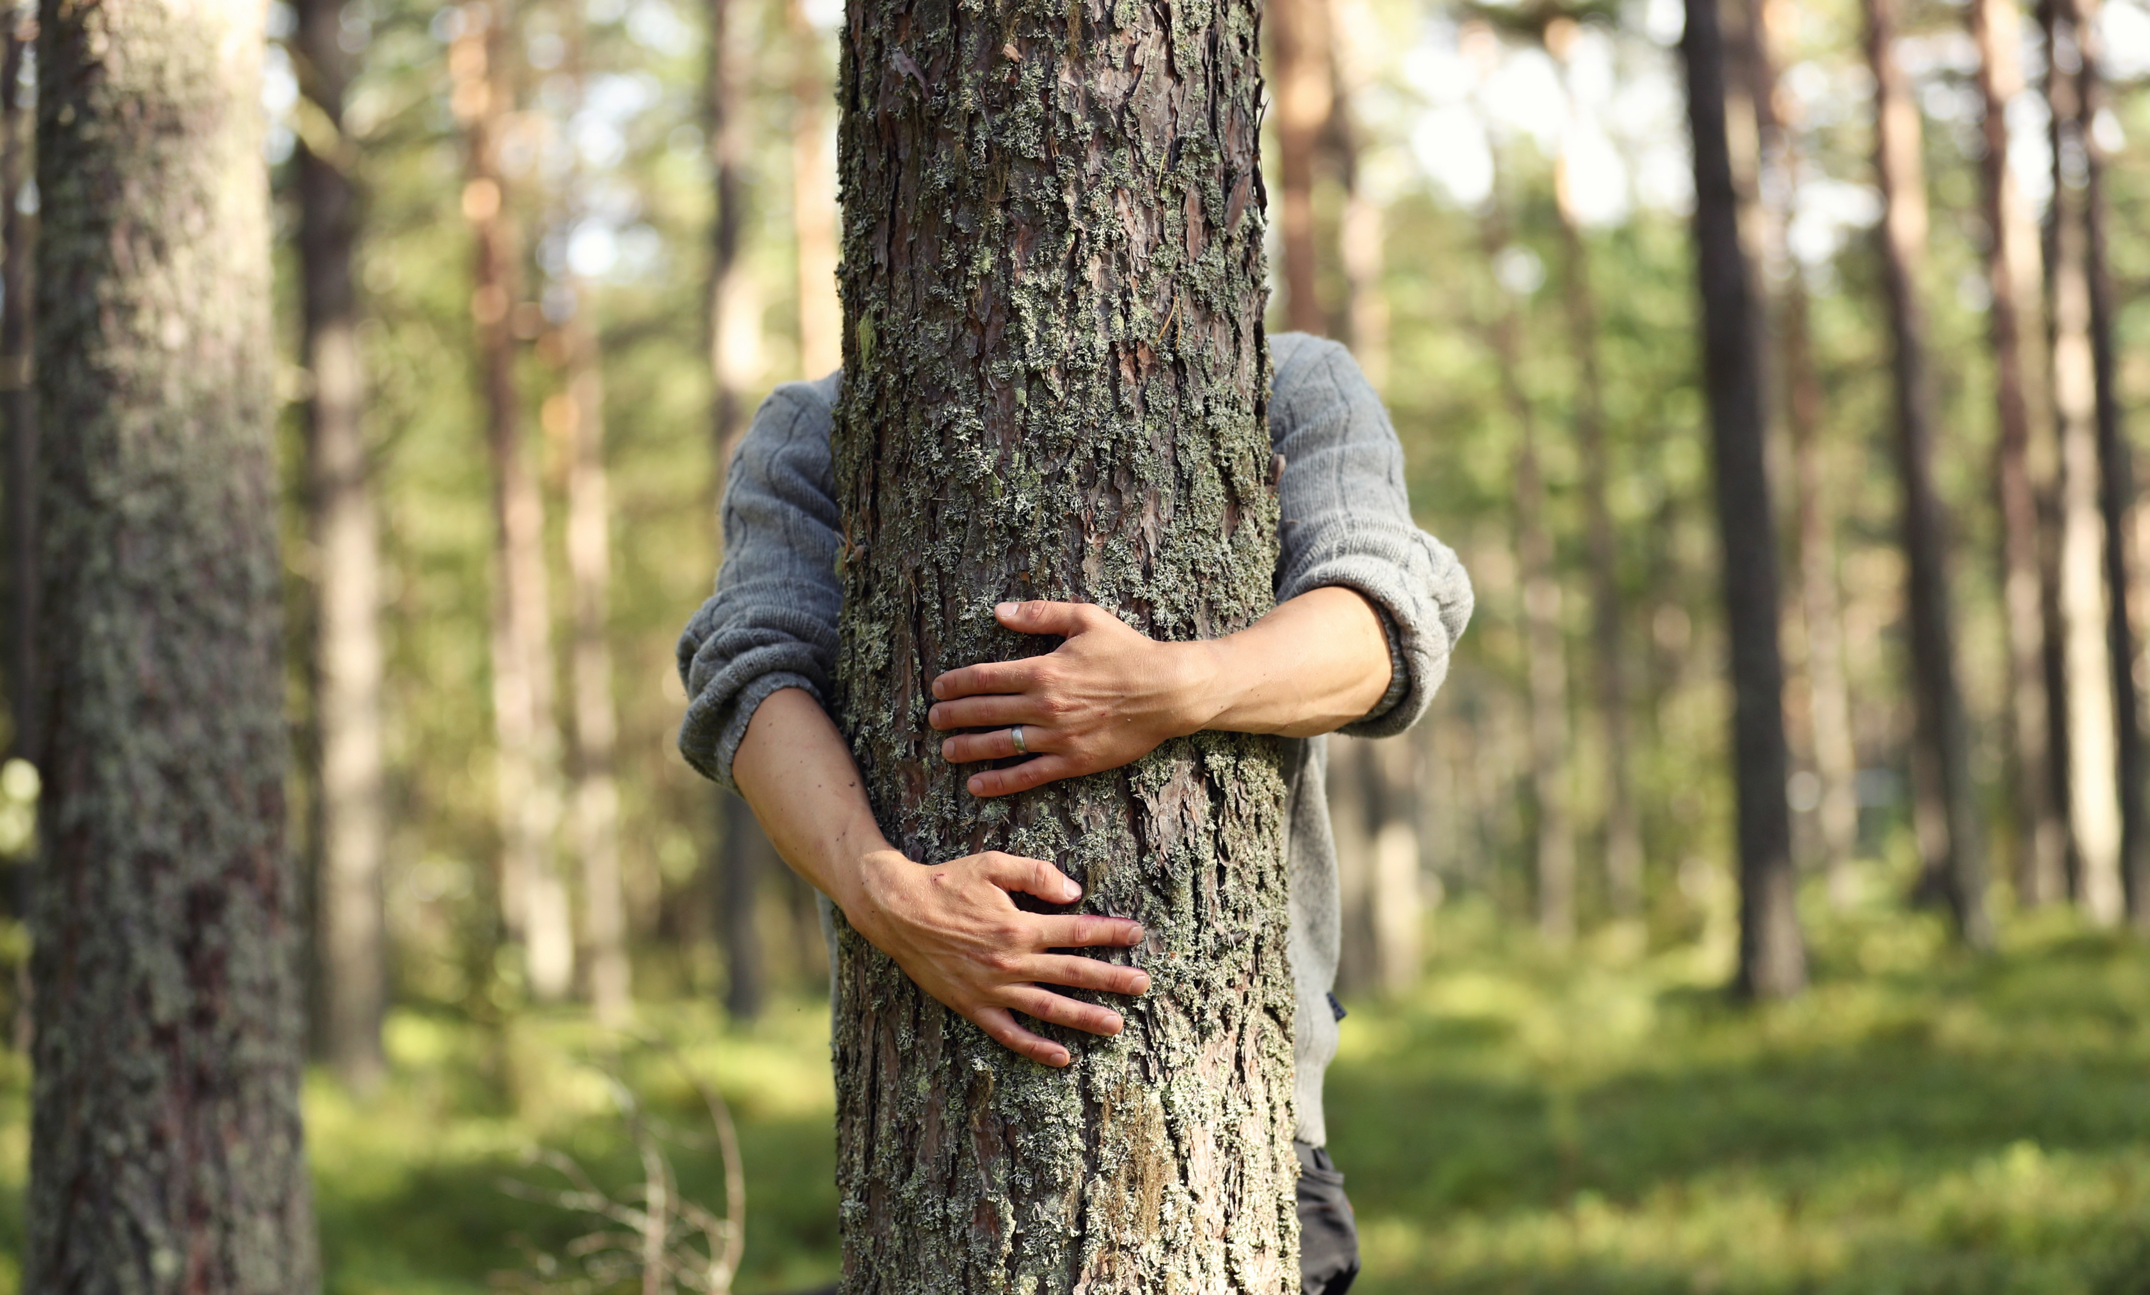
1/10
Over 75% covered in forest,
100% natural flavours
Photo: Harri Tarvainen / Visit Finland

Slide 3
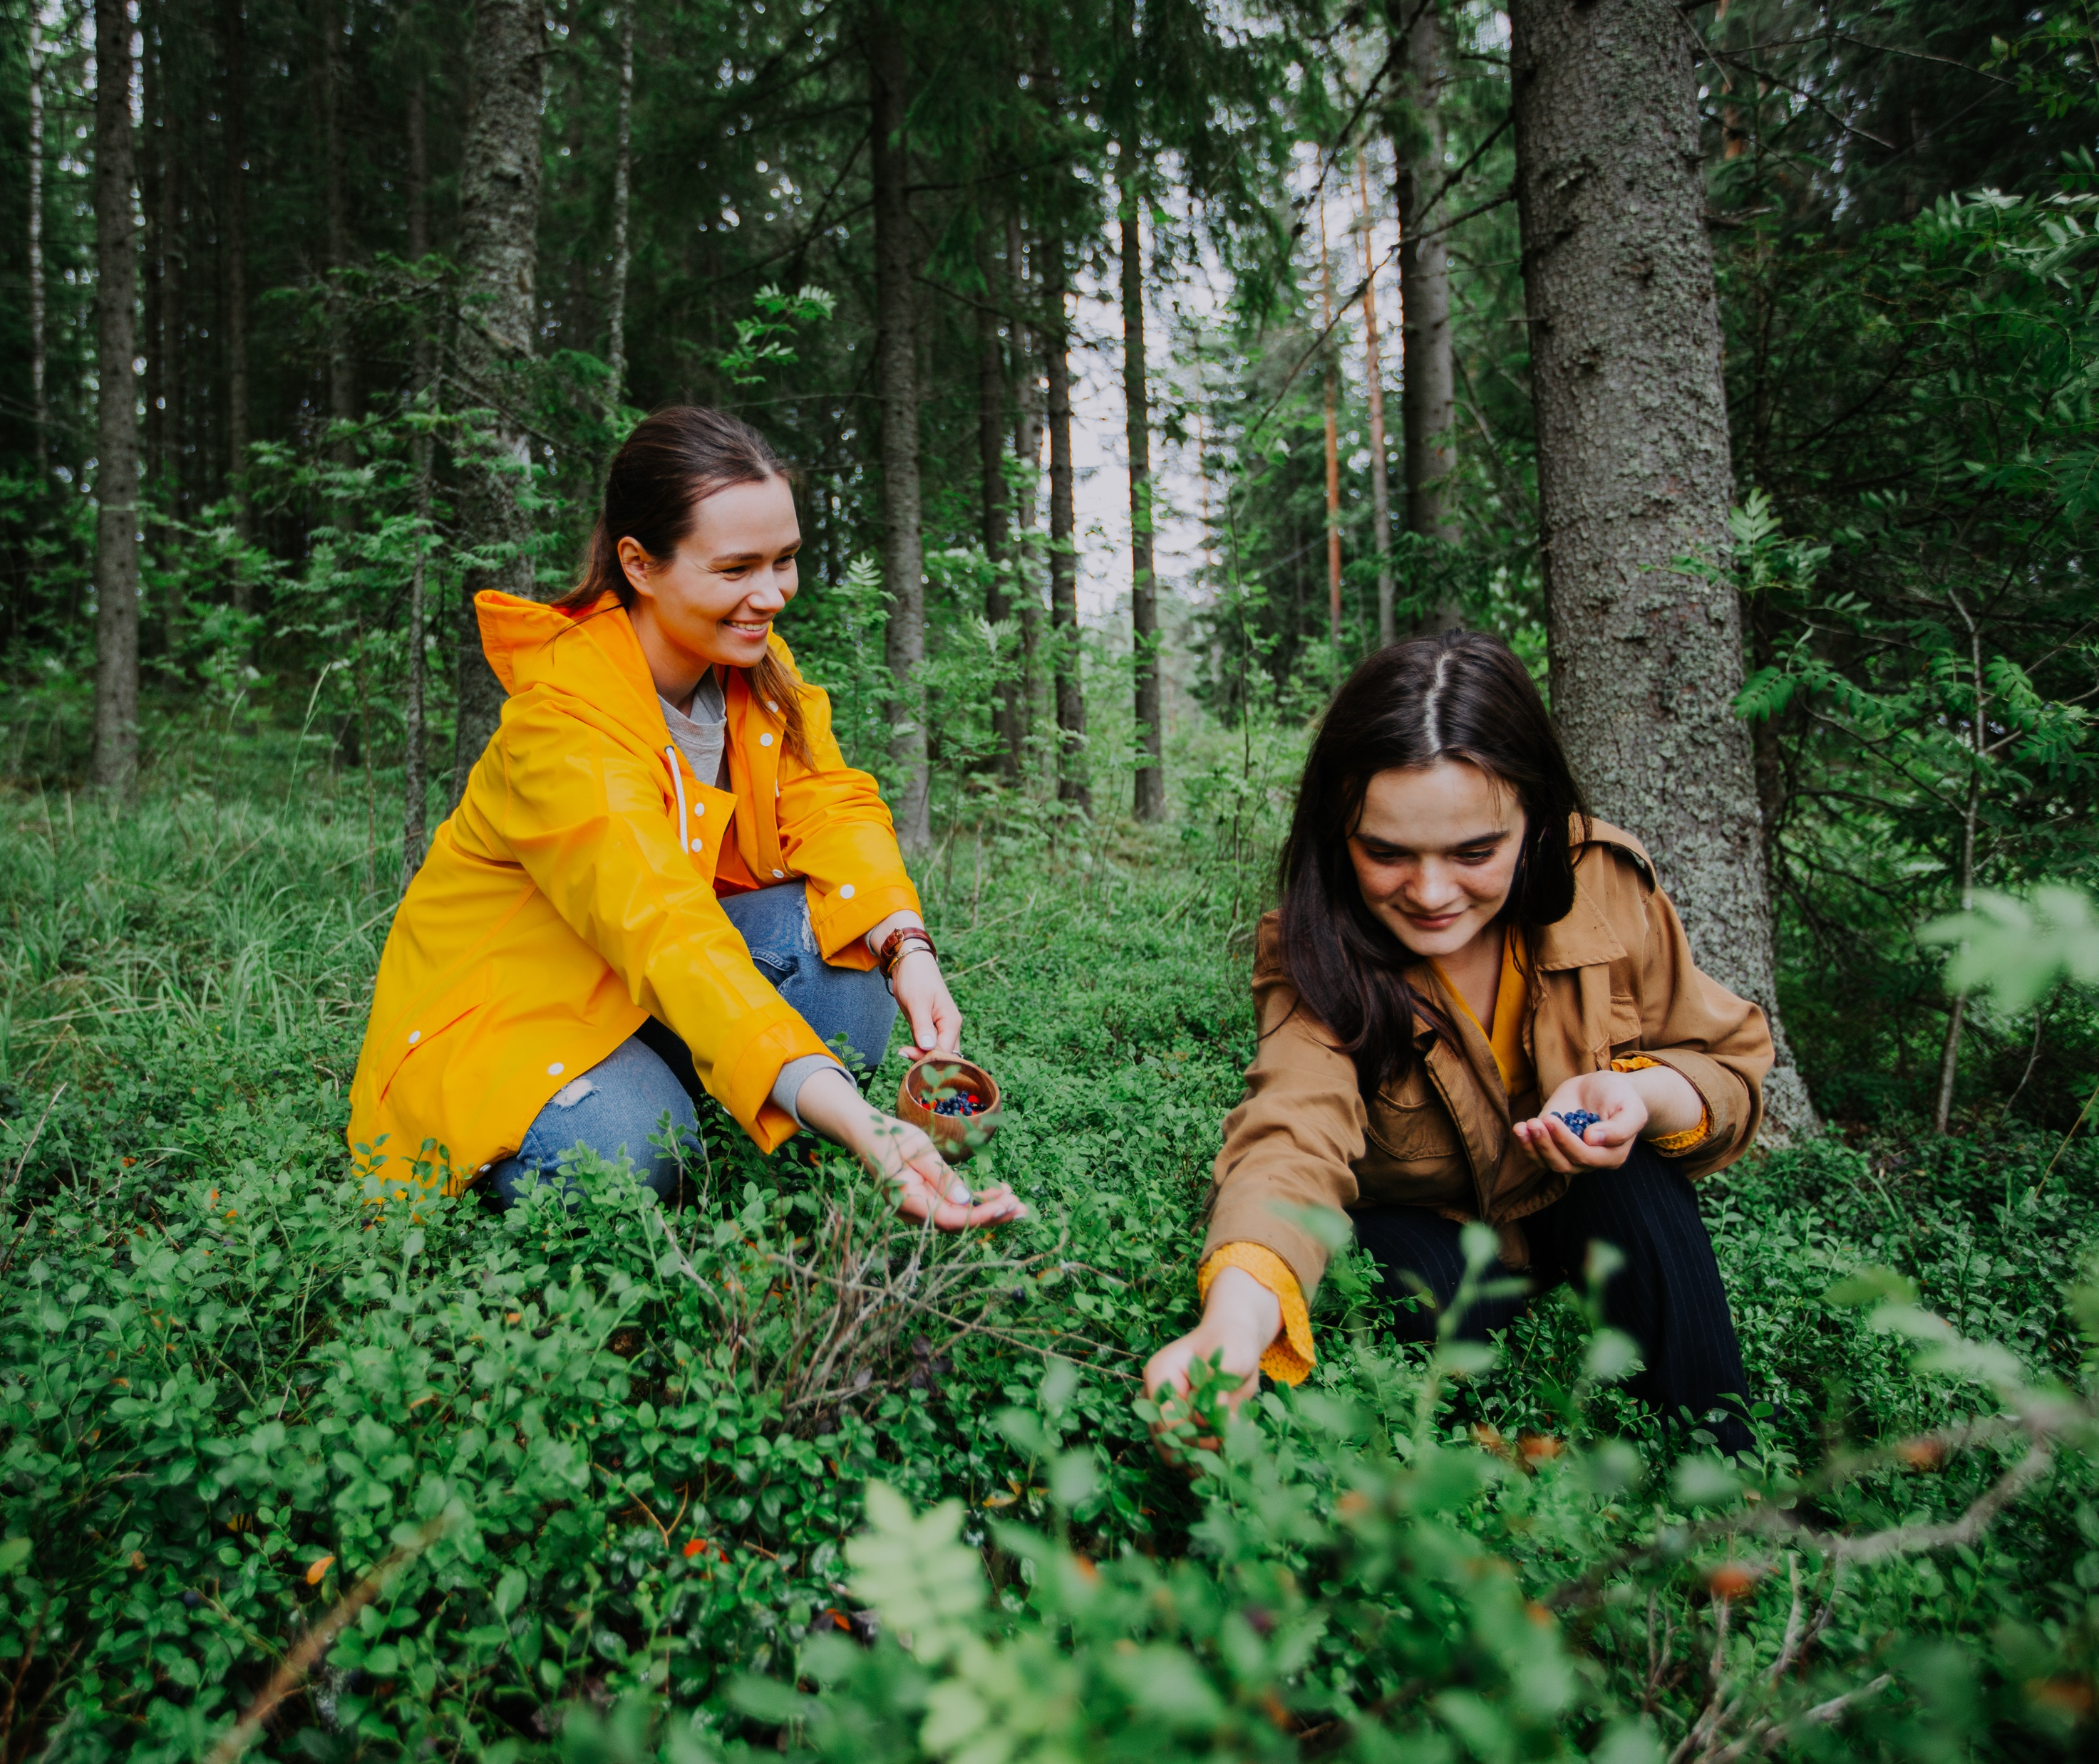
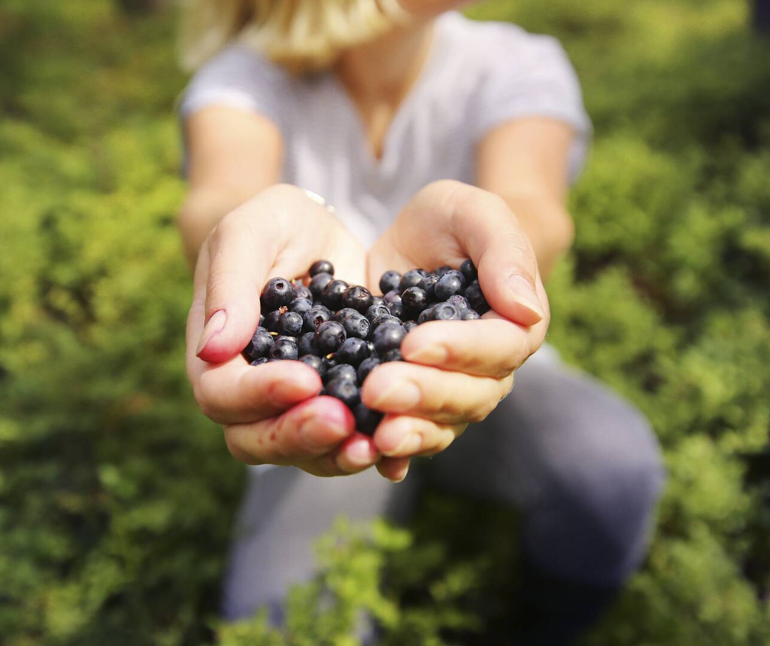
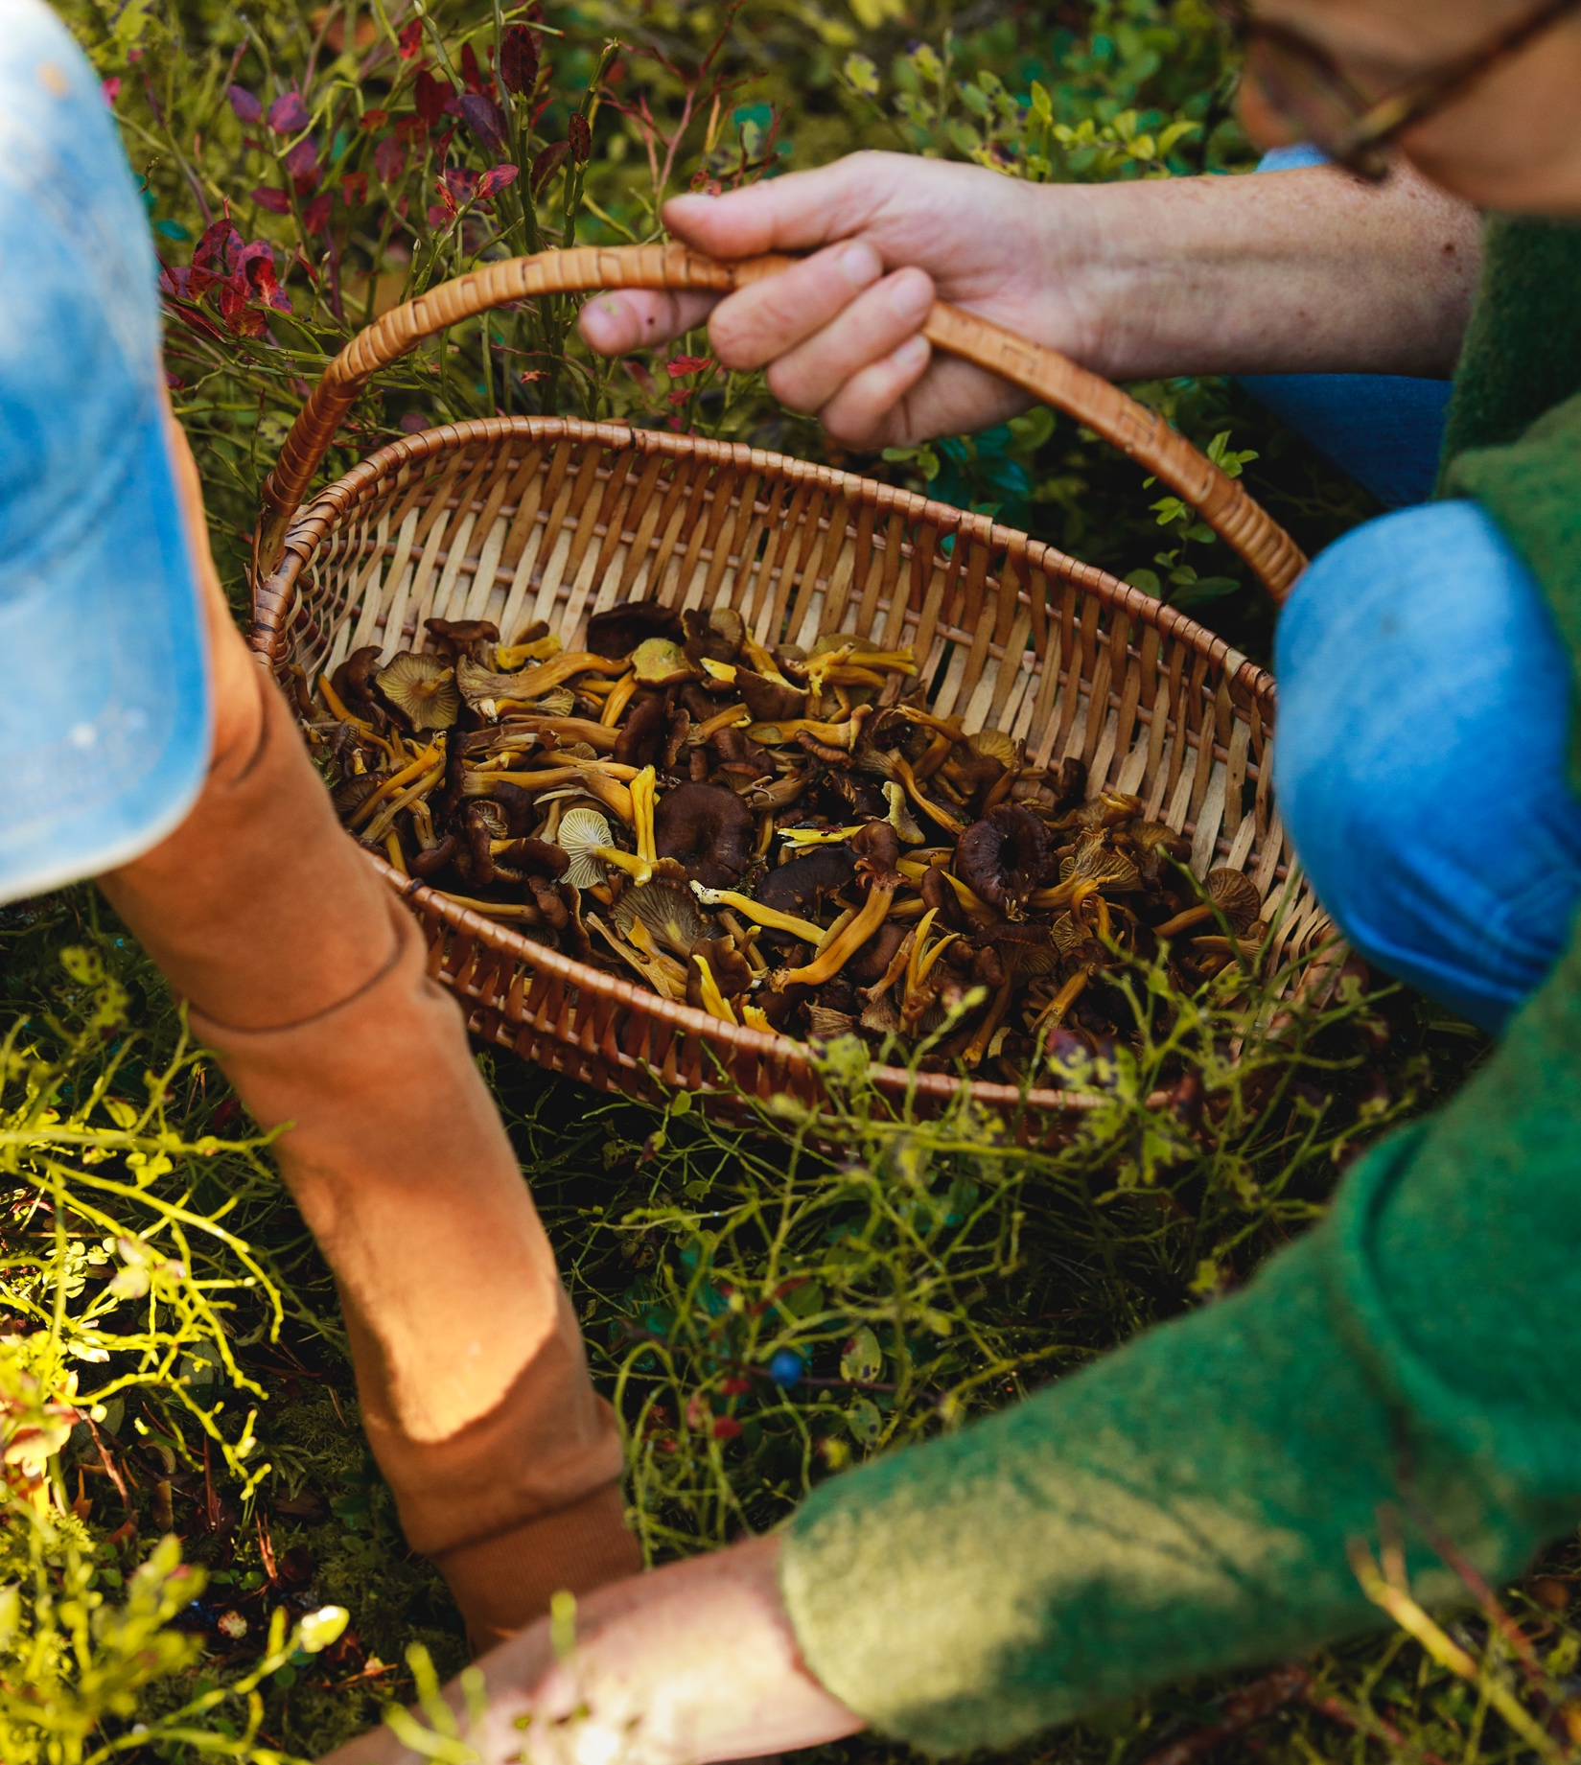
Over 75% covered in forest, 100% natural flavours
FINNISH FOOD CULTURE IN 10 SERVINGS
1
2
3
4
5
6
7
8
9
10
Every Finn lives no more than ten minutes away from the nearest
park or forest.
Thanks to that and statutory everyone’s rights, many of us forage for berries and mushrooms ourselves.
Photo: Ministry of Agriculture and Forestry of Finland
Photo: Julia Kivelä / Lakeland Finland
Photo: Ministry for Foreign Affairs of Finland
Notes:
Finland is covered with beautiful forests, lakes and fells, and Finland is the most forested country in Europe with three-quarters of its land area covered by forests.
Forests have always played a central role in Finnish everyday life. Most Finns regularly spend time in a forest – hiking, cross-country skiing, fishing, picking wild berries and mushrooms, or just relaxing at their vacation homes and summer cottages.
Half of the Finnish population lives within a few minutes’ walk from a forest and two out of three Finns spend time in a forest on a weekly basis. The close relationship with forests is reflected in Finnish culture. Forests have inspired much of Finnish art, design, and architecture.

Slide 4
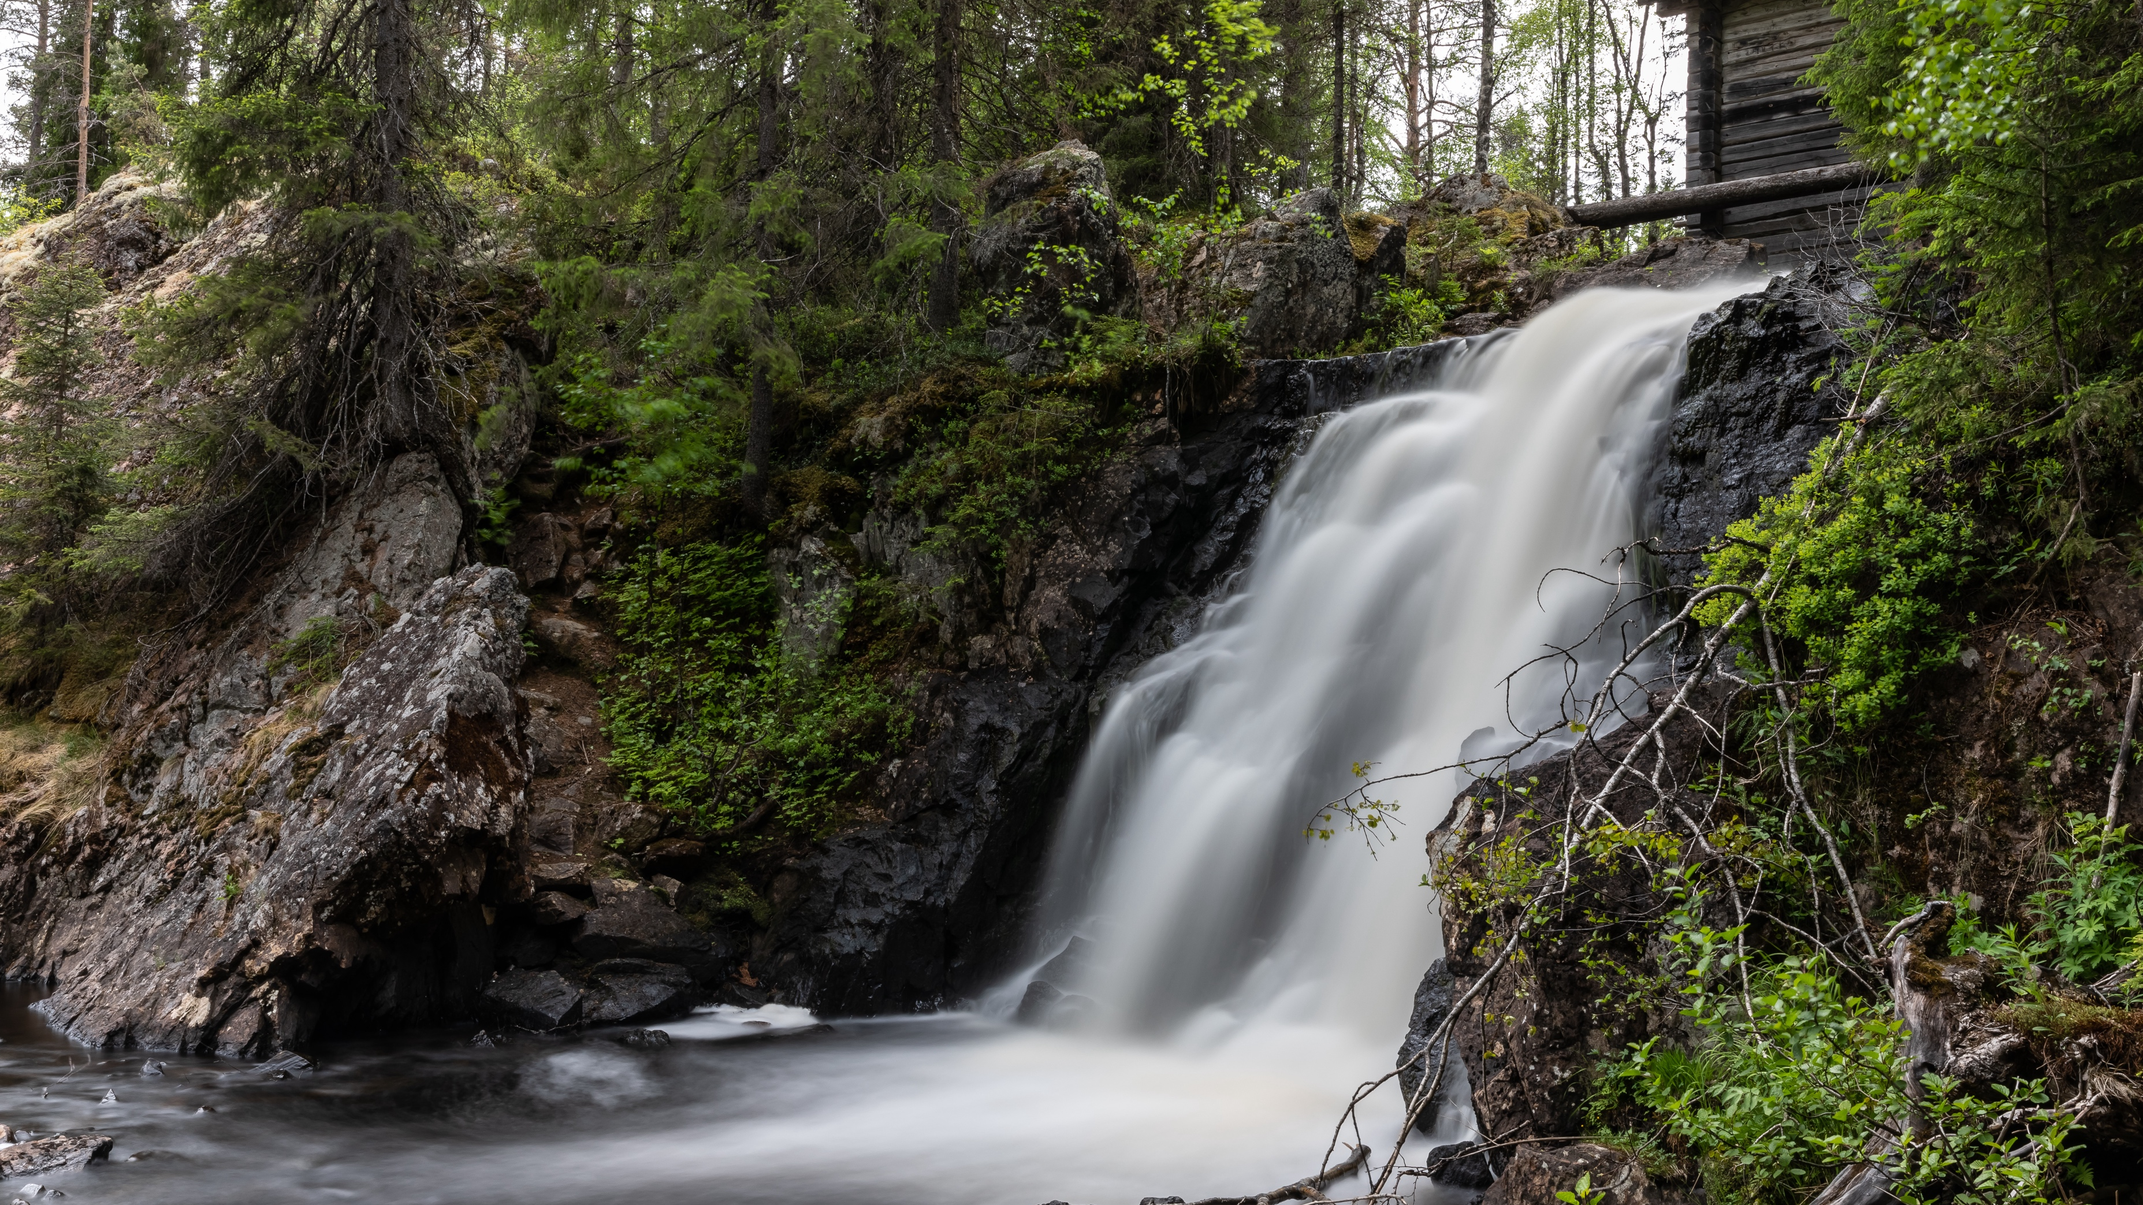
2/10
Put it on my tap: Finland has the
world’s best drinking water
Komulankongas, Hyrynsalmi, Finland.
Photo: Shutterstock

Slide 5
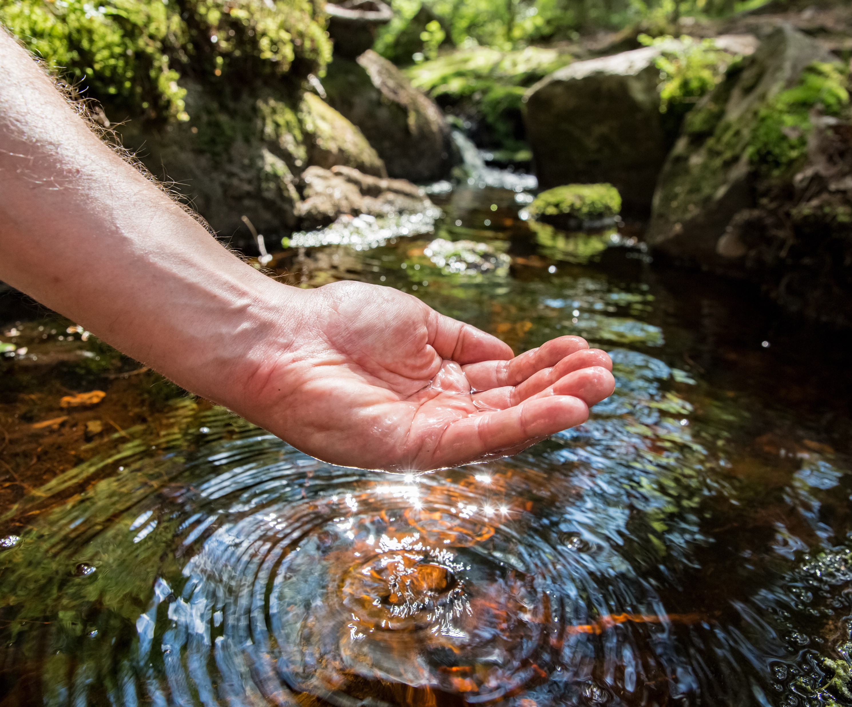
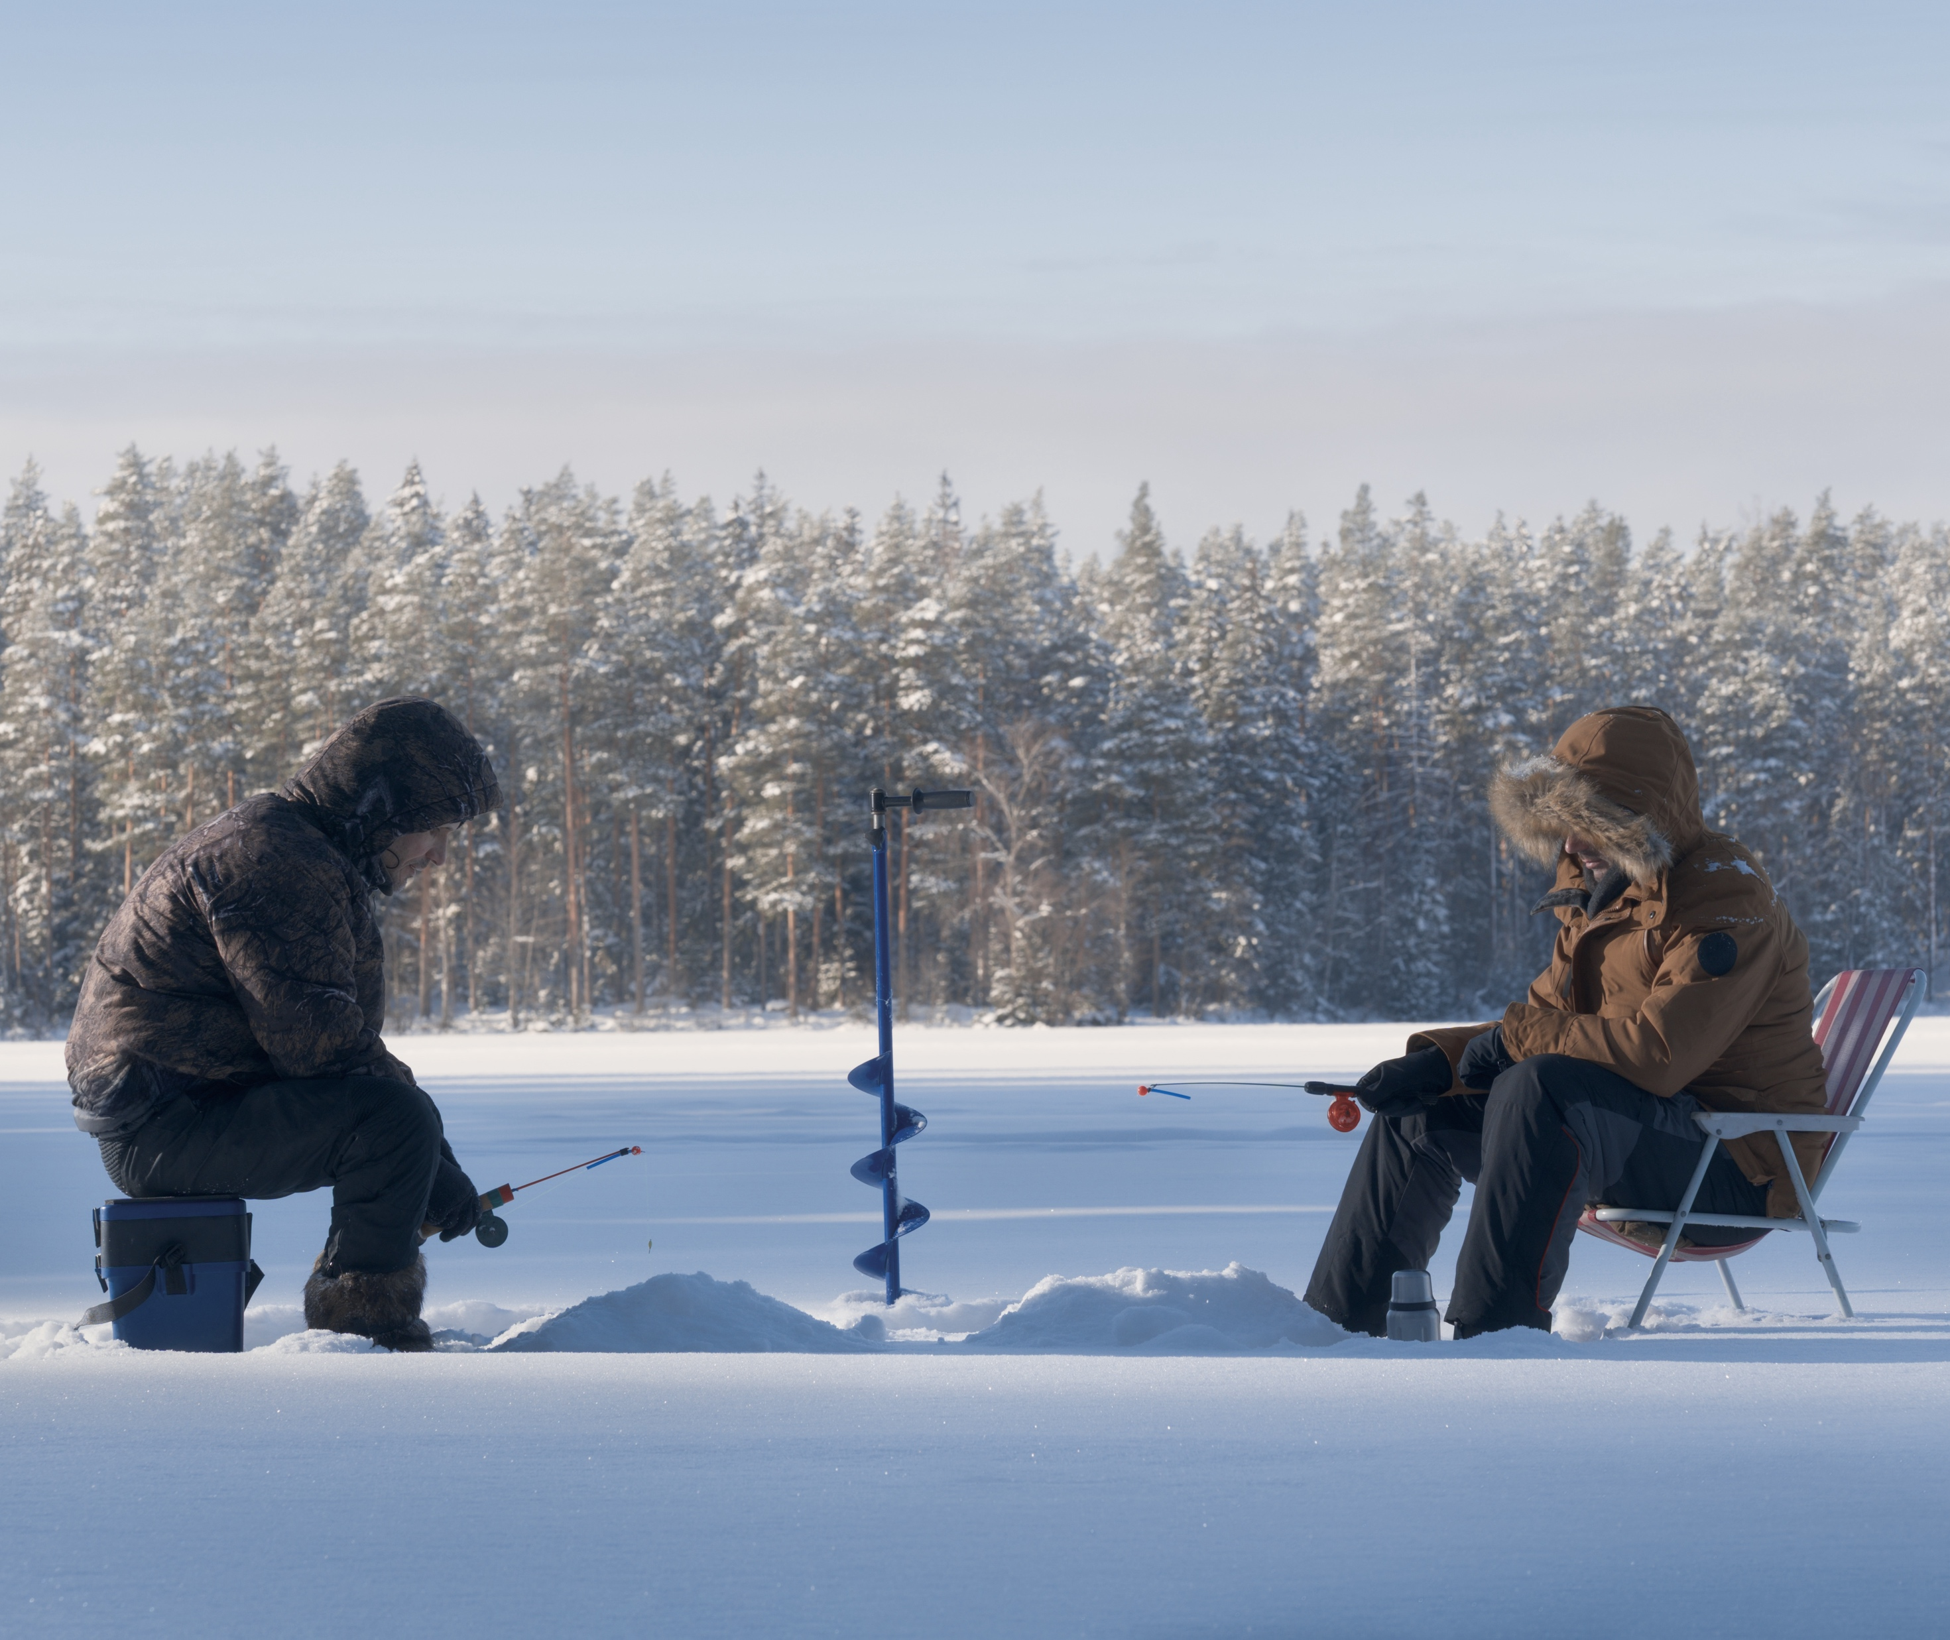
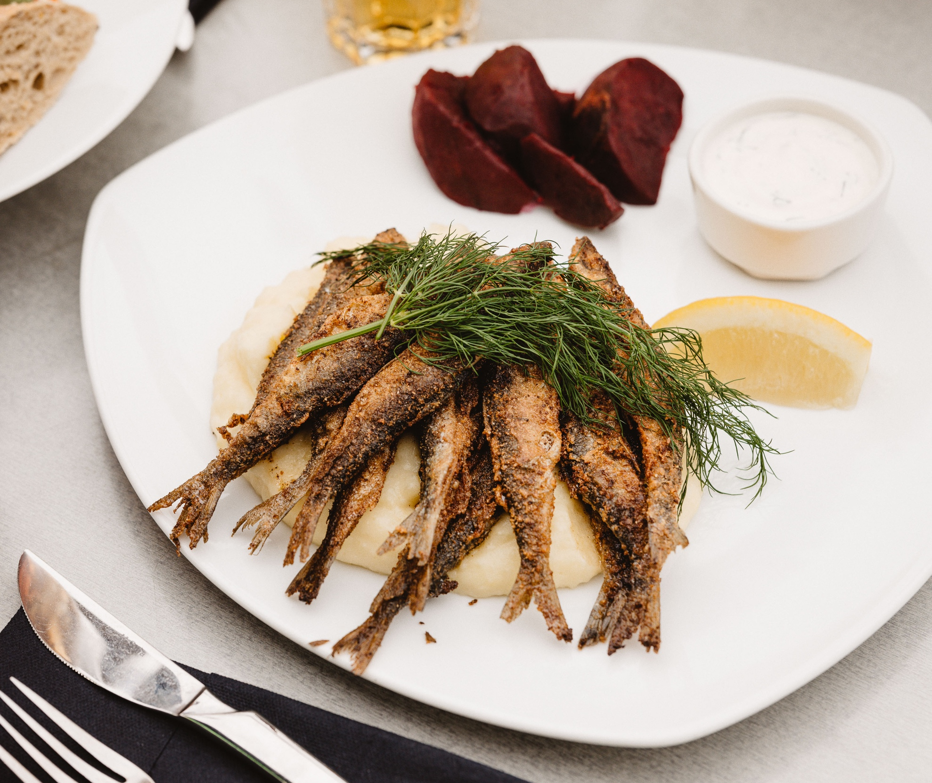
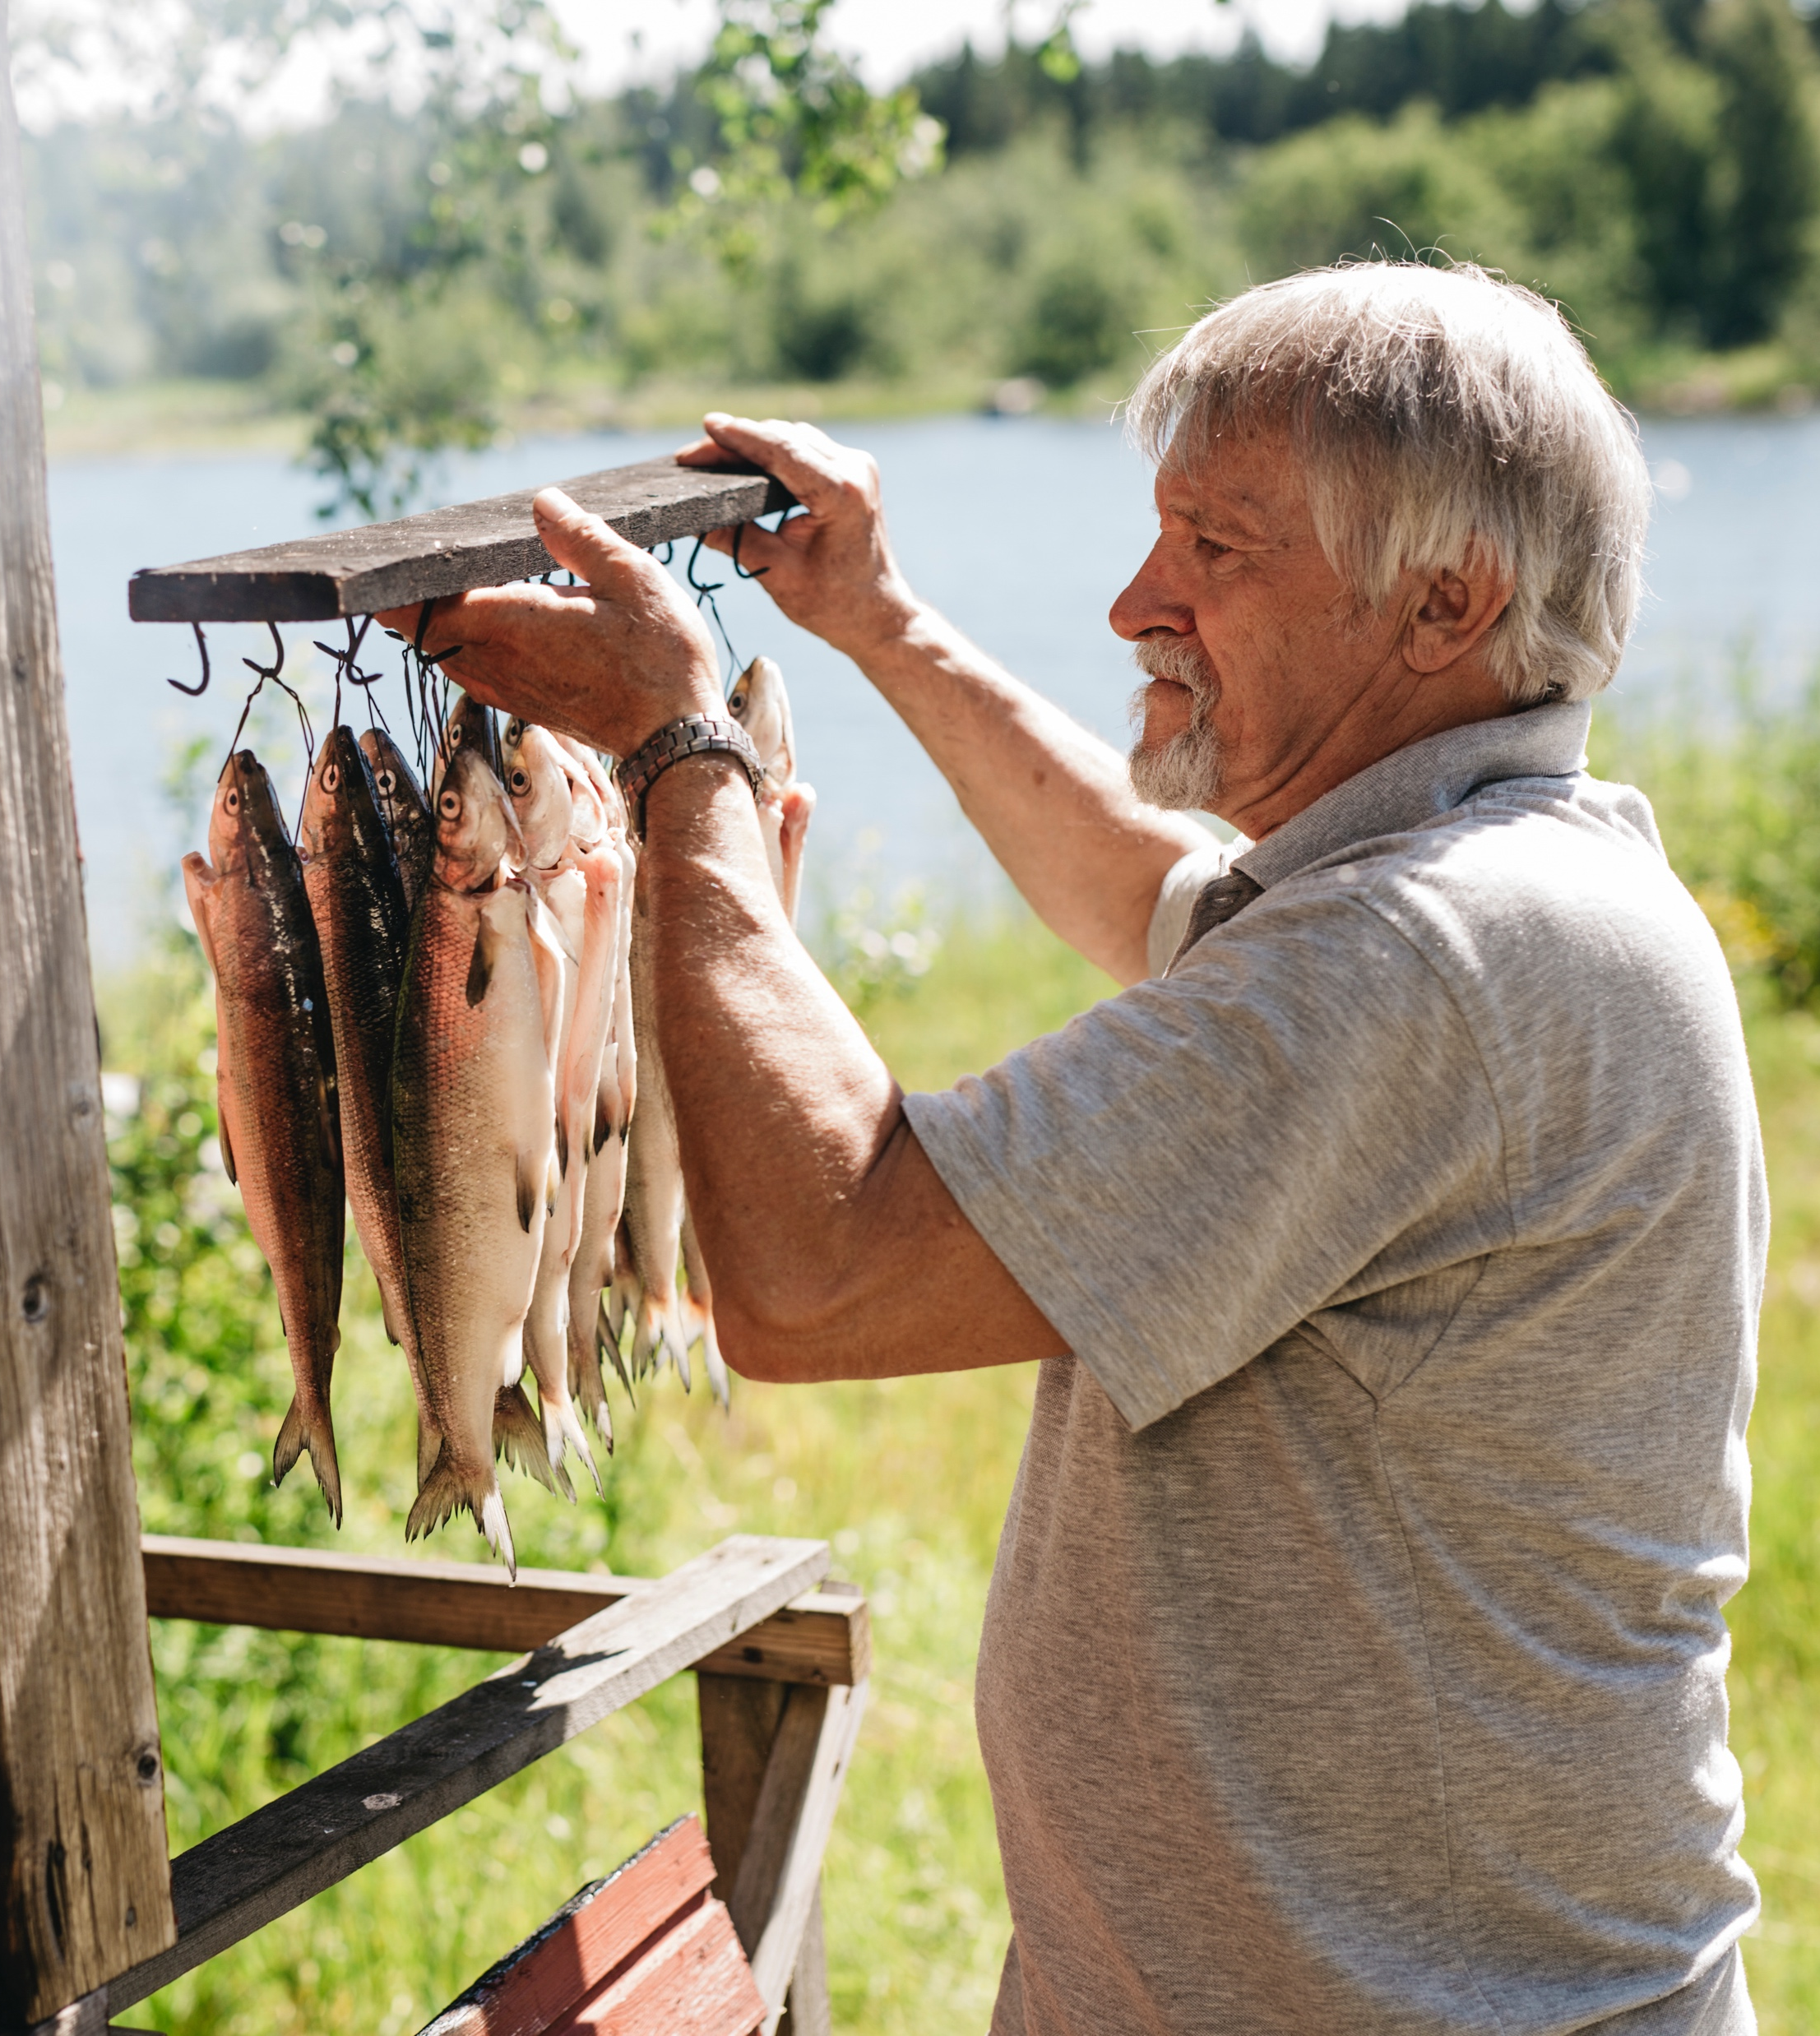
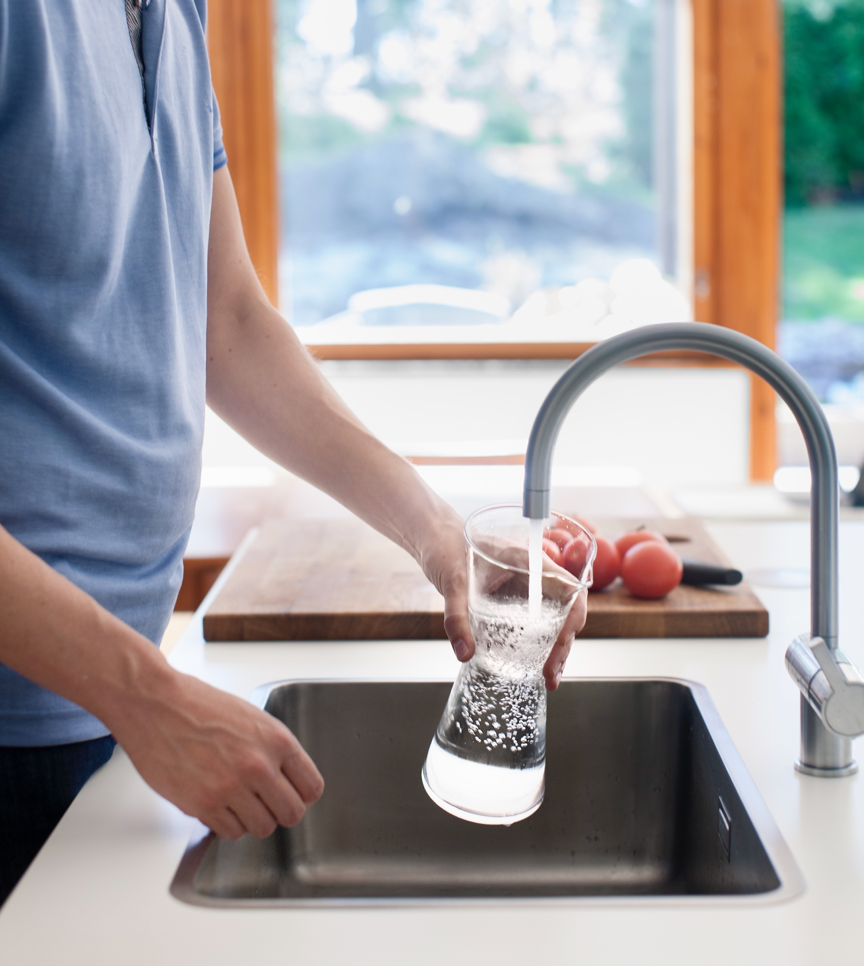
Put it on my tap: Finland has the world’s best drinking water
FINNISH FOOD CULTURE IN 10 SERVINGS
1
2
3
4
5
6
7
8
9
10
A UNESCO study identifies Finland as having the best groundwater in the world.
Our exceptionally pure resources provide us not only with refreshing drinking water, but also with fresh fish – around the year, even in the cold winter.
Ice fishing.
Photo: iStock
Vendace dish at the restaurant Prinsessa Armaada in Lappeenranta.
Photo: goSaimaa
Nuuksio National Park.
Photo: Shutterstock
Photo: Elina Manninen / Keksit
Photo: Jukka Rapo / Finland Image Bank
Notes:
Finland is the most water‑rich country in the world with 188,000 lakes and extensive high‑quality groundwater reserves. Our tap water is equally reliable: 99.99% of supplied water meets all drinking water requirements.
100% of the Finnish population has access to safely managed drinking water services. In Finland, people enjoy clean and safe water wherever they are — from lakes to the tap.
The water supply system in Finland is robust, reliable and cost-effective. It functions 24 hours a day, 7 days a week even when there is a power cut. This level of reliability means the system is often taken for granted — a sign of how well it performs.
Finland’s water sector expertise is widely recognized. Our professionals develop solutions for water purification, wastewater management, groundwater protection and sustainable use of water resources. The goal is to provide practical, scalable solutions to global water challenges using Finnish know‑how and technology.
A UNESCO study identifies Finland as having the best groundwater in the world. This gives us a strong foundation for offering a sustainable, high‑quality source of clean water.
Finland also exports this purity. Our bottled spring waters come from protected and carefully monitored sources that have received international recognition for quality and taste. Through this, we can offer added value to global markets — delivering exceptionally pure water backed by strict environmental standards.
Finland is known as the land of more than 188,000 lakes, and clean waters make fishing also a natural part of Finnish life year‑round. Fish such as salmon, trout and many traditional lake species are central to Finnish cuisine.
In summer, recreational fishing is widely practiced across the country. Common methods include simple rod fishing from the shore or boat angling for species like perch, pike and zander. Summer fishing is accessible, low‑threshold and closely connected to spending time outdoors.
When lakes freeze, fishing continues on ice. Ice angling targets species such as perch and trout. Traditional winter net fishing is also practiced: nets are guided under the ice through openings cut in the surface. A key catch is muikku (vendace), an important lake fish in many regions. Winter muikku is typically fried, smoked or preserved and is valued for its clean, mild flavour.

Slide 6
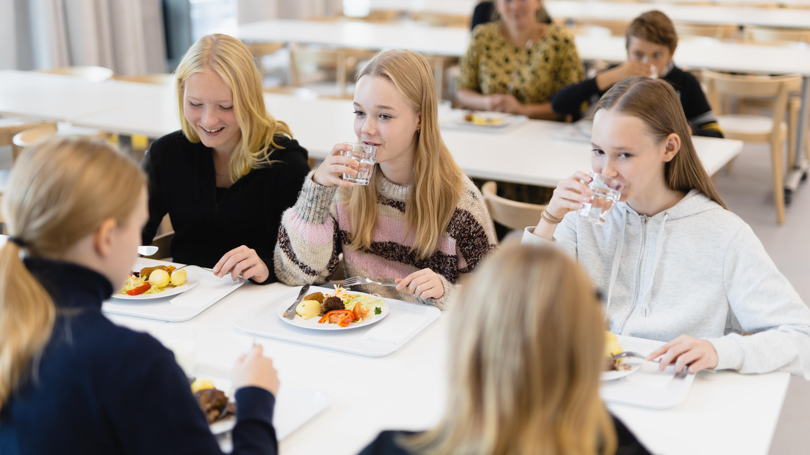
3/10
Finnish schools provide equal opportunities,
in class but also in the cafeteria
Photo: Ministry of Agriculture and Forestry of Finland

Slide 7
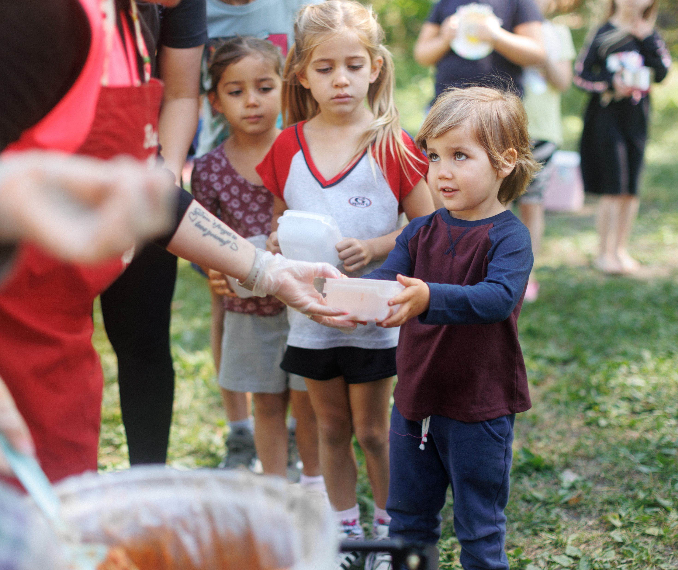
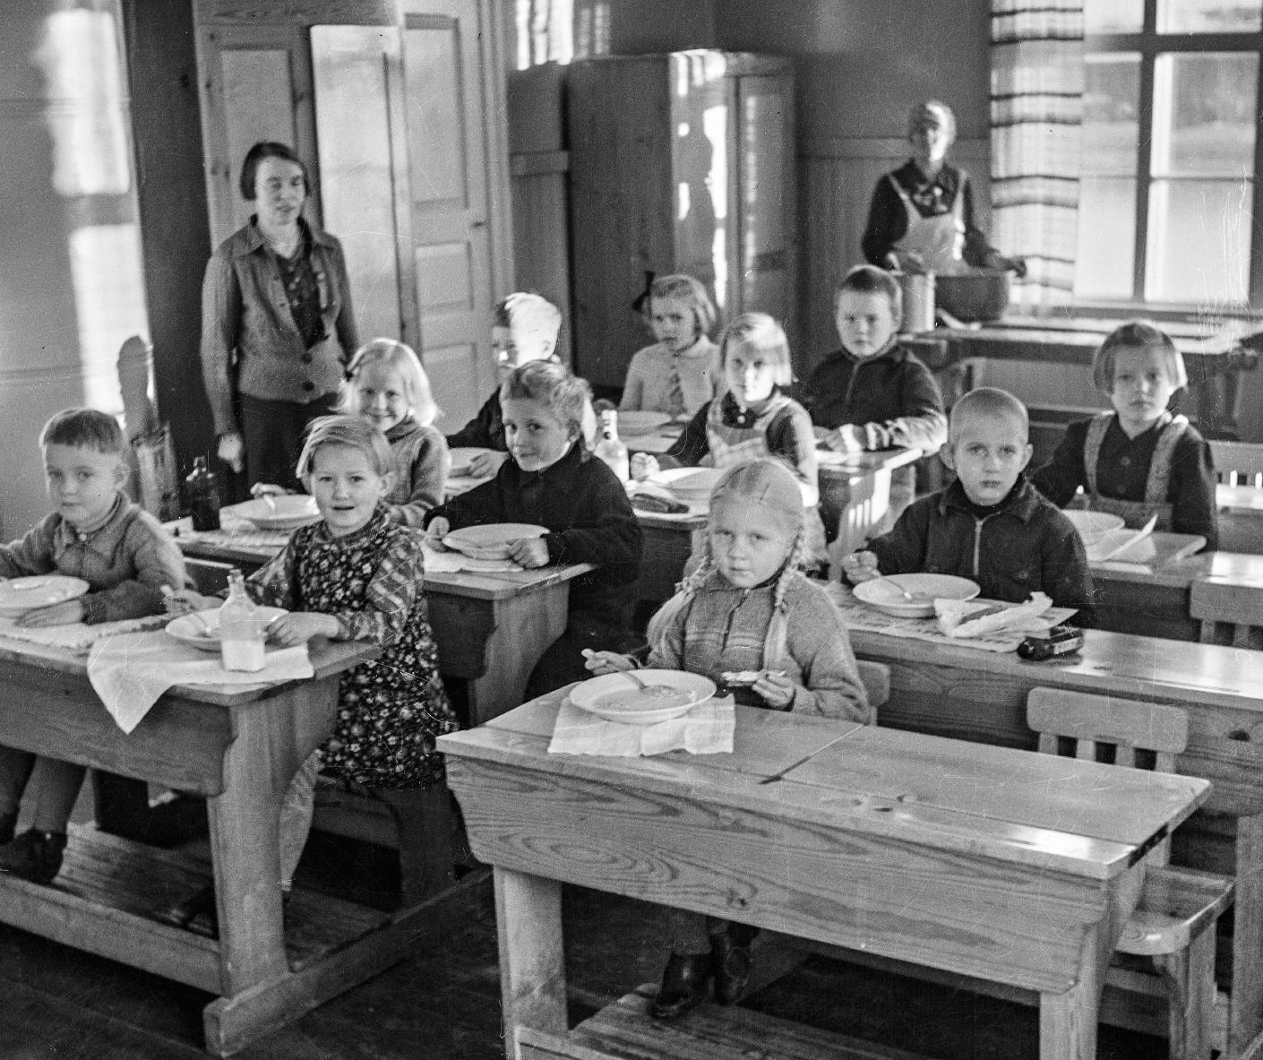
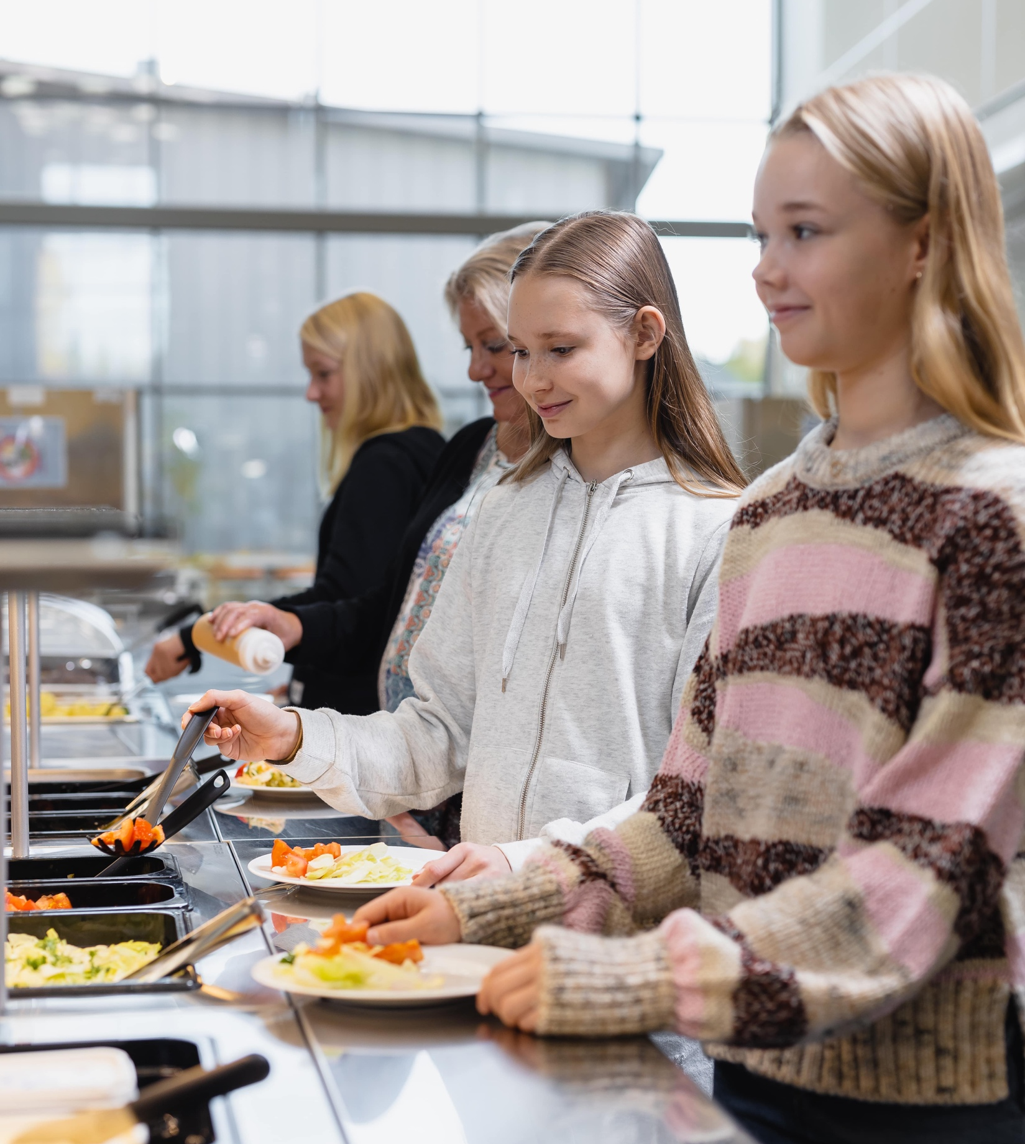
Finnish schools provide equal opportunities, in class but also in the cafeteria
FINNISH FOOD CULTURE IN 10 SERVINGS
1
2
3
4
5
6
7
8
9
10
Finland was the first to offer free school meals.
And they’re good! The meals follow official nutritional guidelines and will consist of 25% organic products by 2030.
Photo: Vesa Laitinen
Photo: Antti Pänkäläinen / Keski-Suomen museo
Photo: Ministry of Agriculture and Forestry of Finland
Notes:
Finland was the first country in the world to provide free school meals for all children — a system that still guarantees every pupil a nutritious daily meal.
Finland was the first country in the world to introduce free school meals for all children in the 1940s. Today, Finland and Sweden remain the only countries where every pupil receives a free, nutritious daily meal, supporting learning and equal opportunities.
The modern Finnish school meal provides about one‑third of a pupil’s daily energy needs and follows national nutrition guidelines. Over their school years, pupils eat more than 2,000 school meals, making the system a long-term investment in health, educational equity and well‑being.
School meals also support food skills, sustainable choices and social learning. They function as a multidisciplinary learning module linked to several school subjects and help build lifelong healthy eating habits.
In Finland, many cities also offer guided activities for families and provide free park lunches during the summer, ensuring that children have access to a warm meal even when schools are closed.
Finland is committed to developing increasingly sustainable school meals. By 2030, the goal is that school food will include at least 25% organic products, alongside a strong emphasis on local and responsibly produced ingredients.
Finland co‑chairs the School Meals Coalition, a global initiative aiming to ensure that every child worldwide has access to a nutritious school meal by 2030.

Slide 8
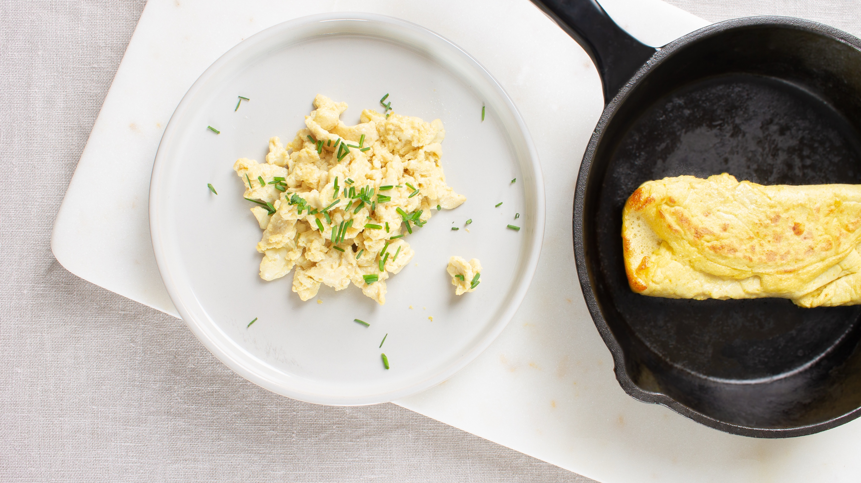
4/10
At our table, there's always
room for innovation
Photo: Onego Bio

Slide 9
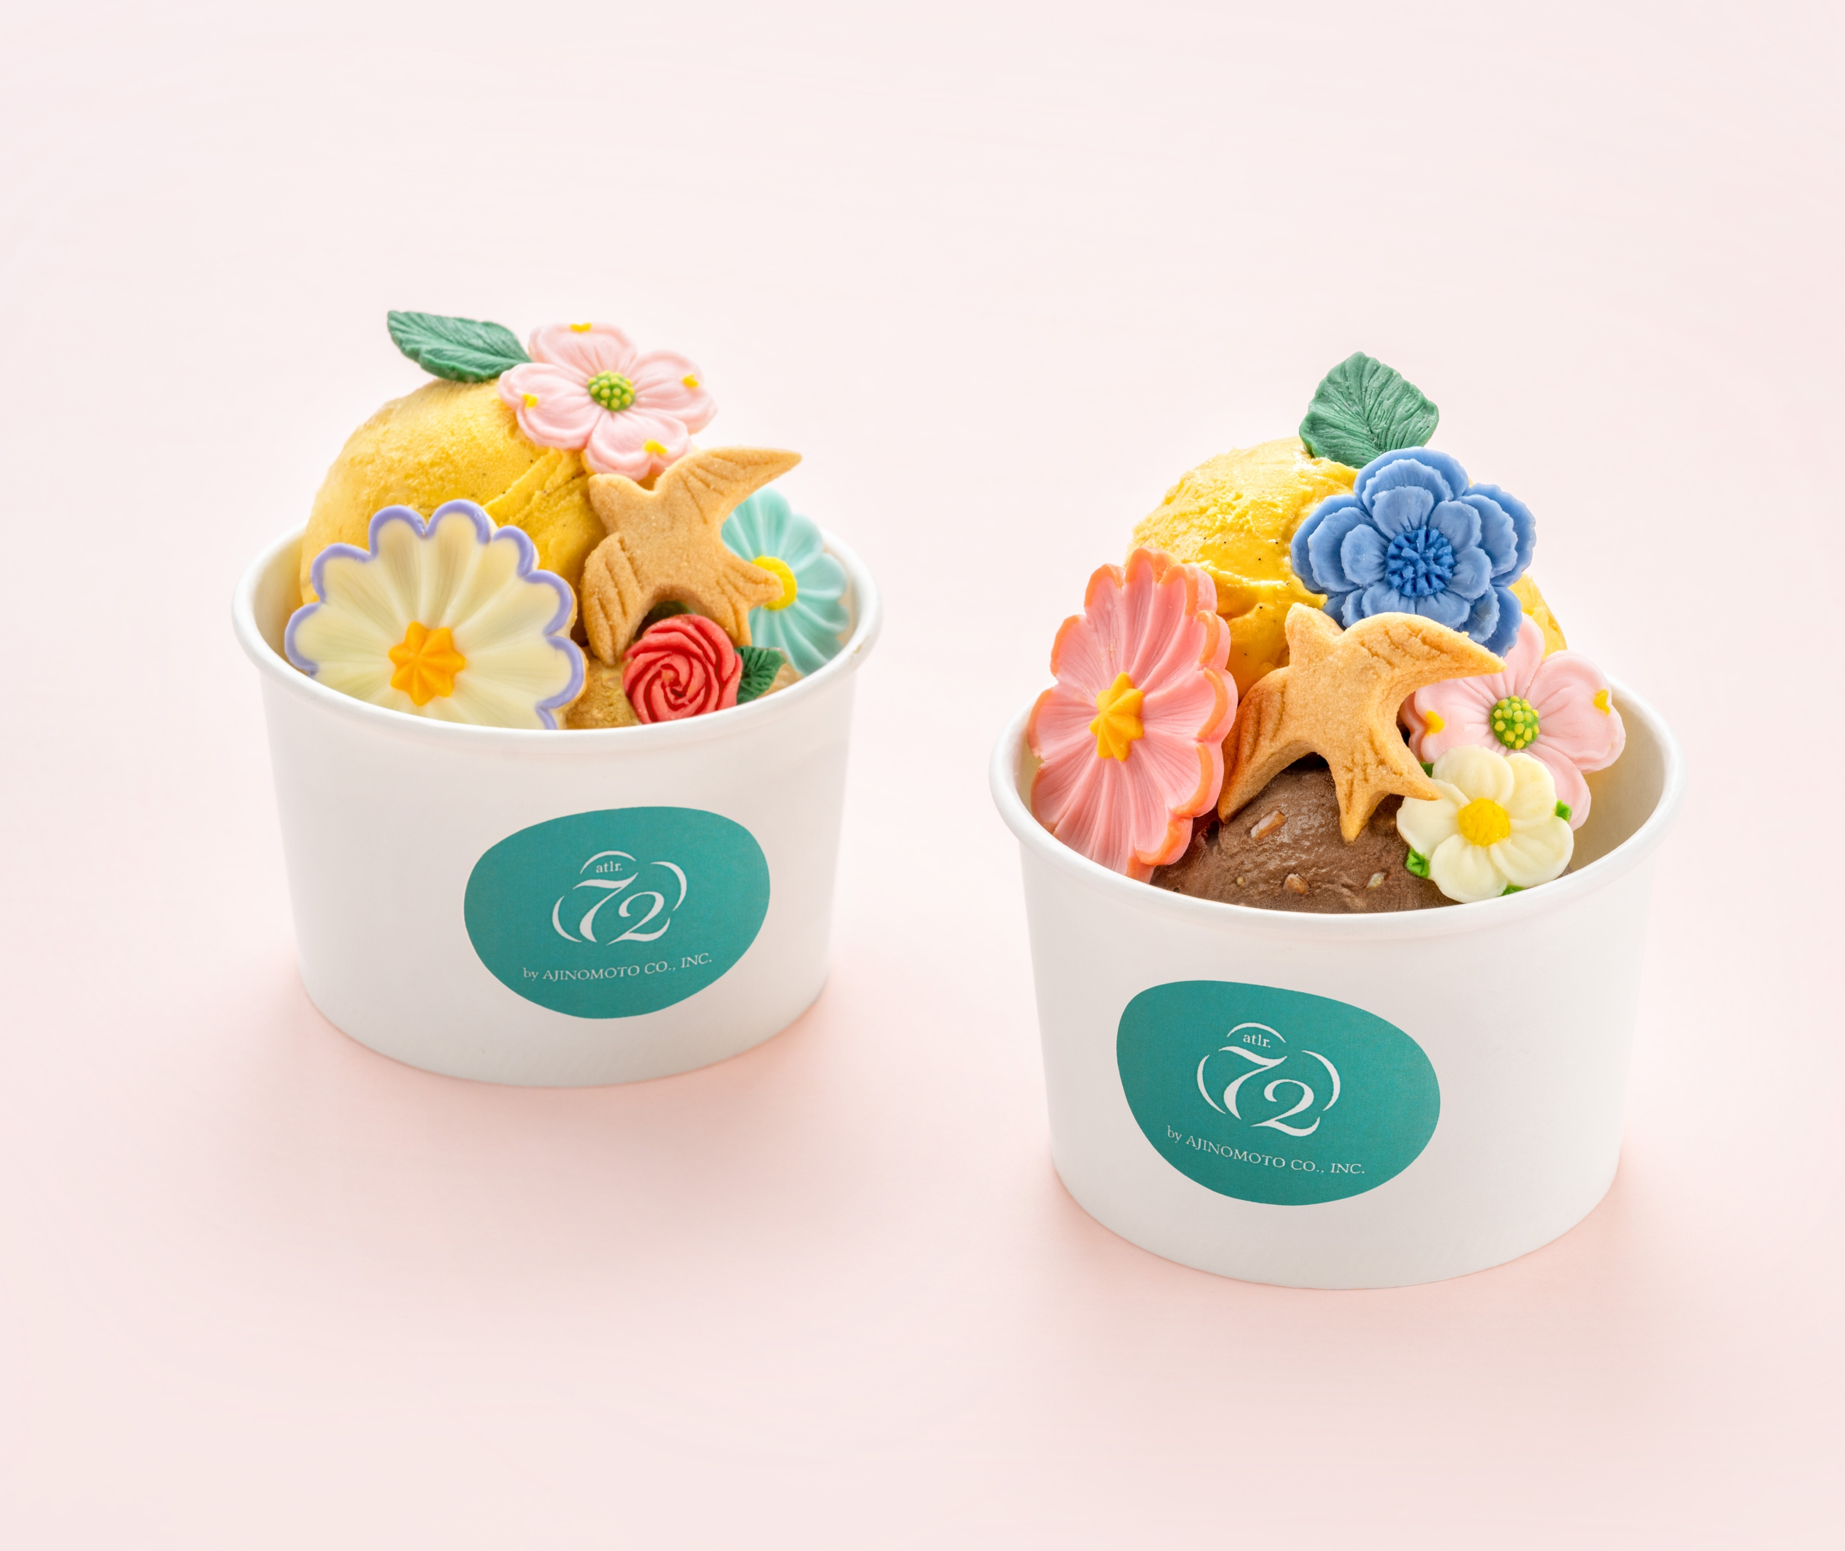
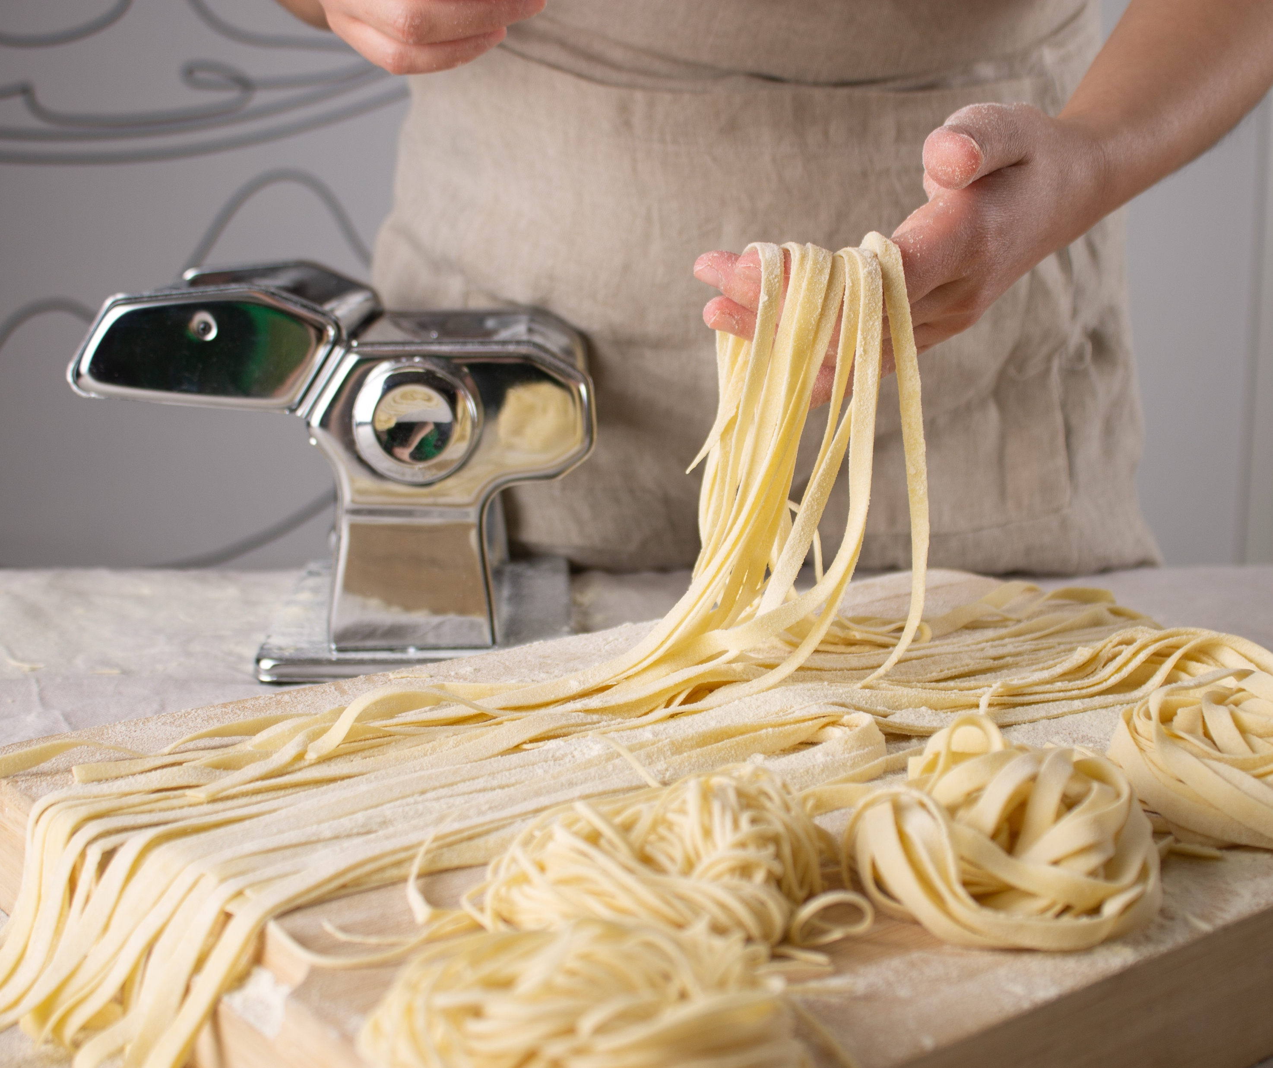
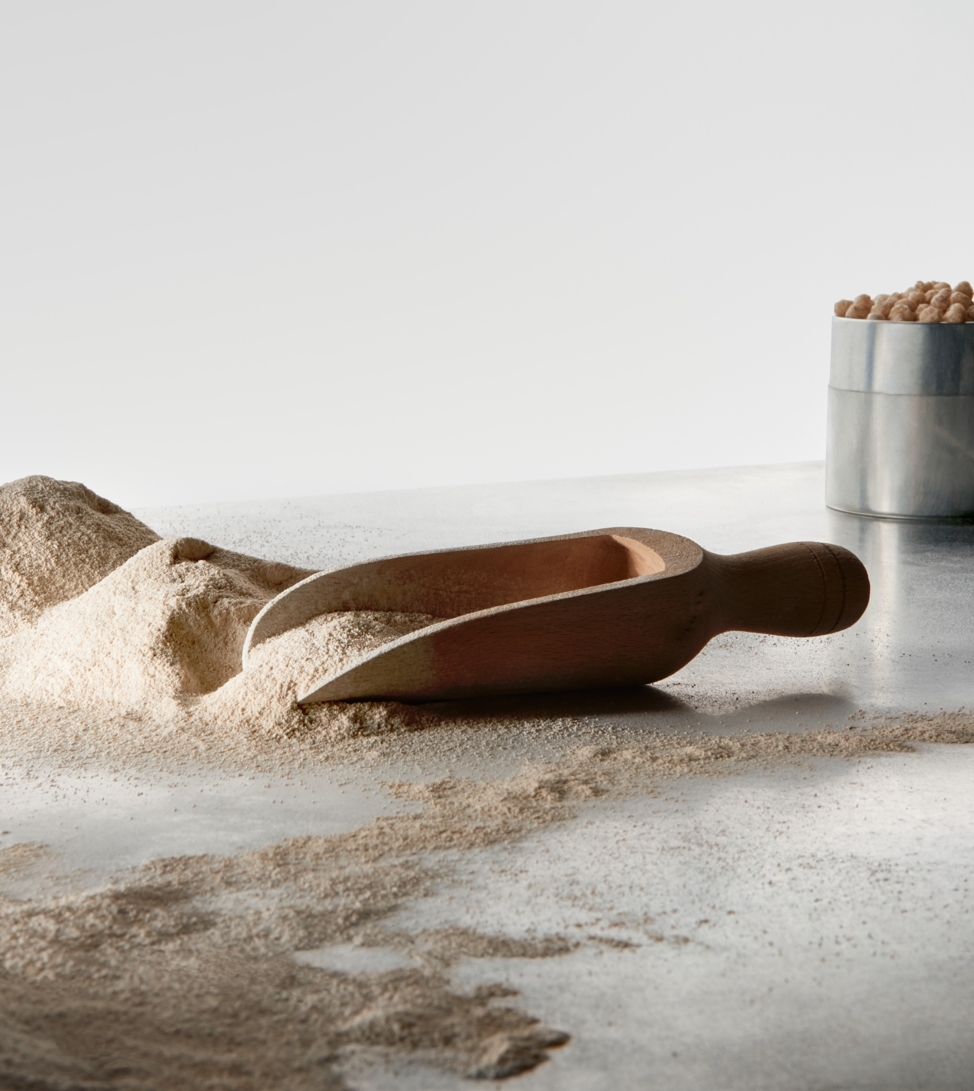
At our table, there's always room for innovation
FINNISH FOOD CULTURE IN 10 SERVINGS
1
2
3
4
5
6
7
8
9
10
Companies are making protein out of thin air.
Finland has emerged as a leading innovator in the production of advanced, ethical, and environmentally friendly alternatives – companies are creating new proteins from industrial by-products, fungi, and even air!
Photo: Onego Bio
Photo: Solar Foods
Photo: Iiro Rautiainen
Notes:
Around the world, the food system is under pressure: population growth, climate change, limited land and water, and unstable supply chains. Finland has emerged as a leader in next‑generation food innovations that offer scalable, sustainable solutions.
Solar Foods’ Solein® is a completely new kind of protein produced using air, water, minerals and renewable electricity instead of fields or animals. It comes from a natural, non‑modified single‑cell organism and contains all essential amino acids.
Producing Solein uses 600× less water and 200× less land than beef protein. Its carbon footprint is up to 98% lower than beef. It is approved for food use in Singapore and recognised as safe (GRAS) in the U.S. by the FDA.
In simple terms: a protein that can be produced anywhere in the world, independent of weather and farming.
Enifer produces PEKILO®, a fungi‑based mycoprotein made by upcycling side streams from the food and agricultural industries. The fermentation process is similar to brewing.
PEKILO® production has a 98% lower carbon footprint than beef.
Neutral taste and colour make it suitable for bakery items, alternative dairy, plant‑based foods and snacks. A new Finnish factory will produce enough protein for a middle-sized Finnish city.
Another practical example of turning industrial by‑products into nutritious food ingredients is Onego Bio’s Bioalbumen®: a real egg‑white protein without chickens. It is a bioidentical egg‑white protein using precision fermentation. The result is exactly the same ovalbumin found in conventional egg whites, with the same foaming, binding and baking properties.
Production requires 95% less land, 97% less water, and emits 89% fewer greenhouse gases than traditional egg production.
The FDA has granted a “no questions” letter, enabling commercialisation in the U.S. market. A way to produce one of the world’s most used food proteins — without relying on poultry farming.

Slide 10
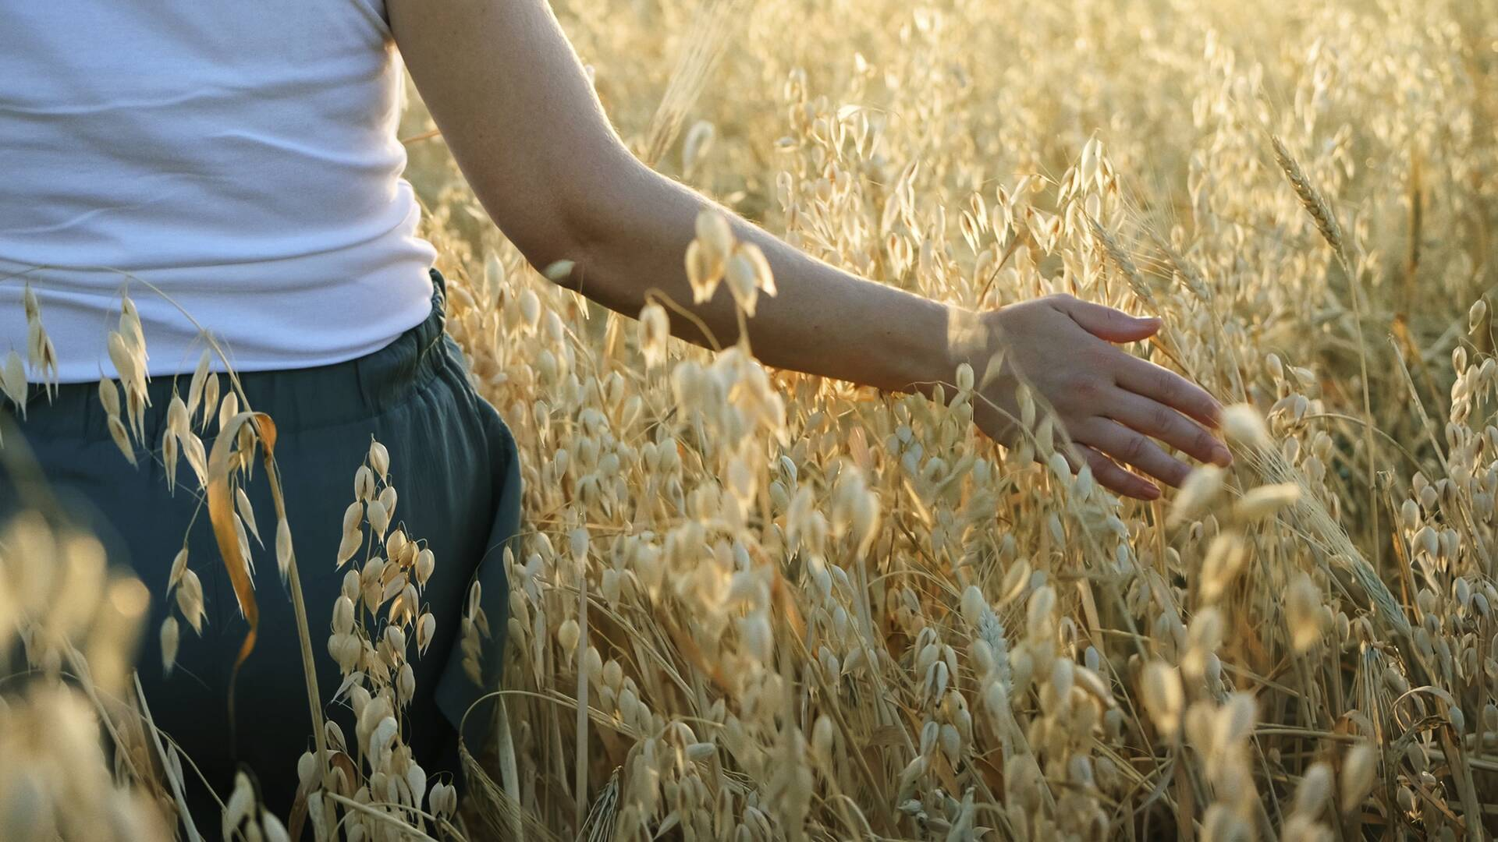
5/10
Oat of this world
taste experiences
Photo: Ministry of Agriculture and Forestry of Finland

Slide 11
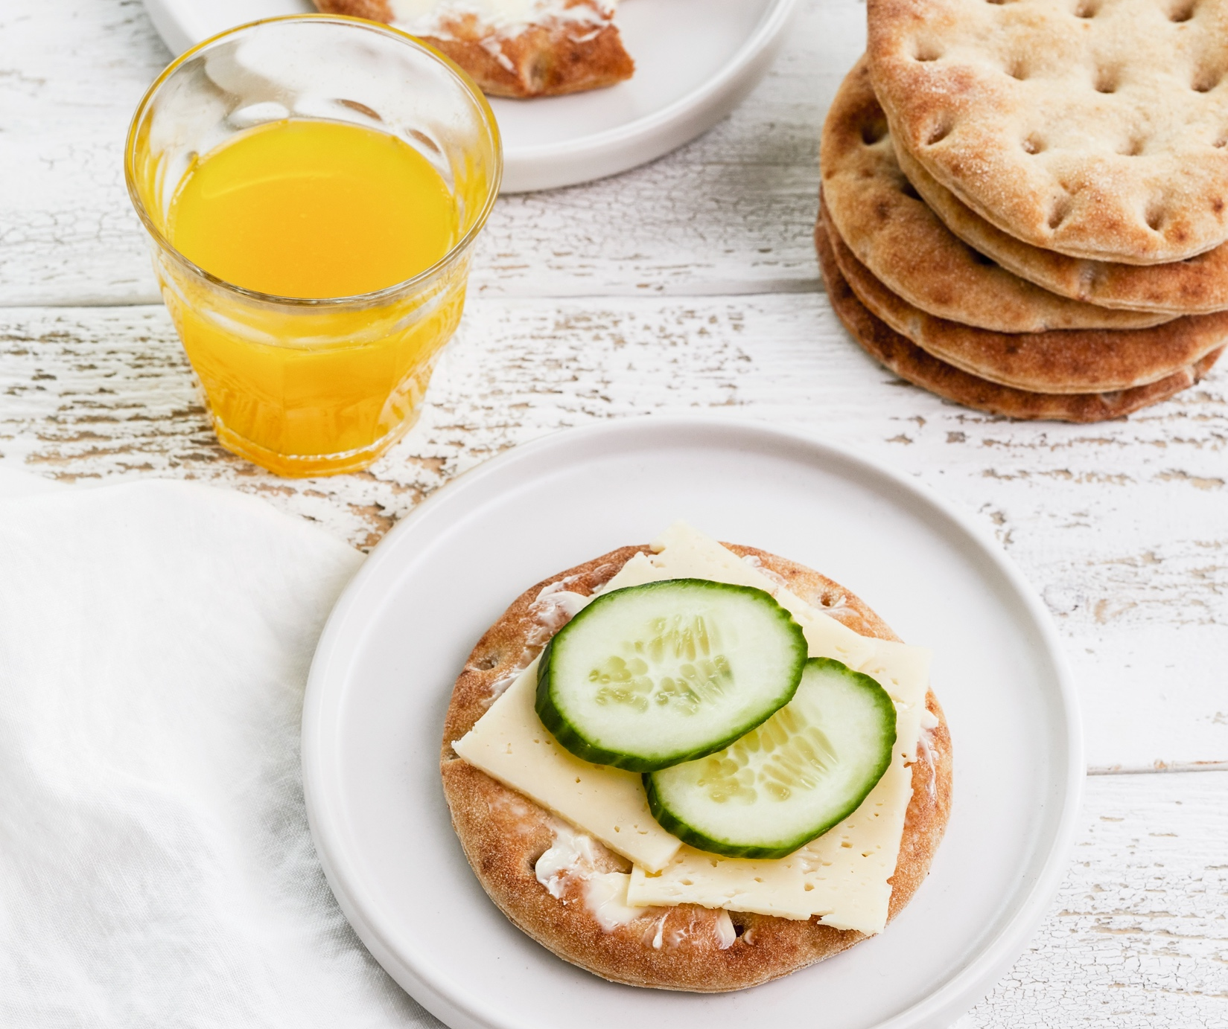
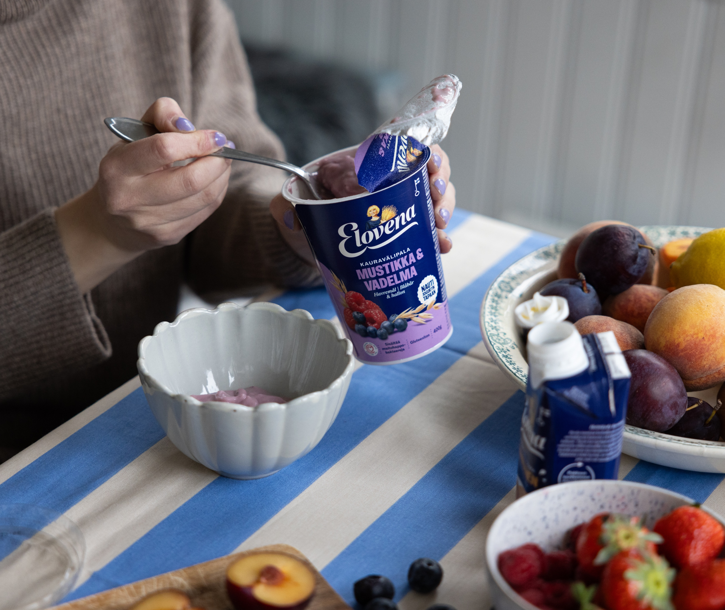
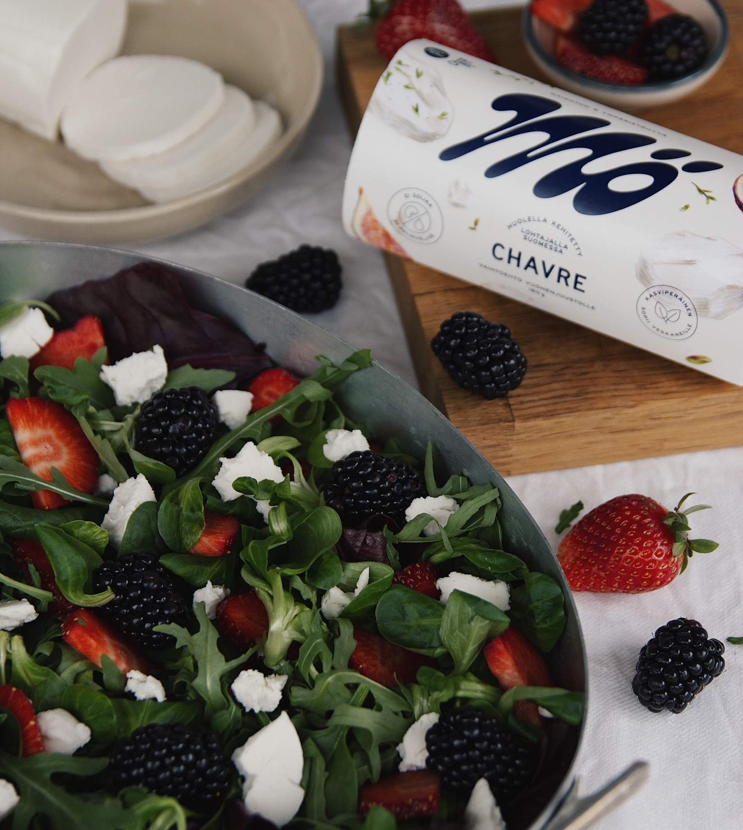
Oat of this world taste experiences
FINNISH FOOD CULTURE IN 10 SERVINGS
1
2
3
4
5
6
7
8
9
10
Finns eat the most oats in the world.
We are also the second largest exporter of oats, turning golden fields into money-making beverages, snacks, and dairy alternatives.
Photo: Raisio
Photo: Fazer
Photo: Mö
Notes:
All Finnish oat fields lie north of the 60th latitude, in the same Arctic zone as Alaska and Greenland. This extreme environment gives Finnish oats their unique quality — long summer days, the midnight sun and winters that naturally freeze the soil clean.
Summers are short but intense, meaning oats receive some of the longest daylight on Earth, which helps them develop large, flavourful grains.
And Finns certainly make good use of them. Finland leads the world in per‑capita oat consumption, with the average Finn eating around 10–12 kilos of oats a year, mostly as porridge, bread and an ever‑growing range of modern oat products.
Finnish oat expertise shows in the products. Finland is the 2nd largest exporting country of oats, supplying with clean, high‑quality grains.
Companies like Fazer, Raisio and Mö turn these oats into drinks, snacks, flours, dairy alternatives and even oat‑based innovations like xylitol made from oat processing side streams. Mö Foods has also expanded its oat-based portfolio internationally since 2025.

Slide 12
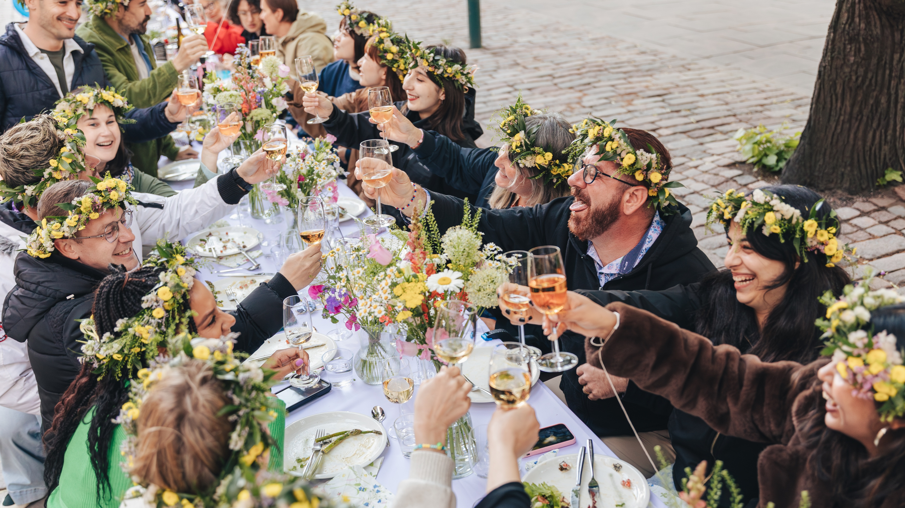
6/10
Pure ingredients and Michelin stars –
Finns are eating good!
Photo: Svante Gullichsen

Slide 13
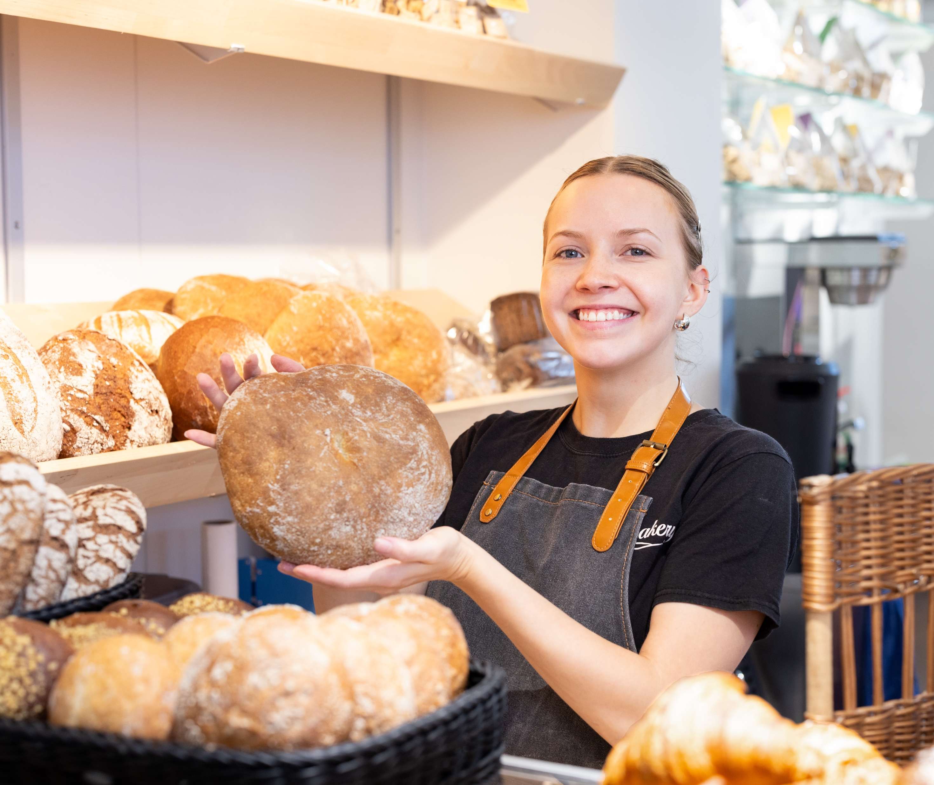
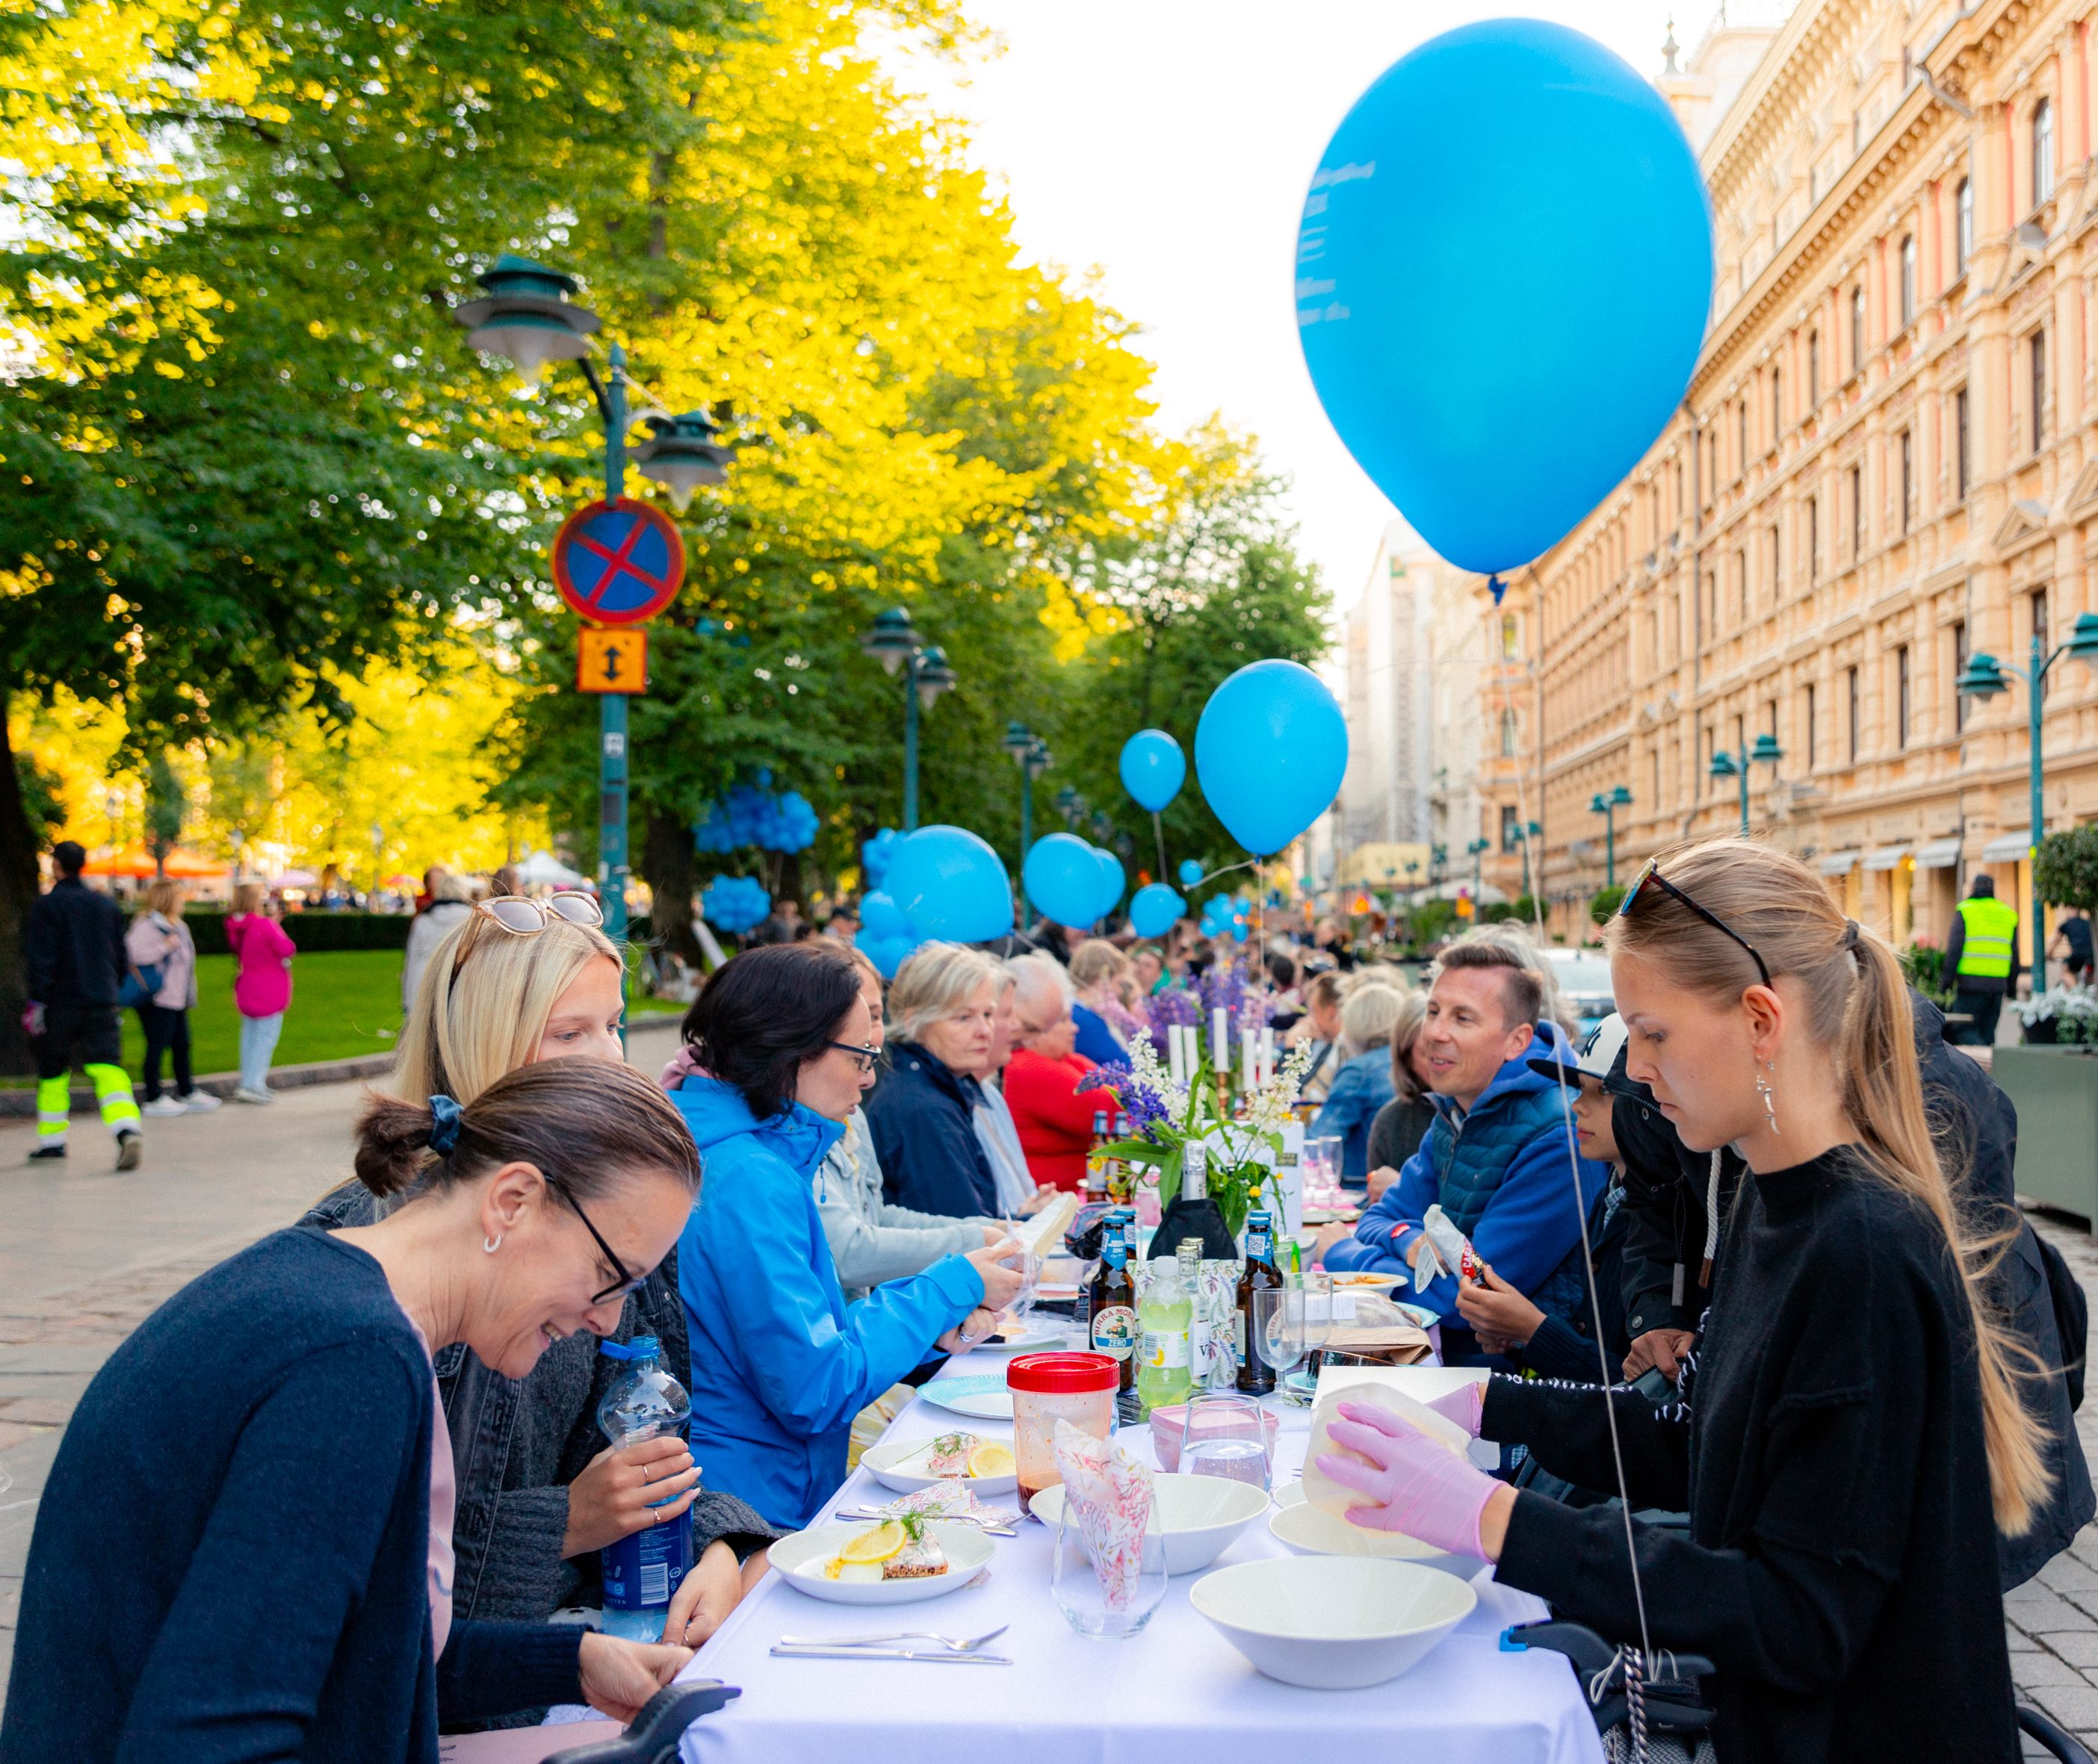
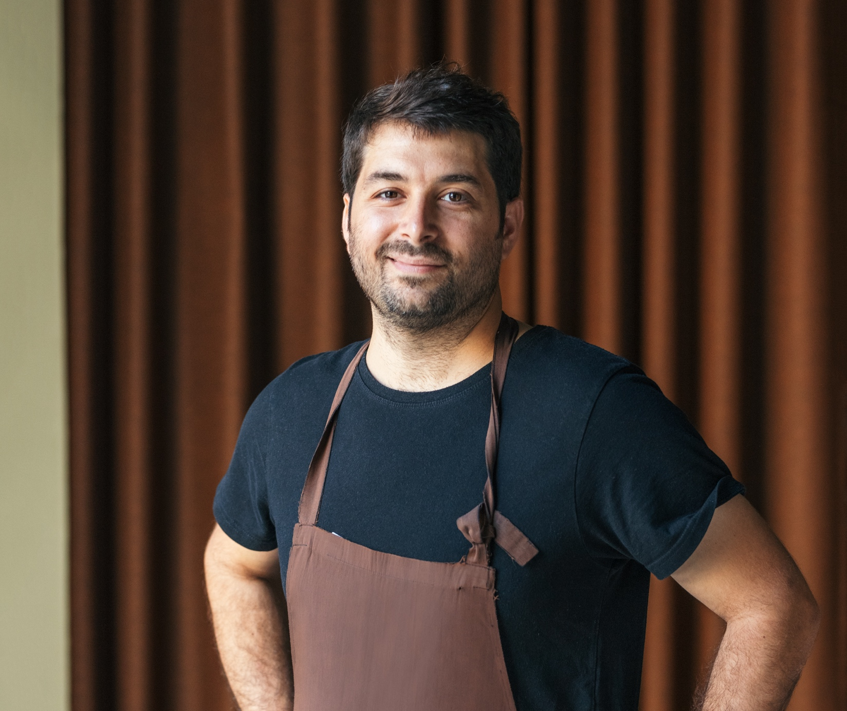
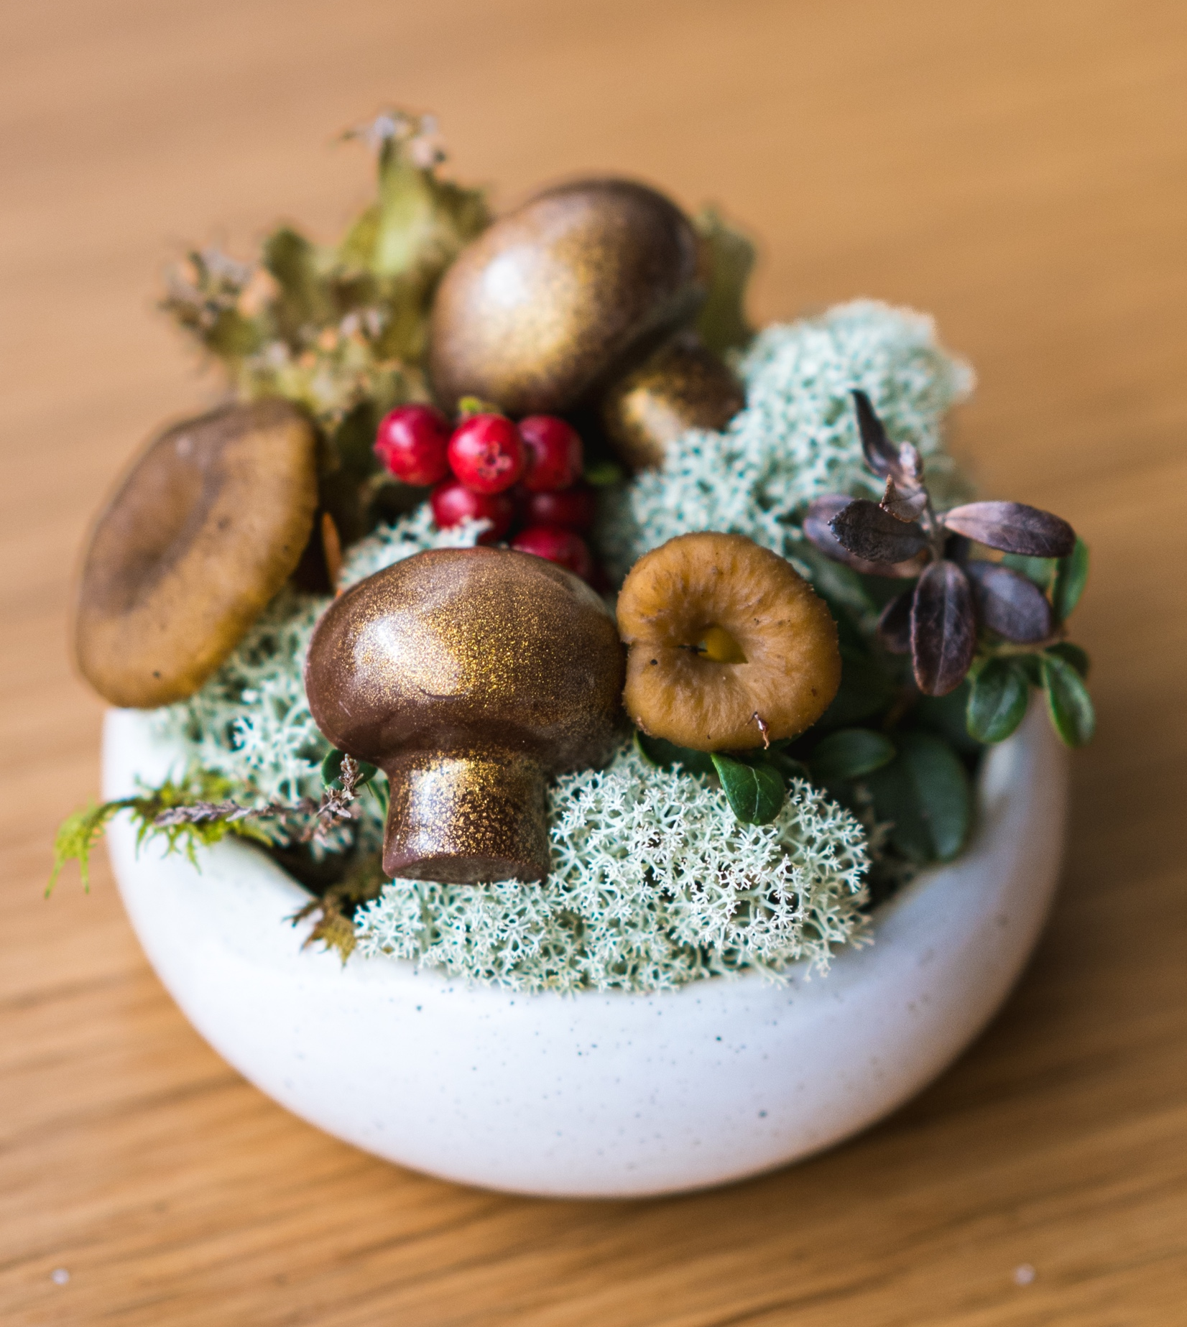
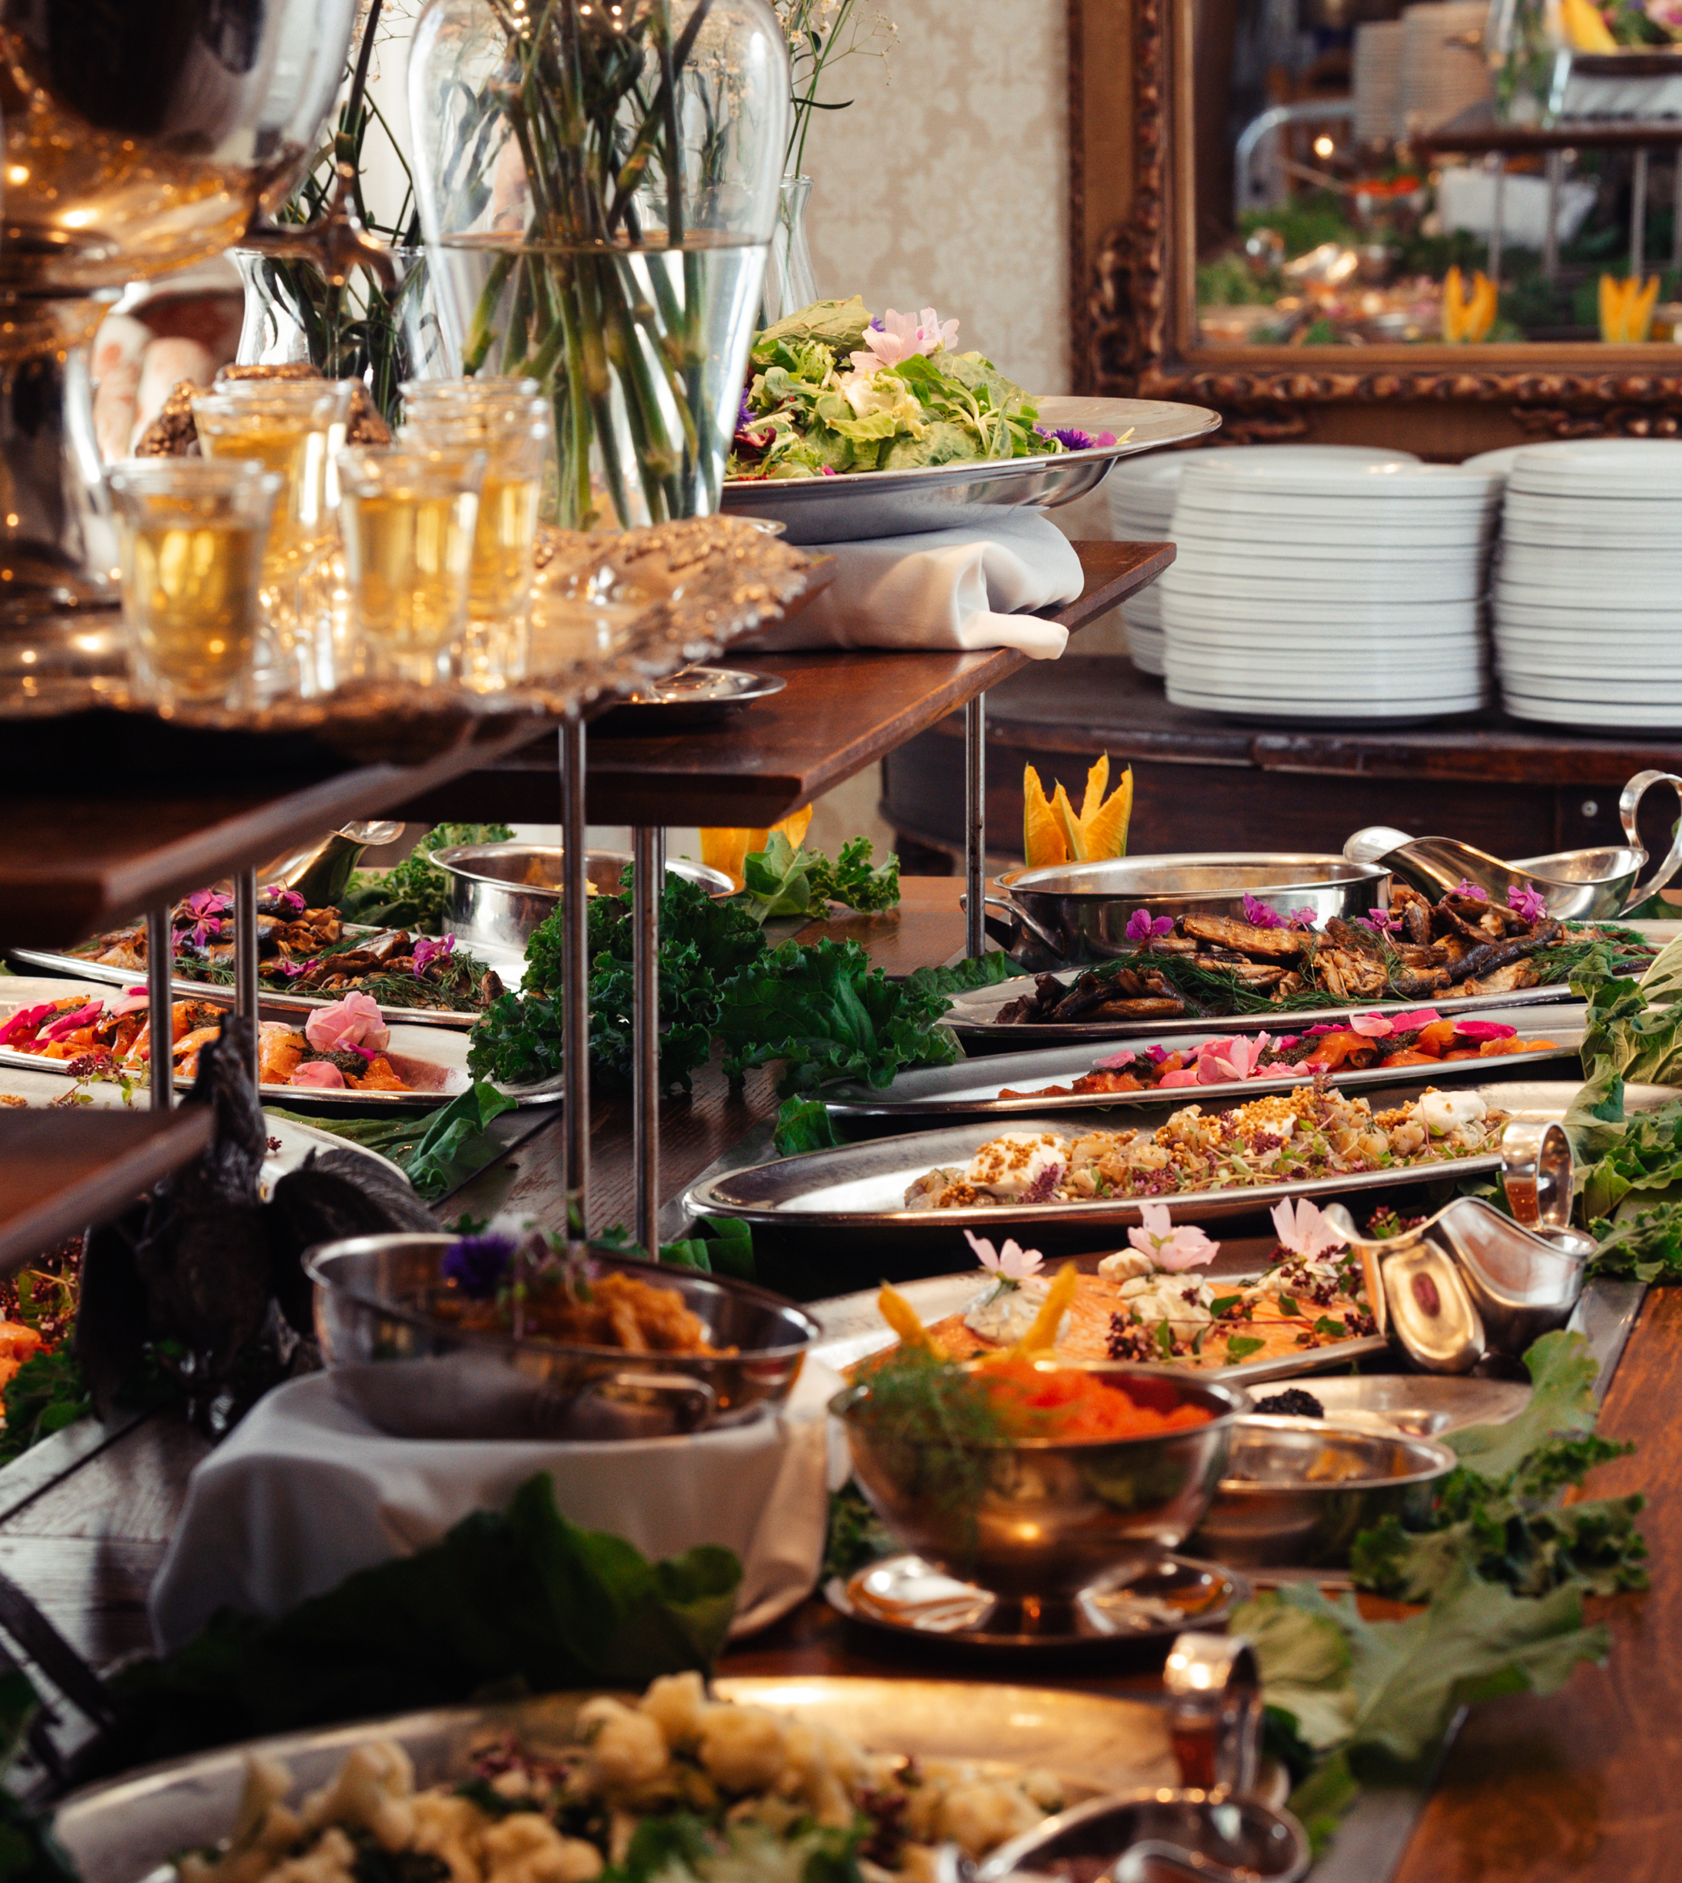
Pure ingredients and Michelin stars – Finns are eating good!
FINNISH FOOD CULTURE IN 10 SERVINGS
1
2
3
4
5
6
7
8
9
10
The very first zero-waste restaurant in the Nordics is located – you guessed it – in Finland.
In addition to sustainability, eating together is also very important to us, and our vibrant restaurant scene supports that.
Albert Franch Sunyer.
Photo: Antti Angeria
Photo: Ministry of Agriculture and Forestry of Finland
Nature-inspired dish at Michelin-star restaurant Grön.
Photo: Anders Husa
Dinner Under the Helsinki Sky.
Photo: Ninni West
Tertti Manor grand buffet.
Photo: Visit Saimaa
Notes:
Let’s take a look at the bustling culinary scene in Finland. Finnish cuisine begins with pure ingredients and a deep respect for nature. Our food system benefits from clean water, a northern climate and strict safety standards, and this purity shapes everything from everyday meals to fine dining.
Eating together is an important part of Finnish life, and it also happens outdoors. One lovely example is Dinner Under the Helsinki Sky, where thousands of people gather each year on Helsinki Day to enjoy a shared meal in parks and public spaces.
From this everyday culture grows a vibrant restaurant scene. Finland is full of new foodie hotspots, cosy neighbourhood bistros, and historic restaurants—but also some of the most exciting fine-dining experiences in the Nordics.
The Michelin guide also recognises this mastery. Our Michelin-starred restaurants elevate local ingredients with pure flavours, minimalistic aesthetics, and exceptional creativity.
Examples include restaurants that pioneer modern Nordic cuisine, creating menus that follow the cycle of northern seasons, as well as those known for focused, plant-based dishes built entirely around what grows right now.
And then there are chefs who lead the way in sustainability. At Helsinki’s zero‑waste restaurant Nolla, chef Albert Franch Sunyer and his team show how local produce and environmental responsibility can go hand in hand—making Nolla the first zero‑waste restaurant in the Nordics.
Together, these places and people tell the story of a food culture that is clean, creative and deeply connected to nature. creative and deeply connected to nature. creative and deeply connected to nature.

Slide 14
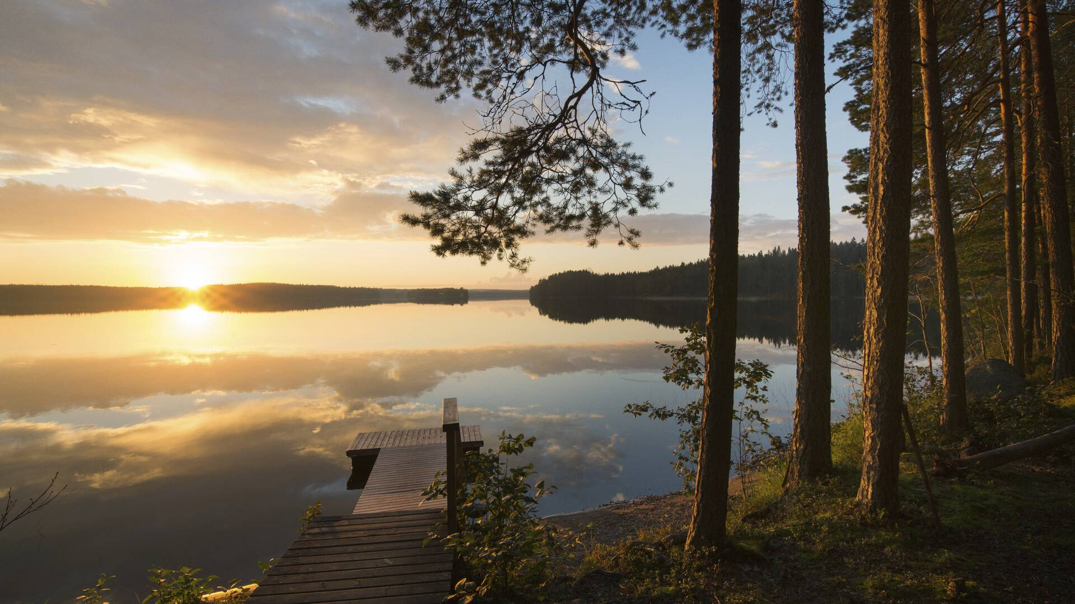
7/10
Four seasons, each
with its own flavour
Photo: Ministry of Agriculture and Forestry of Finland

Slide 15
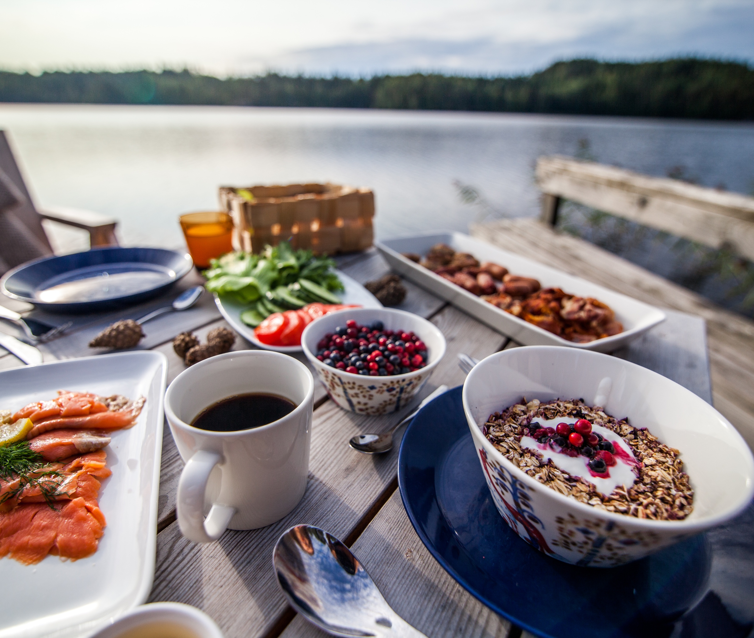
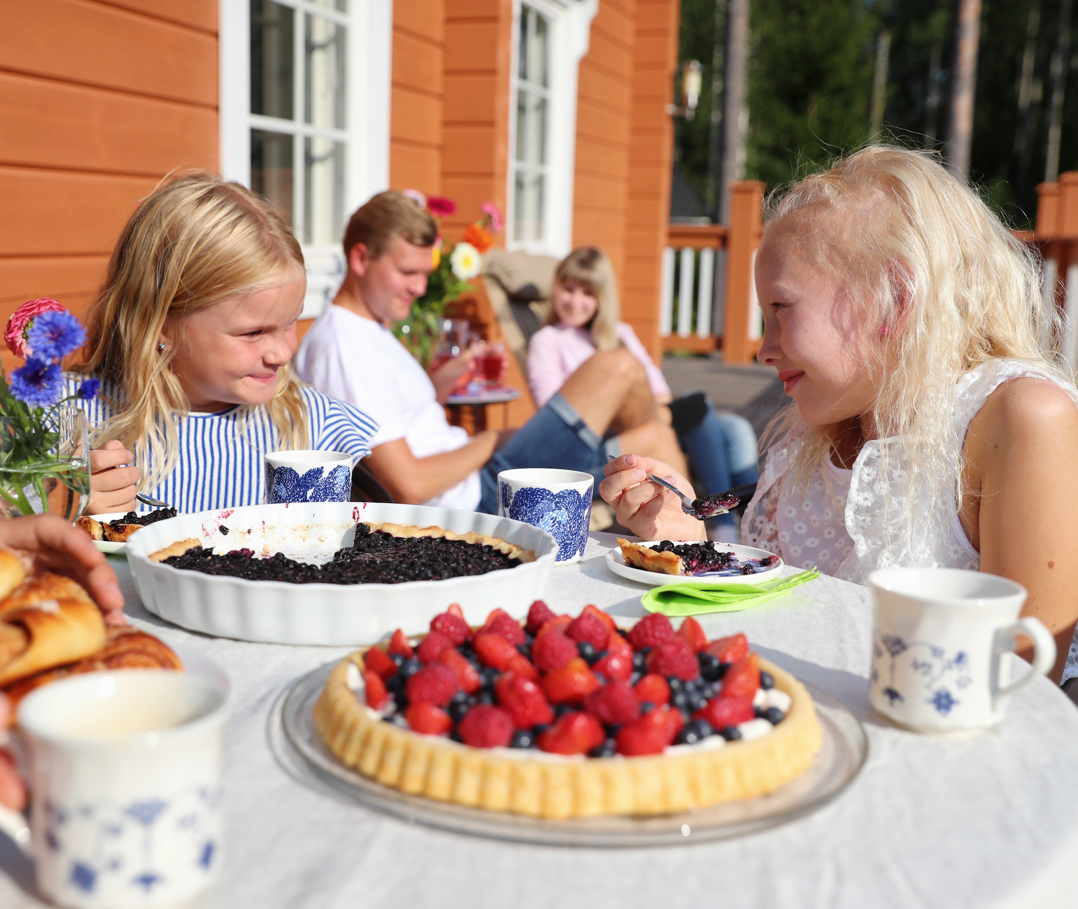
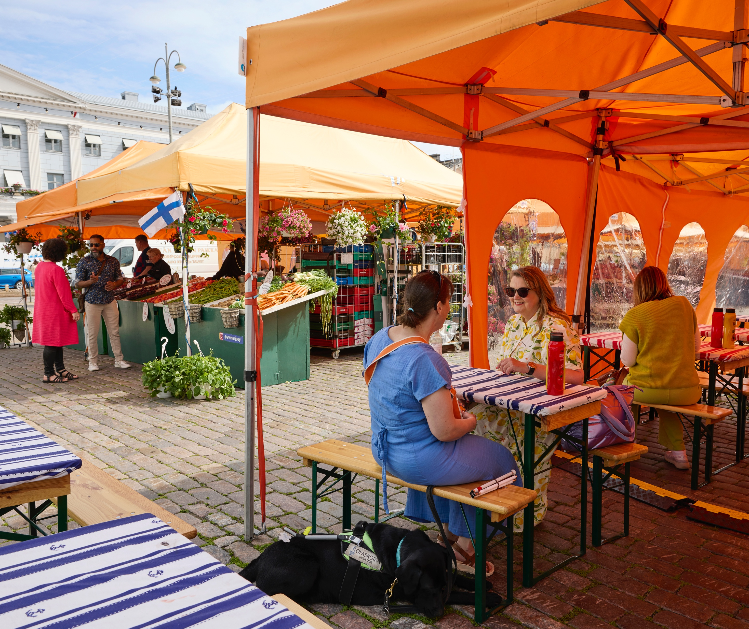
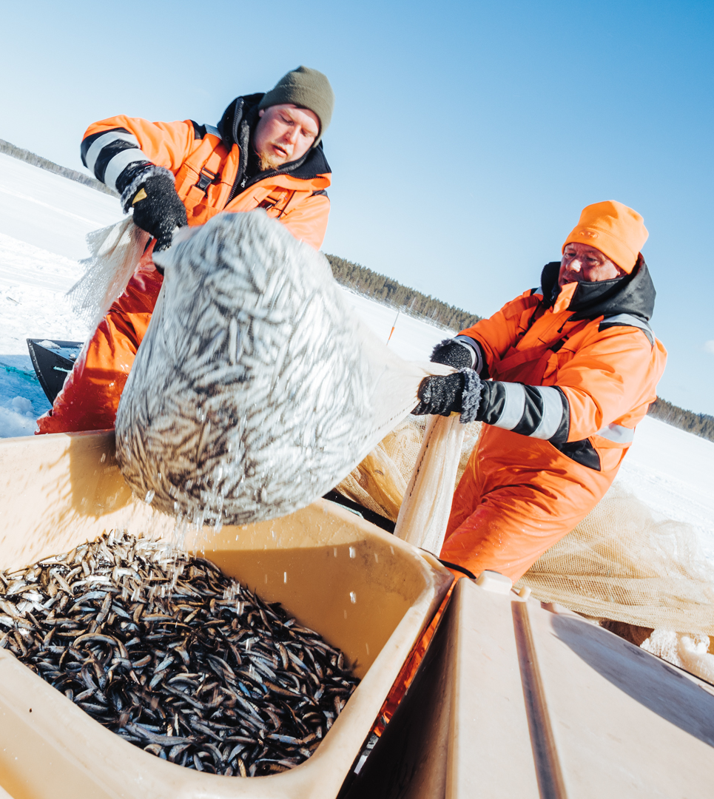
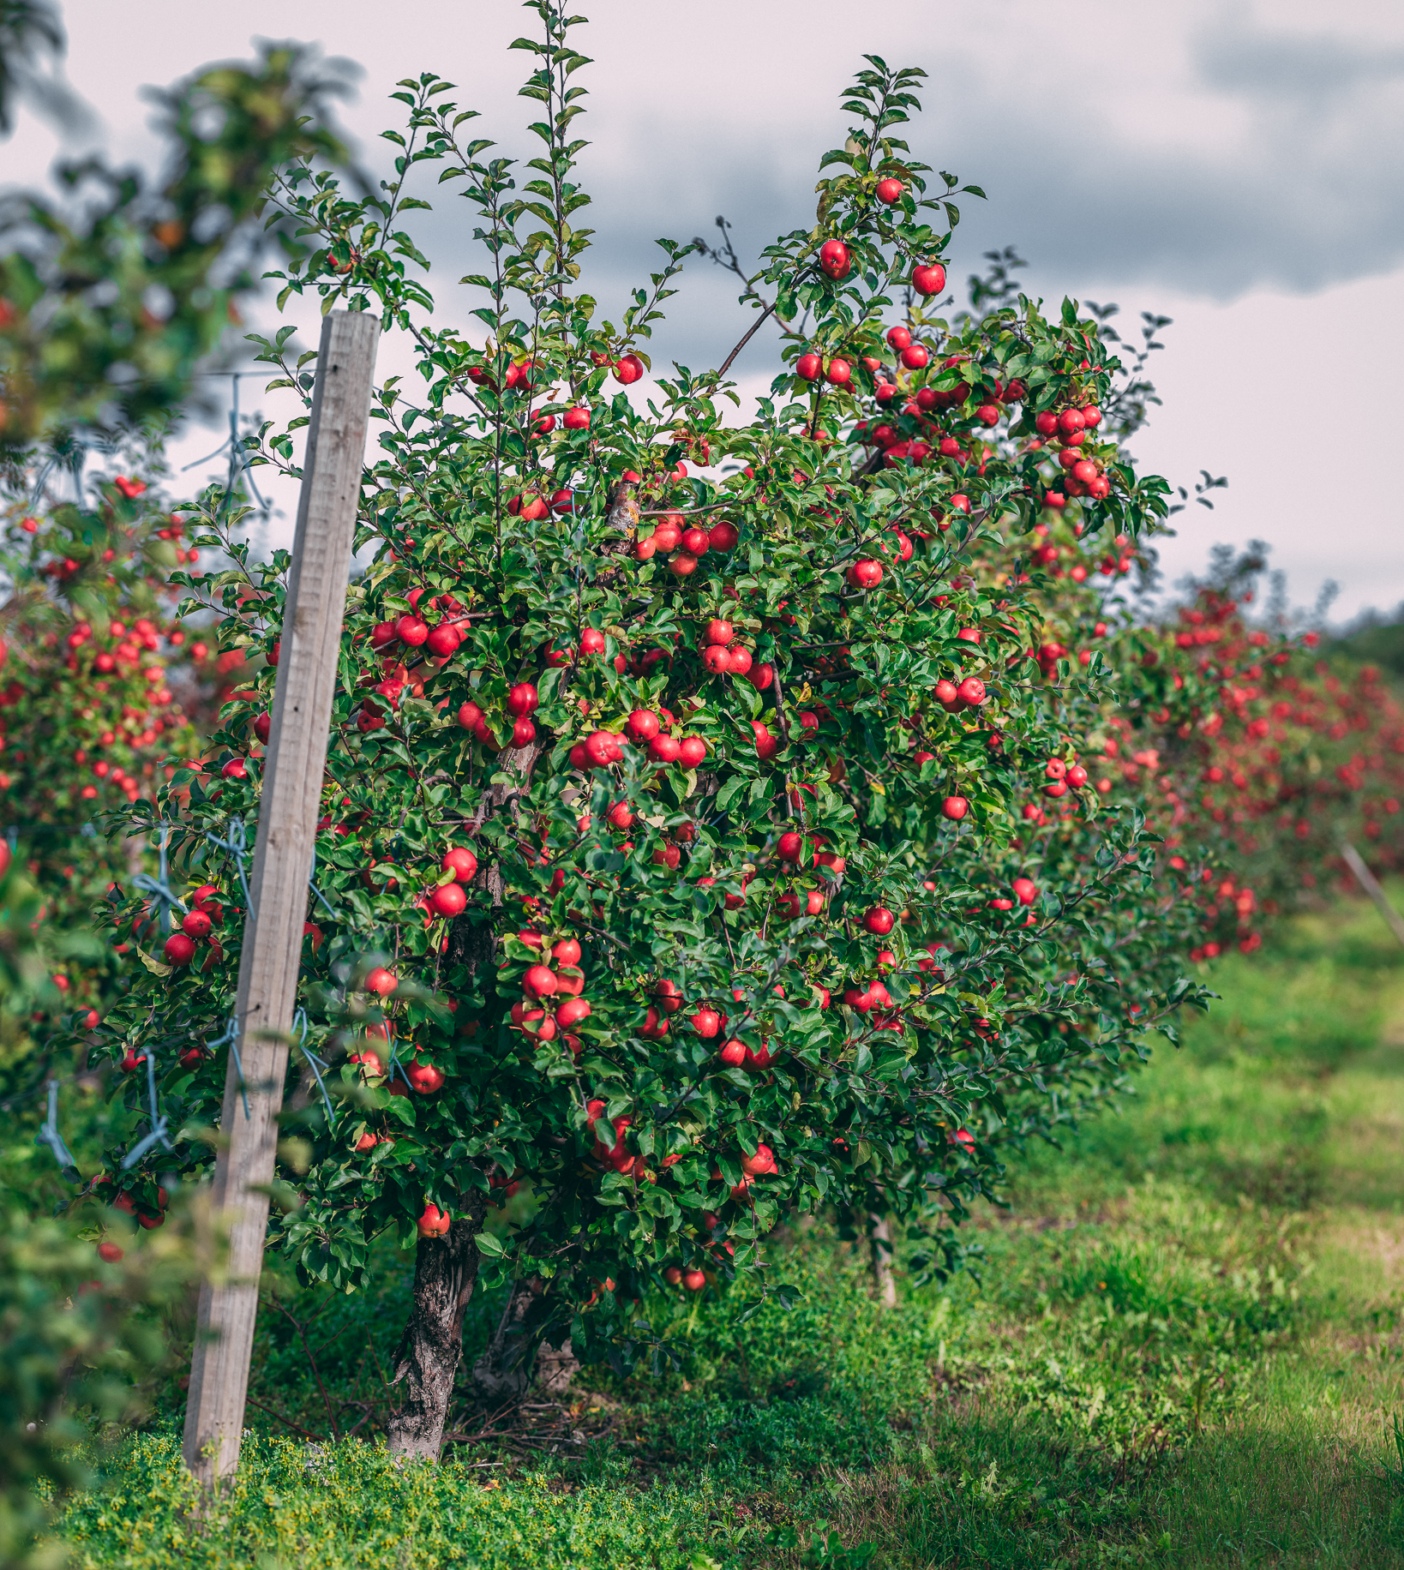
Four seasons, each with its own flavour
FINNISH FOOD CULTURE IN 10 SERVINGS
1
2
3
4
5
6
7
8
9
10
Nightless nights and winter frosts – Finnish delicacies grow extremely tasty in extreme conditions.
Photo: Harri Tarvainen
Breakfast at lake Saimaa.
Photo: Visit Saimaa
Photo: Visit Saimaa
Photo: Marjaana Malkamäki / Helsinki Partners
Photo: Visitaland@com
Notes:
Finland’s four distinct seasons shape our entire food production system. The short but intense summer brings extremely long days — up to 20 hours of light, and in Lapland the sun doesn’t set at all. This abundance of daylight accelerates plant growth and creates the clean, aromatic and flavour-rich ingredients Finland is known for.
Long, cold winters play an equally important role. Temperatures well below zero naturally reduce plant diseases and pests, which is why Finland uses among the lowest amounts of pesticides in Europe. Winter essentially resets the landscape every year, supporting clean and safe food production.
Finland’s pure nature — clean air, water and soils — combines with these seasonal contrasts to create ideal conditions for producing high‑quality food. Summer, from late May to early September, fills markets with new potatoes, berries, peas and herbs. The rhythm of the year is reflected in our food: bright summers concentrate flavour, while long winters bring hearty, comforting dishes.

Slide 16
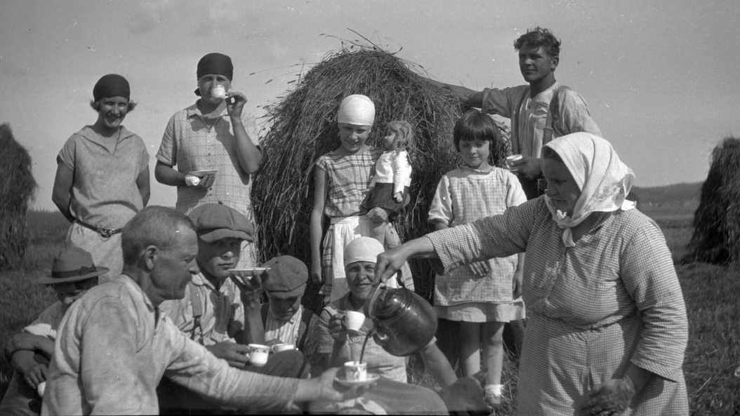
8/10
Time for a coffee break
Photo: Metso Minne 1926–1927 / Nurmijärven museo

Slide 17
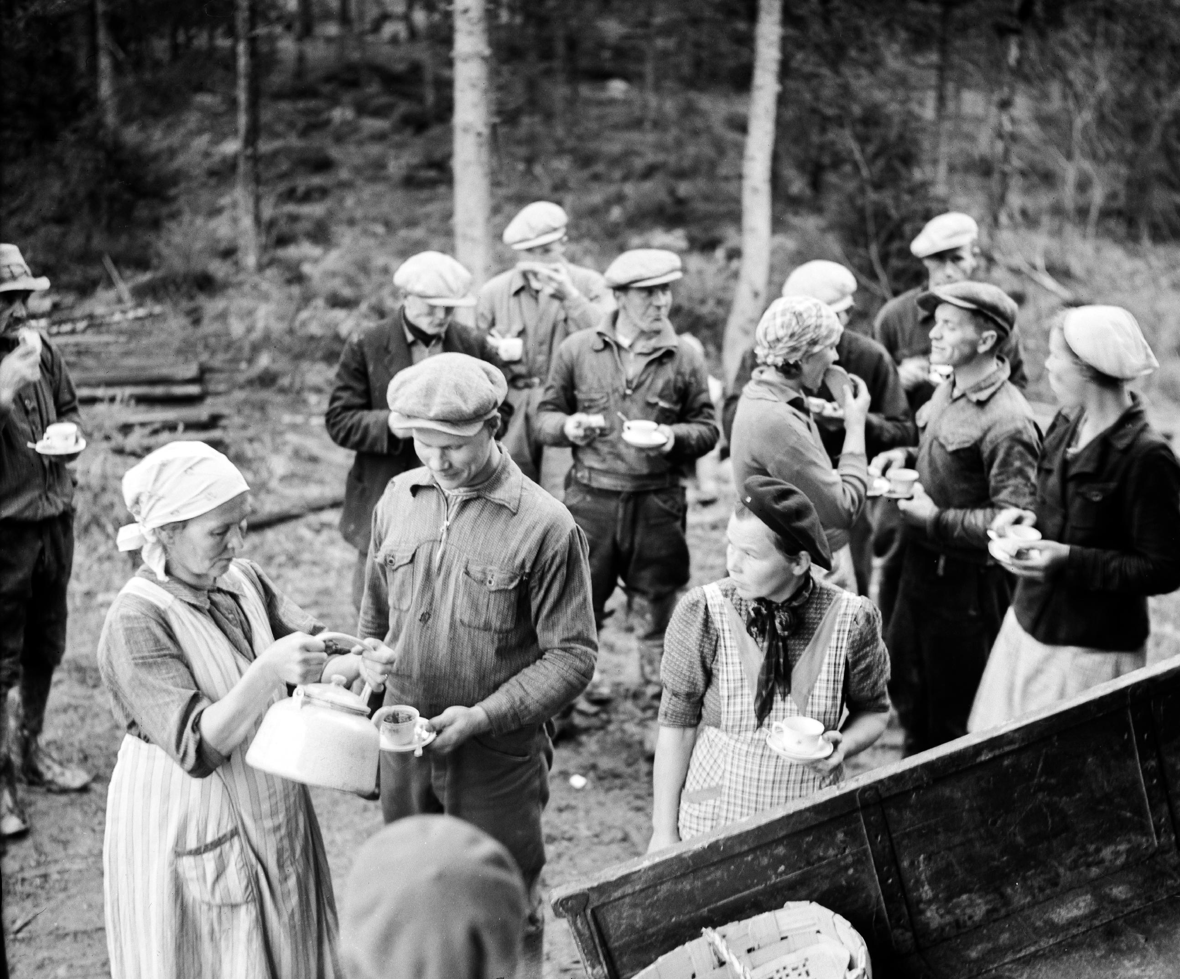
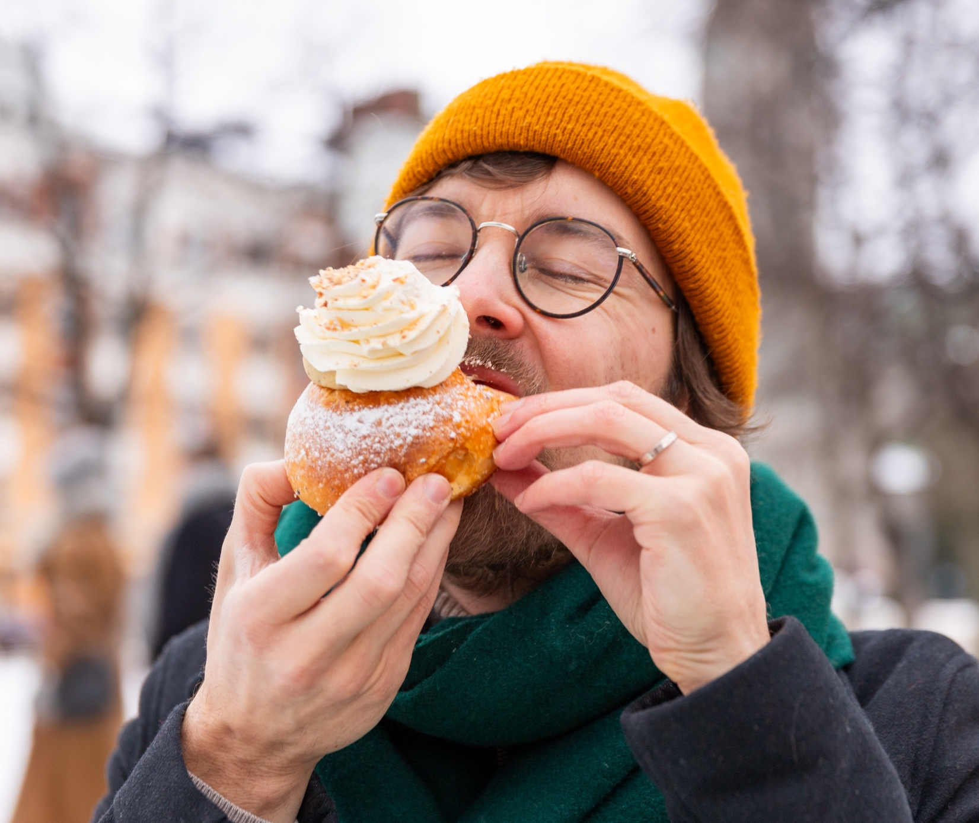
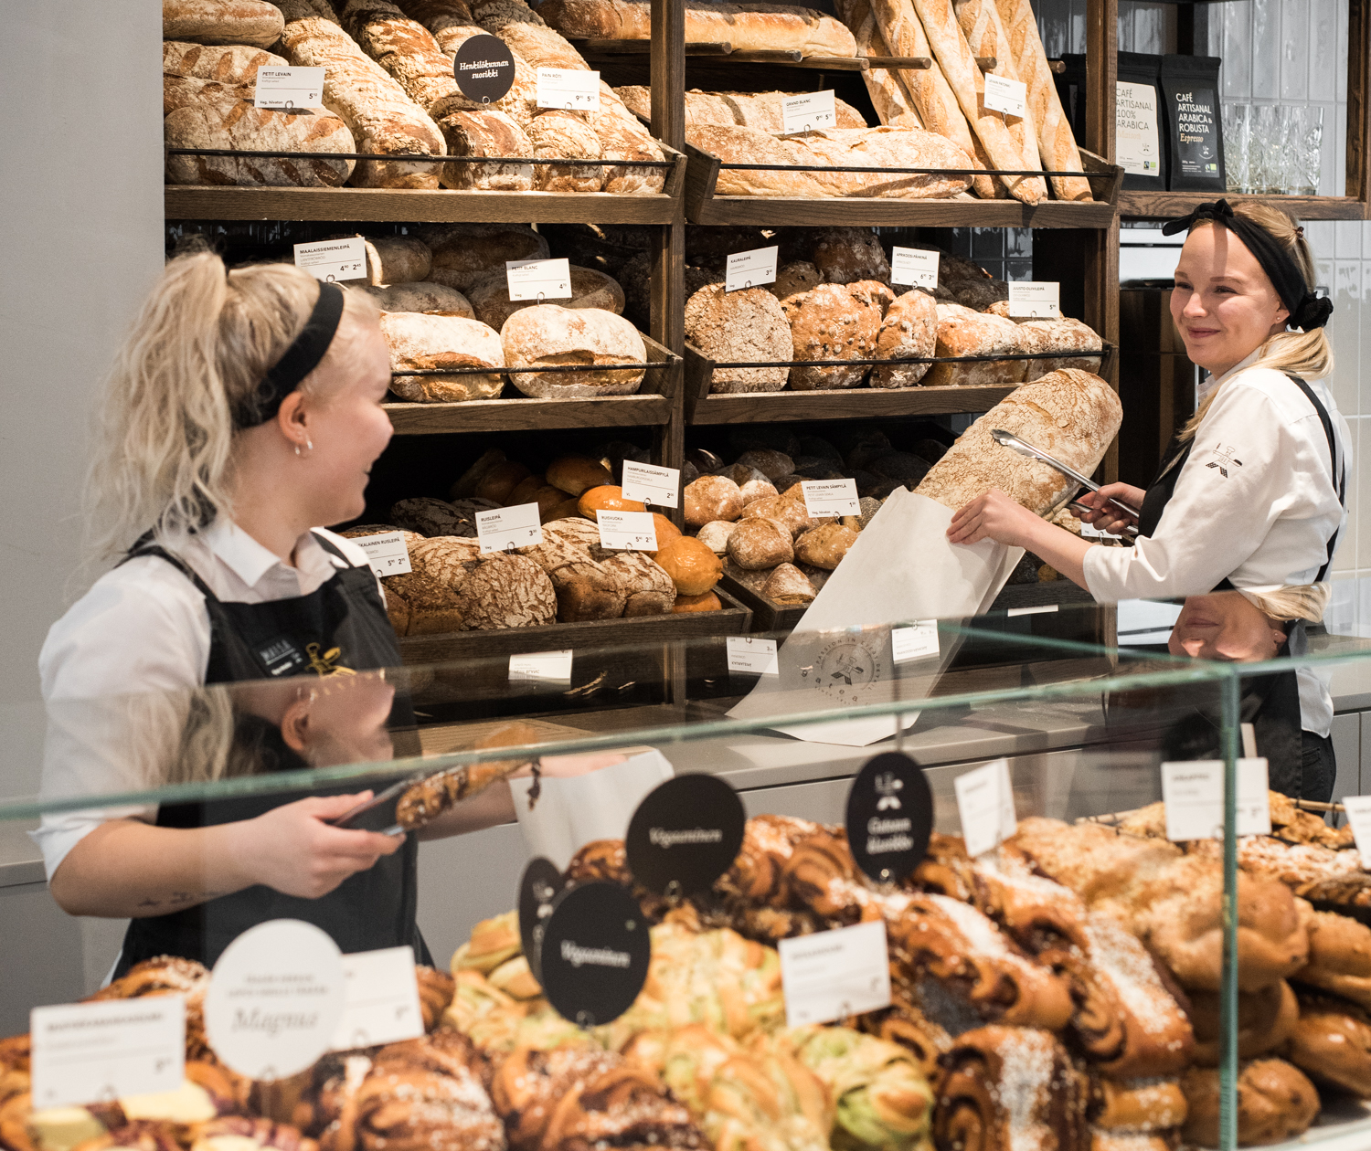
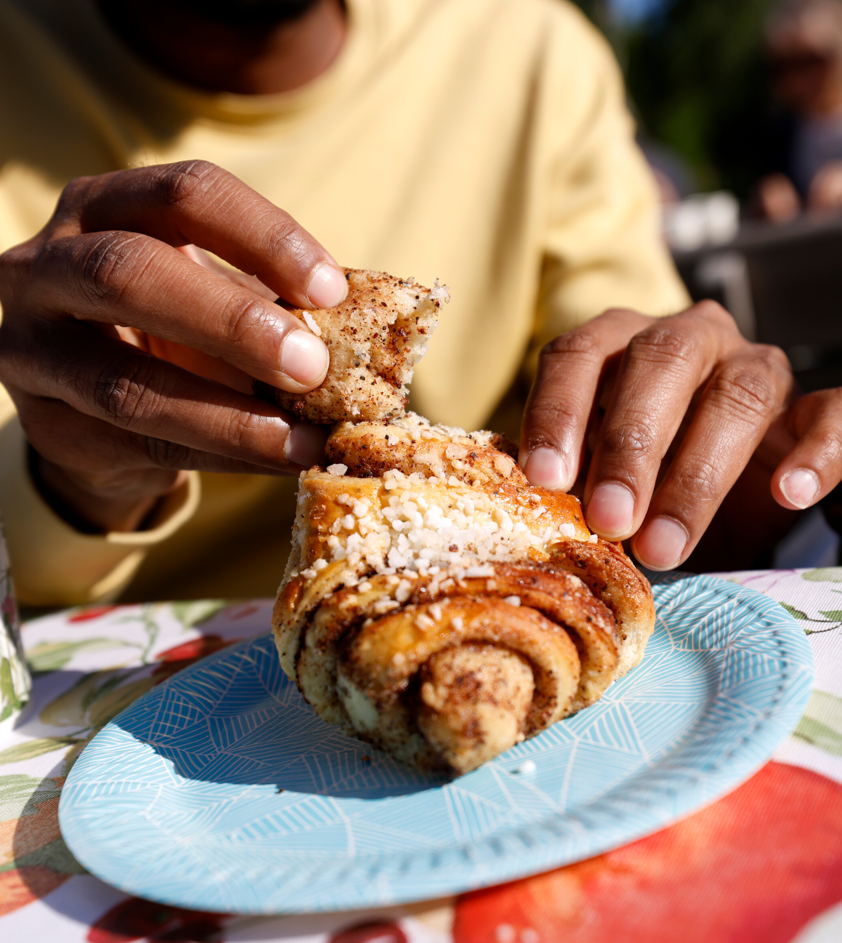
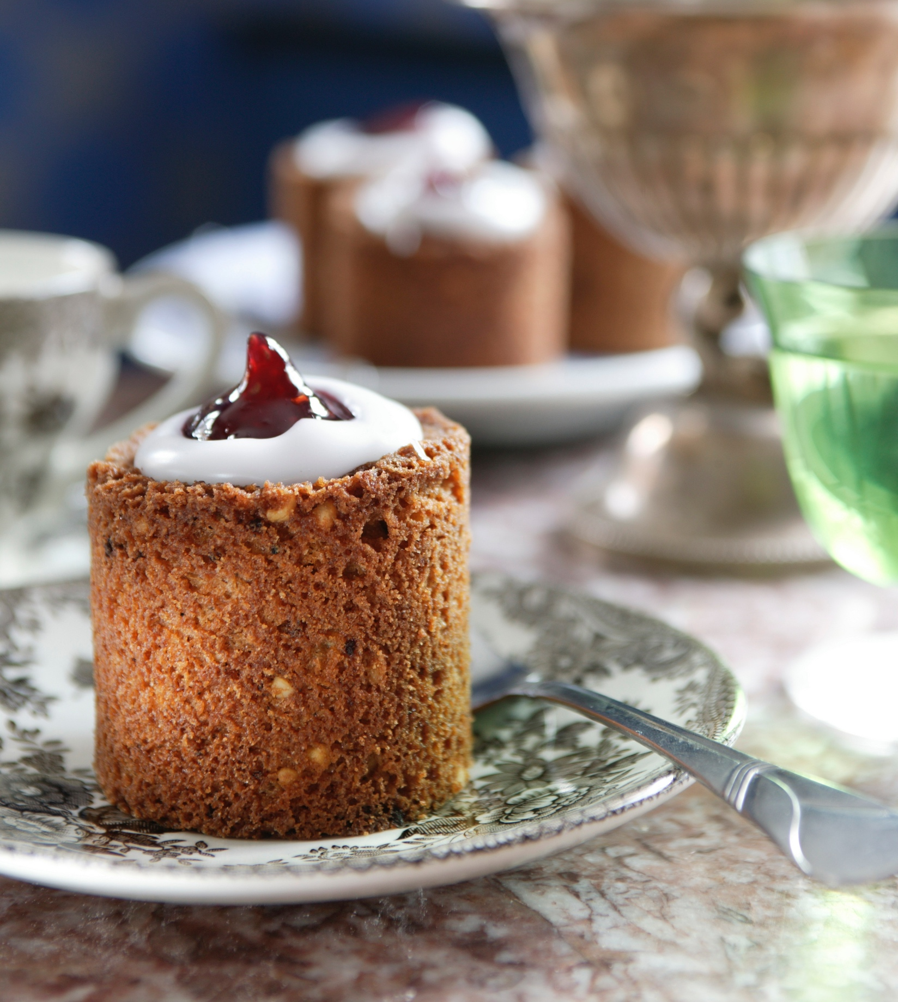
Time for a coffee break
FINNISH FOOD CULTURE IN 10 SERVINGS
1
2
3
4
5
6
7
8
9
10
Finns drink more coffee than anyone else in the world.
And, of course, it is always accompanied by a seasonal pastry.
Laskiaispulla.
Photo: Ninni West / Finland Image Bank
Photo: Fazer
Photo: Finnish Heritage Agency
Korvapuusti.
Photo: Photo: Liisa Takala / City of Helsinki
Runeberg torte.
Photo: Visit Porvoo
Notes:
Finland is a true coffee nation. Finns drink more coffee per capita than anyone else in the world — about 12 kilograms per person each year — and on average four cups a day.
Finns take their coffee seriously — it’s a daily ritual, a social glue, and a defining part of our culture. Coffee is so essential that Finnish law guarantees workers the right to coffee breaks.
Café culture follows the rhythm of the year. Each season has its own traditional pastry to enjoy with coffee. On the 5th of February, cafés fill with Runeberg’s tortes — small arrack- or rum‑flavoured cakes enjoyed nationwide in honour of our national poet. In February, the air also smells of “laskiaispulla”, soft cardamom buns filled with whipped cream and jam or almond paste.
Finland even has a Cinnamon Roll Day on the 4th of October, celebrating our love for “korvapuusti”. Every Finnish holiday has its own pastry, and each one pairs perfectly with a cup of coffee.

Slide 18
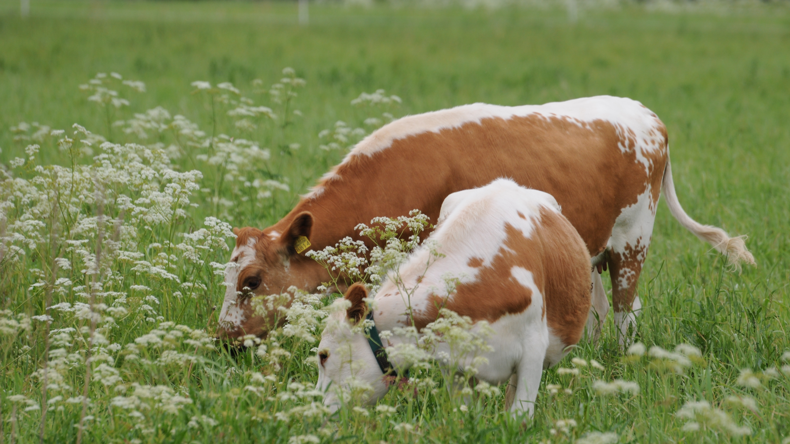
9/10
In the mood for something safe?
Try Finnish food.
Photo: Ministry of Agriculture and Forestry of Finland
Notes:
This may come as no surprise: We might come off as weird at times.

Slide 19
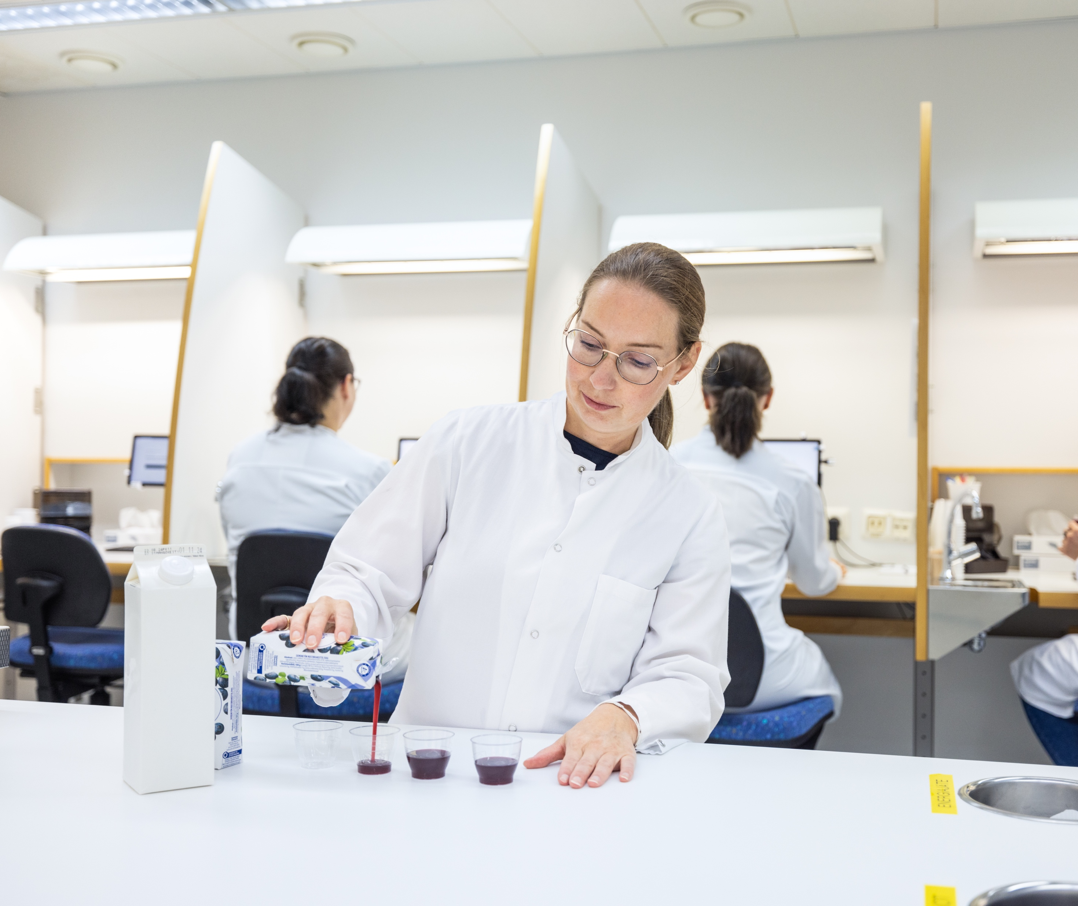
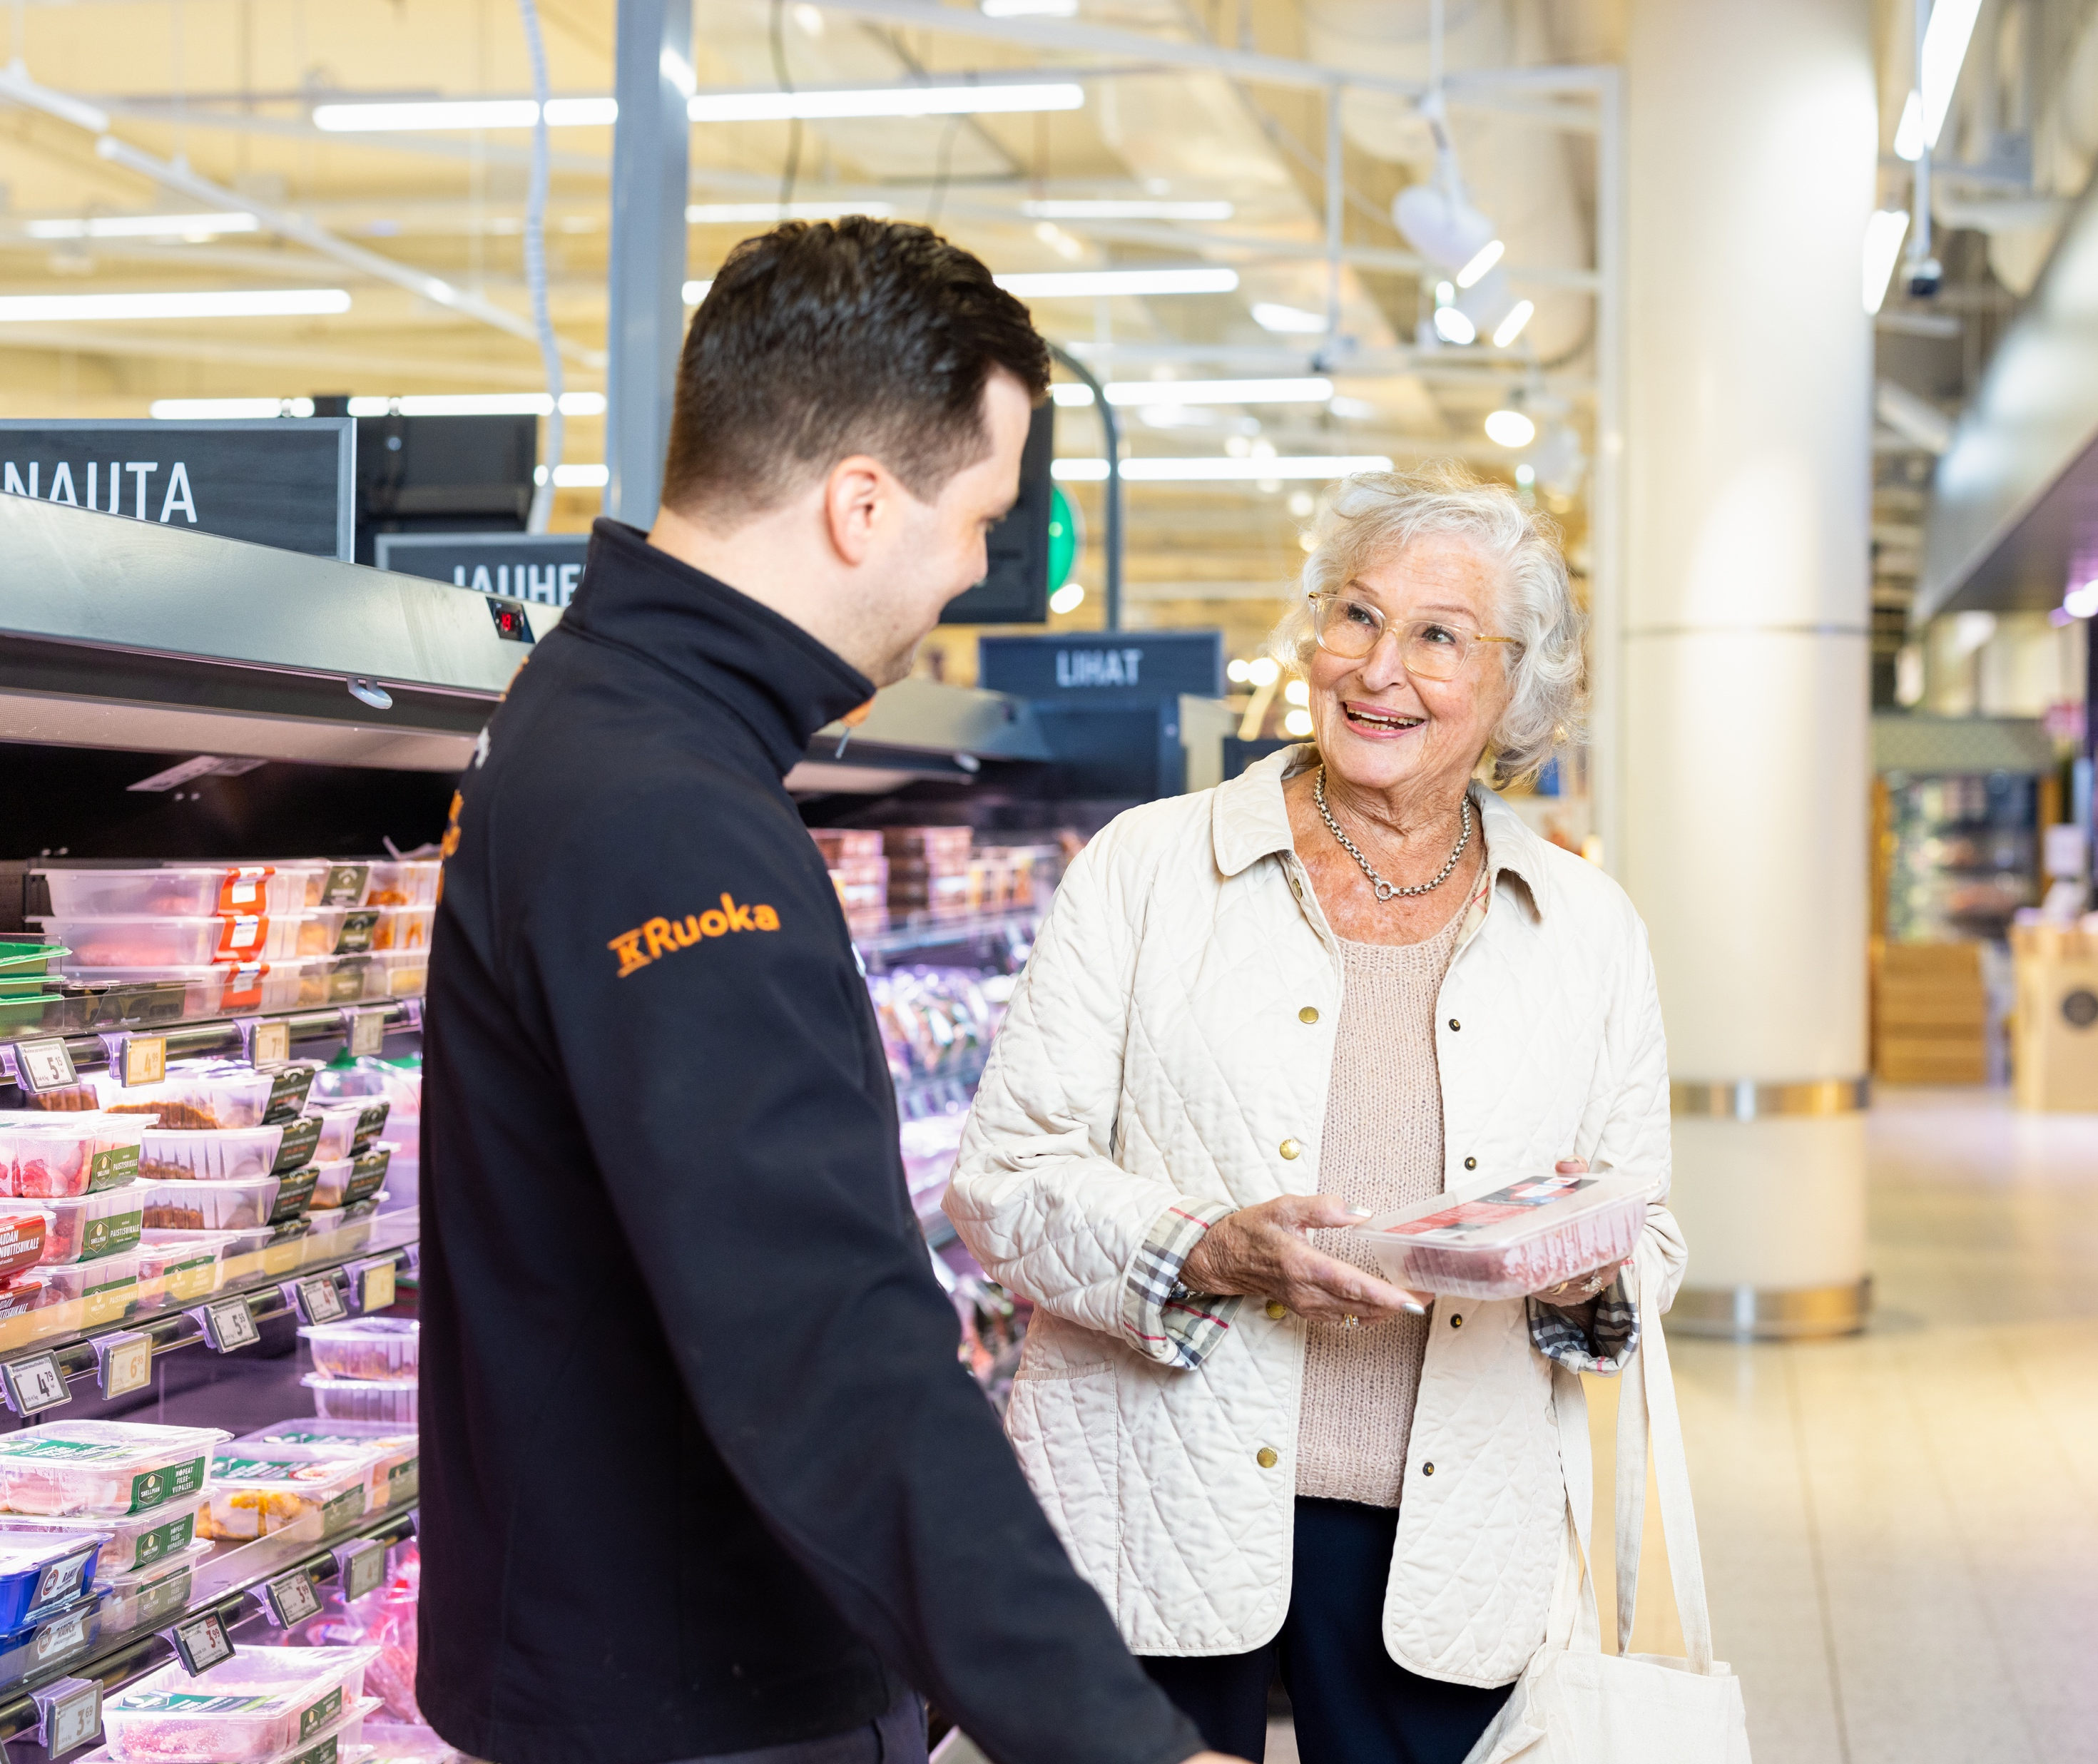
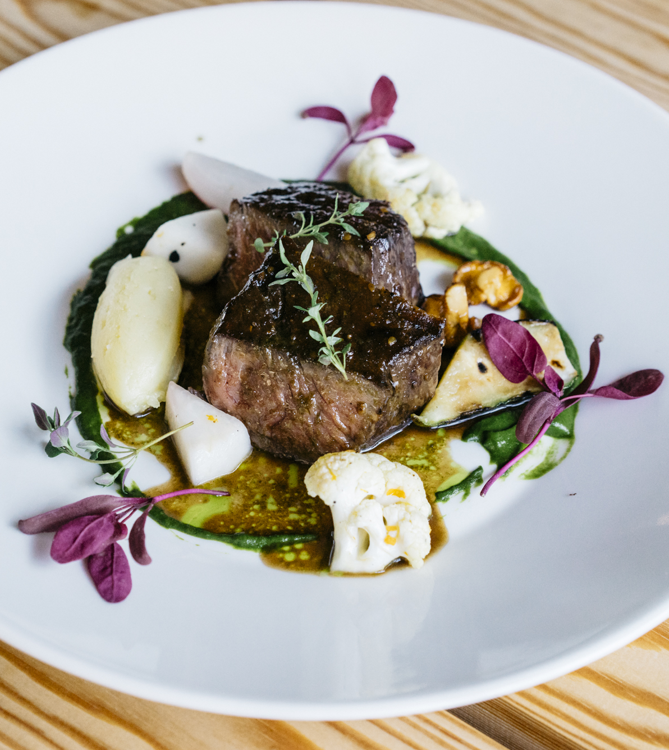
In the mood for something safe? Try Finnish food.
FINNISH FOOD CULTURE IN 10 SERVINGS
1
2
3
4
5
6
7
8
9
10
We are ranked #1 in the Global Food Security Index.
It is thanks to decades of commitment to safety, transparency, and sustainability – for example, we have one of the world’s lowest usage of antibiotics in food production, and salmonella in food is virtually non-existent.
Photo: Ministry of Agriculture and Forestry of Finland
Photo: Ministry of Agriculture and Forestry of Finland
Photo: Visit Finland
Notes:
Finland consistently ranks among the world’s safest and most reliable food nations. Our position at the top of the Global Food Security Index reflects decades of commitment to safety, transparency and sustainability. The entire food chain is monitored from farm to table, ensuring deep consumer trust.
Animal welfare, environmental responsibility and traceability are at the core of our production. We never compromise on food safety — instead, we aim for the most transparent, safe and responsible food chain in the world. Our long-term focus is on developing ever more sustainable and innovative food products.
Finland has one of the world’s lowest uses of antibiotics in food production. Good care and healthy production conditions mean antibiotics are not used preventively, and none have been used in poultry since 2009. Our salmonella control programme is internationally exceptional: salmonella in food is virtually non‑existent.

Slide 20
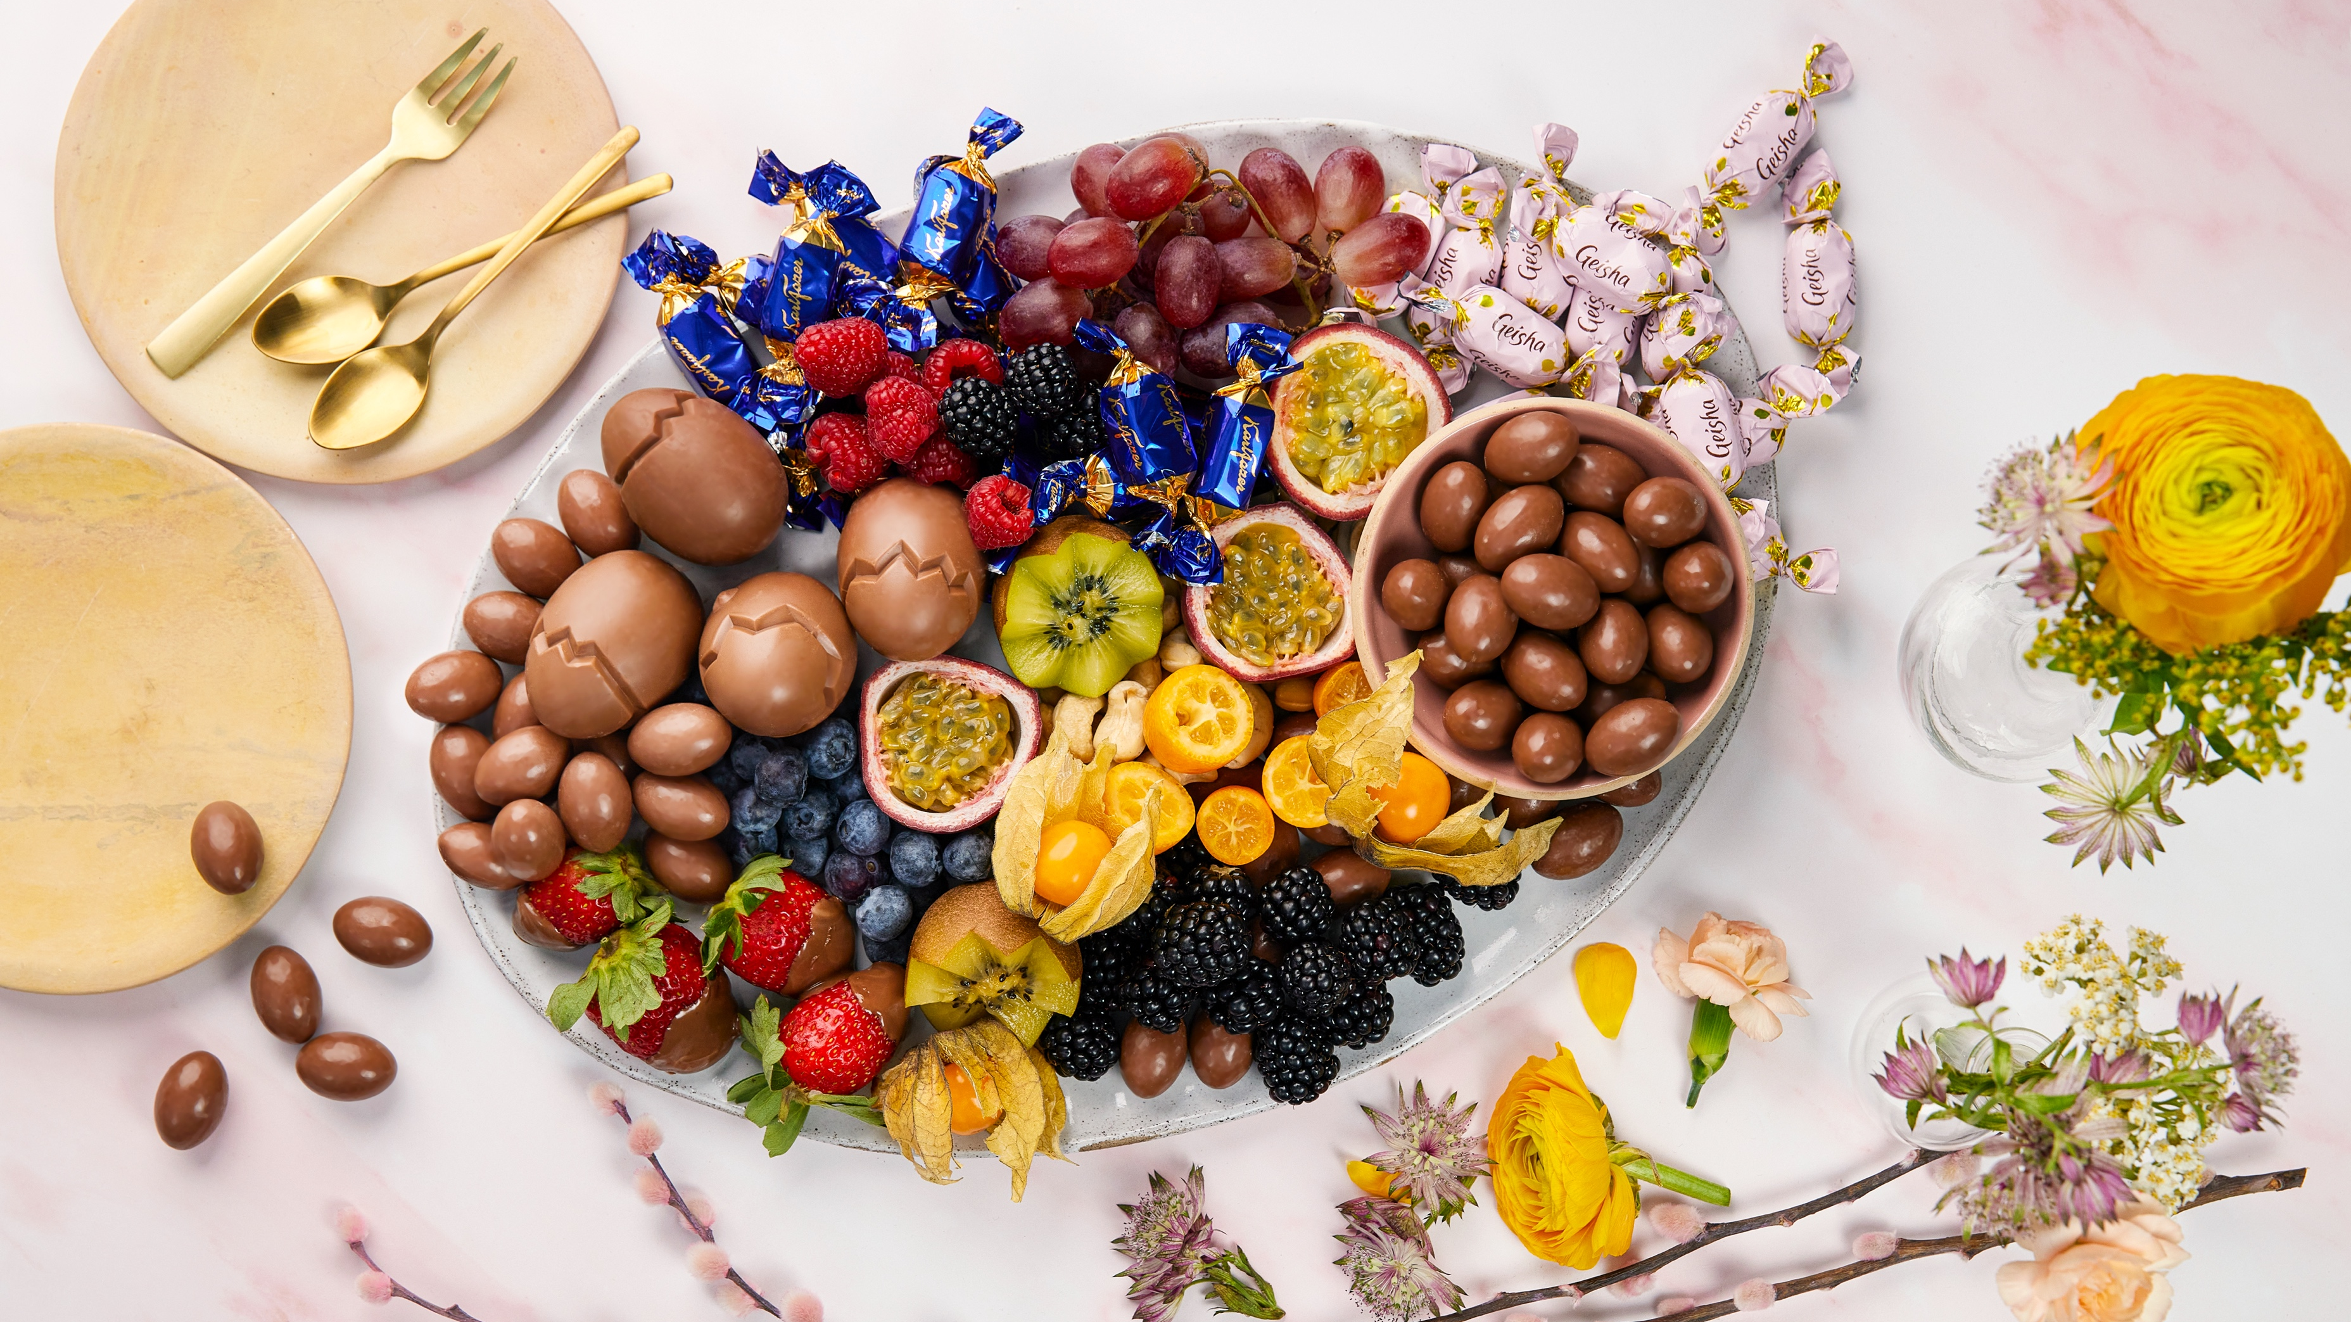
10/10
The icing on the cake:
Our love for local candy flavours
Photo: Fazer

Slide 21
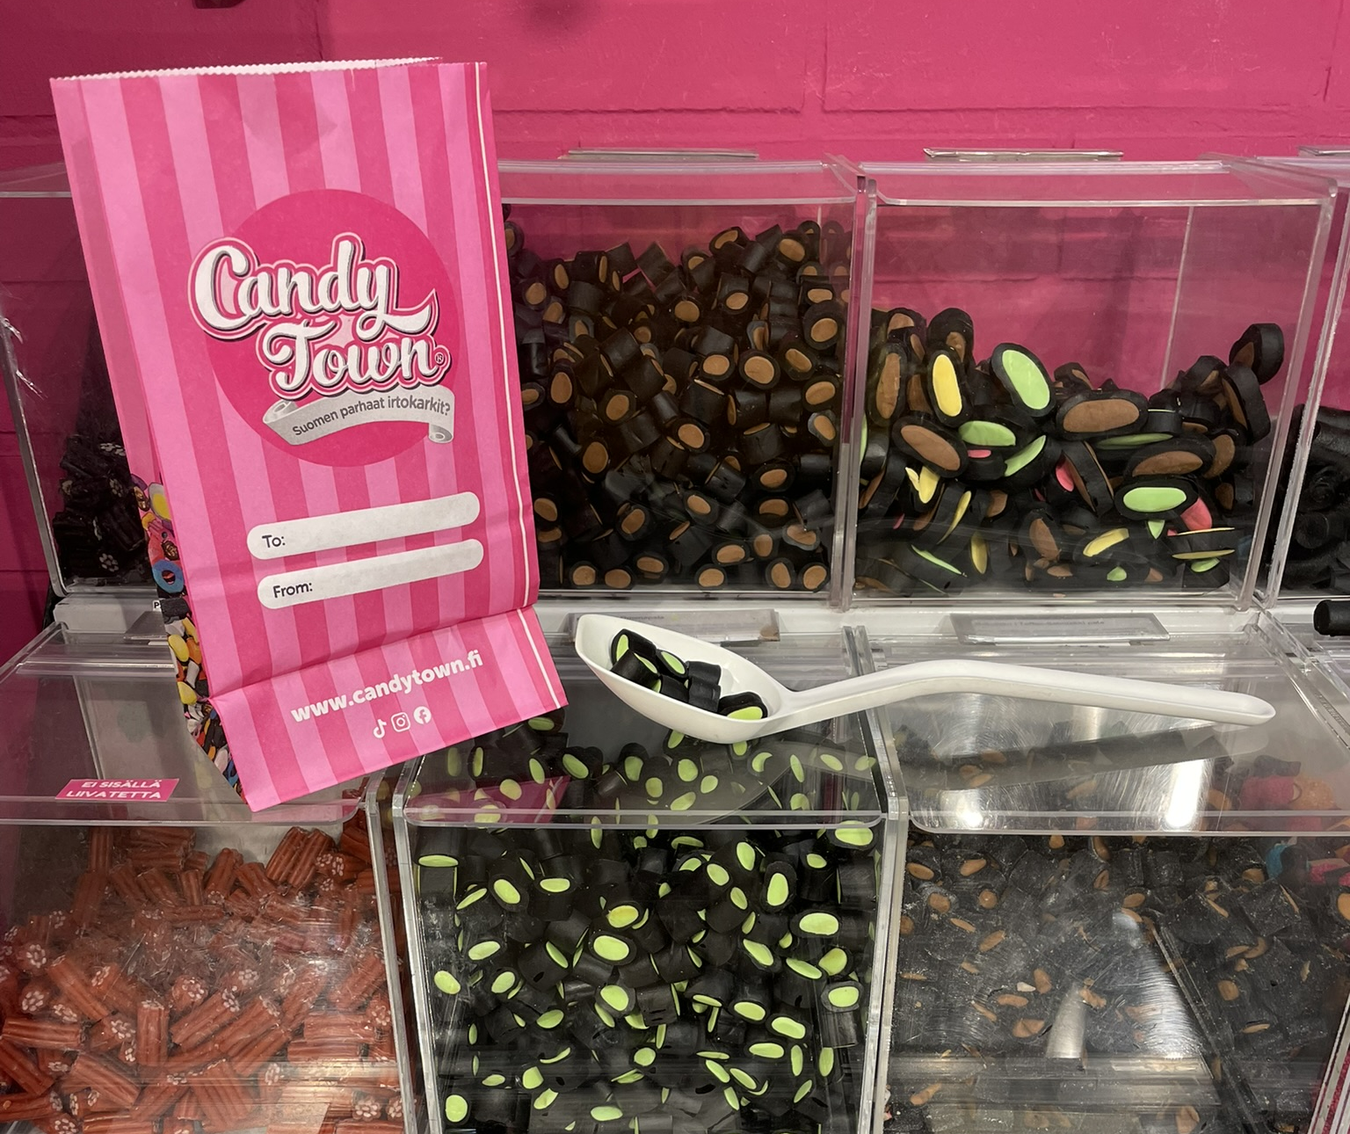
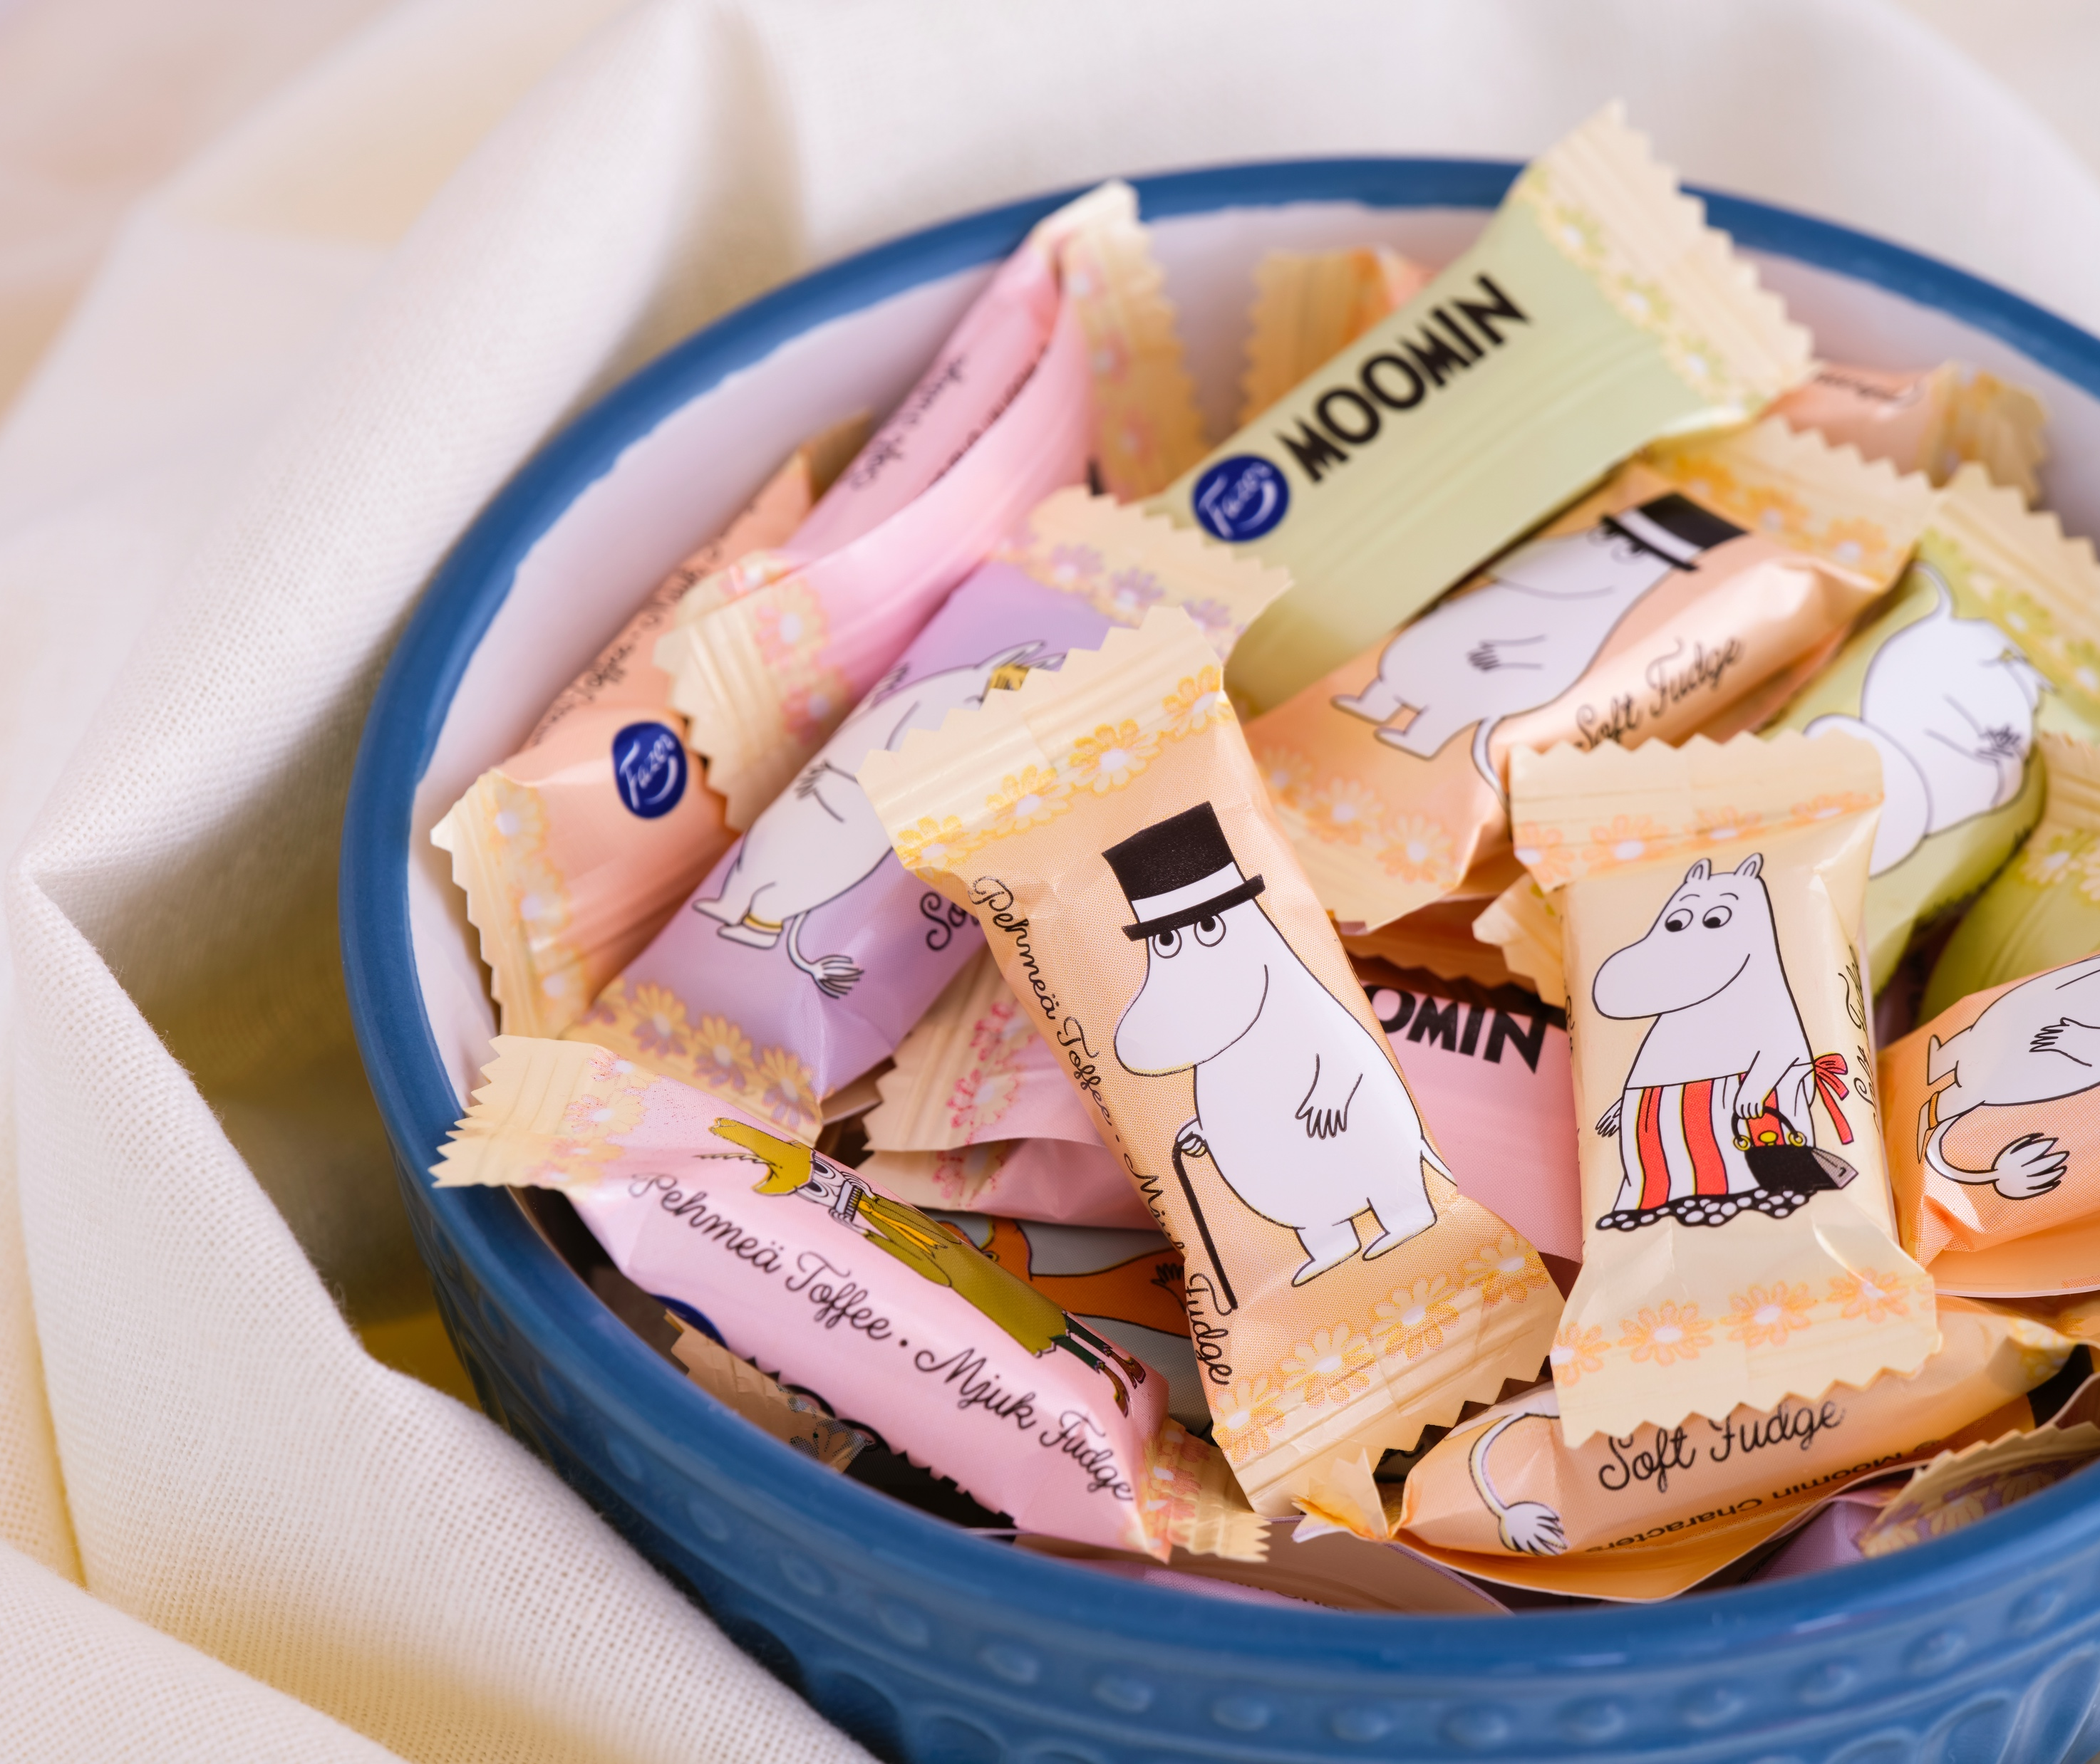
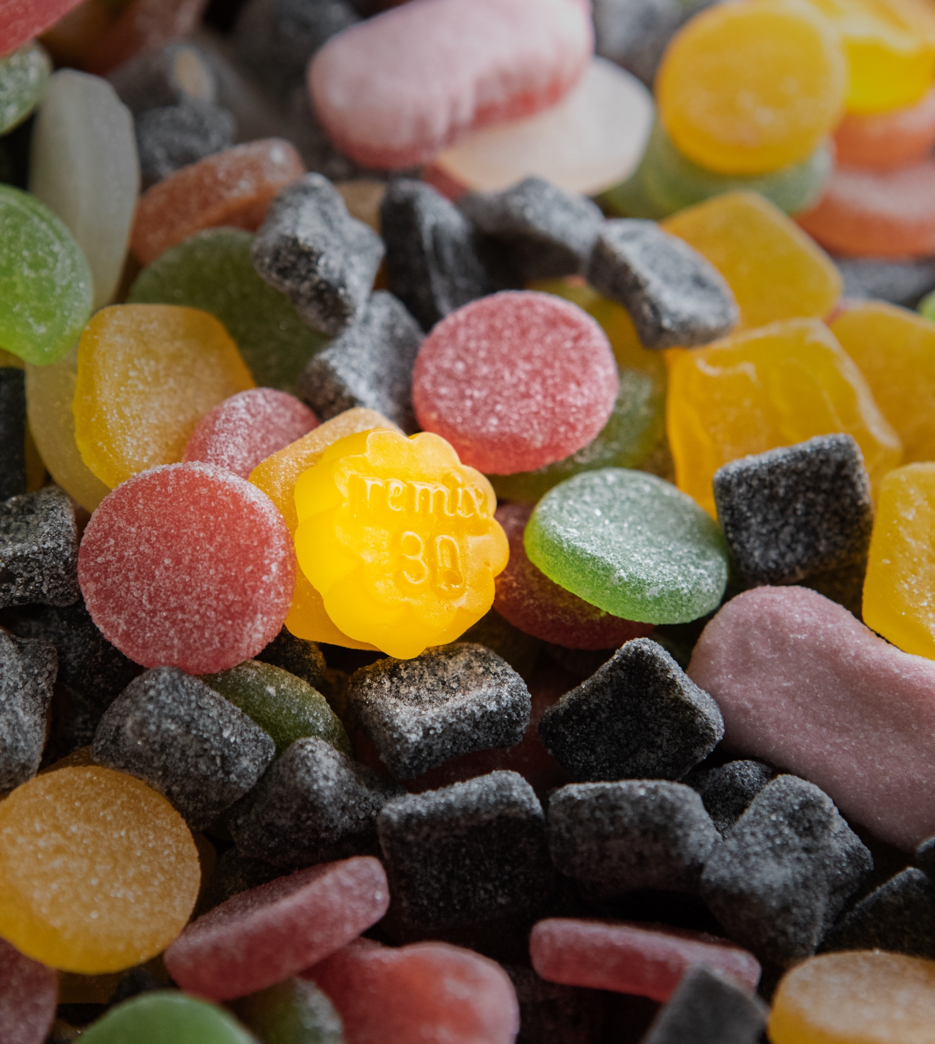
The icing on the cake: Our love for local candy flavours
FINNISH FOOD CULTURE IN 10 SERVINGS
1
2
3
4
5
6
7
8
9
10
Finns want candy!
Many Finnish families follow the tradition of having one day every week, typically Saturday, dedicated to eating their favourite candy – chocolates, salty liquorices, and berry gummies, for example.
Don’t tell this to the kids, but the adults might sneak in an additional candy day or two throughout the week... that’s just how good Finnish candy is!
Photo: xxx
Photo: Ekaterina Minaeva / Shutterstock
Photo: xxx
Notes:
Finland is a country of bold and surprising flavours. When Finns reach for something sweet, it could be anything from smooth, high‑quality chocolate to intensely salty licorice. Finnish confections reflect the same values often seen in Finnish design: quality ingredients, deep traditions, and authenticity over trends.
Finnish candies offer a wide palette — from classic chocolates like Fazer’s iconic blue-wrapped bars to salmiakki, the uniquely salty black liquorice beloved by locals. These flavours are part of a long tradition: chocolates that melt softly, berry candies inspired by Finland’s forests, and seasonal specialties like Fazer’s Mignon Eggs — real eggshells filled with almond‑nougat enjoyed at Easter. Many Finnish sweets feature local berries such as bilberry and black currant, emphasizing purity and natural flavor.
No introduction to Finnish candy is complete without “salmiakki”. Its bold flavour comes from ammonium chloride, giving it a salty, tangy and slightly medicinal character. It’s absolutely an acquired taste — many visitors are shocked at first, then hooked by the fifth bite. You can find salmiakki in ice cream, chocolate bars, pastries, and even drinks. Love it or hate it, salmiakki is essential to understanding Finnish food culture.
Finns also enjoy sweeter liquorice varieties with a firm but tender texture, often less sugary and more nuanced than international versions. But gummy candies, fruit chews and chocolate‑coated treats remain everyday favourites for both children and adults.
For Finns, sweets aren’t just treats — they’re tied to childhood memories, celebrations, family gatherings, and moments of comfort. A small bag of candy can represent joy, nostalgia, or simply a familiar weekly ritual. One uniquely Nordic tradition is Candy Day, when children are allowed sweets on one day of the week — typically Saturday. This practice began as a public health measure to protect children’s teeth and fit naturally into weekend routines, such as family time and the Saturday sauna. Even today, many families continue it as a balanced approach to enjoying treats – at least as far as the kids know...

Slide 22
11/10
11/10
An extra skylight
with views to
common ground.
Epilogue

Slide 23
Epilogue
OTSIKKO TÄHÄN
1
2
3
4
5
6
7
8
9
10
11
Photo: xxx
Any note
can be written here.
This is a place for
more detailed information.
You can use this page to highlight connections between Finnish cinema and your country, shared projects, or even interesting upcoming events.
Notes:
Tähän osioon voi koota vastaanottajan ja tilanteen mukaan personoitavia asioita, toki teatterikulman huomioiden.

Slide 24
Hungry for more?
Let's come up with the next recipe for success together.

