Slide 1
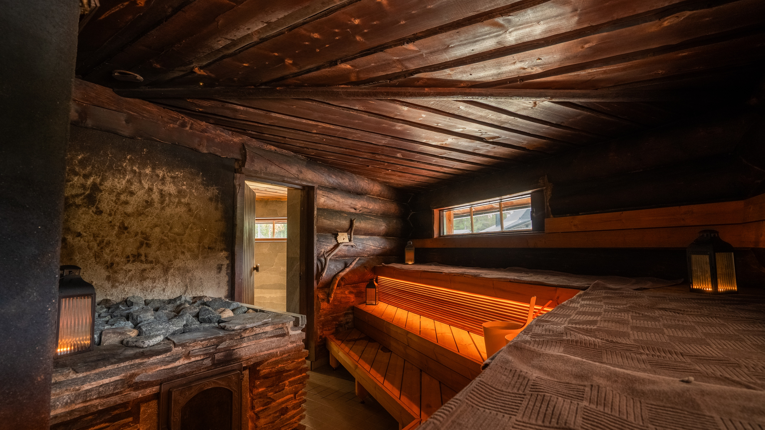
10 degrees of Finnish sauna
Photo: Juho Juuruspolvi

Slide 2
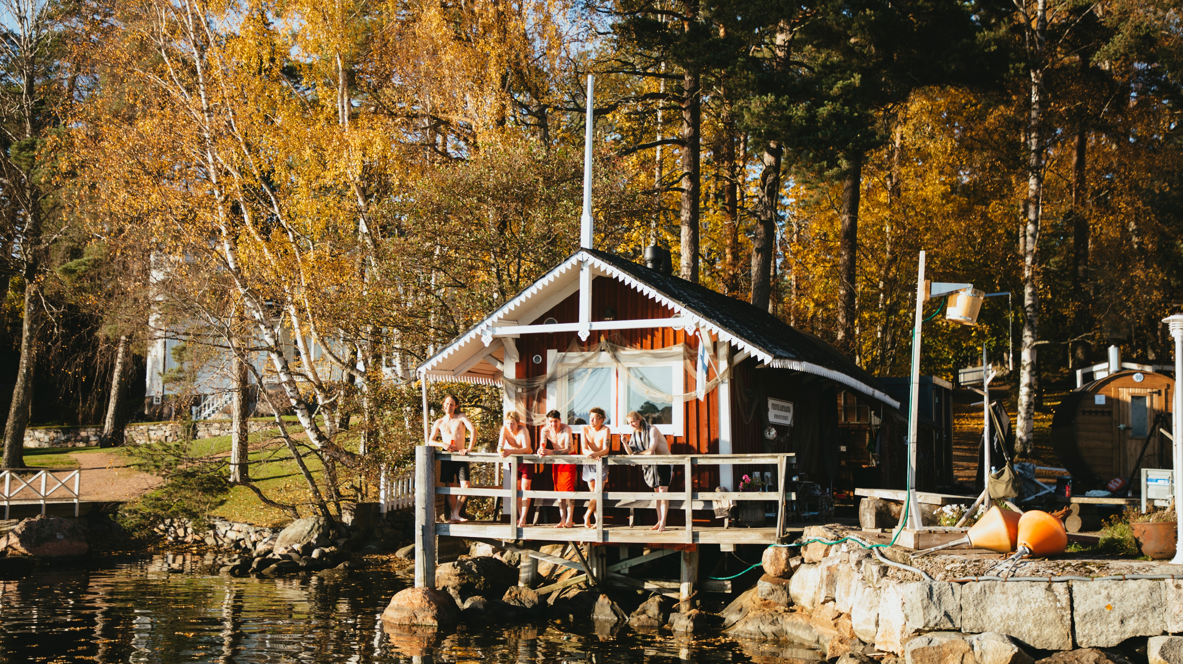
1/10
The one Finnish word
everyone knows
Photo: Anni Hartikainen

Slide 3
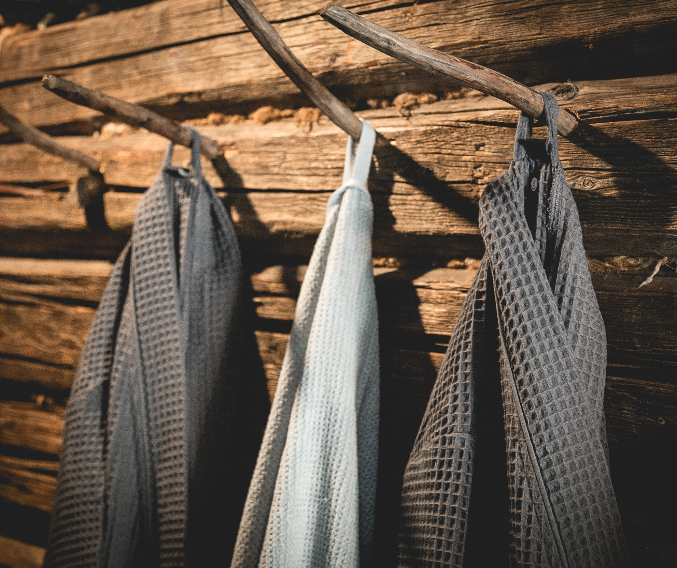
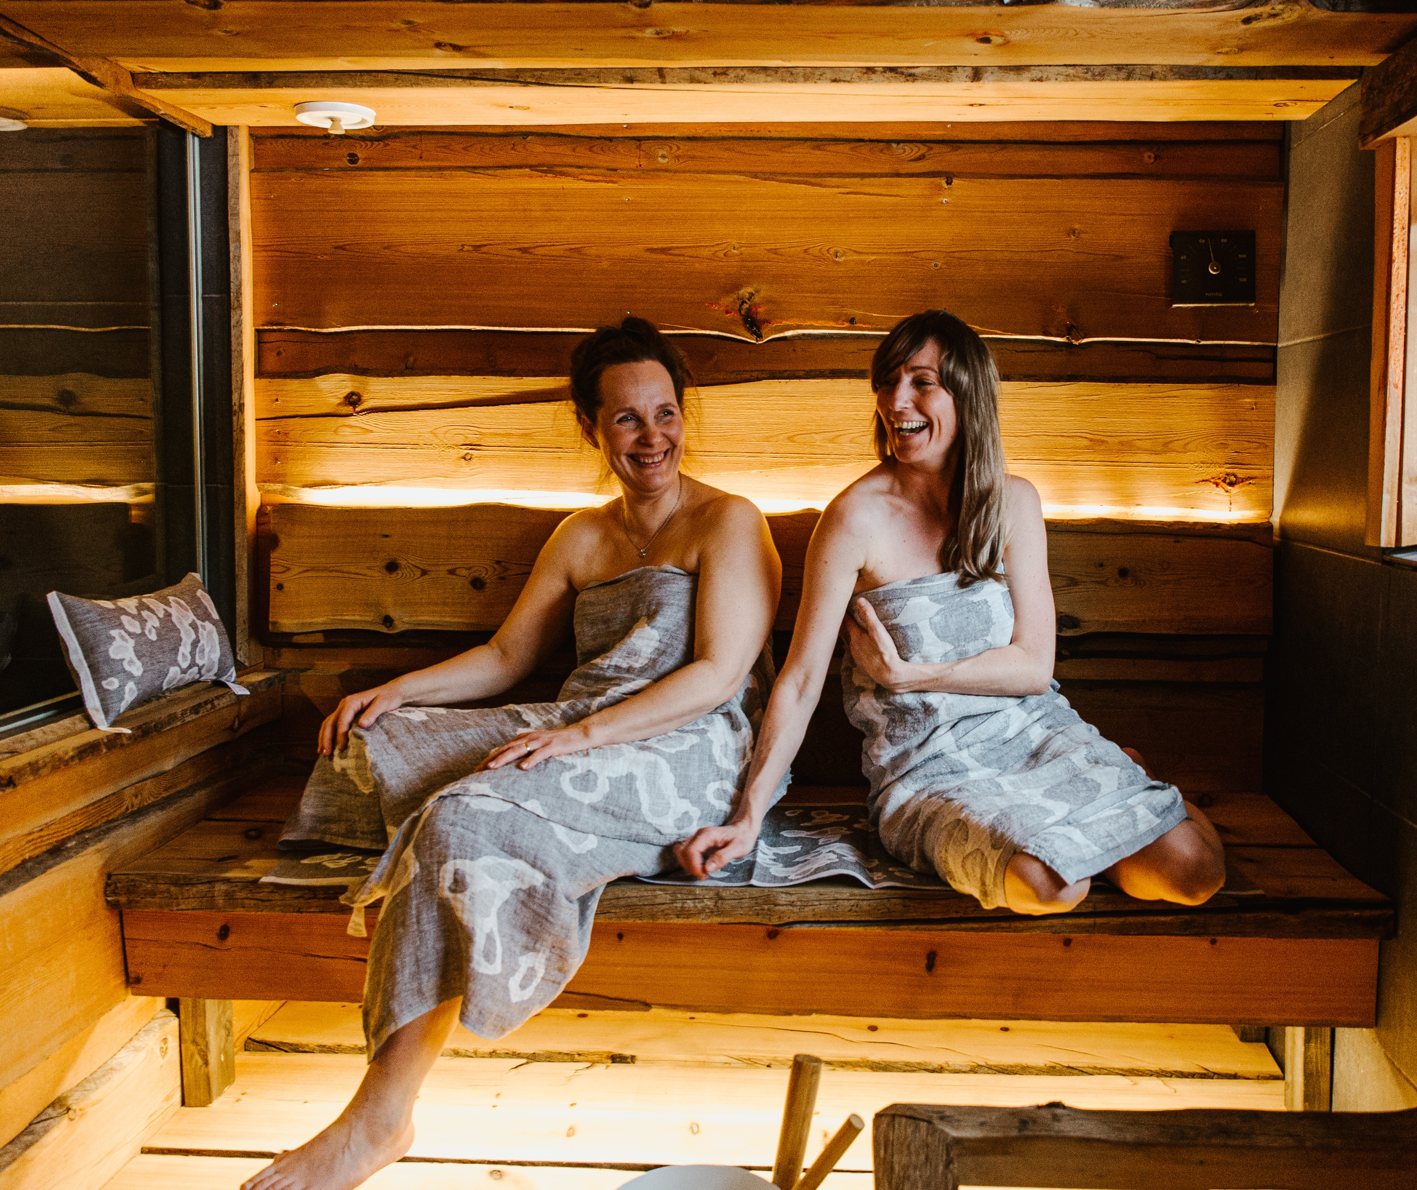
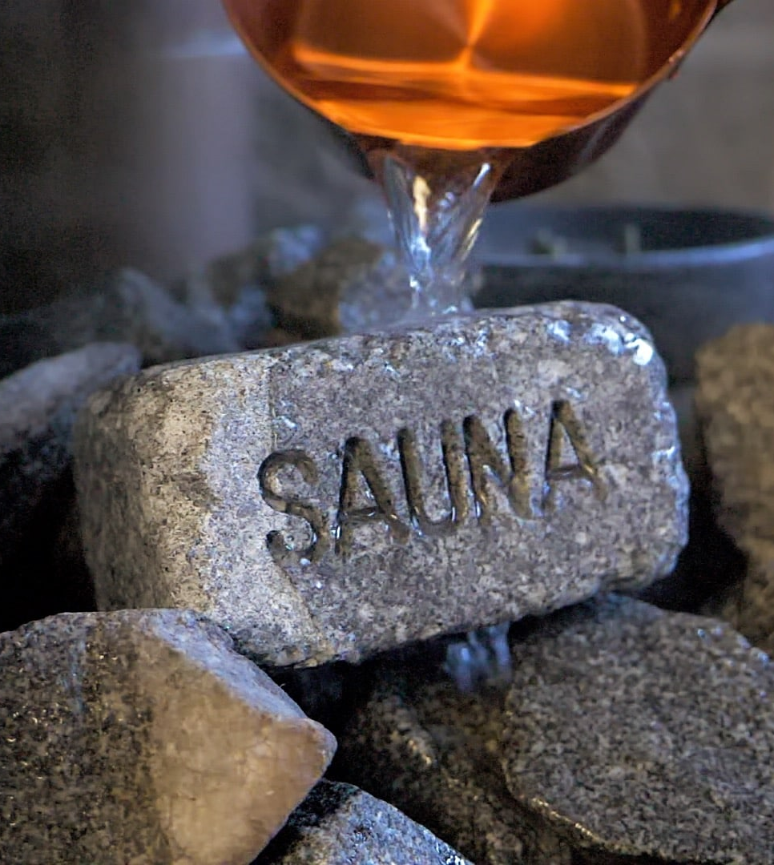
The one Finnish word everyone knows
10 DEGREES OF FINNISH SAUNA
1
2
3
4
5
6
7
8
9
10
Sauna
/SOW-nah/
“Sauna” is the best-known Finnish word in global use. The word and practice are very old, with written references often traced back to the medieval period.
Photo: Sauna from Finland
Photo: Sauna from Finland
Photo: Sauna from Finland
Notes:
A sauna is a small room or building designed for heat sessions, where people sit in high temperatures to relax and sweat. It is traditionally used in Finland for cleansing the body, improving circulation, and clearing minds.
The word “sauna” is also Finland’s gift to the world: it’s the best-known Finnish word in global use. It might be special, but for Finns sauna is also part of everyday life. It is a place to relax, reflect, and spend time together, and there are over 3 million saunas for just 5.7 million Finns.
Finland is not only a sauna country — it is also a sauna expertise country.
Around sauna culture, Finland has developed a broad ecosystem of companies, designers, architects, manufacturers, tourism operators, wellness professionals, and experience developers. Together they create authentic Finnish sauna experiences for homes, hotels, spas, public saunas, destinations, and international markets.

Slide 4
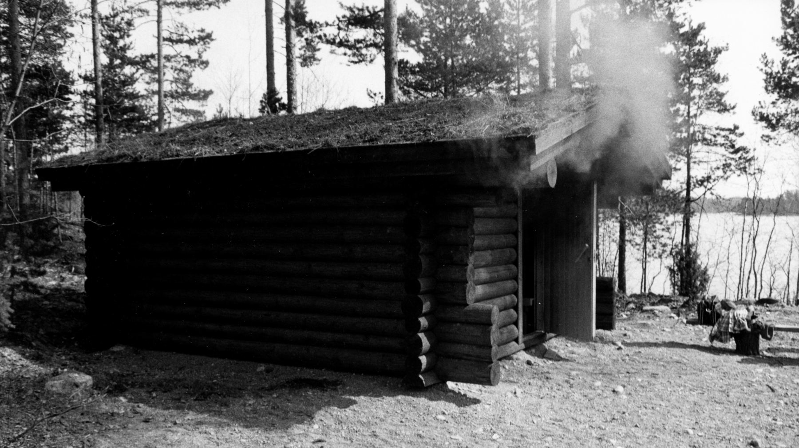
2/10
A short timeline of
Finnish sauna
Photo: Työväen arkisto

Slide 5
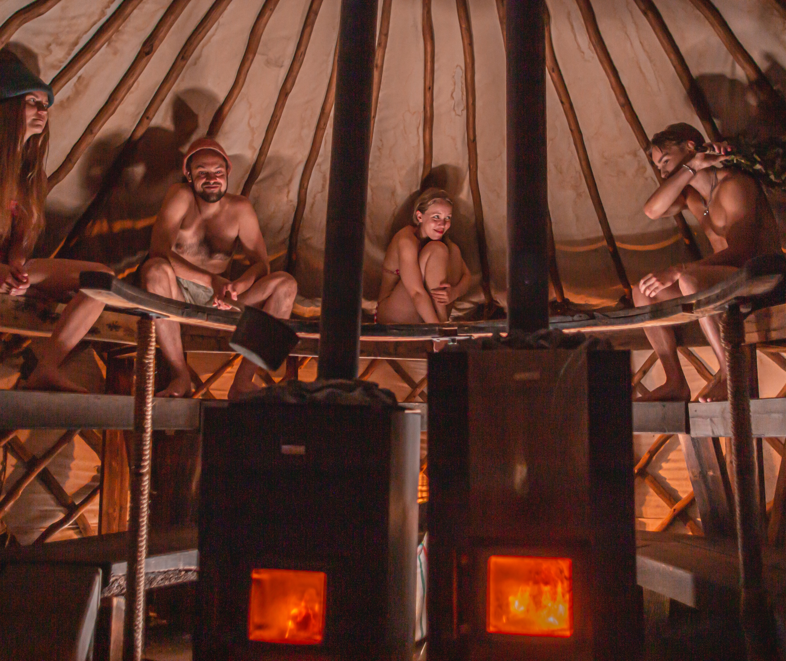
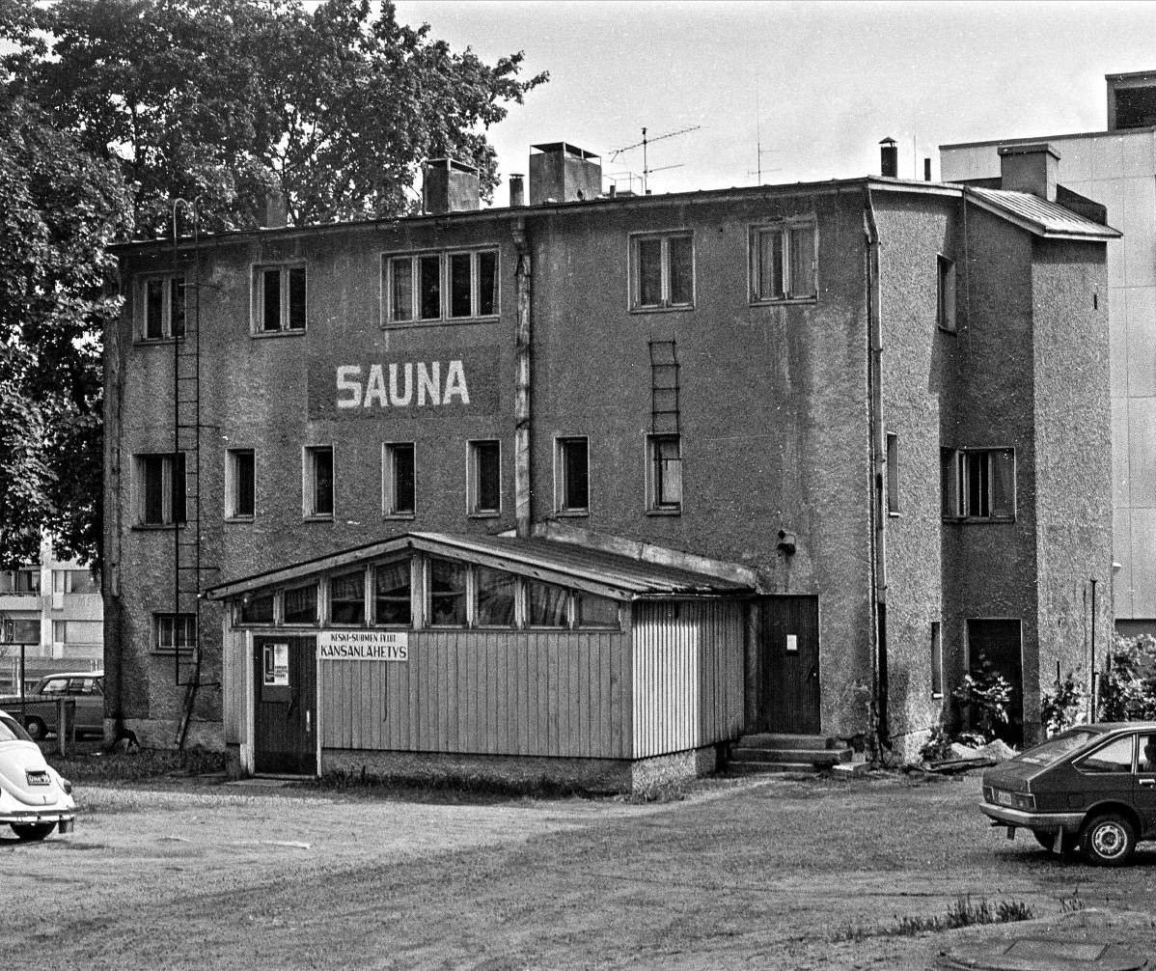
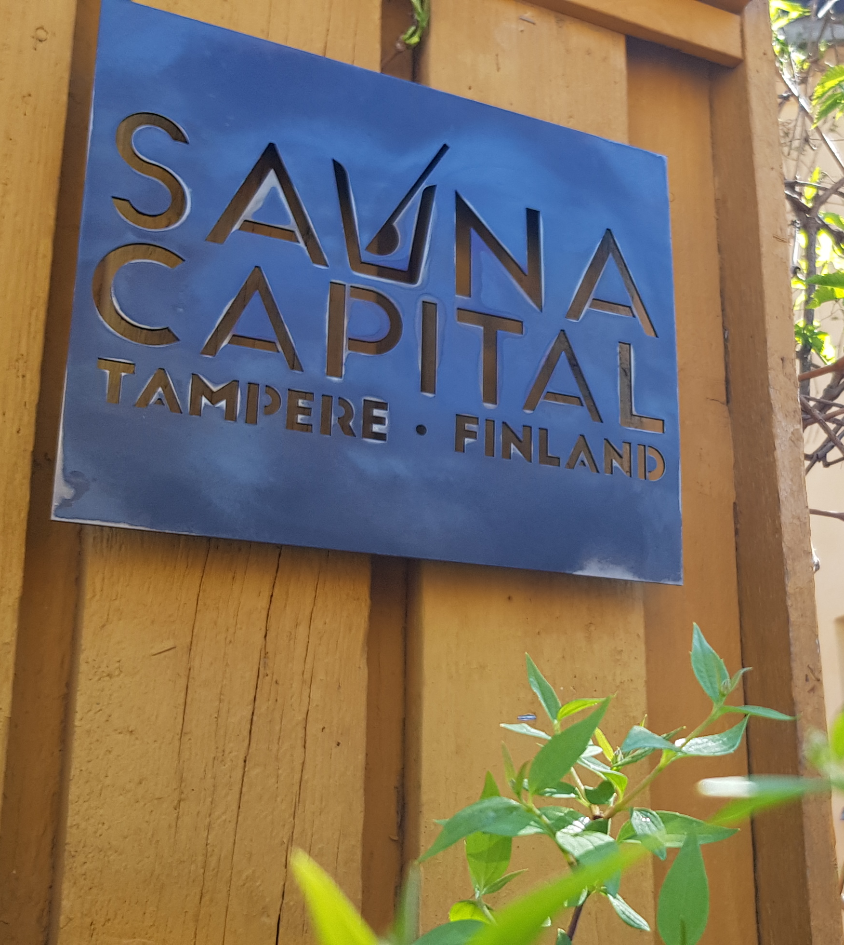
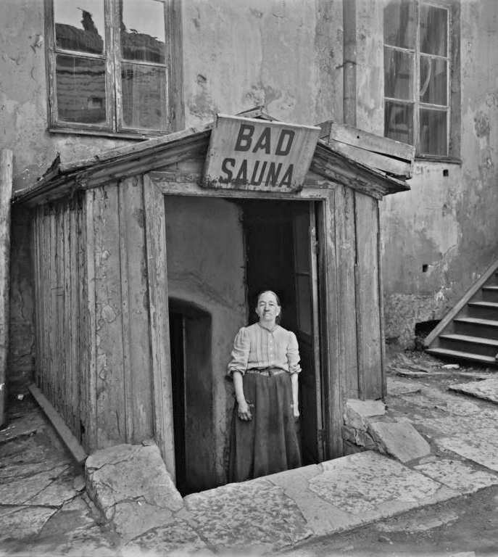
A short timeline of Finnish sauna
10 DEGREES OF FINNISH SAUNA
1
2
3
4
5
6
7
8
9
10
Before the 1900s:
Public saunas and smoke saunas
1900–1950:
The era of apartment building saunas
1950–1980:
The breakthrough of home saunas
From the 1990s onward:
The revival of public saunas
From the 2010s to today:
A new urban sauna culture
In 2020:
Finnish sauna culture was added to the UNESCO Intangible Cultural Heritage list
Sauna Temple Rauhaniemi. Photo: Laura Vanzo / Visit Tampere
Photo: Vesa Hakala / Keski-Suomen museo
Tampere is the Sauna Capital of the World. Photo: Sari Mäkelä / Visit Tampere
Photo: Signe Brander / Helsingin kaupunginmuseo
Notes:
Saunas are ancient – they existed in Finland before churches. Traditionally, the sauna was the cleanest and most sacred building on the property. Back in the day people built the sauna first, then the house.
Historically, births often took place in the sauna due to its warmth, cleanliness, and privacy. For much the same reasons, saunas have also been used for healing, washing the sick, and even preparing the deceased for their final journey – from birth to farewell.
Before the 1900s – Public Saunas and Smoke Saunas: Smoke saunas were especially common in rural Finland for centuries, as they were simple to build and did not require a chimney. They were used not only for bathing but also for cooking, healing, and even preparing for important life events. Because they required patience and skill to heat properly, sauna sessions were often planned as special occasions. In cities public saunas were common. They were places where people bathed and met each other.
1900–1950 – The Era of Apartment Building Saunas: Urbanisation increased the need for shared saunas. The first electric saunas appeared alongside traditional wood-heated saunas. 1906: The oldest still-operating public sauna, Rajaportti, opens in Tampere.
1950–1980 – The Breakthrough of Home Saunas: Private saunas began to be built in detached houses and row houses. The electric sauna made having a home sauna easy and widespread.
From the 1990s to the Present – The Revival of Public Saunas: Most Finns have access to a private sauna or a shared apartment building sauna. Modern public saunas, such as Löyly (est. 2016), have brought communal sauna culture back to cities.
Tampere became the world’s sauna capital in 2018. The title was earned thanks to the region’s high-quality saunas and its having the highest number of public saunas in Finland. The International Sauna Association and the Finnish Sauna Society awarded the Sauna Capital status.
In 2020, Finnish sauna culture was added to the UNESCO Intangible Cultural Heritage list. UNESCO recognised sauna as an important part of Finland’s living cultural tradition, emphasising its role in daily life, wellbeing, and social connection. In Finnish culture, sauna is not just about bathing, it is a space for physical and mental cleansing, equality, and shared experience across generations.
(Global sauna trends today:
Sauna has spread globally from Finland and evolved into many different styles. In some countries, it is no longer just a quiet wellness ritual but a social and sensory experience. A well-known example is Aufguss, especially in Central Europe, where a sauna master uses towels and essential oils to circulate heat, often combined with music, storytelling, or performance elements.
Modern saunas also emphasise sound, smell, and visual arts, using music, aromatherapy, and lighting effects to create immersive experiences. In some places, there are even disco saunas, where DJs, loud music, and colourful lights turn the sauna into a party space.
Today, sauna remains a vibrant part of Finnish identity, with millions of sauna visits every week in Finland, and a growing international interest in sauna culture worldwide.)

Slide 6
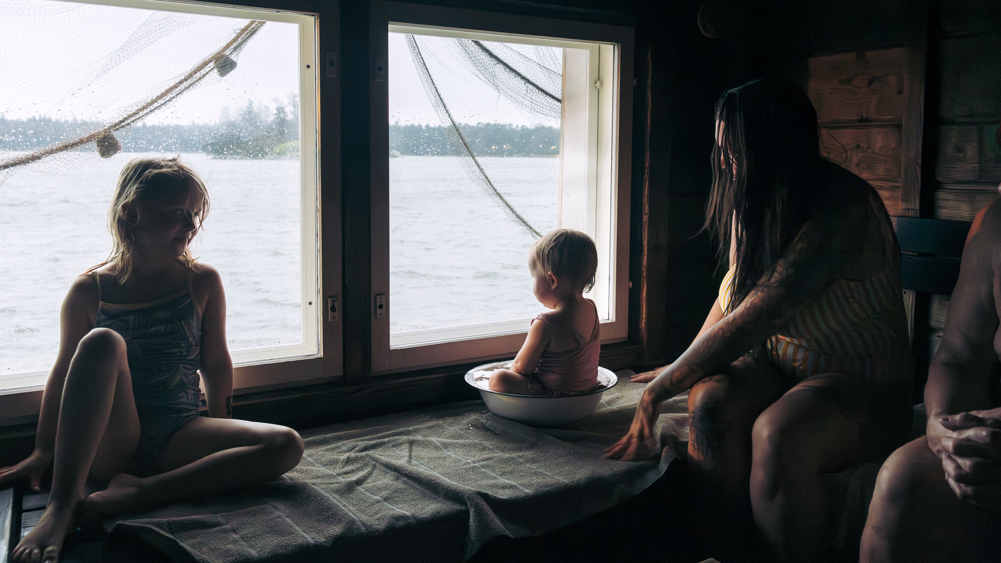
3/10
Homelike warmth:
Sauna as a part of Finnish life
Photo: Aleksi Poutanen

Slide 7
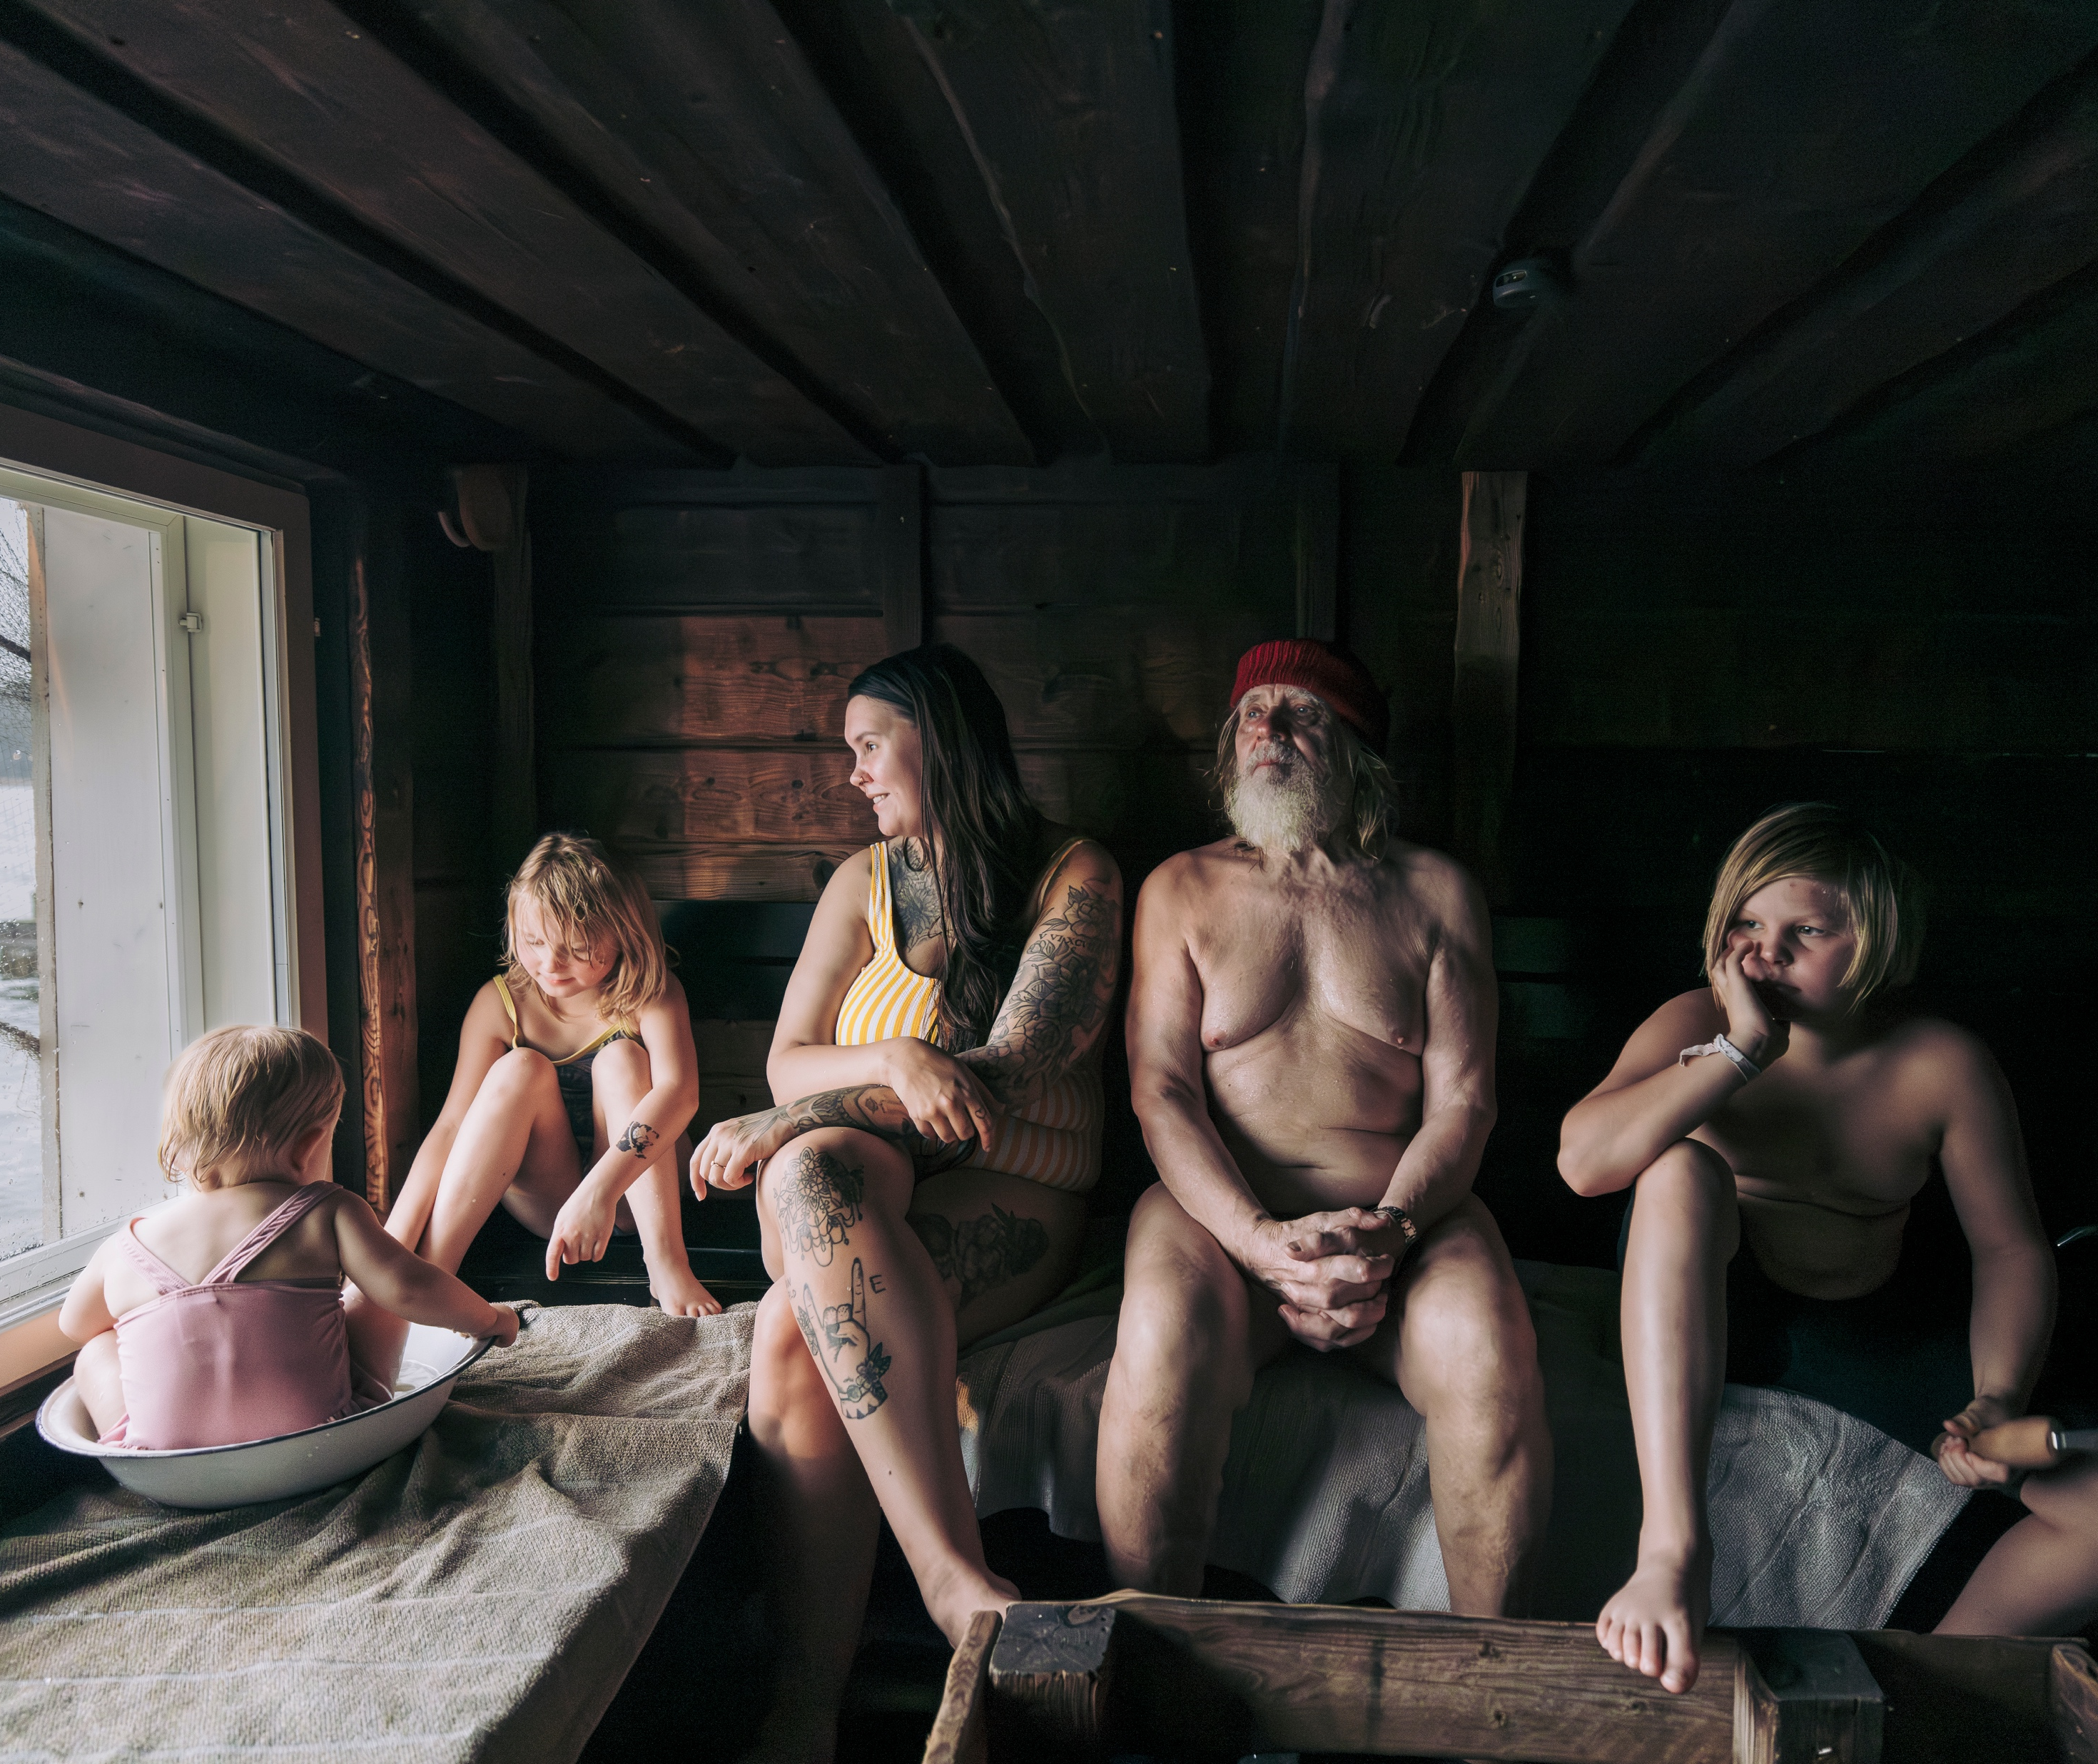
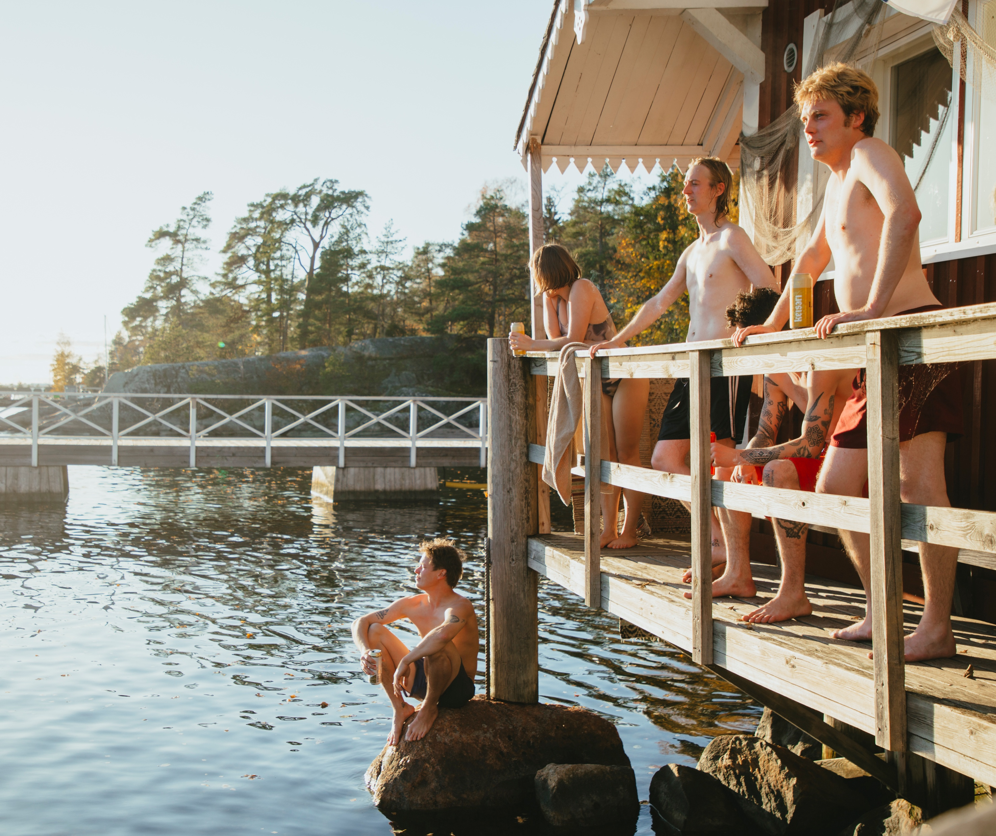
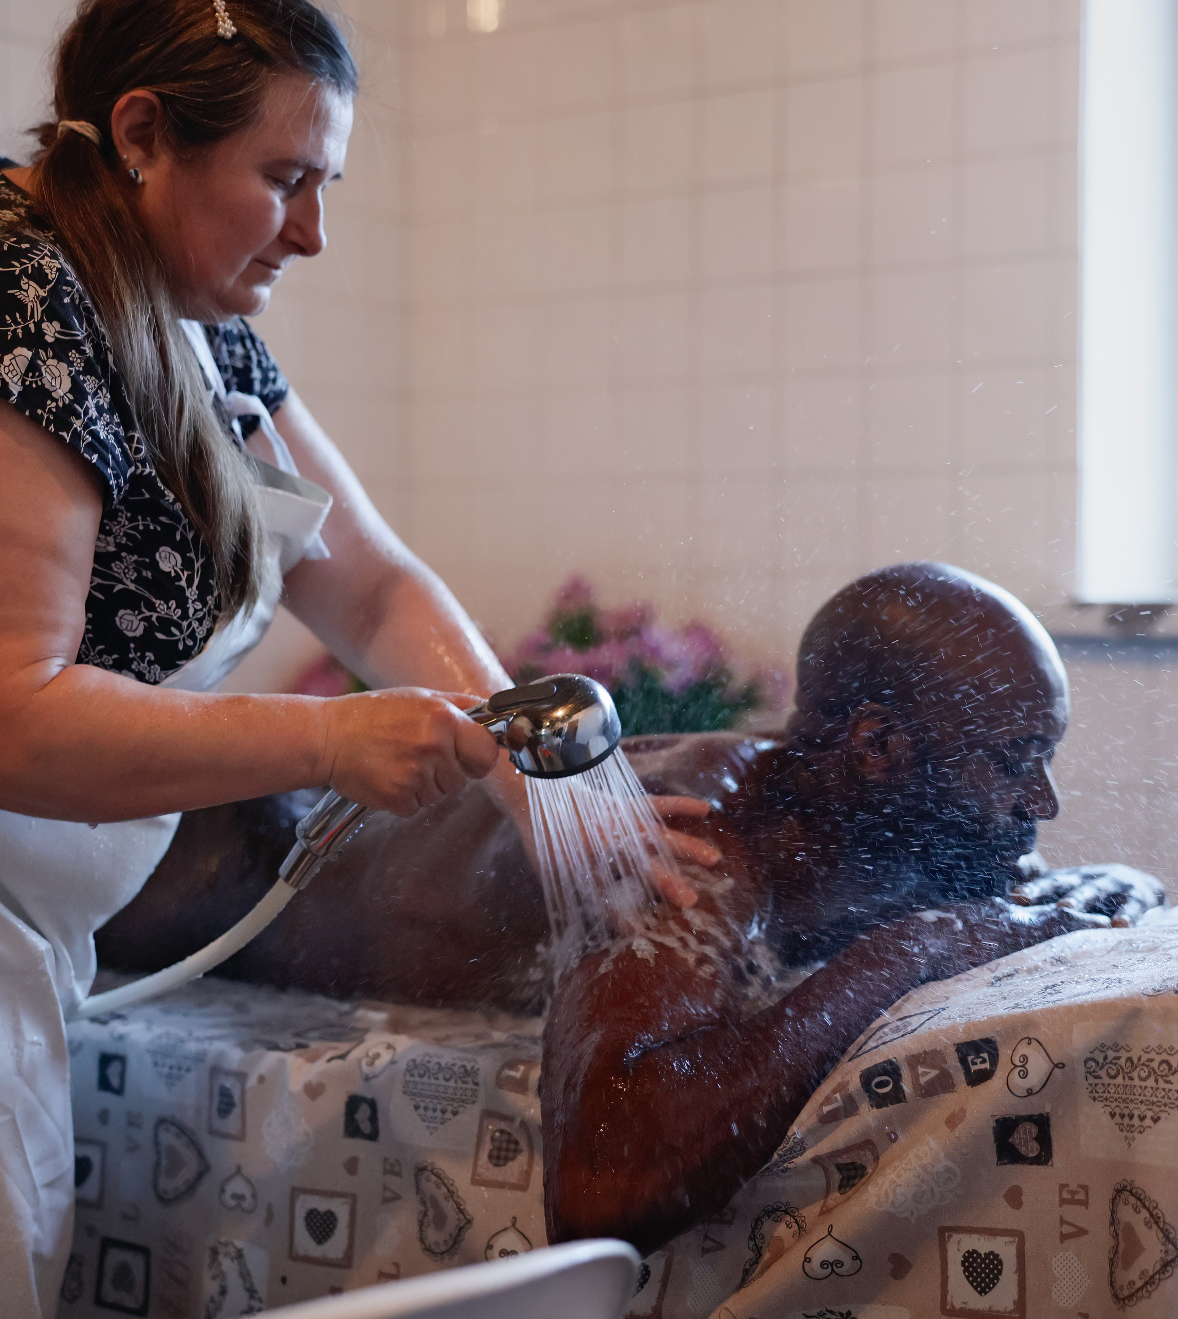
Homelike warmth: Sauna as a part of Finnish life
10 DEGREES OF FINNISH SAUNA
1
2
3
4
5
6
7
8
9
10
Sauna belongs to everyone.
It is inclusive by nature: for all genders, generations, and backgrounds. A typical Finn uses the sauna at least once a week, often on Saturday evenings.
Photo: Anni Hartikainen
Photo: Aleksi Poutanen
Photo: Maija Astikainen
Notes:
Almost everyone living in Finland has access to at least one sauna. Almost every house, apartment and summer cottage has its own sauna. And almost every Finn probably has a photo of them as a baby or a small child sitting on the wooden sauna benches. It captures something very typical of Finnish life: sauna is not just for adults or special occasions, but a natural part of growing up.
Saunas are found almost everywhere in Finnish society. Many workplaces have them to relax at the end of the day. Students hold parties in them to celebrate the night away. Whoever you are, sauna is there for you, at almost any imaginable place, for example:
Sports centers and swimming halls
Hotels and spas
Amusement parks
Universities and student housing
Office buildings and factories
Military bases
Hospitals, maternity facilities, prisons, rehabilitation centers, hospices, and care homes for the elderly
Presidential residences
Government buildings
Embassies abroad
Traditional Finnish belief also links sauna with natural healing. It has been used for colds, pain, fatigue, and melancholy, because it combines physical cleansing with emotional balance. It symbolises endurance, simplicity, and practical wisdom.

Slide 8
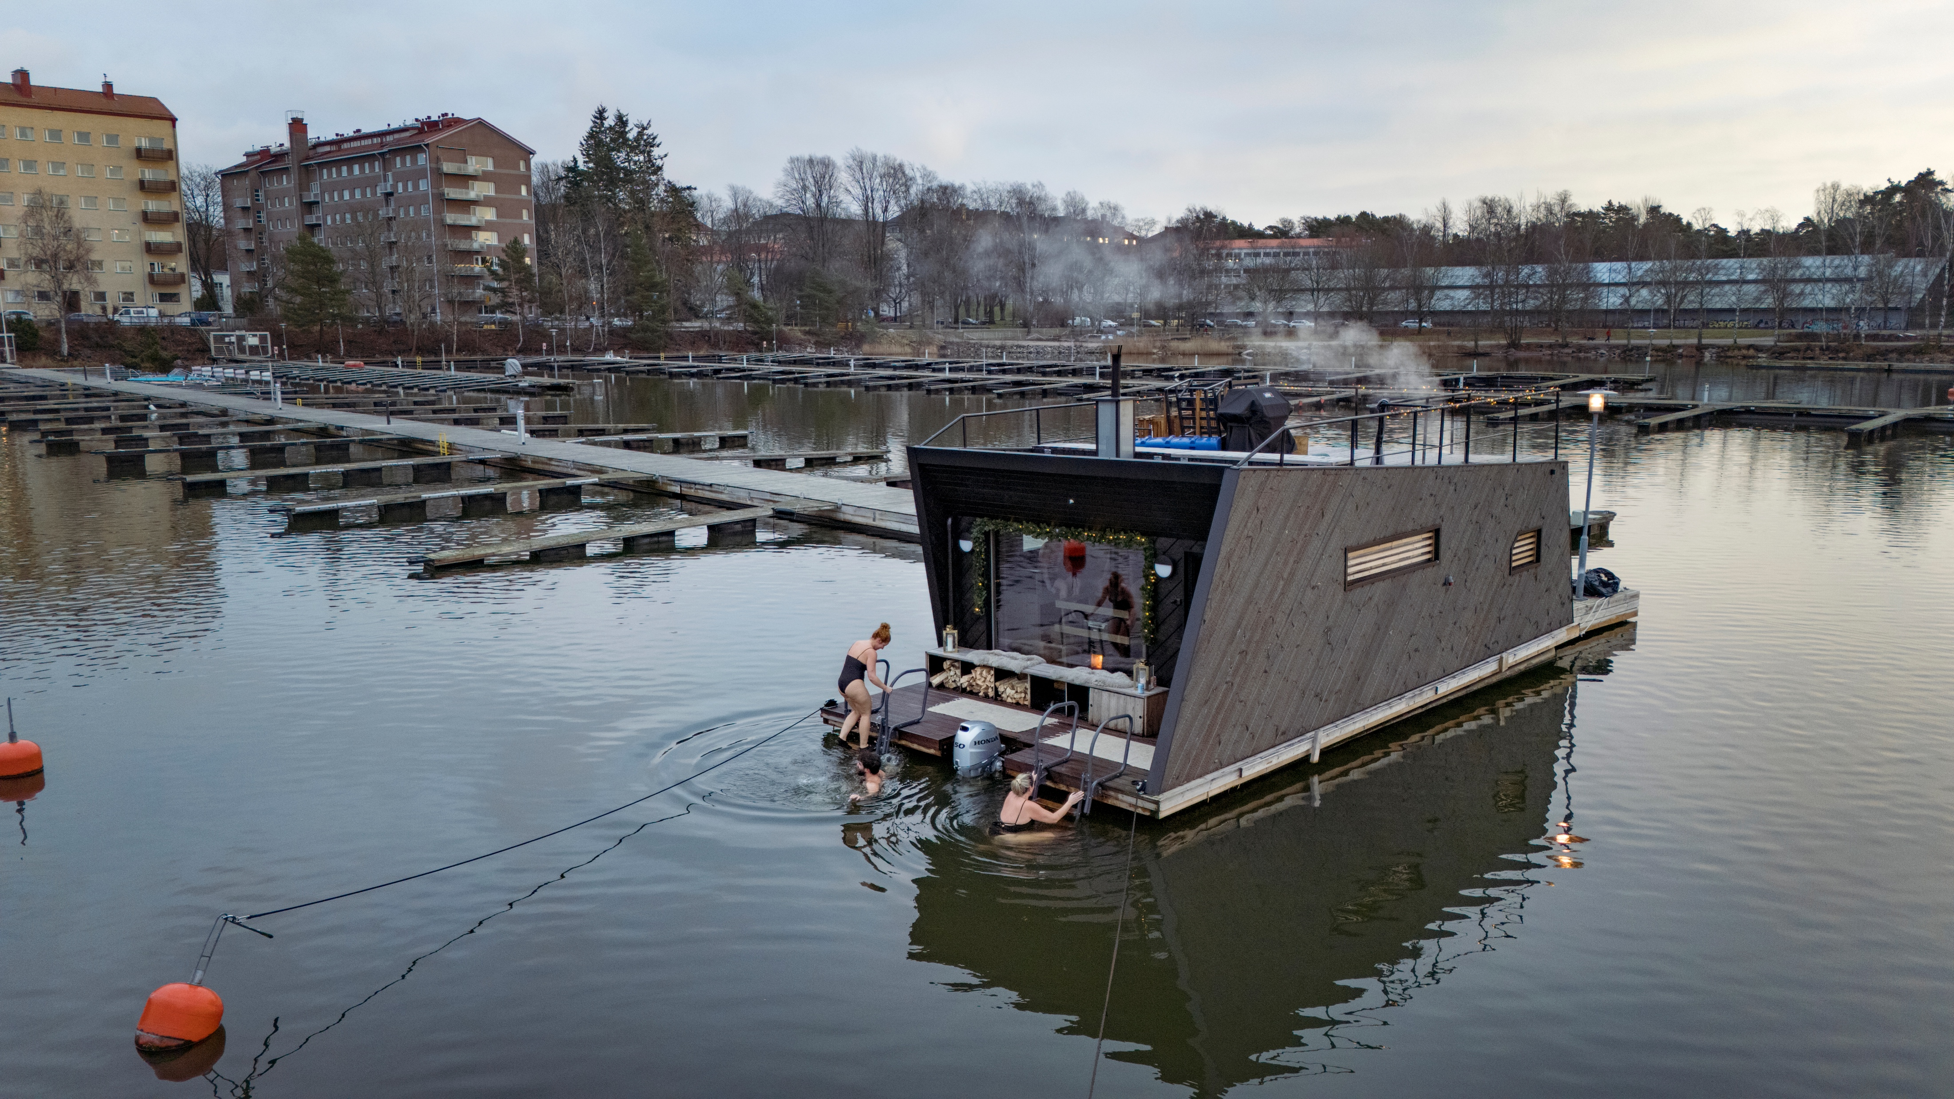
4/10
To each their own – from smoke to skyline
Photo: Maija Astikainen

Slide 9
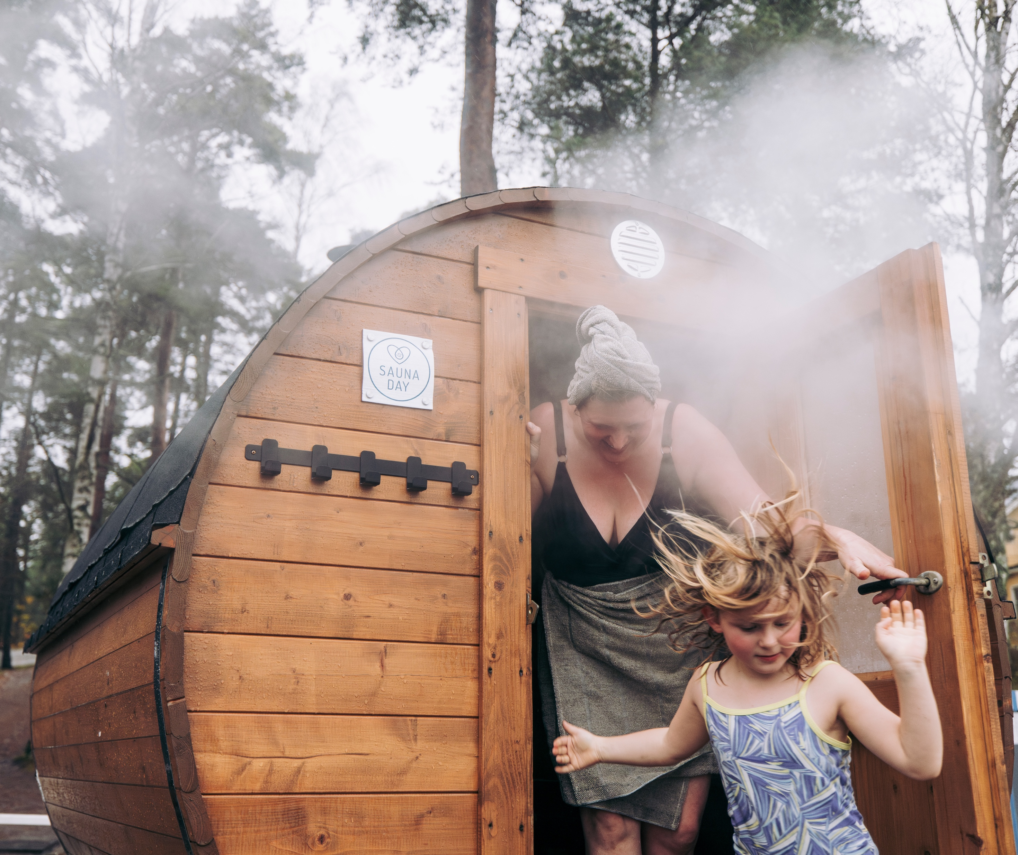
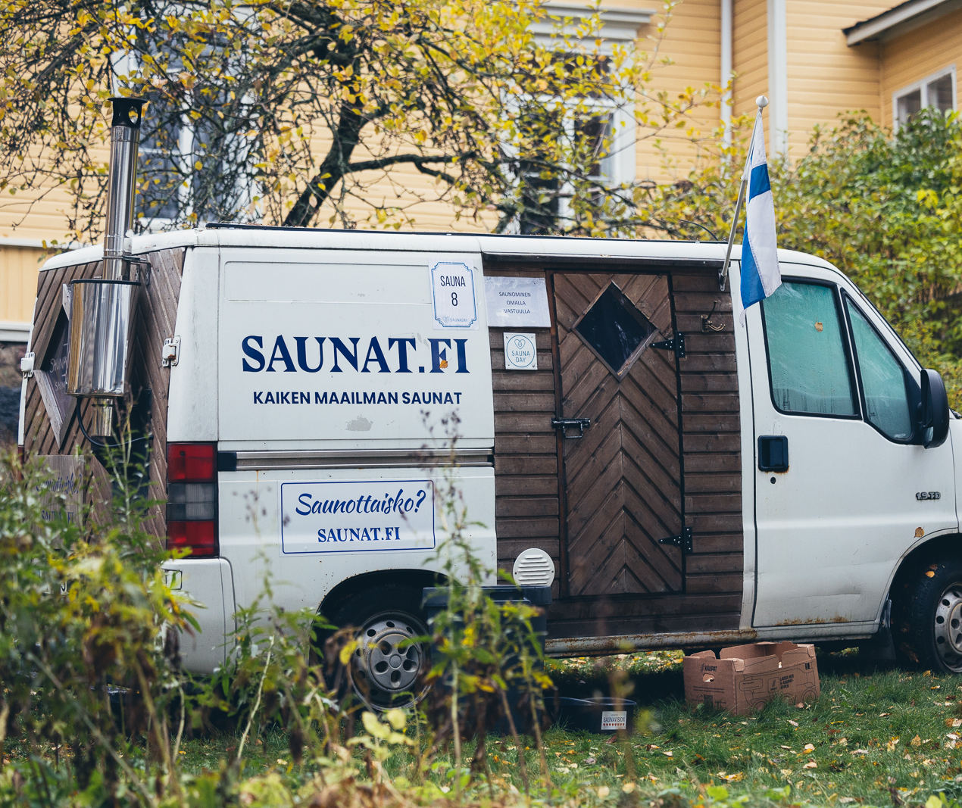
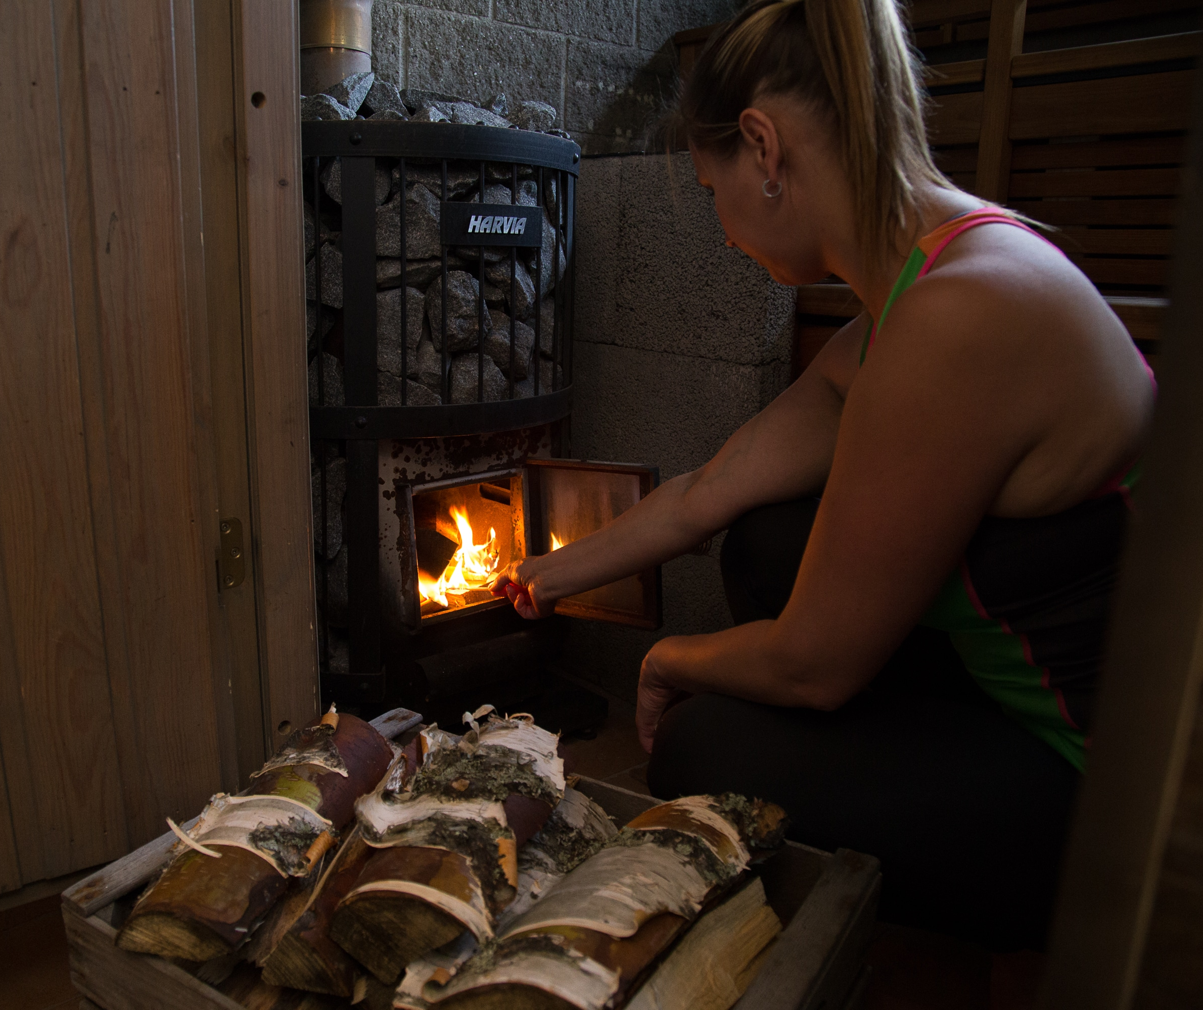
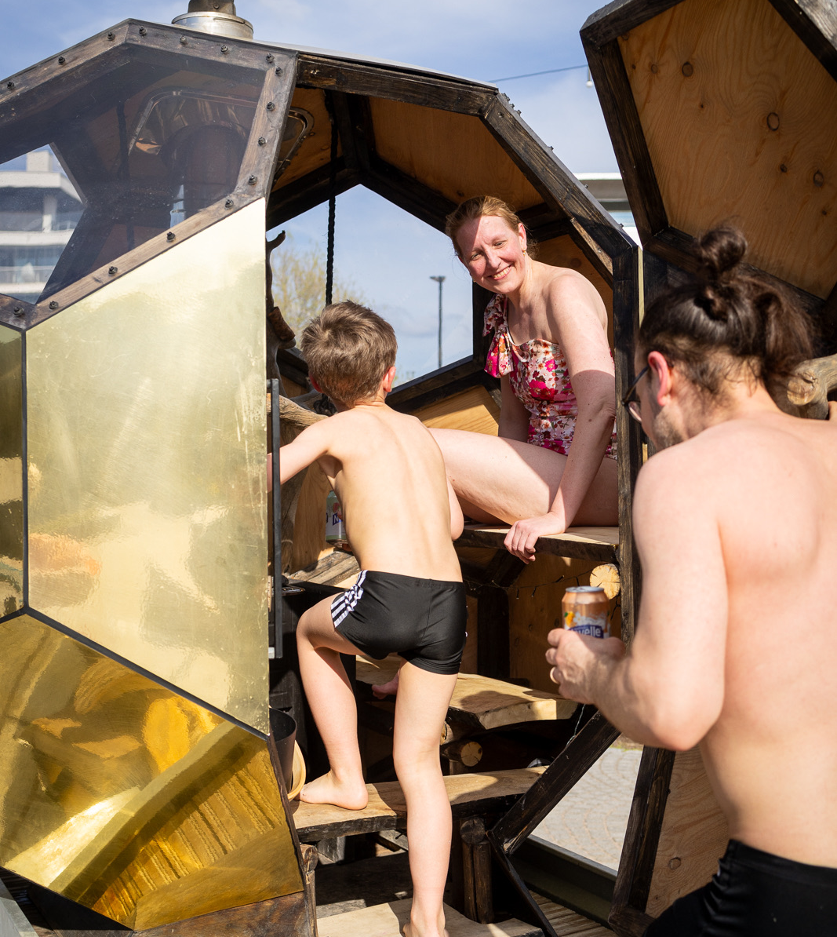
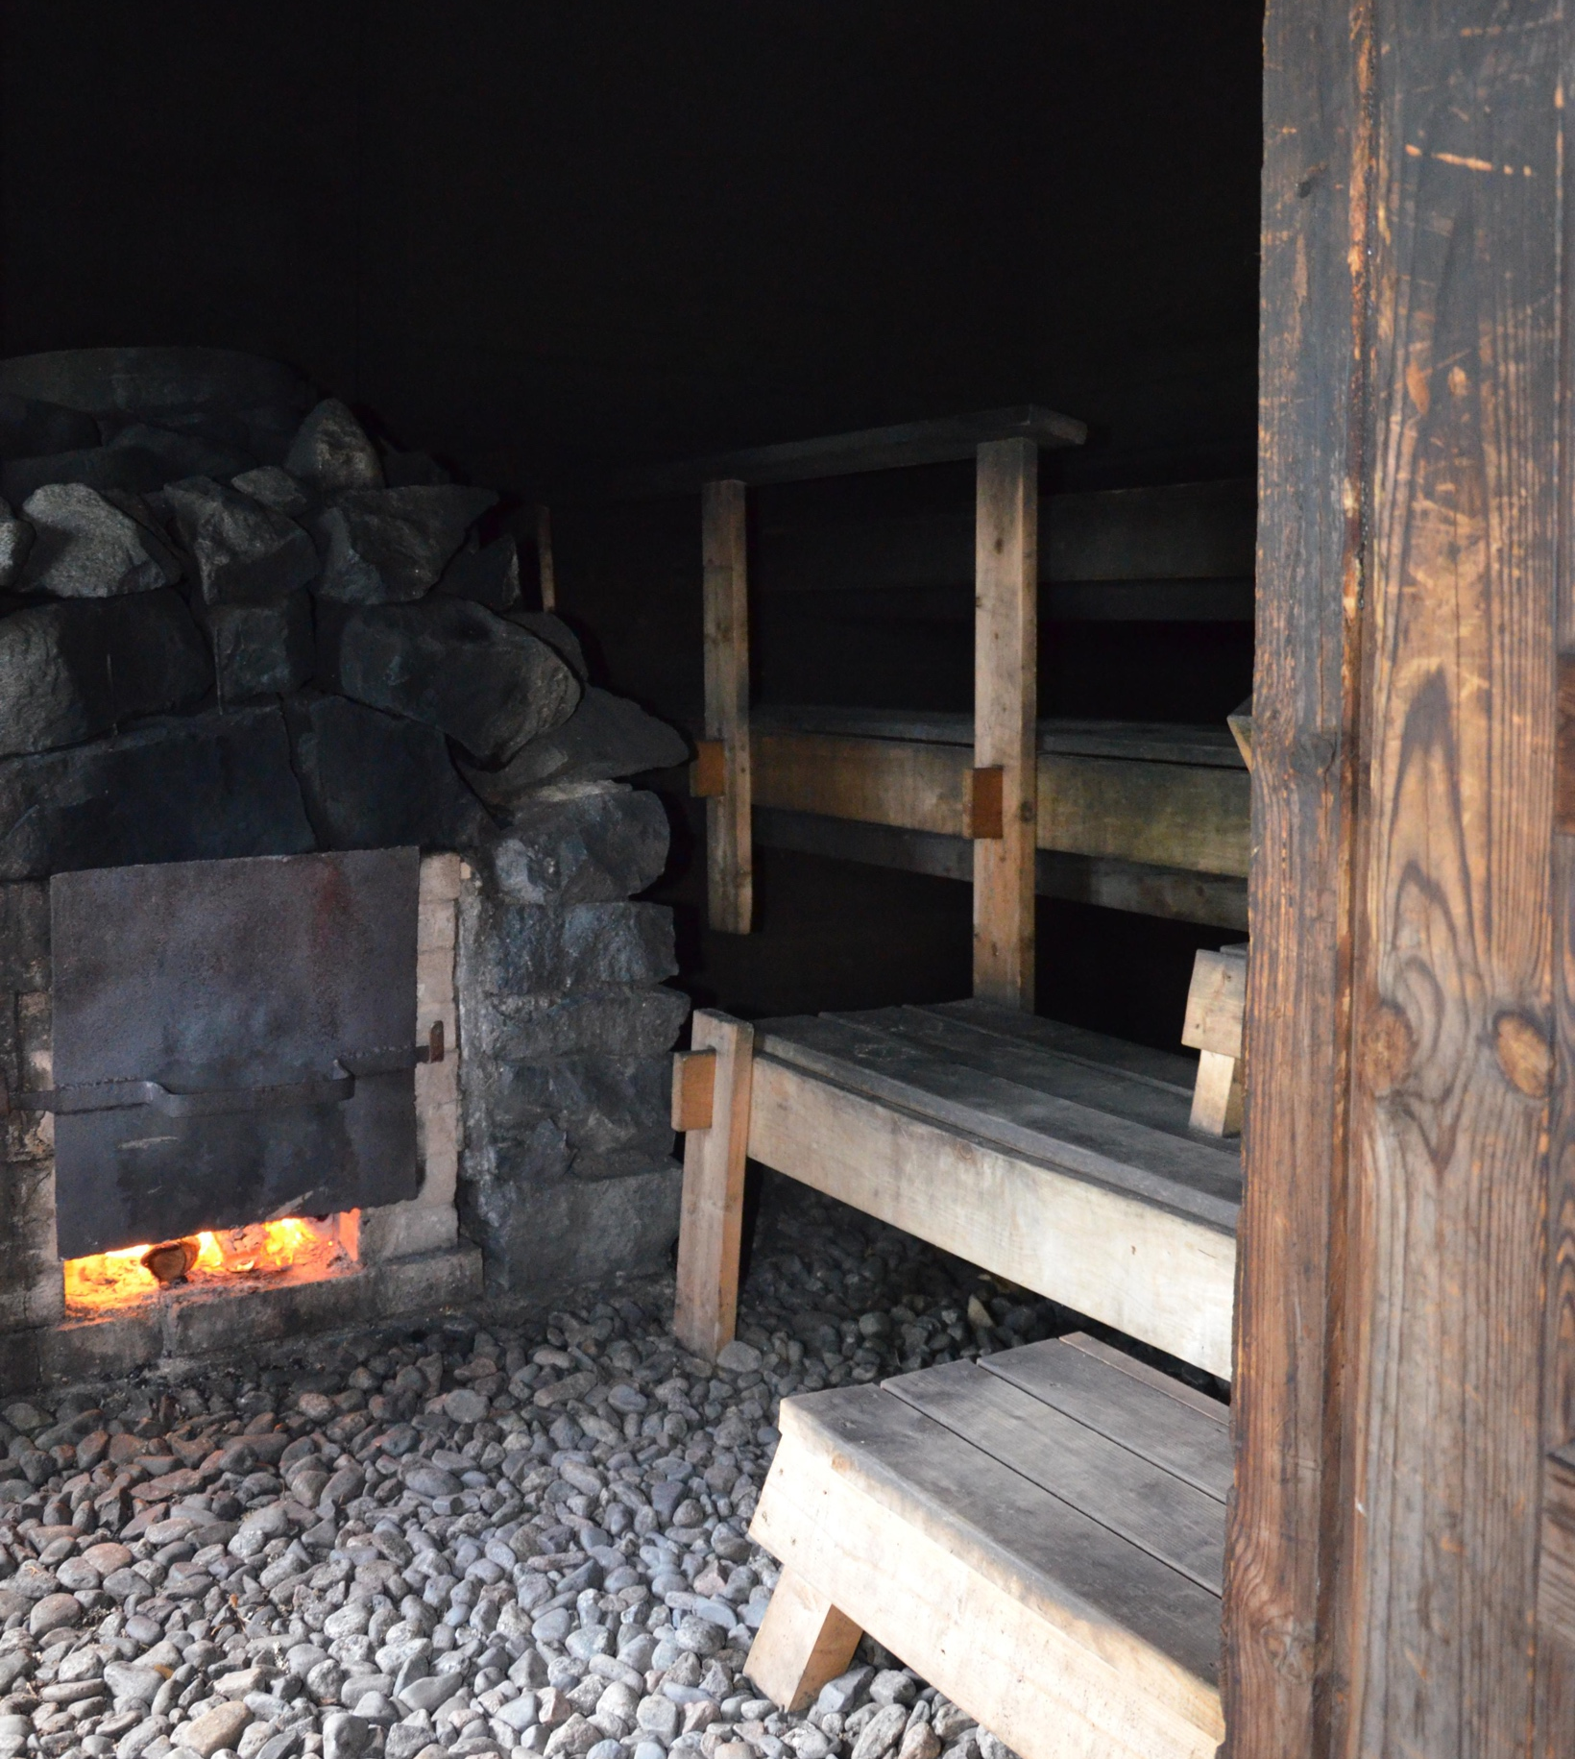
To each their own – from smoke to skyline
10 DEGREES OF FINNISH SAUNA
1
2
3
4
5
6
7
8
9
10
Saunas come in many forms: electric, wood-heated, and smoke saunas.
There are also single-heated and continuously heated
options, and both offer slightly different experiences in terms of heat and humidity.
Photo: Aleksi Poutanen
Photo: Saunafromfinland
Photo: Henri Sinisalmi
Photo: Henri Sinisalmi
Photo: Miinu Mäkelä / Vapriikin kuva-arkisto
Notes:
Saunas can be either single-heated (batch-heated) or continuously heated, depending on how the stove is used.
In a single-heated sauna, the stove is heated once before bathing, and after the fire is allowed to die down, the sauna is used with the stored heat in the stones. This type is traditional in many old Finnish smoke saunas and offers soft, long-lasting heat.
In a continuously heated sauna, the stove stays on during the whole sauna session, maintaining a steady temperature and allowing bathers to adjust the heat and steam as needed. This is the most common type in modern homes and public saunas.
Both types are common in Finland, but they create slightly different sauna experiences in terms of heat quality, humidity, and bathing rhythm.
Smoke sauna (savusauna) is the oldest and most atmospheric form of Finnish sauna. But Finns can make a sauna anywhere: a phone booth, horse trailer, tent, or a gondola. Some saunas can even have a river running through them.
Communal sauna events are also becoming increasingly popular in cities around the world. Public and pop-up saunas bring people together to share the sauna experience in an urban setting.
These events often take place in waterfront locations, or parks where people can alternate between hot sauna sessions and cooling off in the fresh air or cold water. The atmosphere is usually relaxed and social, encouraging conversation and a sense of community among strangers.
In Helsinki, communal sauna culture is deeply rooted in everyday life, with public saunas playing an important role in social wellbeing. Sauna events are a part of the growing wellness and lifestyle trend, introducing the Finnish sauna tradition to new audiences in a modern form.
Saunas are also built as event installations in cities such as Helsinki, Washington D.C., and New York City. This just proves that sauna culture is creative, adaptable, and playful – it fits anywhere.

Slide 10
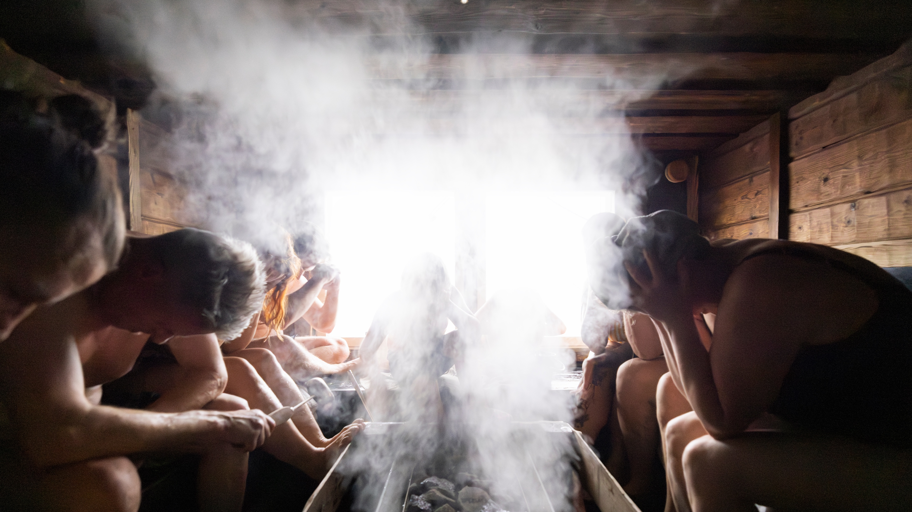
5/10
Meet löyly –
the spirit of the steam
Photo: Aleksi Poutanen

Slide 11
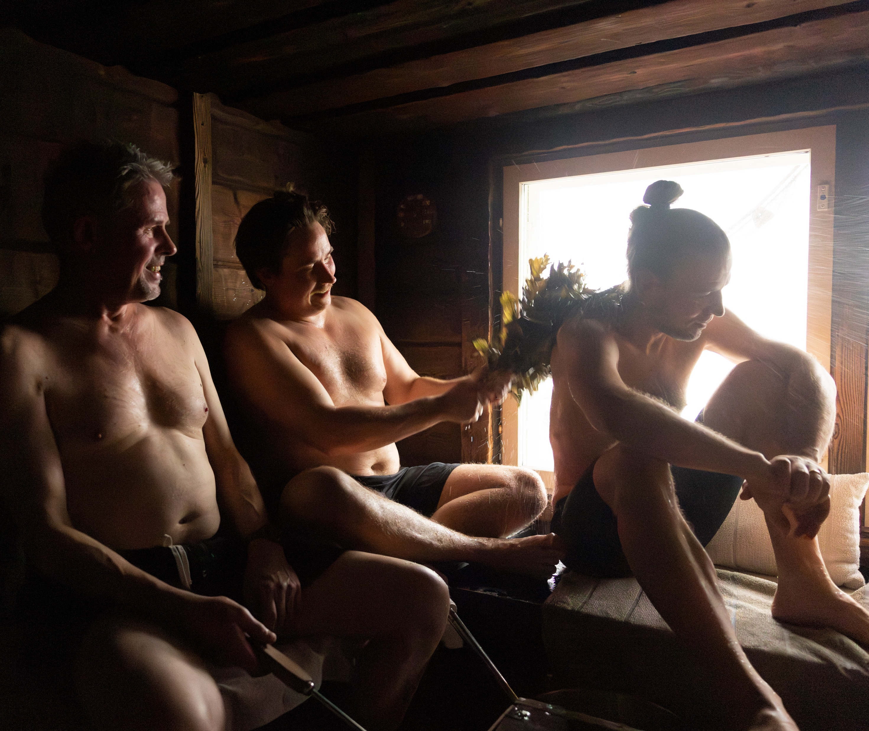
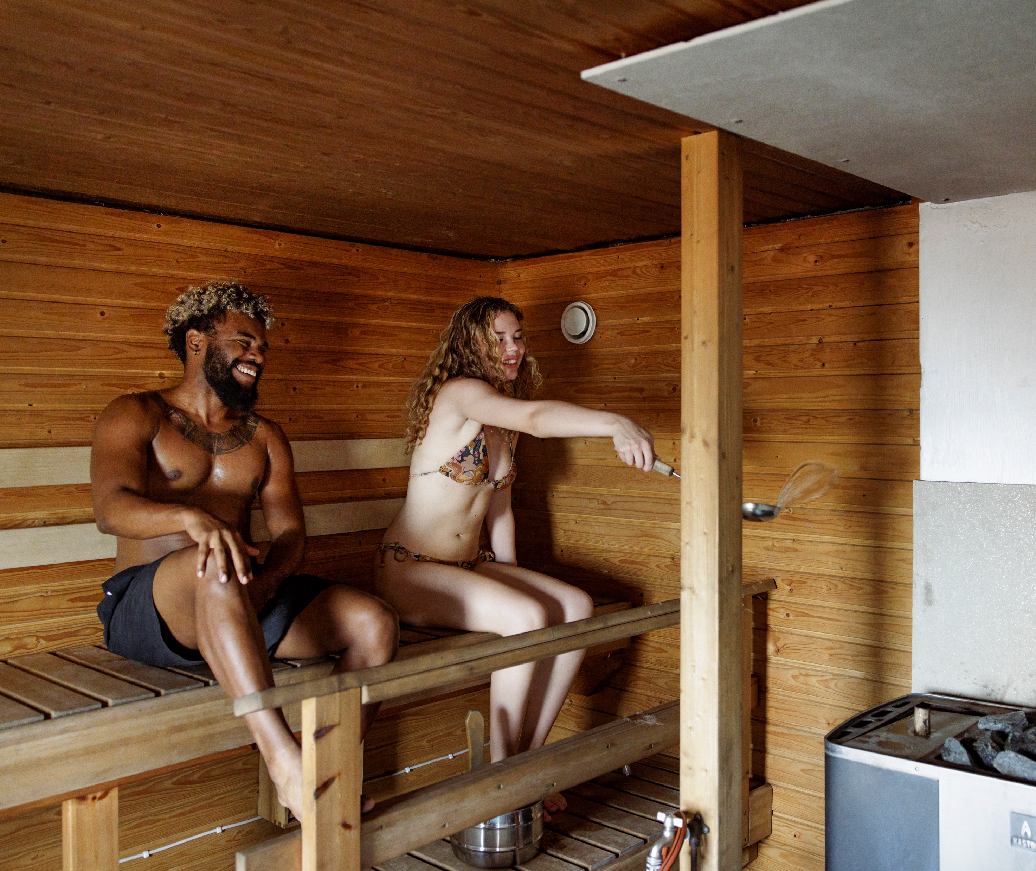
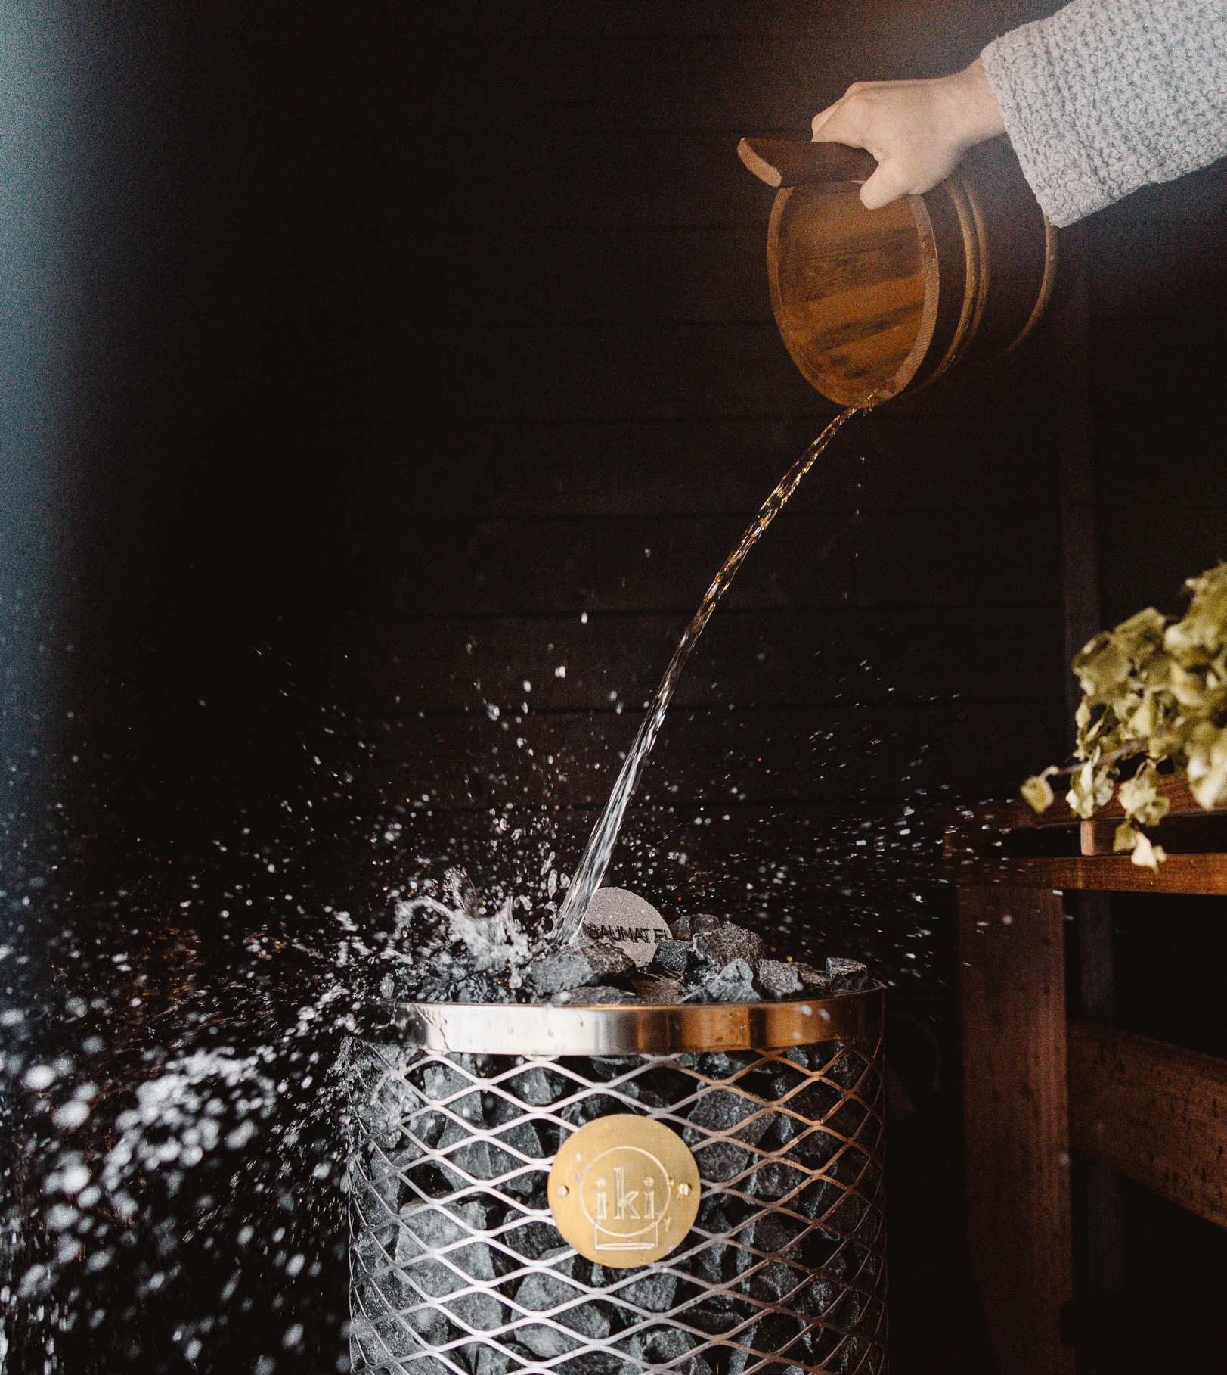
Meet löyly – The spirit of the steam
10 DEGREES OF FINNISH SAUNA
1
2
3
4
5
6
7
8
9
10
The Finnish word “löyly” means both steam and spirit.
And the only place where you can encounter this spirit is in a sauna. It is created when water is thrown onto the hot stones of the sauna heater.
Photo: Maija Astikainen
Photo: Aleksi Poutanen
Niko: Beyond the Northern Lights (2024) by Kari Juusonen and Jørgen Lerdam. Photo: Anima Vitae, Cinemaker.
Photo: Alexander Store
Notes:
For Finns, sauna has always been a place where you can disconnect from everything else and just enjoy the moment. According to ancient belief, one’s soul could even momentarily leave the body with the löyly.
Each sauna has its own personality, defined by its löyly. Some are gentle, some more intense – and every Finn has their own preference. But it is often said that a good löyly is soft, enveloping, and alive.
The important role of löyly in sauna bathing is illustrated by the fact that in Finland, people do not ask “How was the sauna?” but rather “How was the löyly?”.
One key difference from Finland is that in many countries, throwing water on the heater is restricted or even not allowed. For Finns, this is almost unthinkable, since löyly is the core of the sauna experience.
Finnish saunas are also more quiet, simple, and centered on heat, steam, and relaxation, with freedom to control löyly. International saunas are often more structured, and sensory and entertainment driven.

Slide 12
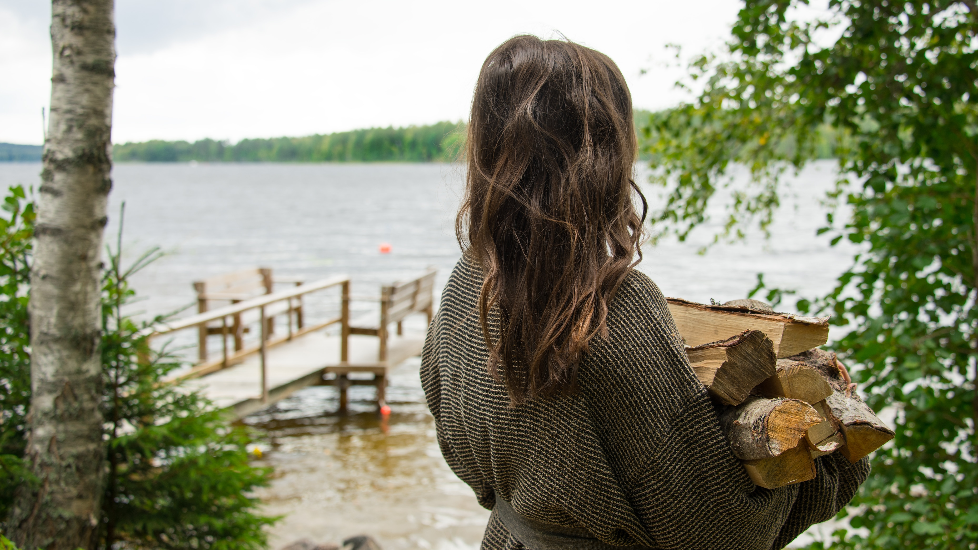
6/10
Finnish sauna is timeless
Photo: Anna-Ruotanen

Slide 13
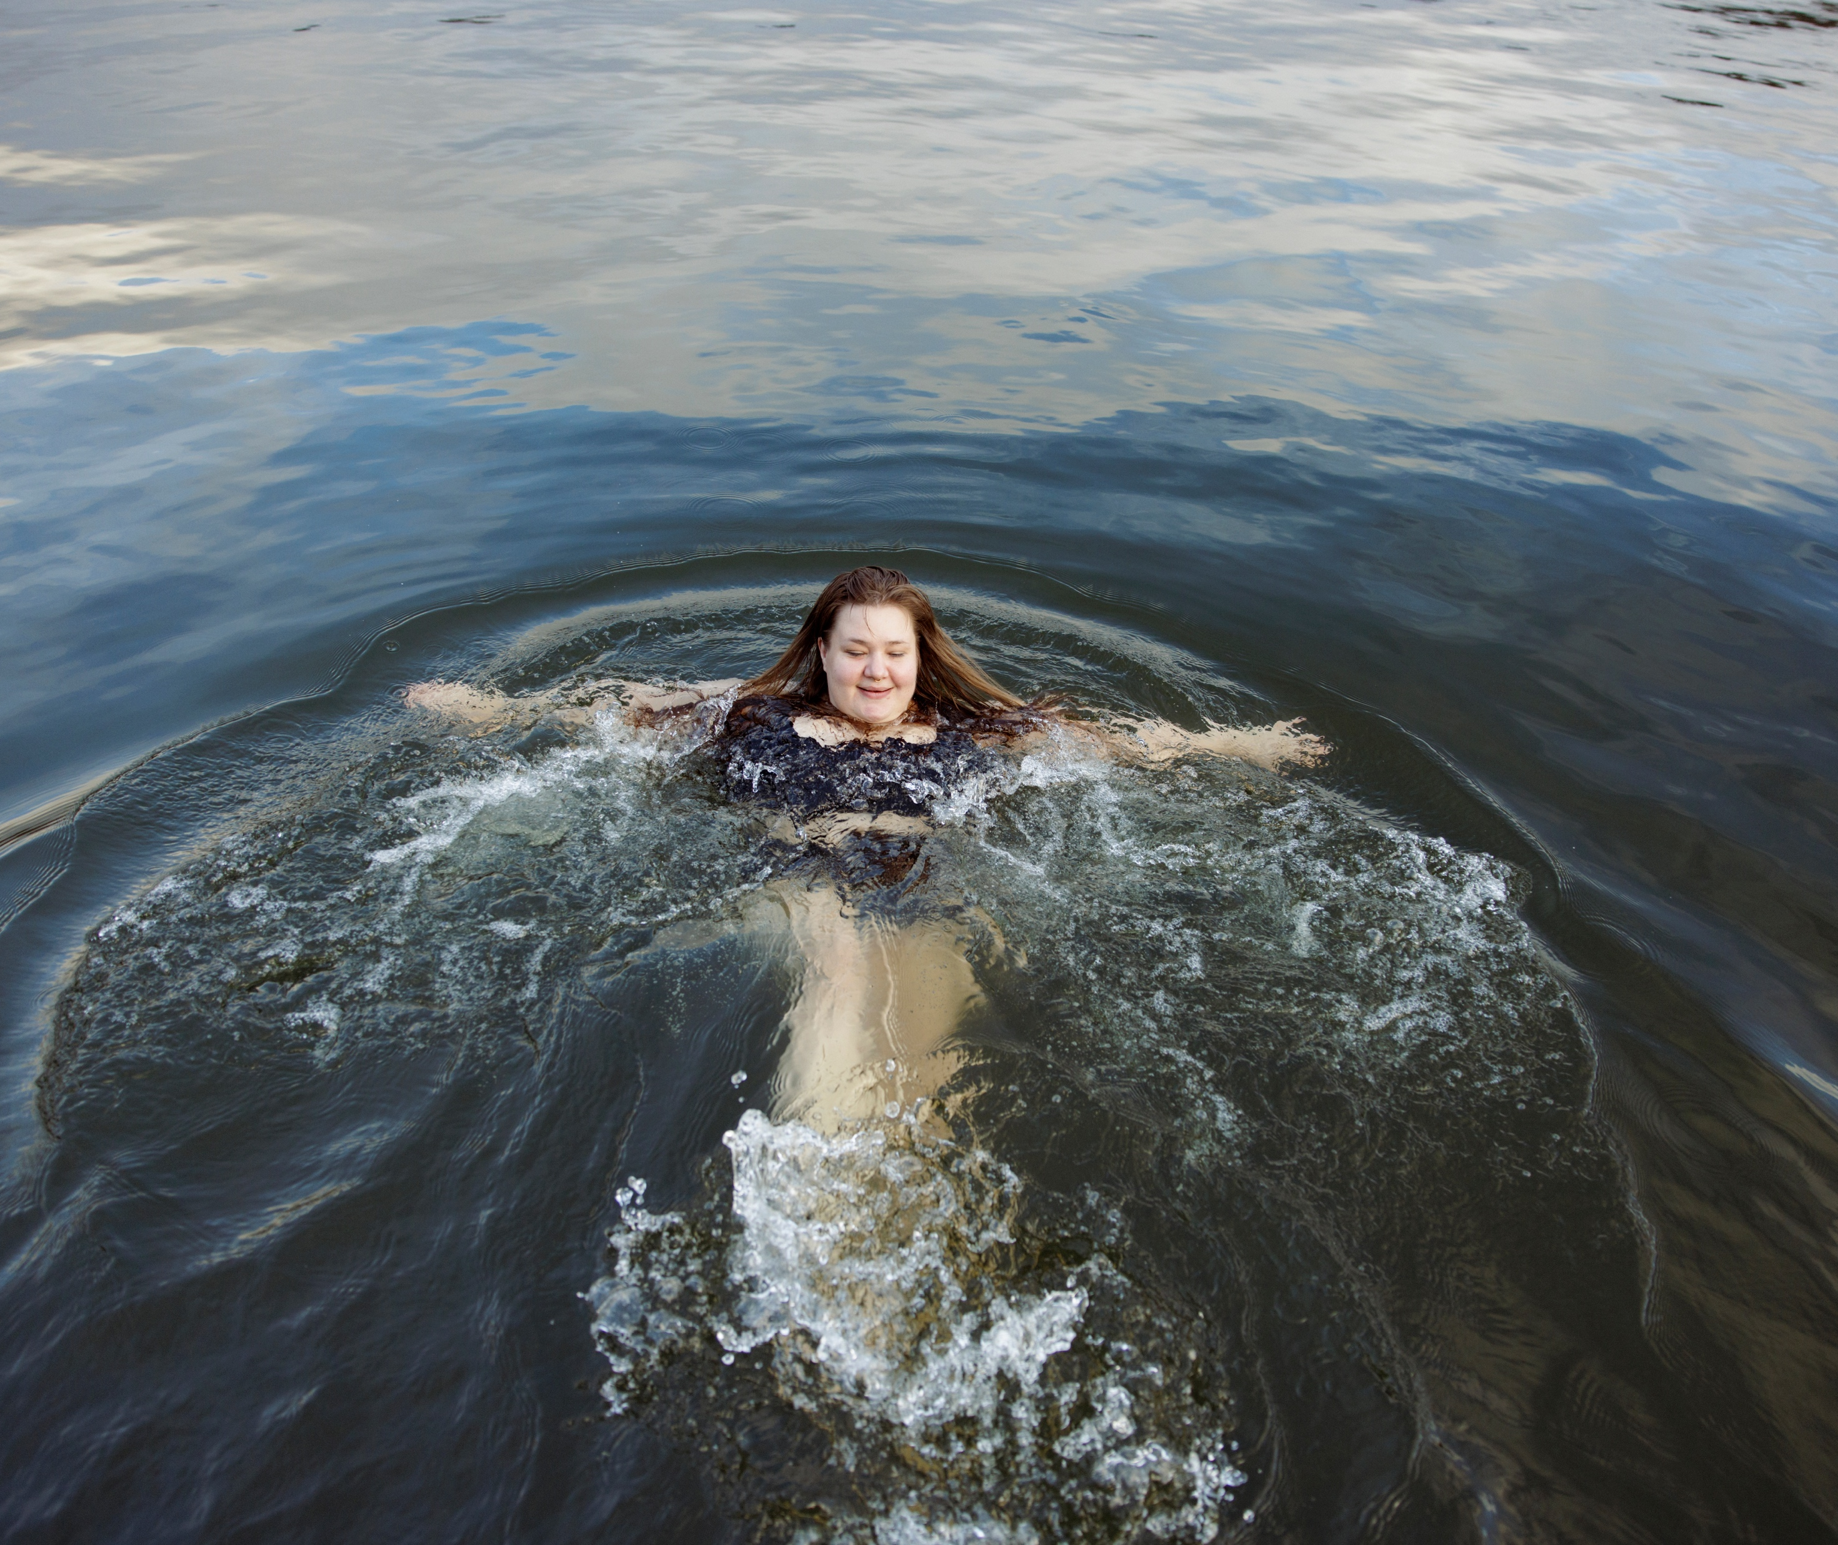
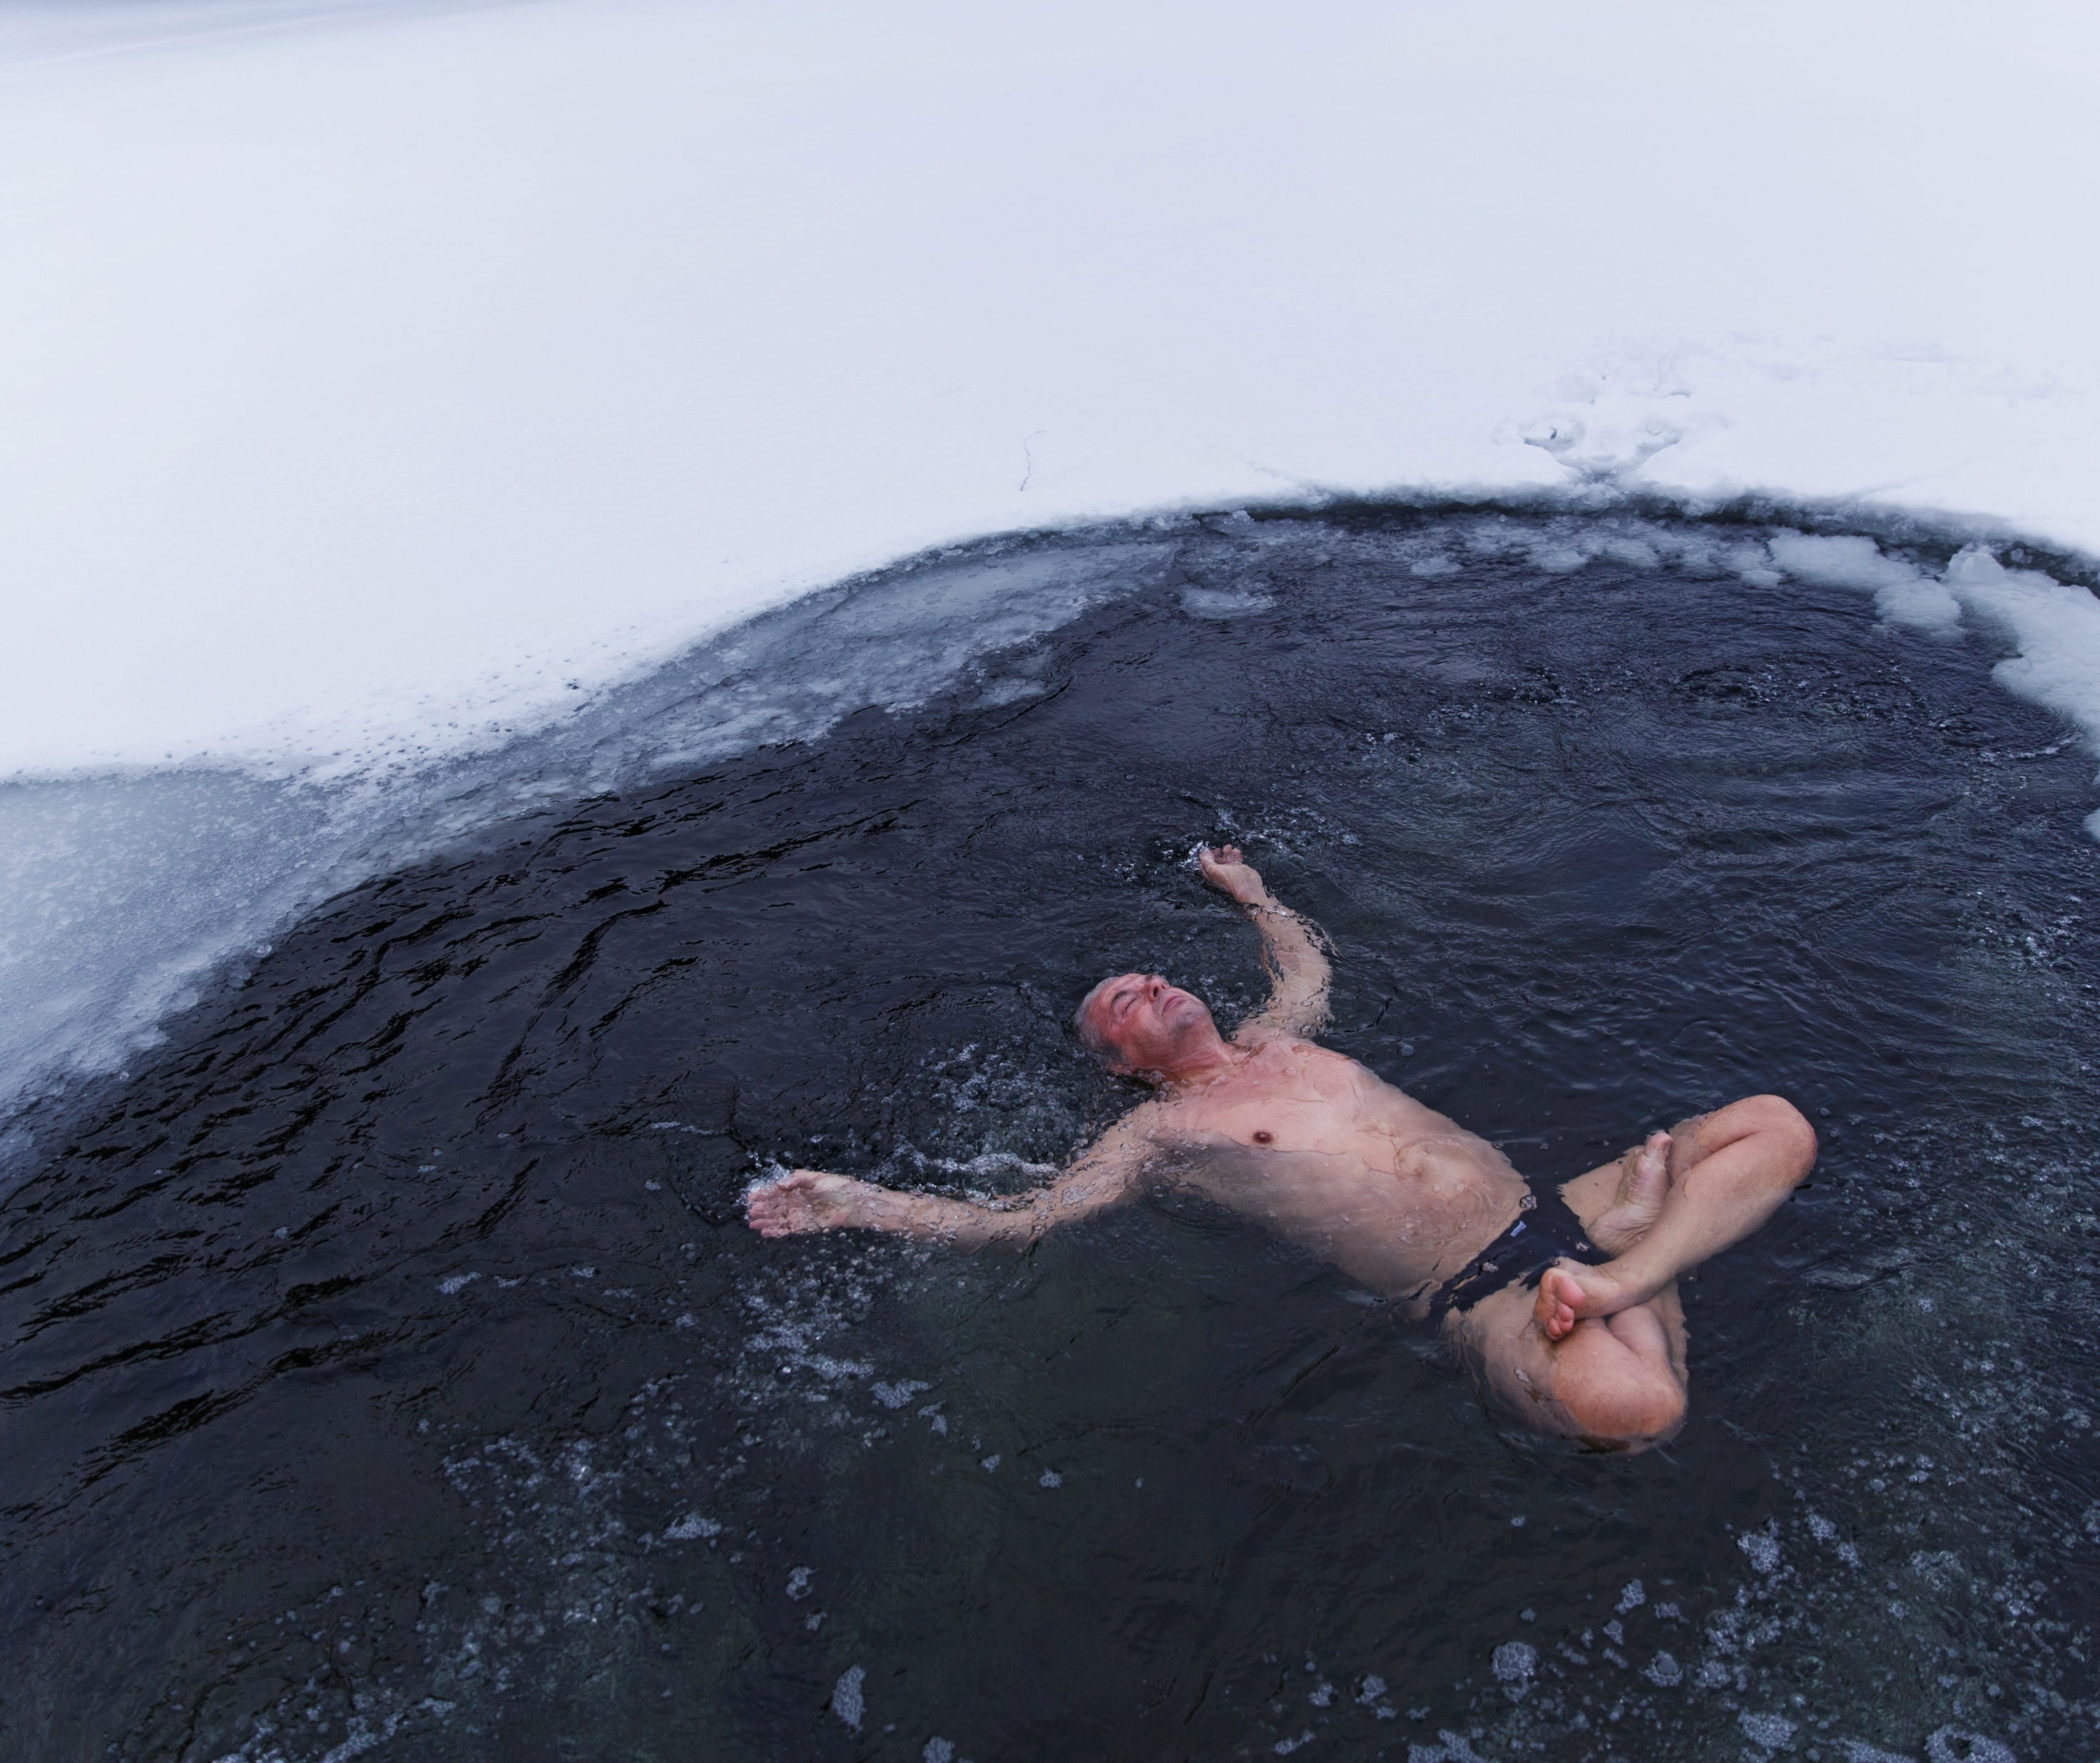
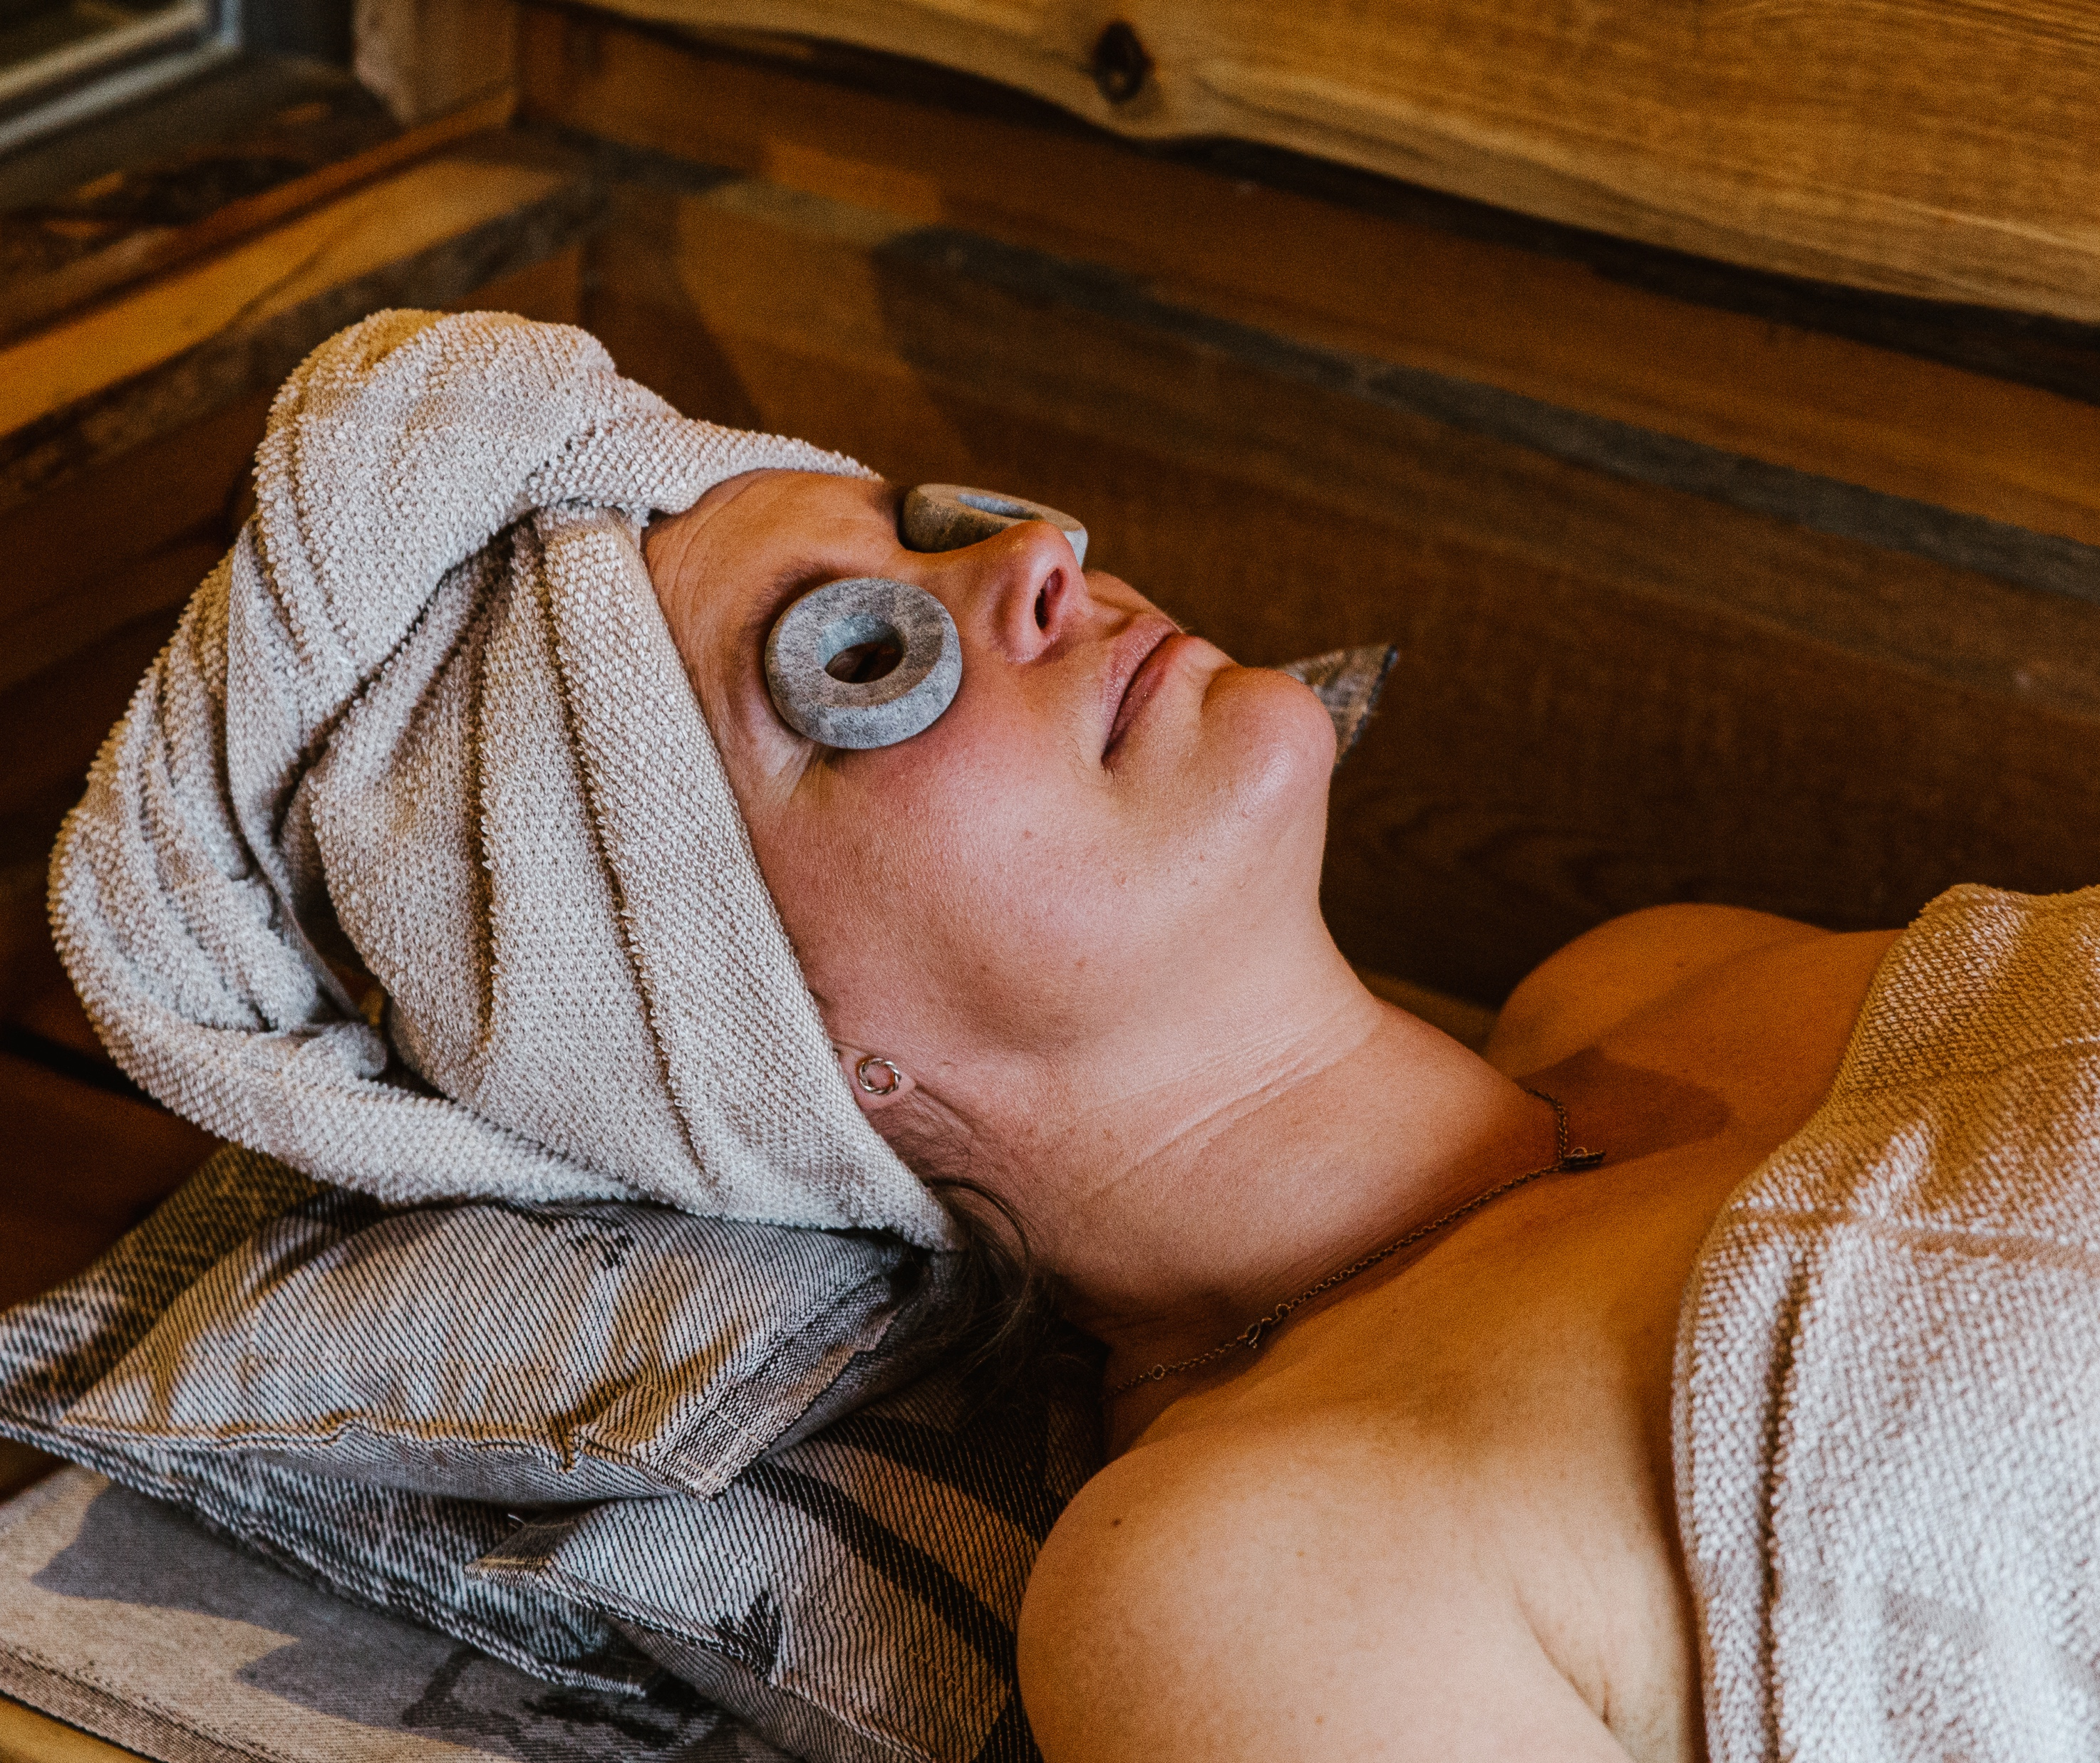
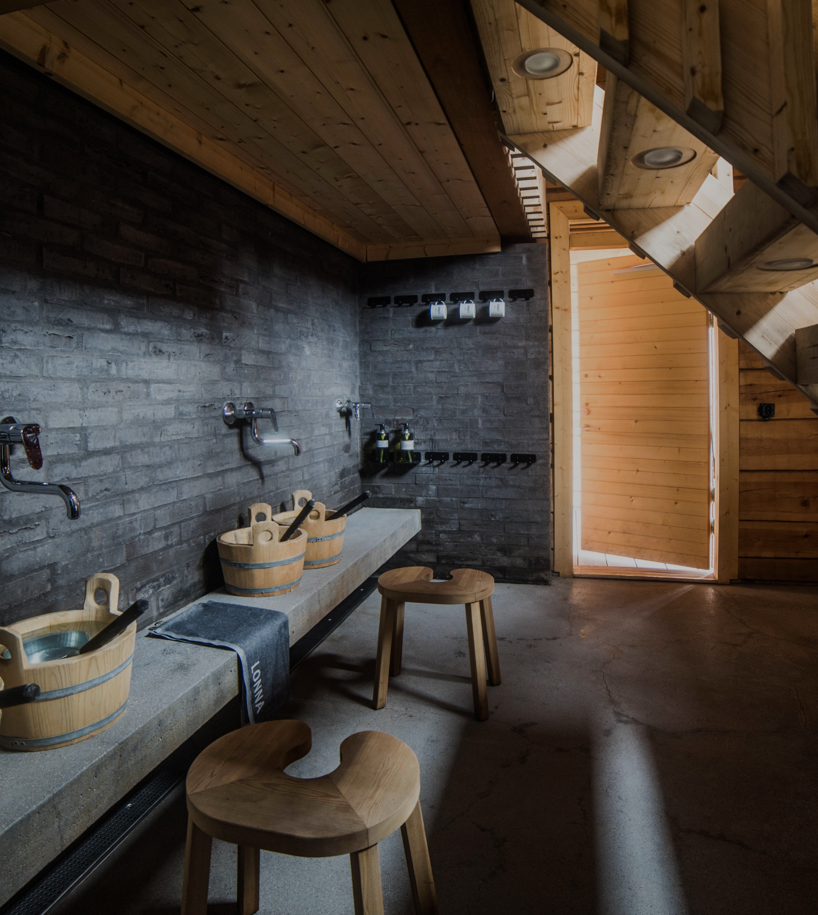
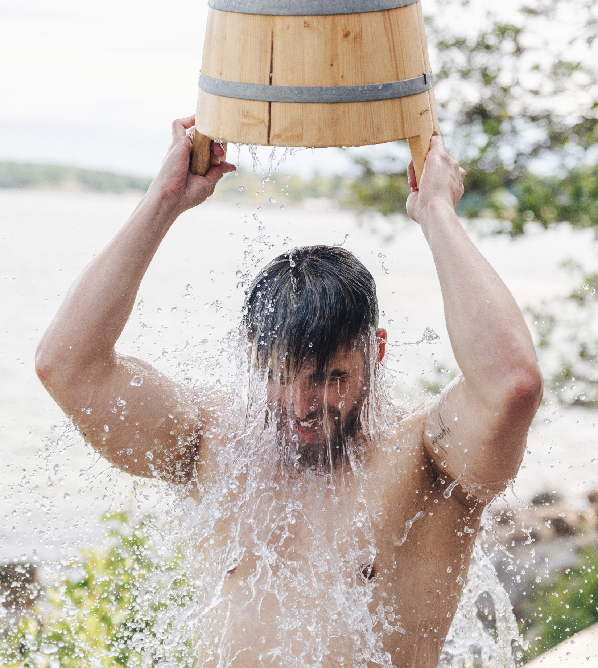
Finnish sauna is timeless
10 DEGREES OF FINNISH SAUNA
1
2
3
4
5
6
7
8
9
10
No stress, no schedule – just good vibes.
Foreigners often wonder how long one is supposed to stay in the sauna, but the truth is there are no rules. Or clocks.
Photo: Sauna from Finland
Photo: Maija Astikainen
Photo: Teemu Lautamies
Photo: Maija Astikainen
Photo: Svante Gullichsen
Notes:
How long are you supposed to stay in the sauna? Well, as long as it feels good. Using the sauna is intuitive, slow, and unmeasured – an antidote to modern life. There’s no schedule, and no stress. You can come and go as you please. You will not find a sand timer or any other kind of clock in a Finnish sauna.
Even though there are not strict rules to sauna bathing, there are some common rituals and customs. For example, cooling off between sauna sessions is an essential part of the sauna ritual. This may involve stepping outside into fresh air, swimming in a lake or sea, or rolling in snow during winter. The contrast between heat and cold is believed to refresh both body and mind.
Sauna is also often a calm, respectful space. While conversation is common among friends and family, generally loud behaviour is avoided, but on celebration days conventions may loosen. Many people treat the sauna as a place for reflection and mental relaxation.
Historically, saunas were also used for special occasions. One well-known tradition is the bridal sauna, where a bride would bathe before her wedding as a symbolic purification ritual. Sauna gatherings are still important today for bonding with family, friends, or guests, and there are many common sauna occasions:
After sports and exercise (recovery and relaxation)
“Lenkkisauna” – post-run sauna
Cold plunge (avanto) – alternating heat and ice-cold water
Communal apartment saunas (taloyhtiösauna)
Celebrations: birthdays, bachelor/bachelorette parties, baby showers
Seasonal events: Christmas (joulusauna), Midsummer (juhannus), Easter, and harvest festivals (kekri)
Construction milestones: topping-out ceremonies
Sports victories and team bonding, “Poika saunoo”

Slide 14
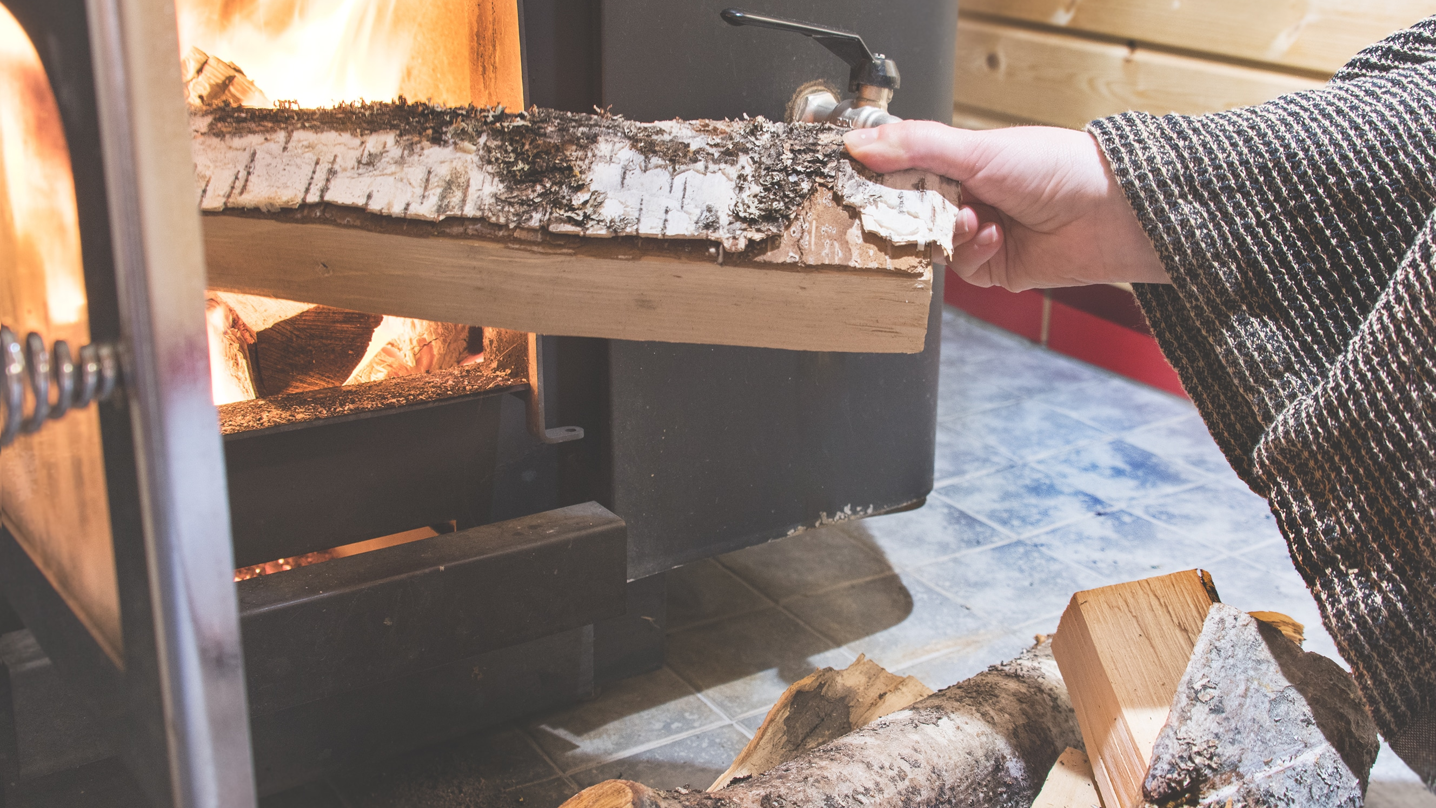
7/10
The nature of sauna –
Full of tradition and rituals
Photo: Anna Ruotanen

Slide 15
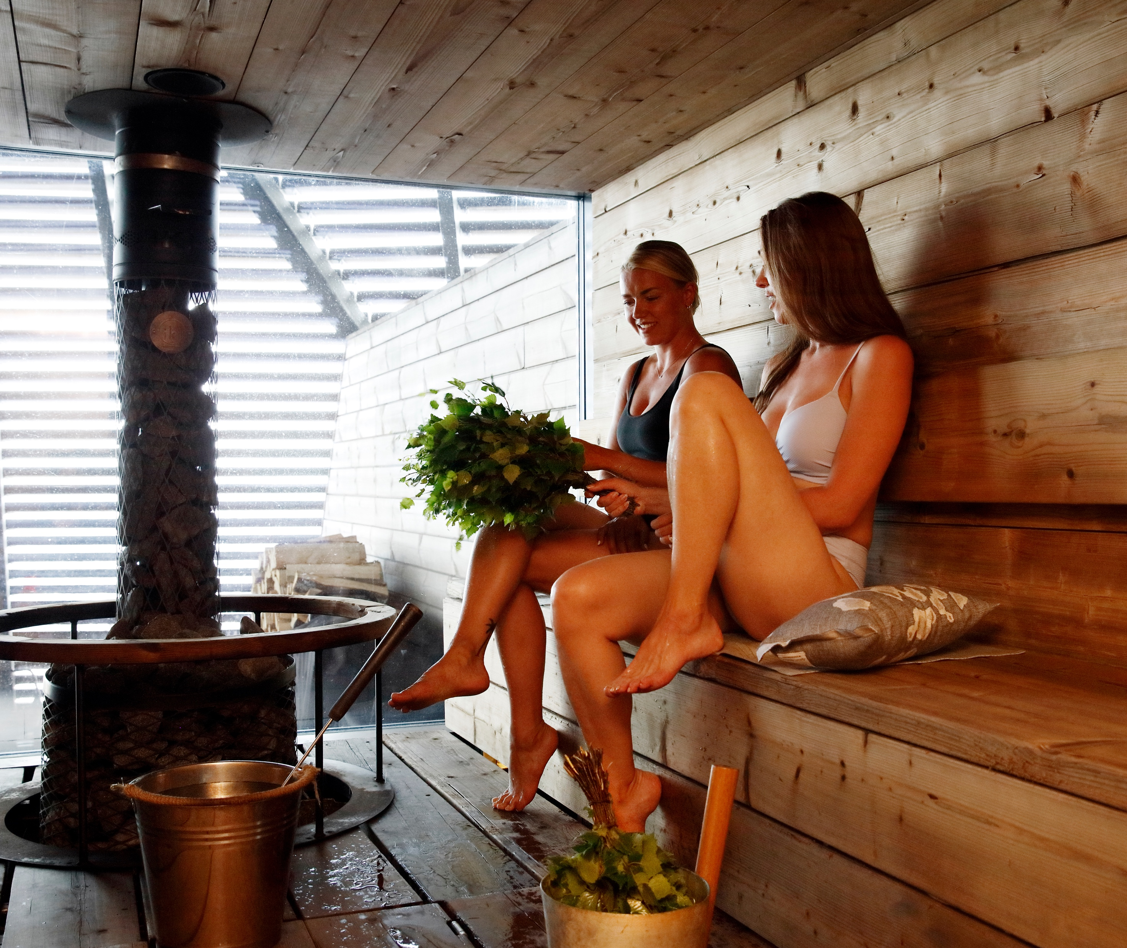
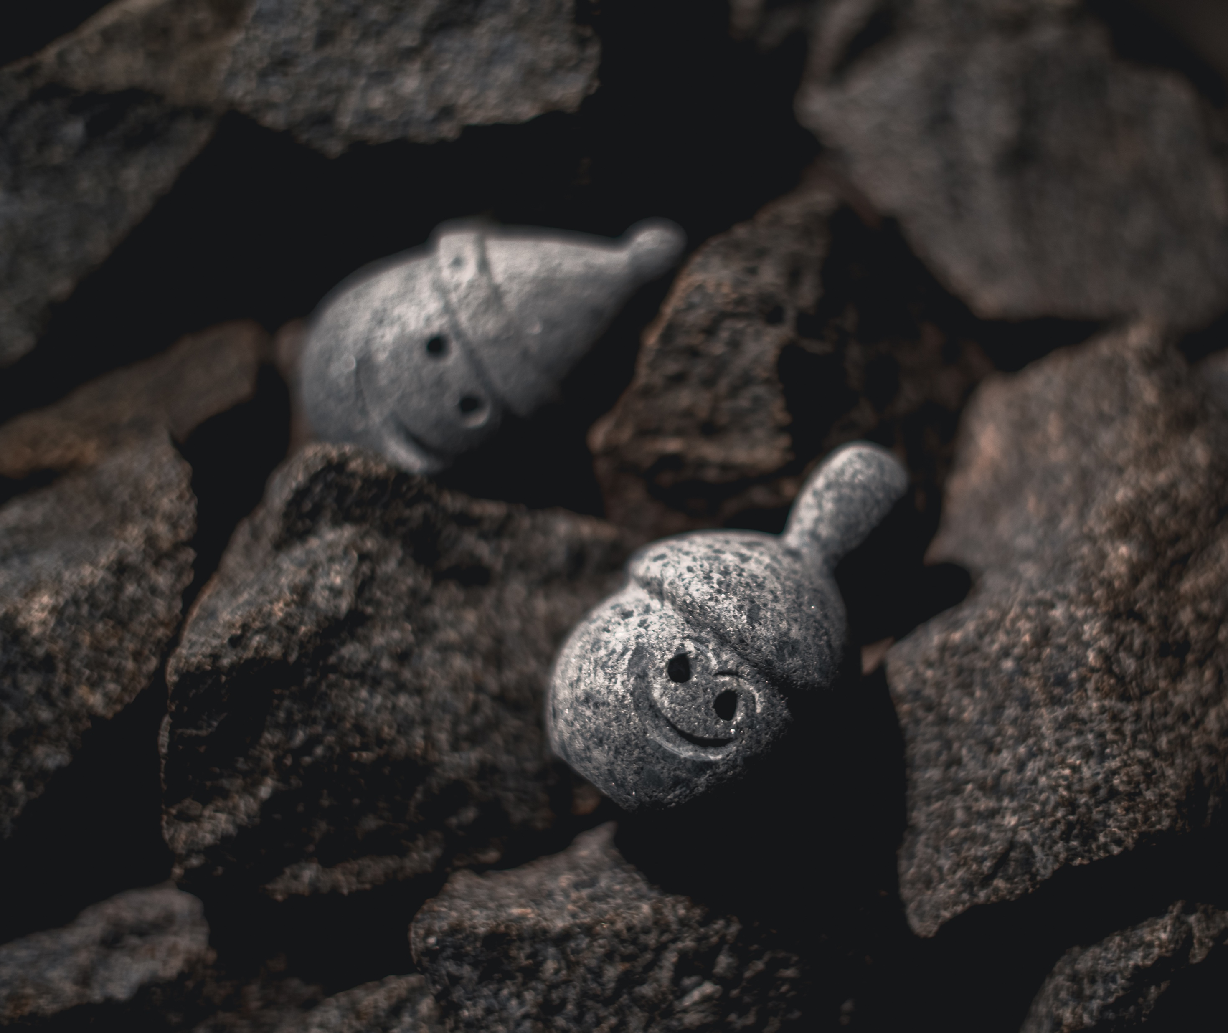
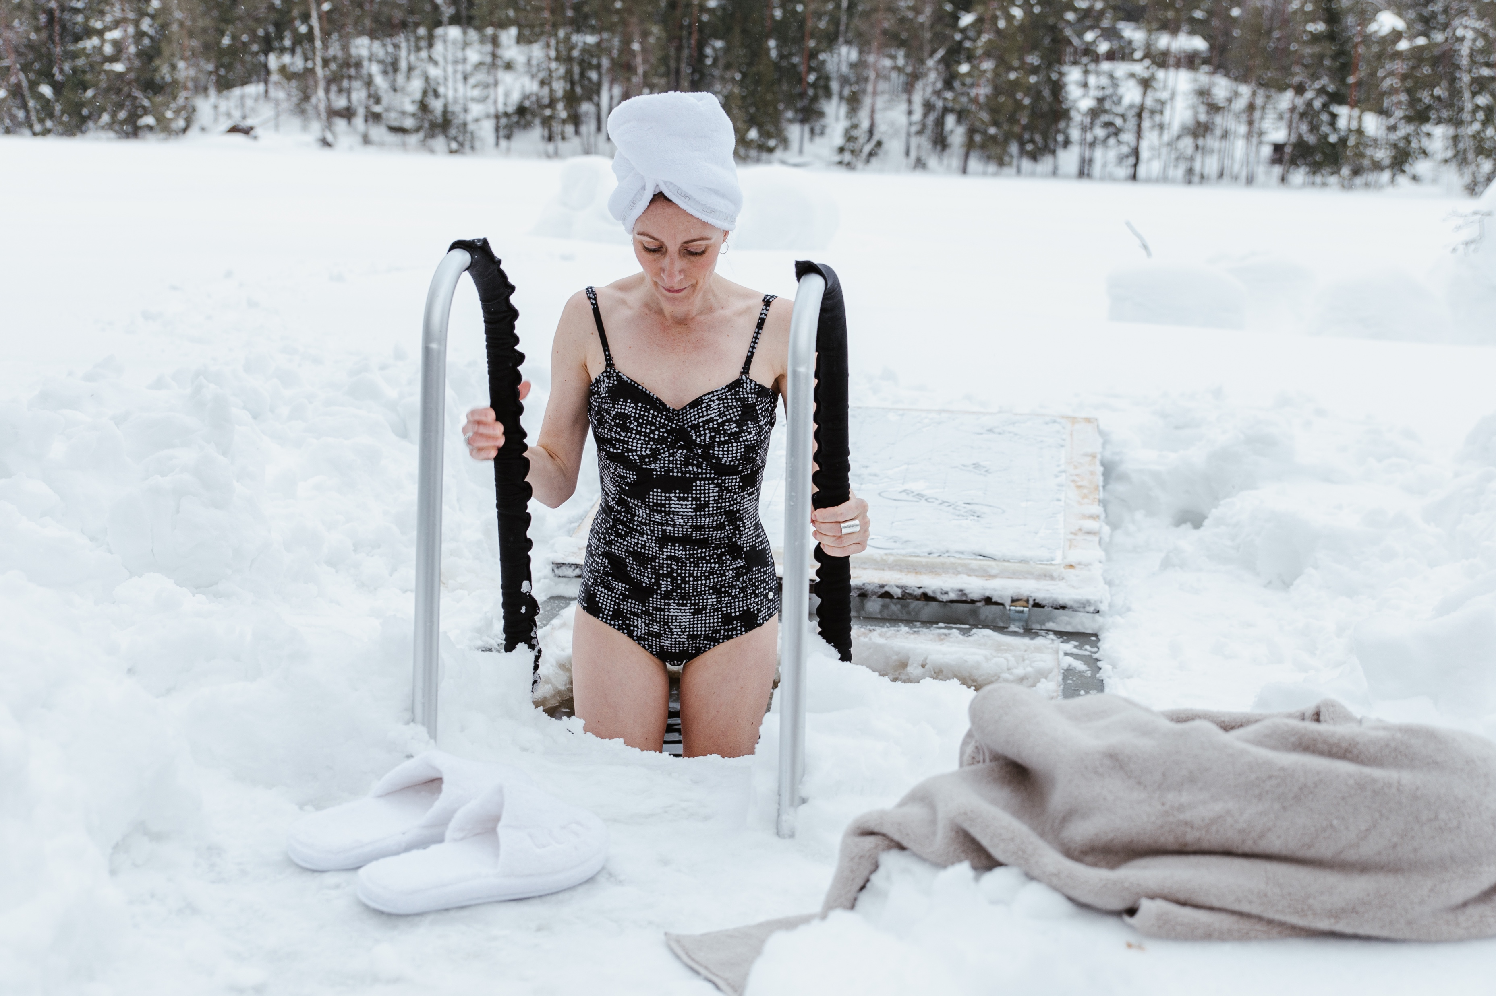
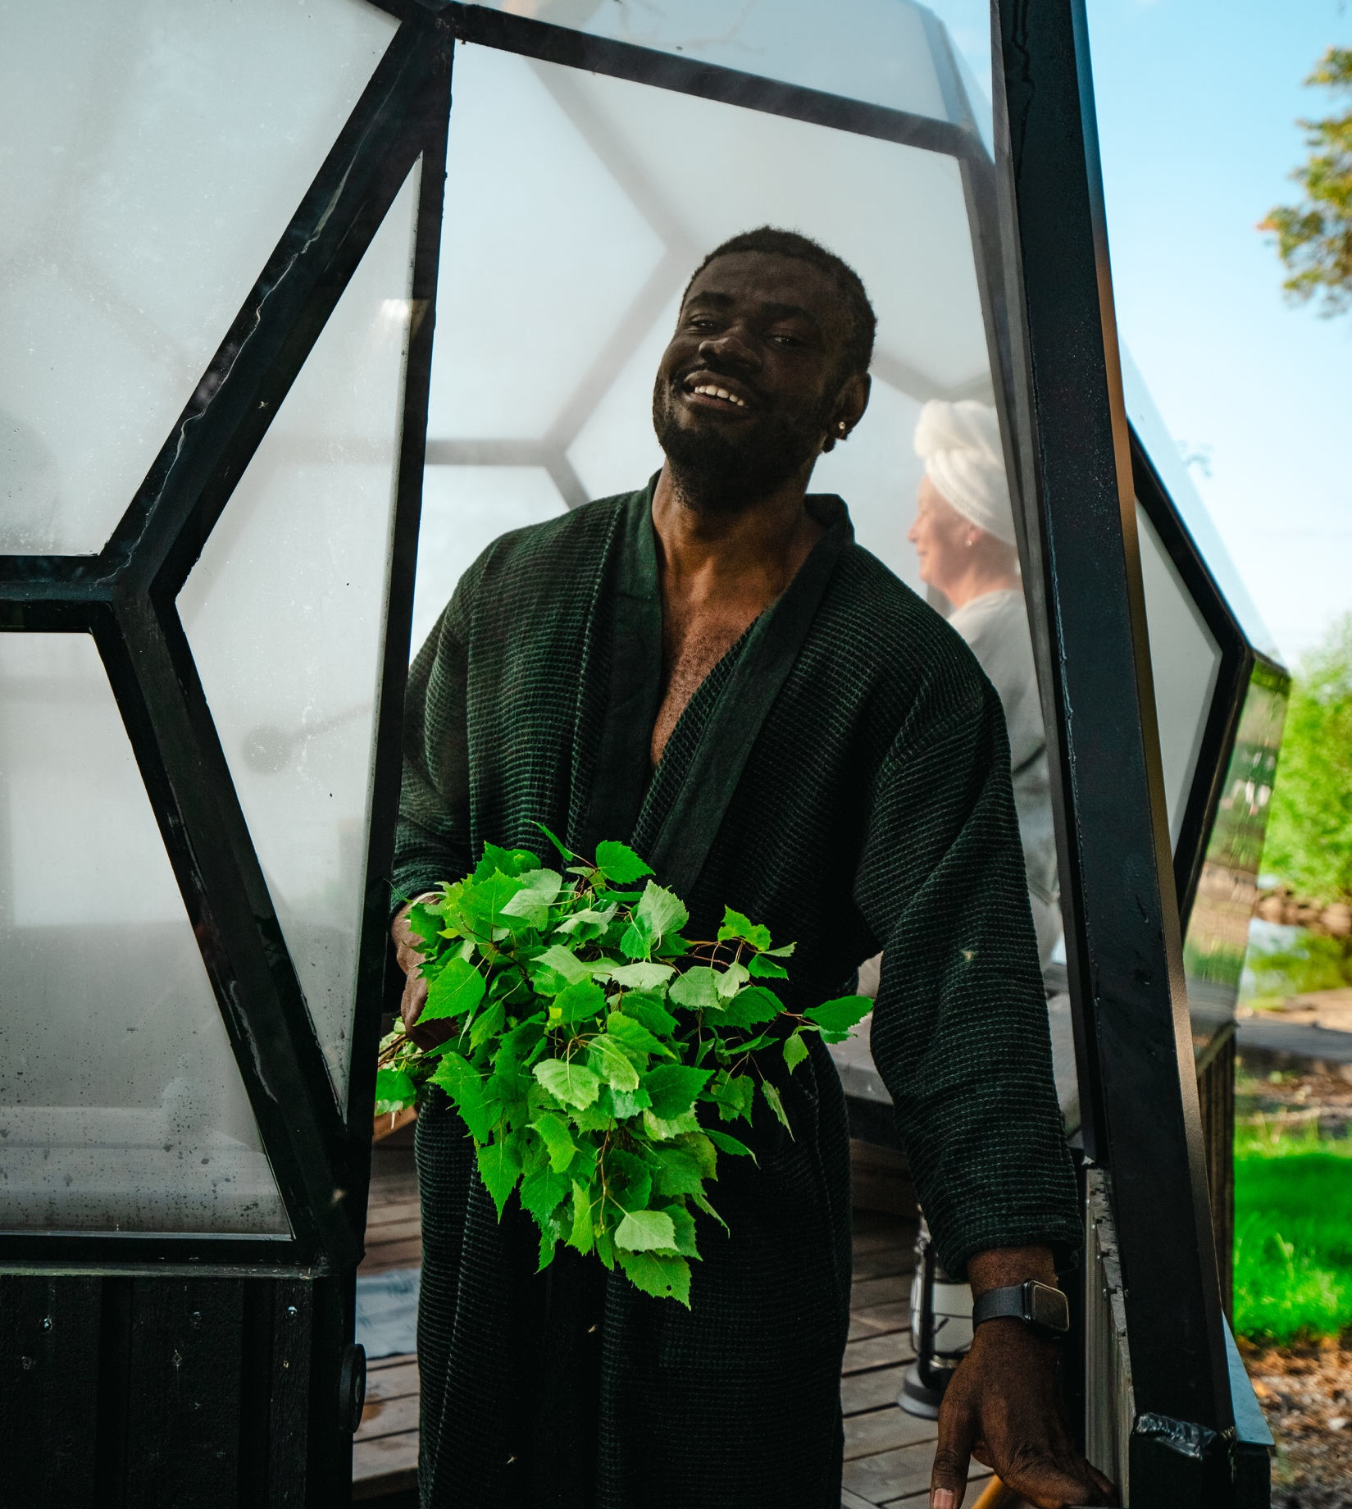
The nature of sauna – Full of tradition and rituals
10 DEGREES OF FINNISH SAUNA
1
2
3
4
5
6
7
8
9
10
A touch of birch and midsummer magic.
The scent of birch is the smell of Finnish summer – and the aroma of a good löyly where a vihta, or vasta, is used.
Photo: Sauna from Finland
Photo: Sauna from Finland
Photo: Karoliina Barlund
Photo: Sauna from Finland
Notes:
Whisking (vihtominen) is a traditional Finnish sauna practice where a bundle of fresh birch branches, called a vihta (western Finland) or vasta (eastern Finland), is used to gently stroke, tap, or lightly beat the skin while sitting in a hot sauna.
Before use, the birch bundle is typically soaked in warm water to soften the leaves and release a fresh, natural aroma. The sauna heat combined with whisking helps stimulate blood circulation, relax muscles, and increase sweating, which many people believe enhances the cleansing and refreshing effect of the sauna.
The sensation is usually pleasant rather than painful; it’s more like a rhythmic massage using natural materials. The birch leaves also contain essential oils that add to the calming and invigorating atmosphere.
Whisking is deeply rooted in Finnish sauna culture and is especially associated with summer traditions, when fresh birch branches are readily available. Even today, it remains a widely practiced and cherished part of an authentic Finnish sauna experience.
Another old sauna tradition is cupping. The sauna environment played an important role because heat was thought to enhance cleansing and healing. Beyond cupping, saunas were also widely used for hygiene and even for treating conditions like lice, especially in earlier rural and wartime Finland.
Today, cupping in Finland is mostly seen as a traditional or alternative therapy rather than a medical treatment, but it remains part of cultural heritage and historical sauna practices, even though it is not as common as whisking.
Some spirits and creatures are also associated with sauna: The saunatonttu, or “sauna elf”, a gentle mythical spirit of the sauna, is believed to watch over the sauna and protect it. In Finnish tradition, this small guardian is treated with respect, as keeping a good relationship with the tonttu is thought to bring harmony and well-being to the sauna.
There are also many traditional sayings about sauna, including:
If tar, vodka, and sauna don’t help, nothing will.
One is born in the sauna and may die in the sauna.
The sauna is a Finn’s best doctor.
Be quiet in the sauna so the steam (löyly) does not escape.
Good steam (löyly) brings a better mood.
After the sauna, the world looks better.
Peace is born in the steam (löyly).

Slide 16
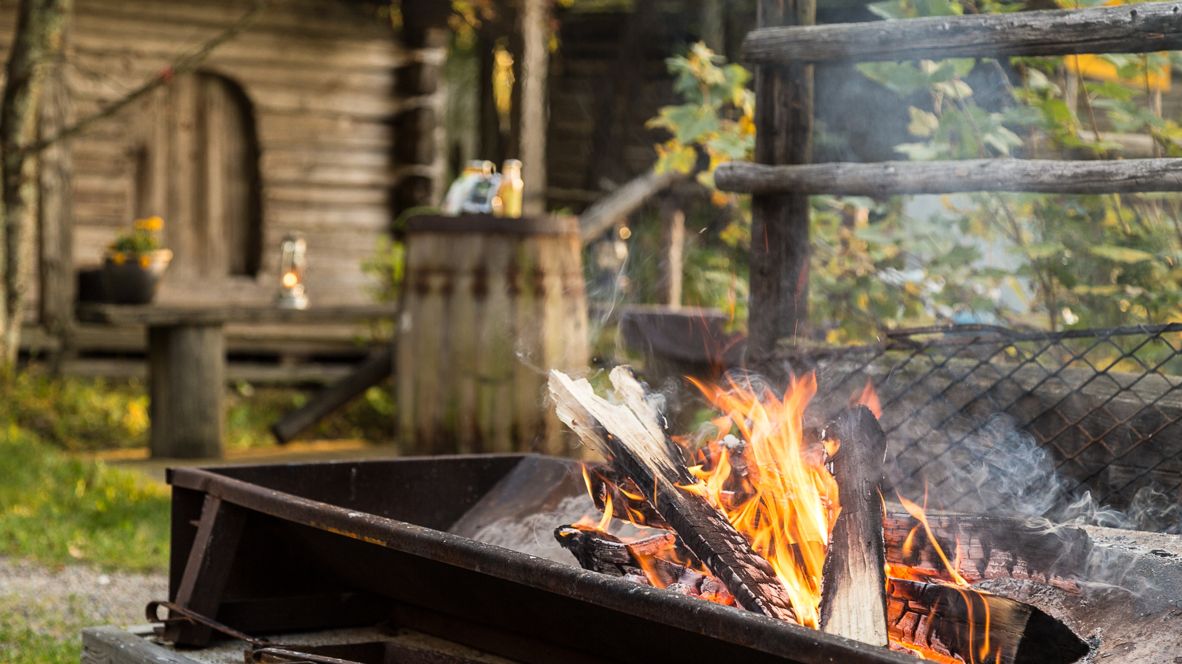
8/10
Snacking pairs perfectly with the warmth
Photo: Sauna from Finland

Slide 17
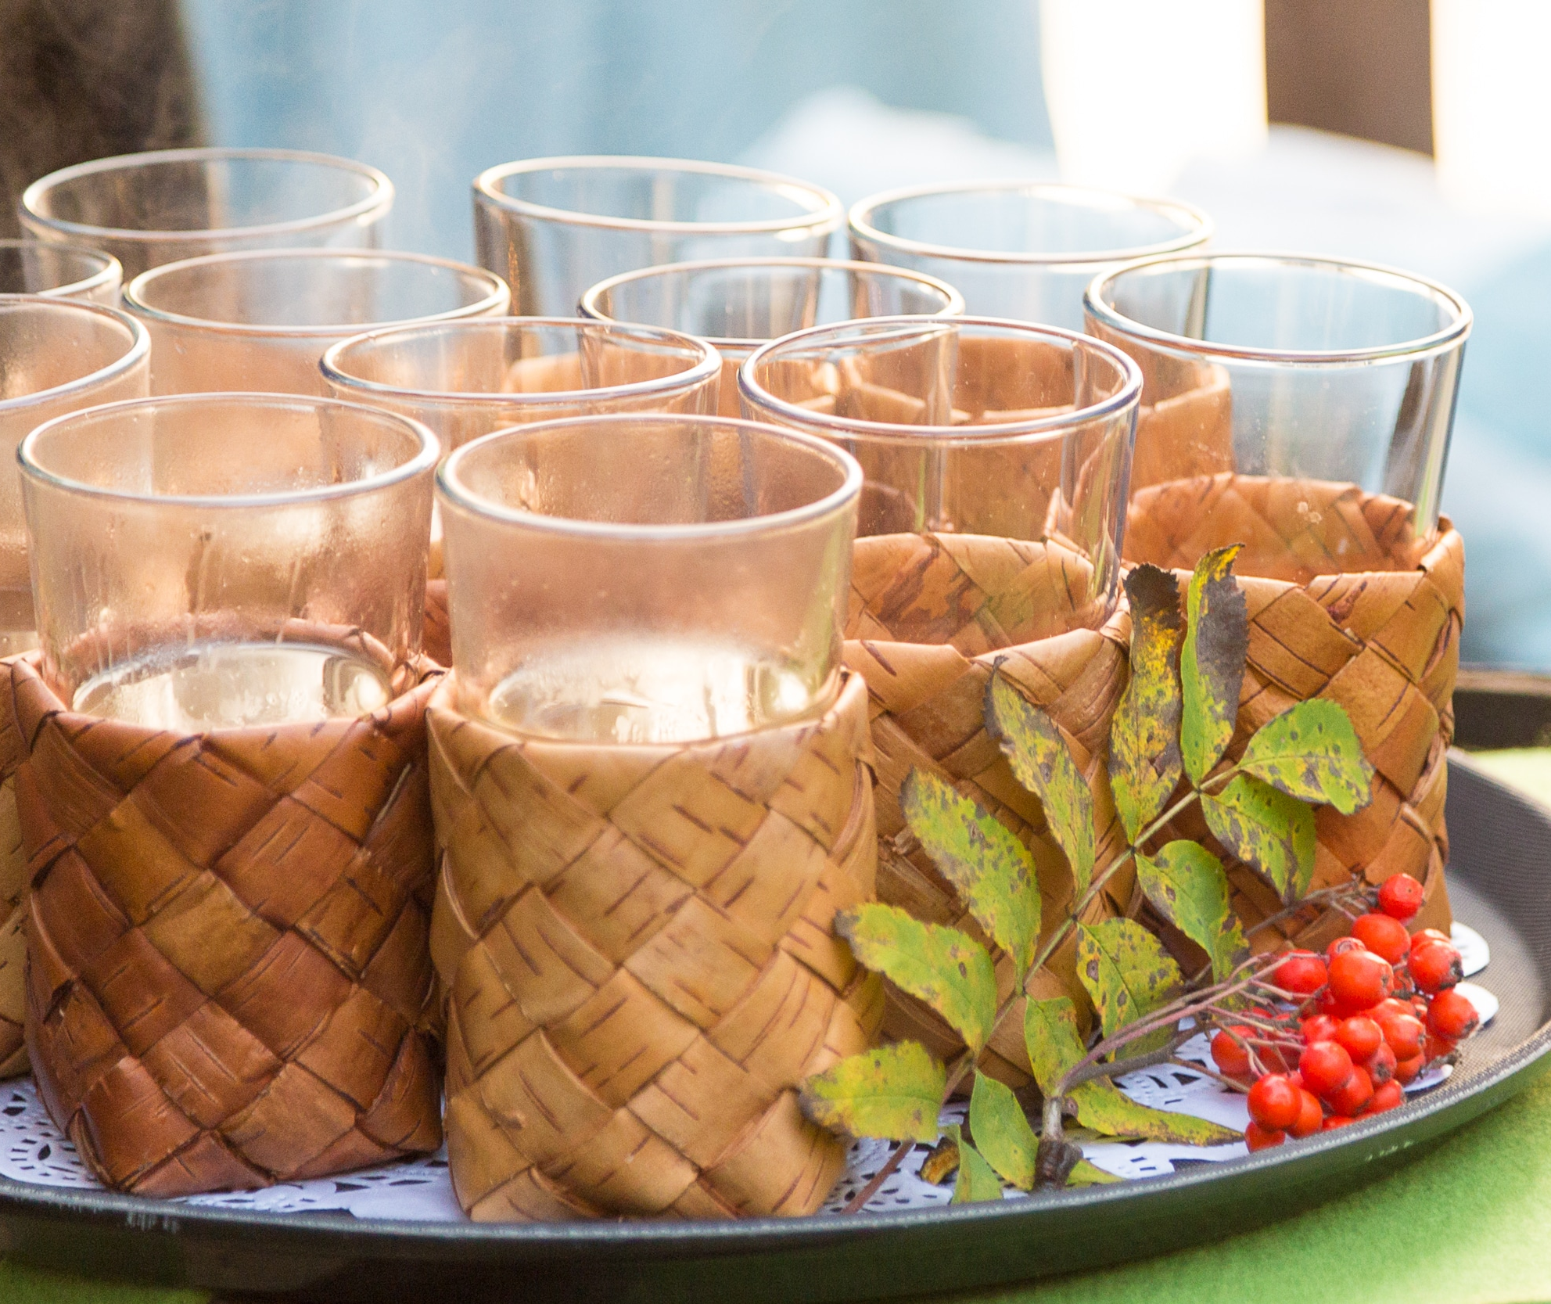
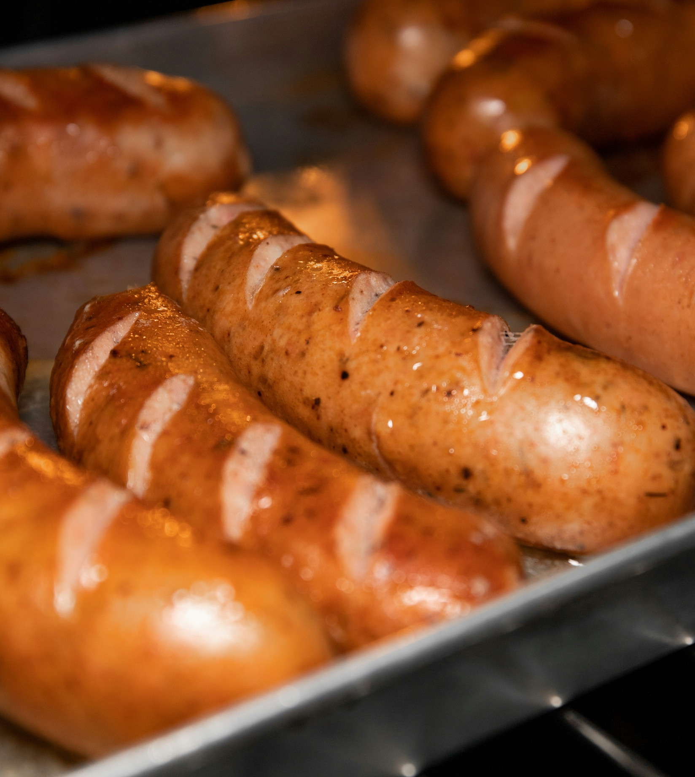
Snacking pairs perfectly with the warmth
10 DEGREES OF FINNISH SAUNA
1
2
3
4
5
6
7
8
9
10
Hot sauna, cold drinks, and hearty food.
Especially sausages, or “saunamakkarat”, are very common food in Finnish sauna.
Photo: Sauna from Finland
Photo: Amanda Lim
Notes:
Sauna snacks such as sausages (saunamakkara) and beer are common in informal settings, especially among friends and family. In many Finnish sauna traditions, a simple meal or light snack is enjoyed either during breaks or after bathing, often eaten outdoors in the fresh air. The combination of hot sauna, cold drinks, and hearty food is seen as part of a relaxed and social experience, where time slows down and conversation flows easily.
Sausages can be prepared in several traditional ways during sauna gatherings. They are often grilled over an open fire or a barbecue, giving them a smoky flavour and crispy texture. At summer cottages, they may also be roasted on sticks over a campfire or wrapped in foil and gently warmed. A popular variation is “kiuasmakkara”, where the sausage is carefully placed near or around the sauna stove to slowly heat in the rising warmth of the sauna.

Slide 18
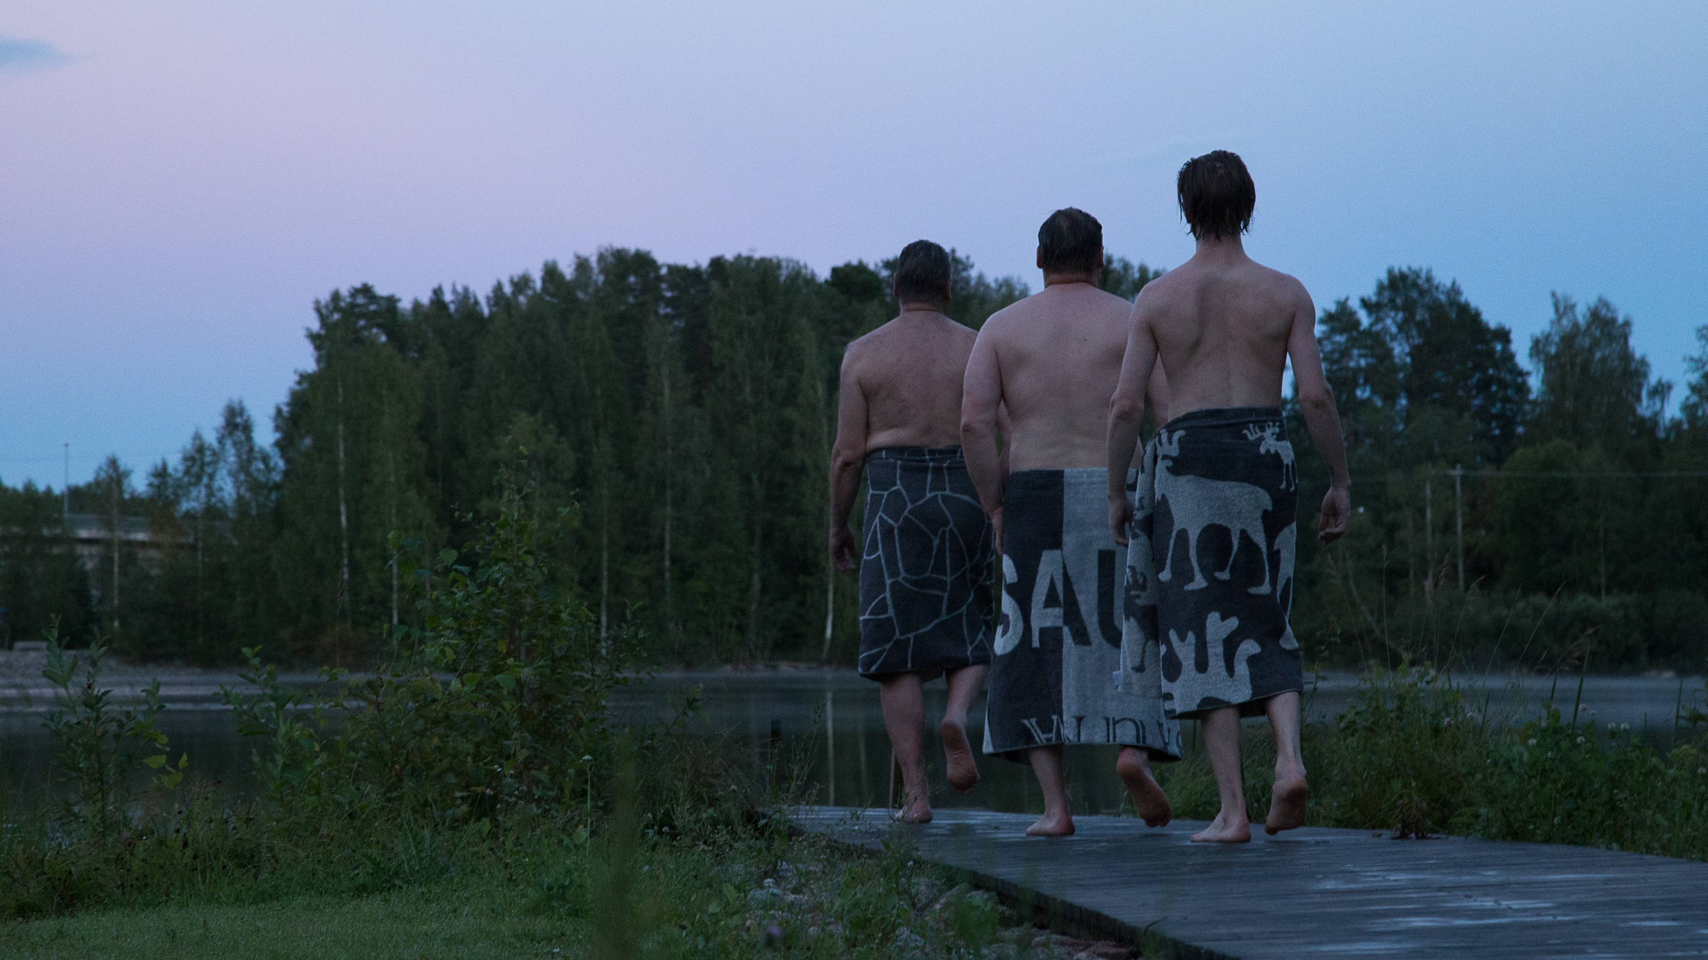
9/10
A spring of wellbeing:
Sweat, silence and smiles
Photo: Sauna from Finland

Slide 19
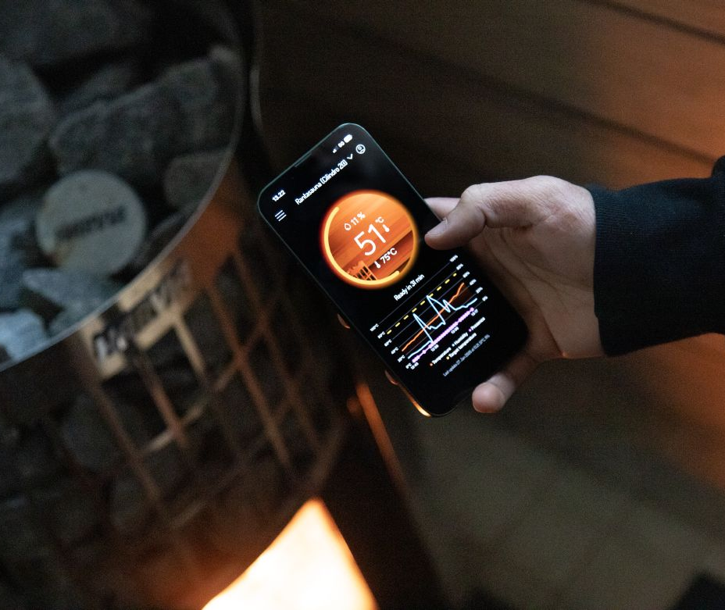
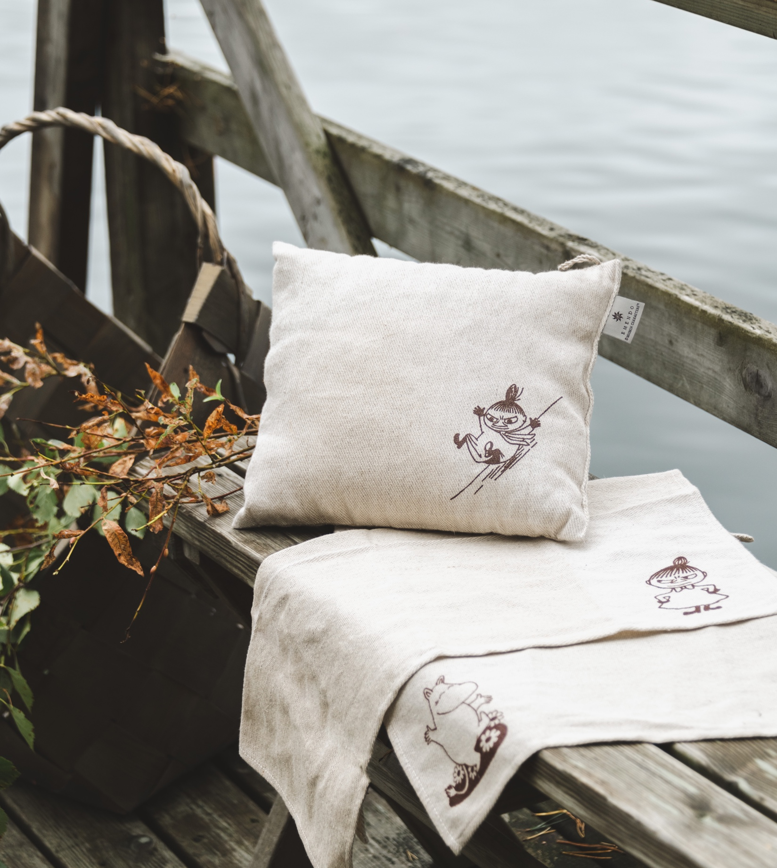
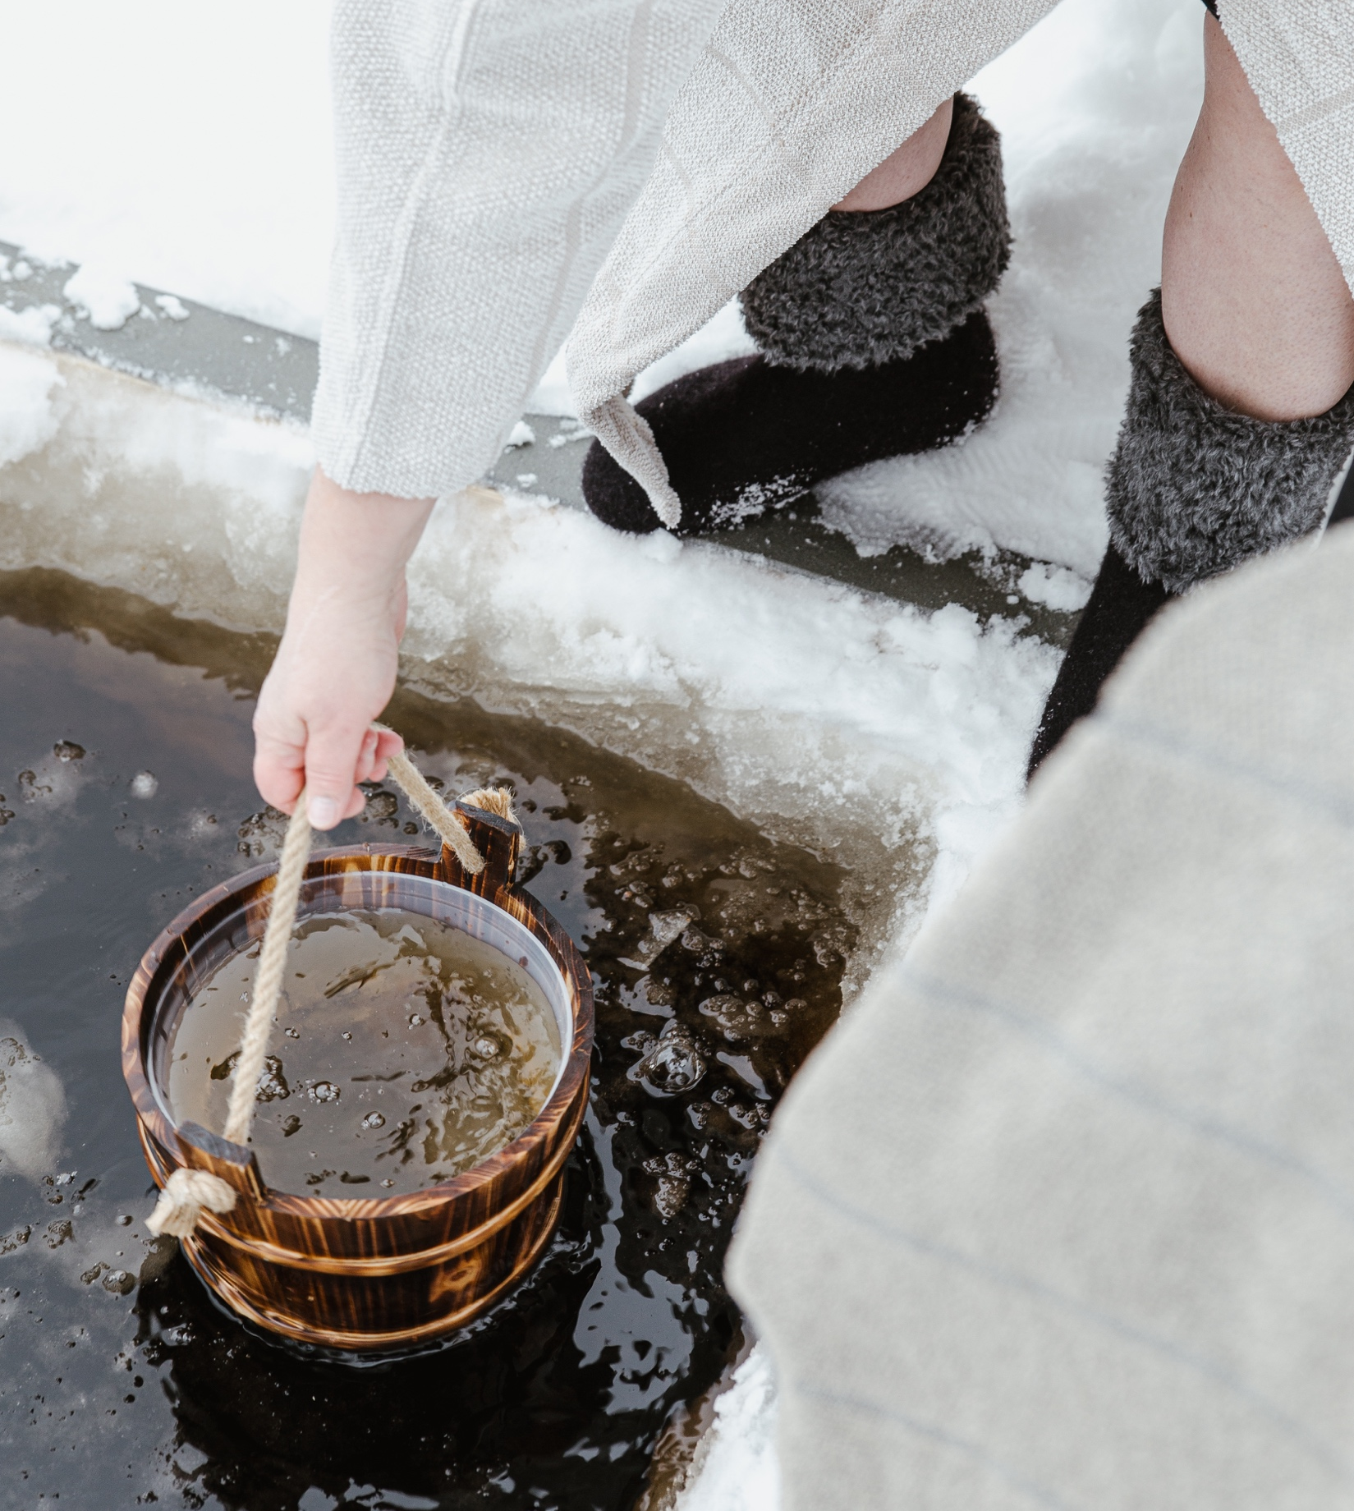
A spring of wellbeing: Sweat, silence and smiles
10 DEGREES OF FINNISH SAUNA
1
2
3
4
5
6
7
8
9
10
Then: An ancient understanding of balance and recovery.
Now: Contrast therapy — alternating heat and cold — is a growing global wellness trend.
Photo: Sauna from Finland
Photo: Harvia
Photo: Sauna from Finland
Photo: Sauna from Finland
Notes:
Sauna supports mental, physical, and social wellbeing. It relaxes muscles, reduces stress, and improves sleep. In addition to being an ancient understanding of wellness, Finnish sauna is also very relevant today: Contrast Therapy is one of the biggest wellness trends in the world in 2026.
Research also suggests that regular sauna bathing may be associated with several longer-term health benefits. Studies, particularly from Finland, have linked frequent sauna use with improved cardiovascular health, including lower risk of high blood pressure and heart disease. Heat exposure increases heart rate and improves circulation in a way similar to moderate exercise, which may support overall heart function.
Some research also indicates potential benefits for brain health and stress resilience, including a reduced risk of dementia and improved mood, possibly due to relaxation effects and improved blood flow. Additionally, sauna use may support recovery after physical activity by easing muscle soreness and reducing inflammation.
While these findings are promising, most experts emphasize that sauna is a supportive wellness practice rather than a medical treatment. The benefits are strongest when sauna bathing is done regularly, safely, and as part of a healthy lifestyle.
While sauna does not have any strict rules to follow, there are a few things that are polite to take into account. The Finnish sauna etiquette is roughly as follows, especially when bathing in a public sauna with people you don’t know:
Wash before entering.
Sit on a seat cover for hygiene.
Keep a calm and respectful atmosphere.
Speak quietly or remain silent.
Ask before adding more water on the heater when others are present.
Respect personal space.
Consider others when sharing a public sauna.
And some nudity etiquette:
In Finnish culture, nudity in the sauna is traditionally non-sexual and natural.
It is associated with equality and practicality.
In public or mixed saunas, swimwear or towels may be used depending on context.
Comfort and consent are essential.
In international settings, expectations should always be clarified in advance.

Slide 20
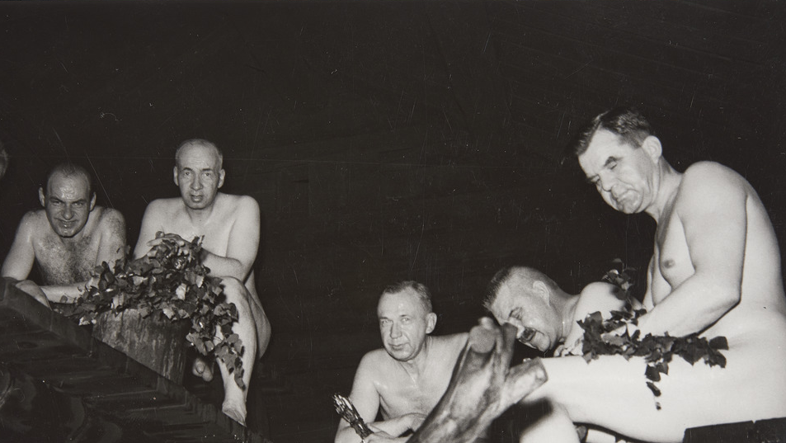
10/10
Sauna diplomacy
and peacebuilding
Photo: Museovirasto

Slide 21
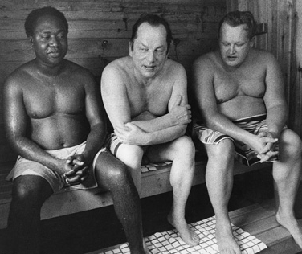
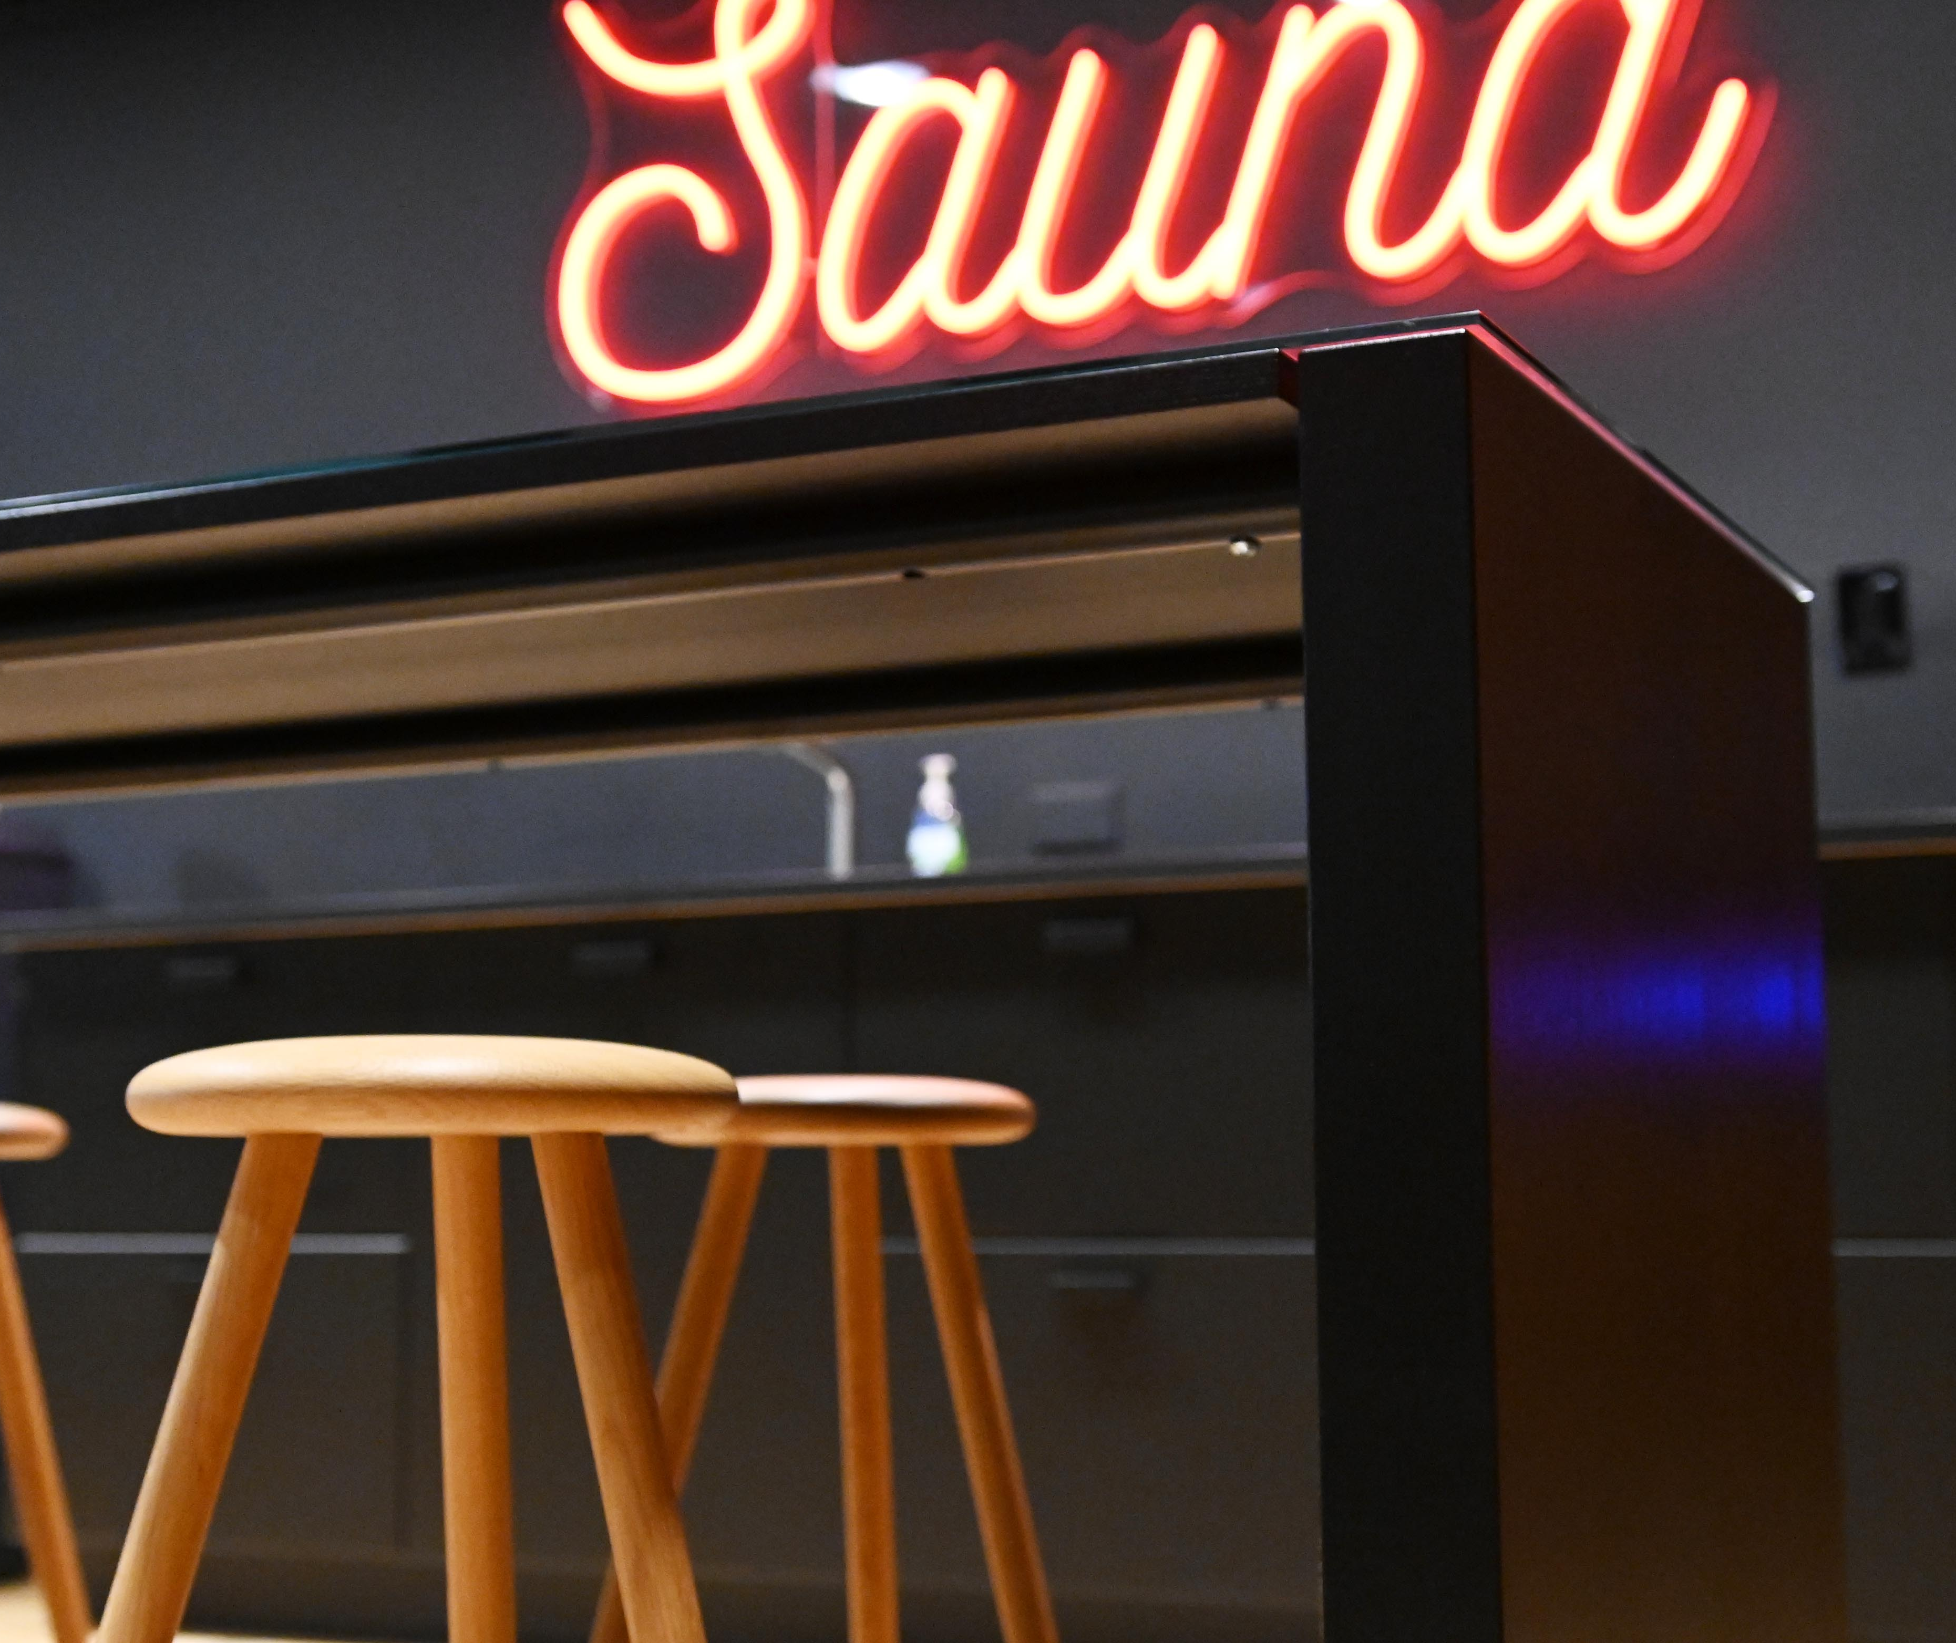
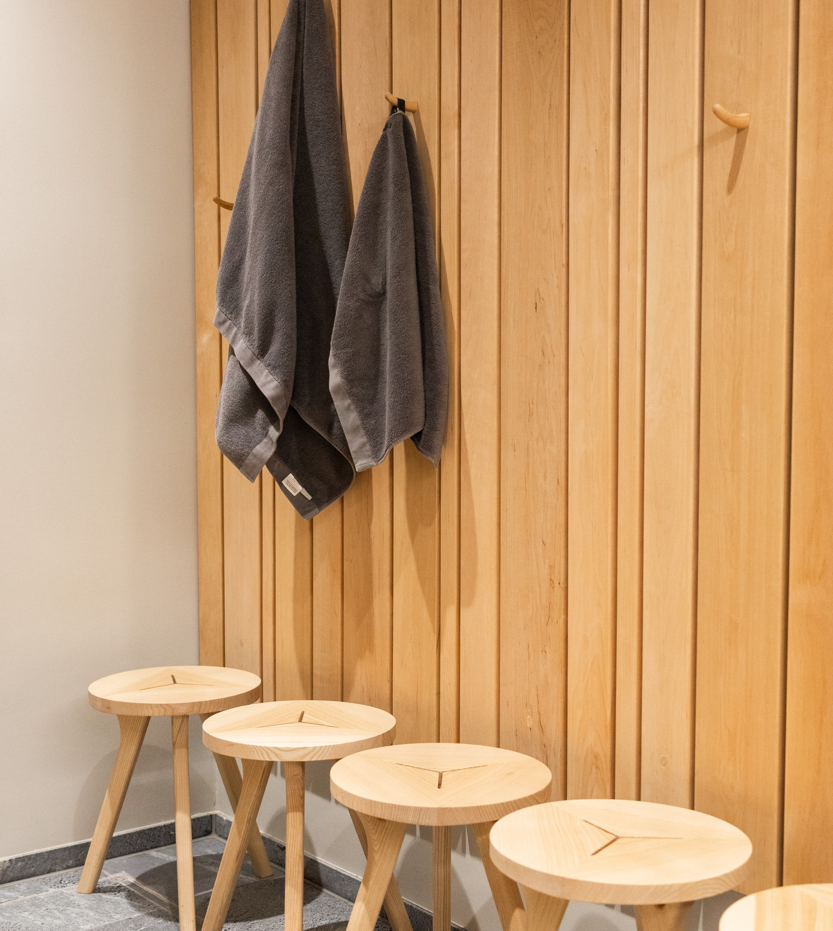
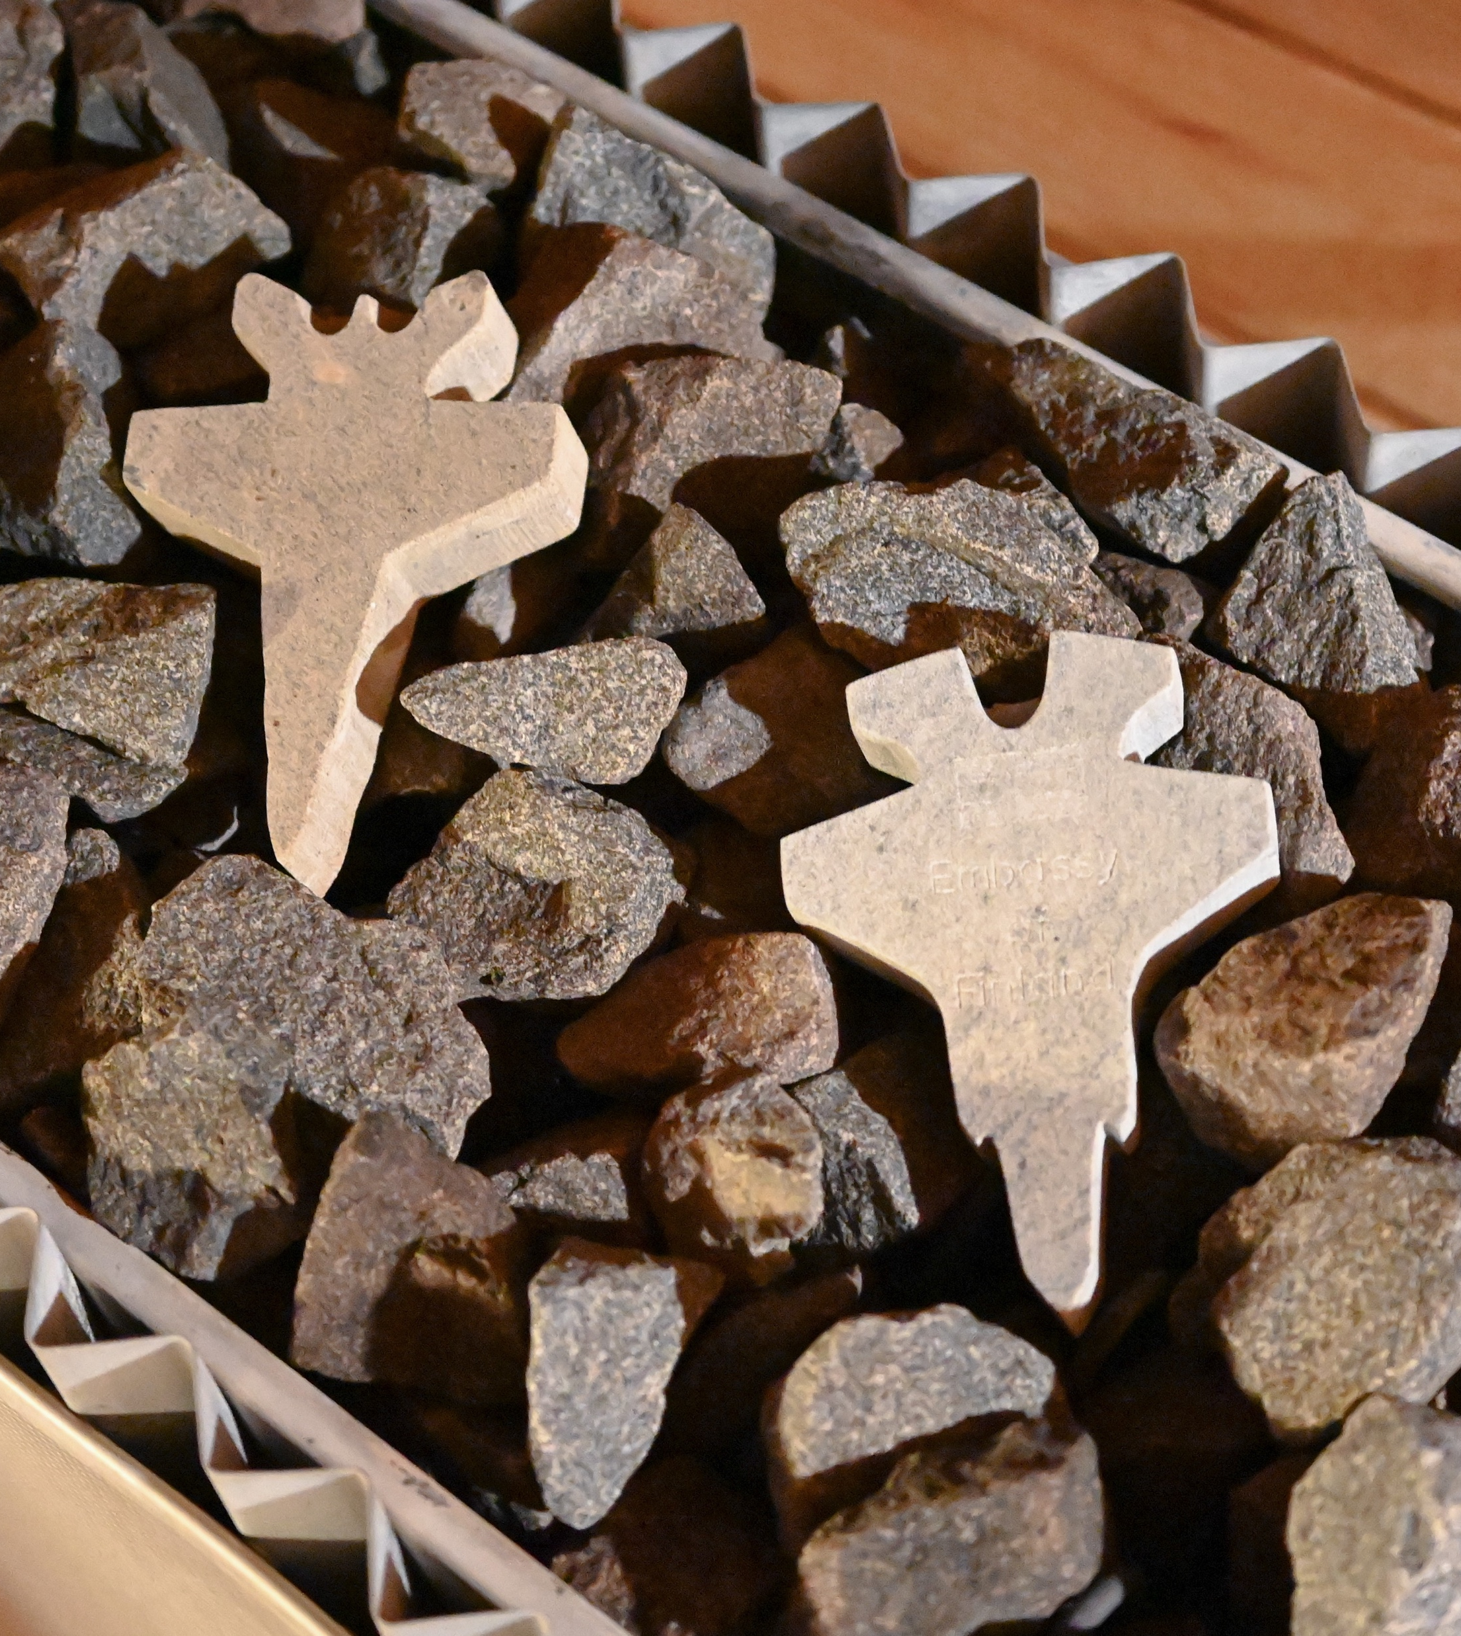
Sauna diplomacy and peacebuilding
10 DEGREES OF FINNISH SAUNA
1
2
3
4
5
6
7
8
9
10
Everyone is equal on the sauna benches.
Many friendships, ideas, and even business deals are born in the sauna.
Photo: Ulkoministeriö
Photo: Ulkoministeriö
Photo: Ulkoministeriö
Photo: Ulkoministeriö
Notes:
Sauna supports mental, physical, and social wellbeing. It relaxes muscles, reduces stress, and improves sleep. In addition to being an ancient understanding of wellness, Finnish sauna is also very relevant today: Contrast Therapy is one of the biggest wellness trends in the world in 2026.
Research also suggests that regular sauna bathing may be associated with several longer-term health benefits. Studies, particularly from Finland, have linked frequent sauna use with improved cardiovascular health, including lower risk of high blood pressure and heart disease. Heat exposure increases heart rate and improves circulation in a way similar to moderate exercise, which may support overall heart function.
Some research also indicates potential benefits for brain health and stress resilience, including a reduced risk of dementia and improved mood, possibly due to relaxation effects and improved blood flow. Additionally, sauna use may support recovery after physical activity by easing muscle soreness and reducing inflammation.
While these findings are promising, most experts emphasize that sauna is a supportive wellness practice rather than a medical treatment. The benefits are strongest when sauna bathing is done regularly, safely, and as part of a healthy lifestyle.
While sauna does not have any strict rules to follow, there are a few things that are polite to take into account. The Finnish sauna etiquette is roughly as follows, especially when bathing in a public sauna with people you don’t know:
Wash before entering.
Sit on a seat cover for hygiene.
Keep a calm and respectful atmosphere.
Speak quietly or remain silent.
Ask before adding more water on the heater when others are present.
Respect personal space.
Consider others when sharing a public sauna.
And some nudity etiquette:
In Finnish culture, nudity in the sauna is traditionally non-sexual and natural.
It is associated with equality and practicality.
In public or mixed saunas, swimwear or towels may be used depending on context.
Comfort and consent are essential.
In international settings, expectations should always be clarified in advance.

Slide 22
11/10
11/10
An extra skylight
with views to
common ground.
Epilogue

Slide 23
Epilogue
10 DEGREES OF FINNISH SAUNA
1
2
3
4
5
6
7
8
9
10
11
Photo: xxx
Any note
can be written here.
This is a place for
more detailed information.
You can use this page to highlight connections between Finnish sauna and your country, shared projects, or even interesting upcoming events.
Notes:
Tähän osioon voi koota vastaanottajan ja tilanteen mukaan personoitavia asioita, toki elokuvakulman huomioiden.

Slide 24
We saved a seat for you.
Let’s enjoy the next löyly together!

