Slide 1
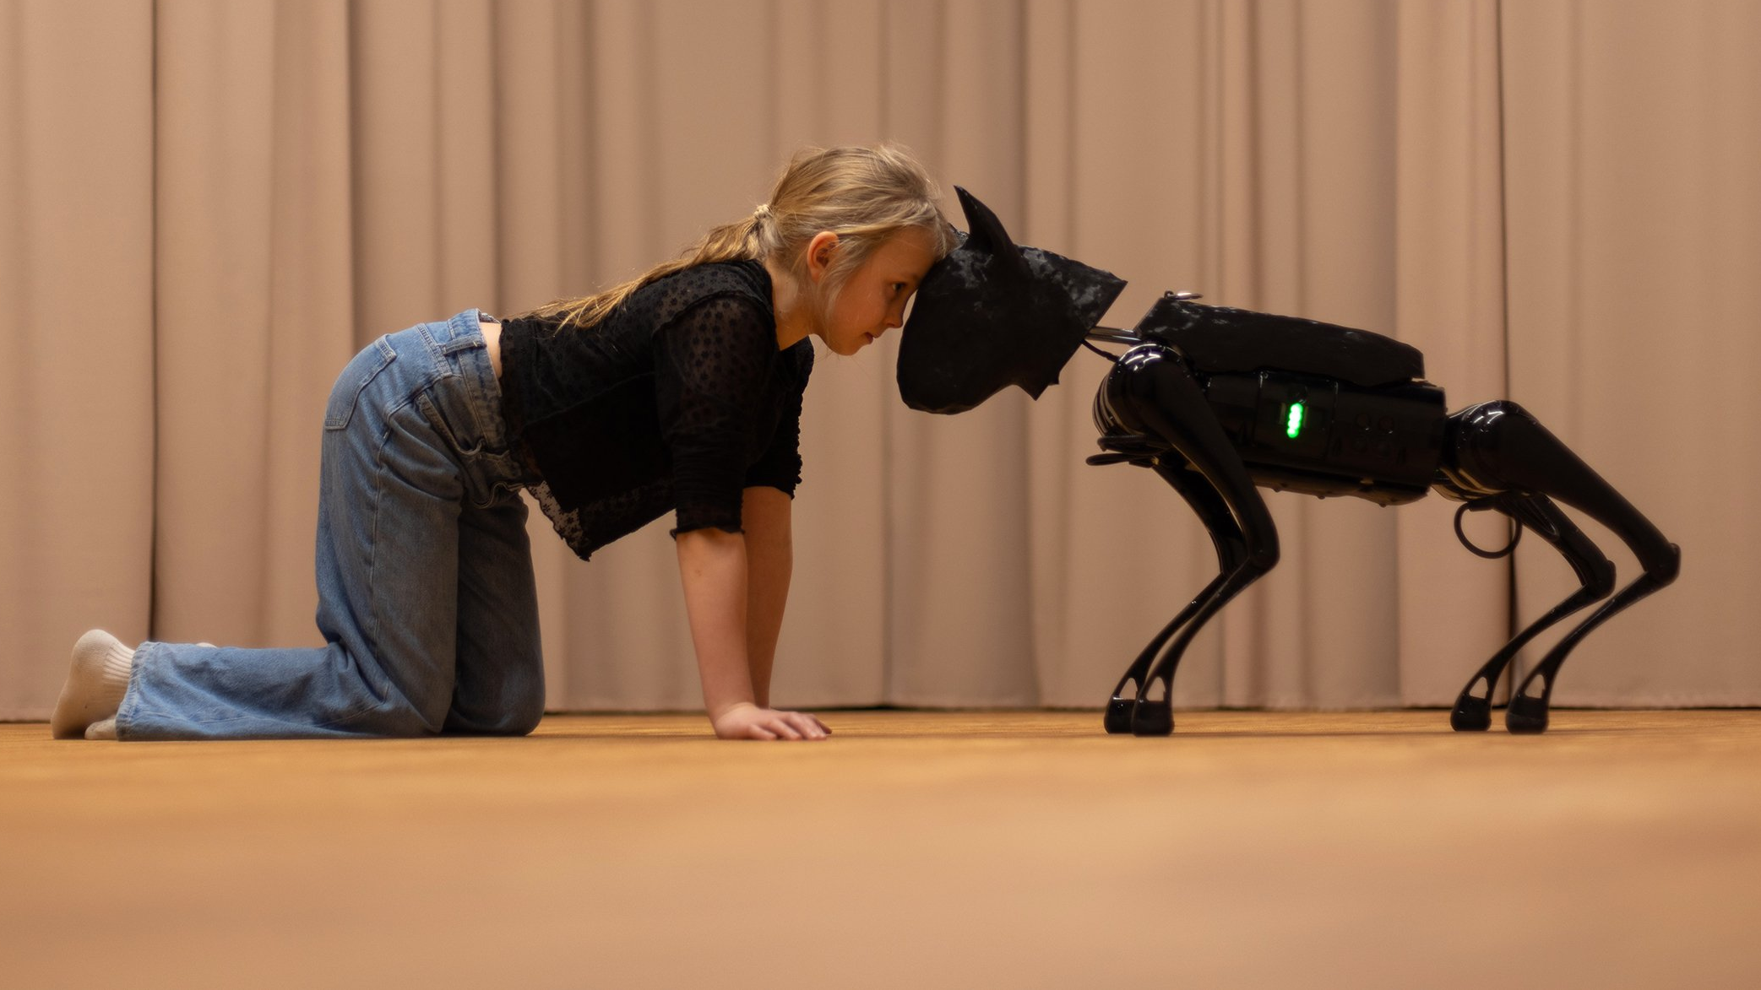

FINNISH THEATRE
IN 10 ACTS
Companion (WAUHAUS, 2024)
Photo: Katri Naukkarinen

Slide 2
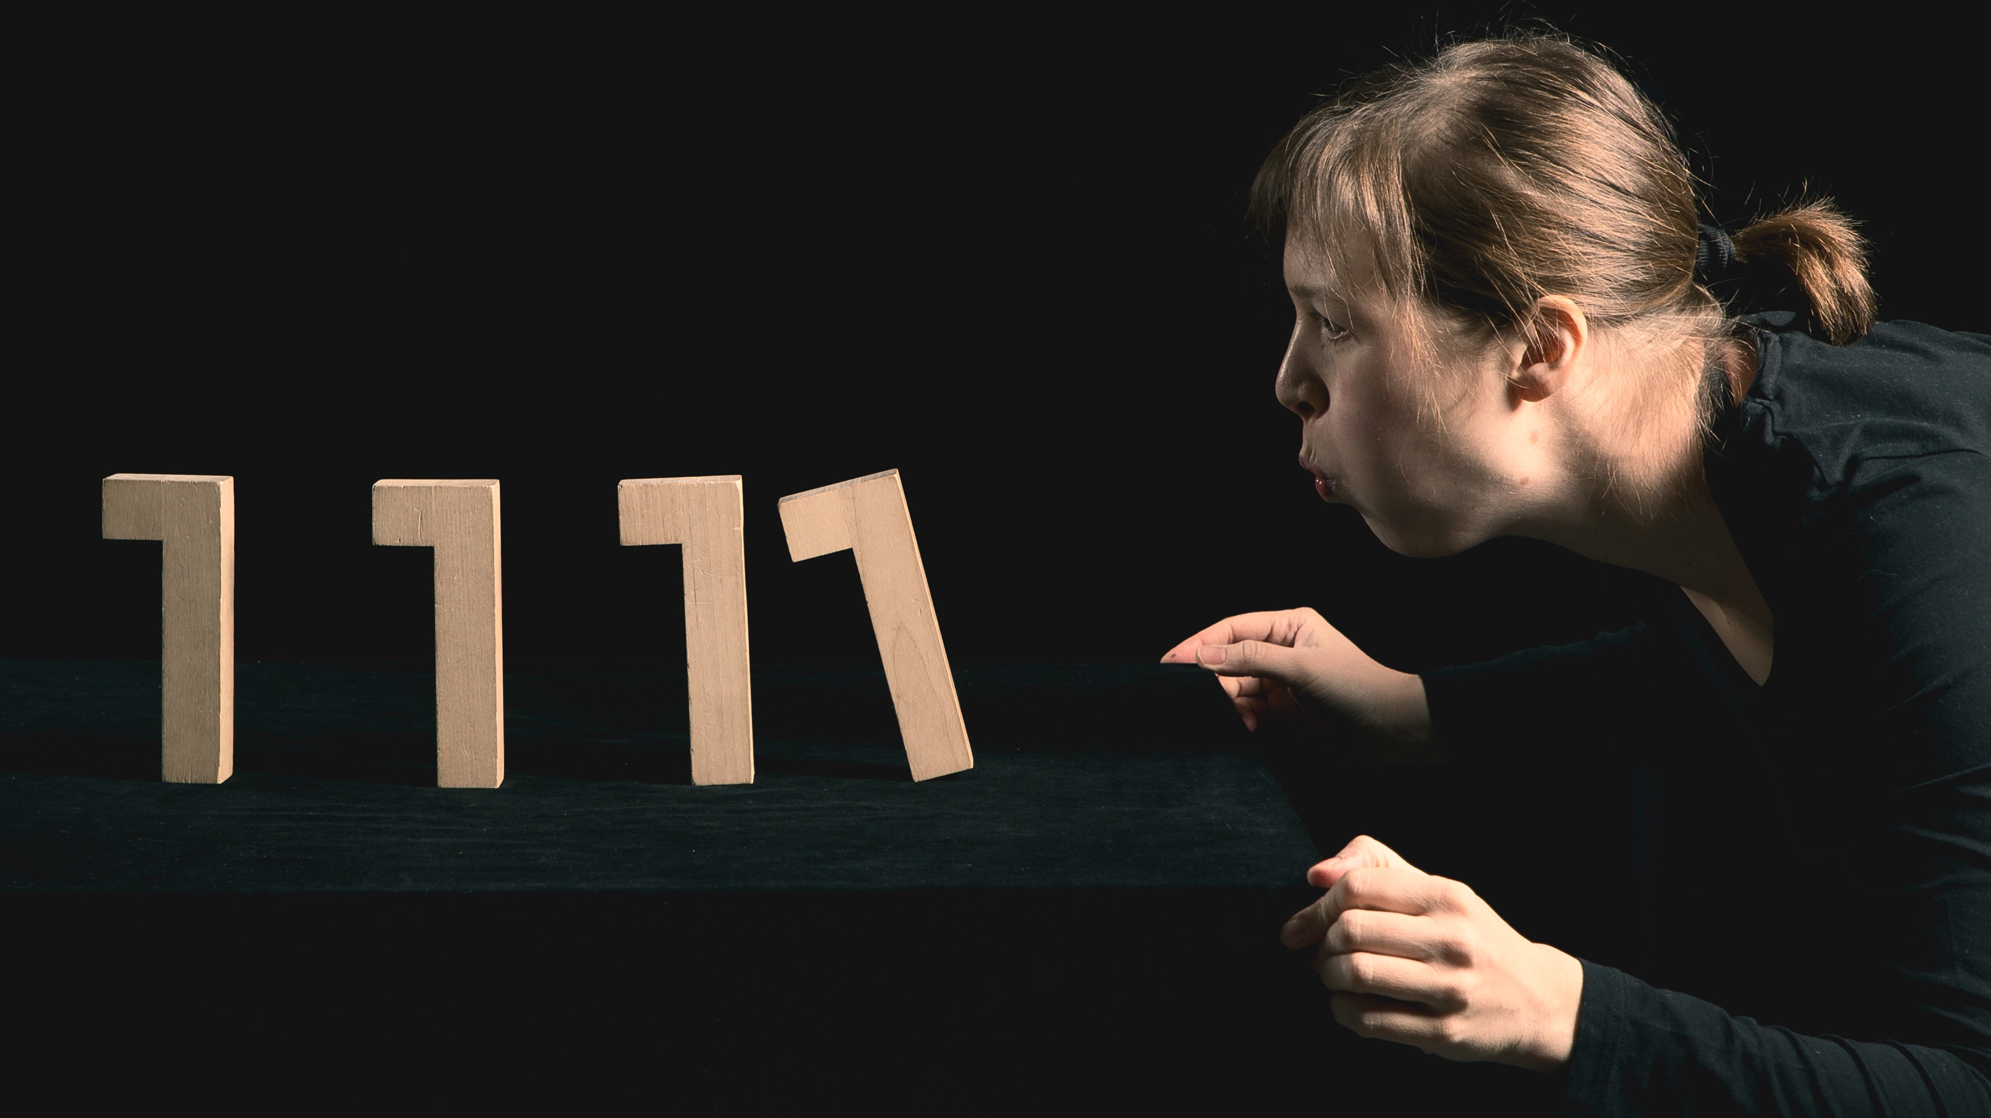
1/10
An introverted country where theatre
actually performs well
Palikkateatteri, 2023. Photo: Jussi Virkkumaa

Slide 3
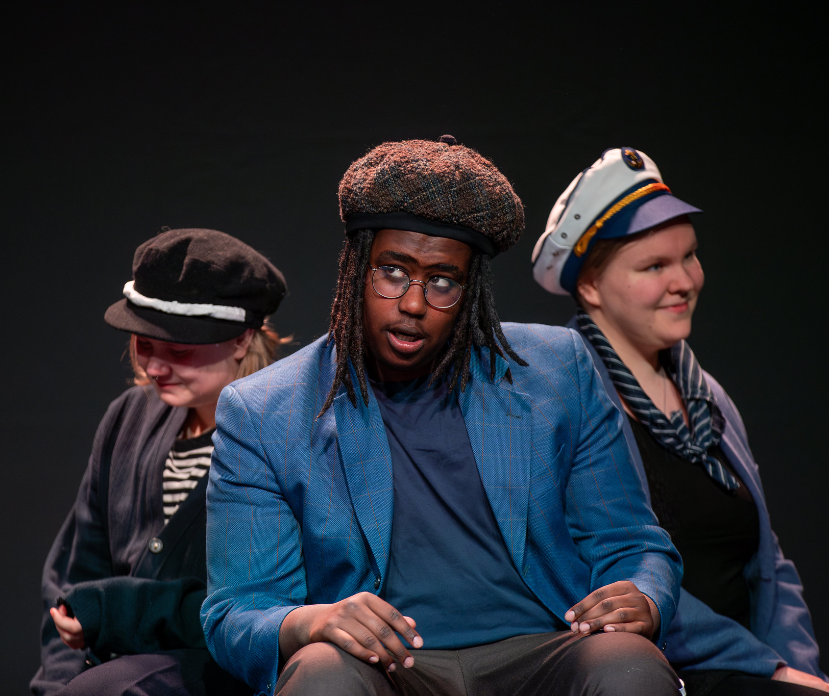
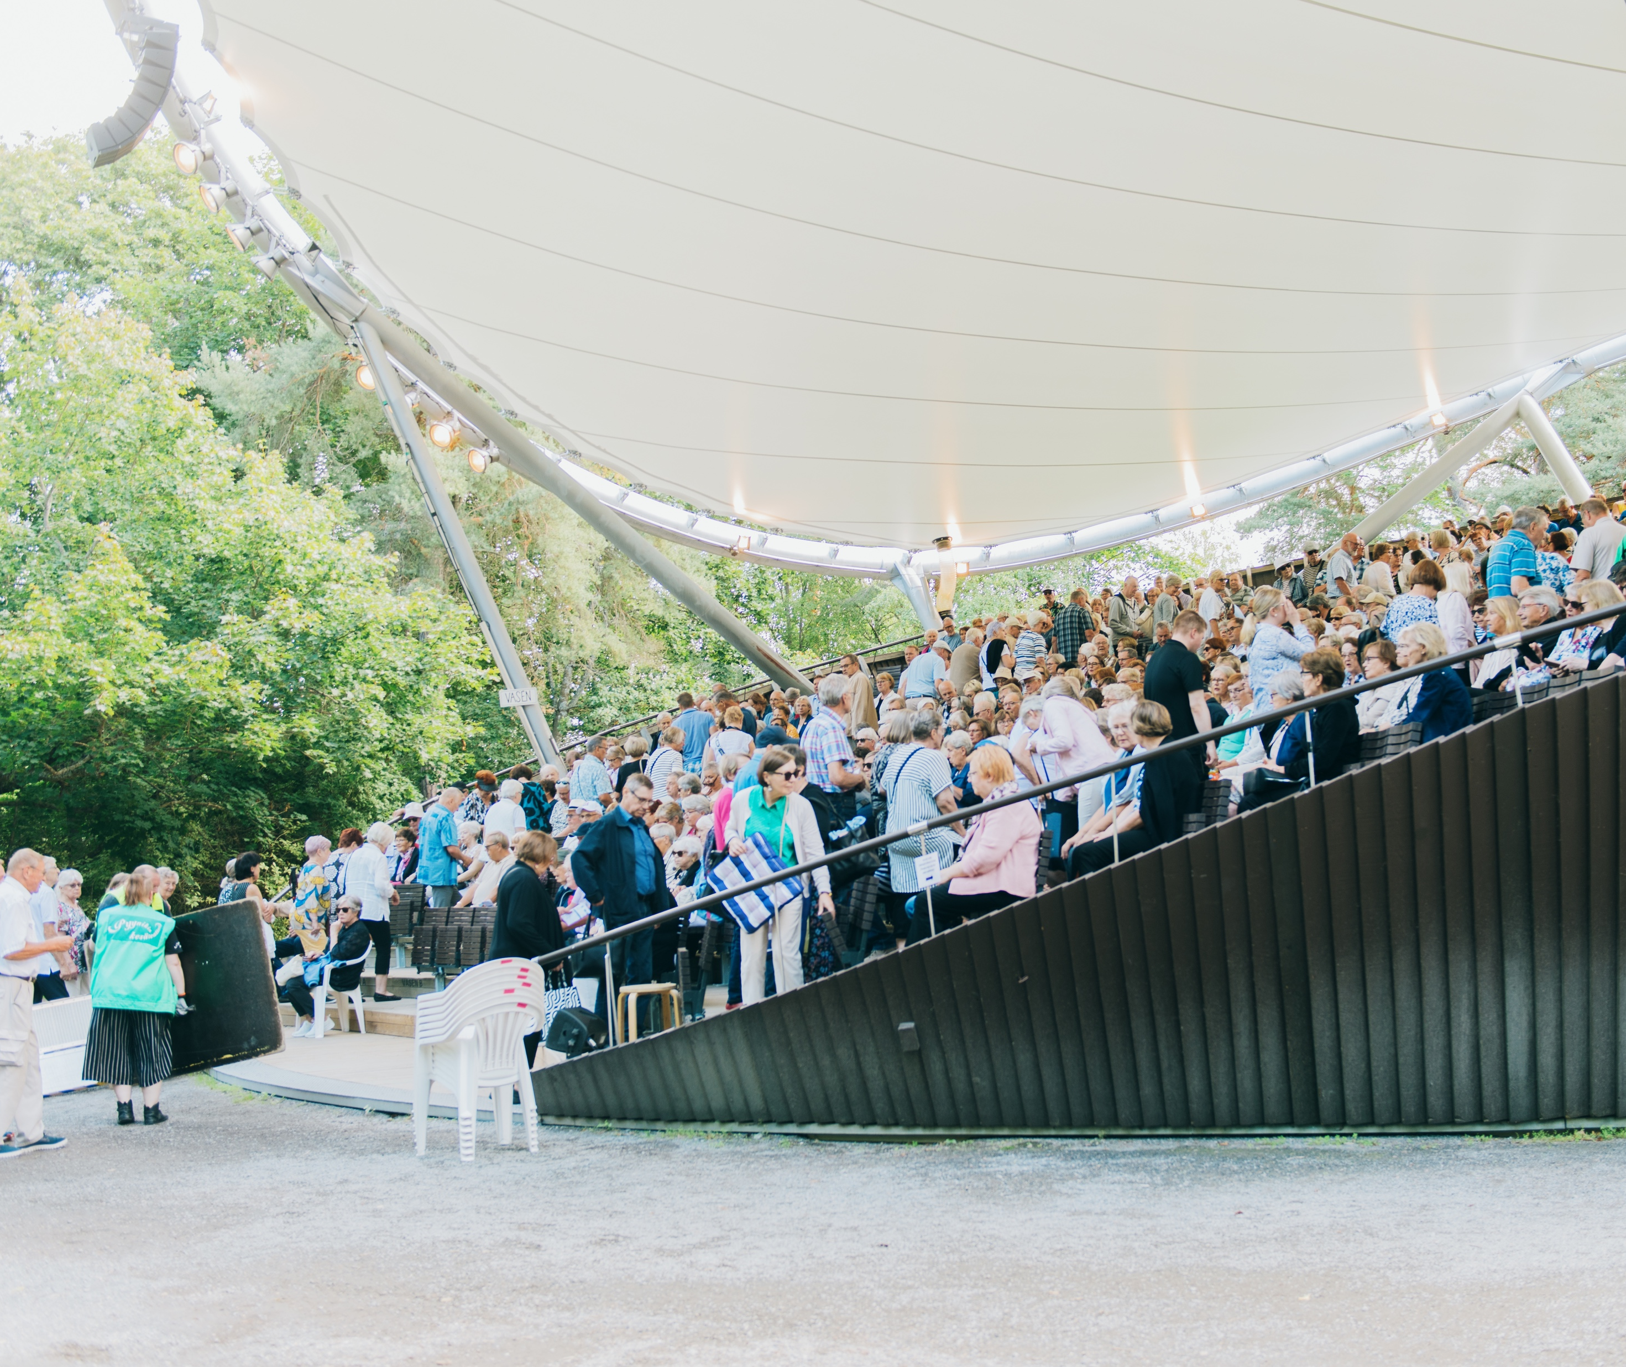

An introverted country where theatre actually performs well
FINNISH THEATRE IN 10 ACTS
1
2
3
4
5
6
7
8
9
10
We have one of the highest performing art attendances per capita in the world.
In a country of 5.6 million people, our performing arts have annually 3.6 to 4.1 million spectators.
Pyynikki Summer Theatre.
Photo: Karri Harju.
The Tampere Youth Theatre, 2024. Photo: Ilana Pantzar
The Unknown Soldier (Pyynikki Summer Theatre, 2025).
Photo: Katri Dahlström
Notes:
The Finnish performing arts have annually had between 3.6 and 4,1 million spectators – in a country of 5.6 million people. We have among the highest performing arts attendance per capita in the world, save for Iceland and Estonia.
Theatre is the most popular performing arts genre with 2.6 million spectators in 2024.
CLICK But what you probably would never have guessed, is that we are also crazy about standing on the stage ourselves. There are about 500-700 amateur theatre groups all over the country – each with tens and tens, sometimes hundreds of volunteers – producing shows within their communities.
CLICK In addition to the 3.5 million annual specators, an additional estimated 1 million people enjoy watching theatre in the summer, outdoors. This is an image from the Pyynikki summer theatre in Tampere, that produces a show every summer – usually a Finnish classic, like the Unknown Soldier in 2025.

Slide 4
2/10
Our nation was forged
on its stages
The founders of the Finnish Theatre, later Finnish National Theatre,
siblings Kaarlo Bergbom and Emelie Bergbom in 1904. Photo: Theatre Museum

Slide 5
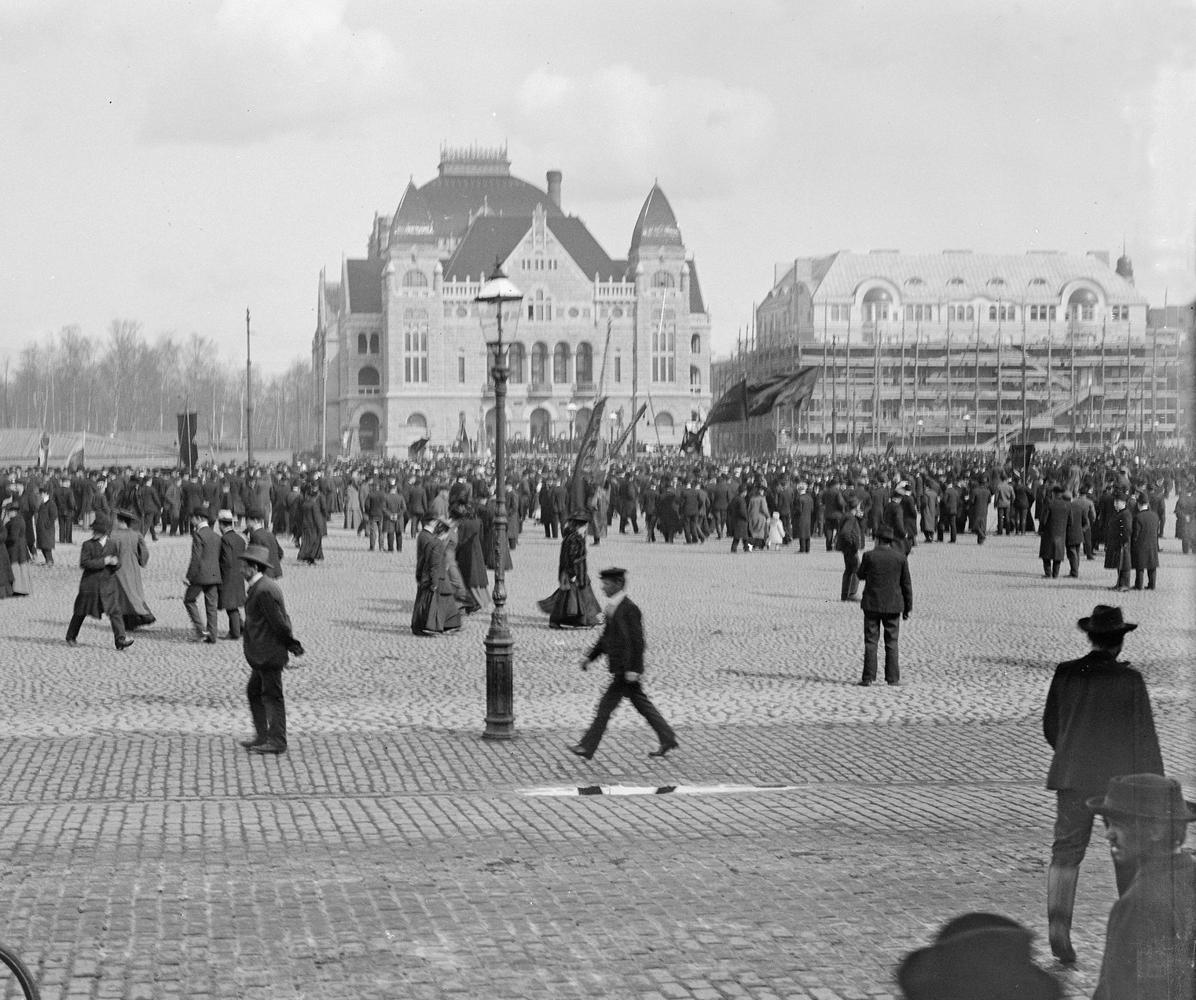
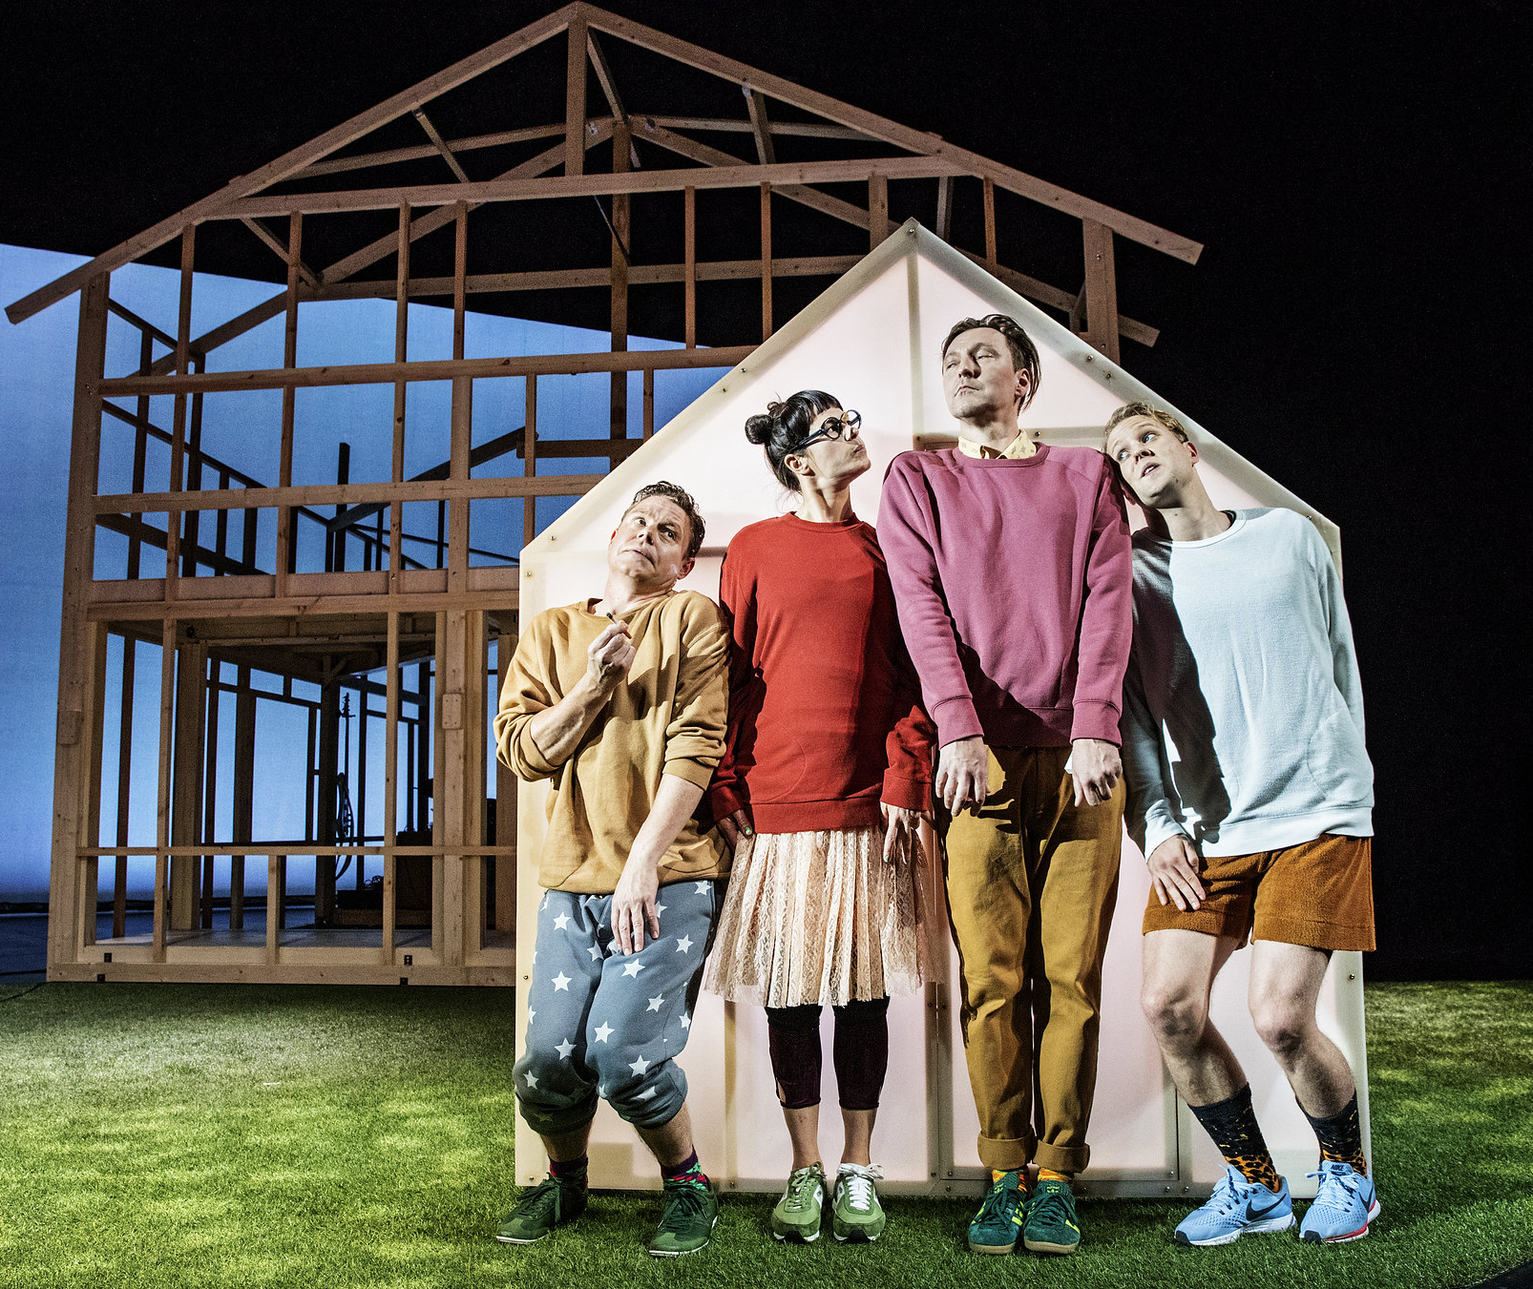
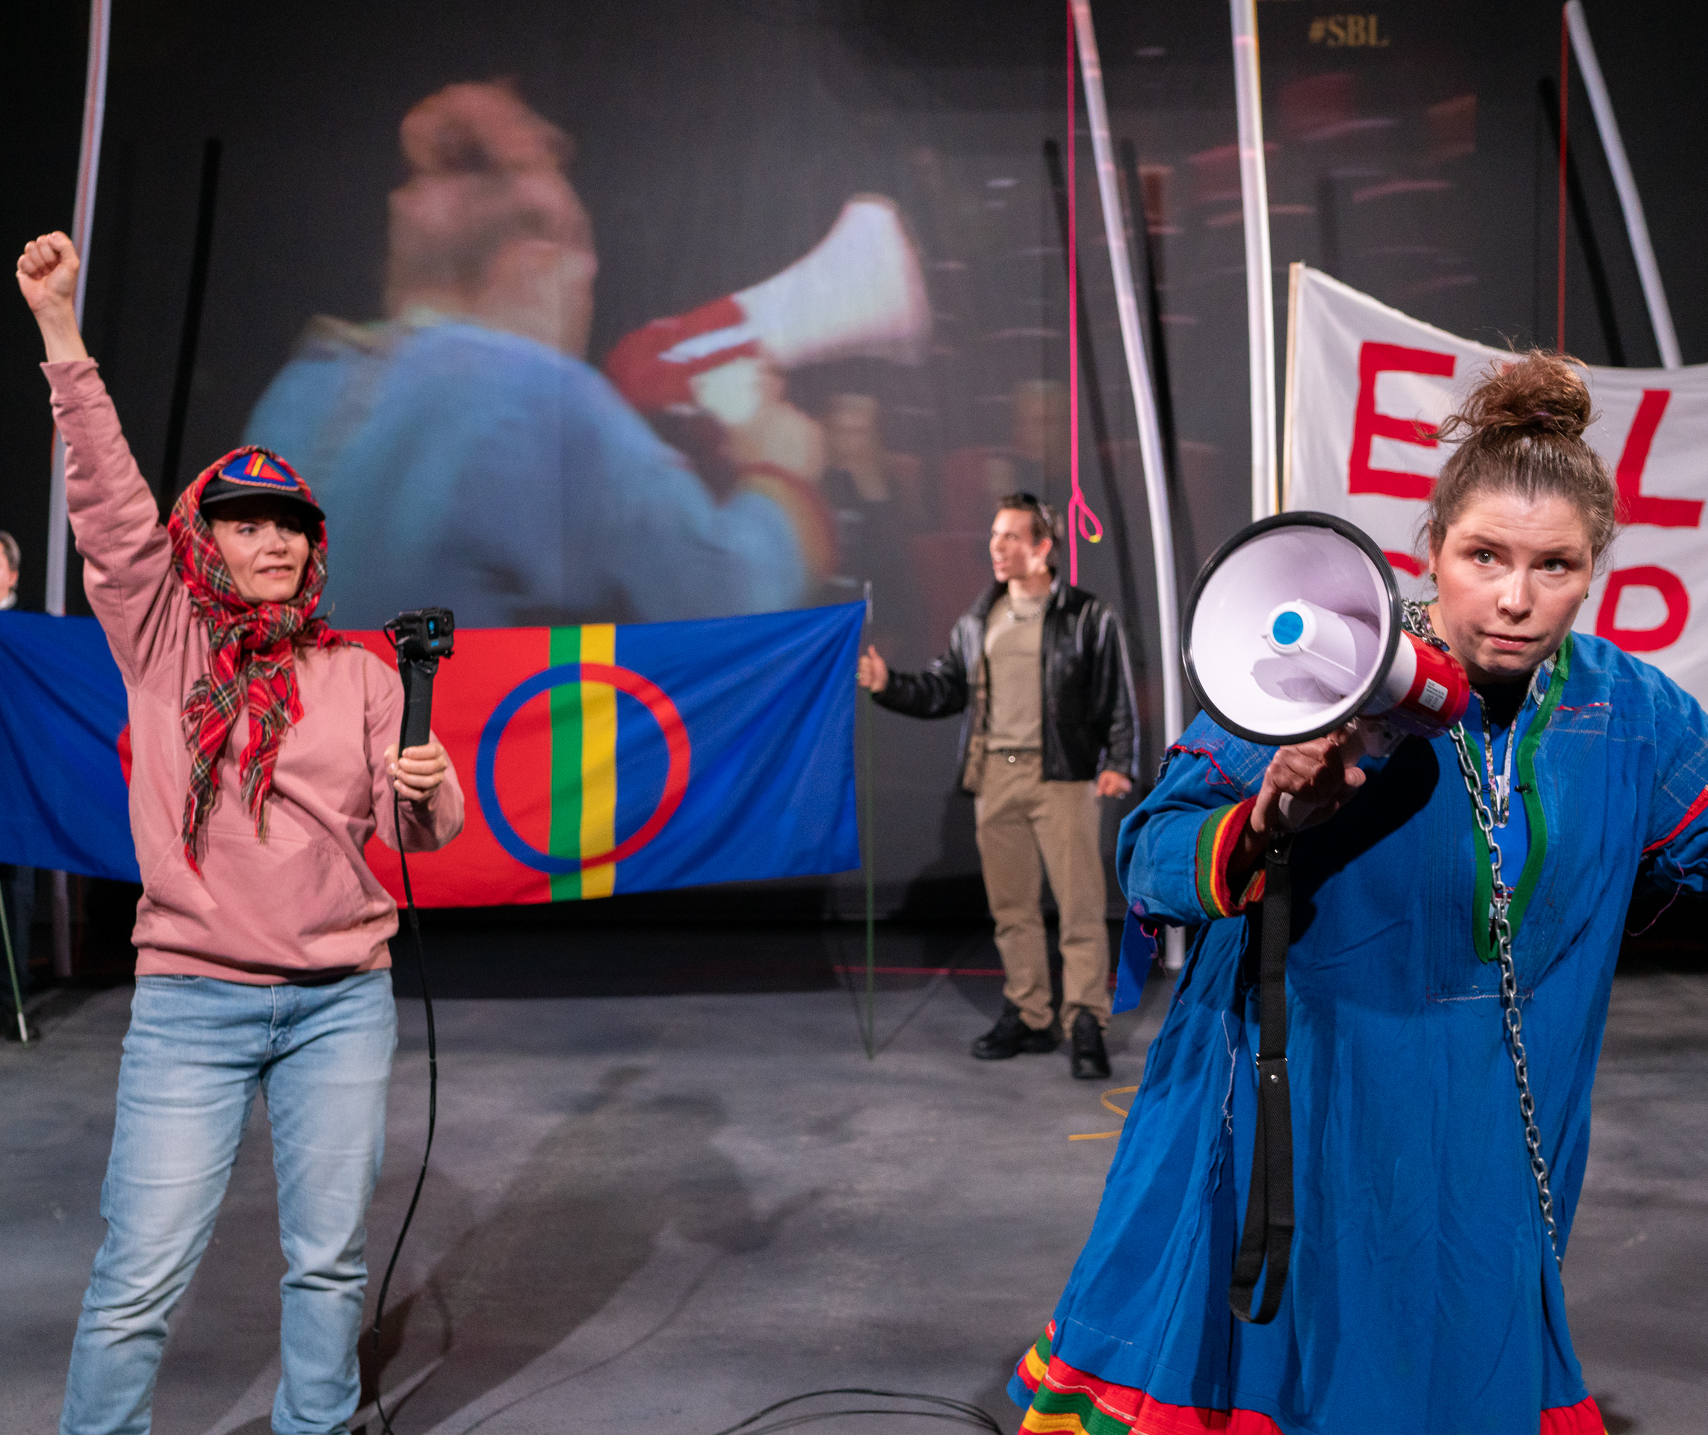
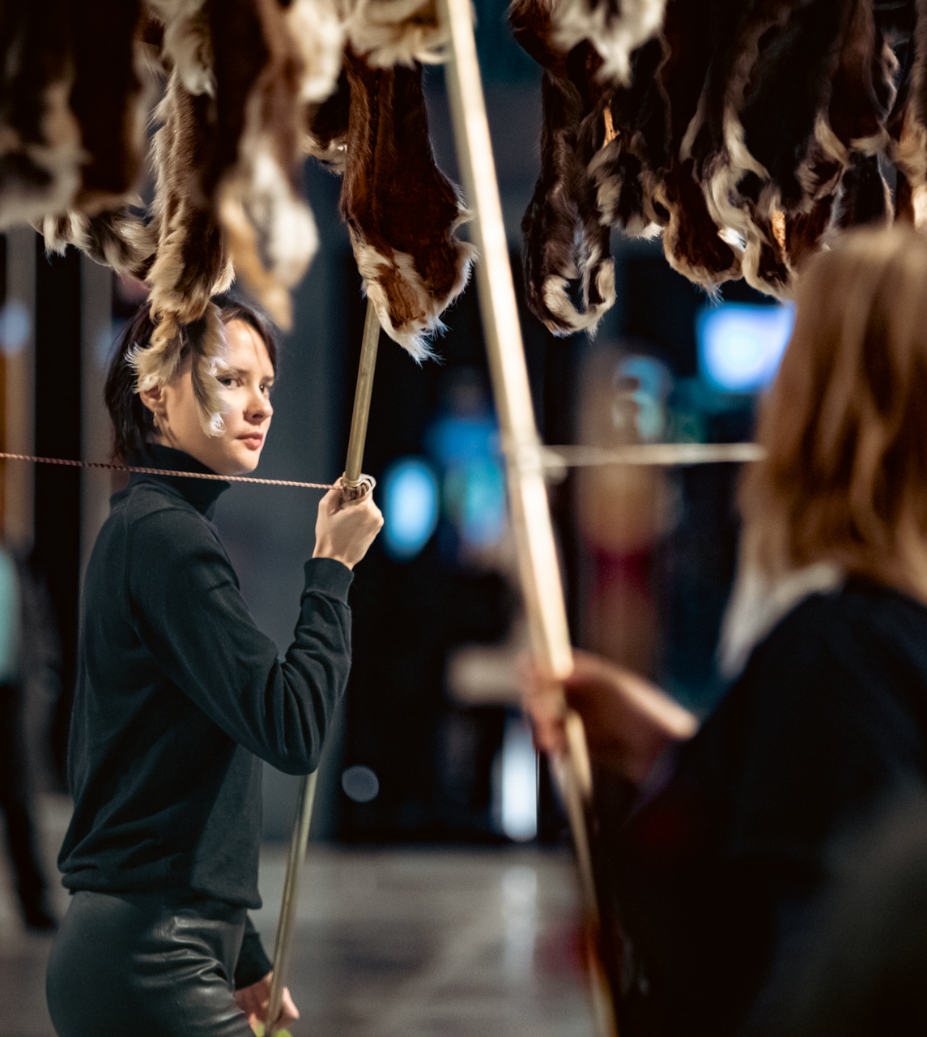
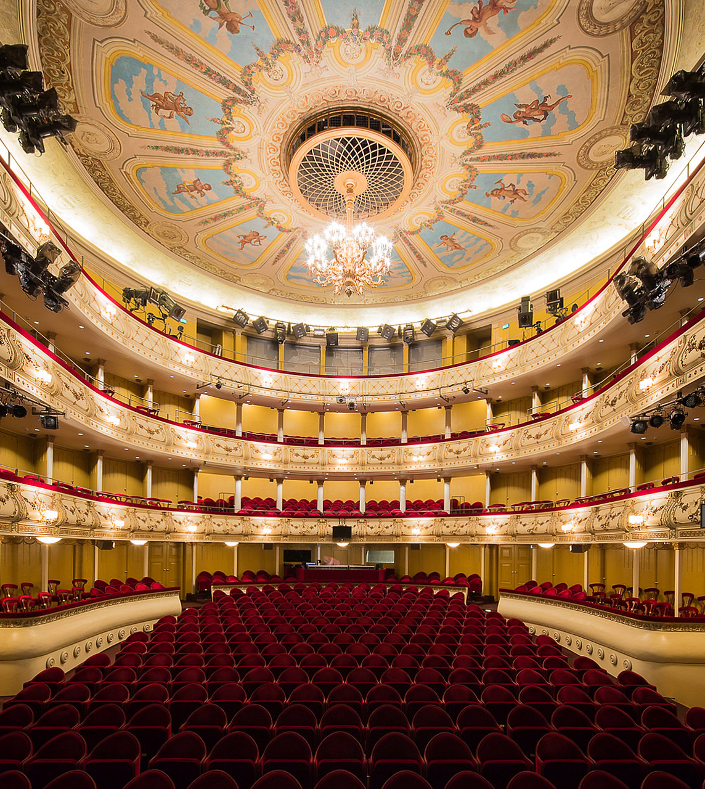
Our nation was forged on its stages
FINNISH THEATRE IN 10 ACTS
1
2
3
4
5
6
7
8
9
10
The Finnish National Theatre was officially established in 1902 – 15 years prior to our independence.
It was an important symbol of a nation existing culturally before it existed politically.
Landet (The Swedish Theatre in Helsinki, 2017).
Photo: Cata Portin
Sámi bucketlistu (Sámi National Theatre Beaivváš, 2025).
Photo: Aslak Mikal Minna
The Finnish National Theatre.
Photo: Gustad Sandberg / Svenska litteratursällskapet i Finland
Matricarchy (Pauliina Feodoroff, 2022).
Photo: Sinem Kayacan
The Swedish Theatre in Helsinki.
Photo: Marc Goodwin
Notes:
The National Theatre received a prominent home in 1902 next to the Central Railway station on the left. This wasn't just a building. It was a symbol of a nation existing culturally before it existed politically. Its mission was to create a national story and a Finnish-language canon.
CLICK Likewise, Swedish-language theatre in Finland has fought its own battles and been in center position as the Swedish-language minority in Finland has debated whether they should focus on establishing a minority culture within the Finnish nation, or maintain their cultural ties to Sweden, by employing Swedish actors and directors. Today the Swedish Theatre in Helsinki is one of several Swedish-language theatres catering to the 300 000 Swedish-speakers in Finland.
CLICK Sámi performance has long been neglected in the national theatre narrative, but theatre makers and activists such as Pauliina Feodoroff among others have brought Sámi culture and performance into the spotlight.
The Sámi National Theatre is based in Norway, but operates across the Sápmi region in Norway, Sweden and Finland, and has frequently toured Russian regions with Sámi communities.
Today, several English-language theatre collectives made up from performing artists of various backgrounds are working to diversify the Finnish performing arts ecosystem, while the institutions are working to reflect the multicultural society of today.

Slide 6
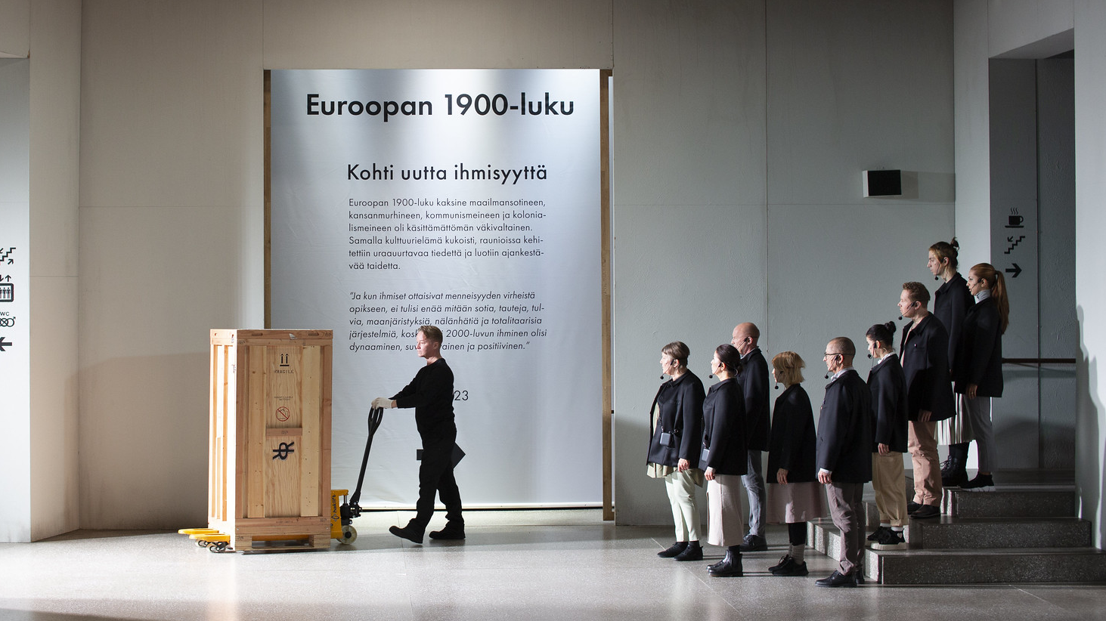
3/10
Funded by all,
open to all
Europeana (Finnish National Theatre, 2023). Photo: Mitro Härkönen

Slide 7
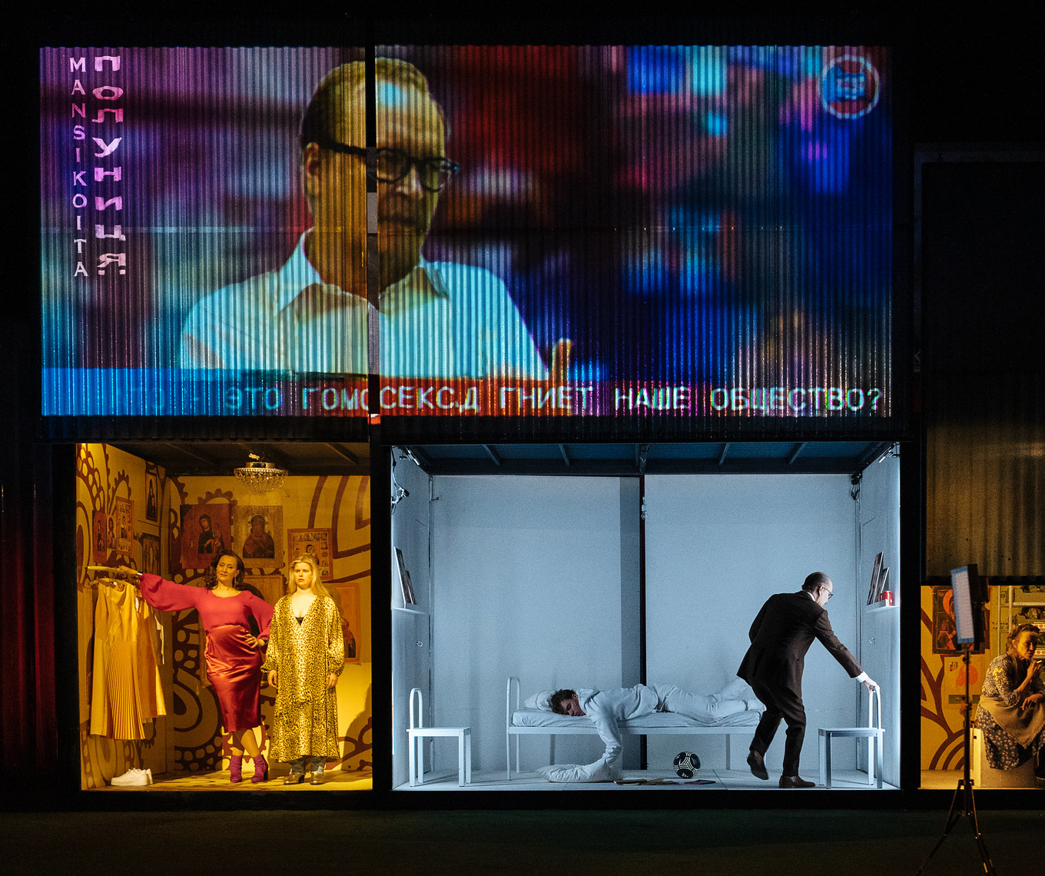
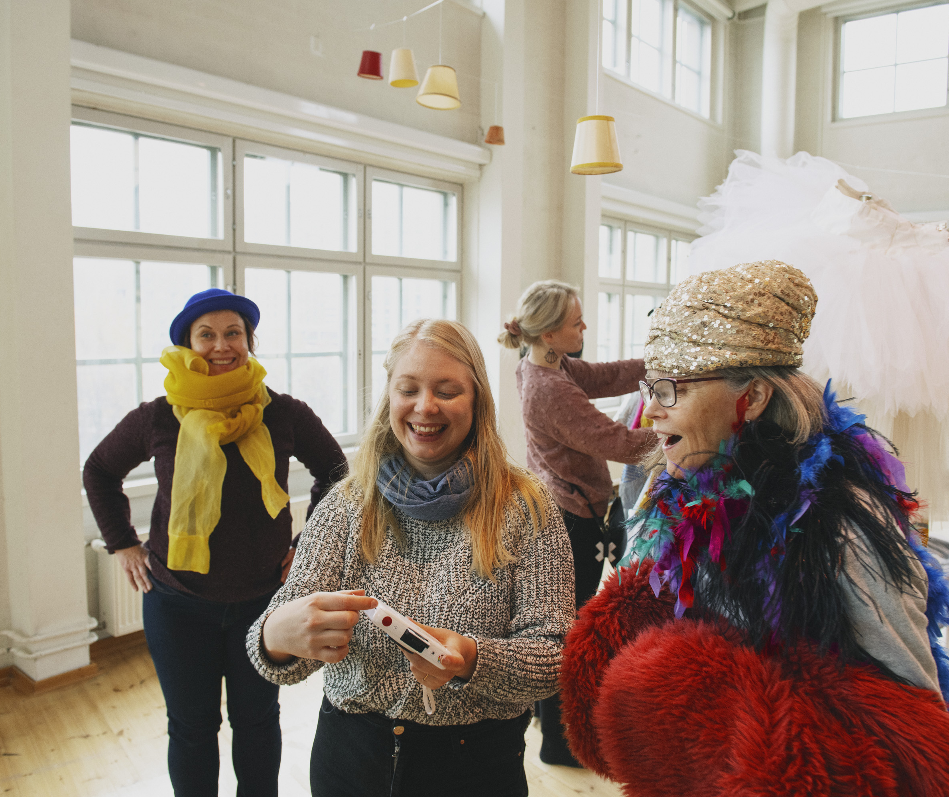
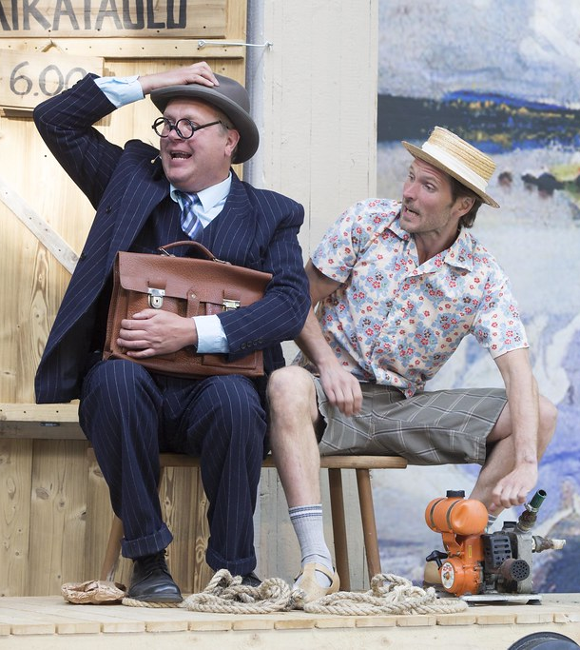
Funded by all, open to all
FINNISH THEATRE IN 10 ACTS
1
2
3
4
5
6
7
8
9
10
Finland has one of the densest theatre networks per capita.
Generous subsidies and a network of municipal theatres and open-air summer theatres guarantee everyone can enjoy shows at reasonable prices – in 2024 the average price for a ticket was just 30 euros!
Mansikkapaikka (Kansallisteatteri 2024).
Photo: Mitro Härkönen
The University of the Arts in Helsinki (Uniarts).
Photo: Veikko Kähkönen
Aatamin puvussa ja vähän Eevankin (Viikinsaaren kesäteatteri, 2018).
Photo: Kai G. Baer
Notes:
Theatres are supported by state and municipal subsidies, as well as by independent foundations and their own ticket revenues.
CLICK But to ensure that everyone has access to theatre – a network of municipal theatres has emerged over several decades, and Finland has now one of the world's densest theatre networks per capita.
This isn't a free-market accident. It's a deliberate, heavily state-subsidized model. Almost every major town has its own professional theatre. As I’ve stated, we view it’s as a basic right, a "public utility" for mental and social well-being.

Slide 8
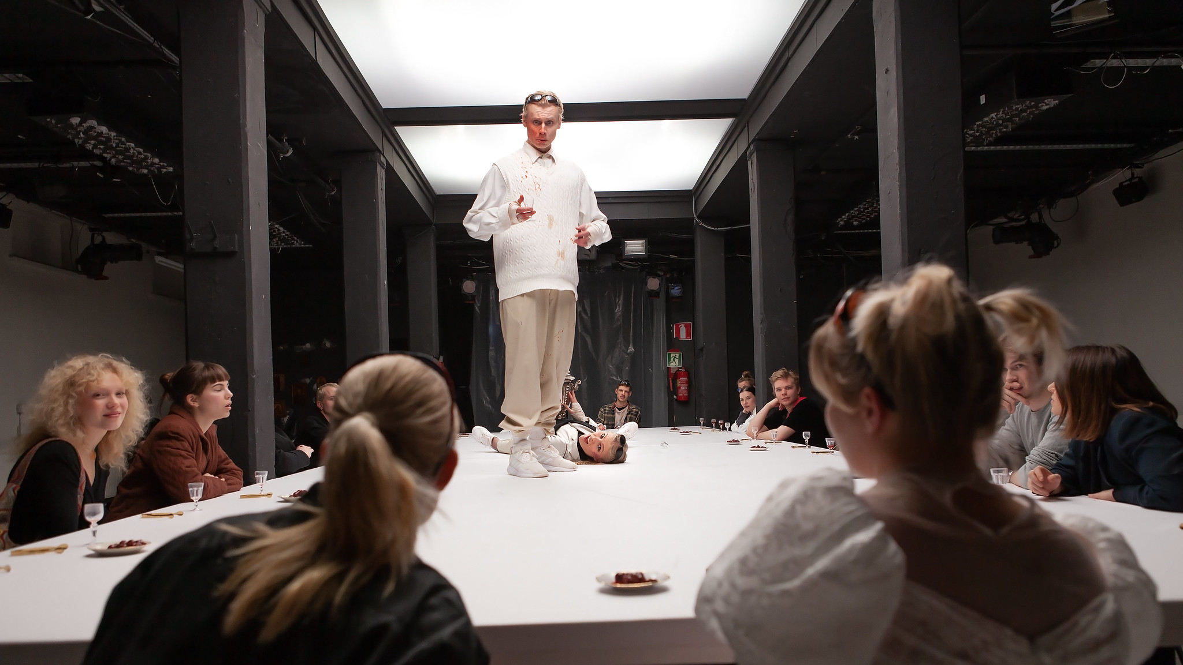
4/10
Ours is an egalitarian stage
Message from Tyler (Minna Lund, 2023). Photo: Pate Pesonius

Slide 9
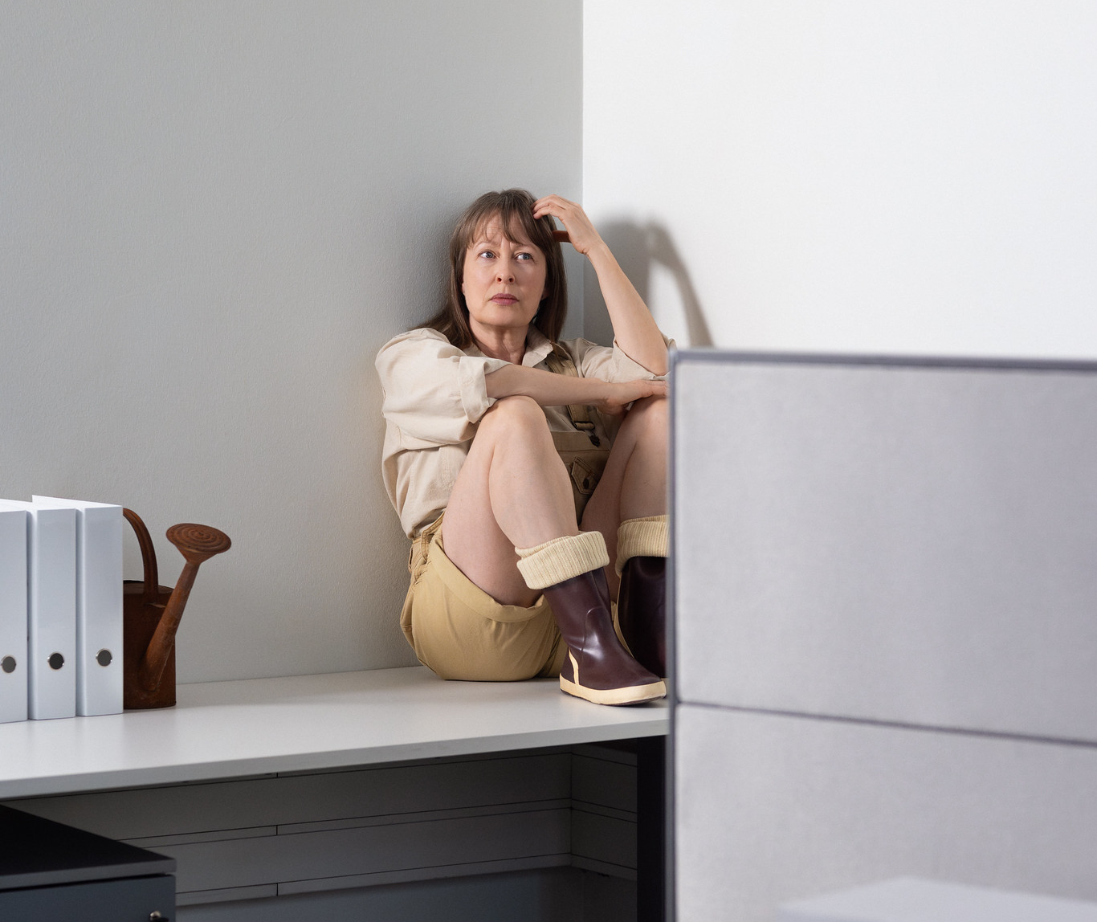
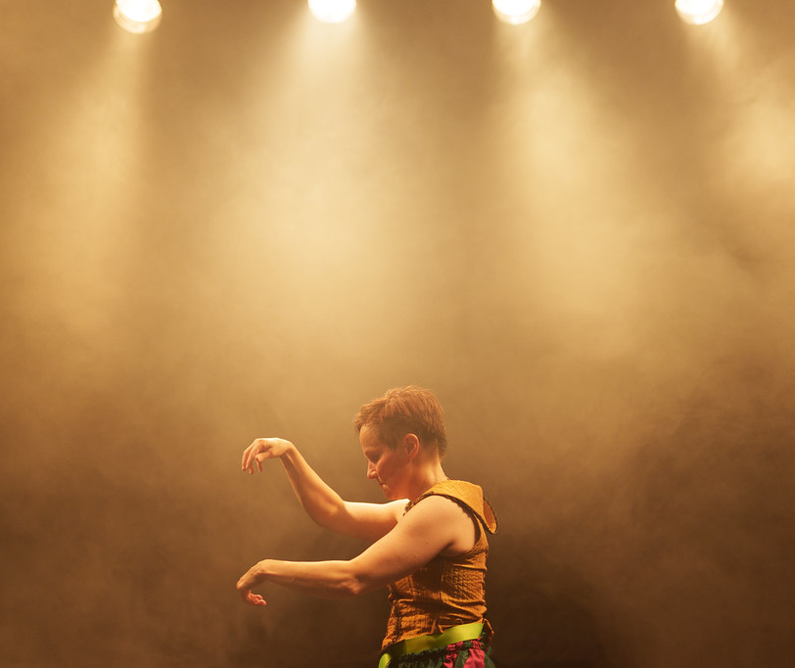
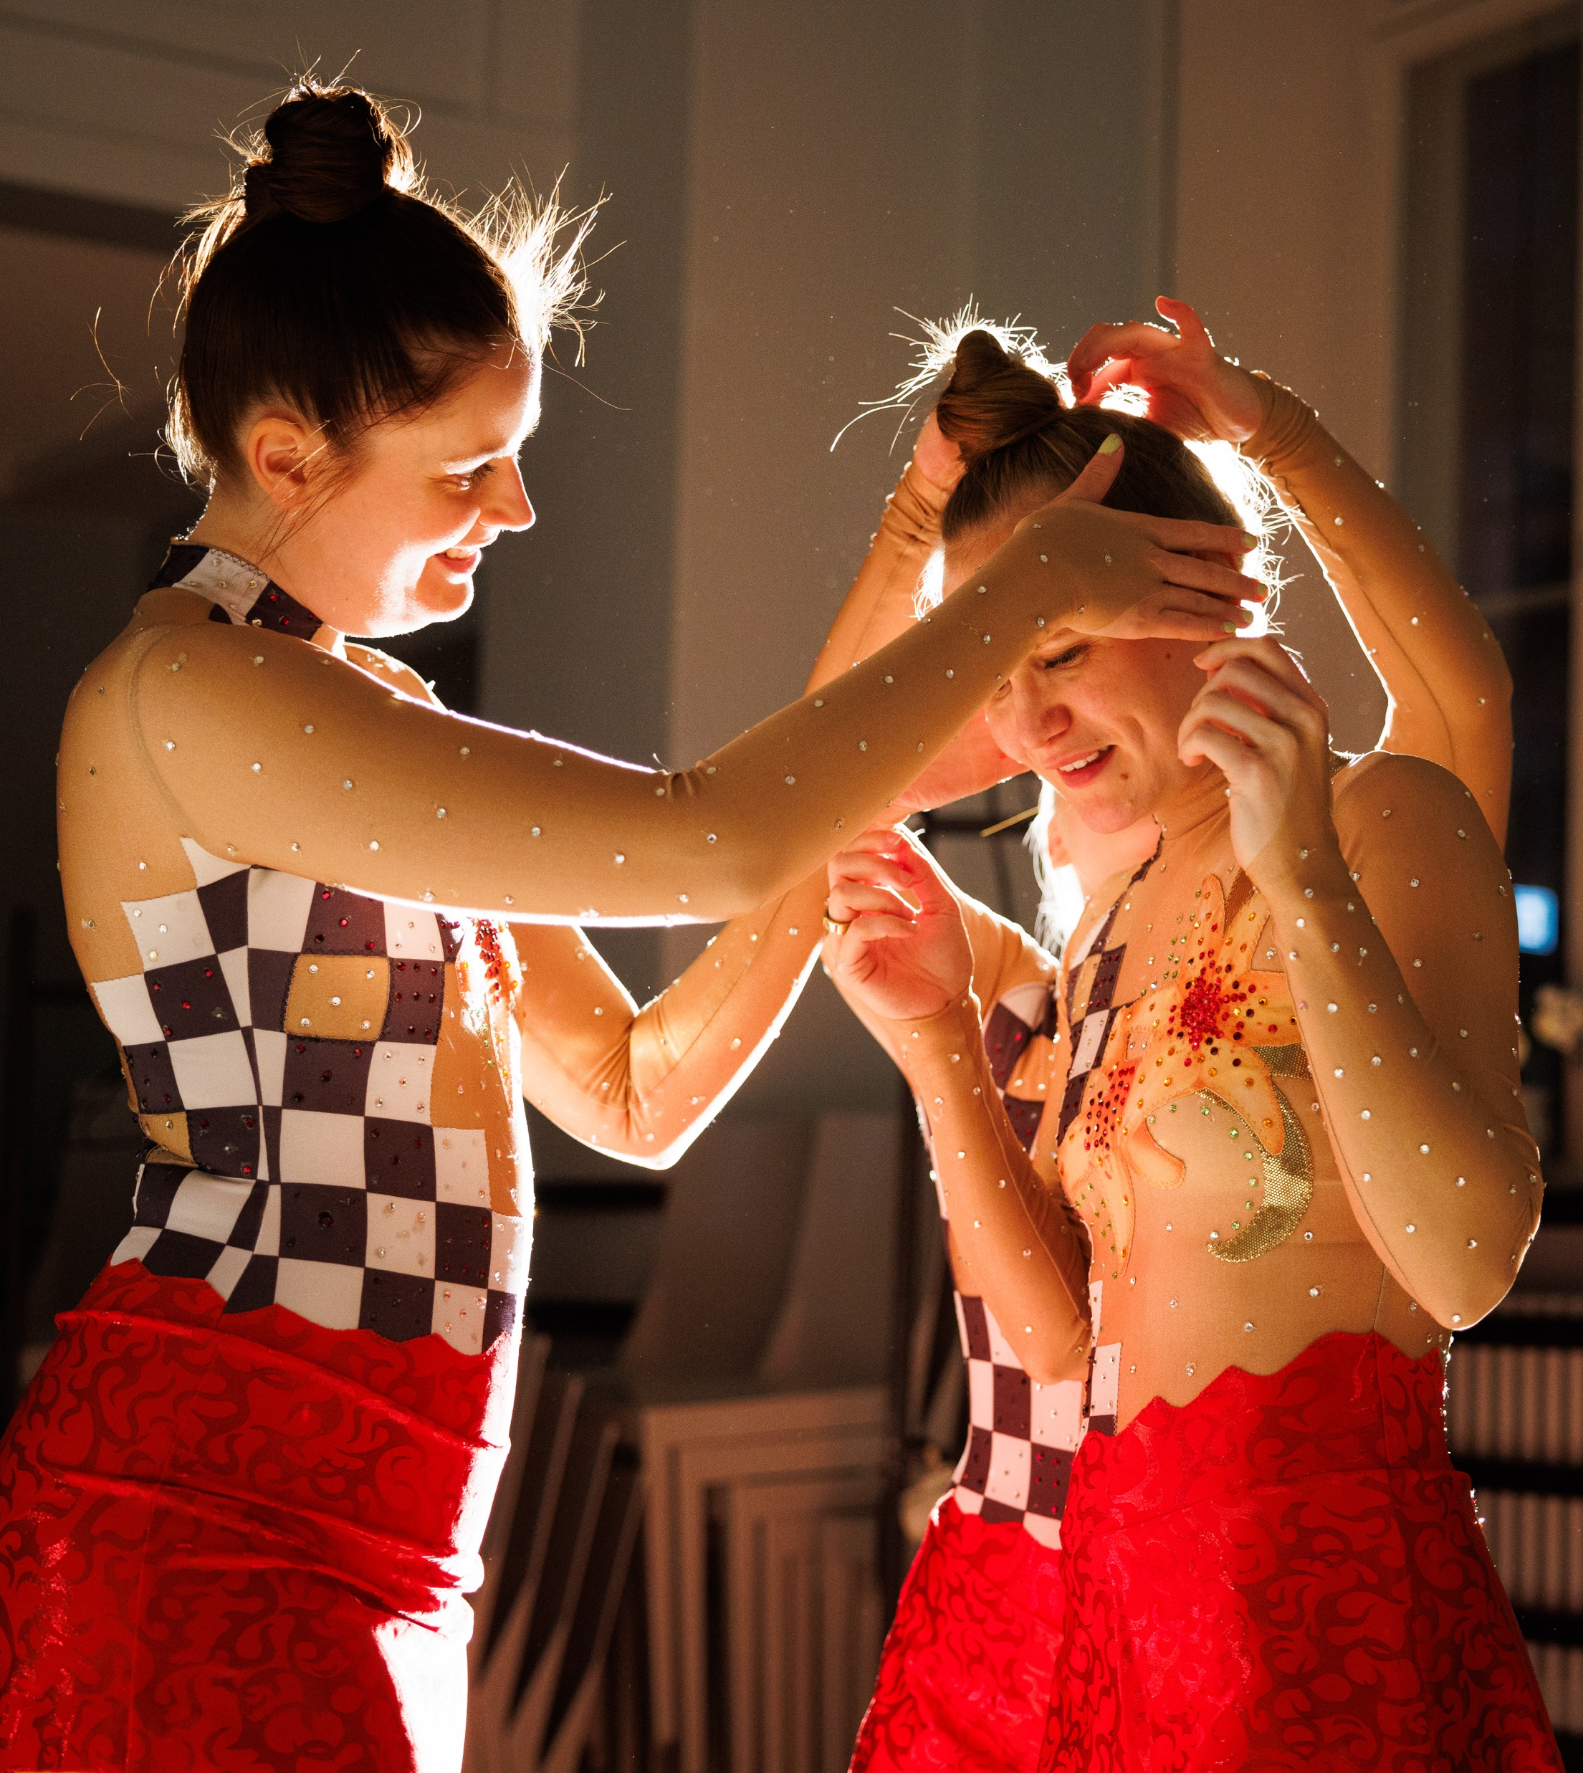
Ours is an egalitarian stage
FINNISH THEATRE IN 10 ACTS
1
2
3
4
5
6
7
8
9
10
The legacy of
Minna Canth
Finnish playwright
(1844–1897)
Canth’s birthday, March 19th, is celebrated as the Day of Equality in Finland.
AntiG (Teatteri Takomo, 2025).
Photo: Mitro Härkönen
Förgät mig (The Swedish Theatre in Helsinki, 2025).
Photo: Heli Blåfield
Minna Canth, 1894.
Photo: Victor Barsokevitsch / Finnish Heritage Agency, Historical Photo Collection
Jumppatytöt (Havukainen / Hyvönen / Lahdenmäki, 2024).
Photo: Jukka Hämeenniemi
Notes:
Finnish playwright Minna Canth – for example – is known for having explored the oppressive structural conditions that governed the lives of women and of working-class people in the late 19th century.
We celebrate her birthday annually as the Day of Equality.
CLICK If we take a closer look at some equality statistics from the field of theatre, we see that – when it comes to gender at least – that state-subsidized theatres have managed to even the playfield. Just as in our society in general, there are however still issues that remain to be worked on in the theatre sector – particularly the gross opportunity differences between the established theatres and the independent sector.
CLICK But Finnish drama has in many respects been developed in Canth’s spirit: today Jumppatytöt, or The Gymnastics Girls – an independent collective of three women with a background in competitive gymnastics are touring the country with a performance that rattles culture and power dynamics of the sport; while performances such as AntiG at the Takomo Theatre in Helsinki asks how one can find a way out of the cycle of inherited violence.
We are upholding the legacy of Minna Canth in offering great roles for women.

Slide 10
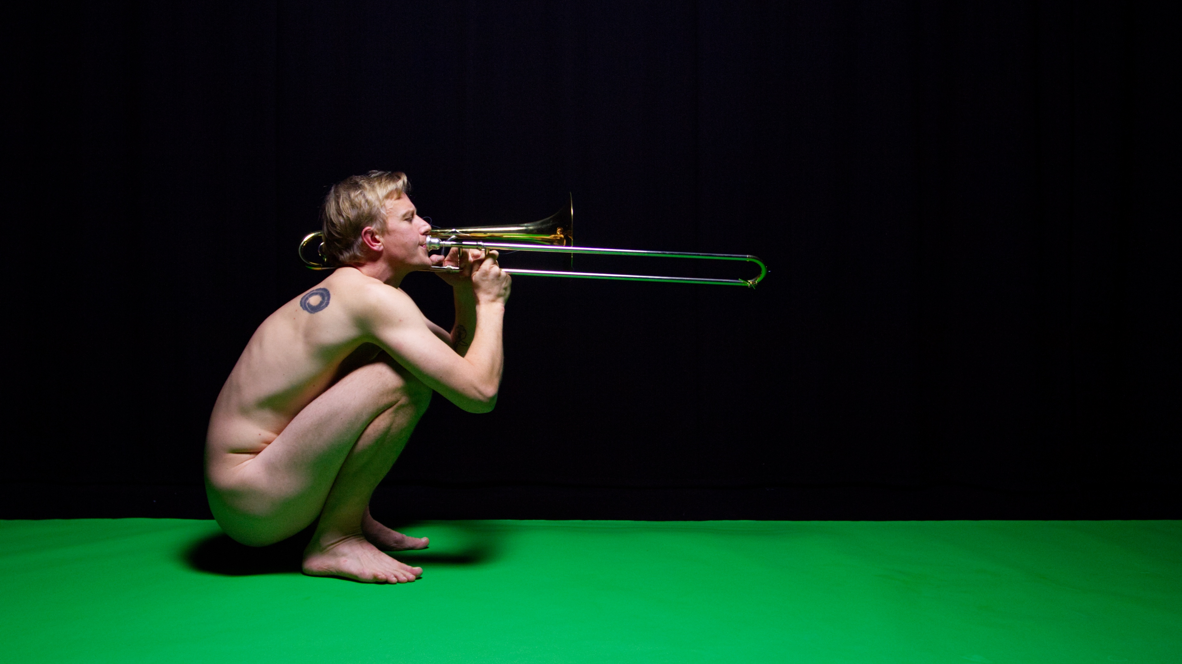
5/10
Our artistic freedom is
constitutionally protected
Hermes (Rasmus Slätis, 2022). Photo: Fabian Nyberg

Slide 11
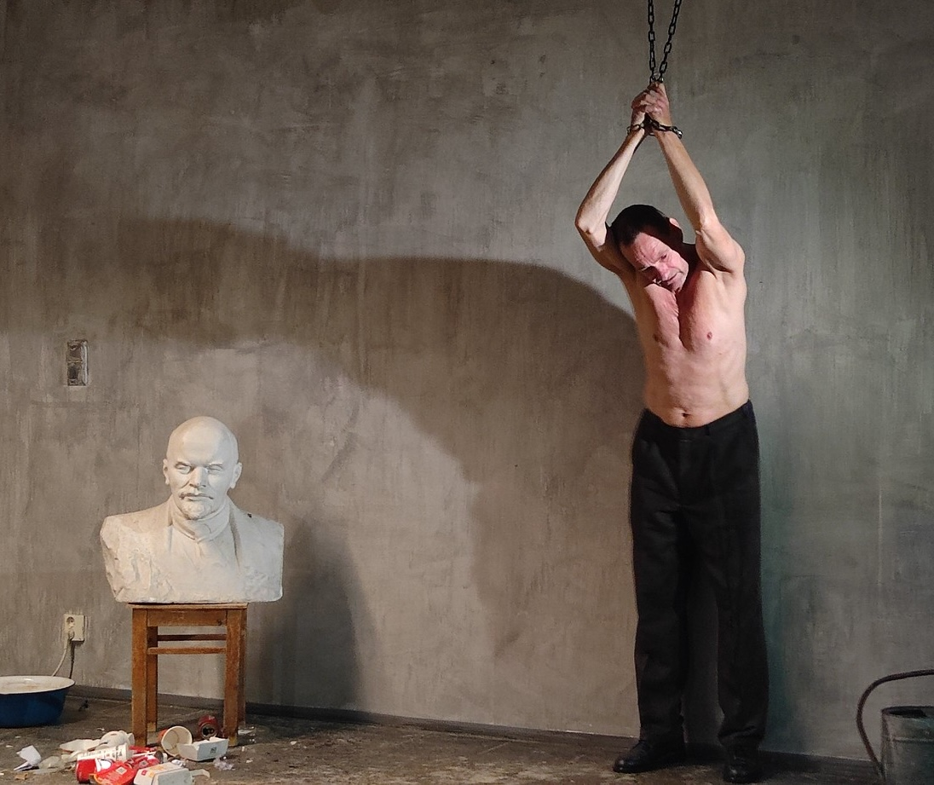
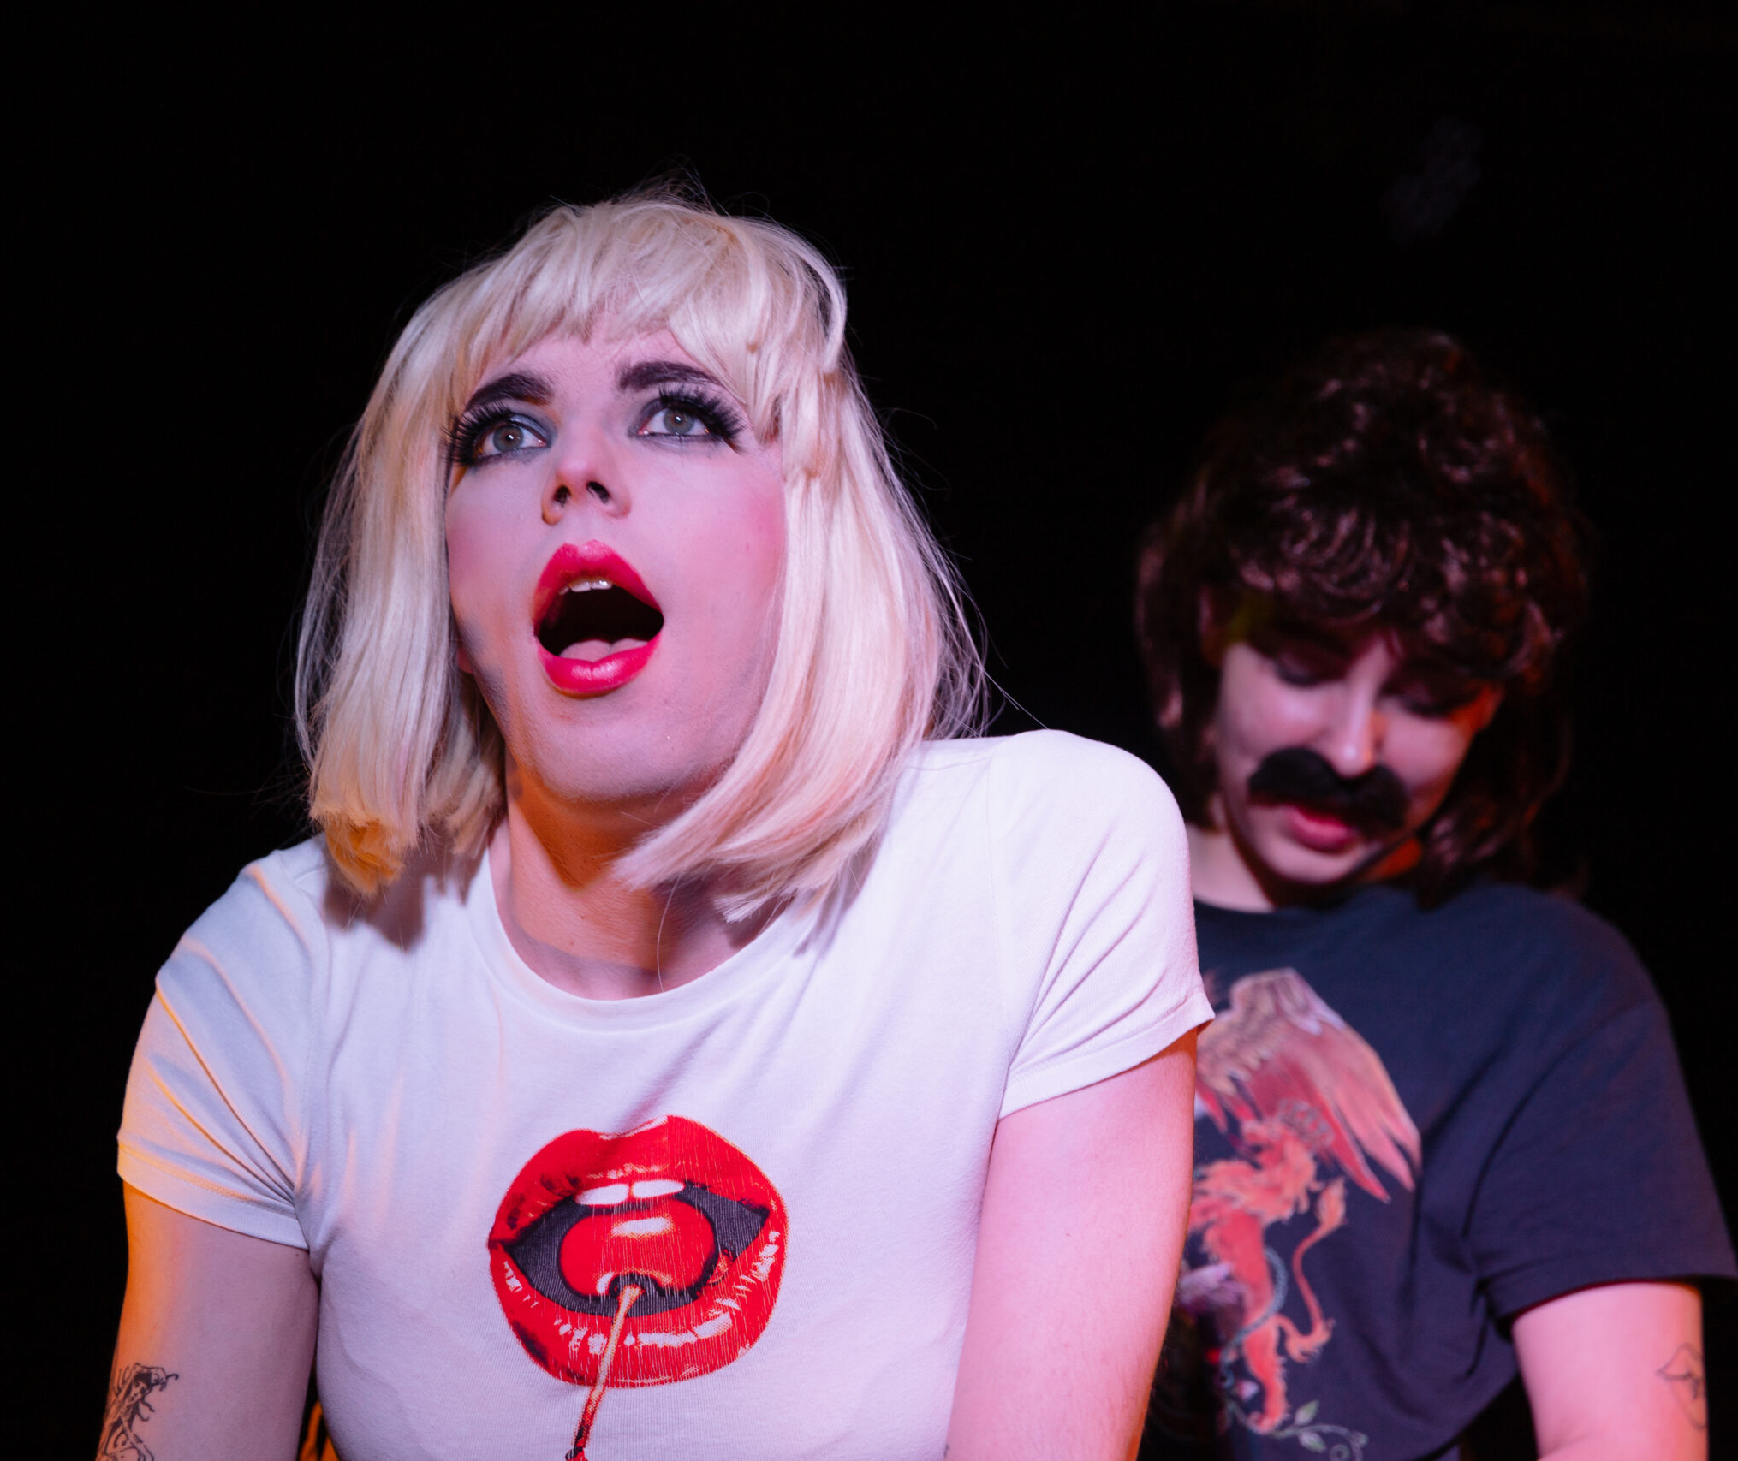
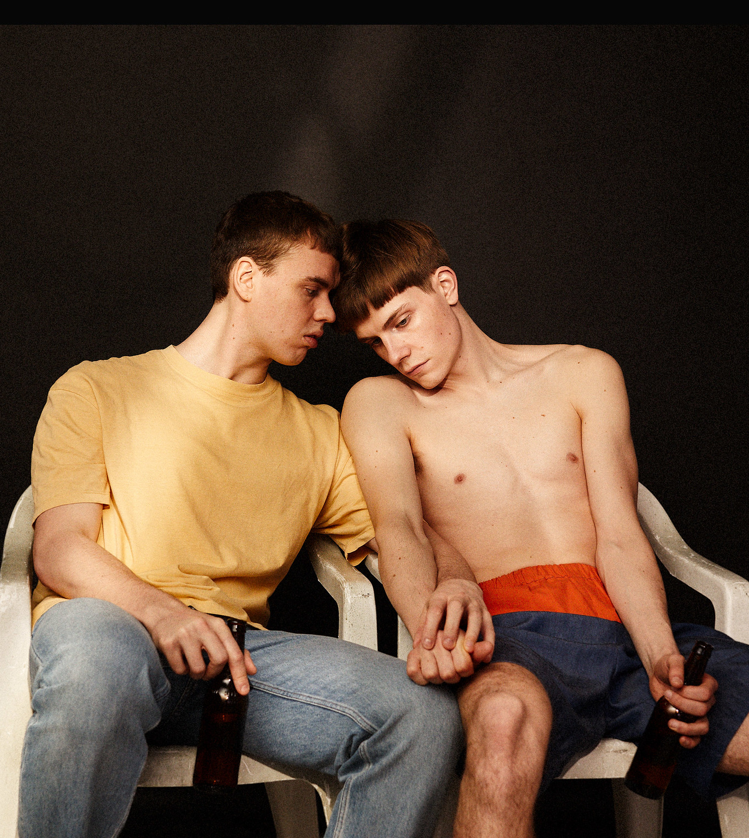
Our artistic freedom is constitutionally protected
FINNISH THEATRE IN 10 ACTS
1
2
3
4
5
6
7
8
9
10
The Freedom of Art is inscribed in our constitution.
Finnish performance has the right to be as bold and as provocative as it wants.
Porn Horror Musical 2 (Glitcher).
Photo: Ninni West
The Last of the Soviets (Helsinki 98, 2023).
Photo: Helsinki 98
Bolla (Helsinki City Theatre, 2022).
Photo: Ilkka Saastamoinen
Notes:
This is a freedom that we don’t take for granted, but often use to its full extent.
This is an image from the Helsinki 98 collective’s production of The Last of the Soviets – a performance based on the book by Svetlana Alexievich’s book Secondhand Time. It was produced in 2023 by a group of artists who fled Putin’s Russia in the immediate aftermath of Russia’s attack on the Ukraine.
CLICK In a free, secular and democratic society art can tell stories from the point of view of minorities; and it can take whatever form it pleases
CLICK It can talk about the long and contentious history of Israel and Palestine with surprising puppets; or it can offer a fun romp for adults.

Slide 12
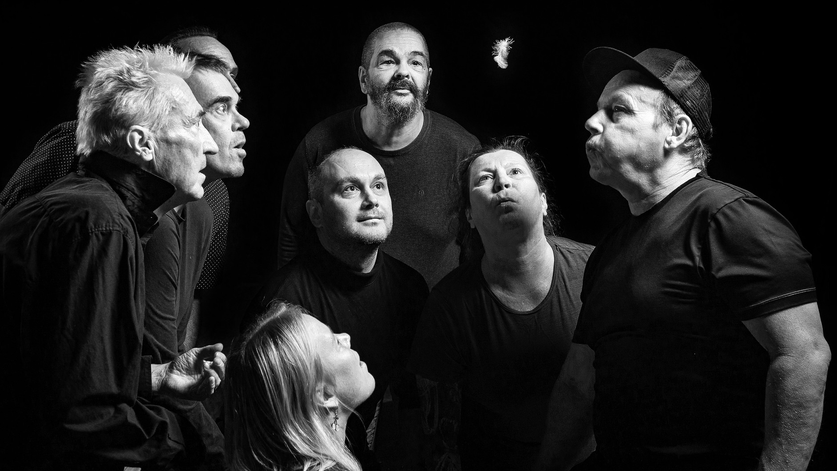
6/10
Inclusivity fuels innovation
Pottery Shards (Porttiteatteri, 2023). Photo: Matti Snellman

Slide 13
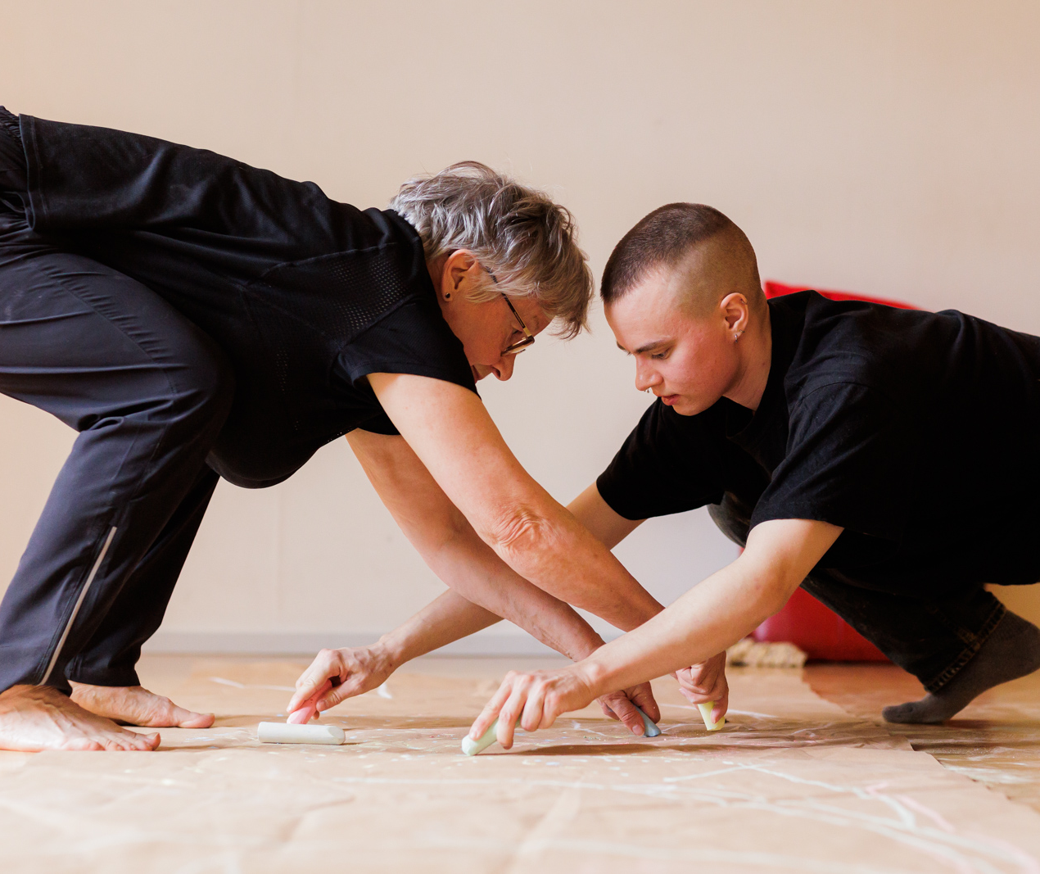
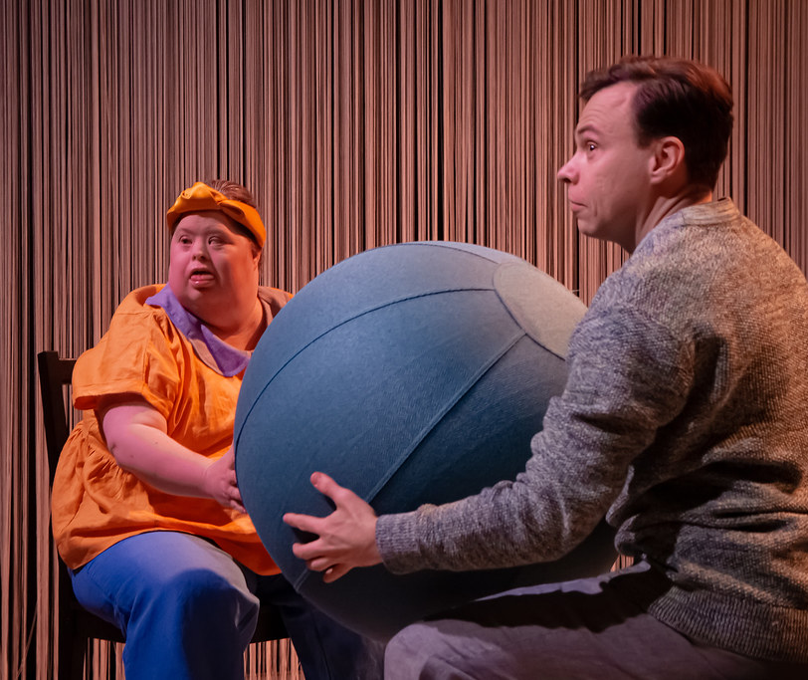
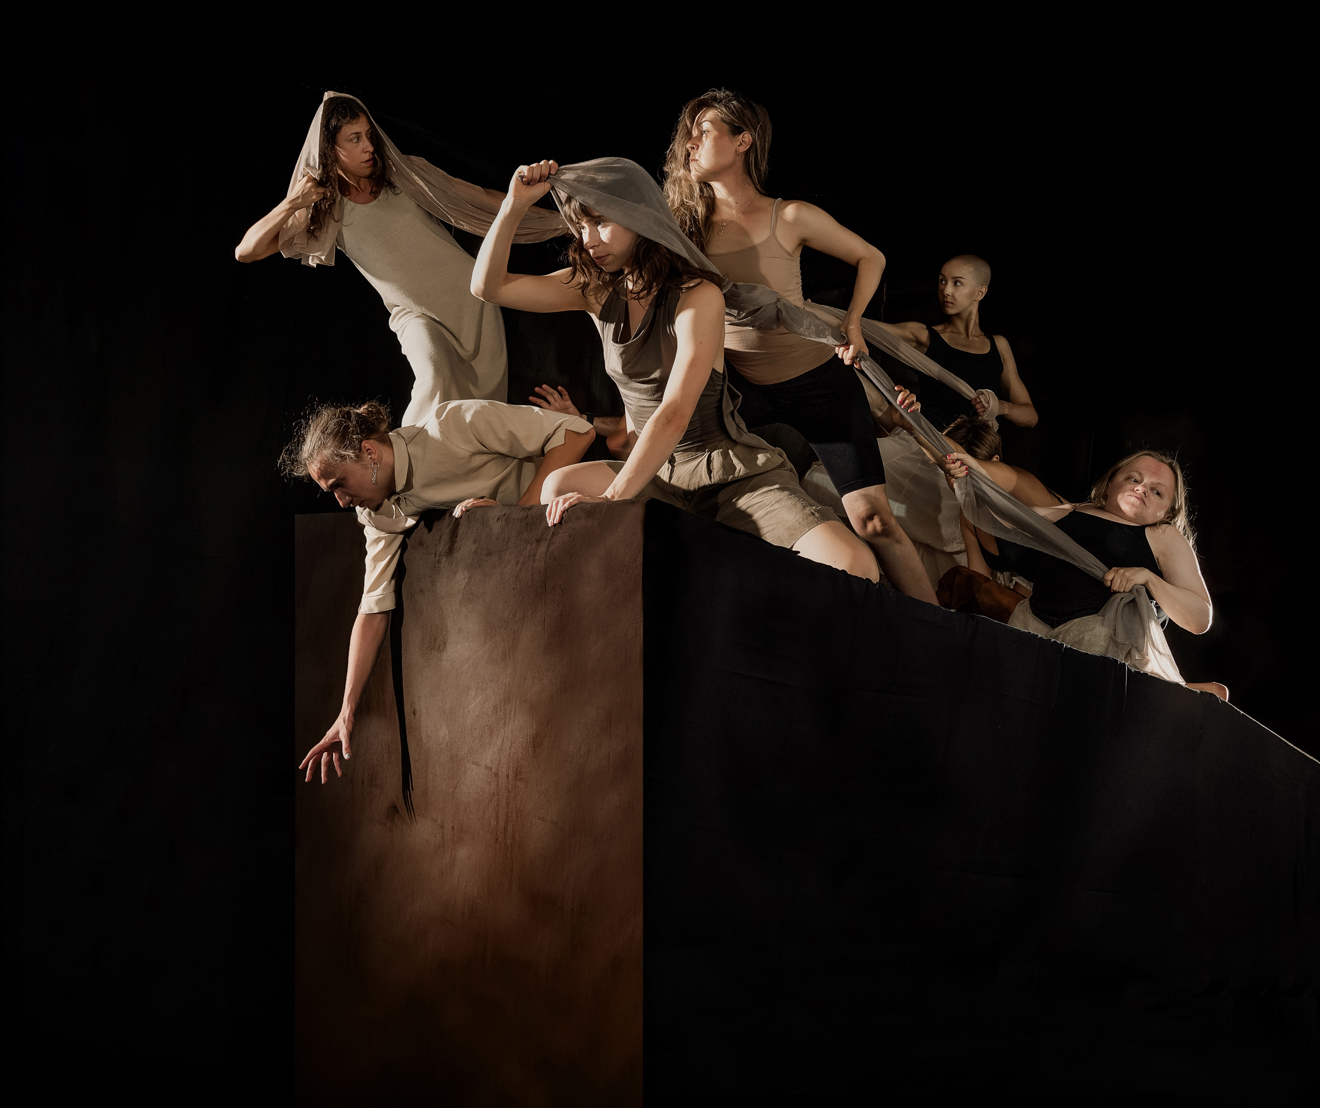
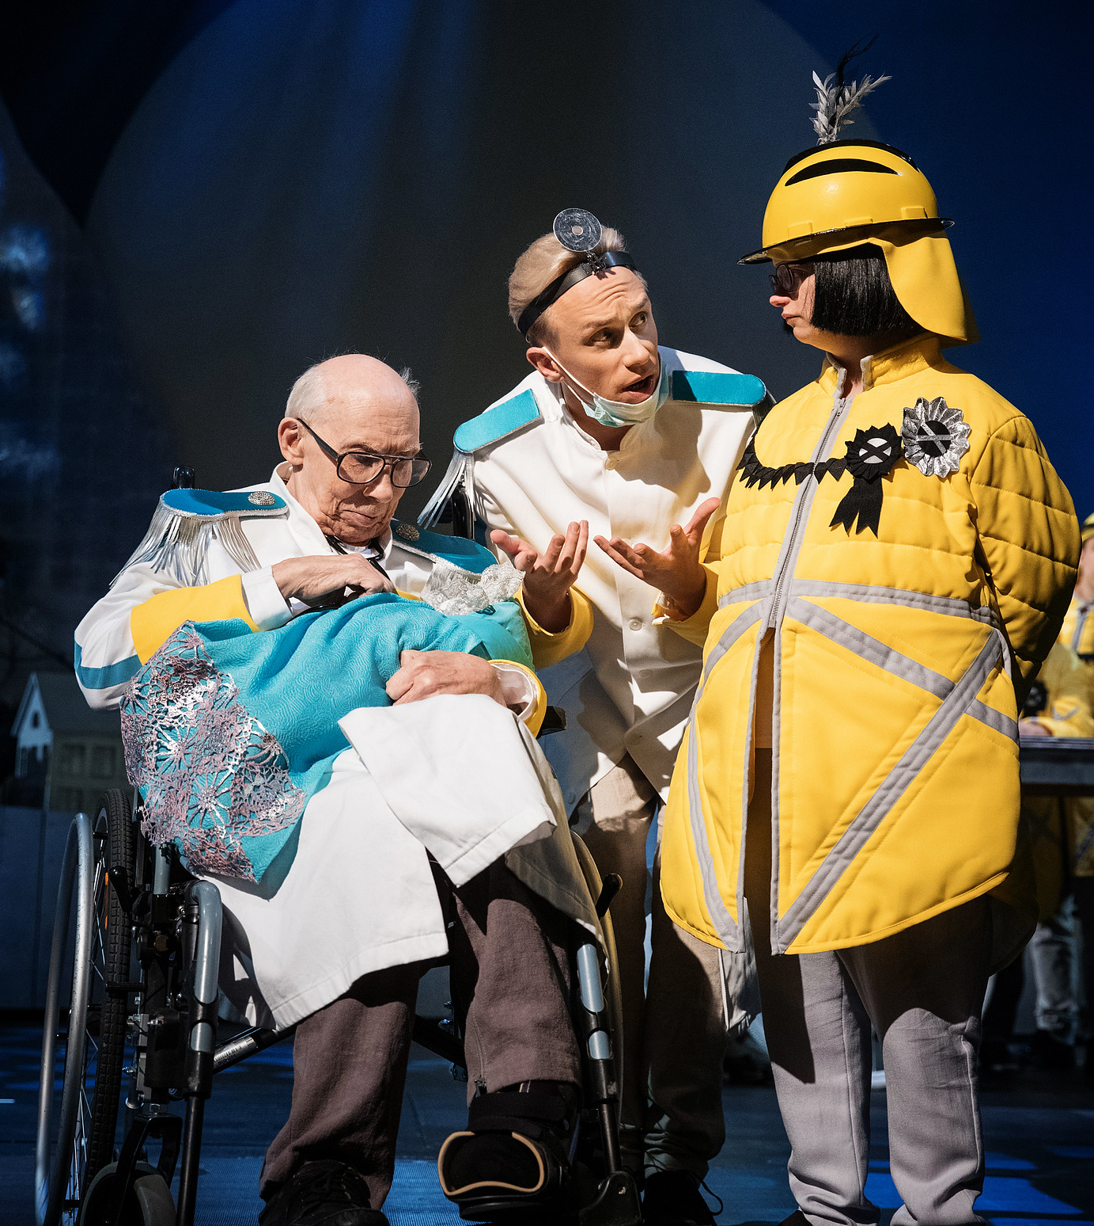
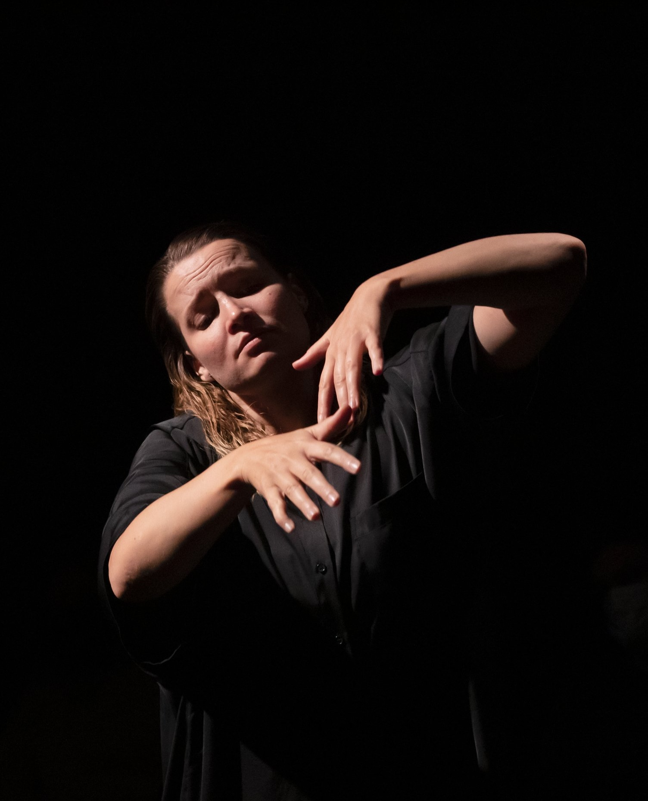
Inclusivity fuels innovation
FINNISH THEATRE IN 10 ACTS
1
2
3
4
5
6
7
8
9
10
Everyone has a story to tell.
In Finnish theatre, inclusivity is more than just add-ons: It’s often the creative starting point and the reason why we get on stage.
Lemmings (Post Theatre Collective, 2025. Dir. Bita Razavi.)
Photo: Suvi Sievilä
Sateenkaarisukupolvet-hankkeen tanssiryhmä. Todellisuuden tutkimuskeskus & Helsingin kaupunki.
Photo: Jussi Ulkuniemi
I det stora landskapet (DuvTeatern, Svenska Teatern,
Resonaarigroup & Wegelius Kammarstråkar, 2019).
Photo: Cata Portin
Vardag (DuvTeatern & Carl Knif Company, 2022).
Photo: Yoshi Omori
Listening (Live Arts Society, 2023).
Photo: Pirje Mykkänen

Slide 14
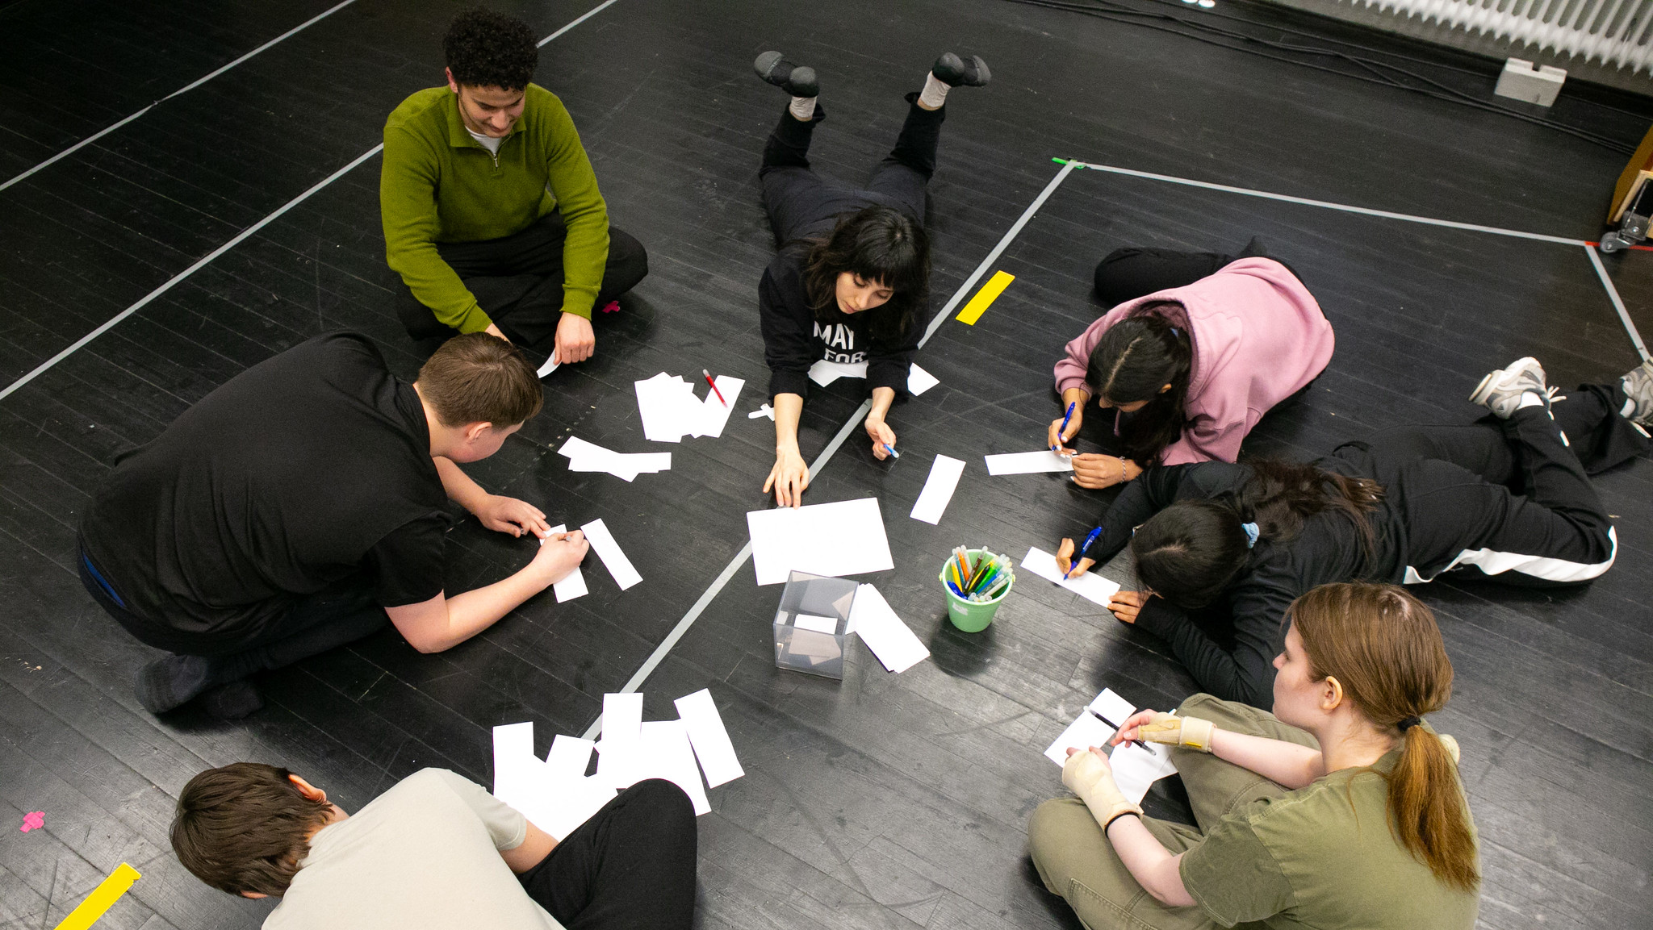
7/10
No better way to start school
than with a little drama
Workshop at the Finnish National Theatre in 2025. Photo: Jeroen Sebrechts

Slide 15
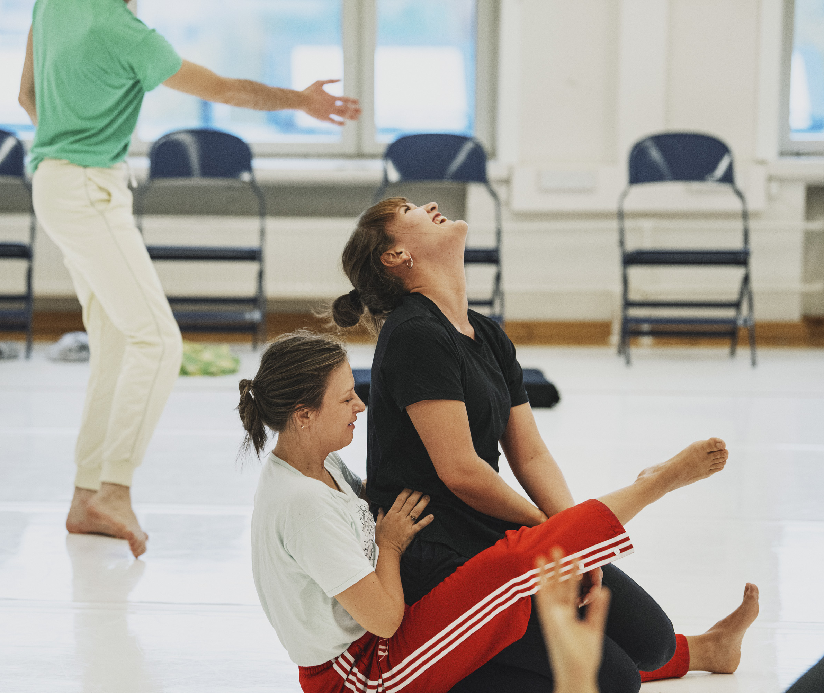
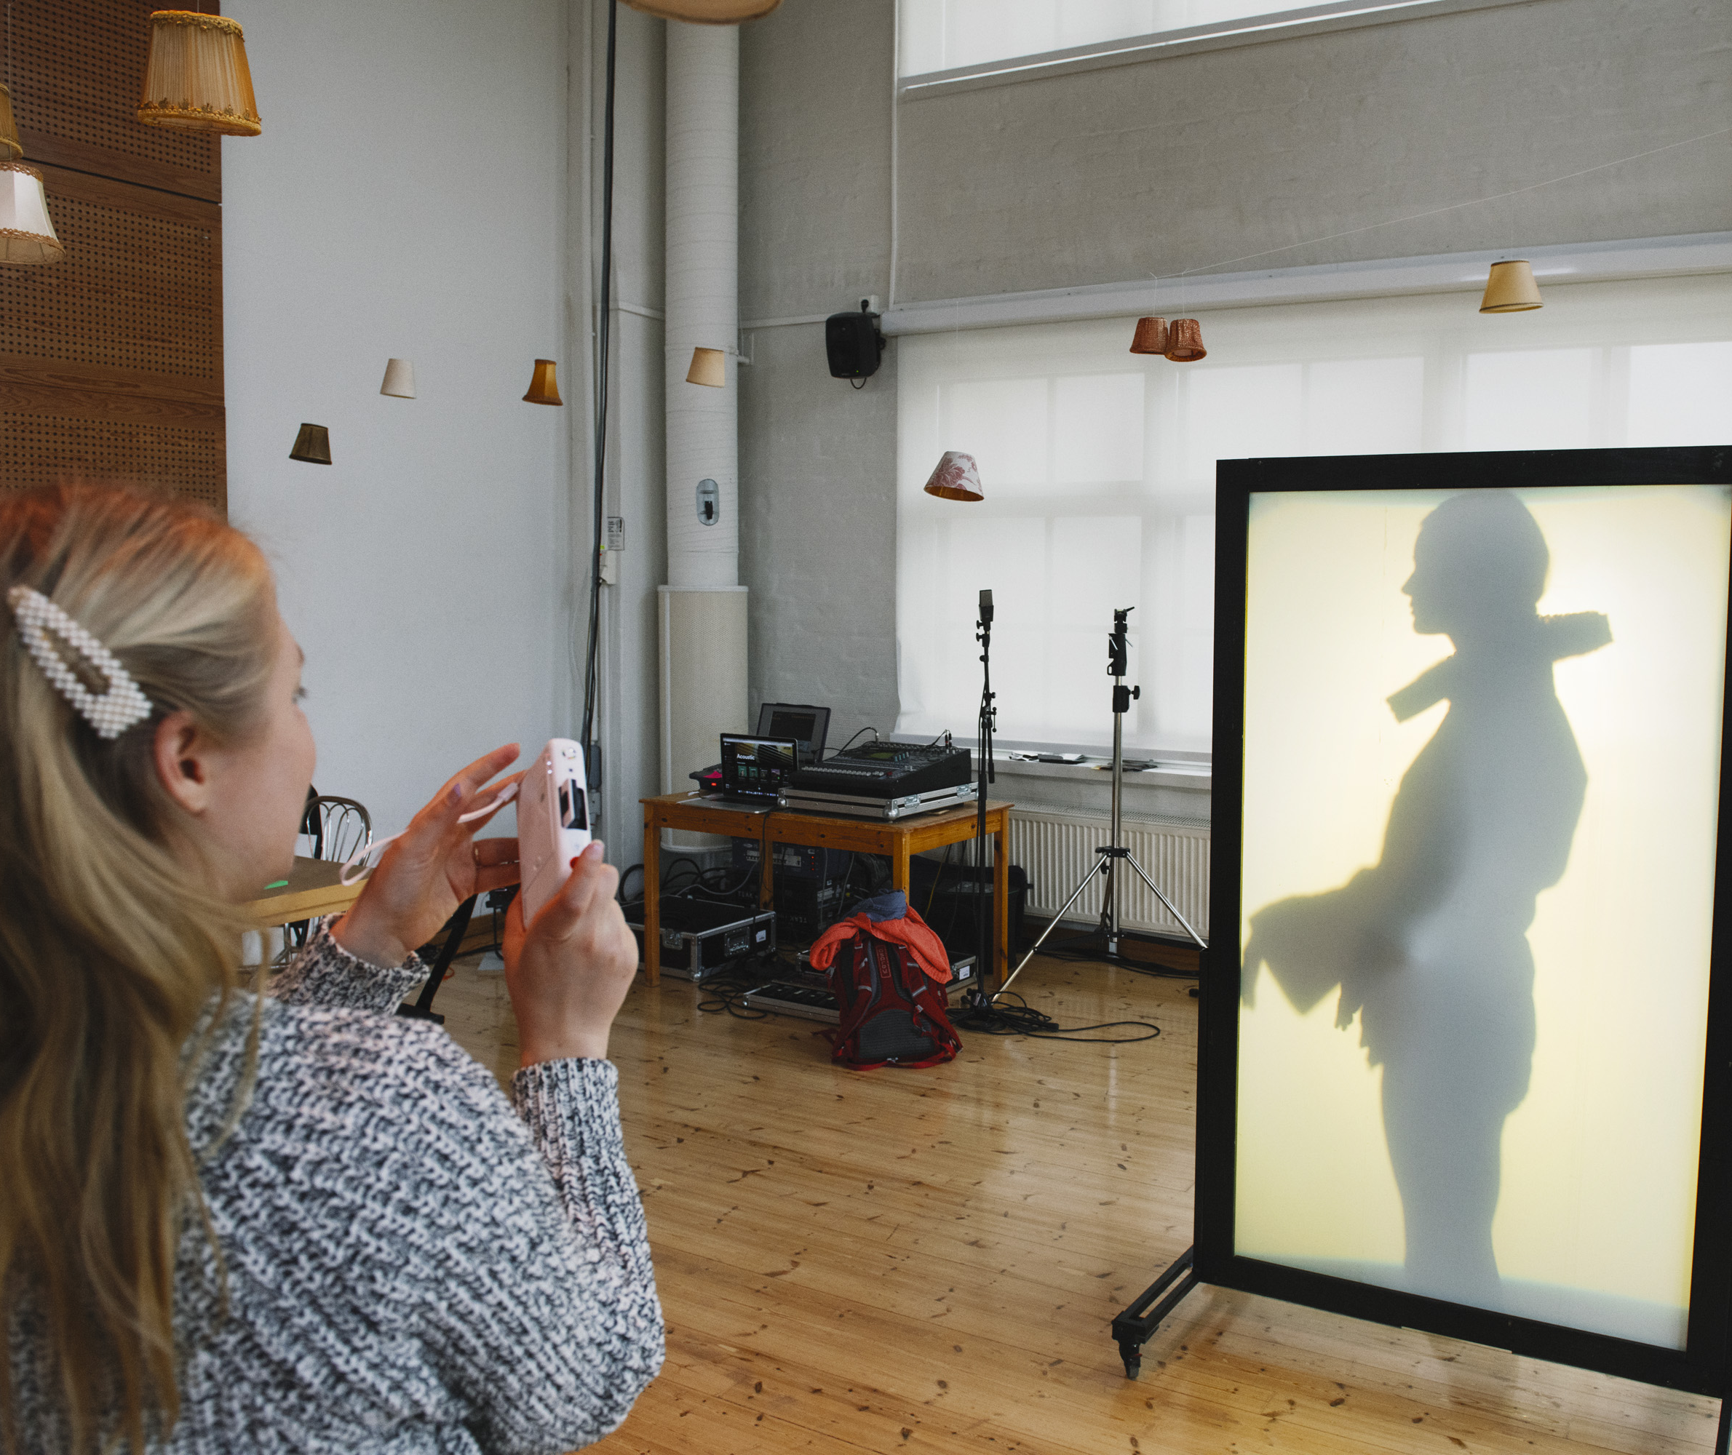
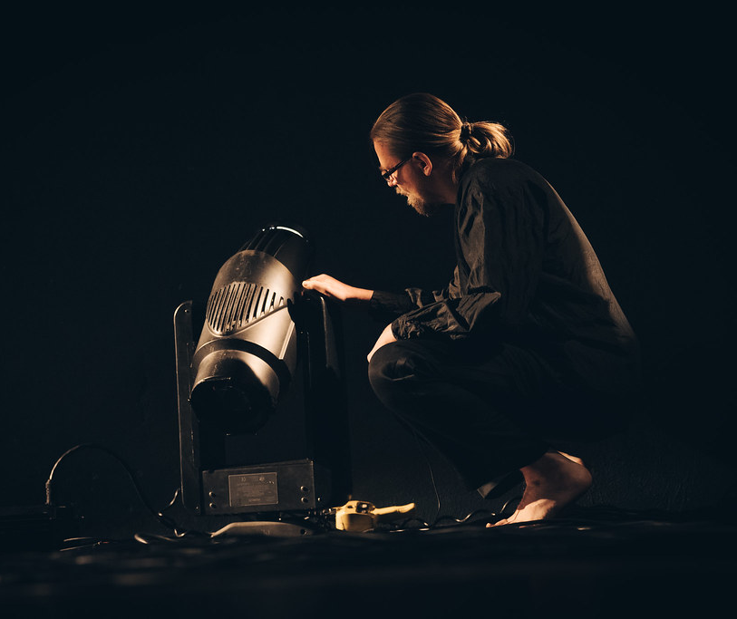
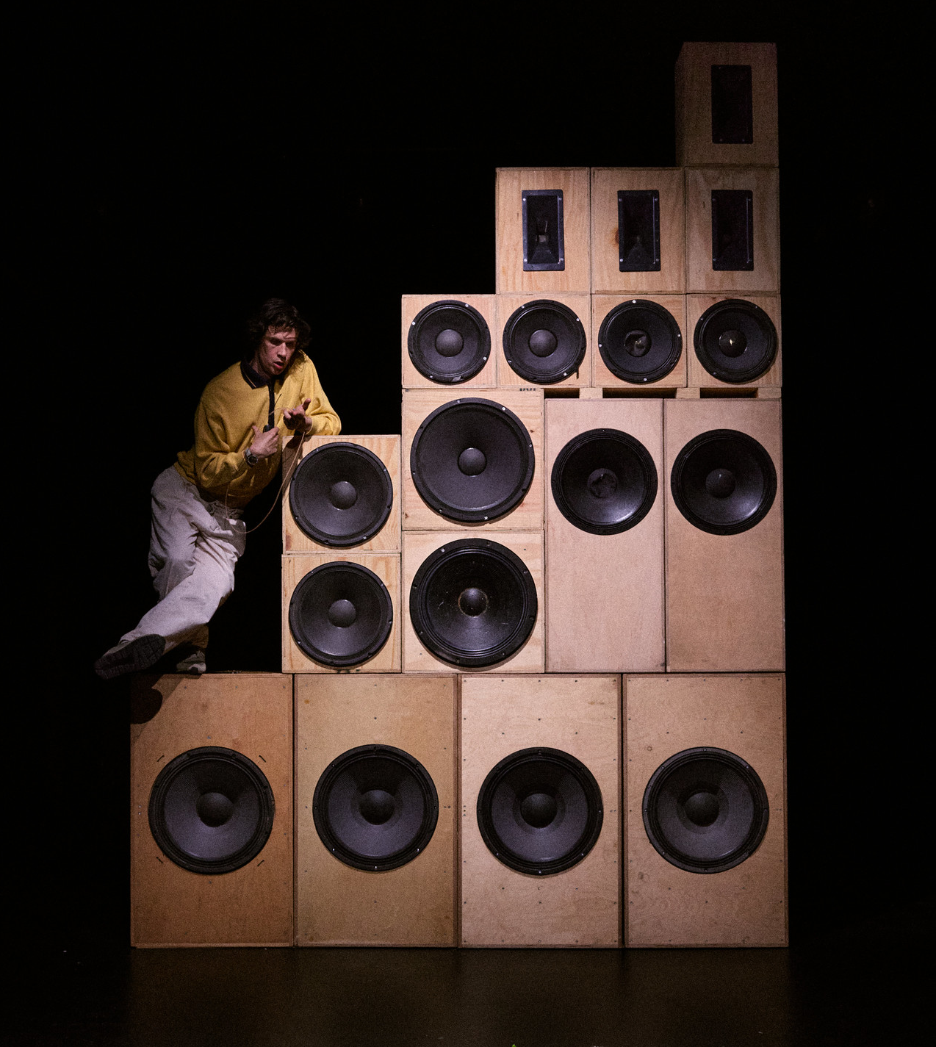
No better way to start school than with a little drama
FINNISH THEATRE IN 10 ACTS
1
2
3
4
5
6
7
8
9
10
In Finland, everyone has access to theatre.
Our free education includes creative expression classes, and schools and daycares often visit or get visited by age-appropriate performances such as puppet shows. But free theatre is not just for kids – performances are even held in nursing homes for the elderly to enjoy, too.
Toisenkaltaiset (Tehdas Teatteri, 2024).
Photo: Jussi Virkkumaa
The University of the Arts in Helsinki (Uniarts).
Photo: Veikko Kähkönen
The University of the Arts in Helsinki (Uniarts).
Photo: Veikko Kähkönen
Kohina (Tatu Nenonen / Samuli Niittymäki, 2024).
Photo: Ilkka Saastamoinen
Notes:
In the capital of Finland, Helsinki, all children born in 2020 or after are part of the Culture Kids program. A child will be assigned their own Helsinki-based cultural operator as a “sponsor”, and that operator will invite the child to at least two cultural events for free every year. The activities continue until the child starts school.
Finnish creative expression education is a versatile entity that covers the areas of spoken communication, performance, theatrical expression, and creative activity. Education is offered even on elementary school level, but even more in upper secondary school, where students get to choose optional subjects to study on top of the compulsory ones.
But theatre is not just for kids, and learning happens throughout life. Theatre performances aimed at nursing homes are an important part of the cultural offering for the elderly, and are organised both as visiting performances and participatory workshops. These performances evoke feelings and memories directly at the care unit premises.

Slide 16
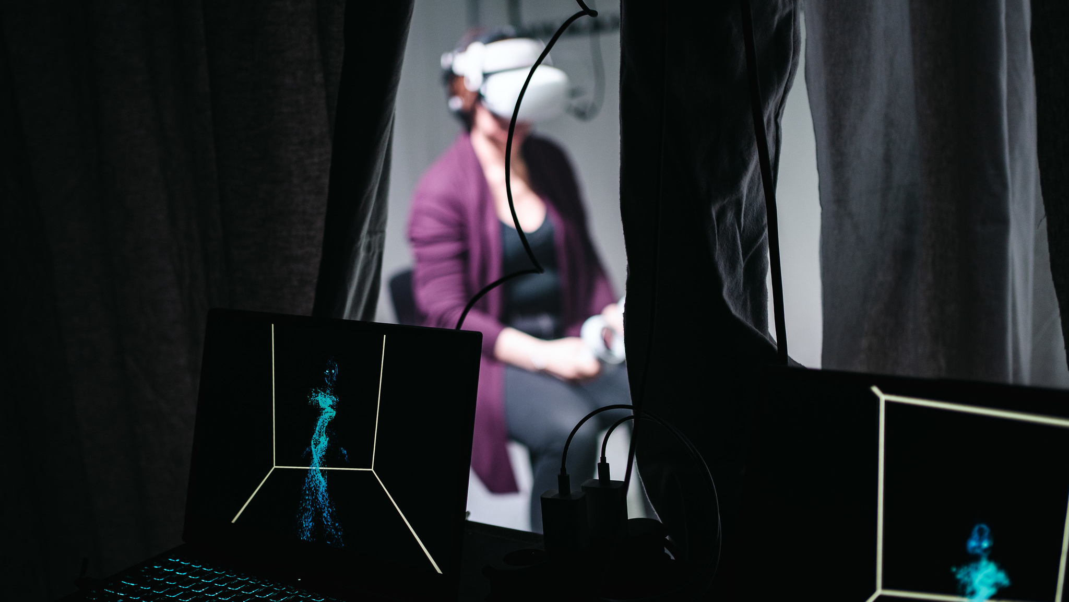
8/10
Tech is changing the scene
Love Simulation EVE (Espoo Theatre, 2023). Photo: Darina Rodionova

Slide 17
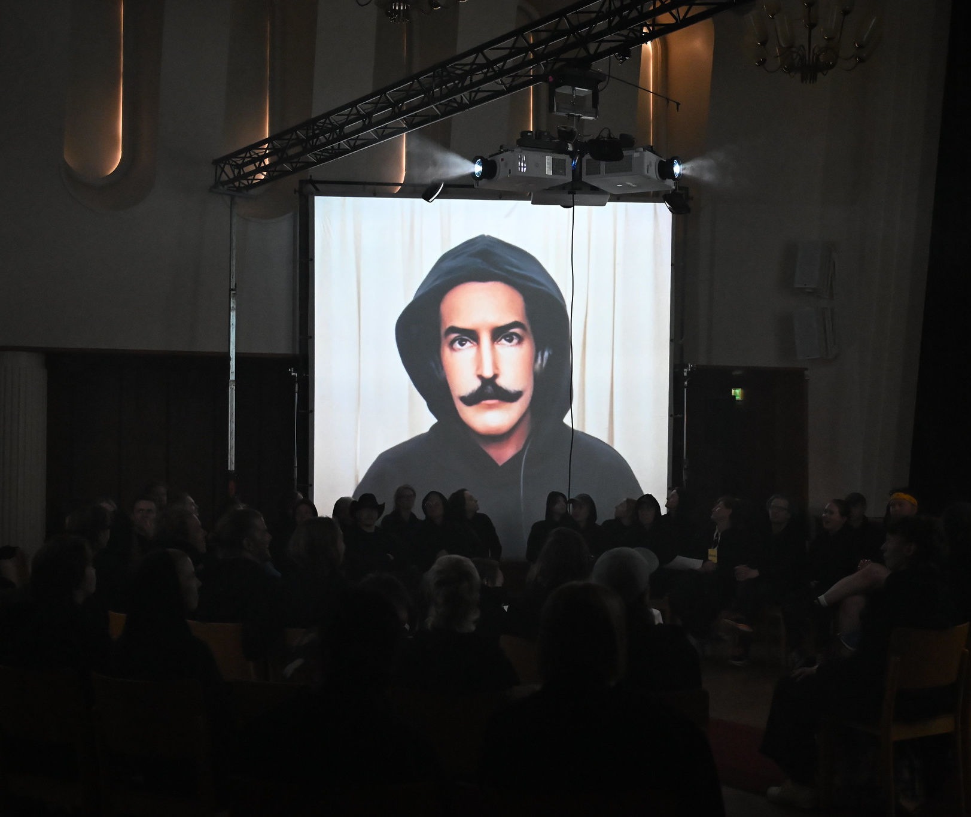
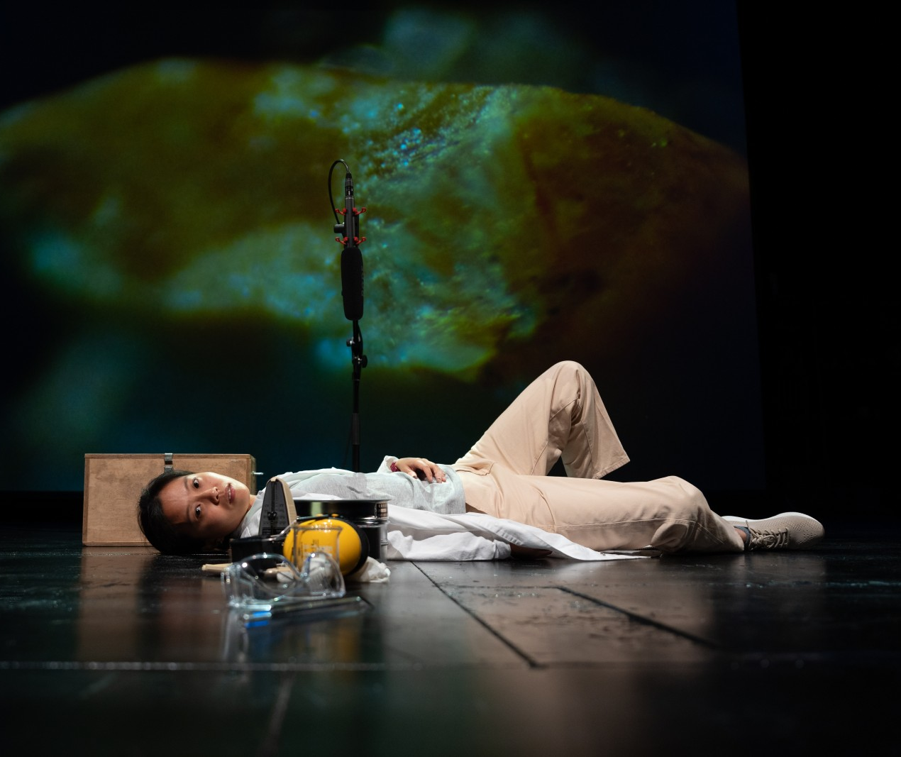
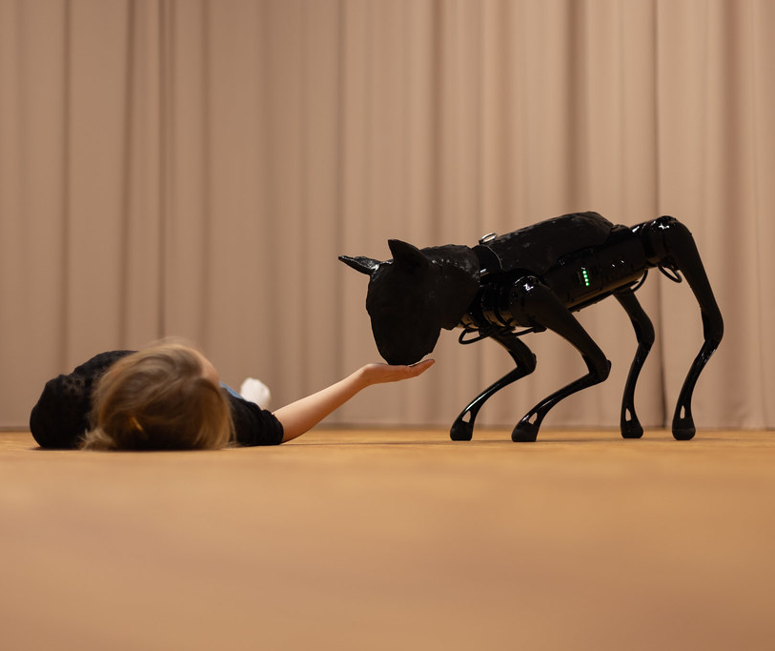
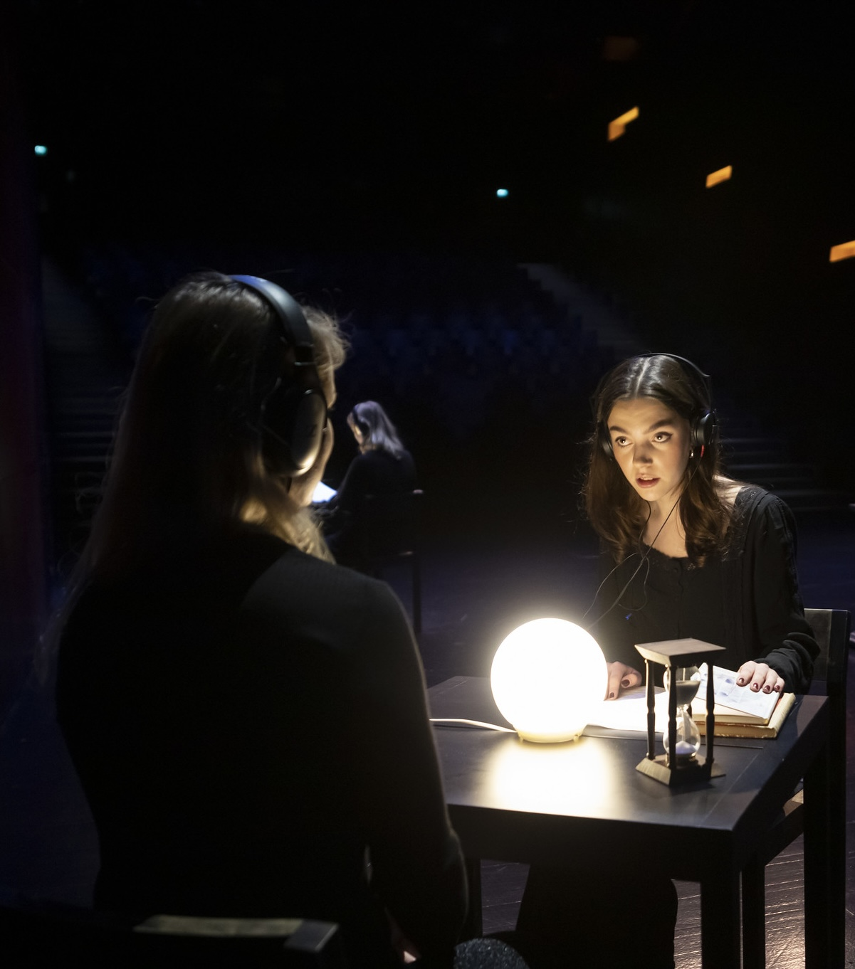
Tech is changing the scene
FINNISH THEATRE IN 10 ACTS
1
2
3
4
5
6
7
8
9
10
Digital innovations are taking Finnish performances to greater heights – and even new dramatic dimensions!
And guess what? Finland is one of the few countries in which you can get a doctorate in sound and light design.
Confessions (Teater 90°, 2025).
Photo: Jo Hislop
Companion (WAUHAUS, 2024).
Photo: Katri Naukkarinen
Nano Steps (Trial & Theatre, 2023).
Photo: Miika Storm
Kemi – muistio puista II (Tuija Kokkonen, 2022).
Photo: Pirje Mykkänen
Notes:
Finland’s global reputation for design and technology extends to theatre — from minimalist set design to pioneering soundscapes and digital projections that enhance storytelling.
And Finland is actually one of the few countries in which you can get a doctorate in sound and light design.

Slide 18
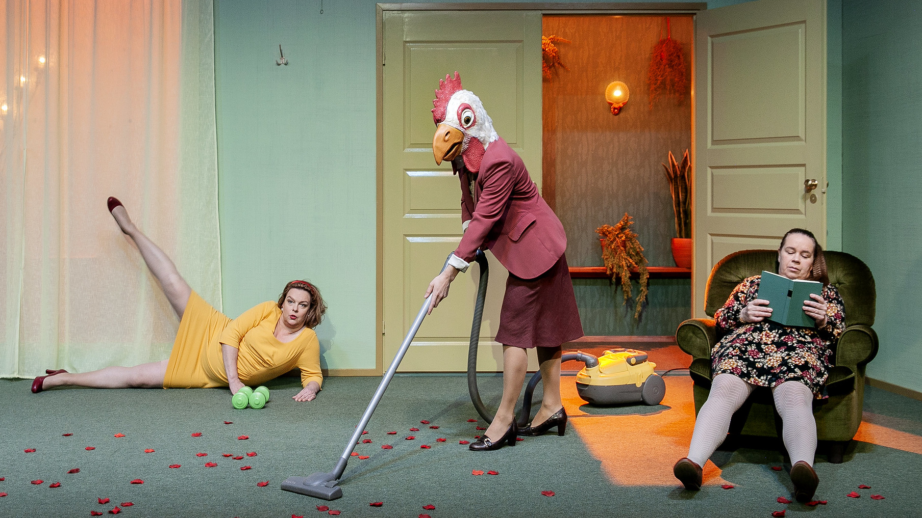
9/10
Yes – We’re quirky on stage, too
Medusan huone (Q-Teatteri, 2019). Photo: Aino Nieminen
Notes:
This may come as no surprise: We might come off as weird at times.

Slide 19
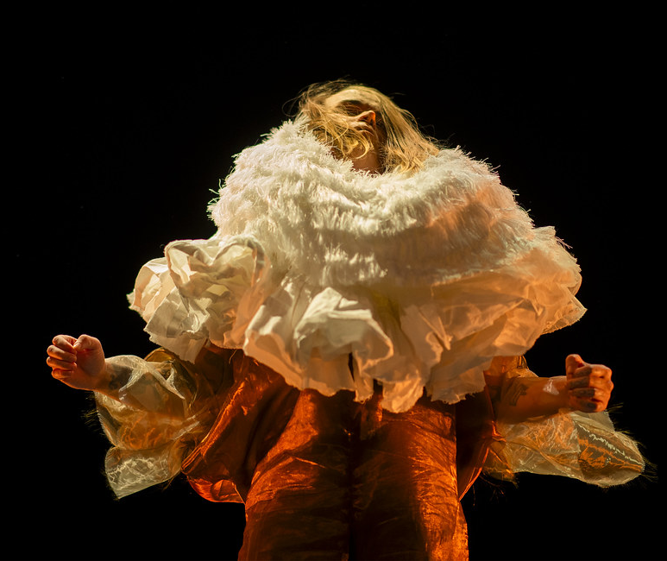
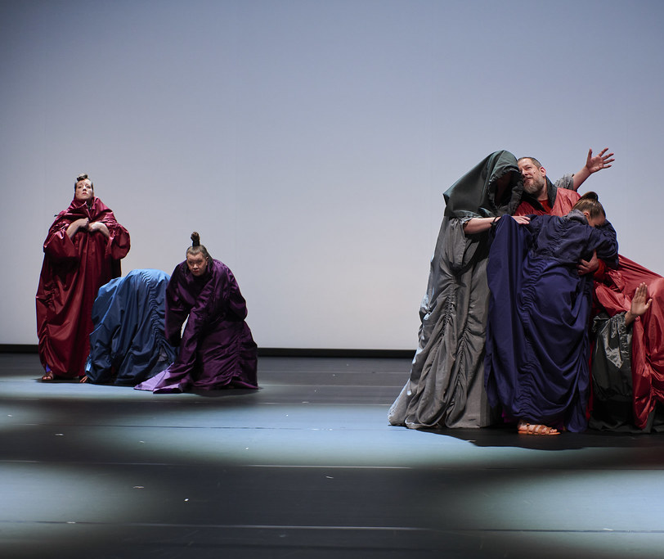
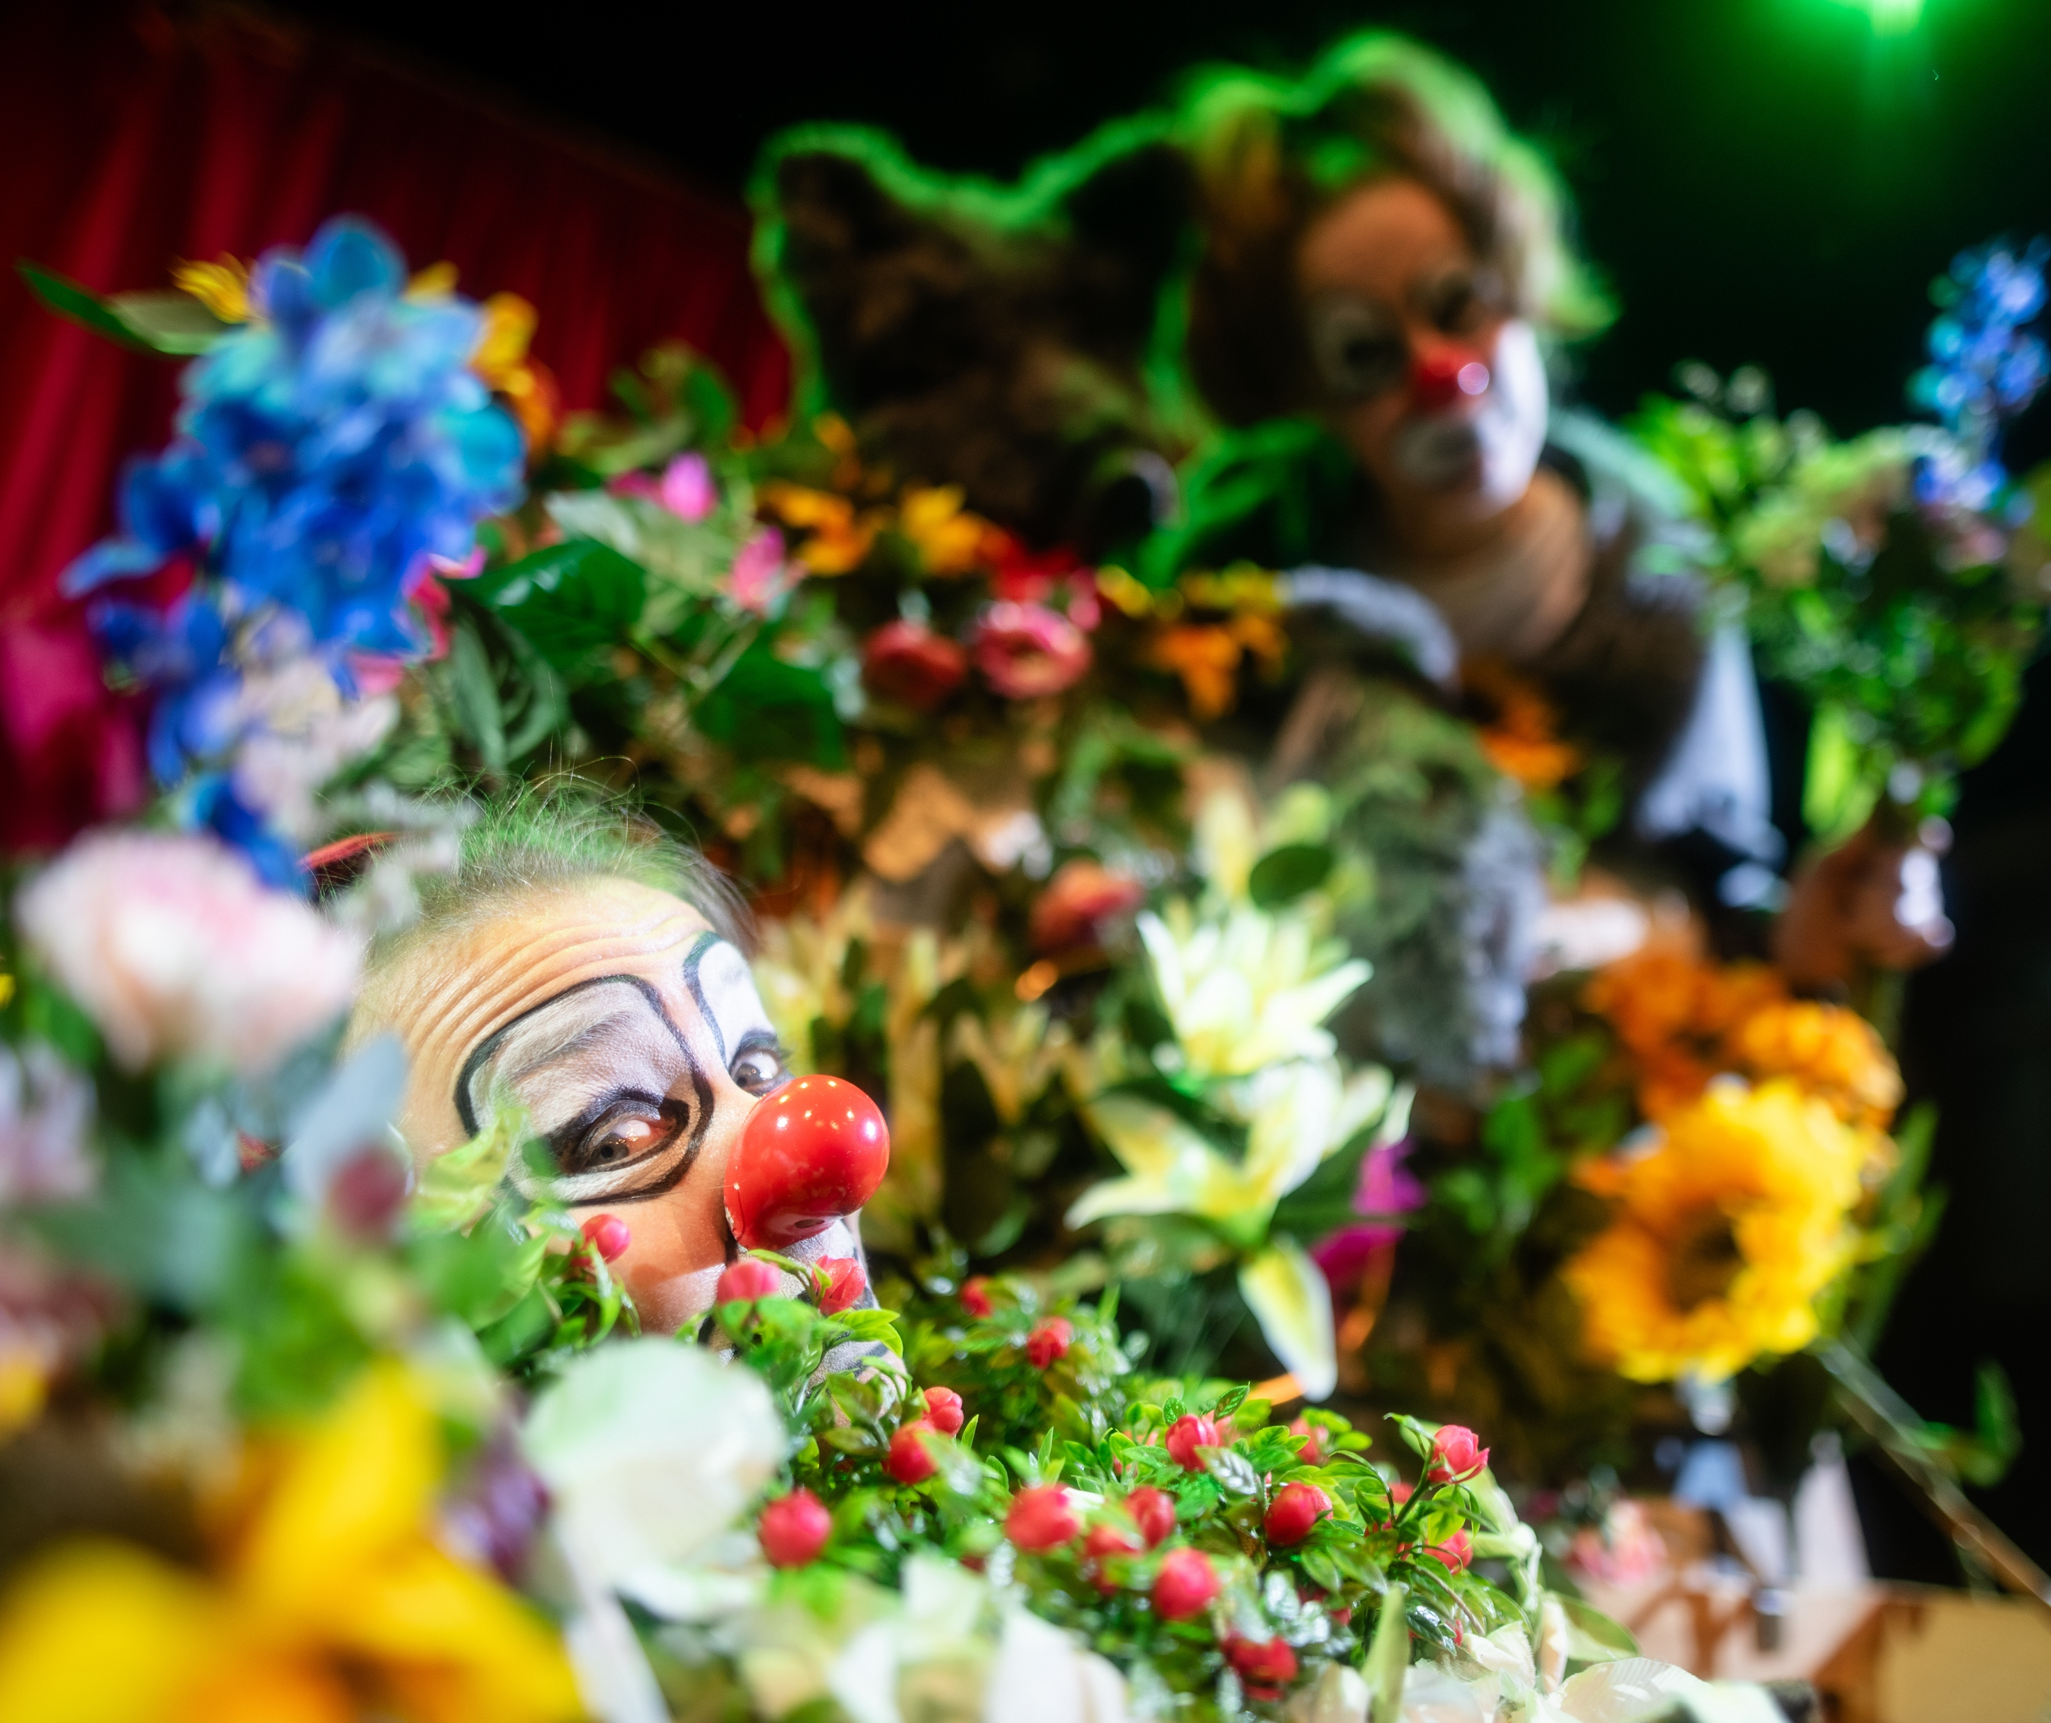
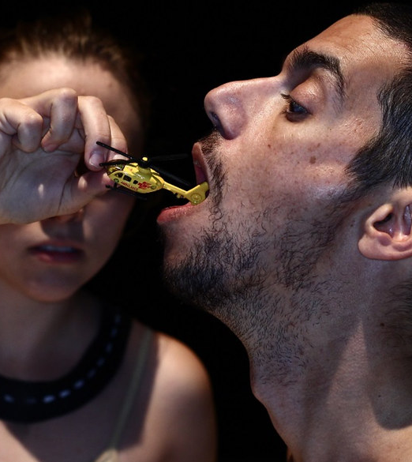
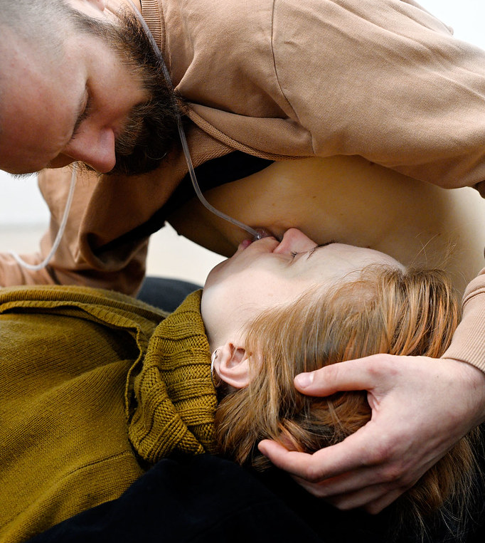
Yes – We’re weird on stage, too
FINNISH THEATRE IN 10 ACTS
1
2
3
4
5
6
7
8
9
10
If you want to steal the show, you must dare to be different.
Finnish performance thrives on being odd and offbeat: it’s our ticket to the world.
Ruff Knowledge (Camille Auer, 2023).
Photo: Tani Simberg
Obsessions at Oper Wuppertal (Oblivia).
Photo: Björn Hickman
Kuolematon Punahilkka (Red Nose Company, 2025).
Photo: Ilari Kallinen
Invisible Lands (Grus Grus Teatteri, 2016).
Photo: Pernilla Lindgren
Nurture (Samuli Laine, 2020).
Photo: Filippo Zambon

Slide 20
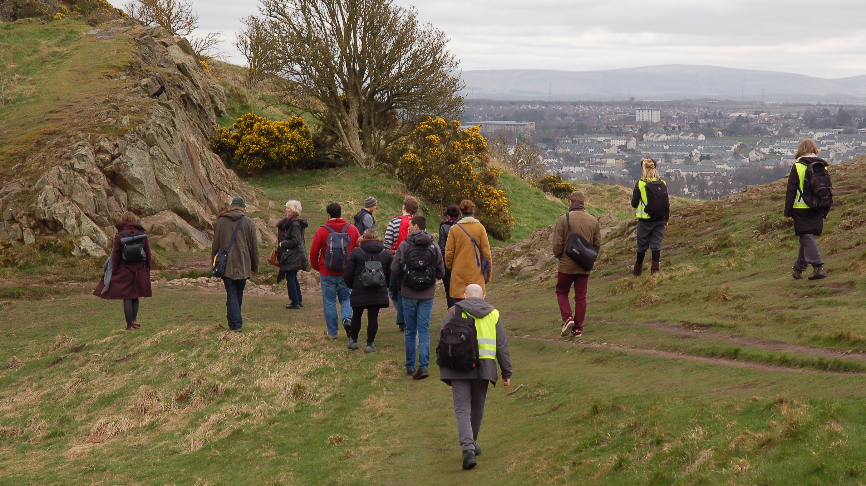
10/10
The world is our stage
Reindeer Safari in Edinburgh (Other Spaces). Photo: Anita Neira Tiemann

Slide 21
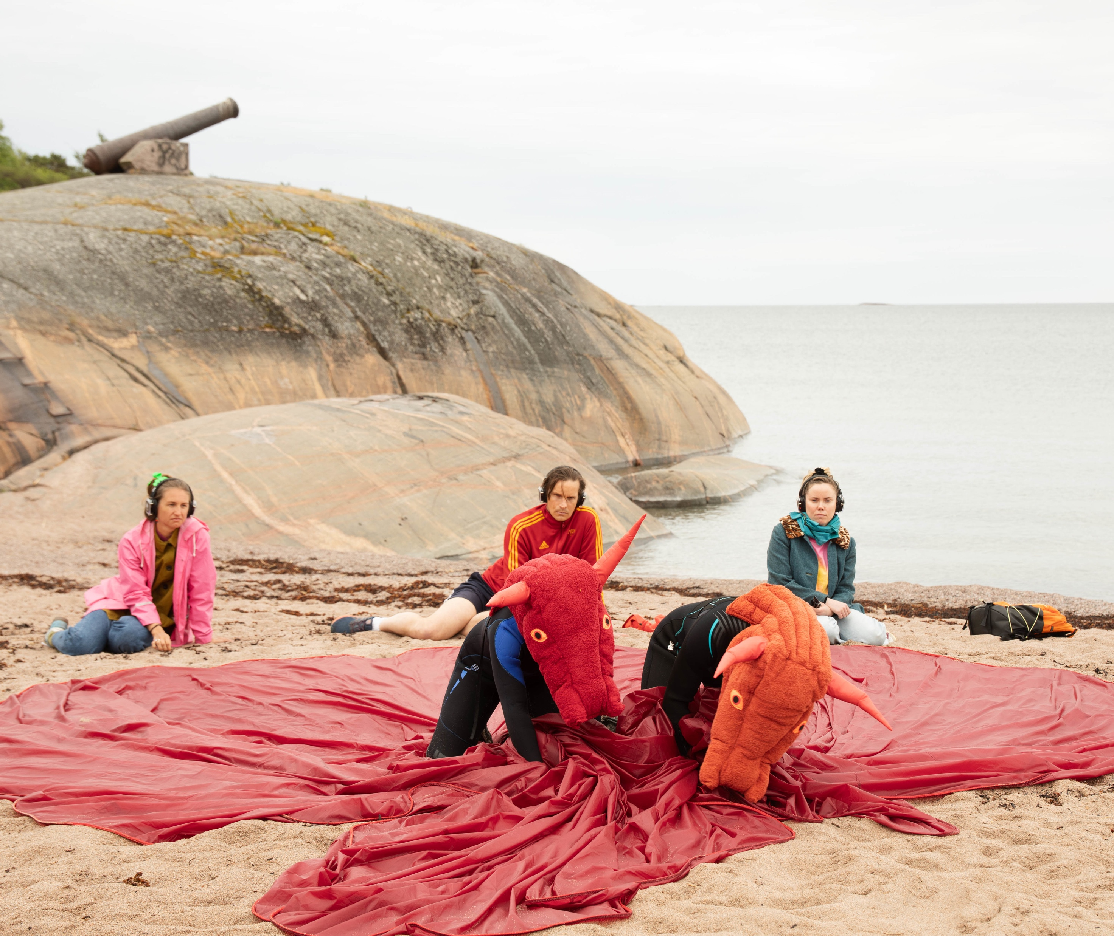
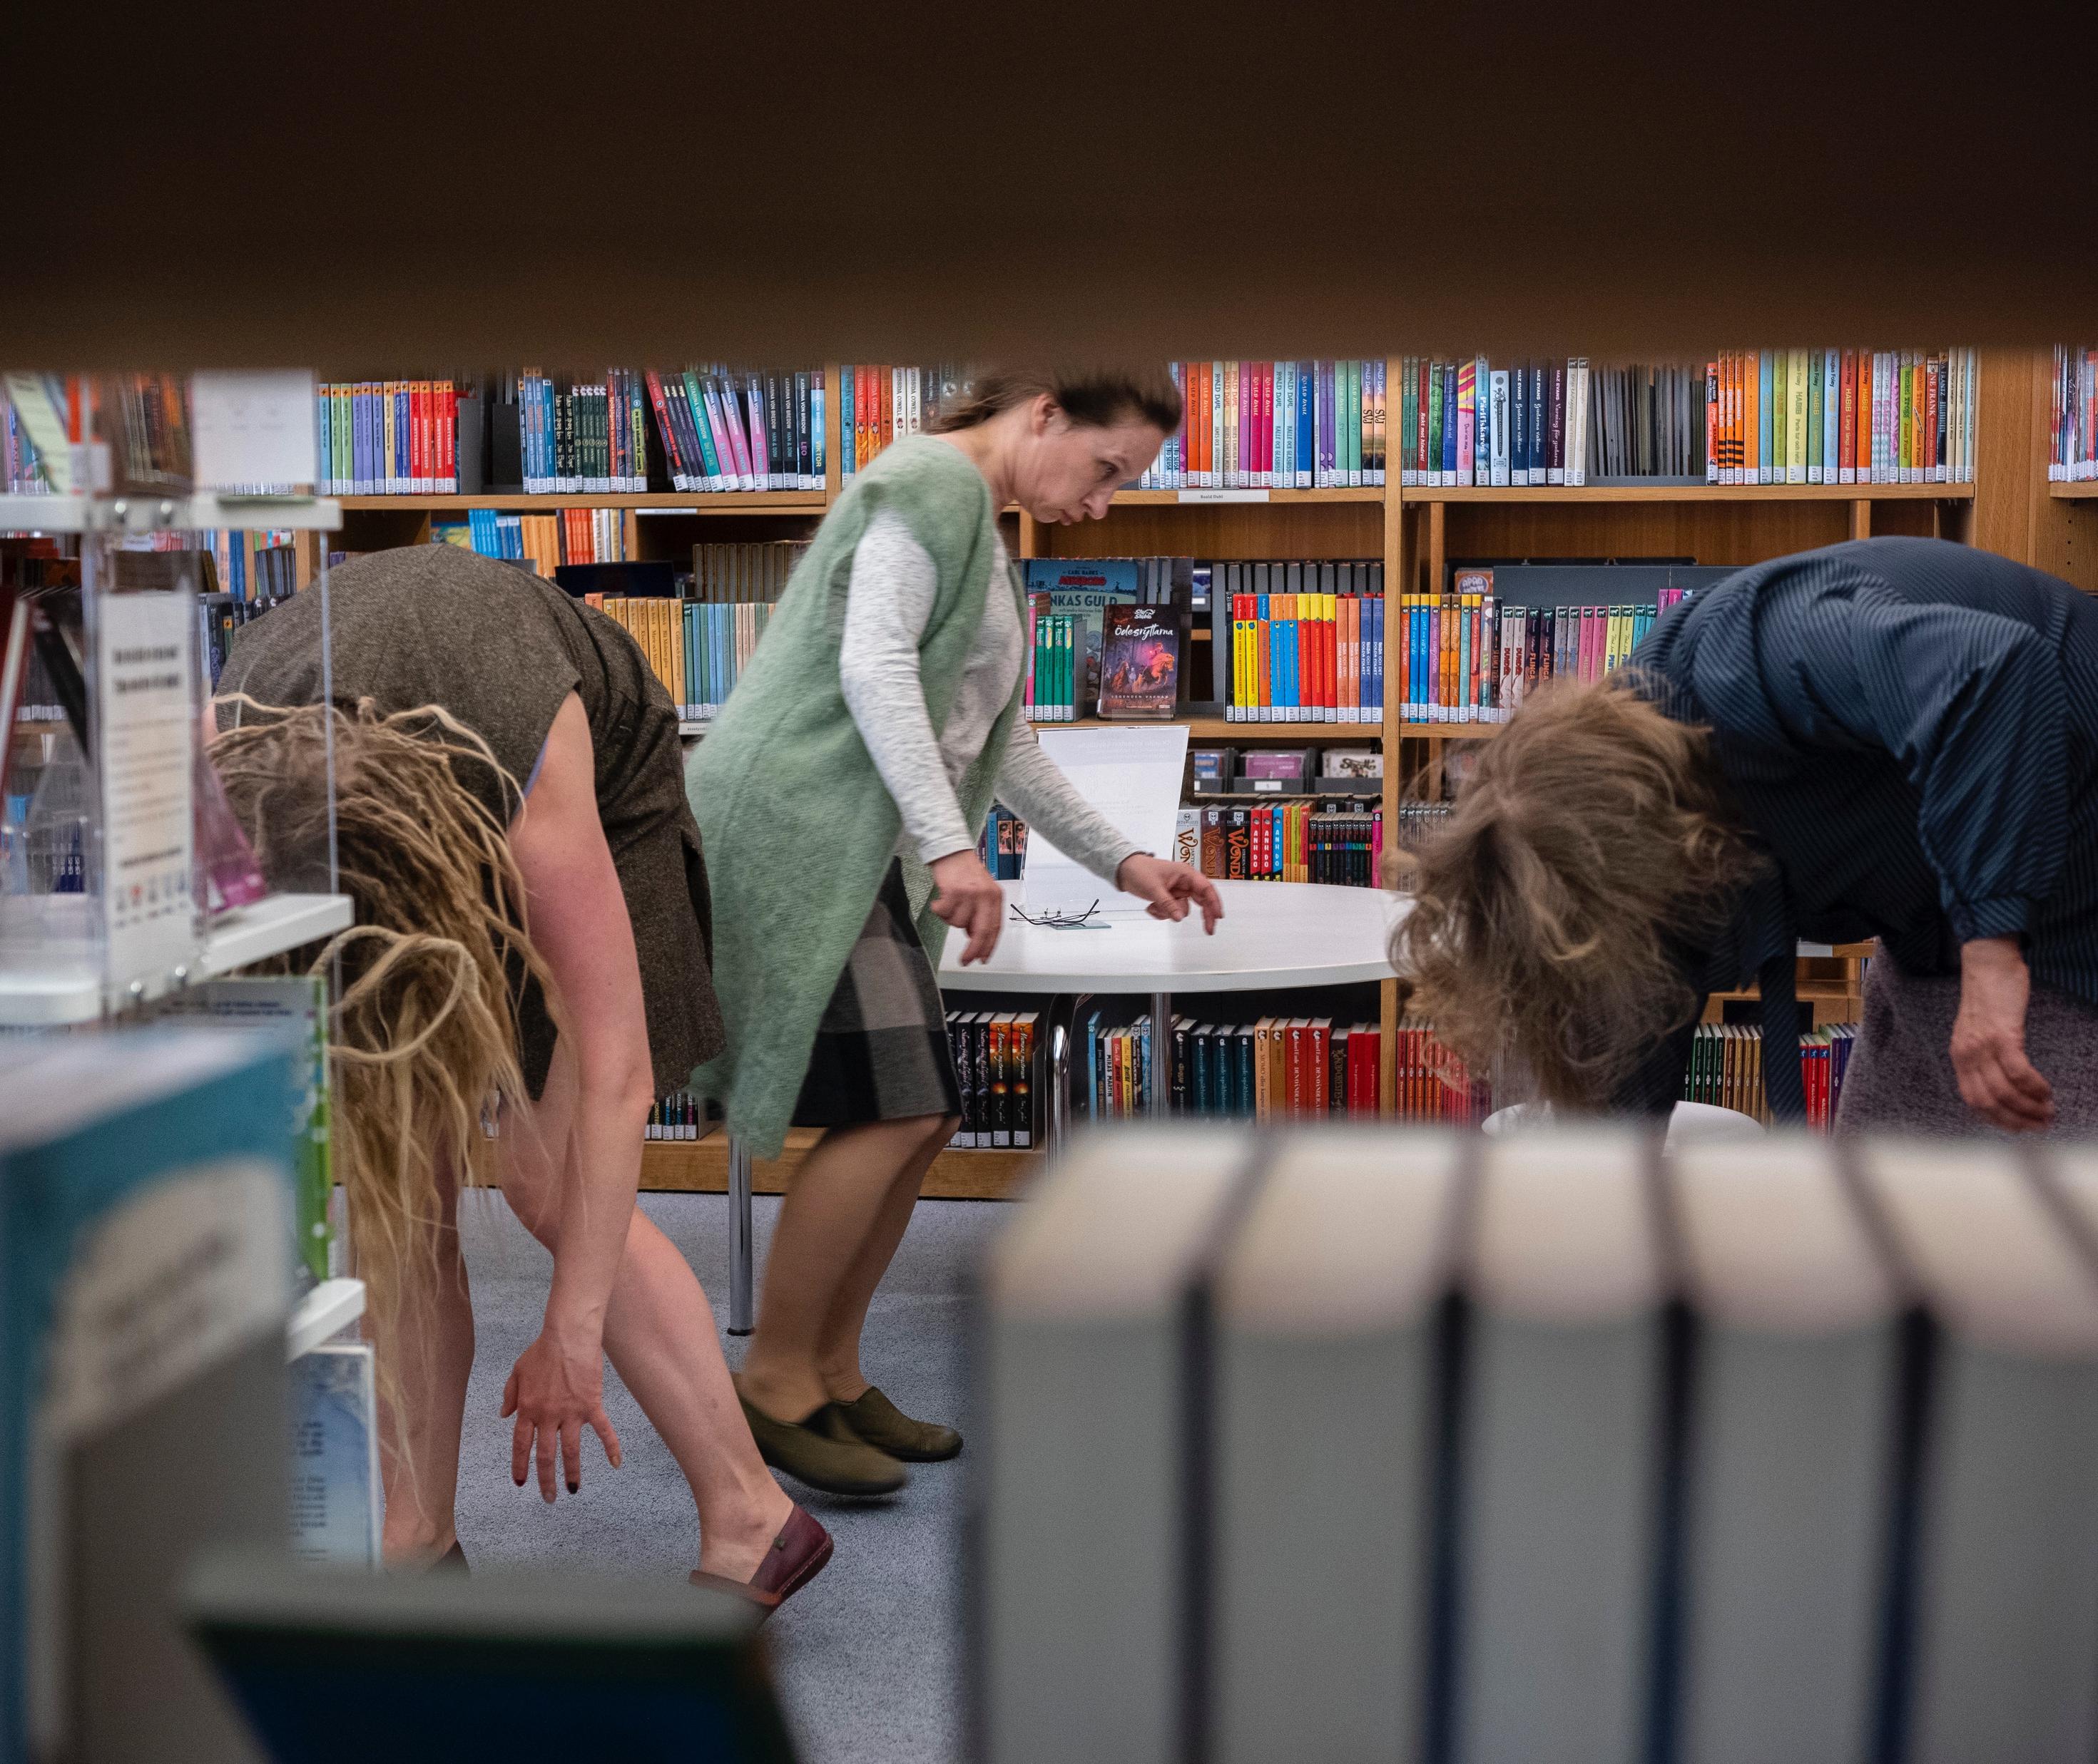
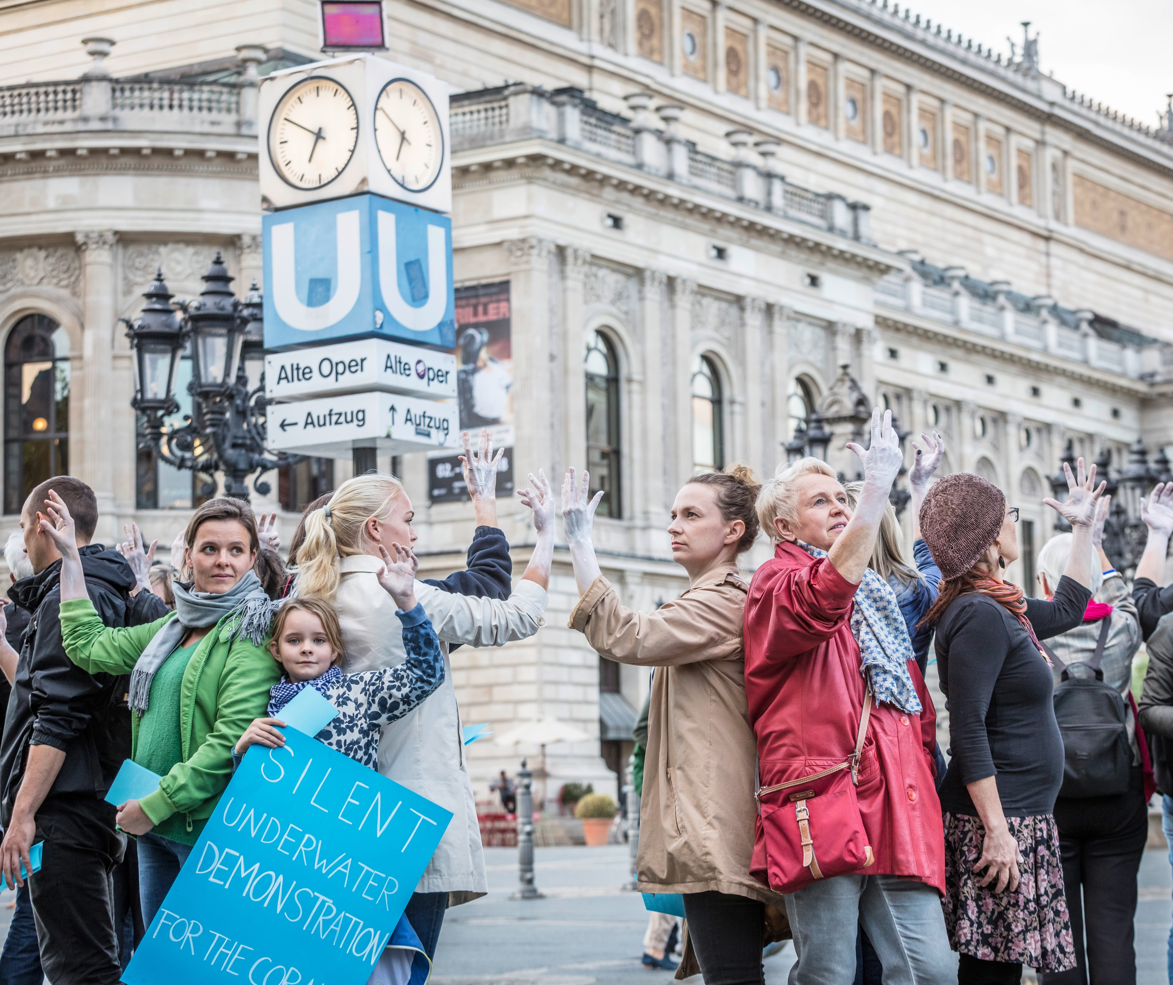
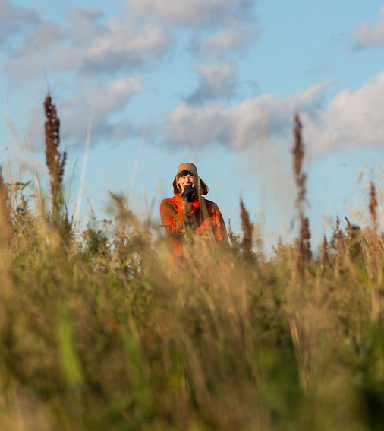
The world is our stage
FINNISH THEATRE IN 10 ACTS
1
2
3
4
5
6
7
8
9
10
Finnish theatre can't be confined indoors.
Some of our internationally most sought-after performances are made for spaces far from the gilded halls.
Collection of Imaginary Beings at the Turku City Library (Other Spaces, 2021).
Photo: Jaakko Ruuska
Underwater Manifestation, a part of The Great Barrier Reef (Other Spaces).
Photo: Achim Reissner
Swell at Hangö Teaterträff 2024 (Sinna Virtanen).
Photo: Emma Reijonen
A Great Mess (WAUHAUS, 2021).
Photo: Katri Naukkarinen
Notes:
Finland's status as a "theatrical superpower" is derived not from scale, but from the intensity of its cultural debate, the depth of its public support, and the boldness of its artistic experimentation.
As it navigates the complex interplay between cherished tradition and radical transformation, the Finnish stage offers a compelling case study for how a small nation can make a unique, powerful, and deeply relevant contribution to the world of theatre.

Slide 22
11/10
11/10
An extra skylight
with views to
common ground.
Epilogue

Slide 23
Epilogue
FINNISH THEATRE IN 10 ACTS
1
2
3
4
5
6
7
8
9
10
11
Photo: xxx
Any note
can be written here.
This is a place for
more detailed information.
You can use this page to highlight connections between Finnish cinema and your country, shared projects, or even interesting upcoming events.
Notes:
Tähän osioon voi koota vastaanottajan ja tilanteen mukaan personoitavia asioita, toki teatterikulman huomioiden.

Slide 24
Curtain call, but not the end.
Want to put on the next show together?

