Slide 1
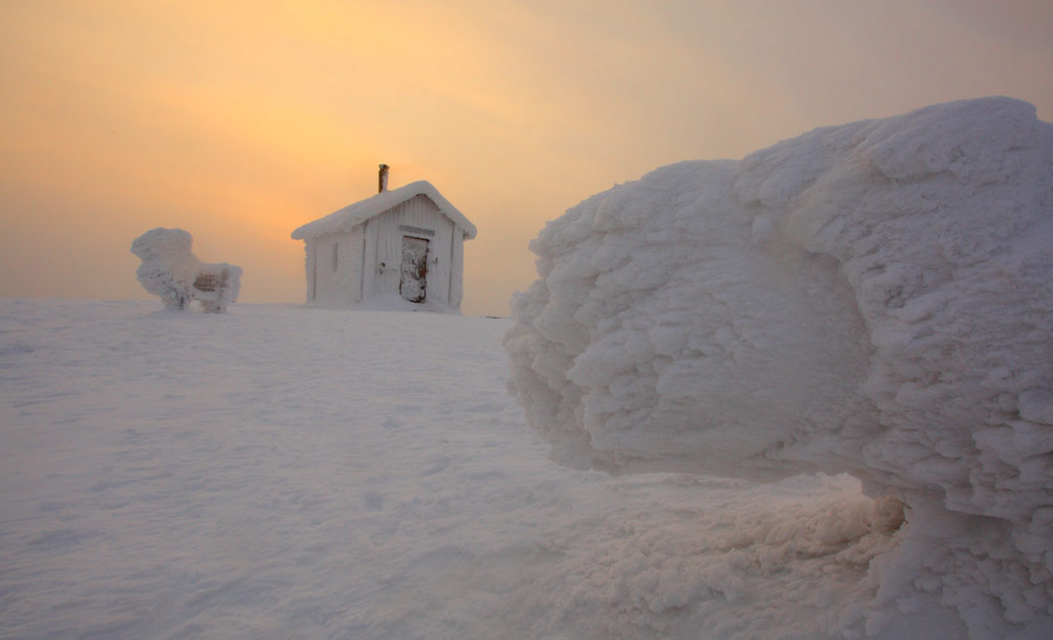
COUNTRY WITH
SNOW-HOW
FINLAND,
A COOL ARCTIC

Slide 2
To succeed in a constantly changing world, you have to change as well. Finland has reinvented itself in just one short century – and we’re still at it. Our national character and northern heritage have boosted us to the top of many kinds of country rankings. The arctic climate gave us guts – or ‘sisu’ as we call it. Neither frost nor snow can stop finns. Roads, airports and vital sea routes are kept open, and machines and equipment keep working. Finland is a country with undisputable arctic expertise. Of course, the nation’s long traditions in this area are based on close familiarity with arctic conditions and the efficient, problem-solving application of such knowledge.

Slide 3
A COUNTRY WITH
SNOW-HOW
The Arctic region is changing rapidly. Arctic areas are witnessing the effects of global warming more dramatically than any other part of world. New transport routes are opening up and energy resources and minerals are being exploited, as tourism increases.

Slide 4
Adopted in 2012, an updated strategy for the Arctic region forms the basis of Finland´s Arctic vision. Finland is seeking a sustainable balance between the limitations imposed and business opportunities provided by the Arctic environment.
International cooperation in a number of forums, such as the Arctic Council, the Barents Euro-Arctic Council, the European Union and the many sub-organisations of United Nations, is the key to achieving a sustainable future for the Arctic. Research and expert networks are also playing an important role in this.

Slide 5
ARCTIC TECHNOLOGY
A SPRINGBOARD
FOR GLOBAL SUCCESS
Perhaps the best example of Finnish Arctic business know-how is provided by marine technology and the related business operations, solutions and services. As a nation, we’ve always been among the first to adapt any kind of new technology.

Slide 6
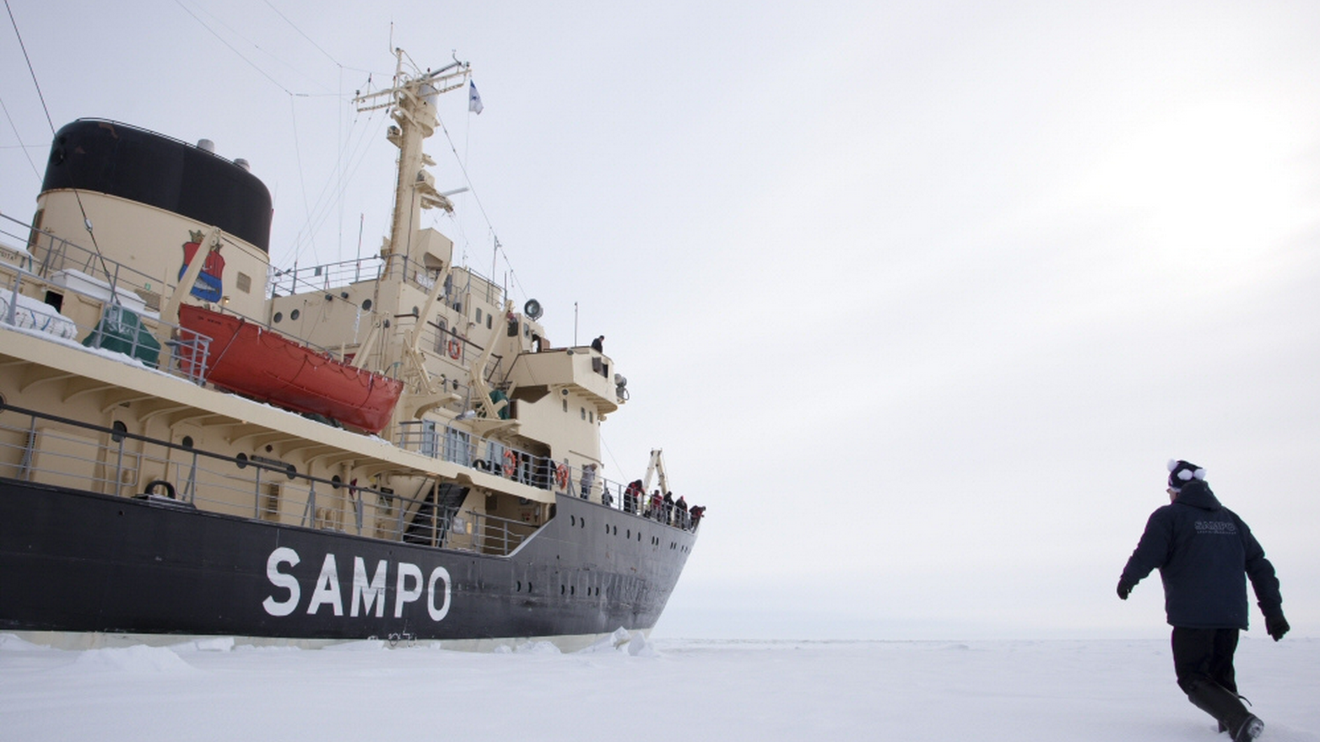

Slide 7
Finland is one of the world’s leading experts in shipbuilding for Arctic conditions, shipping, winter navigation, maritime and offshore technology. Finland manufactures advanced state-of the-art Arctic ice-breakers and specialized offshore vessels. A number of engineering firms in Finland design and develop solutions for maritime logistics, offshore applications and a range of Arctic vessels. Special expertise is also available on winter navigation and the related logistics, ice-breaking, the monitoring and control of sea transport, as well as weather and ice information services.

Slide 8
Another major area is Arctic testing. Over the past few decades, Lapland has become an increasingly important development and testing ground for the international vehicle industry; this has boosted European low-temperature technology around the world.

Slide 9
FINLAND
A SMALL ARCTIC
SUPERPOWER
Finnish shipyards have built more polar class icebreakers than those of any other country in the world.

Slide 10
Finland is a major player in Arctic tourism. Much of the Arctic region’s tourist accommodation is located in Finland. Arctic tourism has a turnover of 600 million euros and over 5,000 people work in the sector in Lapland.
Finland aims to become a global pioneer in the eco-efficient mineral industry by 2020. This objective is supported by the 2011–2016 Green Mining Programme launched by Tekes, the Finnish Funding Agency for Technology and Innovation.
The Arctic Centre of the University of Lapland aims to establish a European Union Arctic Information Centre in Rovaniemi.

Slide 11
WHERE TO FIND FINNISH COLD CLIMATE
KNOW-HOW?
Several Finnish higher education institutions are engaged in Arctic research Aalto University´s Department of Engineering: Arctic technology is a research focus in the department – in areas such as ice, snow, permafrost and their impact on structures and transport. A key research area is related to Arctic maritime technology and winter navigation.

Slide 12
The Arctic Centre of the University of Lapland focuses on global change, sustainable development and environmental and minority law in the region. Its nationwide role includes the dissemination of scientific information, exhibition activities, and expert duties related to the Arctic and the Barents Euro-Arctic Council. The Academy of Finland has launched the Arctic Academy Programme, which aims to strengthen high-quality, transdisciplinary and problem-based Arctic research in Finland in the long term.

Slide 13
Arktiko includes twenty projects and two international Network Projects. The projects cover a wide range of disciplines under the programme’s four thematic areas:
High-quality life in the north
Economic activity and infrastructure in Arctic conditions
The northern climate and environment
Cross-border Arctic policy.

Slide 14
Tekes, the Finnish Funding Agency for Technology and Innovation, has launched a four-year Arctic Seas programme, which aims to strengthen Finland’s position as an expert in shipbuilding for Arctic conditions, shipping, winter navigation and maritime and offshore technology. The new programme will enable renewable and sustainable business in challenging conditions. The Finnish Ministry of Transport and Communication has conducted a feasibility study with the aim of exploring possibilities and need for a Centre of Excellence in Arctic Solutions, with a particular emphasis on combating oil and chemical spills.

